Slide 1
OST-Gadget: a real-world business planning case study
Introduction
Matthäus Alberding

Slide 2
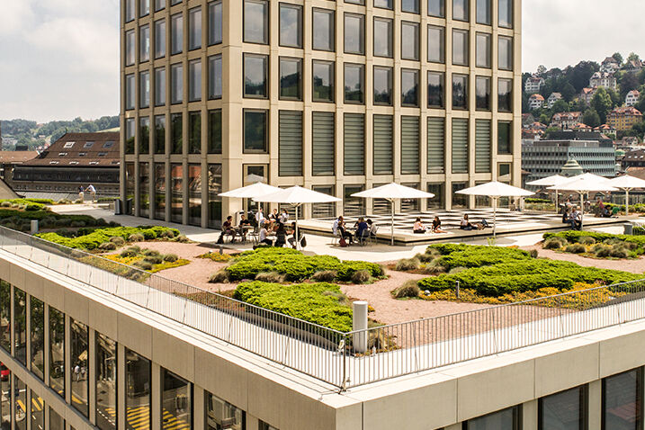

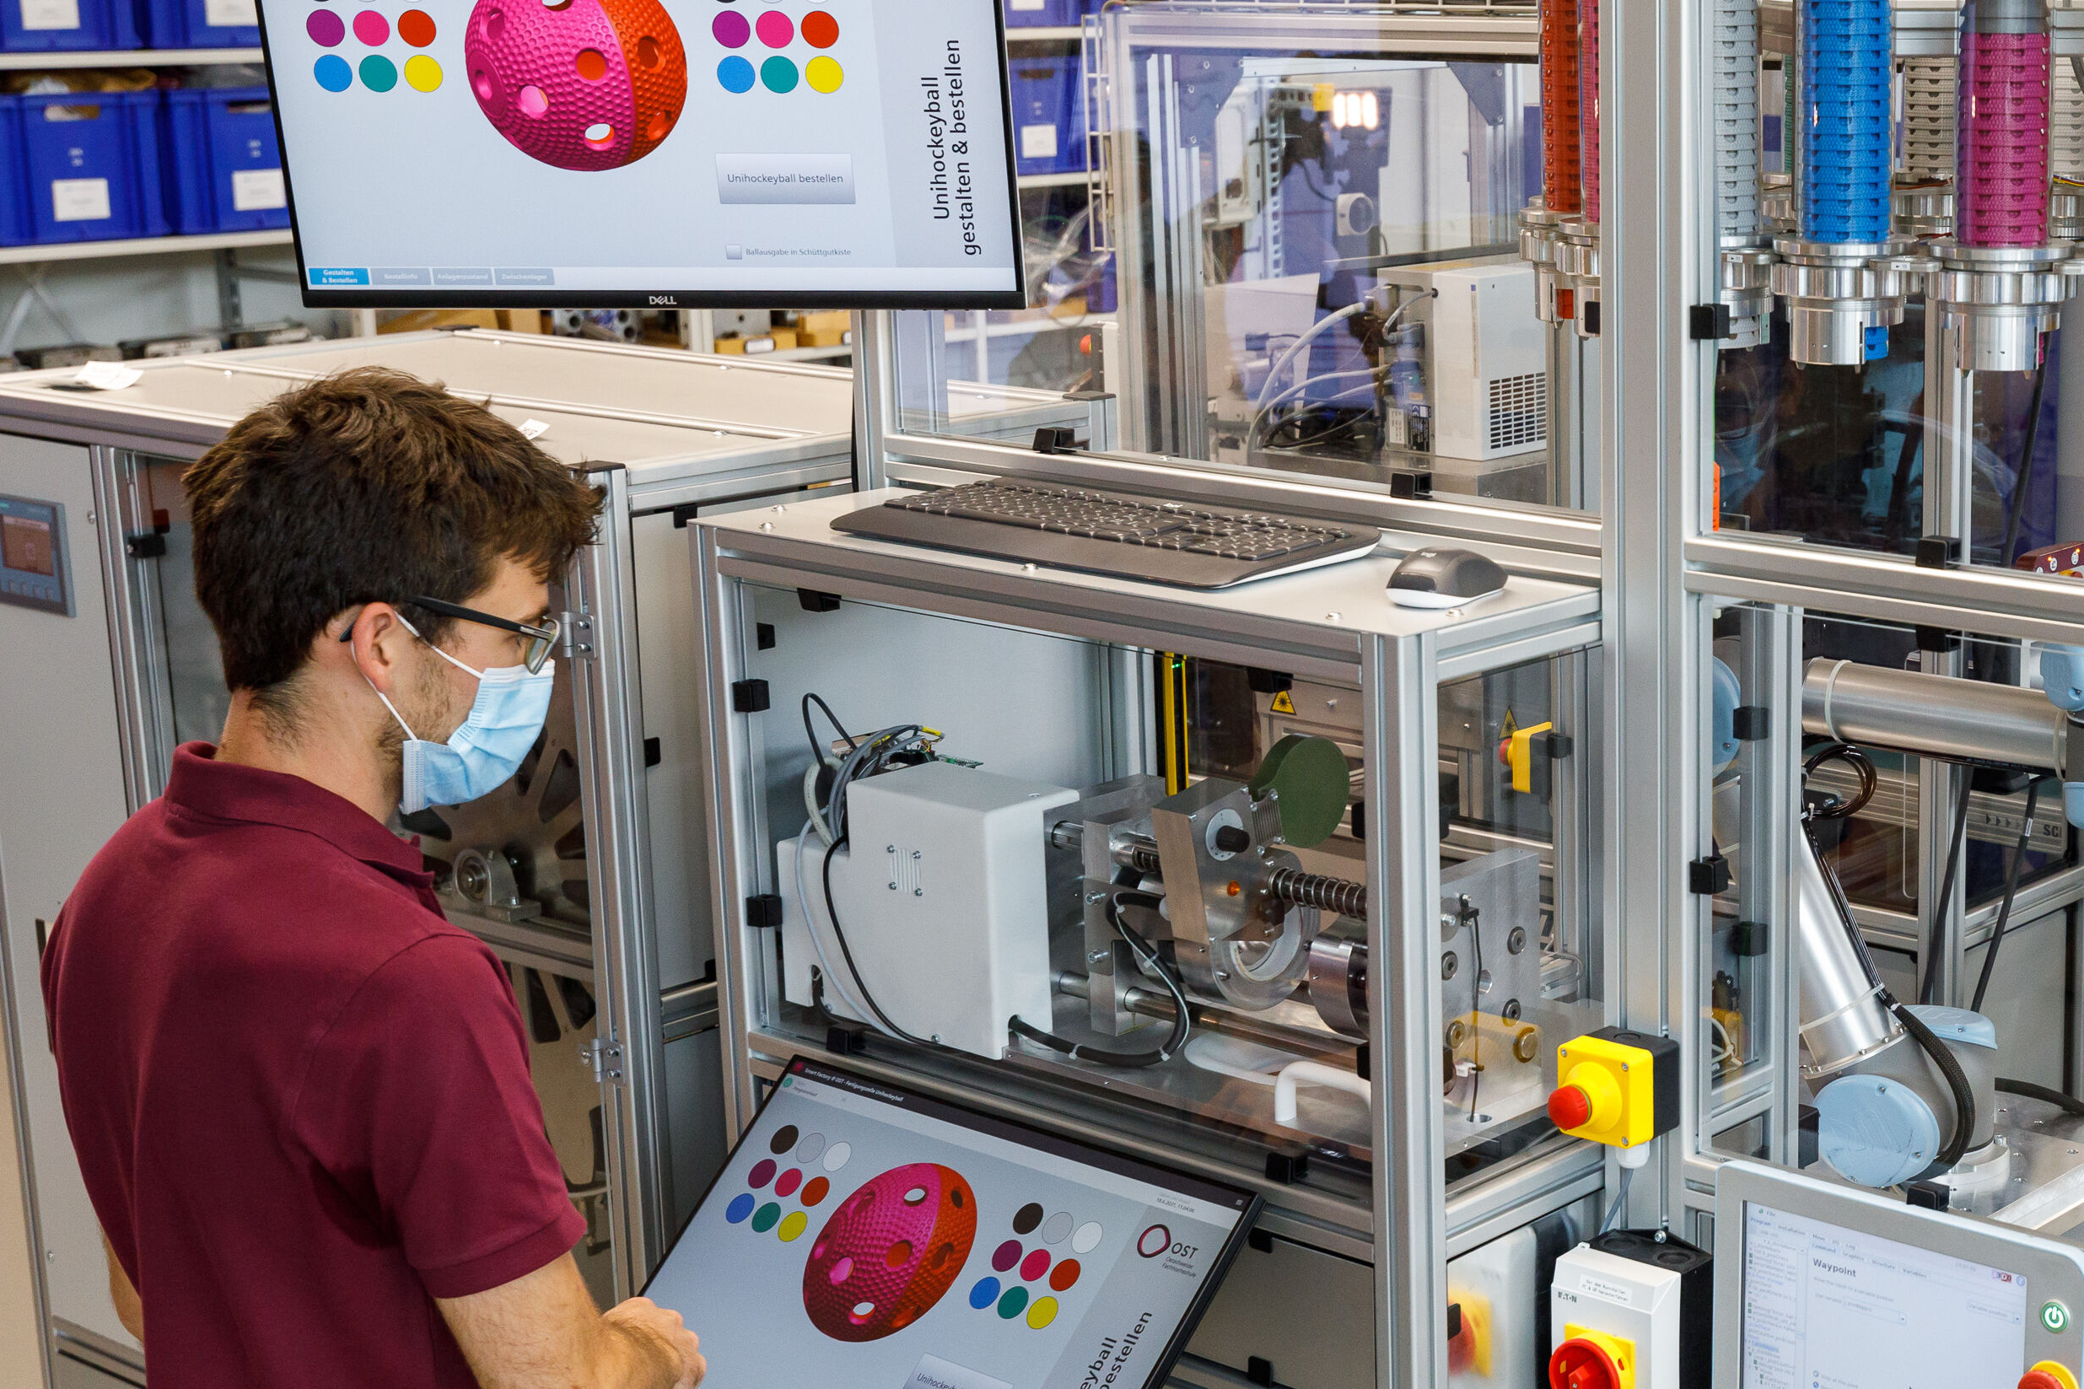
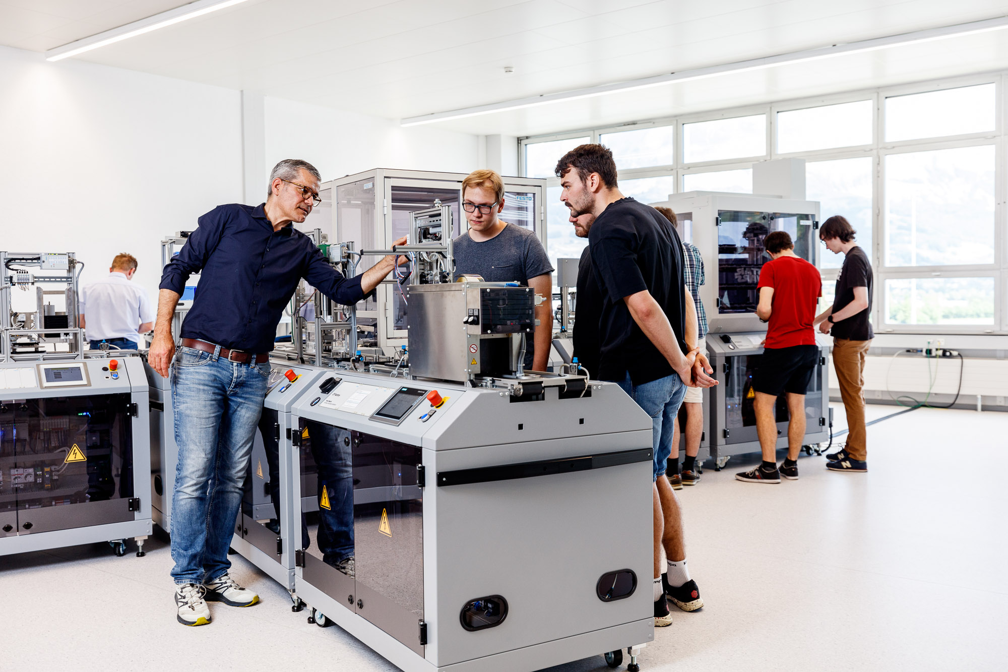

The OST Smart Factory is a real-world industrial production environment to showcase applied digitalization
The OST Smart Factory
St. Gallen
Sales and service.
Buchs
Product management, electronics development, and final assembly.
Rapperswil-Jona
Production of injection-moulded parts.

Slide 3

The smart factory’s product will be the «OST Gadget», a wireless charger for your phone, available in 2022
The OST Gadget
The OST Gadget is a wireless charger for
your smartphone or any other Qi-compatible
device.

Slide 4
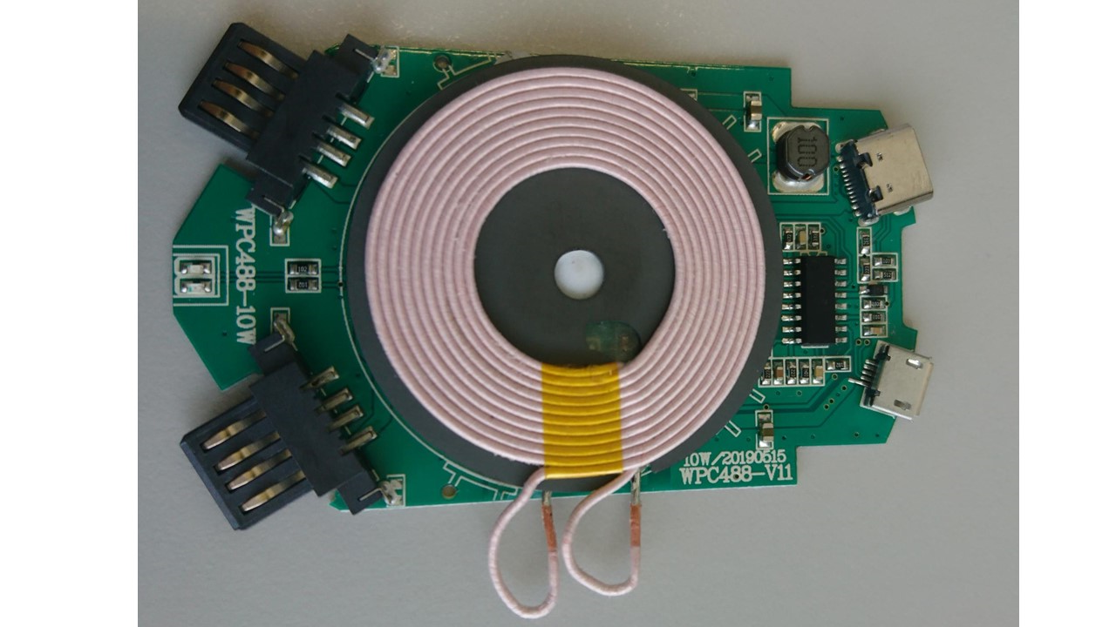
The electronics is currently externally sourced, an internally developed version produced in Buchs is planned
The OST Gadget
Wireless output
DC 5V/1A (5W), DC 9V/1.1A (10W)
charging distance ≤6mm
works with all Qi-compatible devices
USB-C input
DC 5V/2A, DC 9V/1.67A
2 USB-A outputs
DC 5V/1A
LED
Red and blue LED indicating the charging process
Micro-USB input
DC 5V/2A, DC 9V/1.67A
Model WPC488-10W

Slide 5
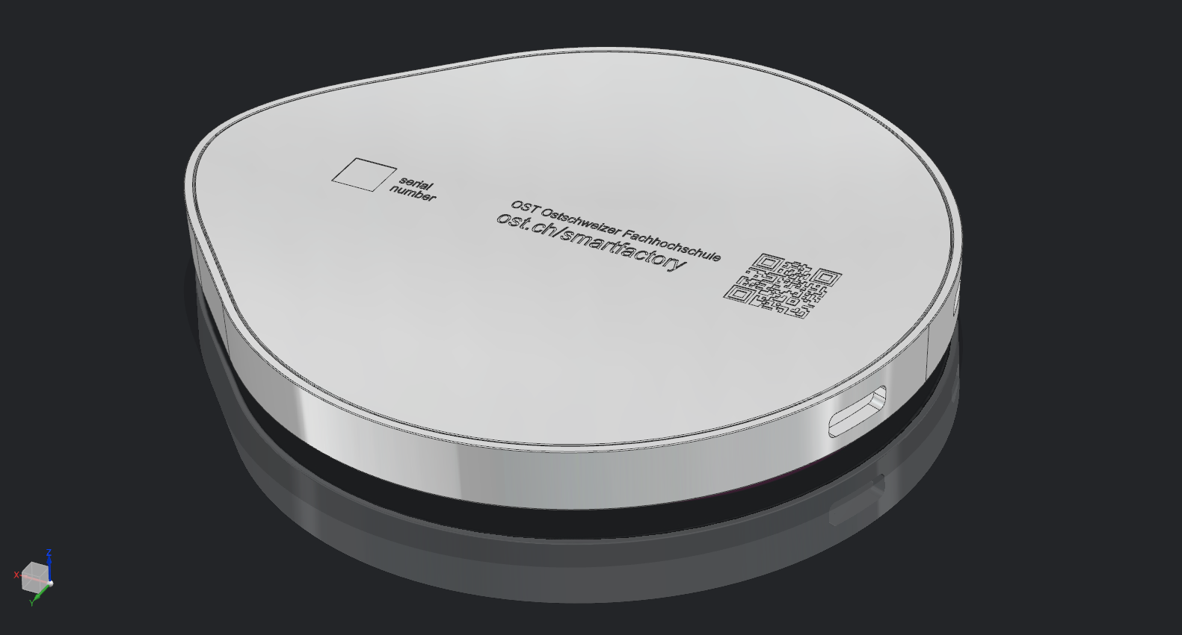
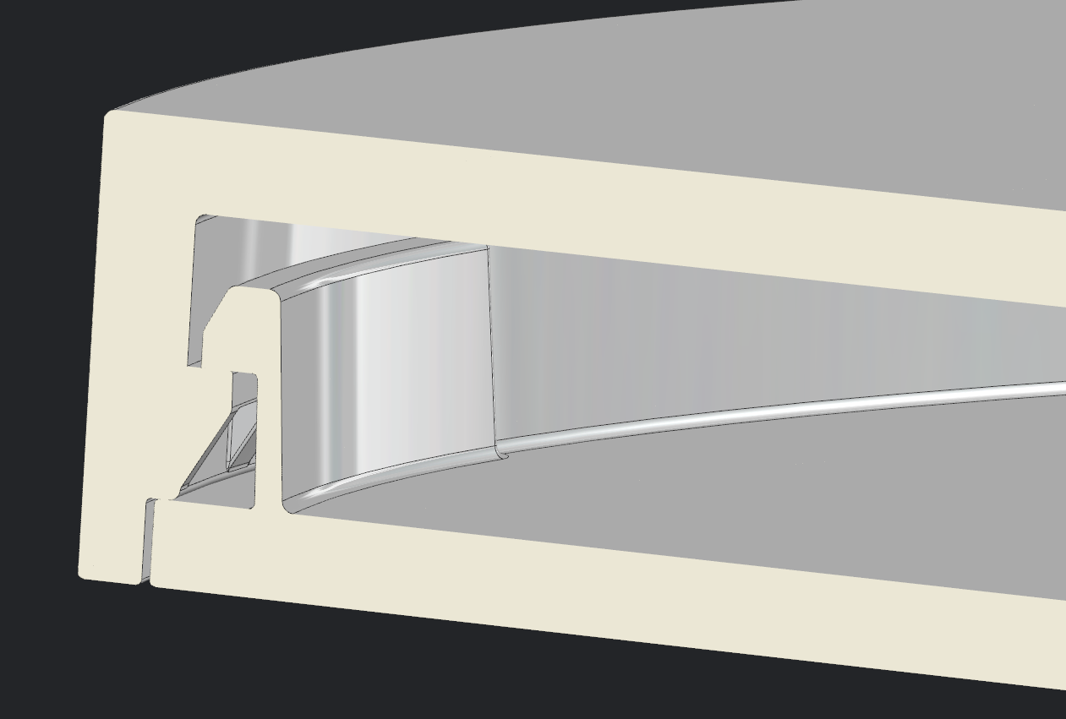
The housing will be produced in Rapperswil
The OST Gadget
Printed plastic film
(back moulded)
Integrated
NFC-chip
Serial number
(DataMatrix-Code)
Housing possible in
different colors
Assembling using snap-in hooks
Connection by
USB-C or Micro-USB

Slide 6
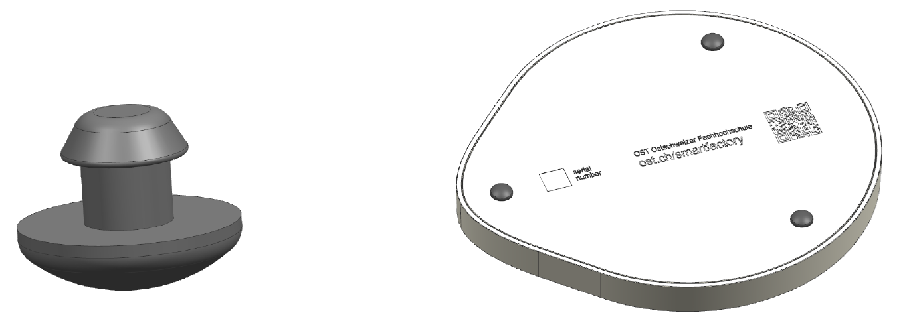
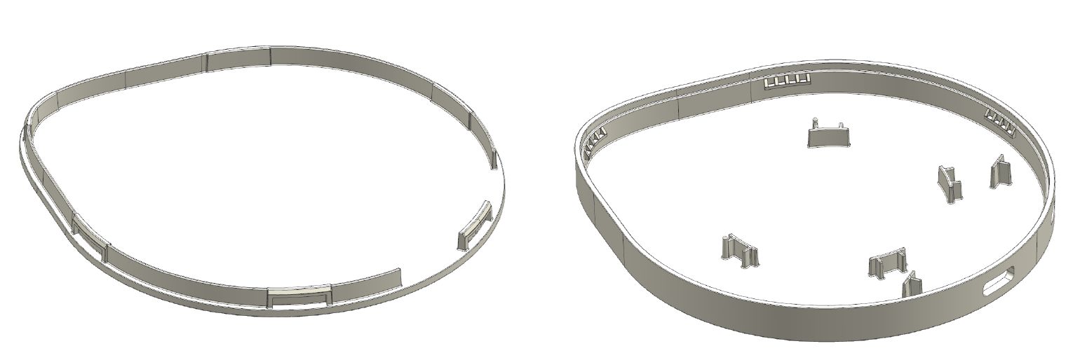
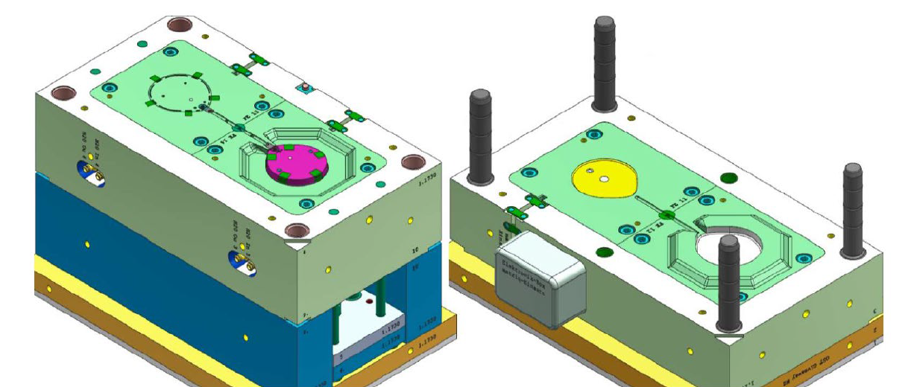
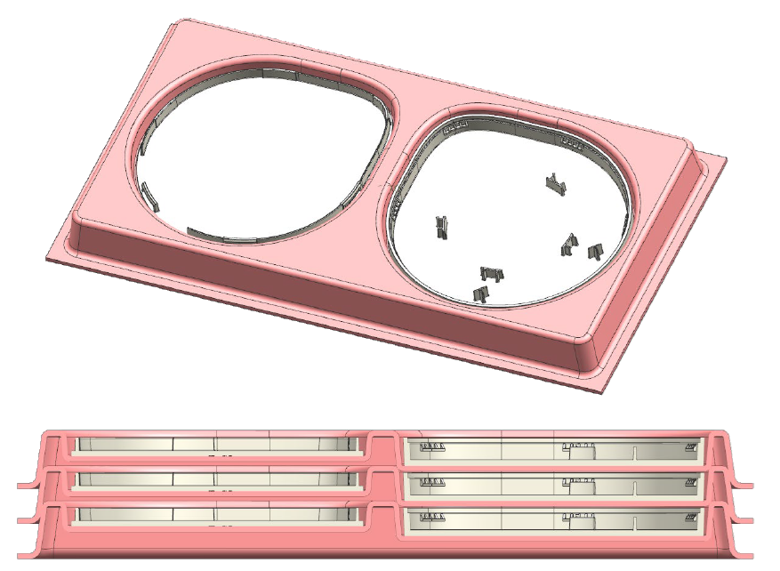
The housing will be produced by injection moulding
The OST Gadget
Upper and lower housing are produced in a family tool injection mold
Rubber studs are produced separately
Transport in thermo-formed trays

Slide 7
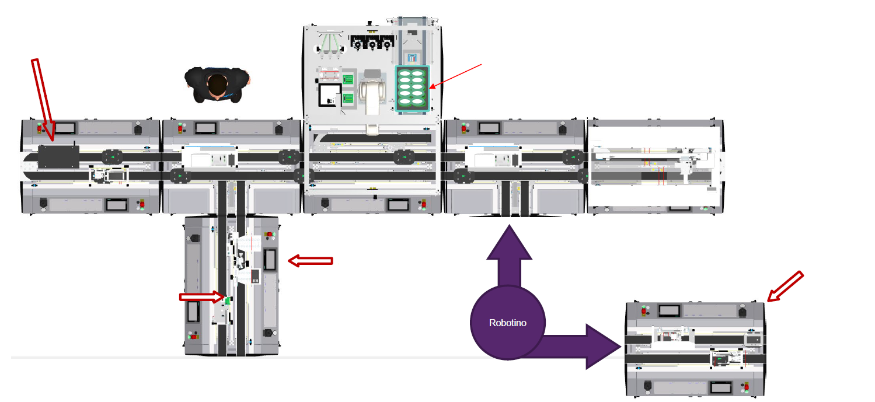
Final assembly will be done in Buchs
The OST Gadget
Electronics
quality check
Upper housing parts
Lower housing parts
and electronics
Output
Press

Slide 8
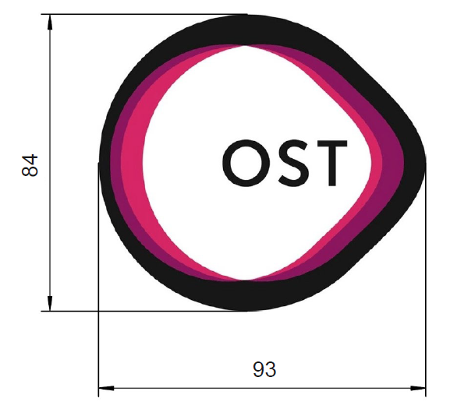
Currently, the material cost is around 8CHF/pc plus 50kCHF fixed cost
The OST Gadget
The variable cost for material is currently around 8CHF/pc
The fixed cost for material is currently around 50’000 CHF
(estimated)
The cost for the injection moulding tools is estimated 50’000 CHF

Slide 9
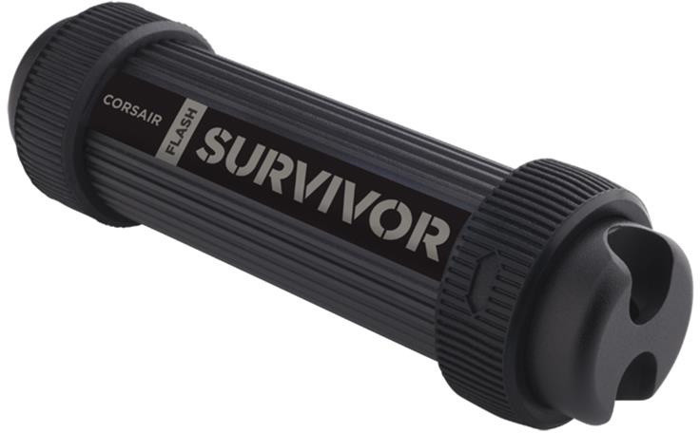
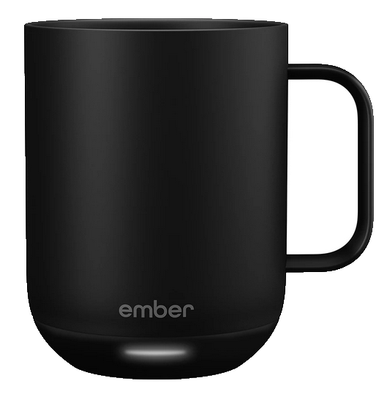
Wireless charging is only the beginning, many more features could be added
The OST Gadget
Waterproof flash drive, reading and writing via OST Gadget?
Use the NFC chip for data exchange?
?
?
Collect data on
charger usage?
?
?
Heating a coffee mug?
?
?
Adapt the charging behavior to phone model etc.?
…?

Slide 10
Any future OST Gadget must meet the
OST Gadget’s requirements
The OST Gadget
Representing OST
Useful
The product needs to show the competencies of OST.
The product must be useful – you need to want to have it!
Suitable for smart factory
More than an app
It must be feasible to produce the product in the smart factory’s infrastructure. Production of variants (e.g. multiple housing colors) must be possible. Simple assembly is a priority.
The function of the product must not be replaceable by an app.
Sustainable
The product must be sustainable – no batteries, use of recycled materials, etc.
Realizable
Product cost and time to market must be reasonable.

Slide 11
Your task is to scout business opportunities for a future version of the OST Gadget
Case Study «OST Gadget»
Your task is to come up with a proposal for a future OST Gadget, making use of the opportunities of digitalization.
Your proposal can be either:
A data-driven service based on the wireless charger (e.g. adapting charging behavior)
An extension or evolution of the wireless charger (e.g. mug heater)
A completely new gadget
Any idea must meet the OST Gadget’s requirements listed before.
2.0

Slide 12
The case study is structured into 6 steps
Case Study «OST Gadget»
1
4
Create your marketing strategy
In the teams, do a SWOT analysis and create a marketing strategy for your business idea.
Develop your idea
Individually, come up with your business idea for a future OST Gadget. Prepare
a short presentation of your idea (“elevator pitch”).
Convince your peers
Present your ideas to the class. Teams of 3-4 students will be formed around the most popular ideas.
2.0
2
5
Define your marketing mix
In the teams, define the marketing mix and do a forecast for your business idea.
Analyze your market
In the teams, do a market analysis for your business idea.
6
Present your results
In the teams, present your results in a final presentation to the class. Submit your slides as a pre-read 2 weeks in advance.
3

