Slide 1

OST-Gadget: a real-world business planning case study
M. Alberding, 07/2022

Slide 2

Introduction
What is the «OST-Gadget»?

Slide 3


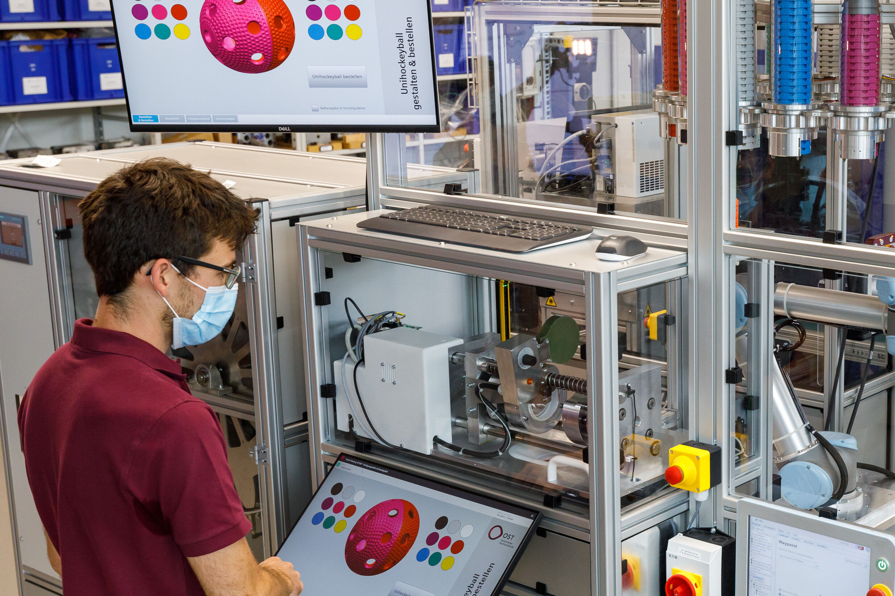
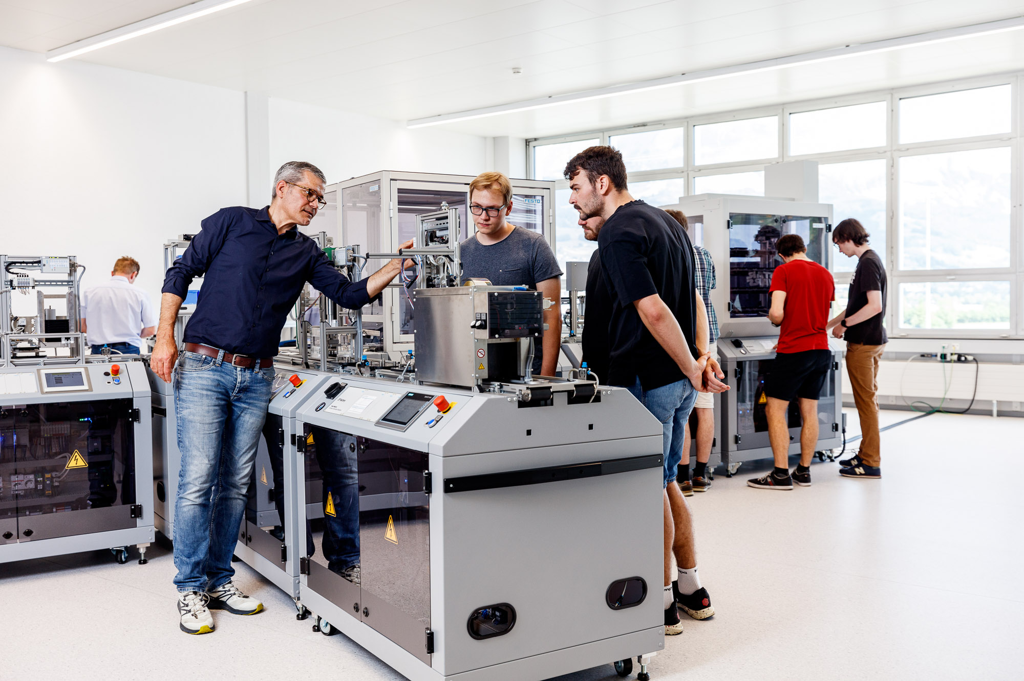
The OST Smart Factory is a real-world industrial production environment to showcase applied digitalization
What is the «OST-Gadget»?
St. Gallen
Sales and service.
Buchs
Product management, electronics development, and final assembly.
Rapperswil-Jona
Production of injection-moulded parts.
Notes:
RJ: Verantwortung für Produktion Spritzgussteile (sehr innovative Infrastruktur)
BU: Produktverantwortung, Elektronikentwicklung und Endmontage; «Business Unit» und RJ ist Teilezulieferer
SG: Verkauf und Service
Alles vollvernetzt und digital integriert über SAP etc.
Story: Task force -> Transparenz (wieviele haben wir, wann laufen wir wo trocken) und Nachverfolgbarkeit (brokerware)

Slide 4
The smart factory’s product is the «OST-Gadget», a wireless charger for your phone
What is the «OST-Gadget»?
The OST-Gadget is a wireless charger for
your smartphone or any other Qi-compatible
device.

Slide 5
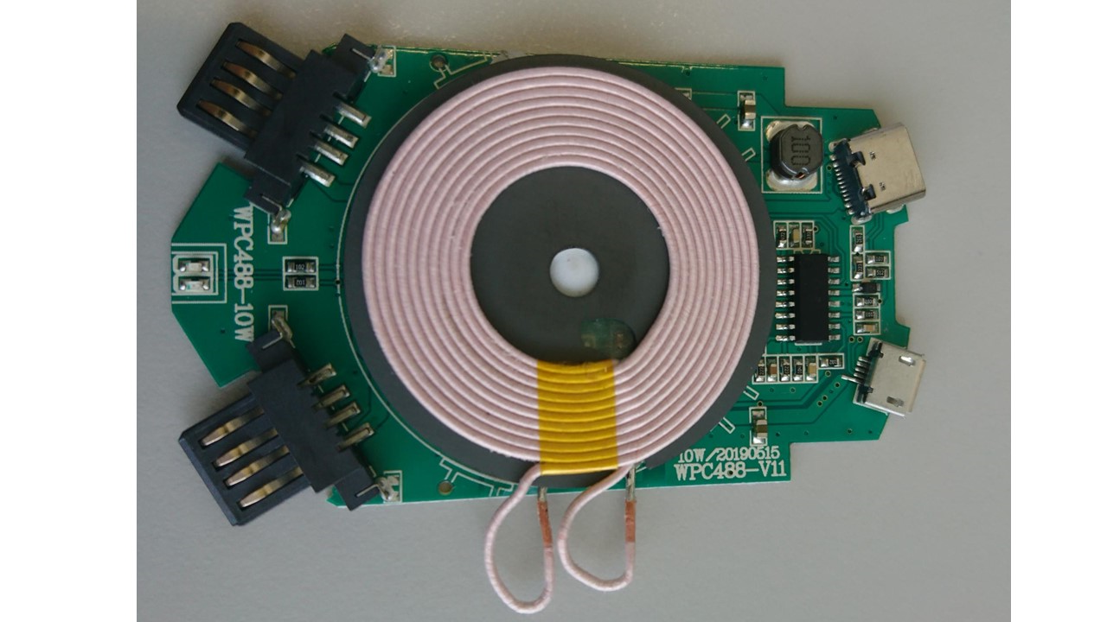
The electronics is currently externally sourced, an internally developed version is planned
What is the «OST-Gadget»?
Wireless output
DC 5V/1A (5W), DC 9V/1.1A (10W)
charging distance ≤6mm
works with all Qi-compatible devices
USB-C input
DC 5V/2A, DC 9V/1.67A
2 USB-A outputs
DC 5V/1A
LED
Red and blue LED indicating the charging process
Micro-USB input
DC 5V/2A, DC 9V/1.67A
Model WPC488-10W

Slide 6
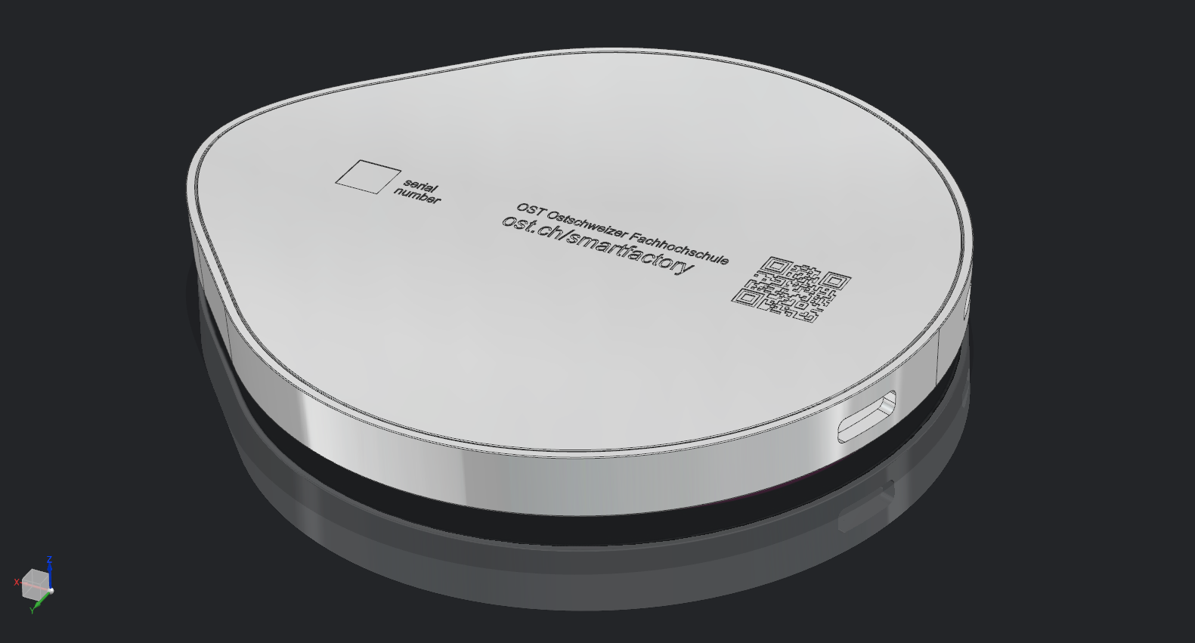
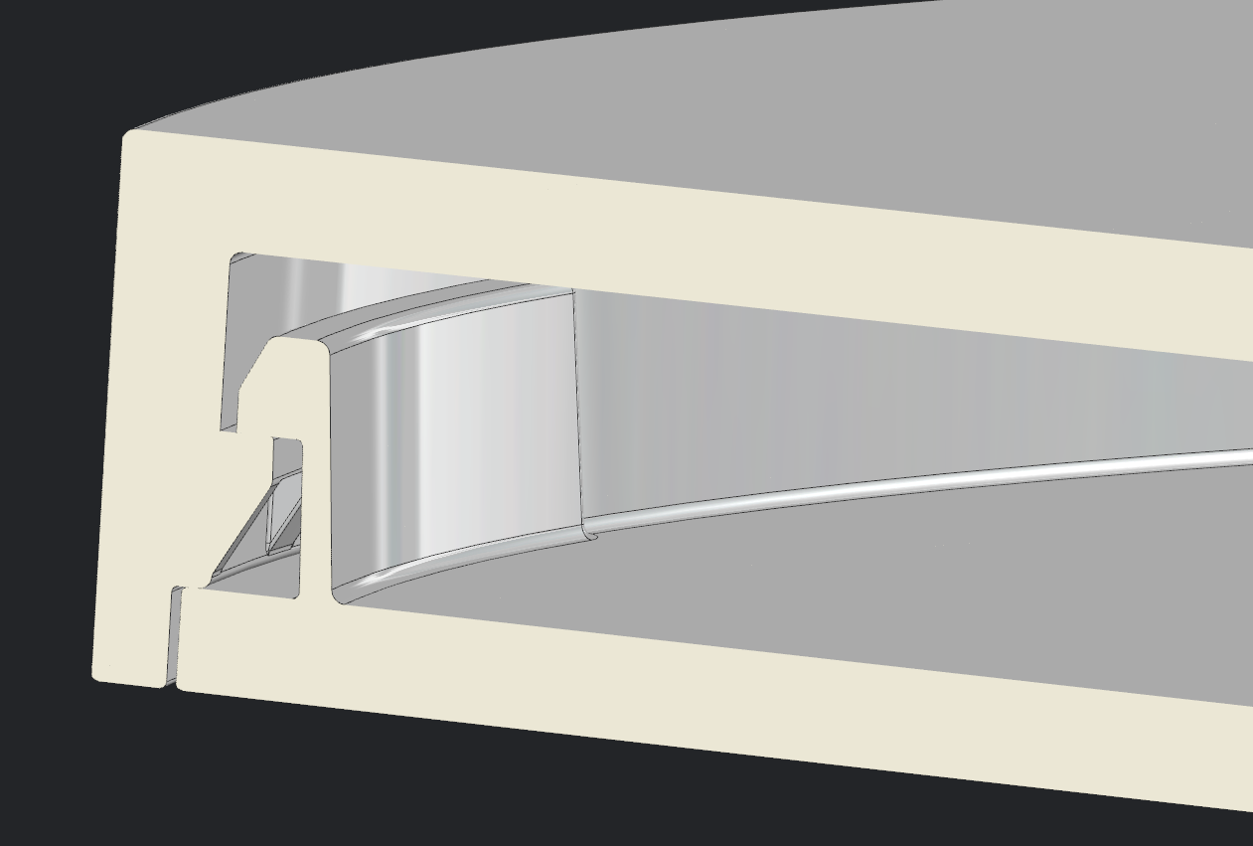
The housing is produced in Rapperswil
What is the «OST-Gadget»?
Printed plastic film
(back moulded)
Integrated
NFC-chip
Serial number
(DataMatrix-Code)
Housing possible in
different colors
Assembling using snap-in hooks
Connection by
USB-C or Micro-USB

Slide 7
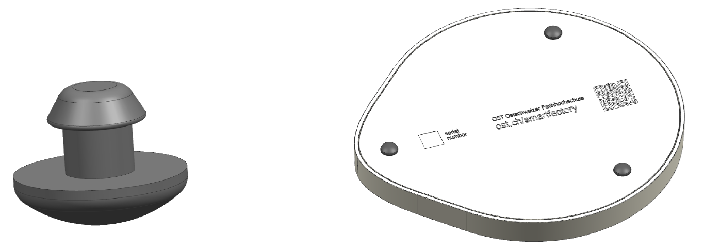
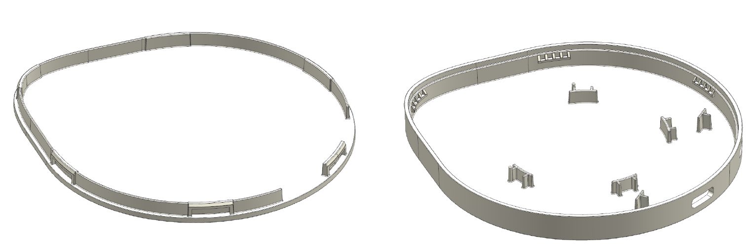
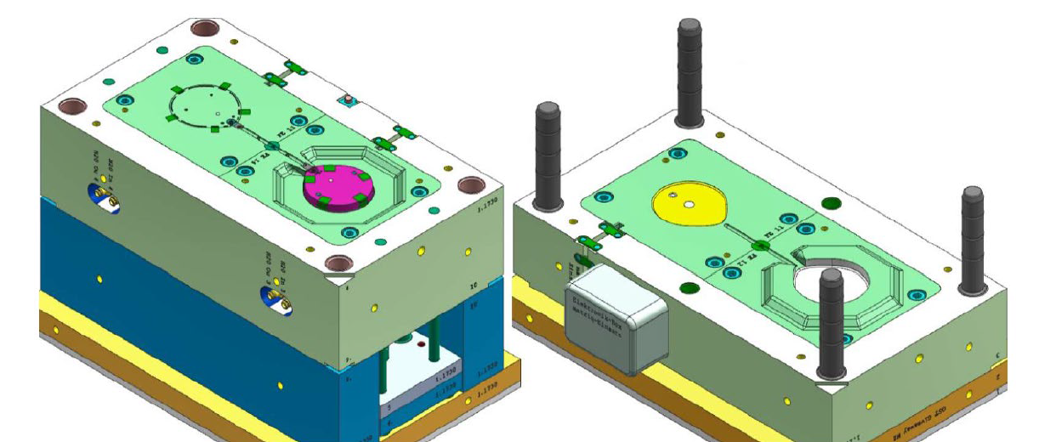
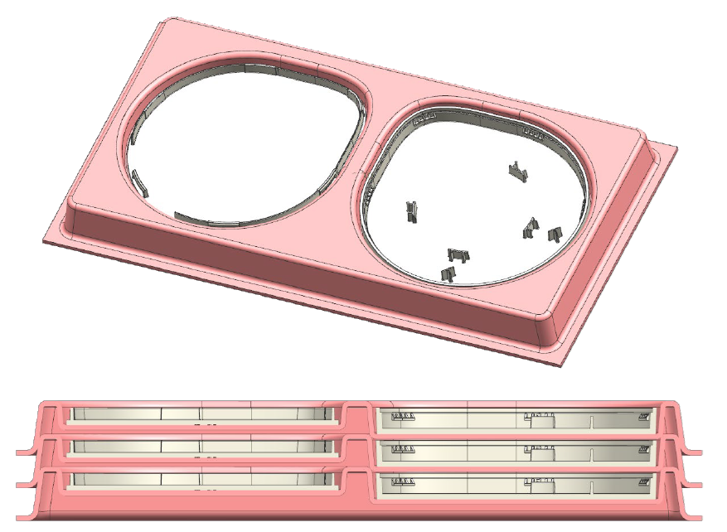
The housing is produced by injection moulding
What is the «OST-Gadget»?
Upper and lower housing are produced in a family tool injection mold
Rubber studs are produced separately
Transport in thermo-formed trays
Notes:
Story aus dem Leben: Spritzguss

Slide 8
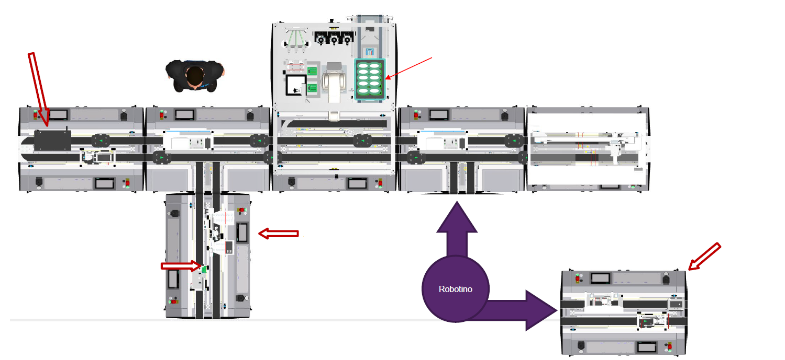
Final assembly is done in Buchs
What is the «OST-Gadget»?
Electronics
quality check
Upper housing parts
Lower housing parts
and electronics
Output
Press
Notes:
- Montage in HLF inkl. Qualitätsprüfung (automatisierte Sichtprüfung)

Slide 9
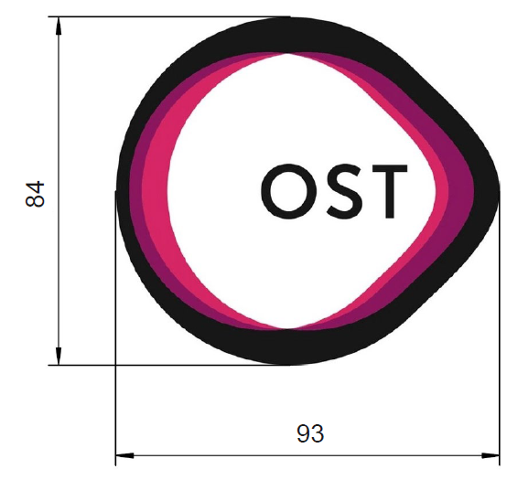
Currently, the material cost is around 8CHF/pc plus 50kCHF fixed cost
What is the «OST-Gadget»?
The variable cost for material is currently around 8CHF/pc
The fixed cost for material is currently around 50’000 CHF
The cost for the injection moulding tools is 50’000 CHF
Assume a depreciation period of 7 years

Slide 10


Wireless charging is only the beginning, many more features could be added
What is the «OST-Gadget»?
Waterproof flash drive, reading and writing via OST-Gadget?
Use the NFC chip for data exchange?
?
?
Collect data on
charger usage?
?
?
Heating a coffee mug?
?
?
Adapt the charging behavior to phone model etc.?
…?
Notes:
Ladegerät nur der erste Schritt – wie geht es weiter? Das ist genau die Frage, auf die Sie eine Antwort geben sollen.
Ein paar Ideen, die auf dem Tisch liegen (im Sinne Brainstorming).
Auf der einen Seite Richtung Daten, auf der anderen Seite Richtung Hardware
Technische Machbarkeit?

Slide 11
Any future OST-Gadget must meet the
OST-Gadget’s requirements
What is the «OST-Gadget»?
Representing OST
Useful
The product needs to show the competencies of OST.
The product must be useful – you need to want to have it!
Suitable for smart factory
More than an app
It must be feasible to produce the product in the smart factory’s infrastructure. Production of variants (e.g. multiple housing colors) must be possible. Simple assembly is a priority.
The function of the product must not be replaceable by an app.
Sustainable
The product must be sustainable – no batteries, use of recycled materials, etc.
Realizable
Product cost and time to market must be reasonable.

Slide 12
Case study
What is the task?

Slide 13
Your task is to scout business opportunities for a future
OST-Gadget. You need to complete four steps.
What is the task of the case study?
4
Define your marketing mix
In the teams, define the marketing mix for your business idea.
3
Create your marketing strategy
In the teams, do a SWOT analysis and create a marketing strategy for your business idea.
Analyze your market
In the teams, do a market analysis for your business idea.
2
Develop your idea
Develop your business idea for a future OST-Gadget.
1
2.0

Slide 14
Develop your idea
What is the task of the case study?
1
4
Define your marketing mix
In the teams, define the marketing mix for your business idea.
3
Create your marketing strategy
In the teams, do a SWOT analysis and create a marketing strategy for your business idea.
Analyze your market
In the teams, do a market analysis for your business idea.
2
Develop your idea
Develop your business idea for a future OST-Gadget.
1
Come up with your idea
Develop an idea for a new OST-Gadget, making use of the opportunities of digitalization.
Important: Any idea must meet all OST-Gadget’s requirements listed before.

Slide 15
Analyze your market
What is the task of the case study?
2
4
Define your marketing mix
In the teams, define the marketing mix for your business idea.
3
Create your marketing strategy
In the teams, do a SWOT analysis and create a marketing strategy for your business idea.
Analyze your market
In the teams, do a market analysis for your business idea.
2
Develop your idea
Develop your business idea for a future OST-Gadget.
1
How is the market characterized?
What is the market of your product? I.e., what are the products most similar to yours from a customer’s perspective? What are facts and figures on that market? Search the internet for public available data. Document any assumptions you make. Hint: make use of the OST access to https://www.statista.com/
What do customers need?
What facts do you know about the product’s customers and their needs?
What is the competition?
What are competing products? What is the pricing? What features make the products different? Are there any major brands or clear market leaders?

Slide 16
Create your marketing strategy
What is the task of the case study?
3
4
Define your marketing mix
In the teams, define the marketing mix for your business idea.
3
Create your marketing strategy
In the teams, do a SWOT analysis and create a marketing strategy for your business idea.
Analyze your market
In the teams, do a market analysis for your business idea.
2
Develop your idea
Develop your business idea for a future OST-Gadget.
1
What is your strategic position?
Do a SWOT analysis: describe internal strengths & weaknesses and external opportunities & threats.
What are your target segments?
What are potential customers that might have an interest in your product? Think both OST-internally and -externally. Can you divide these customers into groups (segments)? What do you know on those segments? Decide which and how many of those customer segments you want to target with your product. Consider segment attractiveness, competition, and your resources. Be detailed in explaining the reasons for your decision.
What is your value proposition?
  Define precisely how your product adds value for your target customer segments. Focus on how are you different from competition. Consider your and your competition’s strengths and weaknesses. Be detailed in explaining the reasons for your decision.

Slide 17
Define your marketing mix
What is the task of the case study?
4
4
Define your marketing mix
In the teams, define the marketing mix for your business idea.
3
Create your marketing strategy
In the teams, do a SWOT analysis and create a marketing strategy for your business idea.
Analyze your market
In the teams, do a market analysis for your business idea.
2
Develop your idea
Develop your business idea for a future OST-Gadget.
1
What is the product?
Describe in detail the product including services you want to offer to realize your value proposition.
What is the price?
Define the price for the product and describe your reasoning of defining that price.
What is the place?
Define how and where the product is to be sold and why you choose this approach.
What is the promotion?
Define on what channels and with what focus you want to communicate the product and why you choose this approach.

Slide 18




Document your results in Powerpoint slides
How to deliver the results?
Document your results in self-explanatory slides
5 mins: Present your executive summary to the class
Document all your results in Powerpoint slides.
The slides must be self-explanatory.
You can choose to do the slides in German or English.
Present your executive summary to the class in a max. 5 min presentation.
10 mins: Discuss your results
Include an executive summary
At the beginning of your slides include an “executive summary”: a short version of your key results (max. 3 slides).
The summary should at least contain your idea, what are your target customers, what is your value proposition & what makes you different from competition.
10 mins discussion will be used to clarify open questions of the lecturer on your submitted documentation and open questions of the class on the executive summary presentation.
Submit your documentation via Moodle
For submissions to Moodle, export your slides to PDF format.
Name the file with your team's name (e.g., “Team 1.pdf”).
Don’t miss the submission deadline!
1
2
3
4
5
6
7
8
9
10
11
12
13
14
Lesson

Slide 19
Your grade is mainly based on the documentation. The discussion is your chance to straighten out unclarities.
How do I get my grade?
Criteria | Weight | Grade 6 | Grade 5.25 | Grade 4.5 | Grade 4 | Grade <4
Plausibility of the business idea | 15% | As a commercial product, the idea would most likely be highly successful | As an OST merchandise, the idea would most likely be highly successful | The idea is suited as an OST merchandise | The idea is suited as an OST merchandise, even if the cost is moderately too high | The idea is not suited as an OST merchandise
Meeting OST-Gadget requirements | 5% | Extraordinary lighthouse for competencies and values of OST | All requirements are clearly met, at least one requirement is met exceptionally well | All requirements are clearly met | The requirements are mostly met | The requirements are clearly violated
Analysis: Quality of the collected data and facts as a basis for decision-making | 30% | Professional business level, exceptionally well & comprehensive data & interpretation | Very well asking the right questions when gathering and analyzing data & facts | Average | Suitable data and facts have been gathered as a basis for decision-making | Missing content or major insufficiencies
Synthesis: Quality, consistency, plausibility, and transparency of the reasoning and decision-making | 40% | Professional business level, exceptionally well thought-out, explained, detailed | Very well thought-out, explained, and detailed | Average | No major logical inconsistencies, all questions sufficiently answered | Missing content or major insufficiencies
Quality of the documentation (messaging, structure, layout, spelling, executive summary to the point, etc.) | 10% | Professional business level, exceptionally clear and persuasive messaging | Clearly above average, particularly well executive summary | Average | Self-explanatory and no major insufficiencies | Major insufficiencies

Slide 20

Join a team on Moodle TODAY!
Where do I sign up?

