Slide 1

OST-Gadget: a real-world business planning case study
Sample Solution: Today’s OST-Gadget
M. Alberding, 07/2022

Slide 2

As product for the smart factory, we propose the
«OST-Gadget», a wireless charger for your phone
Executive Summary
Market analysis
Marketing strategy
Marketing mix
Wireless is the charging technology of the next decade, CAGR +29.4%
Wireless charging is a key priority feature for 78% of smartphone users, 20% own already a wireless charger
Compatibility (Qi standard) and charging speed are key ease-of-use needs
As battery anxiety is a key concern, consumers want to see wireless power available to them in more places
Prices range from ~10-150 CHF, most products around 40CHF
Digital manufacturing know-how is our strength, our weakness is that we are not a real and competitive enterprise
We recommend targeting the segments OST merchandise with expected 300 chargers per year and OST students & staff with expected 200 chargers per year
We propose a focus strategy with personalized design is at the core of our differentiation, combined with OST branding and sustainable materials
Qi certification, sufficient wattage, and durability are must-haves. We prefer a compact, mobile charger. MagSafe and/or USB hub are nice-to-have.
Physical product only – no frills, no service
We make the housing to demonstrate our strengths in digital manufacturing
We buy the electronics to avoid certification and speed up time to market
Est. cost variable 8CHF, fixed 50kCHF
We estimate a 25 CHF price; we could still sell at market’s average 40 CHF if quantities are -50% lower than expected
Students & staff can order online and pick up at the reception, smart factory visitors can watch the product being made
Promotion to students via classes utilizing the smart factory, to staff via intranet

Slide 3
Introducing the OST-Gadget
Showcasing applied digitalization

Slide 4

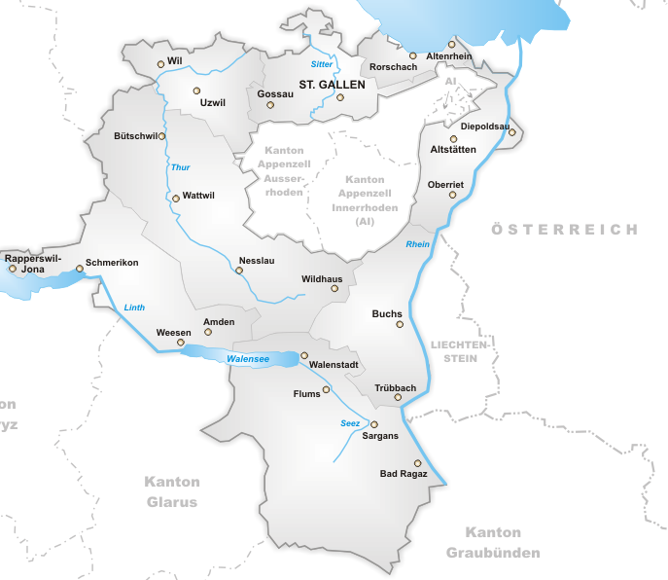
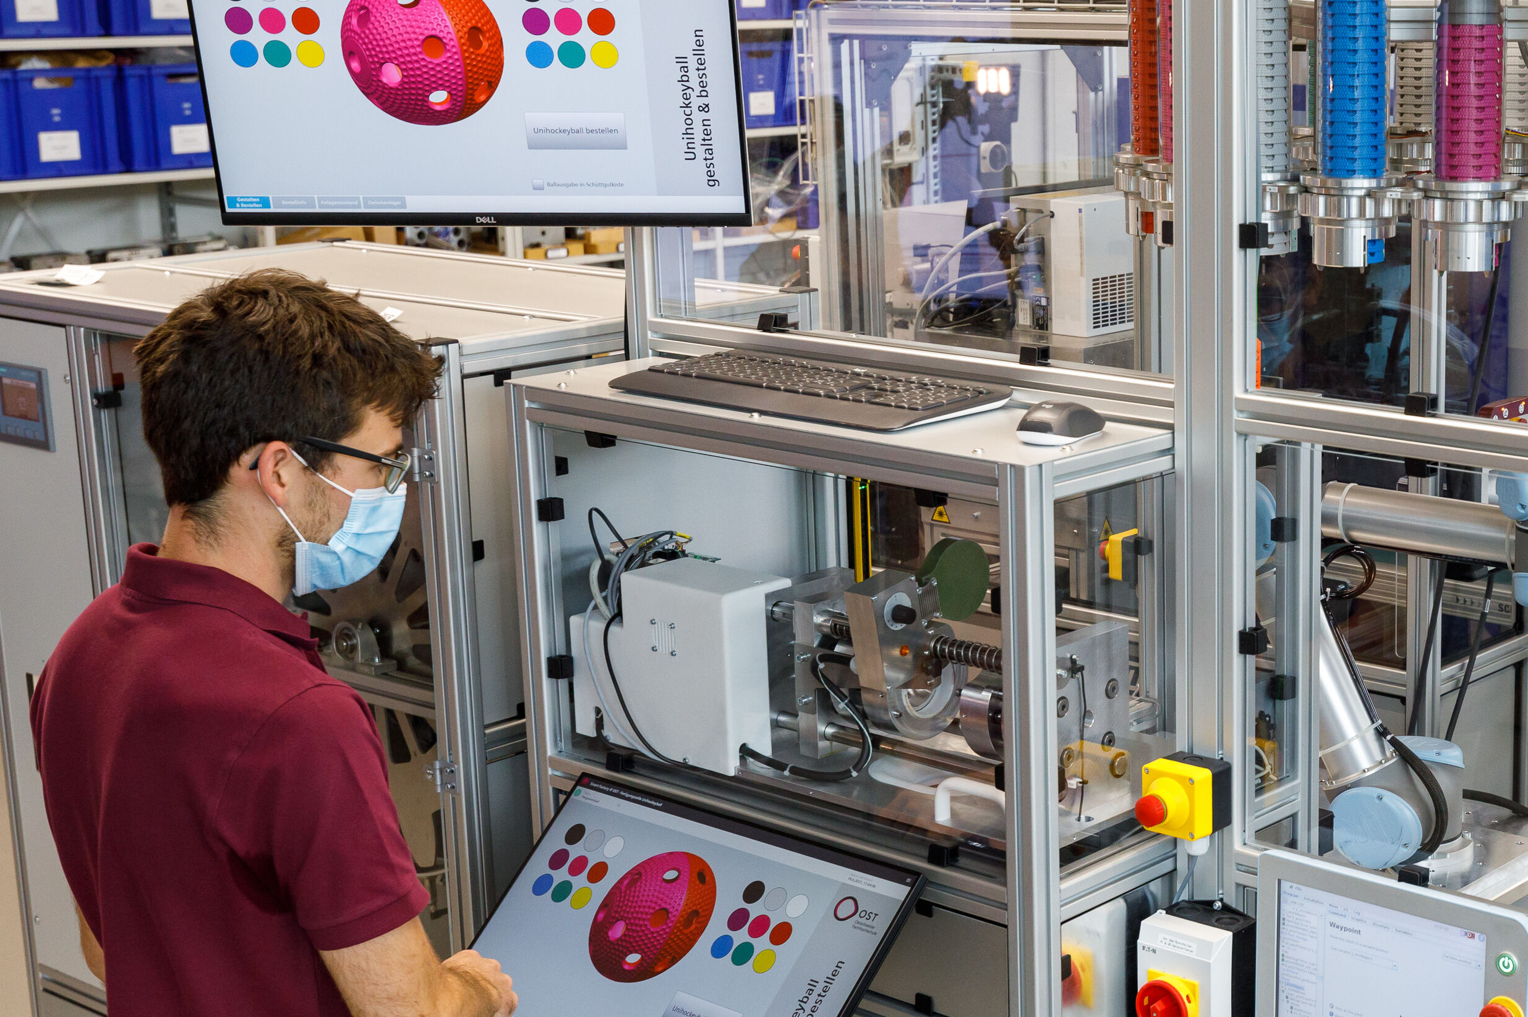
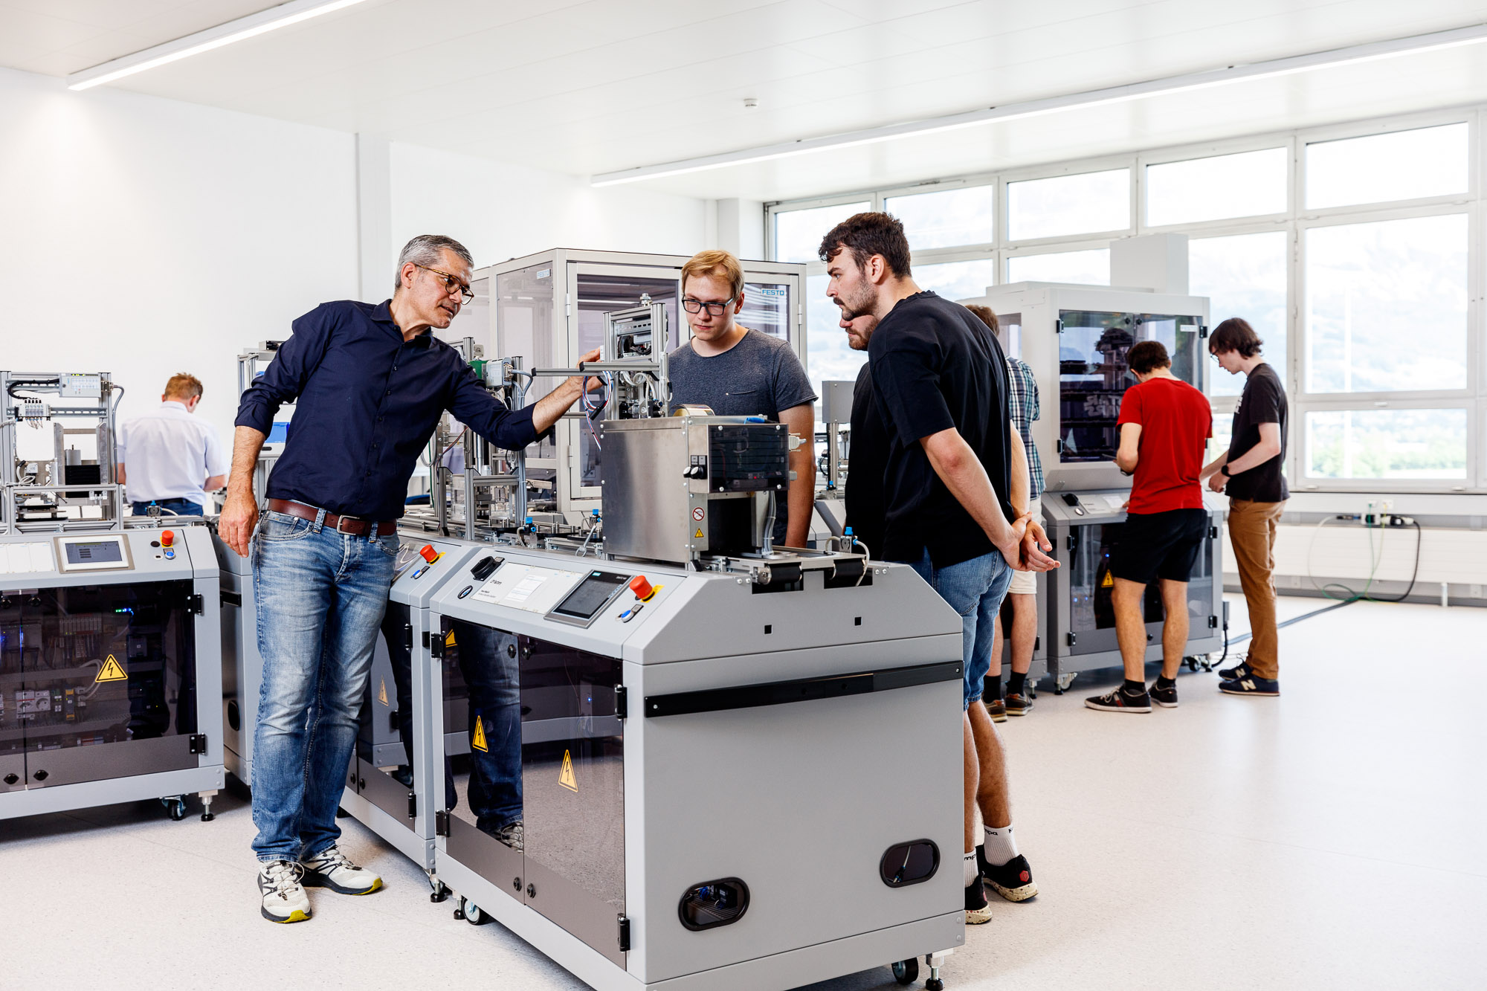
The OST Smart Factory is a real-world industrial production environment to showcase applied digitalization
What is the «OST-Gadget»?
St. Gallen
Sales and service.
Buchs
Product management, electronics development, and final assembly.
Rapperswil-Jona
Production of injection-moulded parts.
Notes:
RJ: Verantwortung für Produktion Spritzgussteile (sehr innovative Infrastruktur)
BU: Produktverantwortung, Elektronikentwicklung und Endmontage; «Business Unit» und RJ ist Teilezulieferer
SG: Verkauf und Service
Alles vollvernetzt und digital integriert über SAP etc.
Story: Task force -> Transparenz (wieviele haben wir, wann laufen wir wo trocken) und Nachverfolgbarkeit (brokerware)

Slide 5
As product for the smart factory, we propose the
«OST-Gadget», a wireless charger for your phone
What is the «OST-Gadget»?
The OST-Gadget is a wireless charger for
your smartphone or any other Qi-compatible
device.

Slide 6

Our proposal meets all defined product requirements, our focus is demonstrating the smart factory’s competencies
What is the «OST-Gadget»?
Focus
of the proposal
Representing OST
Useful
The product needs to show the competencies of OST.
The product must be useful – you need to want to have it!
Suitable for smart factory
More than an app
It must be feasible to produce the product in the smart factory’s infrastructure. Production of variants (e.g. multiple housing colors) must be possible. Simple assembly is a priority.
The function of the product must not be replaceable by an app.
Sustainable
The product must be sustainable – no batteries, use of recycled materials, etc.
Realizable
Product cost and time to market must be reasonable.

Slide 7
Market Analysis
What is our environment?

Slide 8

Almost 80% of the global population is using a smartphone, sales are saturating at a high level
How is the market characterized?
Global smartphone sales to end users 2007-2021
Note(s): Worldwide; 2007 to 2021
Source(s): Gartner

Slide 9
In Switzerland, >97% of the population own a smartphone
How is the market characterized?
Smartphones owners in Switzerland
Hinweis(e): Schweiz; 2017 bis 2020; 2.079 Befragte; repräsentativ für alle Regionen der Schweiz
Quelle(n): Comparis

Slide 10
1.8M smartphones are sold in Switzerland in 2022. With 6% of the population, Kanton St. Gallen would account for ~100k.
How is the market characterized?
Smartphone sales in Switzerland
Hinweis(e): Schweiz
Quelle(n): Statista; Statista Consumer Market Outlook

Slide 11
Smartphones in Switzerland are typically used ≥4 years
How is the market characterized?
How long are you using your smartphone before buying a new one? (Switzerland, 2021)
Hinweis(e): Schweiz; Oktober 2021; 2042 Befragte; repräsentative Befragung in allen Regionen der Schweiz; geplante Nutzungsdauer aktuelles Handy
Quelle(n): Comparis

Slide 12
Android and Apple are dominating
How is the market characterized?
What operating system are you using? (Switzerland, 2021)
Hinweis(e): Schweiz; 07.10. bis 22.12.2021 und 06.07.2021 bis 20.09.2021 und 06.04.2021 bis 16.06.2021 und 07.01.2021 bis 17.03.2021; 1968 Befragte; 18 bis 64 Jahre; Befragte, die ein Smartphone nutzen
Quelle(n): Statista Global Consumer Survey (GCS)

Slide 13
To charge smartphones and other devices, wireless charging is the technology of the next decade, CAGR 2020-2030 +29.4%
How is the market characterized?
Wireless charging market revenues worldwide 2020-2030
CAGR 29.4%
Note(s): Worldwide; 2020 to 2021; * Forecast. CAGR 2020-2030: 29.4% Read more
Source(s): Next Move Strategy Consulting

Slide 14
At least 78% of smartphone buyers can be expected to want a wireless charger
How is the market characterized?
What features are important to you when buying your next smartphone? (2022)
Wireless charging
Hinweis(e): Deutschland; Februar 2022; ab 16 Jahre; 835 Smartphone-Nutzer
Quelle(n): Bitkom Research; ID 180389

Slide 15
20% of smartphone users already own a wireless charger
How is the market characterized?
Ownership of iPhone and Android accessories in Belgium 2019
Note(s): Belgium; 2019; 18-75 years
Source(s): Deloitte; ID 1097587

Slide 16


Desk research identifies compatibility and charging speed as key consumer ease-of-use needs
What do customers need?
Qi certification for compatibility
Sufficient wattage for charging speed
Qi has become the accepted standard for wireless charging, allowing compatibility and safety of wireless chargers with a range of devices.
More Watts = more charging speed.
Qi wireless charging technology can transfer up to 15W.
iPhones currently capped at 7.5W (15W with MagSafe).
10W
7.5W
15W

Slide 17
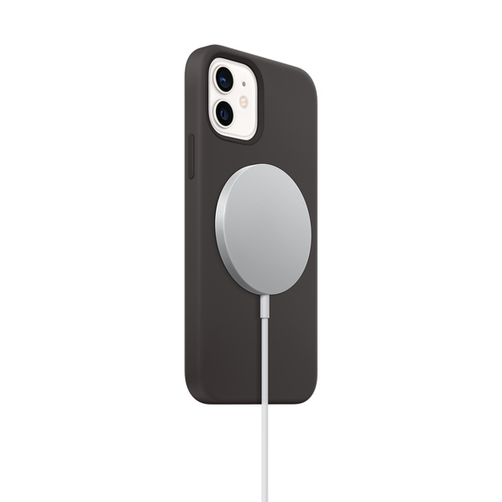
Simple positioning is another relevant ease-of-use request, consumers welcome Apple’s MagSafe feature
What do customers need?
iPhone users most liked new features of the iPhone 12
Source: Apple
Wireless chargers need to be precisely aligned with the device they are charging.
MagSafe is an Apple standard for positioning the phone via magnets for maximum charging efficiency.
Note(s): United States; October 18-26 2020; 18 years and older; 3023 respondents; U.S. based iPhone users
Source(s): SellCell.com; ID 1199139

Slide 18
Generally, durability and quality are key customer preferences for mobile phones and digital gadgets
What do customers need?
Main attributes driving purchase behavior for consumer electronics (mobile phones and digital gadgets)
Note(s): Vietnam; June to July 2020; 1,000 respondents; among households in Hanoi, Ho Chi Minh City, Can Tho and Da Nang
Source(s): Deloitte; ID 1110932

Slide 19
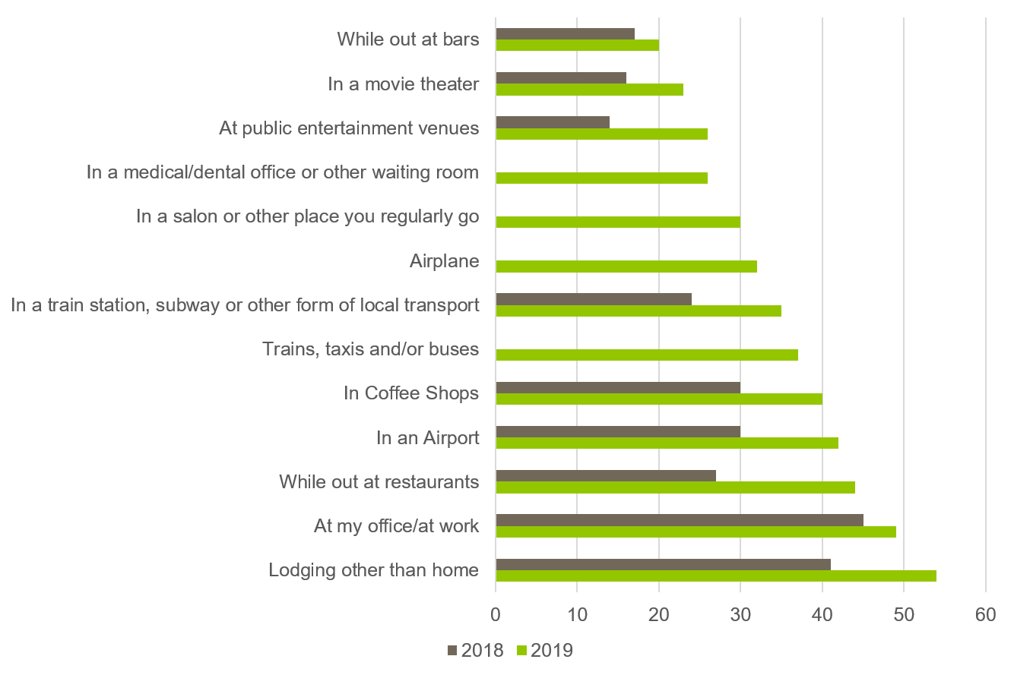
As battery anxiety is a key concern, consumers want to see wireless power available to them in more places
What do customers need?
Consumers experiencing battery anxiety (fear to run out of battery)
Consumers wishing wireless charging options
Note(s): 3,500 consumers across U.S., U.K., Germany, China, India, Indonesia and Japan
Source: WPC Global Consumer Perceptions Study 2019

Slide 20
With our digital manufacturing in mind: 69% of consumers are willing to pay a premium for personalized electrical products
What do customers need?
Premium consumers willing to pay for personalized products in Great Britain 2015
Note(s): United Kingdom (Great Britain); June 2015 ; 16 years and older; 1,560 respondents; All interested in customized products and/or services
Source(s): Deloitte; YouGov; ID 462684

Slide 21
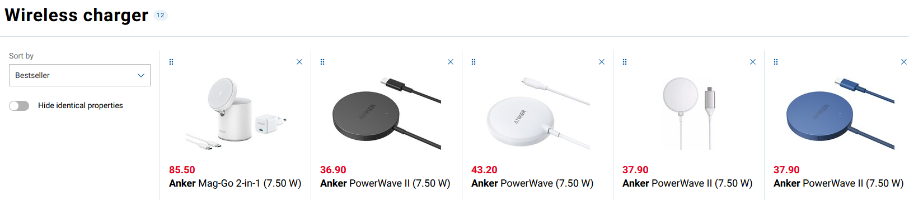


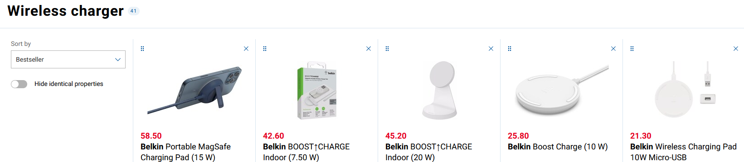

Anker and Belkin are the leading brands
What is the competition?
Wireless charging companies worldwide 2022, by revenue
Note(s): Worldwide; May 2022
Source(s): Statista; ZoomInfo

Slide 22
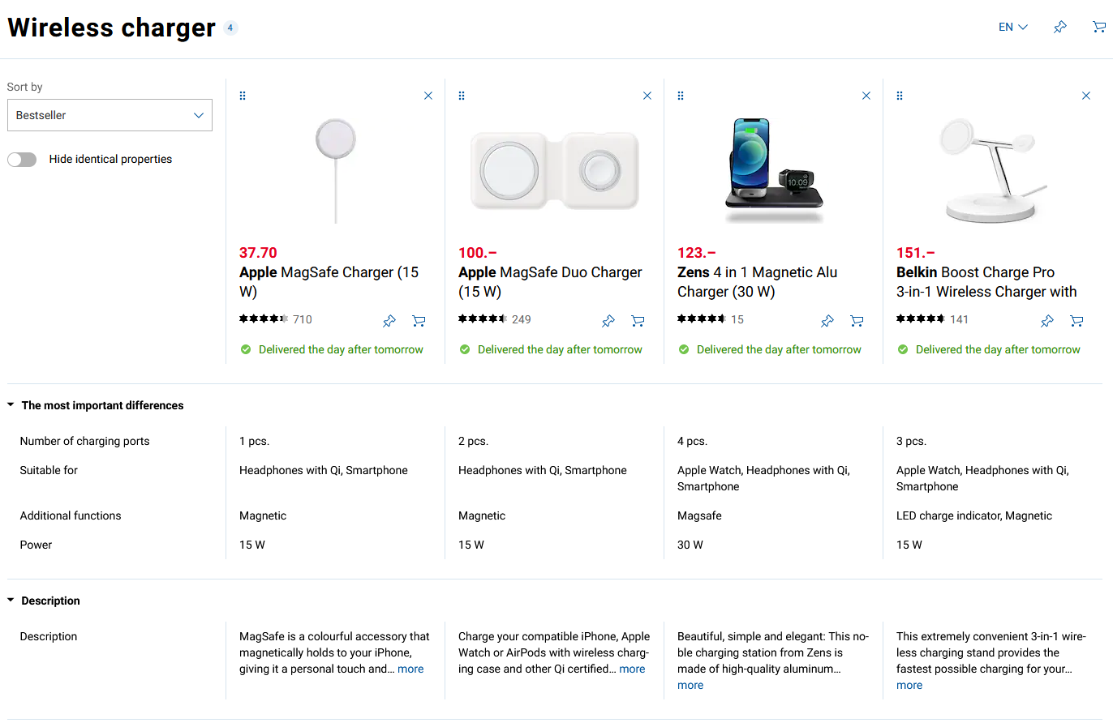

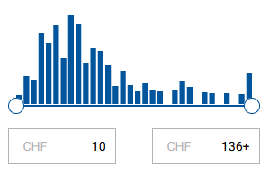
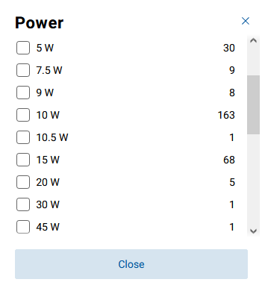
Prices range from ~10-150 CHF, most products around 40CHF, but also strong demand for premium products
What is the competition?

Slide 23
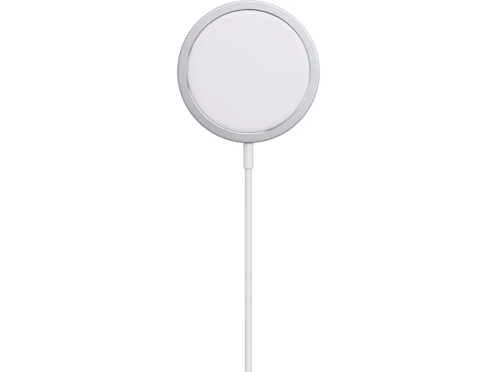
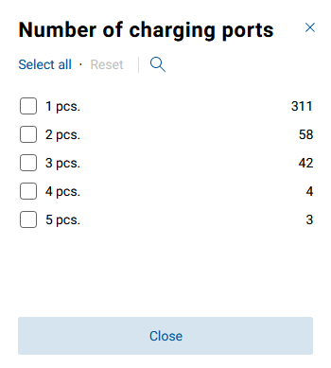
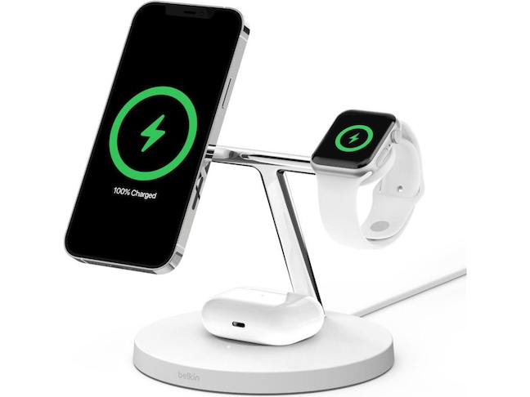
The majority of chargers has a single charging port
What is the competition?
Single charging port
→ compact size for both
mobile and stationary use
Source: Apple
Multiple charging ports
→ stationary use
Source: Belkin

Slide 24
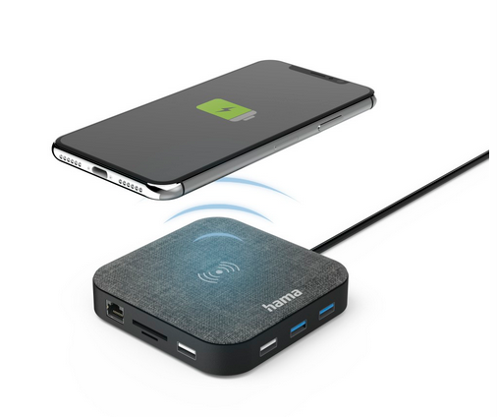
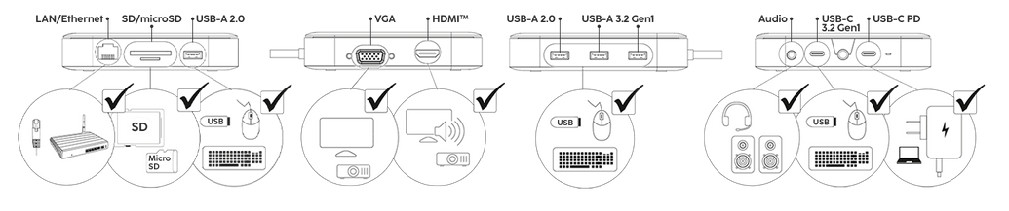
Differentiation can be generated by MagSafe or the combination of wireless charging with an USB hub
What is the competition?
MagSafe
USB hub
Source: Hama
Source: Apple

Slide 25
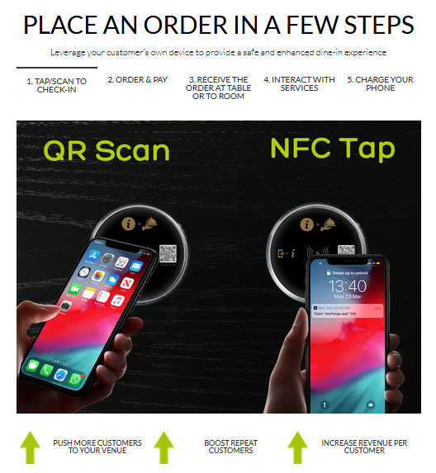
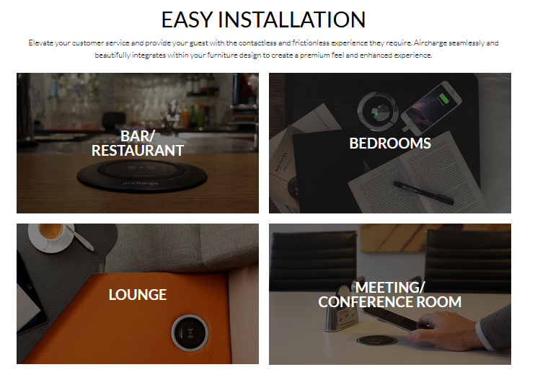
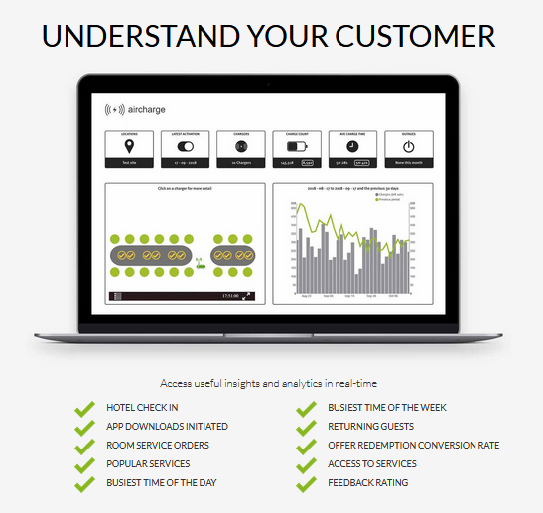
For wireless charging in businesses, there are dedicated suppliers offering additional functions
What is the competition?
Source: Aircharge

Slide 26
Marketing Strategy
Where to play, how to win?

Slide 27




Digital manufacturing know-how is our strength, our weakness is that we are not a real and competitive enterprise
What is our strategic position?
Strengths
Weaknesses
  Cutting-edge digital manufacturing technology, in particular in injection moulding
  Availability of a brain pool of experts with innovative mindset
  OST is a brand known to local students, industry, and limited public that is associated with innovation and education
  No experience, no infrastructure, no personnel for cost-efficient series production, distribution, and service
  Lacking know-how in certification (→ Qi certification)
  High labor cost
  Brand only known locally
  It is not the purpose of OST to create commercial products
Opportunities
Threats
  Pressure to de-globalize supply chains increases interest in smart factory technology
  Exponential growth of wireless charging market
  Battery anxiety and trend to wireless charging on the go
  Trend and pressure by European regulators to standardize smartphone chargers
  Supply chain disruptions endangering raw material supply, in particular electronics, and increase COGS
  Rise of electric vehicles might put further pressure on availability and cost of electronics material
  Continuous development of charging technology and
  standards put pressure on product cadence

Slide 28


Consumer: large segment, but are we ready for a competitive mass market?
What are our target segments?
Segment characteristics
Pro
We expect a potential of 60’000 wireless chargers in Kanton St. Gallen next year.
Assuming we take 1% and demand stays constant,
we could sell 600 chargers per year.
Assumptions:
1.8 Mio. smartphones will be purchased in Switzerland next year, proportionally to the population we assume 100k in Kanton St. Gallen
(→ slide 10)
78% of smartphone buyers want a wireless charger with their next smartphone (→ slide 14)
20% of smartphone buyers already own a wireless charger
(→ slide 15)
Large segment, potential for economies of scale benefits
A successful product would boost awareness for OST in the general public
Con
High competitive pressure
High customer expectation on quality and service
Cost-sensitive
Requires elaborate distribution network
Requires intensive communication
Requires creating after sales service

Slide 29
Consumer premium: Allows to focus & play our strengths, but can we live up to expectations on quality and service?
What are our target segments?
Segment characteristics
Pro
We expect a potential of >8’000 wireless chargers in the premium category in Kanton St. Gallen next year.
Assuming we take 1% and demand stays constant,
we could sell 80 chargers per year (with premium margins).
Assumptions:
Premium category = >80CHF
13% of products >80 CHF (digitec.ch)
Share of sales proportional to available products
A successful product would boost awareness for OST in the general public
Allows playing our strengths in technology, e.g. personalization, to differentiate and justify a price premium (→ slide 20)
Less cost-sensitive
Higher margins can compensate lower quantities
Allows focused communication and distribution
Con
High competitive pressure
Very high customer expectation on quality and service
Requires creating after sales service
Special requirements – you can’t target other segments with the same product
In-house electronics development for technological differentiation might require certification (Qi), where we are lacking know-how

Slide 30
Charging to go in lodging and gastronomy: small and difficult segment
What are our target segments?
Segment characteristics
Pro
We expect a potential of up to 10’000 wireless chargers in Kanton St. Gallen.
Assuming we take 1% and a 5 years cadence, we could sell 20 chargers per year.
Assumptions:
220 hotels with 9292 beds in Kanton St. Gallen (BfS, 2020)
1613 gastronomy businesses in Kanton St. Gallen (BfS, 2018)
A gastronomy business would in average buy 10 chargers, a hotel a charger per bed
53% of customers would welcome a charger in the hotel, 40% in gastronomy (→ slide 19)
Efficiency in communication and distribution – low number of customers, each customer with a demand of potentially double digit nubmer of units
Con
Special requirements (businesses want more than a charger, → slide 25). you can’t target other segments with the same product
Low adoption rate so far – businesses and would need convincing that offering wireless charging is a good idea
Customer pool is very limited
High customer expectation on quality, cost, and service
Requires creating after sales service

Slide 31
Charging to go in the office: We can build on existing industry relationships of OST, but no pull on wireless chargers
What are our target segments?
Segment characteristics
Pro
We expect a potential of up to 50’000 wireless chargers in Kanton St. Gallen.
Assuming we take 1% and a 5 years cadence, we could sell 100 chargers per year.
Assumptions
In Kanton St. Gallen there are 307’000 workplaces (BfS, 2019)
36.7% of employees are working in offices (Institut der deutschen Wirtschaft, 2020)
49% of employees would welcome a wireless charger at their desk
(→ slide 19)
Efficiency in communication and distribution – low number of customers, each customer with a demand of potentially double digit nubmer of units
We have an established relationship with industry partners of OST
Con
Low adoption rate so far – businesses and would need convincing that offering wireless charging is a good idea
Customer pool is very limited
High customer expectation on quality, cost, and service
Requires creating after sales service

Slide 32
OST students and staff: we expect reasonable quantities at moderate effort
What are our target segments?
Segment characteristics
Pro
We expect a potential of 600 chargers for OST students and staff next year.
Assuming we take 30% and demand stays constant we could sell 200 chargers per year.
Assumptions
OST has 3800 students and 1500 staff (OST.ch)
97.2% of OST students and staff own a smartphone
(→ slide 9)
20% of smartphone owners will buy a new device next year
(→ slide 11)
78% of smartphone buyers want a wireless charger with their next smartphone (→ slide 14)
20% of smartphone buyers already own a wireless charger
(→ slide 15)
Identification of students and staff with OST
Simple communication and distribution
As an OST-internal product, service expectations are lower
Con
Small market

Slide 33
OST merchandise: good fit for a premium merchandise, we expect reasonable quantities
What are our target segments?
Segment characteristics
Pro
We expect we could use 300 chargers per year.
Assumptions:
Due to its cost, the Gadget is not distributed as a merchandise on fairs and events
The Gadget is used as a merchandise gift for premium partners, assuming 50/year
Each industry visitor of the smart factory in Buchs or Rapperswil receives a Gadget, assuming 20/month
Good fit for a merchandise: Enables demonstration of technological competencies of OST, in particular of those in the smart factory, and proves OST’s hands-on approach
No distribution network, no promition required
Con
The cost is substantially higher than the unihockey ball previously produced by the smart factory in Rapperswil

Slide 34

We recommend targeting merchandise and students & staff; premium interesting but can’t be targeted with same product
What are our target segments?
Attractiveness | high
 | mid
 | low
 |  | low | mid | high
 |  | Competitive position
Consumer
Consumer
premium
OST merchandise
OST students & staff
Charging to go
office
Charging to go
lodging & gastronomy

Slide 35
Our strategic position implies a focus approach with technological differentiation
What is our value proposition?
Porter’s generic strategies
Scope | Industry-wide | Cost leadership | Differentiation
 | Niche market | Focus
 |  | Low cost | Differentiation
 |  | Competitive advantage
Build on technological strenghts!
Avoid cost sensitive segments!
Avoid complexity in distribution & service!
Stay regional!

Slide 36
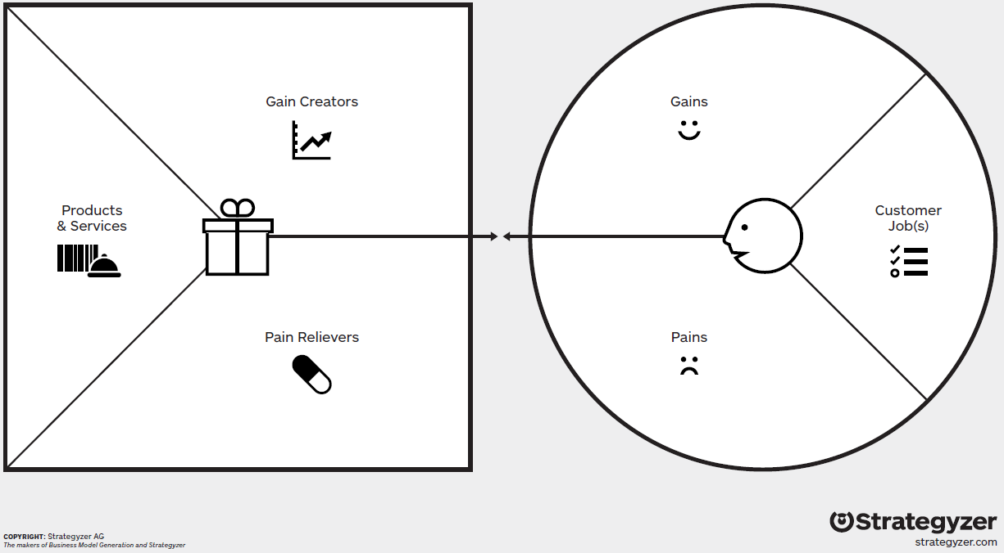
Using a focus strategy, personalized design is at the core of our differentiation
What is our value proposition?
OST branding
Personalized design
Communicate style and values
Identification with OST
Sustainable
materials
Wireless
charger
Keep phone powered
Optional: USB hub
Dual use as USB hub
Waiting while charging
10W-15W power
Compitability
Durability
Keep other devices
powered
Durable
design
Battery anxiety,
charger availability
Qi certification
Optional: MagSafe
Compact size,
single charging pad
Positioning
on charger

Slide 37
Personalization is the core of our differentiation, combined with OST branding and sustainable materials
What is our value proposition?
OST branding
Personalized design
Personalization makes us different
We propose a personalized design as the core of our differentiation, because
Consumers want it (→ slide 20)
Our strenghts in digital manufacturing enables us to do it (→ slide 27)
It enables us to demonstrate OST’s competencies, which is one of the key requirements on the product (→ slide 6)
Sustainable
materials
Wireless
charger
Optional: USB hub
OST branding makes the merchandise
10W-15W power
A strong and visible OST branding makes the product a merchandise.
Durable
design
Qi certification
Sustainable materials represent the values and mission of OST
Optional: MagSafe
Compact size,
single charging pad
Climate and energy is one of the strategic focus areas of OST. The use of sustainable materials enables emphasizing that claim.

Slide 38
Qi certification, sufficient wattage, and durability are must-haves. We prefer a compact, mobile charger.
What is our value proposition?
OST branding
Personalized design
These are must-haves
We consider
Qi certification,
min. 10W and max 15W power, and
durable design
hygiene factors that we must have, but which do not add to differentiation.
Sustainable
materials
Wireless
charger
Optional: USB hub
10W-15W power
We prefer mobility
Durable
design
We prefer a compact, single-pad, mobile charger over a stationary charger with multiple charging pads. This solution is
less costly,
more flexible,
makes charging available on the go, and
displays the OST branding in public.
Qi certification
Optional: MagSafe
Compact size,
single charging pad

Slide 39
MagSafe and/or USB hub are nice-to-have
What is our value proposition?
OST branding
Personalized design
Sustainable
materials
An USB hub is nice to have
Wireless
charger
Optional: USB hub
An USB hub feature adds to differentiation, but is not related to our core competencies or values. We consider the feature nice to have if it can be added at minimum cost.
10W-15W power
Durable
design
A MagSafe feature is nice to have
Qi certification
A MagSafe feature adds to differentiation and will be welcomed by users of iPhone 12 or later (→ slide 17). Since these are only a minority of the market, we consider the feature nice to have if it can be added at moderate cost.
Optional: MagSafe
Compact size,
single charging pad

Slide 40
Marketing Mix
How to turn strategy into action?

Slide 41
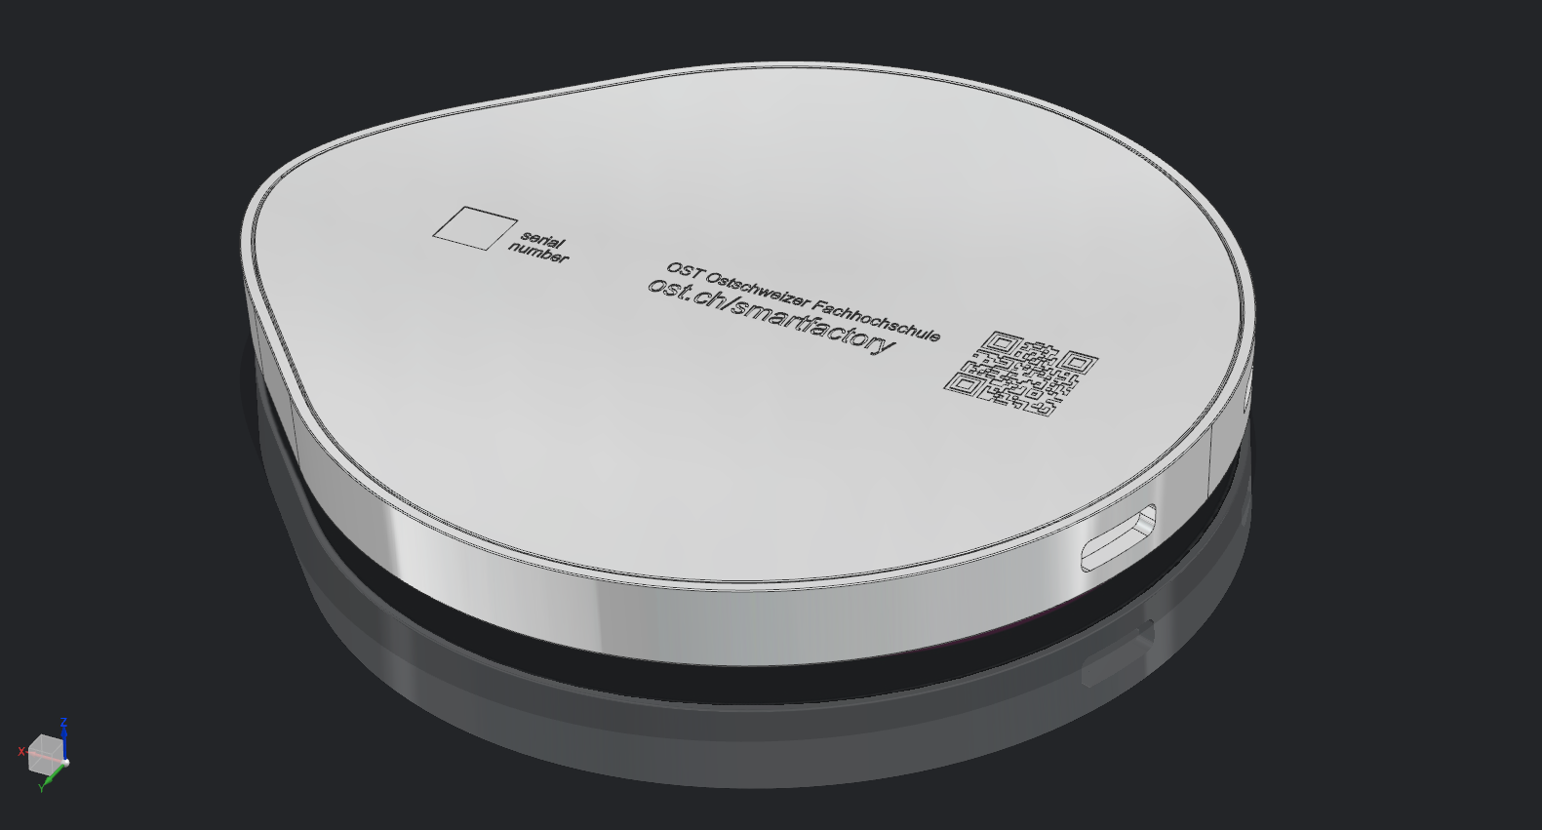
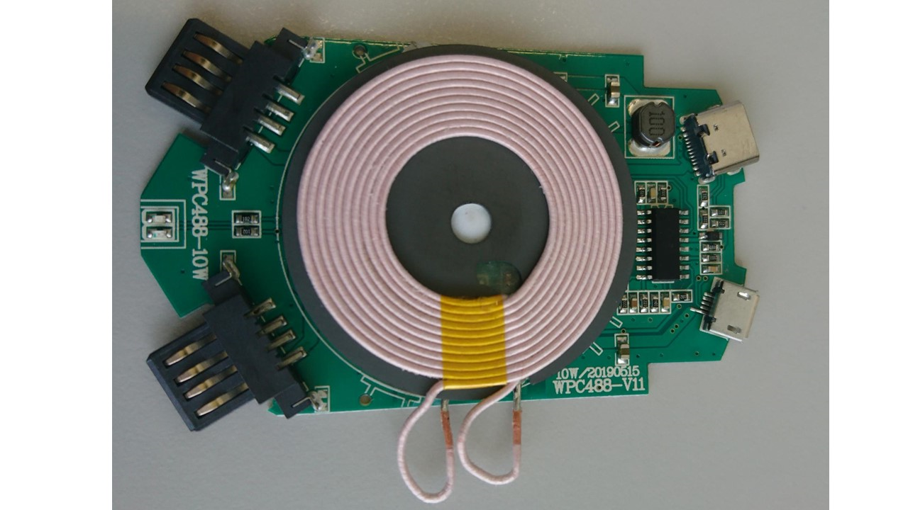
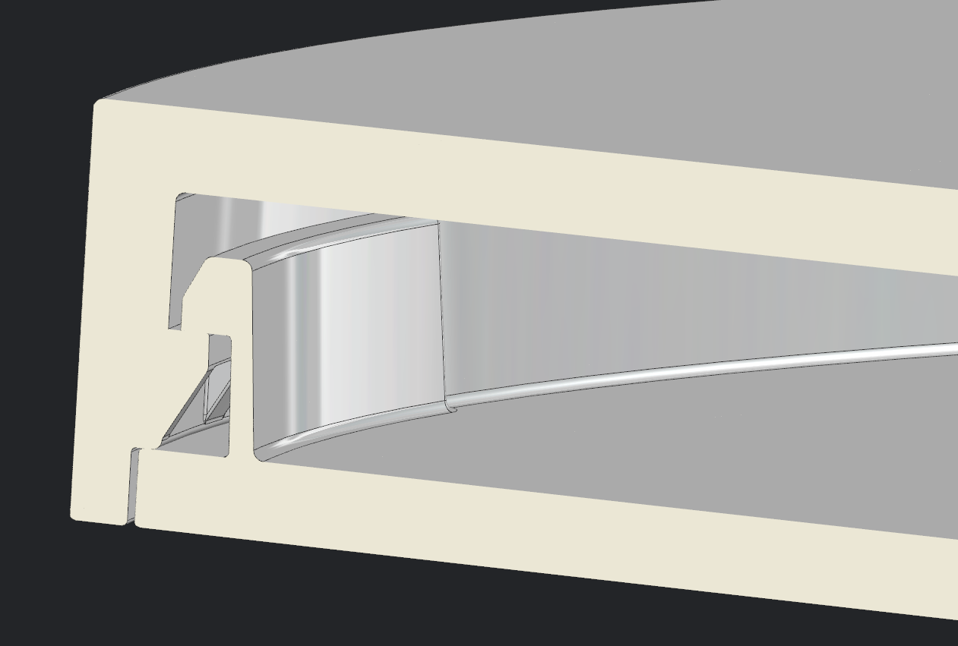
We only offer the physical product – no frills, no service.
We make the housing, we buy the electronics.
What is the product?
We make the housing to show our strengths
We buy the electronics to avoid certification
Printed plastic film
(back moulded)
Integrated
NFC-chip
Wireless output
DC 5V/1A (5W), DC 9V/1.1A (10W)
charging distance ≤6mm
works with all Qi-compatible devices
Serial number
(DataMatrix-Code)
Housing possible in
different colors
USB-C input
DC 5V/2A, DC 9V/1.67A
2 USB-A outputs
DC 5V/1A
Assembling using snap-in hooks
Connection by
USB-C or Micro-USB
LED
Red and blue LED indicating the charging process
Micro-USB input
DC 5V/2A, DC 9V/1.67A
In-house production to demonstrate the smart factory’s competencies and infrastructure in injection moulding and digital manufacturing
Personalized design e.g. by choice of colors, variants or fully personalized print, etc.
Strong OST branding by housing in the shape of the OST logo
Durable design with sufficient thickness
Using recycled plastics for sustainability
Model WPC488-10W
To avoid the need for a Qi certification and to shorten time to market, we source the electronics externally
Assembly of housing and electronics is done in-house
The propsed electronics feature 10W wireless output, compact size for a single charging pad, Qi certification, durable design, and an USB hub.

Slide 42
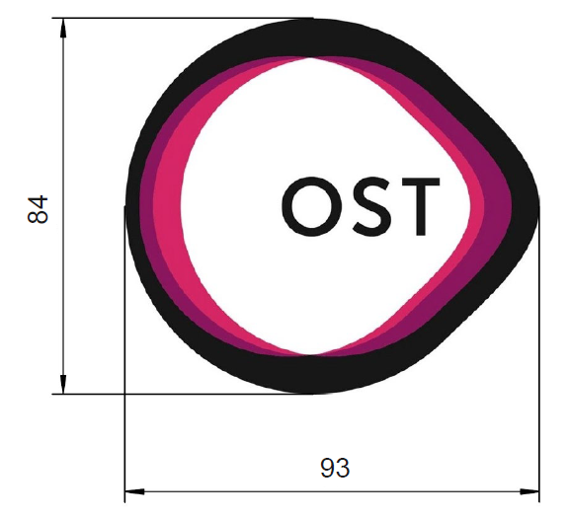
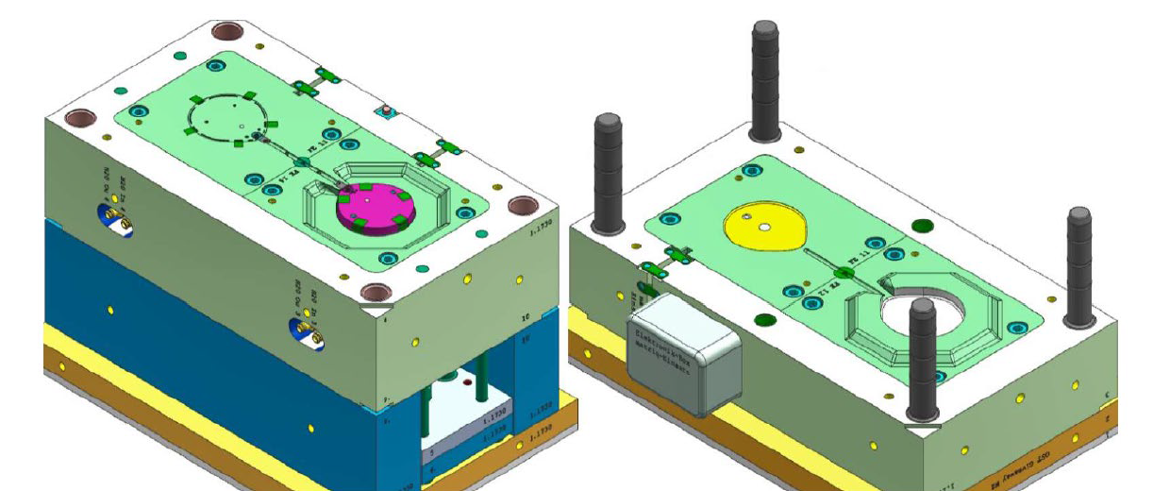
We estimate the material cost around 8CHF/pc plus 50kCHF fixed cost
What is the price?
The variable cost for material is currently around 8CHF/pc
The fixed cost for material is currently around 50’000 CHF
The cost for the injection moulding tools is 50’000 CHF
Assume a depreciation period of 7 years

Slide 43
We estimate a 25 CHF price; we could still sell at market’s average 40 CHF if quantities are -50% lower than expected
What is the price?
Assumptions
Per unit
We expect 300 chargers per year for merchandise
(→ slide 33).
We expect 200 chargers per year for OST students and staff (→ slide 32).
We assume depriciation of the tooling over 7 years
We only consider materials cost, labor covered by running the smart factory, no cost for distribution
We consider Swiss VAT 7.7%
For the use as merchandise and sales to students and staff, we want to sell non-profit
40 CHF
Fixed cost
25 CHF
Variable cost
Units
250 pcs per year
500 pcs per year

Slide 44
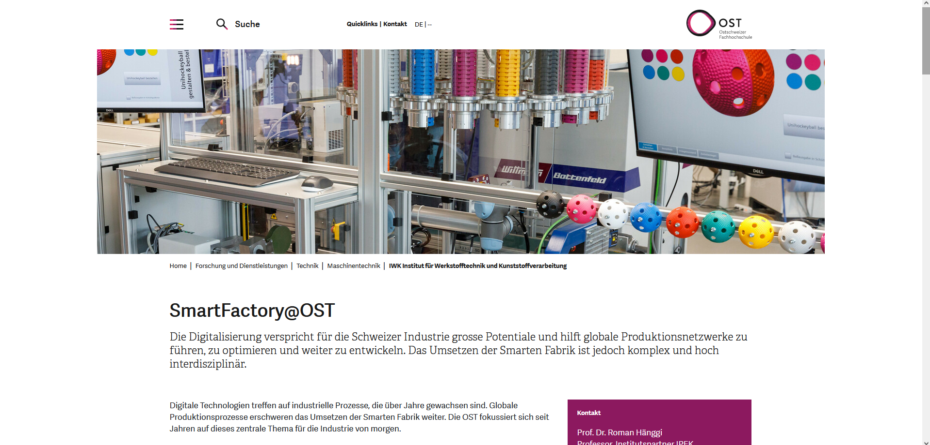
OST students and staff can order online and pick up their product at the reception
What is the place?
Order online
Pick up at the reception
The ordering infrastructure should create only moderate effort and allow personalizing the product.
We propose an online system:
Order on the smart factory’s homepage
Online design personalization
Online payment
The distribution should not require additional infrastructure or staff and be available at all OST locations.
We propose picking up orders at the reception desks of each OST location. We use regular employee traffic between locations for logistics.

Slide 45
For use as merchandise, smart factory visitors can watch the product being made
What is the place?
Buchs
Visitors can watch the final assembly. Personalization only with a pre-defined choice of designs.
Rapperswil-Jona
Visitors can watch the housing production. Final assembly with the electronics has to be done manually.

Slide 46
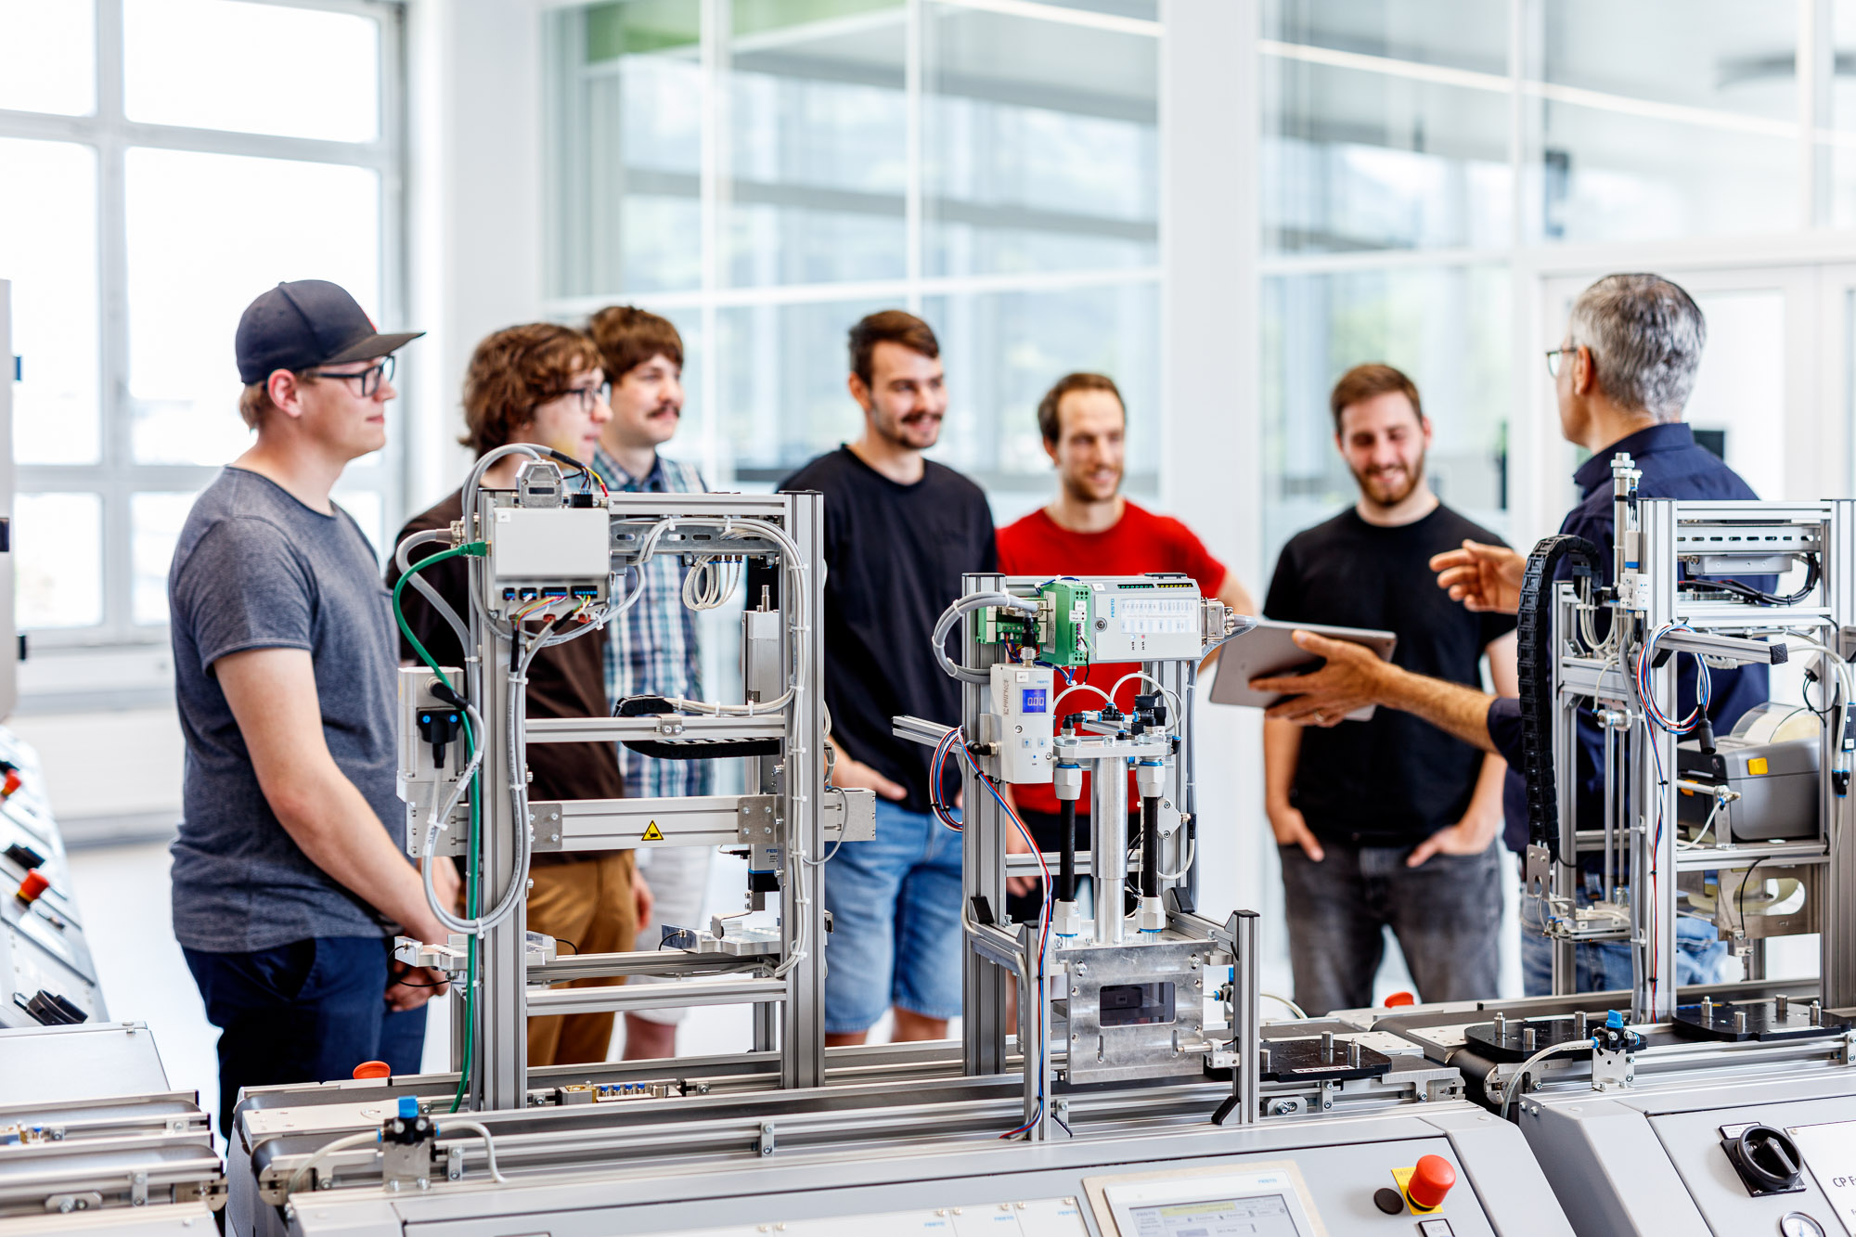
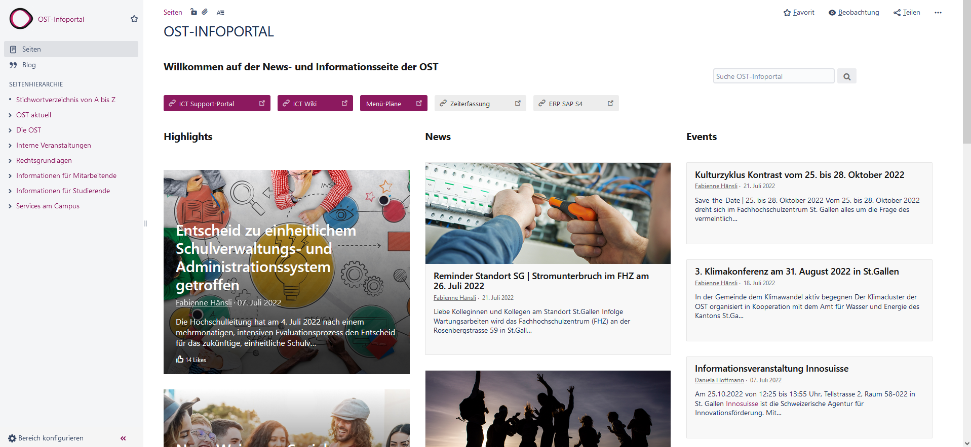
Communication to OST students via classes utilizing the smart factory, to OST staff via intranet
What is the promotion?
OST students via classes
OST staff via intranet
Direct communication to classes that utilize the smart factory does not create any cost
Students who have had classes in the smart factory are more likely to be interested in the product
No further promotion to avoid cost
Regular announcements on the intranet does not create any cost and should reach a high share of employees
No further promotion to avoid cost

