Slide 1



Digital Manufacturing
Injection Moulding in a Smart Factory
Curdin Wick MSc.

Slide 2
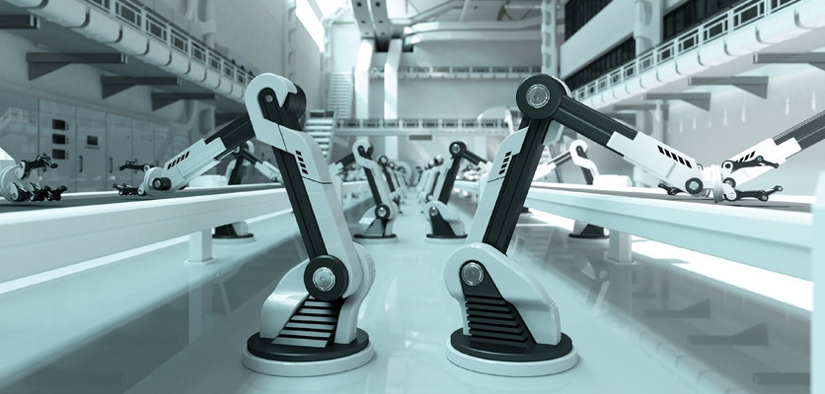
What is a Smart Factory and why is it the future?
Digital Manufacturing
" Future state of a fully connected factory, which leads the interaction of man - machine in the focus. The smart factory generates, receives and processes data to realize the production of all kinds of goods in a data-driven way."
Source: Osterrieder, Budde & Friedli (2019): The Smart Factory as a key construct of Industry 4.0: A systematic literature review
Notes:
Roman Hänggi

Slide 3

Smart Factory @ OST – floorball production
Digital Manufacturing

Slide 4
Injection moulding in times of digitalisation
Digital Manufacturing
Everyone is talking about digitalization, the smart factory and Industry 4.0, and these topics are also becoming increasingly relevant for injection moulding.
In order to implement Industry 4.0 in injection moulding companies, data must be collected and analysed in order to make predictions.
However, the data-driven monitoring, optimization or operation of an injection moulding production is still often a dream today.
Industry 4.0 / Learning from Machine Data
Additional data from the machine
Combining machine data with data
from IT Entreprise solutions (orders)
Implementation of IT – Entreprise
(CAD, PLM, ERP, MES)
IT Entreprise Solutions focus on
integrated process & data flow
Key Information / data for a company
Lean Processes first
Stable & robust processes are the base
Reduction of Waste
Lean Principle focus on the important
digital needs

Slide 5
Learning from data
Digital Manufacturing
The main goal of the smart factory is to optimize production by learning from data.
"What you can't measure, you can't control"
Peter Drucker, American economist
Only if the exact actual condition of the machines and peripheral equipment is known work on optimizing the processes can be done.
Source: LEAN Production

Slide 6
Challenges in implementing Industry 4.0
Digital Manufacturing
There are two main challenges in implementing Industry 4.0 today.
lack of awareness in practice, both for possible applications and for the necessity of a implementation. We are talking about the actual target orientation or also use case definition for the smart factory. This concretization must be oriented to the following questions:
  How can I increase my value creation by using data?
  How can I use my data? What is the goal?
  What data do I need to implement a specific use case?
learning from data requires a complete data base. Some questions arise here as well:
  Which signals do I need? Which signals are available at all?
  What quality of data do I need? Is the data available in this required quality?
  How do I get the data out of my machine?
  How do I synchronize data from different machines and devices?

Slide 7
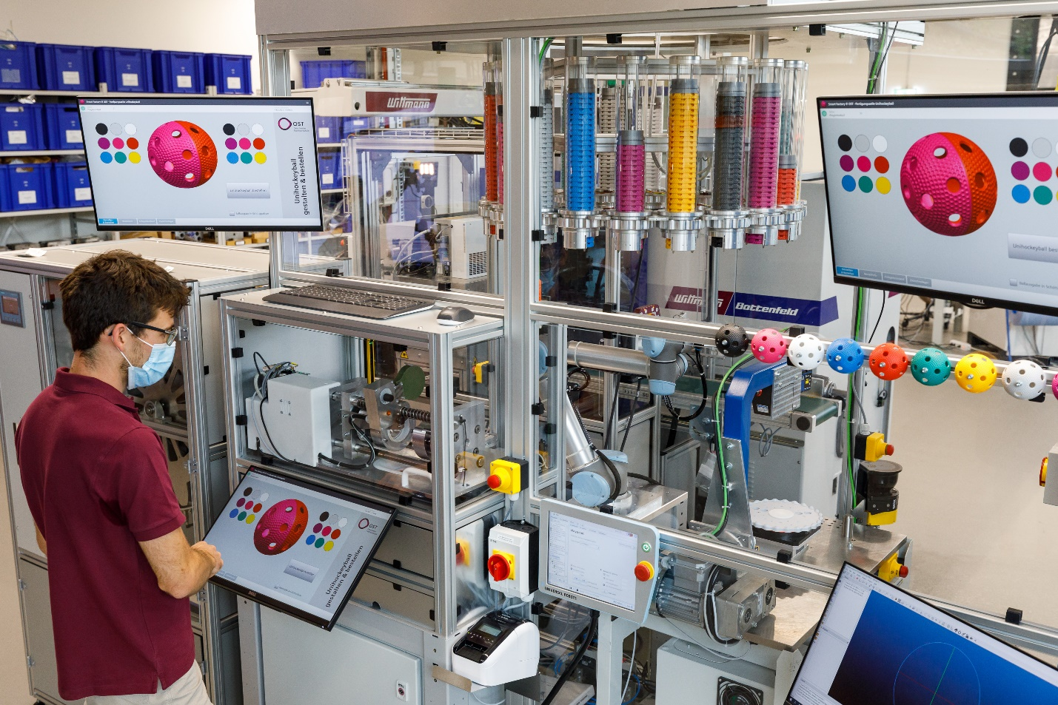
Learning objectives of this lecture
Digital Manufacturing
The students can…
… apply the concept for learning from data in the smart factory
… identify difficulties in its implementation

Slide 8
Injection Moulding in a Smart Factory
Digital Manufacturing
Implementation of machine learning in the factory
Use Cases for injection moulding
Exercise:
Experience the floorball manufacturing cell

Slide 9
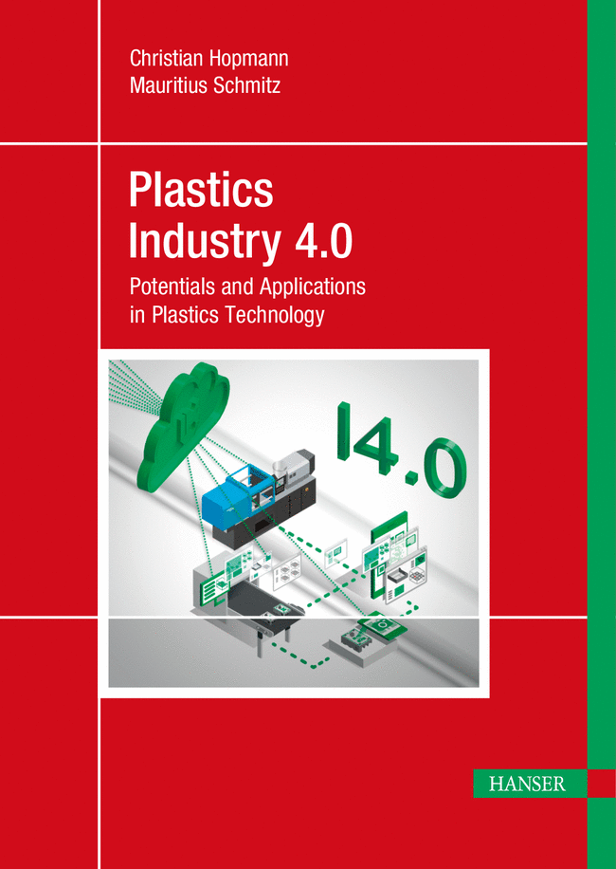
Additional reading
Digital Manufacturing
Plastics Industry 4.0
Potentials and Applications in Plastics Technology
Christian Hopmann, Mauritius Schmitz
Print ISBN: 978-1-56990-796-2
eISBN: 978-1-56990-797-9
https://www.hanser-elibrary.com/doi/10.3139/9781569907979.fm

Slide 10

Additional reading
Digital Manufacturing
Data Science – was ist das eigentlich?!
Algorithmen des maschinellen Lernens verständlich erklär
Annalyn Ng, Kenneth Soo
Print ISBN: 978-3-662-56775-3
eISBN: 978-3-662-56776-0
https://link.springer.com/book/10.1007/978-3-662-56776-0

Slide 11
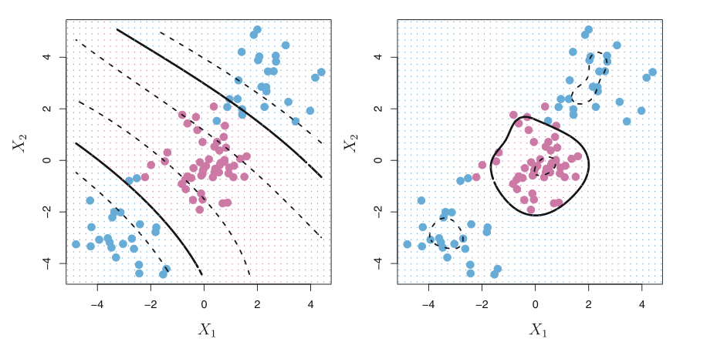
Implementation of machine learning in the factory

Slide 12
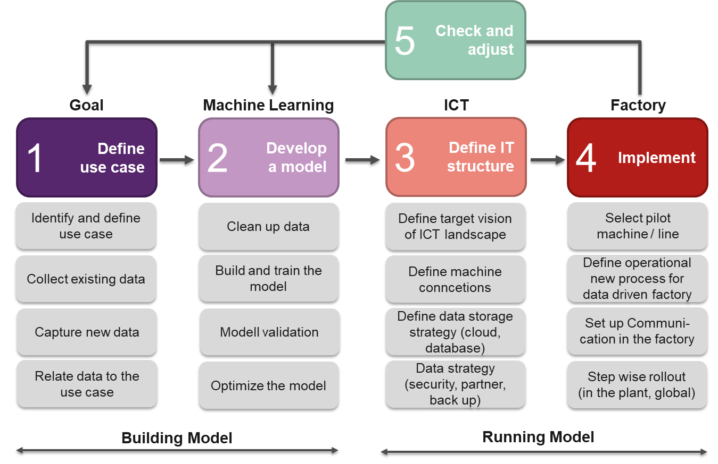
Model for the implementation of machine learning in the factory
Smart Factory @ OST
Investigations showed that a step-by-step approach to implement Industry 4.0 in plastics processing is target-oriented.

Slide 13
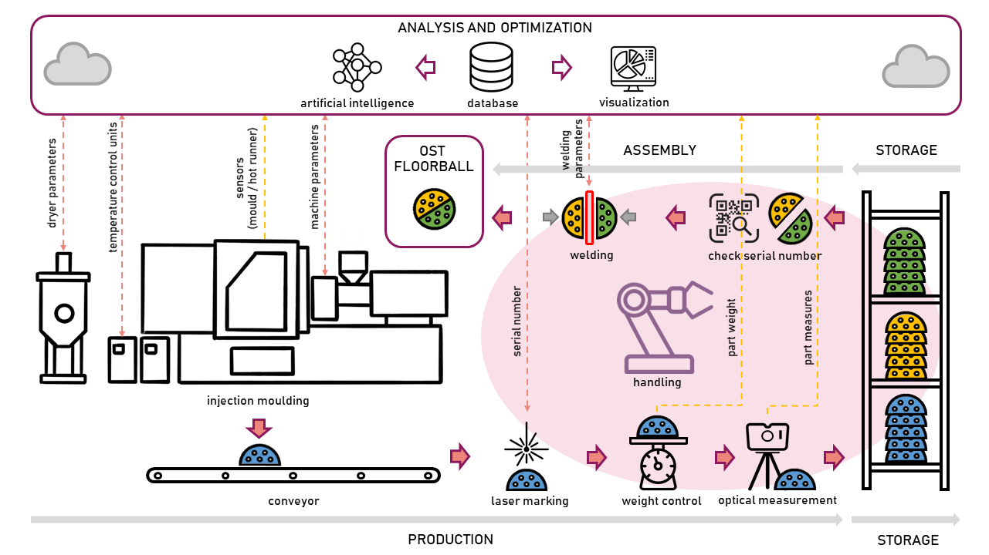
Manufacturing cell floorball
Smart Factory @ OST

Slide 14
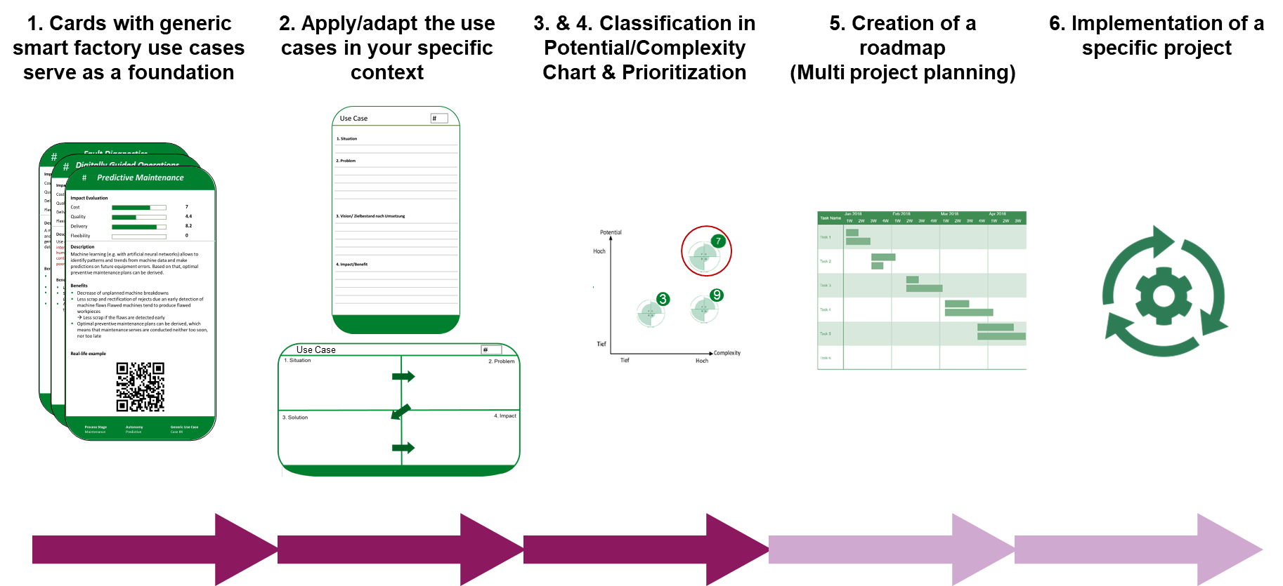
From Smart Factory use case patterns to specific use-cases
Implementation of machine learning in the factory: use case

Slide 15
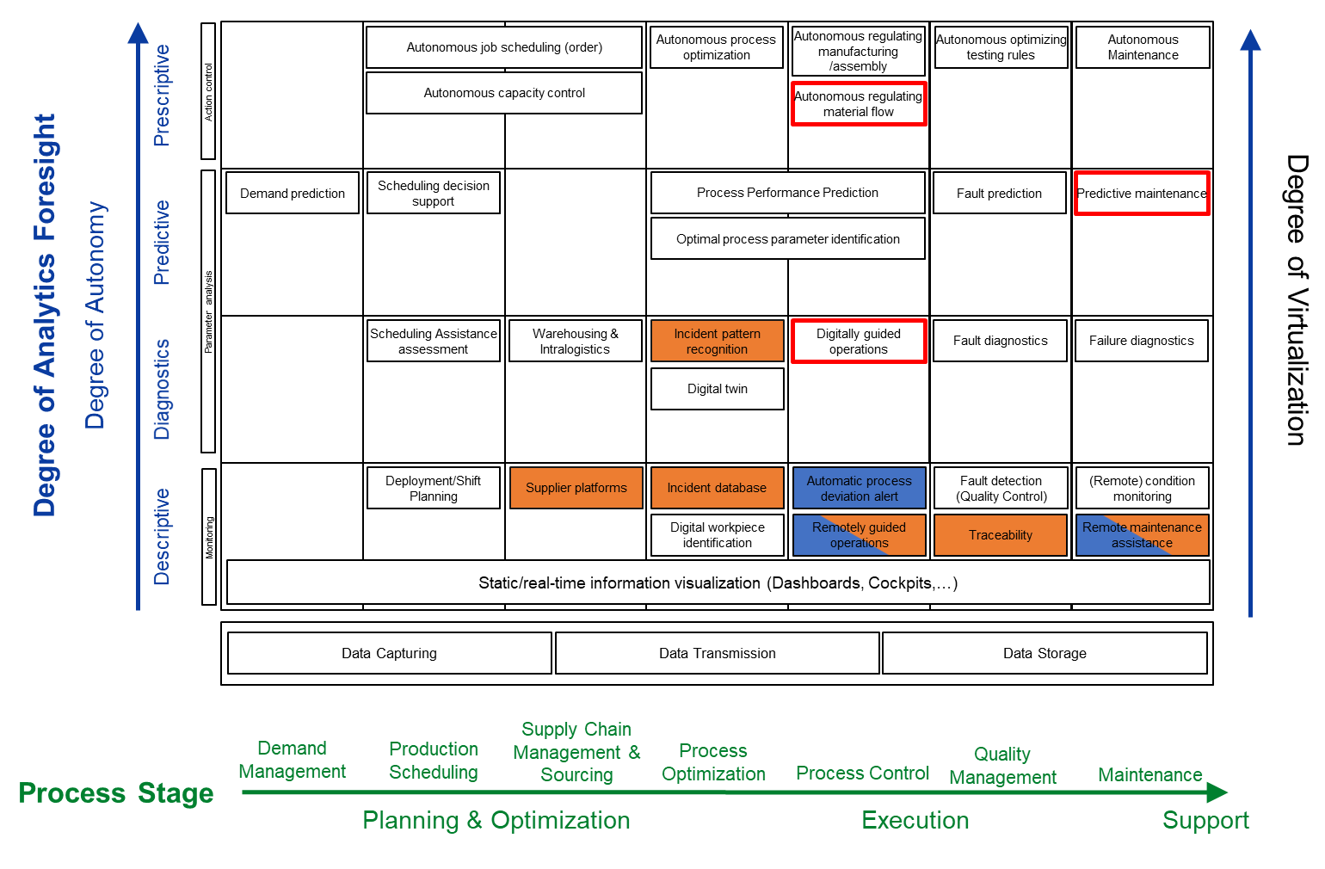
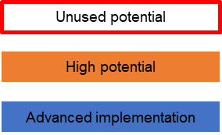
Classification of digitalization use cases
Implementation of machine learning in the factory: use case

Slide 16
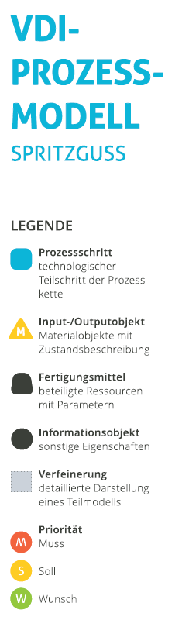
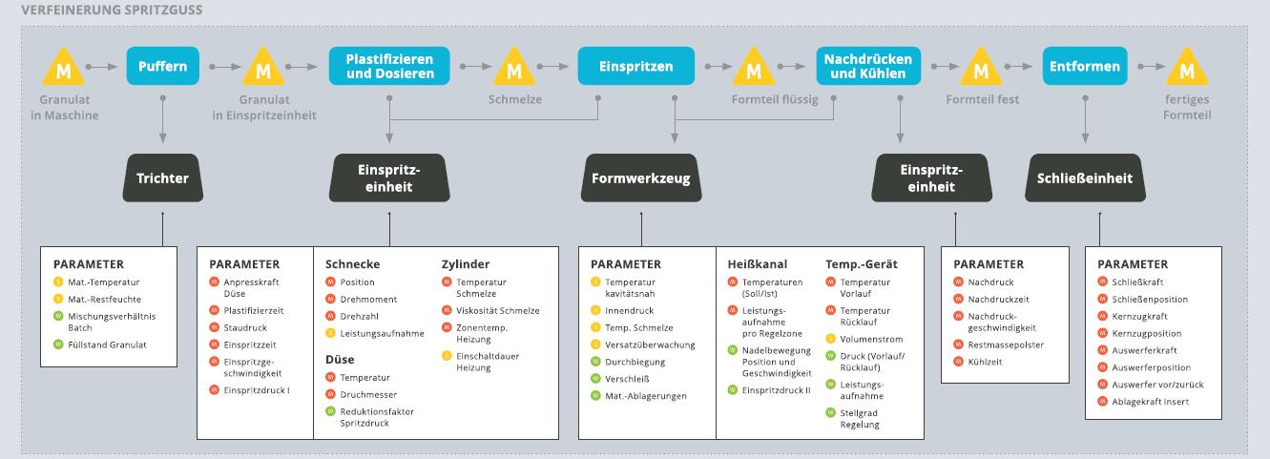
Which data do I need? - Injection moulding process database
Implementation of machine learning in the factory: use case
Use case defines the data you need
Source: VDI-Statusreport – Industrie 4.0 in Spritzgießunternehmen

Slide 17




Build and train your model
Implementation of machine learning in the factory: develop a model
Use case:
Autonomous process optimization

Slide 18
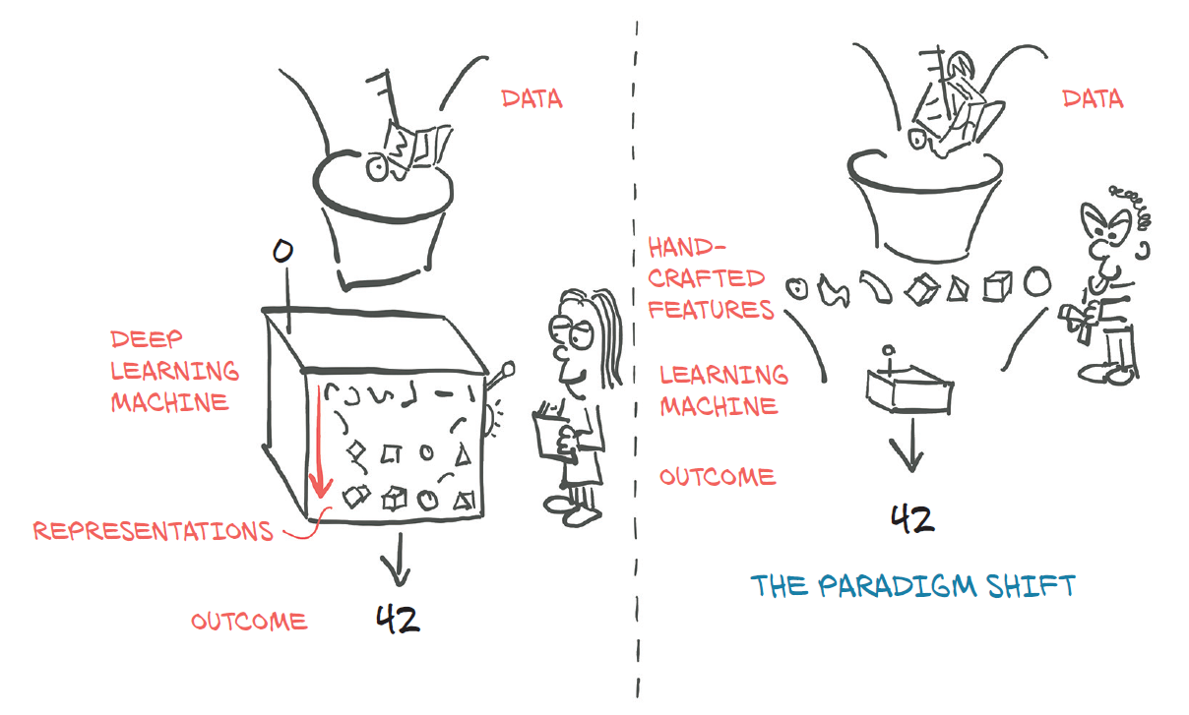
Data preparation
Implementation of machine learning in the factory: develop a model
Advantage:
  features do not have to be found by the user, but are learned implicitly by the network.
  Correlations that can only be represented by complicated features can also be taken into account quite simply.
Disadvantage
  depending upon enormous memory and computation effort which is needed
  debugging of a non-functioning model is also very difficult.
Advantage:
  data can be reduced by feature building
  easier for implementation und better understandable
Disadvantage
  possibly loss of information
  additional data handling
Source: Deep Learning with Py-Torch
Possible methods for feature engineering:
Statistical feature building (local and global features)
KPI based on expert knowledge

Slide 19
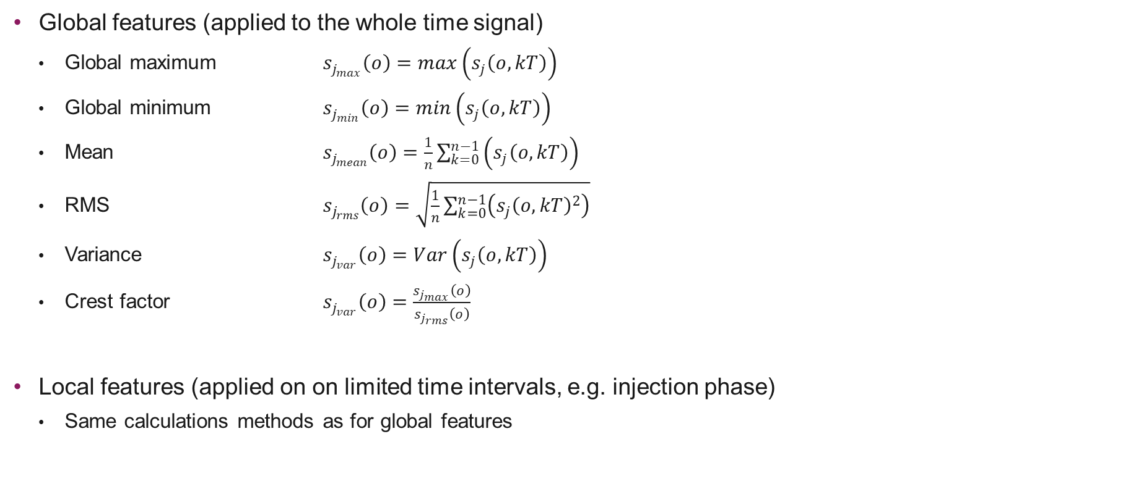
Feature building: Statistical Features
Implementation of machine learning in the factory: develop a model
Global features (applied to the whole time signal)
  Global maximum $s_{j_{max}}\left(o\right)=max\left(s_{j}\left(o, kT\right)\right)$
  Global minimum $s_{j_{min}}\left(o\right)=min\left(s_{j}\left(o, kT\right)\right)$
  Mean $s_{j_{mean}}\left(o\right)=\frac{1}{n}\sum_{k=0}^{n−1}{\left(s_{j}\left(o, kT\right)\right)}$
  RMS $s_{j_{rms}}\left(o\right)=\sqrt{\frac{1}{n}\sum_{k=0}^{n−1}{\left(s_{j}{\left(o, kT\right)}^{2}\right)}}$
  Variance $s_{j_{var}}\left(o\right)=Var\left(s_{j}\left(o, kT\right)\right)$
  Crest factor $s_{j_{var}}\left(o\right)=\frac{s_{j_{max}}\left(o\right)}{s_{j_{rms}}\left(o\right)}$
Local features (applied on on limited time intervals, e.g. injection phase)
  Same calculations methods as for global features
Notes:
To reduce data we then calculated statistical features for the different process curves.
Explain
It is also possible to add some features with expert process knwoledge, for example injection work. But for this first attempt we just worked with statistical features.
All in all we had approximately 250 features then. And these features we used for the classification of the test series

Slide 20
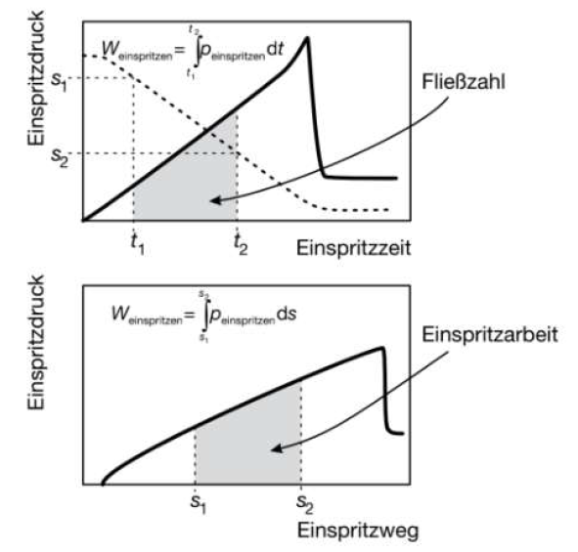
Feature building: KPI based on expert knowledge
Implementation of machine learning in the factory: develop a model
Another approach is to work directly with process
parameters (e.g. injection work, flow coefficient, integral WID,
changeover pressure, etc.).
These parameters are based on expert knowledge from
the plastics industry and can often be calculated and recorded
directly by the machines. These process parameters can also
be calculated from the curve data described above, if they can
be recorded.
Source: Handbuch Spritzgiessen

Slide 21
Feature building: KPI based on expert knowledge
Implementation of machine learning in the factory: develop a model
Beschreibung | Einheit | Berechnung | Anzahl Werte pro Zyklus
Fliesszahl | [bar*s] | Integral Massedruck über Einspritzzeit | 1
Einspritzarbeit | [J] | Integral Massedruck über Einspritzweg | 1
Nachdruckarbeit | [J] | Integral Massedruck über Nachdrucksweg | 1
Maximaler Einspritzdruck | [bar] | Max Einspritzdruck während Einspritzphase | 1
Umschaltdruck | [bar] | Druck bei Ende Einspritzen | 1
Umschaltpunkt | [mm] | Schneckenposition bei Ende Einspritzen | 1
Massepolster | [mm] | Schneckenposition bei Ende Nachdruck | 1
Massedruck beim Nachdruck | [bar] | Mittelwert Massedruck während Nachdruckphase | 1
Einspritzzeit | [s] | Sumvalid Trigger Einspritzen | 1
Dosierzeit | [s] | Sumvalid Trigger Plastifizieren | 1
Zykluszeit | [s] |  | 1
Drehzahl | [1/min] | Mittelwert Drehzahl beim Plastifizieren | 1
Drehmoment | [Nm] | Mittelwert Drehmoment beim Plastifizieren | 1
Staudruck | [bar] | Mittelwert Massedruck beim Plastifizieren | 1
Maximaler Werkzeuginnendruck | [bar] | Maximaler Werkzeuginnendruck | Entspricht Anzahl Kavitäten
Werkzeuginnendruckintegral |  | Integral Werkzeuginnendruck | Entspricht Anzahl Kavitäten
Einschaltdauer jeder Zylinderheizung | [%] | Mittelwert Ansteuerung Zylinderheizung | 5
Temperatur jeder Zylinderheizung | [°C] | Mittelwert Zylindertemperatur | 5
Einschaltdauer Heisskanal | [%] | Mittelwert Ansteuerung Werkzeugheizung | 6
Temperatur Werkzeugheizung | [°C] | Mittelwert Temperatur Werkzeugheizung | 6
Temperatur Temperiergeräte | [°C] | Mittelwert Temperatur Temperiergeräte | 2
Durchfluss Temperiergeräte | [l/min] | Mittelwert Durchluss Temperiergeräte | 2
Maxmimale Werkzeugtemperatur | [°C] | Maximum der Werkzeugtemp | Entspricht Anzahl Kavitäten
Werkzeugtemperatur Einspritzphase | [°C] | Werkzeugtemp zum Start der Einspritzphase | Entspricht Anzahl Kavitäten
Umgebungstemperatur | [°C] |  | 1
Luftfeuchtigkeit Umgebung | [%] |  | 1

Slide 22
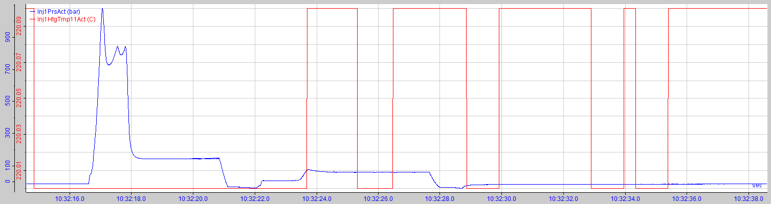
What data quality do I actually need?
Implementation of machine learning in the factory: develop a model
High-frequency signals vs. slow signals
  Injection pressure [bar]
  Nozzle temperature [°C]
If, for example, the injection pressure can only be recorded at low frequency, valuable information is lost (e.g. maximum)
Use case and model define the data quality you need

Slide 23
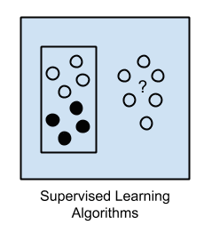
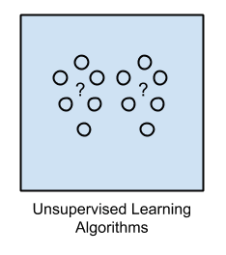
Build and train your model
Implementation of machine learning in the factory: develop a model
Supervised Learning
A model is prepared through a training process in which it is required to make predictions and is corrected when those predictions are wrong.
The training process continues until the model achieves a desired level of accuracy on the training data.
Unsupervised Learning
A model is prepared by deducing structures present in the input data. This may be to extract general rules.
It may be through a mathematical process to systematically reduce redundancy, or it may be to organize data by similarity.
Source: https://machinelearningmastery.com/a-tour-of-machine-learning-algorithms/

Slide 24
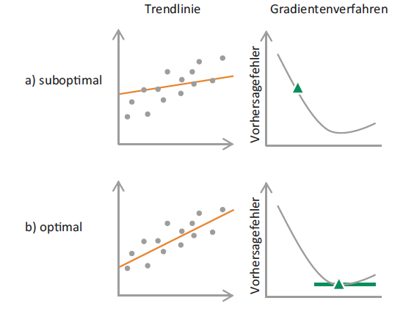
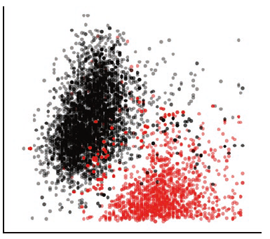
Build and train your model
Implementation of machine learning in the factory: develop a model
Linear Regression
finds the "best fit trend line" that touches as many data points as possible, or at least comes as close to them as possible.
Works best when there is little correlation between predictors and no outliers
K-Nearest Neighbors
classifies data points based on the values of neighboring data points.
k is the number of data points considered, reasonable values for this parameter are obtained by cross-validation
Source: Data Science – Was ist das eigentlich?

Slide 25
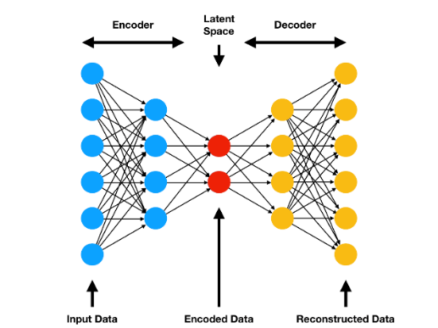
Build and train your model
Implementation of machine learning in the factory: develop a model
Neuronal networks
the weights in the encoder and decoder are adjusted so that there is as little error as possible between input and output.
work best when large data sets and powerful computers are available
Support Vector Machine
classifies data points into two groups by drawing a boundary line midway between the boundary points, here called support vectors.
SVM is insensitive to outliers, since it uses a buffer zone
Source: Data Science – Was ist das eigentlich?

Slide 26
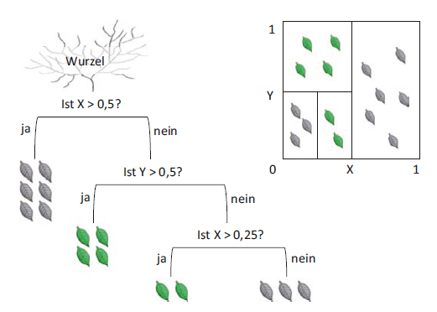
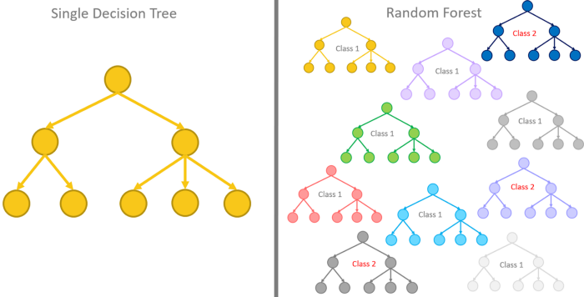
Build and train your model
Implementation of machine learning in the factory: develop a model
Decision Tree
makes predictions based on a sequence of binary questions.
In this way, the data are gradually divided until they break down into a number of sufficiently homogeneous groups.
Random Forests
has usually better prediction accuracy than individual decision trees.
Used where they are easy to implement - especially where predictive accuracy is more important than interpretation of results.
Source: Data Science – Was ist das eigentlich?

Slide 27
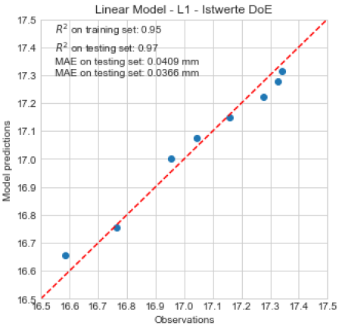
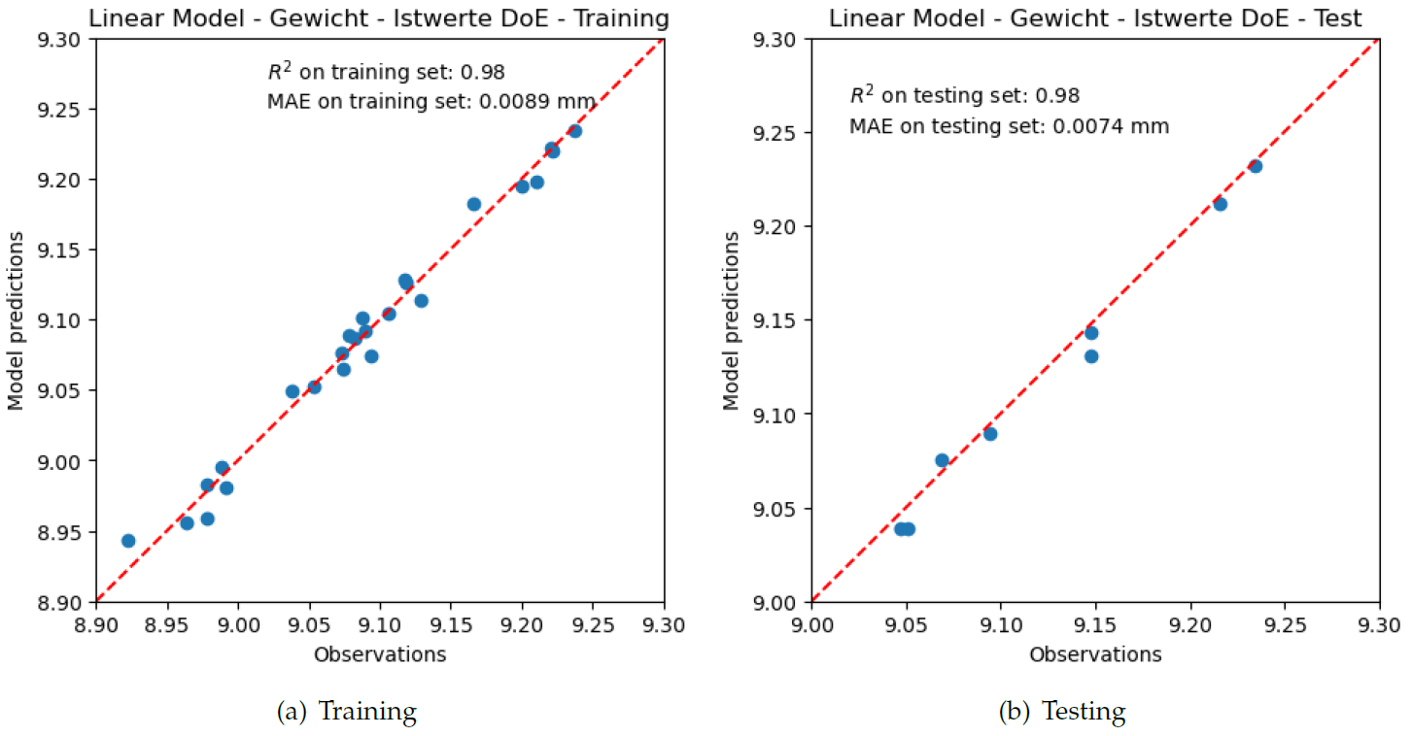
Model validation
Implementation of machine learning in the factory: develop a model
Building a different model with linear and polynomial regression for different materials and quality features
Validation of the model with a test set and evaluation metrics (not used for the training of the model)
Very good prediction for the quality features and weight just with a few important features found by feature selection
g
g
Test set for the polynomial regression model for quality feature
including parameters of the training

Slide 28
Define your IT structure
Implementation of machine learning in the factory: IT structure
Use case:
Autonomous process optimization

Slide 29



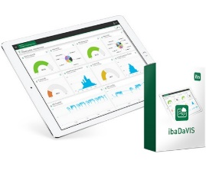

Cloud & platform solution and specific DB solution
Implementation of machine learning in the factory: IT structure
Different data export / connectivity options as well as different data storage solutions will be demonstrated:
Variant 1 (Cloud- & platform solution)
  Siemens Mindsphere
  All process data as "raw data" in the cloud
  Visualisation of process parameters
Variant 2 (specific local database solution)
  Solution from the company iba
  All process data as "raw data" and calculated process parameters in a database
  Visualisation of process parameters with ibaDaVIS

Slide 30
Challenges in setting up the data acquisition
Implementation of machine learning in the factory: IT structure
A number of challenges has to be overcome in order to set up this type of data acquisition for machine learning:
Often device-specific solutions had to be implemented so that the data could be exported and recorded in the desired quality.
Another difficulty is the synchronization of data from different machines and devices (e.g. injection molding machine, temperature control units, ambient conditions).
The allocation of data from different pre or post-processes is also an issue.
  data acquisition differs between continuous processes, e.g. material drying, in which continuous time series are recorded, and discontinuous processes such as injection
  data from pre-process steps must be able to be clearly assigned to the later data of the part.

Slide 31
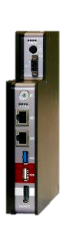
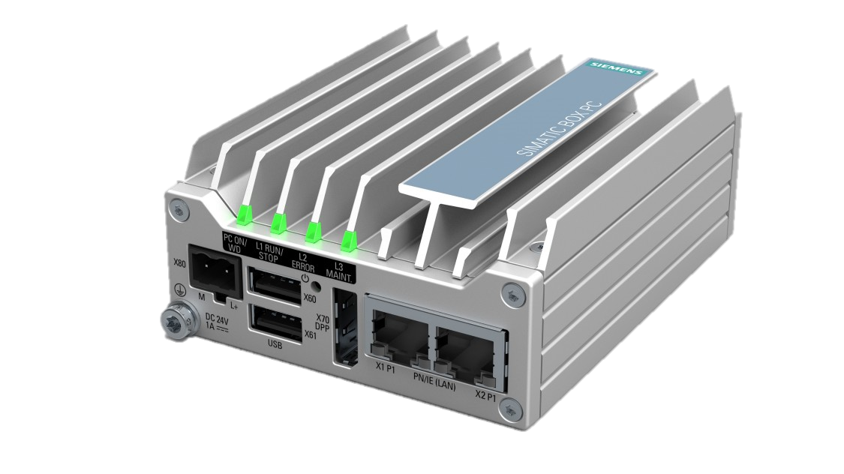
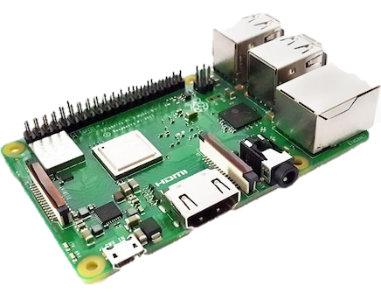
Data storage / upload
Implementation of machine learning in the factory: IT structure
In the Smart Factory @ OST different devices are used for data acquisition, storage and upload:
System | Siemens IPC | iba DAQ-C | Raspberry Pi
Data recording | no | yes | yes
Data upload | yes, manual programming | yes, through ibaPDA | yes, manual programming
timestamp | from machine | from DAQ-C for all devices | from Raspberry Pi

Slide 32


How do I get the data out of my machine?
Implementation of machine learning in the factory: IT structure
For the cyclic export of process parameters, the Euromap 63 and Euromap 77 (OPC-UA) interfaces play an important role:
Euromap 77 (OPC UA)
  simple standardised data exchange, but the sampling frequency is limited to approx. 2 Hz (depending on the subscription the machine or device allows)
  currently only available on very new machines
  developed for the cyclic export of process parameters
Euromap 63
  less standardised and the sampling frequency is also limited (maximum is approx. 1 Hz)
  widely used on newer machines
  also developed for the cyclic export of process parameters

Slide 33
Implementation: manufacturing cell
Implementation of machine learning in the factory: implement

Slide 34

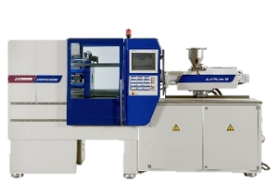
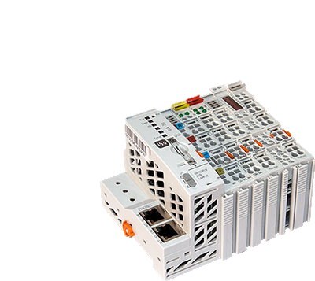

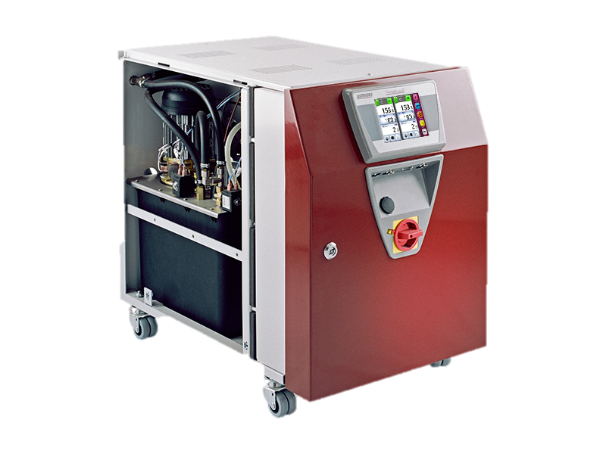
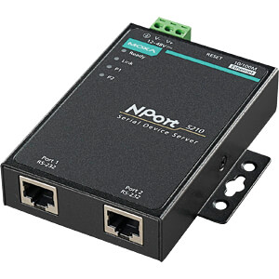
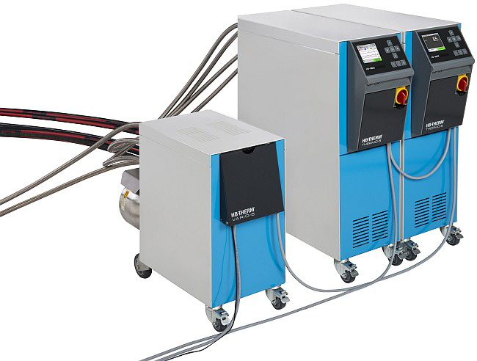
Battenfeld Smart Power 60/210
Implementation of machine learning in the factory: implement
RaspberryPi Touch (trial data)
Data from the injection moulding machine
Euromap 63 (via Raspberry Pi)
  Curve signals with 0.5 Hz sampling frequency rather cyclical values
  Process parameters and setting parameters
Sensor signals from the machine control cabinet
  Curve signals with max. 1kHz sampling frequency (via I/O module)
Data from the tool
Cavity pressure sensors 1 channel
  Curve signals with max. 1kHz sampling frequency (via control cabinet and I/O module)
Peripheral and environmental data
Temperature control units Wittmann Tempro Plus D (via RS232 & NPort)
  Curve signals with 1Hz sampling frequency
HB-Vario 5 unit (via OPC UA)
  Curve signals with 1Hz sampling frequency
Ambient temperature and humidity (via I/O module)
  Curve signals with max. 1kHz sampling frequency (via I/O module)
Trial data
Input via touch screen (via TCP/IP)
TCP/IP
SmartPower 60/210
Raspberry Pi Battenfeld
AI / DI
AI
Raumkombifühler
iba I/O-System
RS232
TCP/IP
Wittmann Tempro Plus D
N-Port Converter
iba DAQ-C
HB-Vario-5

Slide 35
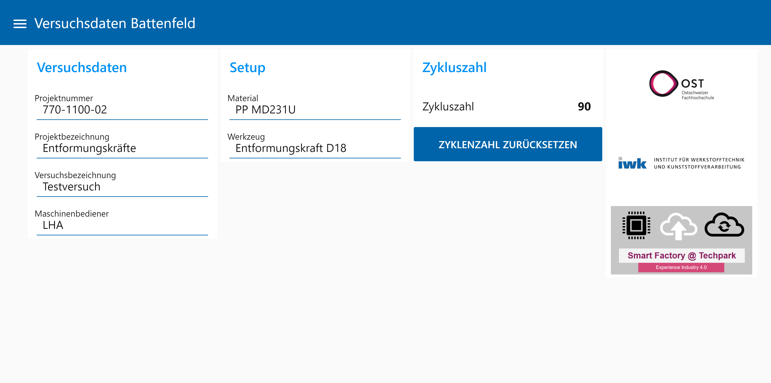
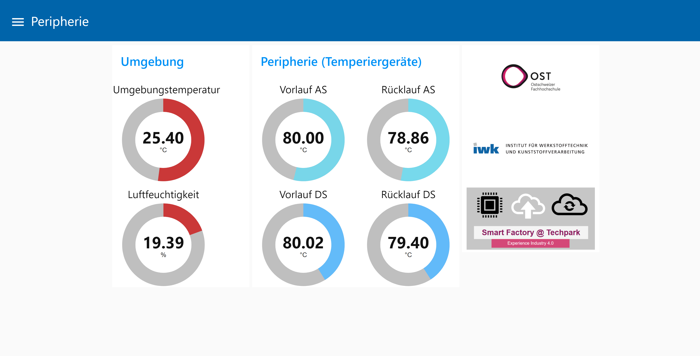
Input for manual / trial data
Implementation of machine learning in the factory: implement
To ensure that the recorded data can also be assigned to the corresponding trials, information on the trials is required in addition to the process data. For this purpose, each machine was equipped with a touch display with which the test data can be recorded but also the process data can be visualised.

Slide 36

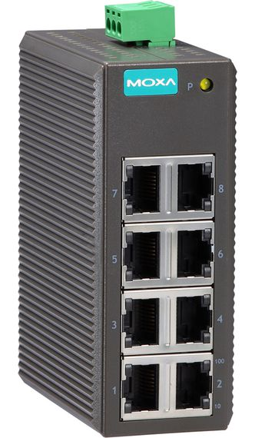
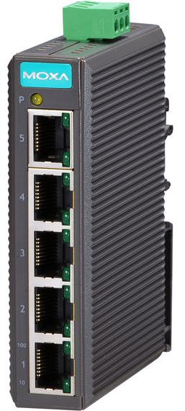
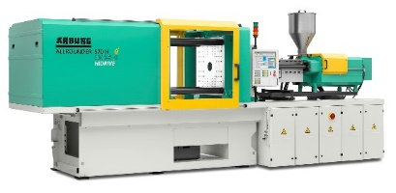
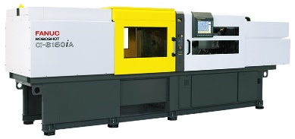
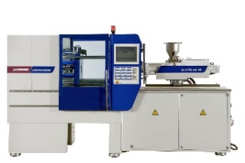
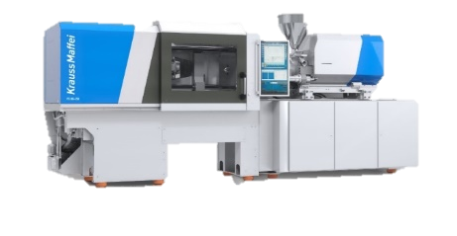
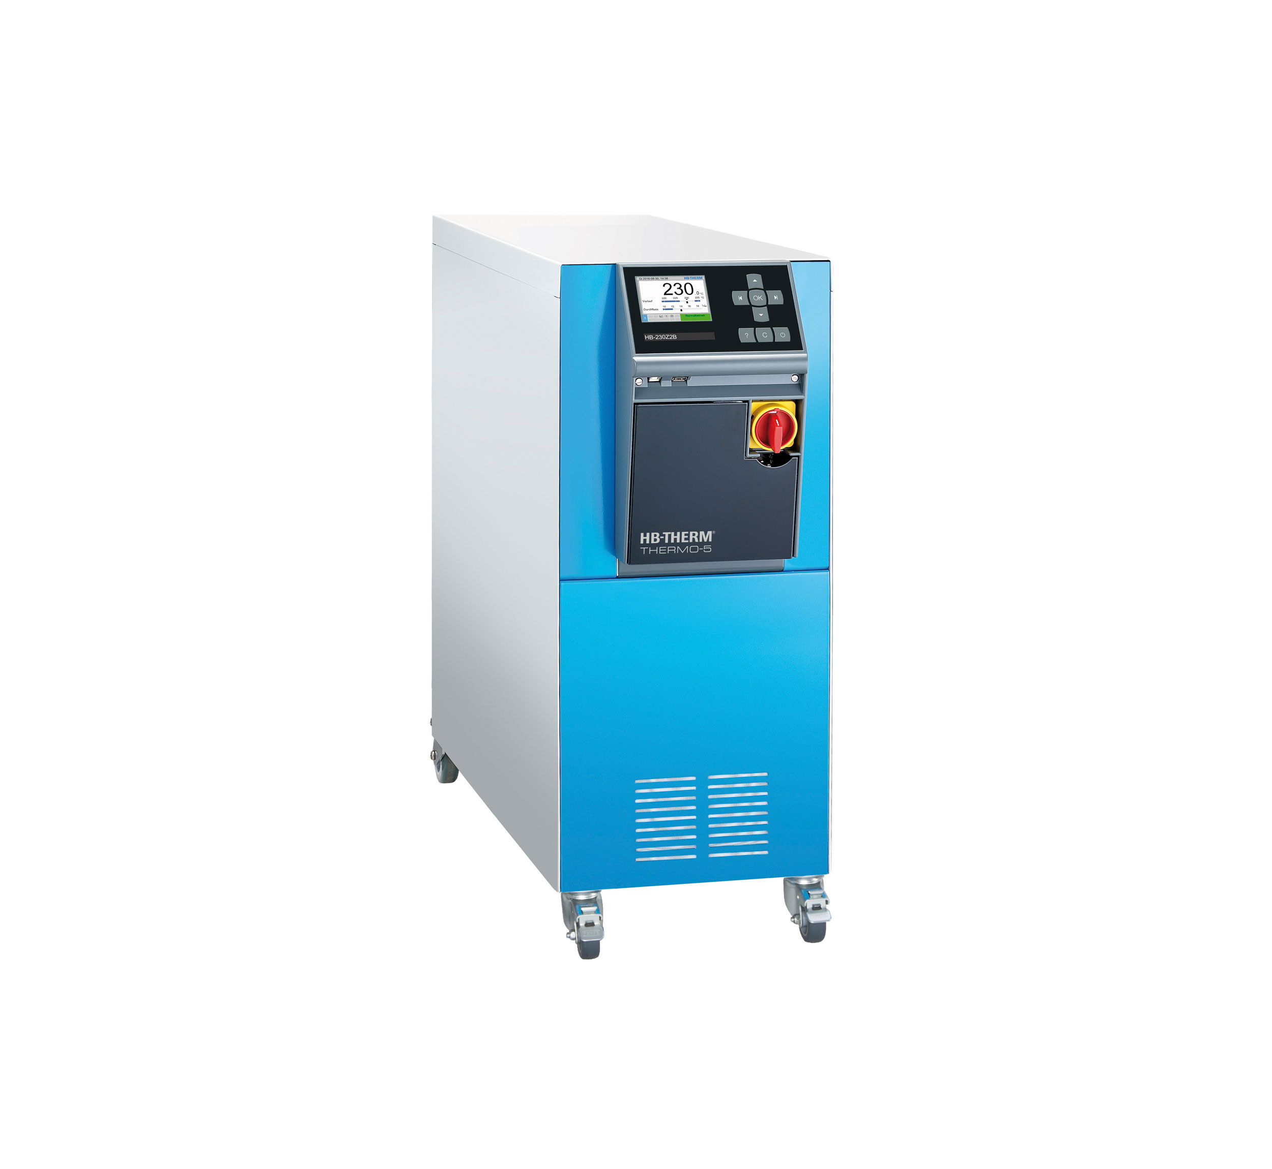
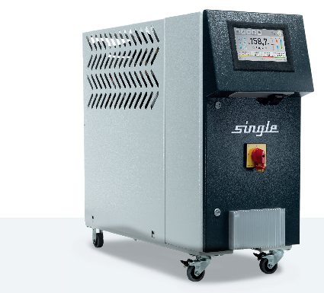
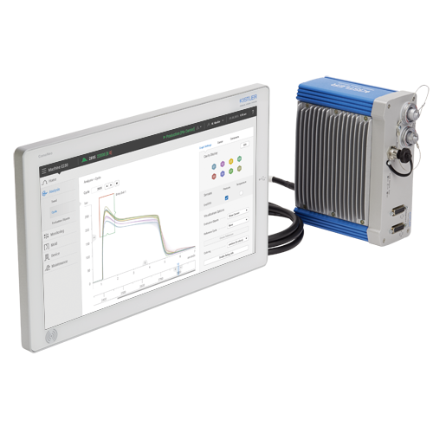

Networkplan
Implementation of machine learning in the factory: rollout
Machine hall injection moulding
RaspberryPi Touch
Gerät für Daten-
aufzeichnung / -upload
(Datenbank / Mindsphere)
U1-14.14
U1-14.15
U1-14.1
U1-14.2
Ethernet
OST-Netzwerk
3x free
2x free
1x free
…
…
1x free
…
…
Switch Fertigungszelle
…
…
Arburg 570H 2000-800
Fanuc Roboshot ɑ s-150ia
SmartPower 60/210
KraussMaffei PX120-380
Siemens IPC KM
iba DAQ-C
Single Smart Line
Raspberry Pi Battenfeld
HB-160Z1
Weitere Geräte:
(Anschluss an freie Netzwerkdosen)
RaspberryPi Touch
Single Smart Line
HB-Vario-5
HB-160Z1
Kistler Como Neo
RaspberryPi Touch
HB-Vario-5
RaspberryPi Touch
Smart Factory NB

Slide 37



Data flow injection moulding
Implementation of machine learning in the factory: rollout
Raspberry Pi
Versuchsdaten KM
Raspberry Pi
Versuchsdaten Engel
KraussMaffei PX120-380
DataXplorer
copy
Siemens IPC KM
raw data KM
DatCoordinator
copy
raw data Engel
Siemens IPC Engel
raw data Arburg / Fanuc / Battenfeld
iba DAQ-C
KPI Arburg / Fanuc / Battenfeld / KM
ibaPDA
DatCoordinator
ibaAnalyzer
raw data Arburg / Fanuc / Battenfeld / KM
Raspberry Pi Battenfeld
Smart Factory NB
Kistler Como Neo

Slide 38
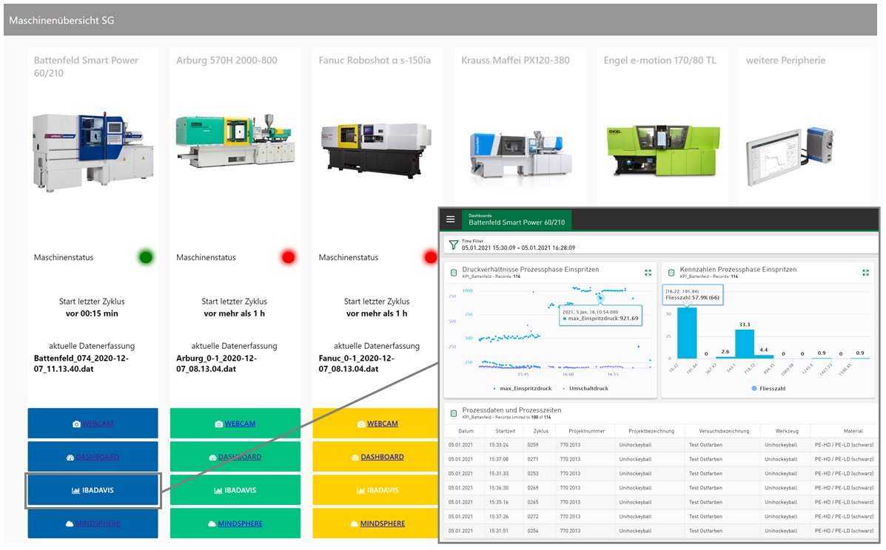
Dashboard injection moulding machines
Implementation of machine learning in the factory: rollout

Slide 39
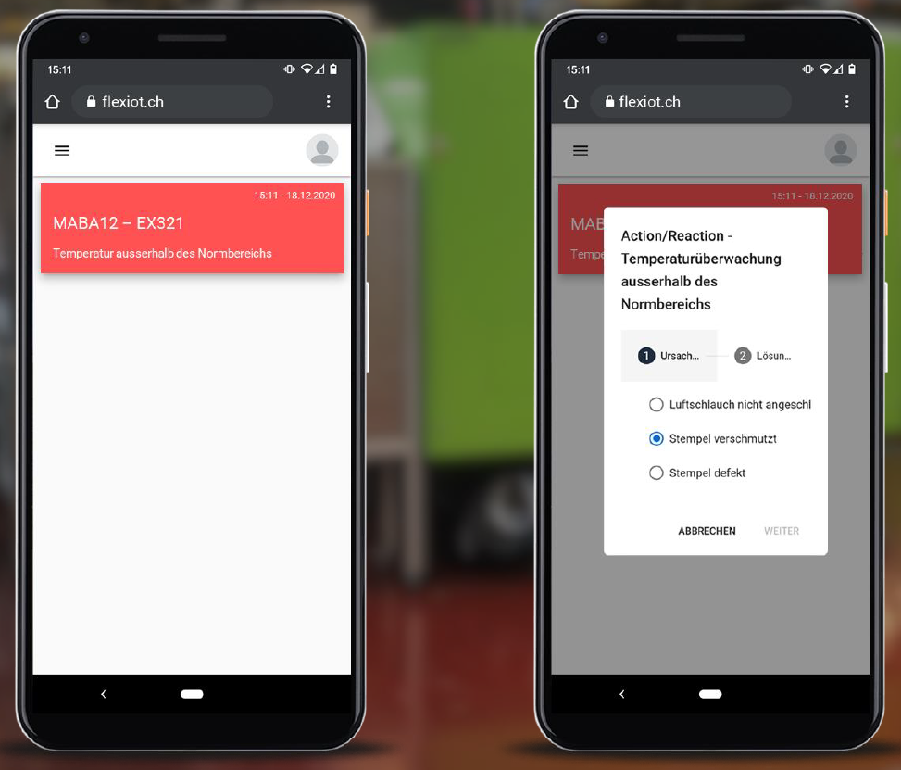
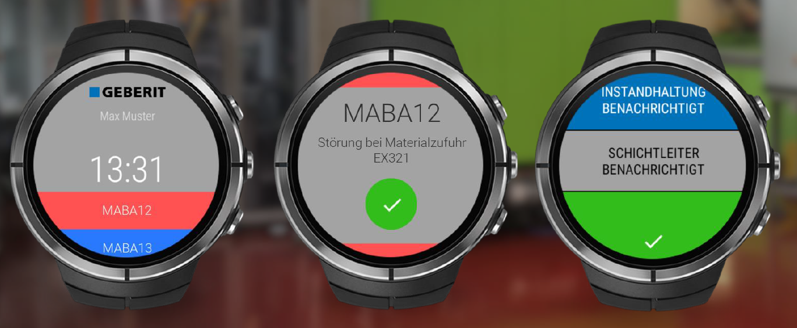
Notifications for shop floor
Implementation of machine learning in the factory: rollout
Highly automated , increasingly connected production environments and constantly growing amounts of «industrial data »
Several applications with complex information dashboards and for concrete maintenance tasks available, but …
How can manufacturing workers at the shop floor be informed about the current production status and potential interventions?
[PRISM Preventive Intervention in Smart Manufacturing]

Slide 40
Validate your model
Implementation of machine learning in the factory: check and adjust

Slide 41
Model for the implementation of machine learning in the factory
Smart Factory @ OST

Slide 42
Smart Factory components and roadmap
Smart Factory @ OST
Due to the existing knowledge in the field of plastic production technologies and robotics, these areas also serve as central elements of the smart factory.
The networking and the development of data export for the machines of the IWK served as the initiation for the development of the smart factory, which is now to be continuously and diversely expanded.
2019
2020
2021
2022
2023
Plastic processing machines
Production and assembly cells (Rapperswil / Buchs)
Robots
Additive Manufacturing (metal / plastic)
CNC machines (metal workcenters)

Slide 43


Implementation partner: competencies united
Smart Factory @ OST
Plastics processing
Data acquisition and processing
Smart Factory
IWK
IPEK
ILT
INS
IMP
IPM
ITEM
IPM Institut für Informations- und Prozessmanagement
Industry 4.0
Information and communication technology
SAP
IMP Institut für Mikrotechnik und Photonik
Production strategy
Business models
Mechatronic systems
Network and cloud infrastructure
Security
Robotics
Automation solutions
Notes:
Roman Hänggi

Slide 44
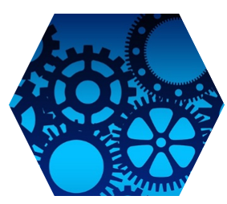
Further Use Cases for injection moulding

Slide 45
Use cases for injection moulding @ OST
Smart Factory @ OST
Use case 1: anomaly detection
Use of internal machine data for anomaly detection and logging events at occurrence
Proposal of an appropriate countermeasure
Use case 2: quality data prediction
Use of internal machine and tool data (cavity pressure) to predict quality of injection moulded parts
Use case 3: preventive and predictive maintenance
Use of internal machine data for the evaluation of the condition of key components of an injection moulding machine (e.g. non return valve)
Determination of the time for a replacement

Slide 46
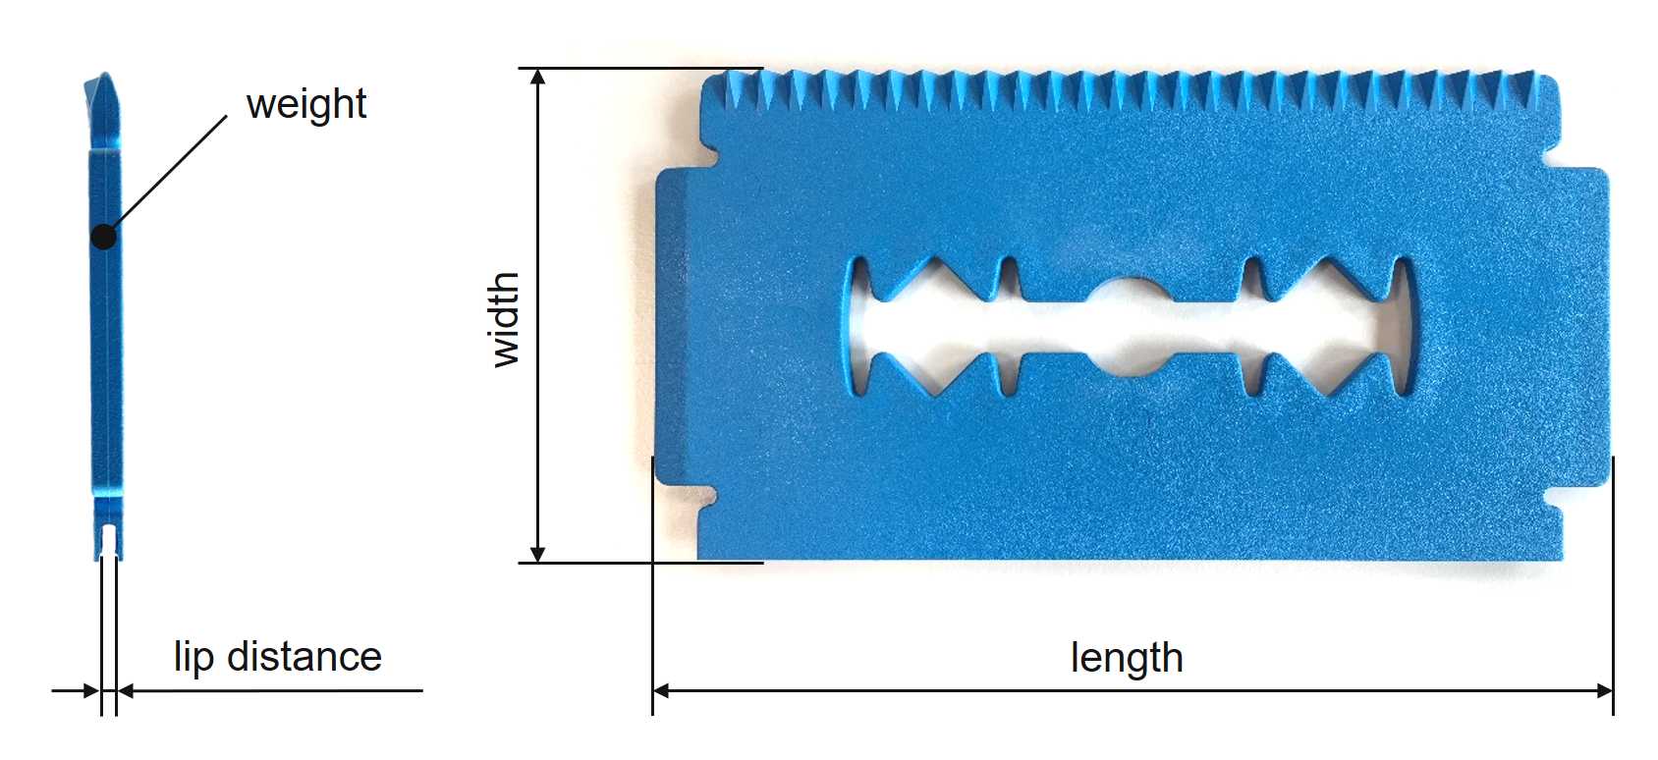
Anomaly detection: trial design
Smart Factory @ OST
4 test series, part: ice scraper, material: PP
  Trial series 1 (72 parts) - reference trial series → ice scrapers lie within the tolerances
  Trial series 2 (56 parts) - calcified cooling channels → temperature of the mould temperature medium increased
  Trial series 3 (57 parts) - batch fluctuation → cylinder temperature increased
  Trial series 4 (52 parts) - wrong material → 10% foreign material added
Database
  Process curves recorded with
  the DataXplorer
  Additionaly the corresponding
  quality data were measured
  (shown in picture on the right)
Notes:
In the 1st study we made several injection moulding trials, which can be seen on this slide. We tried to recreate known process anomalies.
The trials were performed with a tool to produce an ice scraper and with the material PP
During the trials we recorded all internal machine data with the DataXplorer and additionaly measured the quality data of the moulded parts

Slide 47
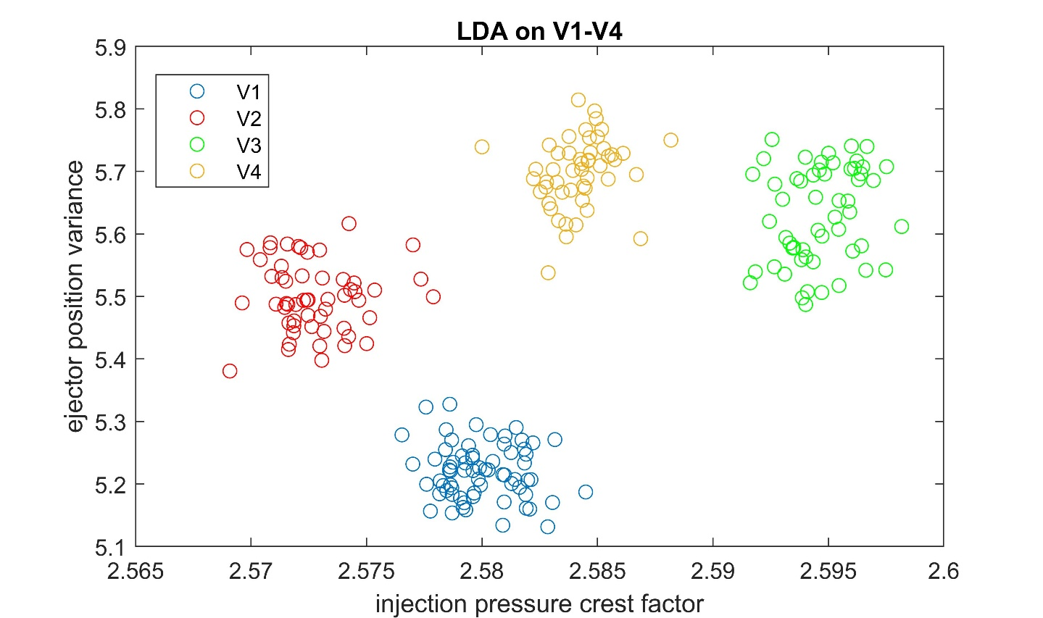
Anomaly detection: classification of trial series
Smart Factory @ OST
Can ML be used to anticipate process anomalies based on internal measurement signals?
trial series V1-V4 can be completely classified with just two important features (a linear discriminant analysis (LDA) was used for the actual classification of the trial series)
Notes:
A classification of the test series is possible as it can be seen on the picture.
The features … and … were used for classification.
As the test series can be clearly classified it should also be possible to detect process anomalies with ML

Slide 48


Quality data prediction: results
Smart Factory @ OST
Test sets (random data from the trial series that were not used for the development of the models) were used to test the models by predicting the quality data of the already moulded parts.
  Very good prediction of quality data of NEW components, based only on internal machine data
 | weight | length | width | lip distance
STD-Error $σ$ | 0.009 g | 0.017 mm | 0.014 mm | 0.032 mm
$$CV=\frac{σ}{μ }$$ | 0.03 % | 0.02 % | 0.02 % | 1.38 %
Notes:
Additionaly we were able to predict quality data of the moulded parts with ML.
Therefore we tried to estimate quality data of moulded parts, which were not used for the training of the ML system
Results can be seen on this slide, prediction is very accurate except when measurement error is bigger (lip distance)

Slide 49

Anomaly detection: application in practice
Smart Factory @ OST
When the anomaly score increases, a recommendation for action is suggested to the operator (Fig. 5, bottom right), which can be used to correct the process again.

Slide 50



Predictive maintenance: defect non-return valve
Smart Factory @ OST
Operating principle non-return valve: prevents the melt from flowing back over the screw bars
Otherwise no reproducible production is possible; undefined dwell time of the material in the cylinder
Dosiervorgang
[Kaiser, Sächtling]
[IKV]

Slide 51

Predictive maintenance: trial design
Smart Factory @ OST
A well-known anomaly in the injection moulding process is the wear of non-return valve
  To simulate this anomaly the ring of a non-return valve was artificially damaged, means notches with different depths were milled
5 test series, part: ice scraper, material: ASA
  Trial series 1 – intact non-return valve
  Trial series 2 – damaged non-returned valve, notch depth 0,20 mm
  Trial series 3 – damaged non-returned valve, notch depth 0,33 mm
  Trial series 4 – damaged non-returned valve, notch depth 0,67 mm
  Trial series 5 – damaged non-returned valve, notch depth 1,00 mm
Database
  Process curves recorded with the DataXplorer
non-return valve with machined notches
Notes:
To answer this second question we tried to simulate a well known process anomaly in injection moulding, the wear of a non return valve
Trials were perfomed with ASA and the already knwon ice scraper
During the trials we again recorded all internal machine data with the DataXplorer

Slide 52



Predictive maintenance: classification of trial series
Smart Factory @ OST
With damaged non-return valves the screw covers significantly longer distances during holding pressure phase, scattering increases with higher wear → already known in industry
The wear of the non-return valve can be clearly detected with the component scores of a PCA → probably the damage can even be reliably estimated
1st PC score seems to be a good indicator for the depth of the notch
Notes:
On the left you can see a diagramm of the screw position in function of time for one cycle
The blue curve represents the intact non return valve and with damaged valve the screw covers significantly longer distances during holding pressure phase
Also for this study we tried to classify the trial series, this time with 1st and 2nd score of a PCA. Classification is possible too.

Slide 53



Predictive maintenance: use of an auto encoder
Smart Factory @ OST
Can ML detect these anomalies even before the machine operator and determine the time for a replacement?
  Results of additional trials with an unhardened non-return valve and high reinforced PPA material:
Yes, anomaly can be detected right from the start
Auto encoder (neural network with different levels)
Reconstruction error calculation with RMS
Reconstruction error in function of cycle number
$$f_{{rms}_{ }}=\sqrt{\frac{1}{n}\sum_{k=1}^{n}{\left({\left(\hat{x_{k}}−x_{k}\right)}^{2}\right)}}$$
features
recalculated features
Notes:
To simulate a continous wear additonal trials with a unhardened non-return valve were perfomed. To detect the process anomaly we used an auto encoder.
This is a neural network were we reccalculate our features and use the reconstruction error as indication for process anomalies
On the right you can see the recaclulation error as a function of the numbers of moulded parts. The first 1000 cycles were used for the training of the network. After that the reconstruction error increases from the begining, means an anomaly can be detected right from the start. But is this really the wear of the non return valve or are we decting something different?

Slide 54

Predictive maintenance: use of an auto encoder
Smart Factory @ OST
Can ML detect these anomalies even before the machine operator and determine the time for a replacement?
  Results of additional trials with an unhardened non-return valve and high reinforced PPA material:
Reason for anomaly can also be identified by comparing and ranking the reconstruction error of the used features
Identification of anomalies
Reconstruction error in function of cycle number
reconstruction error
number of cycles
1. minimal screw position = melt cushion
2. variance screw position
Notes:
This question can be answered with the results on this slide. The reason for anomaly can also be identified by comparing and ranking the reconstruction error of the used differnet features
Most imported features are … which corresponds to knowledge from industry
So this means an anomlay can be detected right from the start even if before an operator can see it

Slide 55
Thank you for your attention
Curdin Wick MSc.
curdin.wick@ost.ch
058 257 47 70

