Slide 1



Angewandte Digitalisierung in der Industrie
L04: Injection moulding in times of digitalization
Curdin Wick MSc.

Slide 2
Time Table – Lecture schedule
Angewandte Digitalisierung in der Industrie
Datum | Thema | Vorlesung v1: 15:10 - 16:50 Uhr | Praktika 1 p11: 17:00 - 18:40 Uhr | Durchführung
22.02.2022 | Einführung & Strategie | Roman Hänggi | Roman Hänggi | Techpark
01.03.2022 | Smarte Fabrik: Prod. Techn. | Curdin Wick | Curdin Wick | Techpark
08.03.2022 | Smarte Fabrik: Prod. Techn. | Curdin Wick | Curdin Wick | Techpark
15.03.2022 | Smarte Fabrik: Prod. Techn. | Curdin Wick | Curdin Wick | Techpark
22.03.2022 | Diskrete Event Simulation | Lukas Kretschmar | Lukas Kretschmar | Techpark
29.03.2022 | Diskrete Event Simulation | Lukas Kretschmar | Lukas Kretschmar | Techpark
05.04.2022 | IT Architektur - IoT | Felix Nyffenegger | Samuel Helbling | Techpark
12.04.2022 | Frühlingsferien
19.04.2022 | Unterrichtsfrei
26.04.2022 | IT Architektur - IoT | Felix Nyffenegger | Samuel Helbling | Techpark
03.05.2022 | IT Architektur - IoT | Felix Nyffenegger | Samuel Helbling | Techpark
10.05.2022 | Machine Learning | Dejan Šeatović | Dejan Šeatović | Techpark
17.05.2022 | Machine Learning | Dejan Šeatović | Dejan Šeatović | Techpark
24.05.2022 | Machine Learning | Dejan Šeatović | Dejan Šeatović | Techpark
31.05.2022 | Real World bei Geberit | Roman Hänggi | Curdin Wick | Geberit
07.06.2022 | Zusammenfassung | Roman Hänggi | Curdin Wick | Techpark

Slide 3
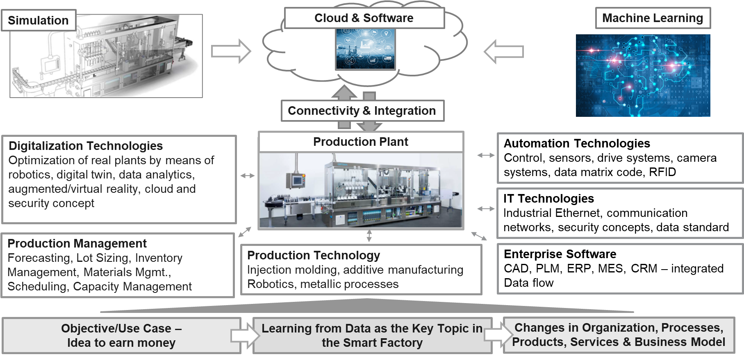
Complexity needs to be managed
Angewandte Digitalisierung in der Industrie
Dejan Šeatović, week 10, 11, 12
Lukas Kretschmar, week 5, 6
Felix Nyffenegger, week 7, 8, 9
Curdin Wick, week 2, 3, 4
Roman Hänggi, week 1, 13, 14

Slide 4
Recap Week 3
Angewandte Digitalisierung in der Industrie

Slide 5
Overview: injection moulding as application example
Angewandte Digitalisierung in der Industrie
Level of automation | Data basis / commonness
Process management
Process monitoring
Process control
Week | Date | Lecture v1: 15:10 - 16:50 Uhr | Exercise p11: 17:00 - 18:40 Uhr
02 | 01.03.2022 | L04: Process basics and process management Repetition injection moulding Setting up the process Statistical design of experiments | E04: Correlation of setting parameters and quality characteristics Practical training on the SG machine with Stasa QC
03 | 08.03.2022 | L05: Process monitoring Motivation for process monitoring Process monitoring with cavity pressure (incl. presentation of ComoNeo) | E05: process monitoring with ComoNeo Practical training on the SG machine with Como Neo
04 | 15.03.2020 | L06: Injection moulding in times of digitalization Uses Cases for injection moulding Smart Factory@Techpark Creating a database (signals, data quality, data recording) Handling of data (curve data / KPI) | E06: Processing and evaluation of process data Practical training with own laptop with ibaAnalyzer
data basis
commonness in the field of injection moulding

Slide 6
Week 4: Goals of this weeks lecture / exercise
Angewandte Digitalisierung in der Industrie
The students can…
… explain possible use cases for injection moulding which are made possible through digitalization
… define which recording rate is useful for which signals
… understand how to get data out of machines and how to deal with different machines and devices
… highlight the possibilities of the SmartFactory@OST
… calculate KPI's out of raw data and set up an automated process protocoll

Slide 7
L04: Injection moulding in times of digitalization
Angewandte Digitalisierung in der Industrie
Data driven injection moulding
Dealing with Big Data in injection moulding
Data Acquisition
Uses Cases for injection moulding
Smart Factory@OST
Exercise:
Processing and evaluation of process curve data

Slide 8

Additional reading
Digital Manufacturing
Data Science – was ist das eigentlich?!
Algorithmen des maschinellen Lernens verständlich erklär
Annalyn Ng, Kenneth Soo
Print ISBN: 978-3-662-56775-3
eISBN: 978-3-662-56776-0
https://link.springer.com/book/10.1007/978-3-662-56776-0

Slide 9
Data driven injection moulding

Slide 10
Digitalization in injection moulding
Uses Cases for injection moulding
To implement Industry 4.0 in injection moulding companies, data must be collected, analyzed and also predicted.
Inevitably, the term "big data" cannot be ignored. Big data is a term that has already been around for a few years, but continues to attract a great deal of attention with regard to various aspects.
Questions that injection moulding companies are getting in touch with:
  How can I use my data?
  How can I increase my added value through data?
  What exact examples are there and how can I learn from them?
Industry 4.0 / Learning from Machine Data
Additional data from the machine
Combining machine data with data
from IT Entreprise solutions (orders)
Implementation of IT – Entreprise
(CAD, PLM, ERP, MES)
IT Entreprise Solutions focus on
integrated process & data flow
Key Information / data for a company
Lean Processes first
Stable & robust processes are the base
Reduction of Waste
Lean Principle focus on the important
digital needs

Slide 11
Challenges for successful implementation of Industry 4.0
Uses Cases for injection moulding
Missing awareness about both possible applications and the necessity for implementation. The awareness of possible applications can either be generated by exemplary projects or by gaining a general knowledge about the possibilities of Industry 4.0 systems and therefore the transfer to new applications.
Todays opportunities continue to be underused, but this is not always necessarily due to a lack of ideas for the use of data.
In the field of production systems there are no suitable industry-wide standardized specifications and protocols available that can easily be integrated with a variety of different data sources and database systems.
Fortunately, many standards and specifications are currently in development, such that interoperability will improve drastically in the future

Slide 12
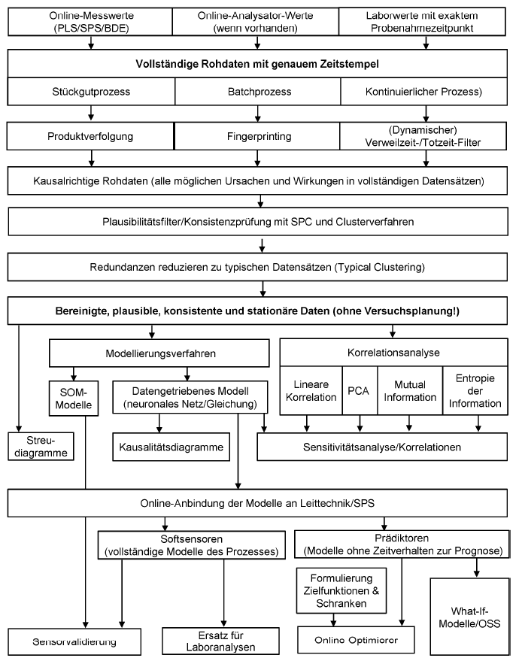
Challenges for successful implementation of Industry 4.0
Uses Cases for injection moulding
Some of the possibilities for data analysis are shown in the adjacent flow chart.
However, the first stumbling block is usually already the database. Problems that arise:
  What data do I need?
  Is the data available in sufficient quality? What data quality do I need at all?
  How do I get the data out of my machine?
  How do I synchronise data from different machines and devices?
The development of a data acquisition system for several injection moulding machines at the IWK serves as an example for the existing challenges.
  Different injection moulding machines (Krauss Maffei, Engel, Arburg, Fanuc, Battenfeld)
  Different data storage solutions (Database, Cloud)
[VDI-Statusreport – Chancen mit Big Data Best Practice]

Slide 13
Data is the new gold
Uses Cases for injection moulding
"What you can't measure, you can't control"
Peter Drucker, American economist

Slide 14
Injection moulding in times of digitalization
Uses Cases for injection moulding
If you know the exact actual state of your machines you can work on optimization of the process.
There is a improved data availability on injection moulding machines. Few machines are already offering the export of process signals as curve data, most of the new machines provide at least cyclical parameters.
In combination with Artificial Intelligence (AI), which currently experiences a boom because it is made possible by affordable computing power, there are improved possibilities for process monitoring:
  employees will be able to look after a larger machine park
  lower scrap rates
  higher productivity
[LEAN Production]

Slide 15
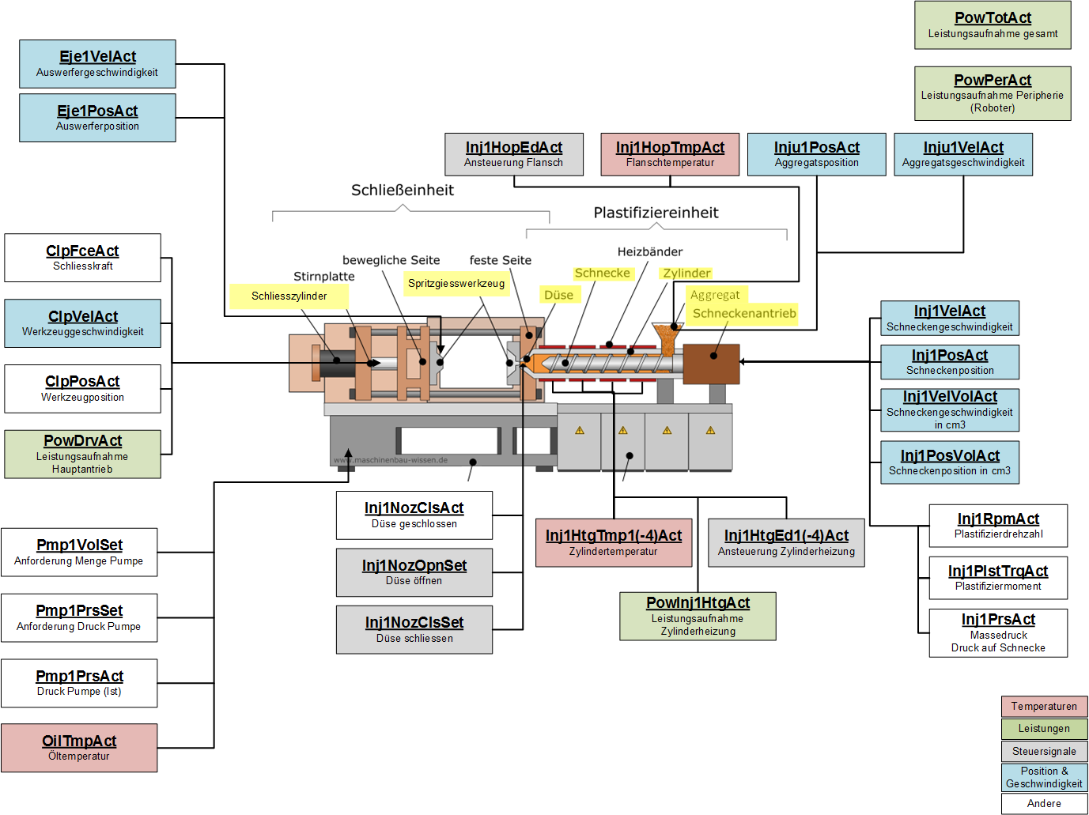
Injection moulding machine with improved data availability
Use cases for injection moulding
Krauss Maffei Injection moulding machine PX 120-380 at the IWK-lab with DataXplorer which enables the recording of:
  more than 50 different process signals with a sampling frequency of 200 Hz
  setting parameters of the injection moulding machine with a sampling frequency of 0.6 Hz
Notes:
As already mentioned
So basically we are able to see everything that happens within this machine. You can even identify what , exactly changed with a software update of the injection moulding machine. Because the ML-approach once recognised this as a process anomaly.

Slide 16
Possible application: Fully connected production cell for automated process setup
Use cases for injection moulding
[Plastics Industry 4.0]

Slide 17
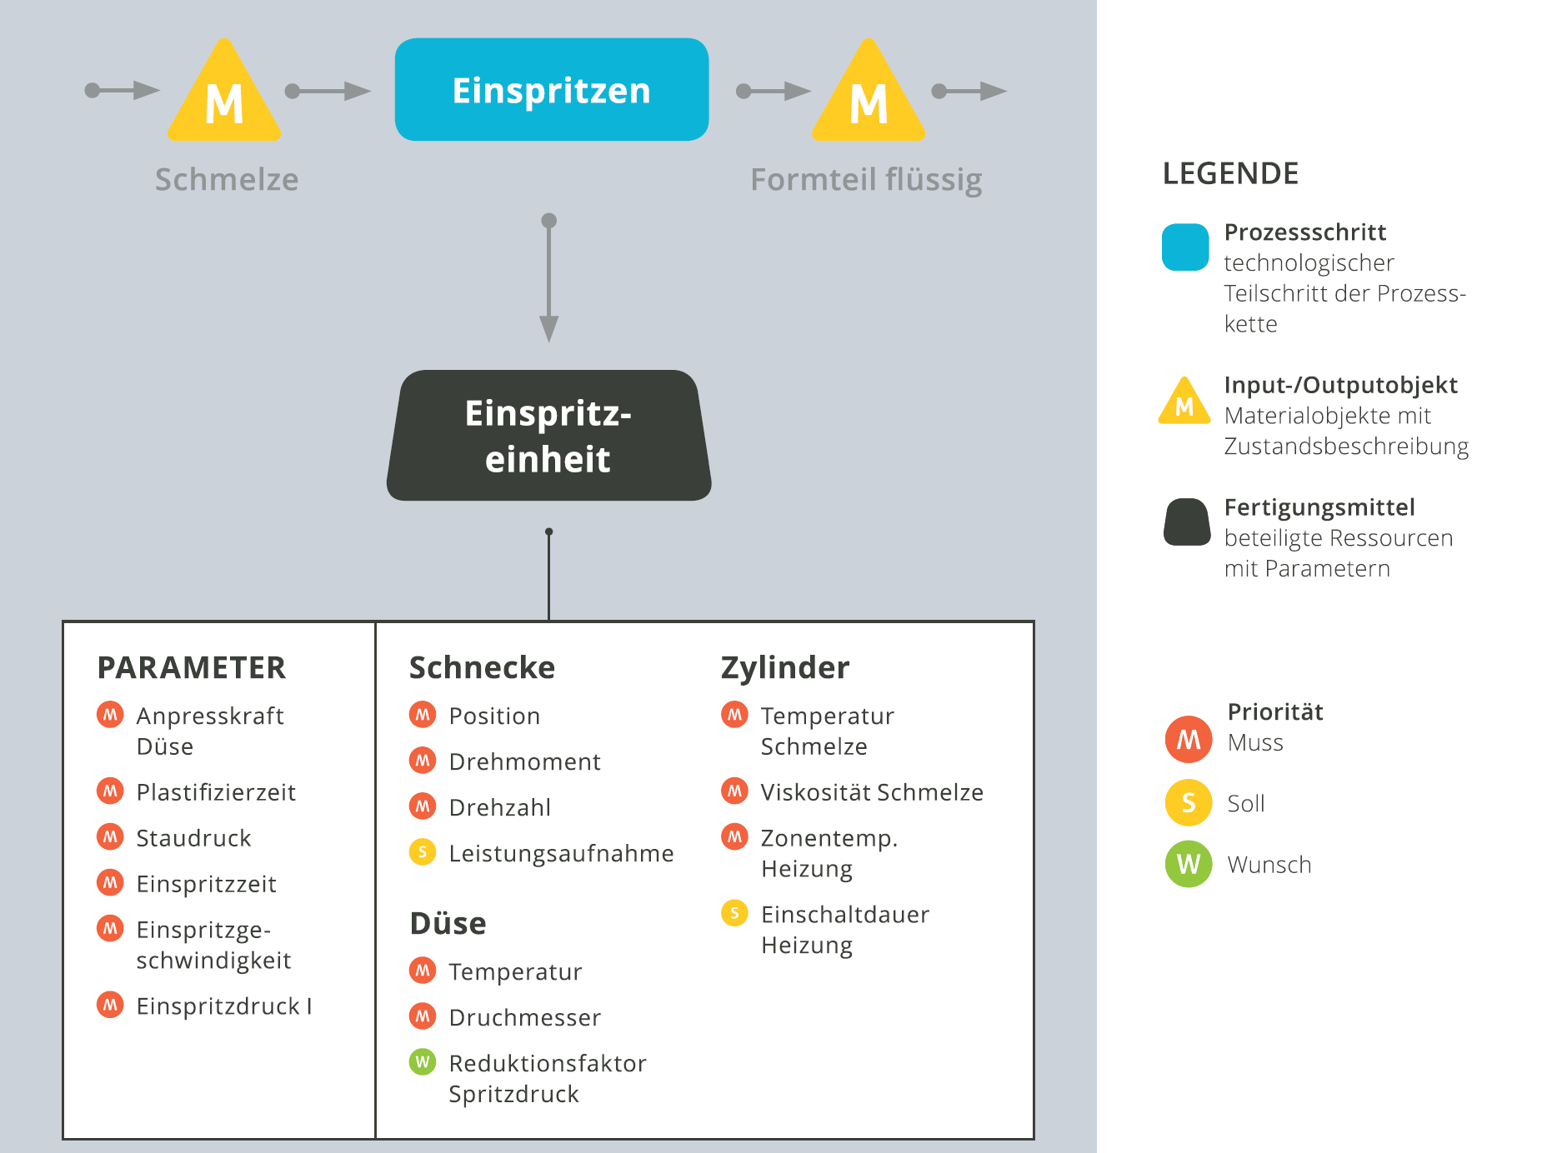
Dealing with Big Data in injection moulding

Slide 18
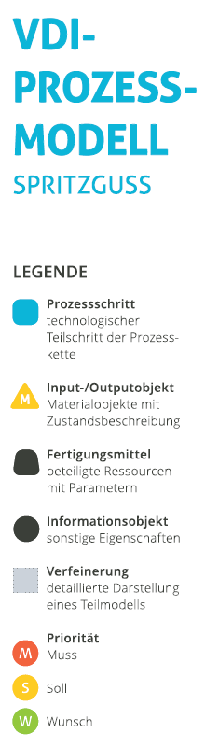
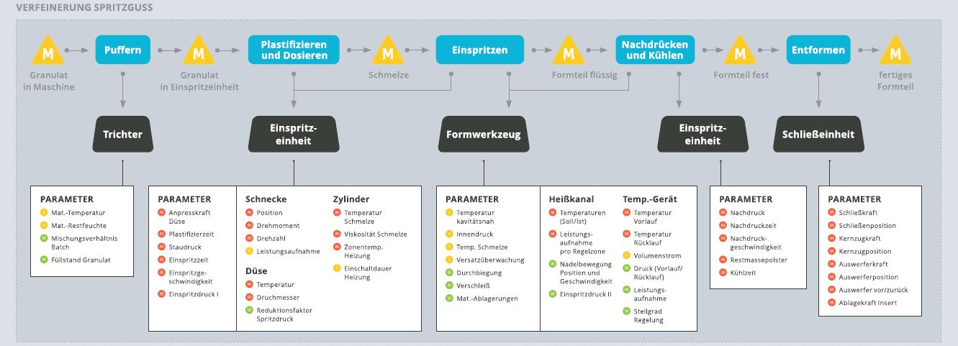
Which data do I need? - Injection moulding process database
Dealing with Big Data in injection moulding
[VDI-Statusreport – Industrie 4.0 in Spritzgießunternehmen]

Slide 19
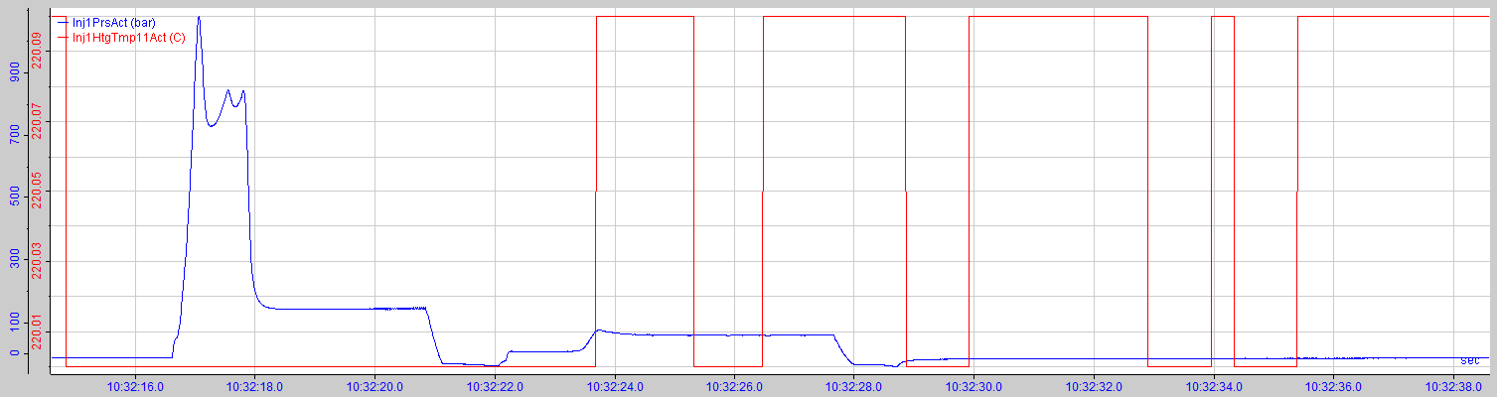
What data quality do I actually need?
Dealing with Big Data in injection moulding
High-frequency signals vs. slow signals
  Injection pressure [bar]
  Nozzle temperature [°C]
If, for example, the injection pressure can only be recorded at low frequency, valuable information is lost (e.g. maximum)

Slide 20
What data quality do I actually need?
Dealing with Big Data in injection moulding
The data recorded by the injection moulding machines is used for machine learning purposes.
In a first step, therefore, as much data as possible should be recorded, recommendation for machine learning: curve data of various process signals
  with 100-200Hz sampling frequency: injection pressure, screw position, plasticizing torque, screw speed, mould position, ejector position and force, WID signals, trigger signals for process phases (injection, holding pressure, etc.)
  with 1Hz sampling frequency: cylinder temperatures and power consumption (per zone), temperatures and mould heating (per zone), data temperature control units (temperatures, flow), ambient conditions
In addition to the process parameters, the setting parameters should also be exported, so that direct changes to the process can also be detected.

Slide 21
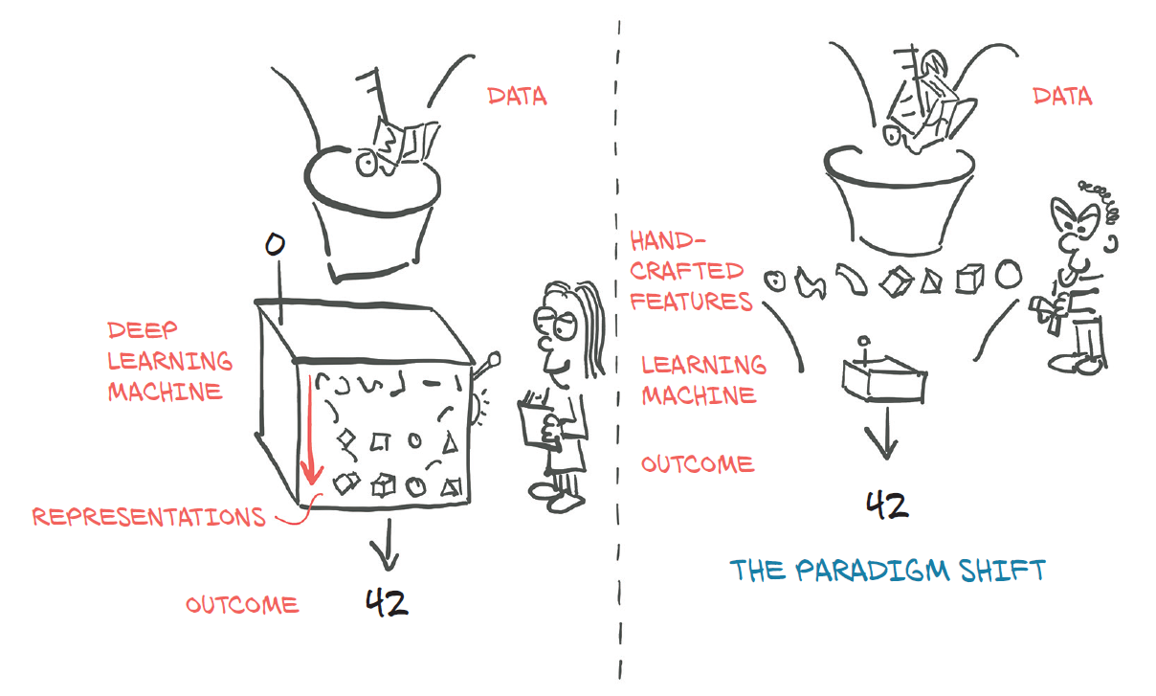
Data preparation
Dealing with Big Data in injection moulding
For machine learning you can either work directly with these data curves, means with curve-based methods, or with feature-based methods.
[Deep Learning with Py-Torch]

Slide 22
Data preparation
Dealing with Big Data in injection moulding
The large amounts of data (Big Data) can be reduced by feature building to work with feature-based methods for machine learning.
The goal is to reduce curve data (or image data) to as few features as possible while retaining as much information as possible.
Possible methods:
Statistical feature building (local and global features)
KPI based on expert knowledge
Feature based-methods are easier for implementation und better understandable.
[Deep Learning with Py-Torch]

Slide 23
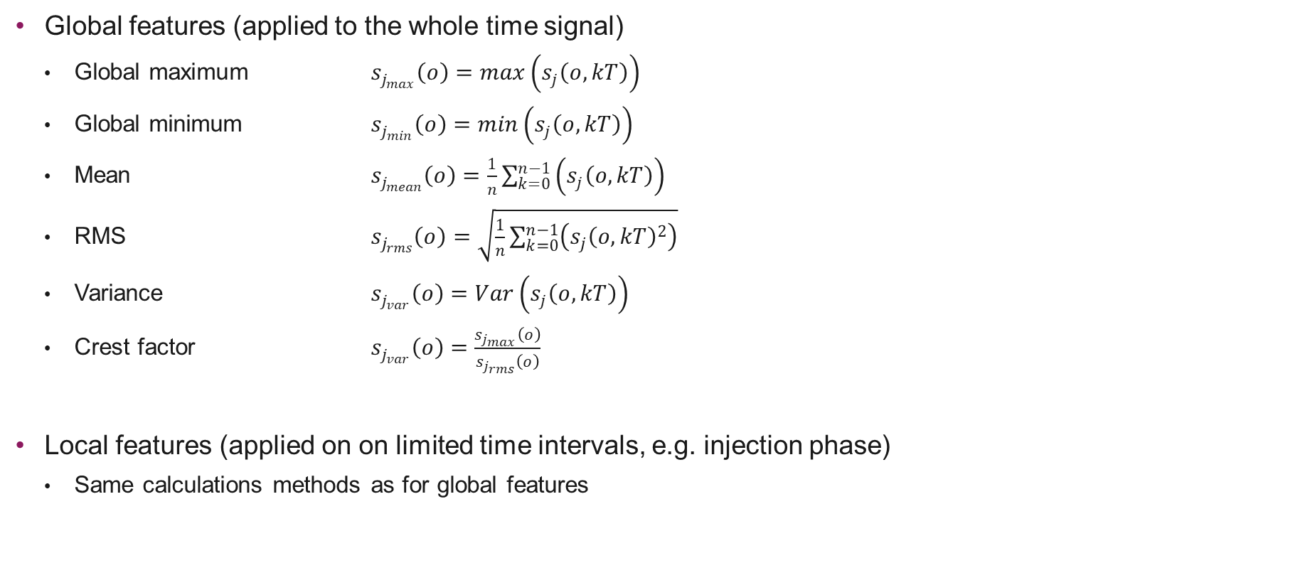
Feature building: Statistical Features
Dealing with Big Data in injection moulding
Global features (applied to the whole time signal)
  Global maximum $s_{j_{max}}\left(o\right)=max\left(s_{j}\left(o, kT\right)\right)$
  Global minimum $s_{j_{min}}\left(o\right)=min\left(s_{j}\left(o, kT\right)\right)$
  Mean $s_{j_{mean}}\left(o\right)=\frac{1}{n}\sum_{k=0}^{n−1}{\left(s_{j}\left(o, kT\right)\right)}$
  RMS $s_{j_{rms}}\left(o\right)=\sqrt{\frac{1}{n}\sum_{k=0}^{n−1}{\left(s_{j}{\left(o, kT\right)}^{2}\right)}}$
  Variance $s_{j_{var}}\left(o\right)=Var\left(s_{j}\left(o, kT\right)\right)$
  Crest factor $s_{j_{var}}\left(o\right)=\frac{s_{j_{max}}\left(o\right)}{s_{j_{rms}}\left(o\right)}$
Local features (applied on on limited time intervals, e.g. injection phase)
  Same calculations methods as for global features
Notes:
To reduce data we then calculated statistical features for the different process curves.
Explain
It is also possible to add some features with expert process knwoledge, for example injection work. But for this first attempt we just worked with statistical features.
All in all we had approximately 250 features then. And these features we used for the classification of the test series

Slide 24
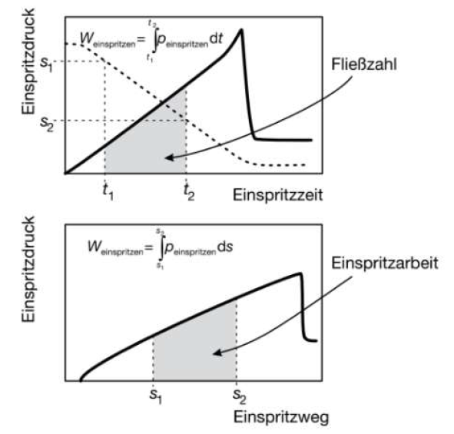
Feature building: KPI based on expert knowledge
Dealing with Big Data in injection moulding
Another approach is to work directly with process
parameters (e.g. injection work, flow coefficient, integral WID,
changeover pressure, etc.).
These parameters are based on expert knowledge from
the plastics industry and can often be calculated and recorded
directly by the machines. These process parameters can also
be calculated from the curve data described above, if they can
be recorded.
[Handbuch Spritzgiessen]

Slide 25
Feature building: KPI based on expert knowledge
Dealing with Big Data in injection moulding
Beschreibung | Einheit | Berechnung | Anzahl Werte pro Zyklus
Fliesszahl | [bar*s] | Integral Massedruck über Einspritzzeit | 1
Einspritzarbeit | [J] | Integral Massedruck über Einspritzweg | 1
Nachdruckarbeit | [J] | Integral Massedruck über Nachdrucksweg | 1
Maximaler Einspritzdruck | [bar] | Max Einspritzdruck während Einspritzphase | 1
Umschaltdruck | [bar] | Druck bei Ende Einspritzen | 1
Umschaltpunkt | [mm] | Schneckenposition bei Ende Einspritzen | 1
Massepolster | [mm] | Schneckenposition bei Ende Nachdruck | 1
Massedruck beim Nachdruck | [bar] | Mittelwert Massedruck während Nachdruckphase | 1
Einspritzzeit | [s] | Sumvalid Trigger Einspritzen | 1
Dosierzeit | [s] | Sumvalid Trigger Plastifizieren | 1
Zykluszeit | [s] |  | 1
Drehzahl | [1/min] | Mittelwert Drehzahl beim Plastifizieren | 1
Drehmoment | [Nm] | Mittelwert Drehmoment beim Plastifizieren | 1
Staudruck | [bar] | Mittelwert Massedruck beim Plastifizieren | 1
Maximaler Werkzeuginnendruck | [bar] | Maximaler Werkzeuginnendruck | Entspricht Anzahl Kavitäten
Werkzeuginnendruckintegral |  | Integral Werkzeuginnendruck | Entspricht Anzahl Kavitäten
Einschaltdauer jeder Zylinderheizung | [%] | Mittelwert Ansteuerung Zylinderheizung | 5
Temperatur jeder Zylinderheizung | [°C] | Mittelwert Zylindertemperatur | 5
Einschaltdauer Heisskanal | [%] | Mittelwert Ansteuerung Werkzeugheizung | 6
Temperatur Werkzeugheizung | [°C] | Mittelwert Temperatur Werkzeugheizung | 6
Temperatur Temperiergeräte | [°C] | Mittelwert Temperatur Temperiergeräte | 2
Durchfluss Temperiergeräte | [l/min] | Mittelwert Durchluss Temperiergeräte | 2
Maxmimale Werkzeugtemperatur | [°C] | Maximum der Werkzeugtemp | Entspricht Anzahl Kavitäten
Werkzeugtemperatur Einspritzphase | [°C] | Werkzeugtemp zum Start der Einspritzphase | Entspricht Anzahl Kavitäten
Umgebungstemperatur | [°C] |  | 1
Luftfeuchtigkeit Umgebung | [%] |  | 1

Slide 26
Data preparation
Dealing with Big Data in injection moulding
The other approach is to work directly with curve data.
A big advantage of curve-based models is that the features do not have to be found by the user, but are learned implicitly by the network.
Thus, for example, curve progressions (or correlations) that can only be represented by complicated features can also be taken into account quite simply.
Disadvantage of these models is the depending upon enormous memory and computation effort which is needed. In addition, the debugging of a non-functioning model is also very difficult.
The most well-known applications for curve-based models are language models (since information is to have influence partly over sentences) or for example temperature or stock price forecasts.
[Deep Learning with Py-Torch]

Slide 27


Data acquisition in injection moulding

Slide 28
How do I get the data out of my machine?
Data acquisition in injection moulding
In the field of injection moulding, standardised interfaces / communication protocols offer a possibility for "simple" data export:
Euromap 77 (OPC UA)
  simple standardised data exchange, but the sampling frequency is limited to approx. 2 Hz (depending on the subscription the machine or device allows)
  currently only available on very new machines
  developed for the cyclic export of process parameters
Euromap 63
  less standardised and the sampling frequency is also limited (maximum is approx. 1 Hz)
  widely used on newer machines
  also developed for the cyclic export of process parameters

Slide 29
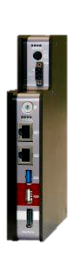
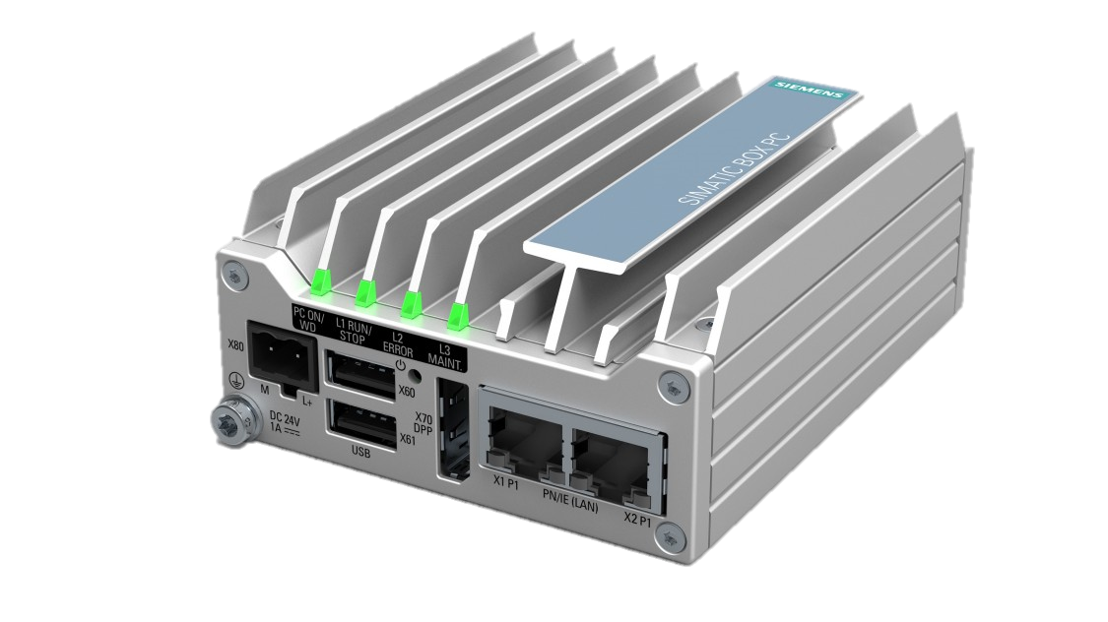
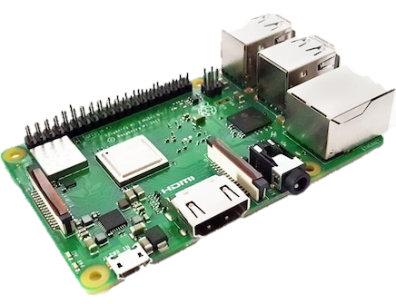
Data storage / upload
Data acquisition in injection moulding
To ensure that the data can be recorded and exported in the desired quality, device-specific solutions must often still be implemented. Thus, there is a different solution for data recording for each injection moulding machine at the IWK.
IPCs from Siemens and a DAQ-C system from iba are used for data storage and upload.
System | Siemens IPC | iba DAQ-C | Raspberry Pi
Data recording | no | yes | yes
Data upload | yes, manual programming | yes, through ibaPDA | yes, manual programming
timestamp | from machine | from DAQ-C for all devices | from Raspberry Pi

Slide 30


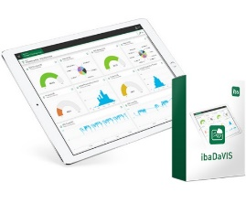
Implementation: Cloud & platform solution and specific DB solution
Data acquisition in injection moulding
Different data export / connectivity options as well as different data storage solutions will be demonstrated. Therefore, the following two main solution variants will be developed:
Variant 1 (Cloud- & Plattformlösung)
  Siemens Mindsphere
  All process data as "raw data" in the cloud
  Visualisation of process parameters
Variant 2 (specific local database solution)
  Solution from the company iba
  All process data as "raw data" and calculated process parameters in a database
  Visualisation of process parameters with ibaDaVIS

Slide 31
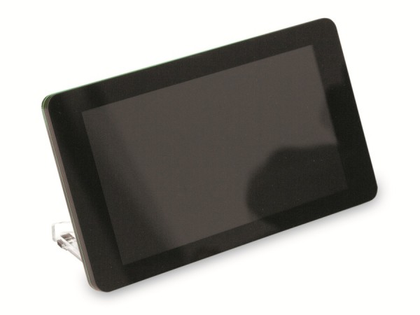
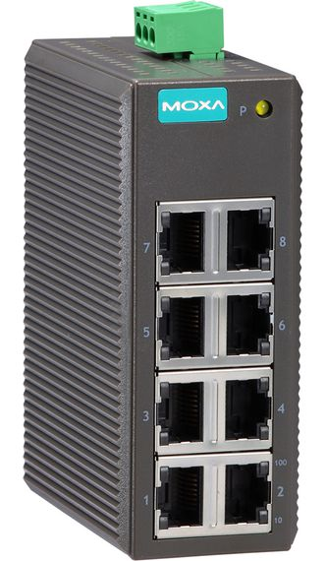
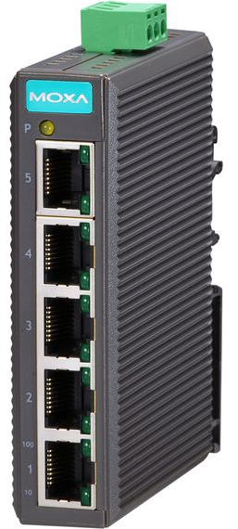
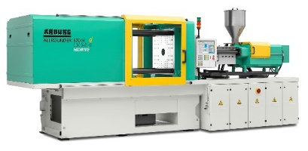
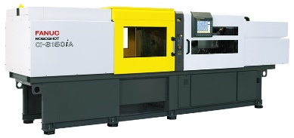
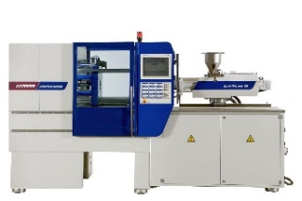
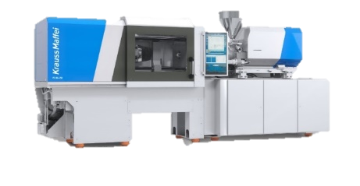
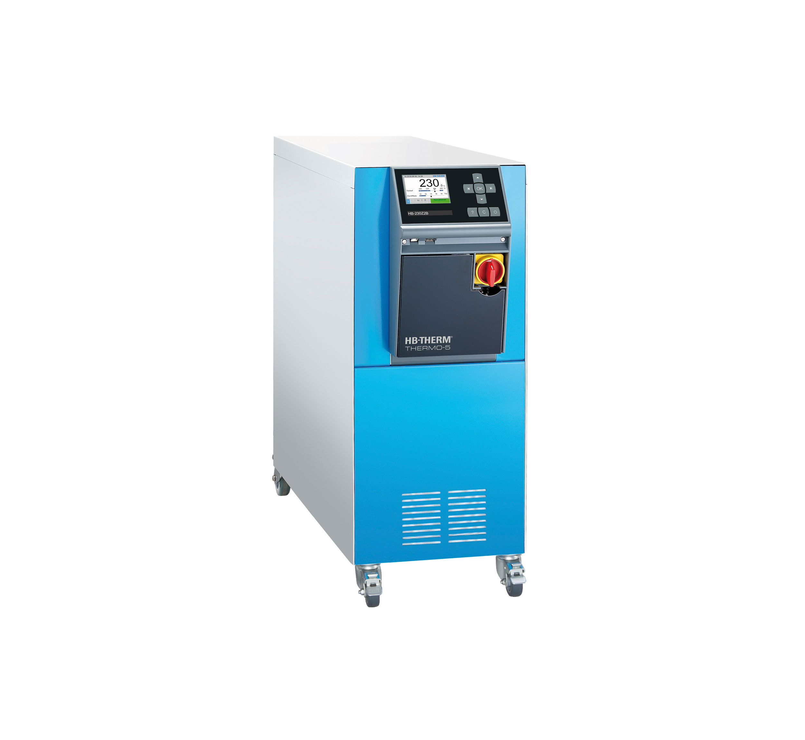
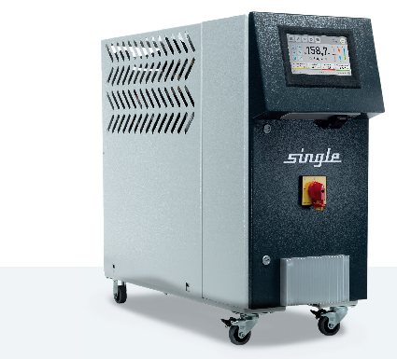
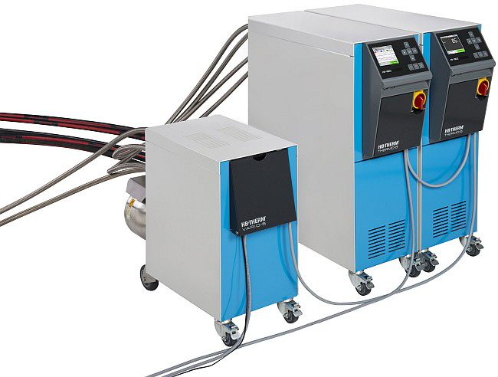
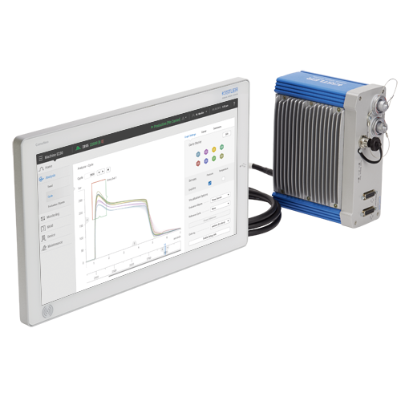

Networkplan – OST-network
Data acquisition in injection moulding
Gerät für Daten-
aufzeichnung / -upload
(Datenbank / Mindsphere)
Ethernet
OST-Netzwerk
Machine hall injection moulding
RaspberryPi Touch
U1-14.14
U1-14.15
U1-14.1
U1-14.2
3x free
2x free
1x free
…
…
1x free
…
…
Switch Fertigungszelle
…
…
Arburg 570H 2000-800
Fanuc Roboshot ɑ s-150ia
SmartPower 60/210
KraussMaffei PX120-380
Siemens IPC KM
iba DAQ-C
Single Smart Line
Raspberry Pi Battenfeld
HB-160Z1
Weitere Geräte:
(Anschluss an freie Netzwerkdosen)
RaspberryPi Touch
Single Smart Line
HB-Vario-5
HB-160Z1
Kistler Como Neo
RaspberryPi Touch
HB-Vario-5
RaspberryPi Touch
Smart Factory NB

Slide 32
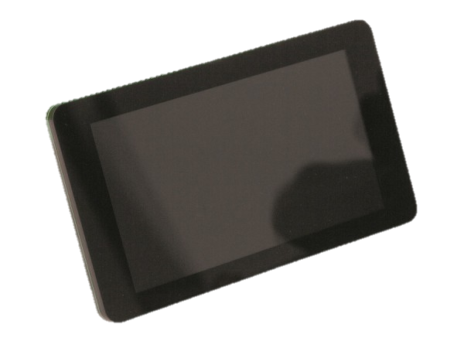



Data flow injection moulding
Data acquisition in injection moulding
Raspberry Pi
Versuchsdaten KM
Raspberry Pi
Versuchsdaten Engel
RaspberryPi Engel
KraussMaffei PX120-380
DataXplorer
copy
Siemens IPC KM
raw data KM
DatCoordinator
copy
raw data Engel
Siemens IPC Engel
raw data Arburg / Fanuc / Battenfeld
iba DAQ-C
KPI Arburg / Fanuc / Battenfeld / KM
ibaPDA
DatCoordinator
ibaAnalyzer
raw data Arburg / Fanuc / Battenfeld / KM
Raspberry Pi Battenfeld
Smart Factory NB
Kistler Como Neo

Slide 33
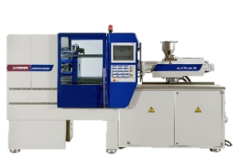
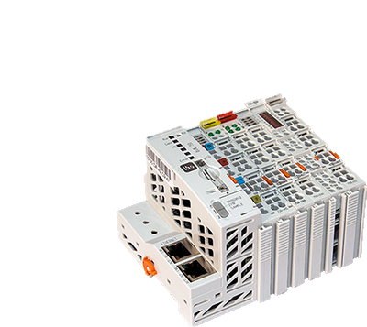
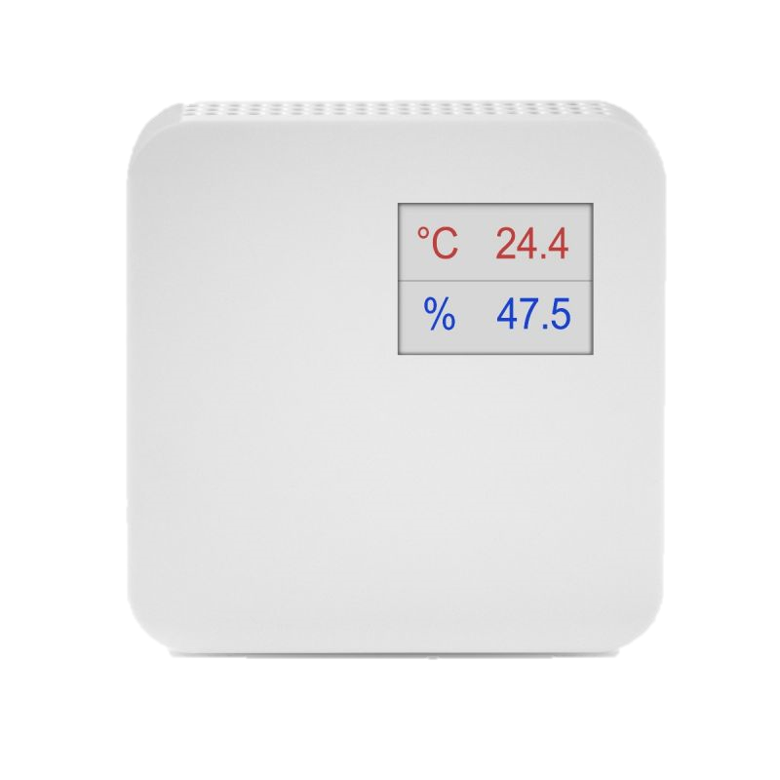
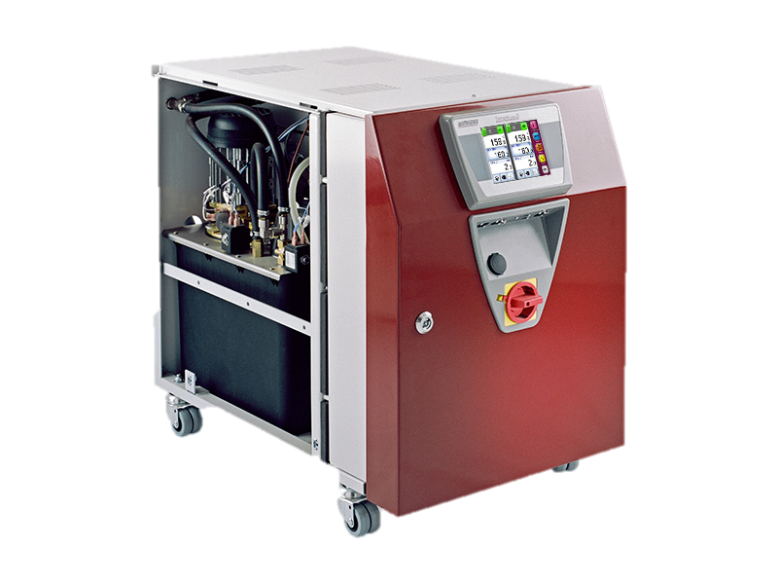
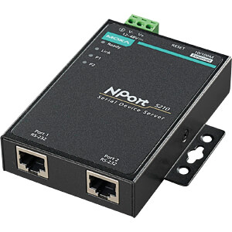
Battenfeld Smart Power 60/210
Data acquisition in injection moulding
RaspberryPi Touch (trial data)
Data recording with iba DAQ-C
Data from the injection moulding machine
Euromap 63 (via Raspberry Pi)
  Curve signals with 0.5 Hz sampling frequency rather cyclical values
  Process parameters and setting parameters
Sensor signals from the machine control cabinet
  Curve signals with max. 1kHz sampling frequency (via I/O module)
Data from the tool
Cavity pressure sensors 1 channel
  Curve signals with max. 1kHz sampling frequency (via control cabinet and I/O module)
Peripheral and environmental data
Temperature control units Wittmann Tempro Plus D (via RS232 & NPort)
  Curve signals with 1Hz sampling frequency
HB-Vario 5 unit (via OPC UA)
  Curve signals with 1Hz sampling frequency
Ambient temperature and humidity (via I/O module)
  Curve signals with max. 1kHz sampling frequency (via I/O module)
Trial data
Input via touch screen (via TCP/IP)
TCP/IP
SmartPower 60/210
Raspberry Pi Battenfeld
AI / DI
AI
Raumkombifühler
iba I/O-System
RS232
TCP/IP
Wittmann Tempro Plus D
N-Port Converter
iba DAQ-C
HB-Vario-5

Slide 34
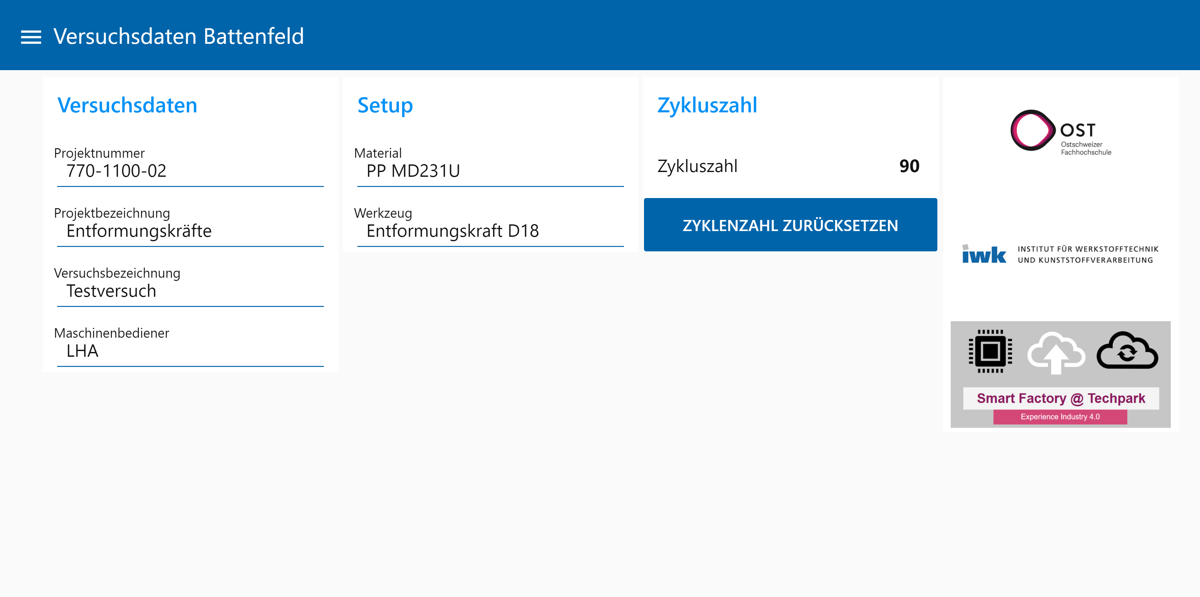
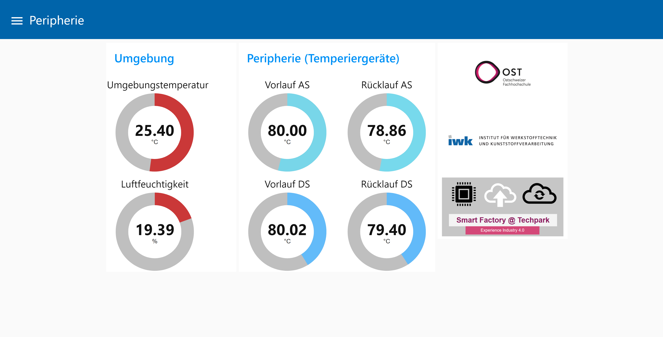
Input for manual / trial data
Data acquisition in injection moulding
To ensure that the recorded data can also be assigned to the corresponding trials, information on the trials is required in addition to the process data. For this purpose, each machine was equipped with a touch display with which the test data can be recorded but also the process data can be visualised.

Slide 35
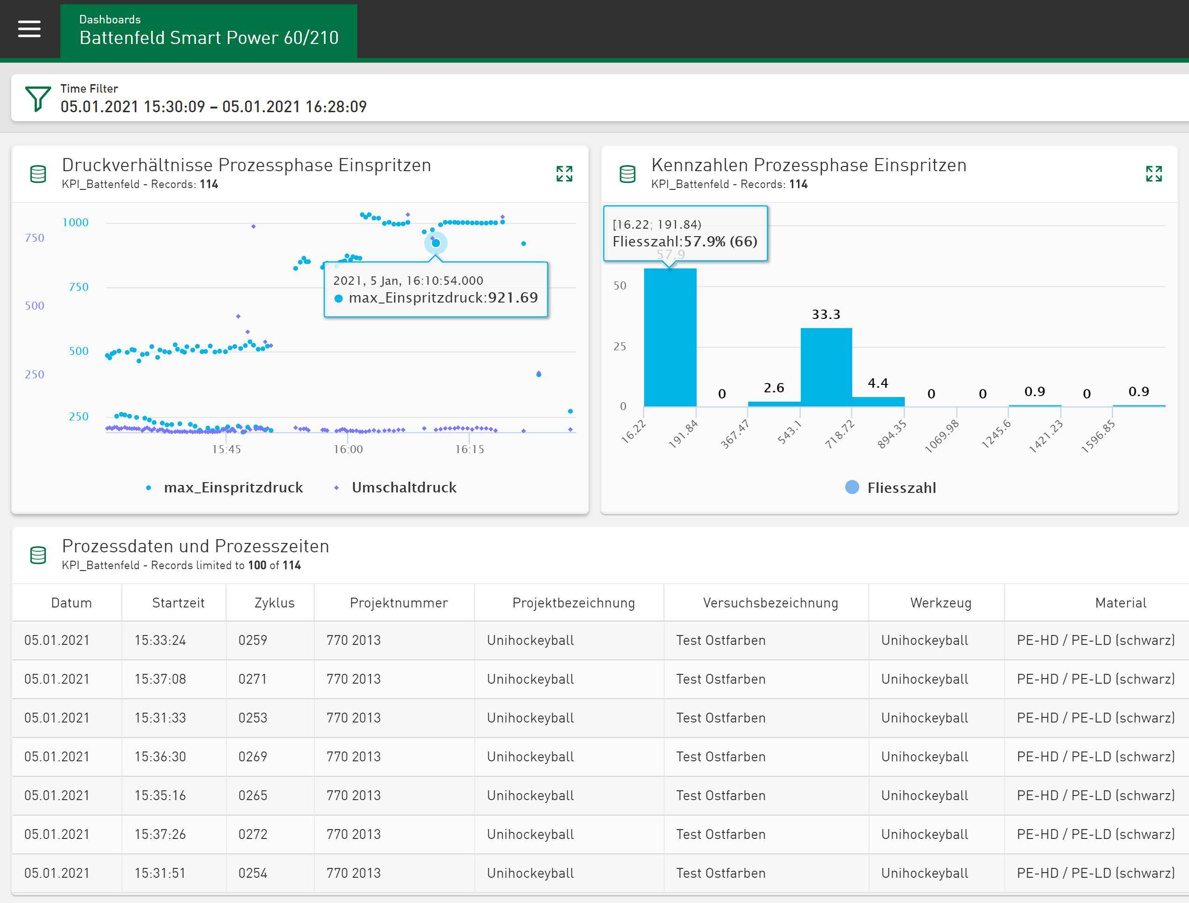
Data visualisation
Data acquisition in injection moulding
In addition to data recording, the visualisation of the data is also a central objective:
Edge2Web application in Siemens Mindsphere
data from the local database can be visualised with ibaDaVIS (picture on the right).

Slide 36
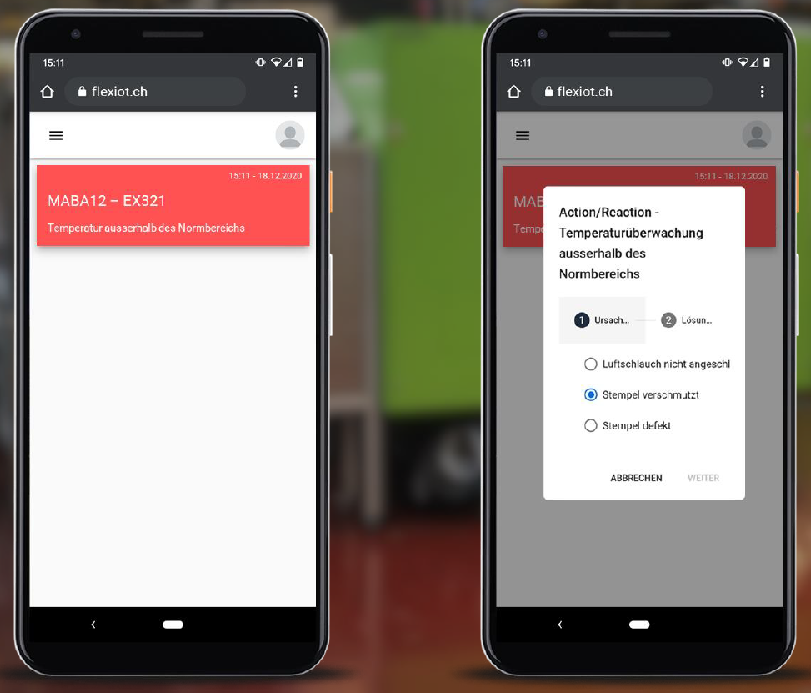
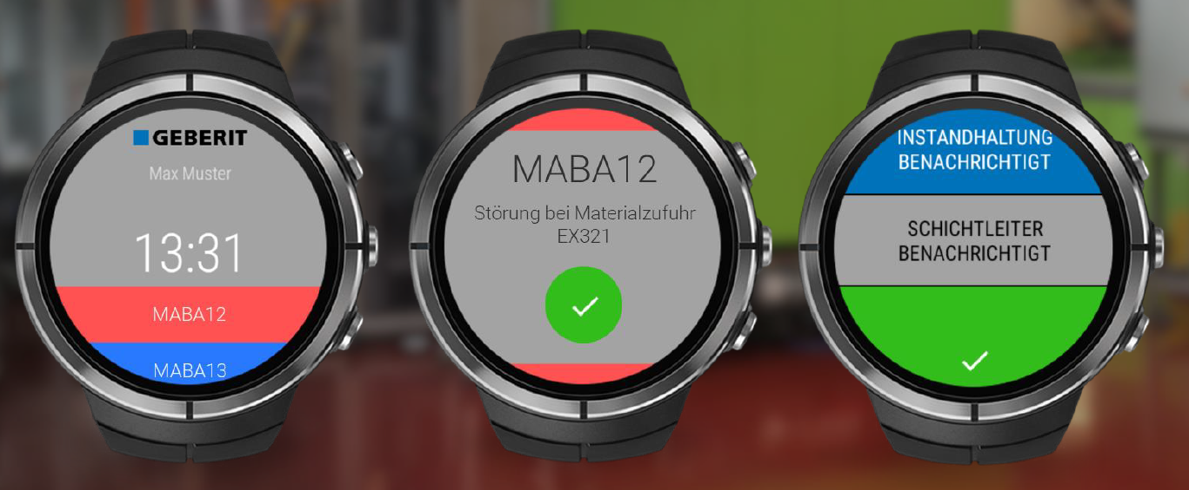
Notifications
Data acquisition in injection moulding
Highly automated , increasingly connected production environments and constantly growing amounts of «industrial data »
Several applications with complex information dashboards and for concrete maintenance tasks available, but …
How can manufacturing workers at the shop floor be informed about the current production status and potential interventions?
[PRISM Preventive Intervention in Smart Manufacturing]

Slide 37


Further use of the recorded data
Data acquisition in injection moulding
The created database also provides other possibilities, for example automated process protocols:
Automated calculation of process parameters
Creation of the protocol for a given cycle
Inclusion of trial data, process curves, process parameters, setting parameters and also images of the process.
This guarantees that the process is documented completely and always in the same way. In addition, the exact settings and parameters for each cycle are documented.

Slide 38
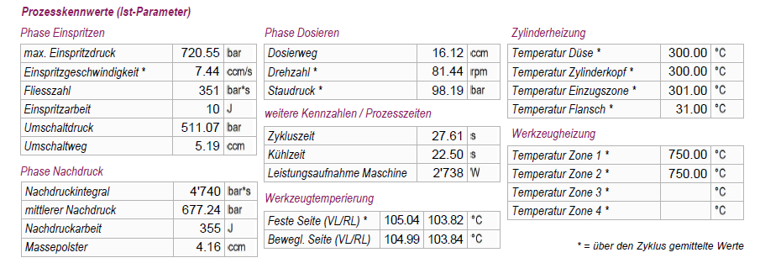
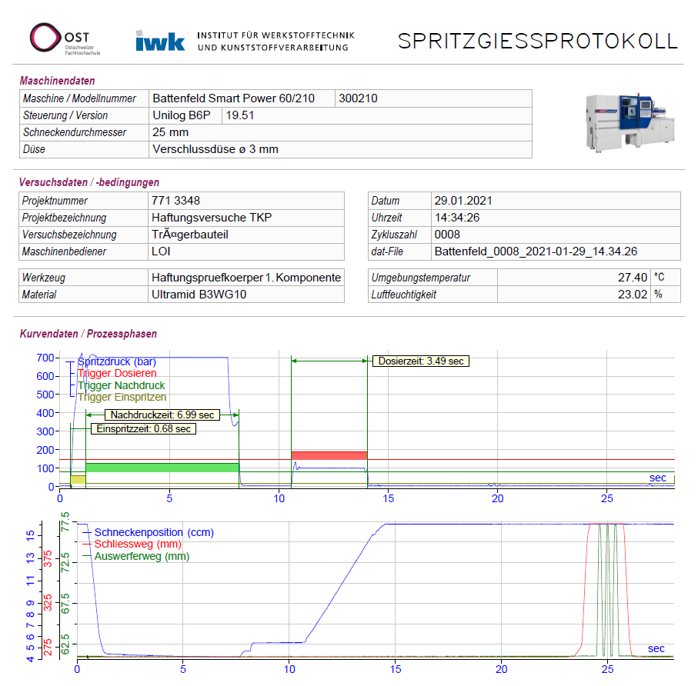
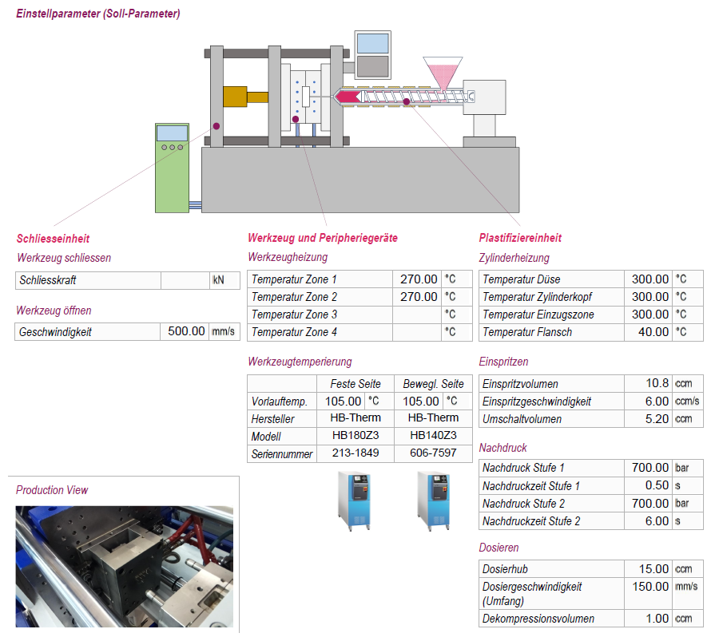
Further use of the recorded data
Data acquisition in injection moulding

Slide 39
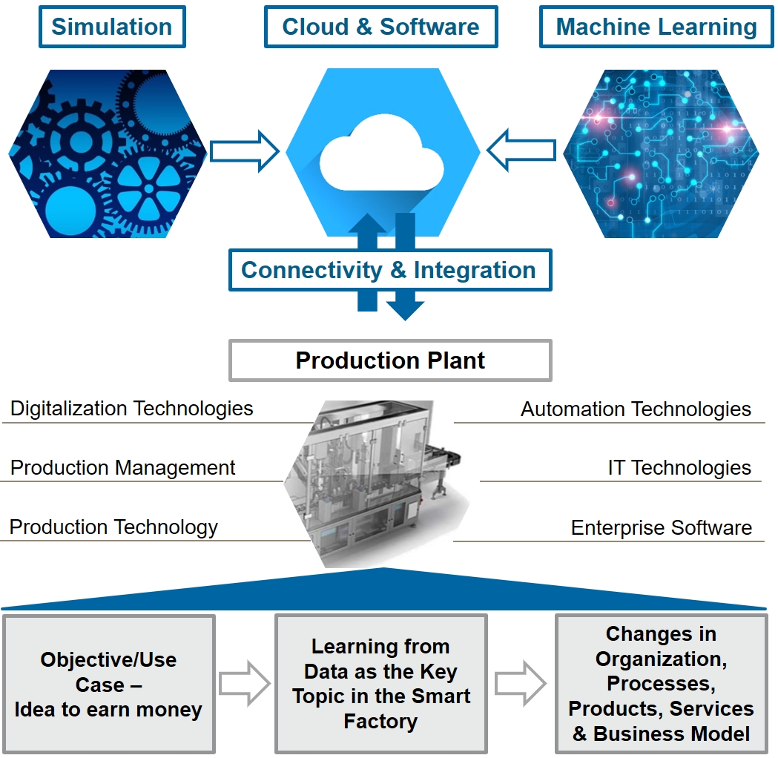
Uses Cases for injection moulding

Slide 40
Overview: use cases for injection moulding @ OST
Use cases for injection moulding
Use case 1: anomaly detection
Use of internal machine data for anomaly detection and logging events at occurrence
Proposal of an appropriate countermeasure
Use case 2: quality data prediction
Use of internal machine and tool data (cavity pressure) to predict quality of injection moulded parts
Use case 3: preventive and predictive maintenance
Use of internal machine data for the evaluation of the condition of key components of an injection moulding machine (e.g. non return valve)
Determination of the time for a replacement

Slide 41
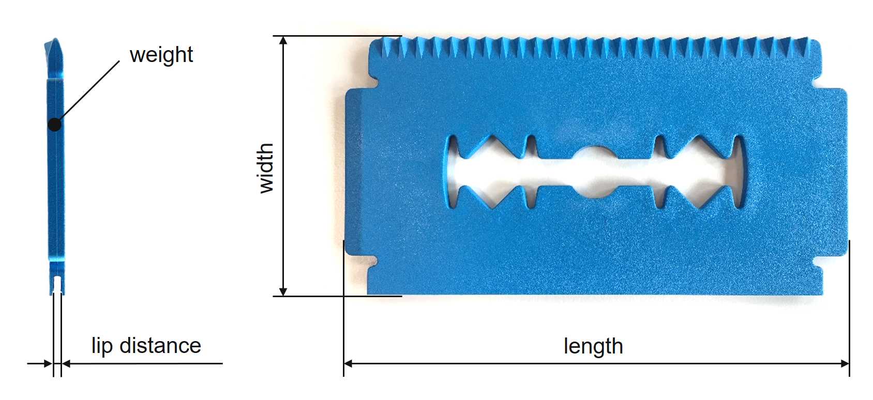
Anomaly detection: trial design
Use cases for injection moulding
4 test series, part: ice scraper, material: PP
  Trial series 1 (72 parts) - reference trial series → ice scrapers lie within the tolerances
  Trial series 2 (56 parts) - calcified cooling channels → temperature of the mould temperature medium increased
  Trial series 3 (57 parts) - batch fluctuation → cylinder temperature increased
  Trial series 4 (52 parts) - wrong material → 10% foreign material added
Database
  Process curves recorded with
  the DataXplorer
  Additionaly the corresponding
  quality data were measured
  (shown in picture on the right)
Notes:
In the 1st study we made several injection moulding trials, which can be seen on this slide. We tried to recreate known process anomalies.
The trials were performed with a tool to produce an ice scraper and with the material PP
During the trials we recorded all internal machine data with the DataXplorer and additionaly measured the quality data of the moulded parts

Slide 42
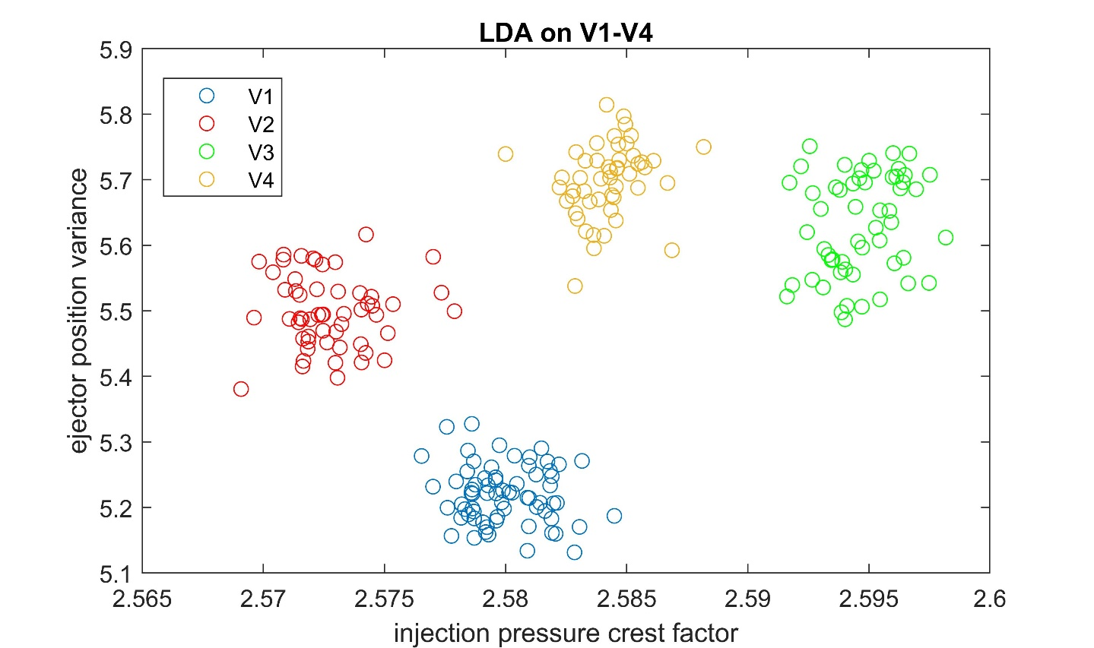
Anomaly detection: classification of trial series
Use cases for injection moulding
Can ML be used to anticipate process anomalies based on internal measurement signals?
trial series V1-V4 can be completely classified with just two important features (a linear discriminant analysis (LDA) was used for the actual classification of the trial series)
Notes:
A classification of the test series is possible as it can be seen on the picture.
The features … and … were used for classification.
As the test series can be clearly classified it should also be possible to detect process anomalies with ML

Slide 43
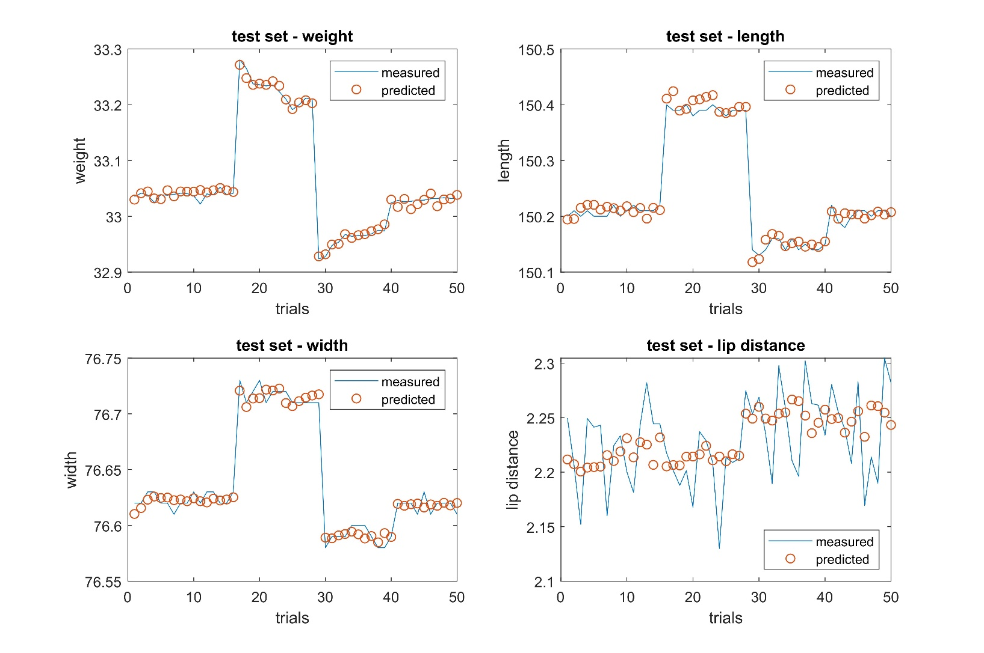
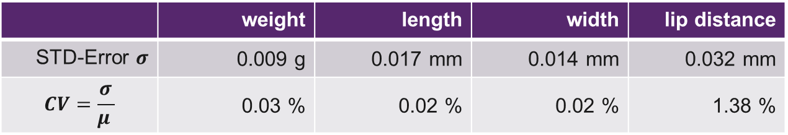
Quality data prediction: results
Use cases for injection moulding
Test sets (random data from the trial series that were not used for the development of the models) were used to test the models by predicting the quality data of the already moulded parts.
  Very good prediction of quality data of NEW components, based only on internal machine data
 | weight | length | width | lip distance
STD-Error $σ$ | 0.009 g | 0.017 mm | 0.014 mm | 0.032 mm
$$CV=\frac{σ}{μ }$$ | 0.03 % | 0.02 % | 0.02 % | 1.38 %
Notes:
Additionaly we were able to predict quality data of the moulded parts with ML.
Therefore we tried to estimate quality data of moulded parts, which were not used for the training of the ML system
Results can be seen on this slide, prediction is very accurate except when measurement error is bigger (lip distance)

Slide 44
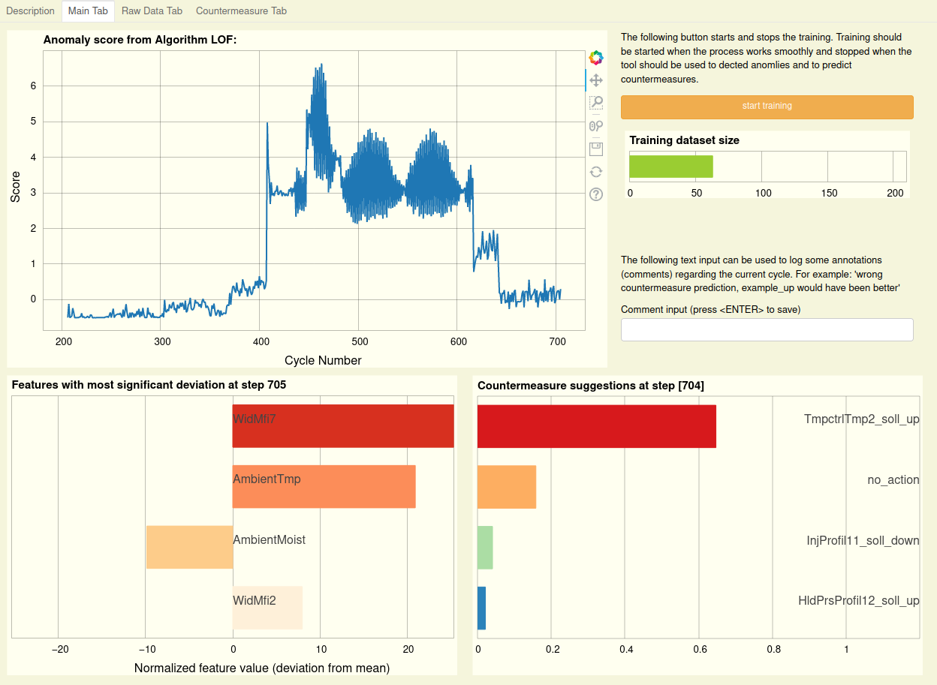
Anomaly detection: application in practice
Smart Factory @ OST
When the anomaly score increases, a recommendation for action is suggested to the operator (Fig. 5, bottom right), which can be used to correct the process again.

Slide 45
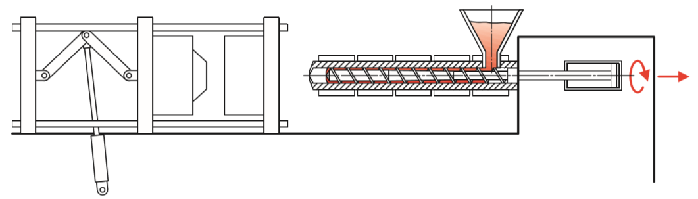
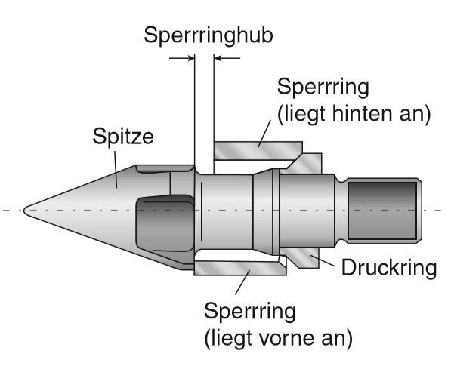
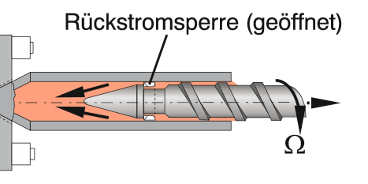
Predictive maintenance: defect non-return valve
Use cases for injection moulding
Operating principle non-return valve: prevents the melt from flowing back over the screw bars
Otherwise no reproducible production is possible; undefined dwell time of the material in the cylinder
Dosiervorgang
[Kaiser, Sächtling]
[IKV]

Slide 46
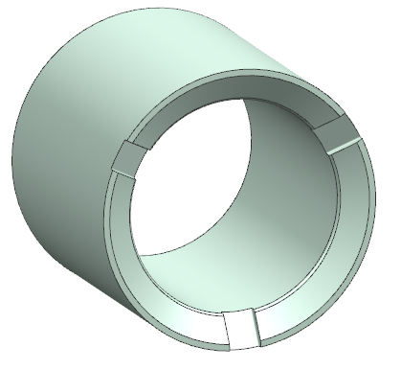
Predictive maintenance: trial design
Use cases for injection moulding
A well-known anomaly in the injection moulding process is the wear of non-return valve
  To simulate this anomaly the ring of a non-return valve was artificially damaged, means notches with different depths were milled
5 test series, part: ice scraper, material: ASA
  Trial series 1 – intact non-return valve
  Trial series 2 – damaged non-returned valve, notch depth 0,20 mm
  Trial series 3 – damaged non-returned valve, notch depth 0,33 mm
  Trial series 4 – damaged non-returned valve, notch depth 0,67 mm
  Trial series 5 – damaged non-returned valve, notch depth 1,00 mm
Database
  Process curves recorded with the DataXplorer
non-return valve with machined notches
Notes:
To answer this second question we tried to simulate a well known process anomaly in injection moulding, the wear of a non return valve
Trials were perfomed with ASA and the already knwon ice scraper
During the trials we again recorded all internal machine data with the DataXplorer

Slide 47
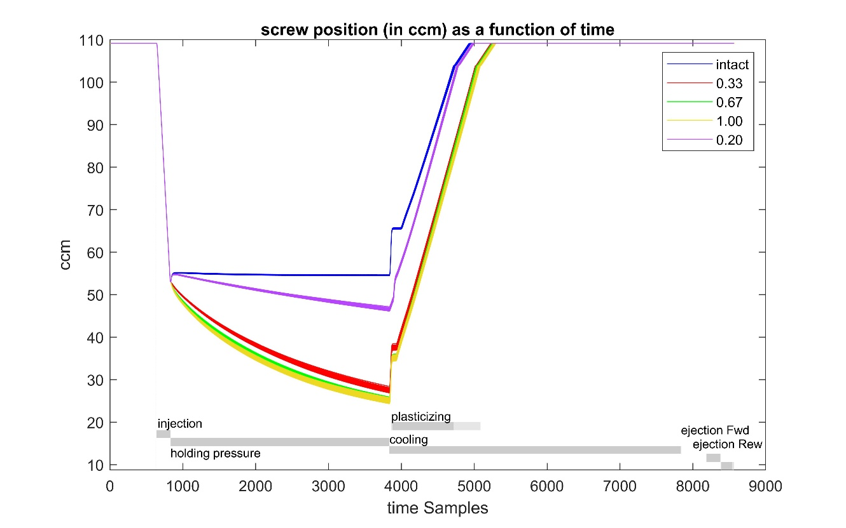


Predictive maintenance: classification of trial series
Use cases for injection moulding
With damaged non-return valves the screw covers significantly longer distances during holding pressure phase, scattering increases with higher wear → already known in industry
The wear of the non-return valve can be clearly detected with the component scores of a PCA → probably the damage can even be reliably estimated
1st PC score seems to be a good indicator for the depth of the notch
Notes:
On the left you can see a diagramm of the screw position in function of time for one cycle
The blue curve represents the intact non return valve and with damaged valve the screw covers significantly longer distances during holding pressure phase
Also for this study we tried to classify the trial series, this time with 1st and 2nd score of a PCA. Classification is possible too.

Slide 48



Predictive maintenance: use of an auto encoder
Use cases for injection moulding
Can ML detect these anomalies even before the machine operator and determine the time for a replacement?
  Results of additional trials with an unhardened non-return valve and high reinforced PPA material:
Yes, anomaly can be detected right from the start
Auto encoder (neural network with different levels)
Reconstruction error calculation with RMS
Reconstruction error in function of cycle number
$$f_{{rms}_{ }}=\sqrt{\frac{1}{n}\sum_{k=1}^{n}{\left({\left(\hat{x_{k}}−x_{k}\right)}^{2}\right)}}$$
features
recalculated features
Notes:
To simulate a continous wear additonal trials with a unhardened non-return valve were perfomed. To detect the process anomaly we used an auto encoder.
This is a neural network were we reccalculate our features and use the reconstruction error as indication for process anomalies
On the right you can see the recaclulation error as a function of the numbers of moulded parts. The first 1000 cycles were used for the training of the network. After that the reconstruction error increases from the begining, means an anomaly can be detected right from the start. But is this really the wear of the non return valve or are we decting something different?

Slide 49

Predictive maintenance: use of an auto encoder
Use cases for injection moulding
Can ML detect these anomalies even before the machine operator and determine the time for a replacement?
  Results of additional trials with an unhardened non-return valve and high reinforced PPA material:
Reason for anomaly can also be identified by comparing and ranking the reconstruction error of the used features
Identification of anomalies
Reconstruction error in function of cycle number
reconstruction error
number of cycles
1. minimal screw position = melt cushion
2. variance screw position
Notes:
This question can be answered with the results on this slide. The reason for anomaly can also be identified by comparing and ranking the reconstruction error of the used differnet features
Most imported features are … which corresponds to knowledge from industry
So this means an anomlay can be detected right from the start even if before an operator can see it

Slide 50
Smart Factory @ OST

Slide 51

Model for the implementation of machine learning in the factory
Smart Factory @ OST
Investigations showed that a step-by-step approach to implement Industry 4.0 in plastics processing is target-oriented.

Slide 52
Smart Factory components and roadmap
Smart Factory @ OST
Due to the existing knowledge in the field of plastic production technologies and robotics, these areas also serve as central elements of the smart factory.
The networking and the development of data export for the machines of the IWK served as the initiation for the development of the smart factory, which is now to be continuously and diversely expanded.
2019
2020
2021
2022
2023
Plastic processing machines
Production and assembly cells (Rapperswil / Buchs)
Robots
Additive Manufacturing (metal / plastic)
CNC machines (metal workcenters)

Slide 53


Implementation partner: competencies united
Smart Factory @ OST
Plastics processing
Data acquisition and processing
Smart Factory
IWK
IPEK
ILT
INS
IMP
IPM
ITEM
IPM Institut für Informations- und Prozessmanagement
Industry 4.0
Information and communication technology
SAP
IMP Institut für Mikrotechnik und Photonik
Production strategy
Business models
Mechatronic systems
Network and cloud infrastructure
Security
Robotics
Automation solutions
Notes:
Roman Hänggi

Slide 54


Outlook: production cell
Smart Factory @ OST
A manufacturing cell is / was set up in the Techpark for the production of
a floorball with individual color configuration starting from quantity 1.
an OST-gadget (wireless charger)
Goals:
Demonstration of the possibilities of an automated production cell with continuous data acquisition
Complete product traceability
Complete coupling with an SAP system

Slide 55

Manufacturing cell floorball
Smart Factory @ OST

Slide 56

Outlook: production cell floorball - overview
Smart Factory @ OST
Interim storage
floorball
Linear handling injection moulding machine
Injection moulding machine
Conveyor belt
Output storage
floorball
Measuring cell
Welding machine
floorball
Collaborative robot

Slide 57










Outlook: production cell - production flow OST-gadget
Smart Factory @ OST
Injection moulding machine cell
Injection moulding machine
QR-Code Matriq
Measuring cell
Interim storage
Assembly
Process steps
Linear handling injection moulding machine
Conveyor belt
Collaborative robot
Handling

Slide 58

Assembly cell OST-Gadget @ Campus Buchs
Smart Factory @ OST

Slide 59

Outlook to Exercise 04

Slide 60
E04 – Processing and evaluation of process data
Angewandte Digitalisierung in der Industrie
Practical course with ibaAnalyzer (on own laptop):
Analysis of curve data (data from preliminary tests on the injection moulding machines)
Calculation of KPIs
Creation of automated process protocol

Slide 61
Thank you for your attention
Curdin Wick MSc.
curdin.wick@ost.ch
058 257 47 70

