Slide 1

Web Development Fundamentals
Data Visualisation with D3.js
Prof. Dr. Matthias Baldauf
School of Management / Institute for Information and Process Management

Slide 2
Content
Data visualisation in a Nutshell
Frameworks for Data Visualisation
Introduction to D3.js
  What’s D3.js
  The SVG HTML5-Tag
  An easy Example
Use Case: Smartfactory@OST
  Webservice
  JSON Data
  Exercises

Slide 3
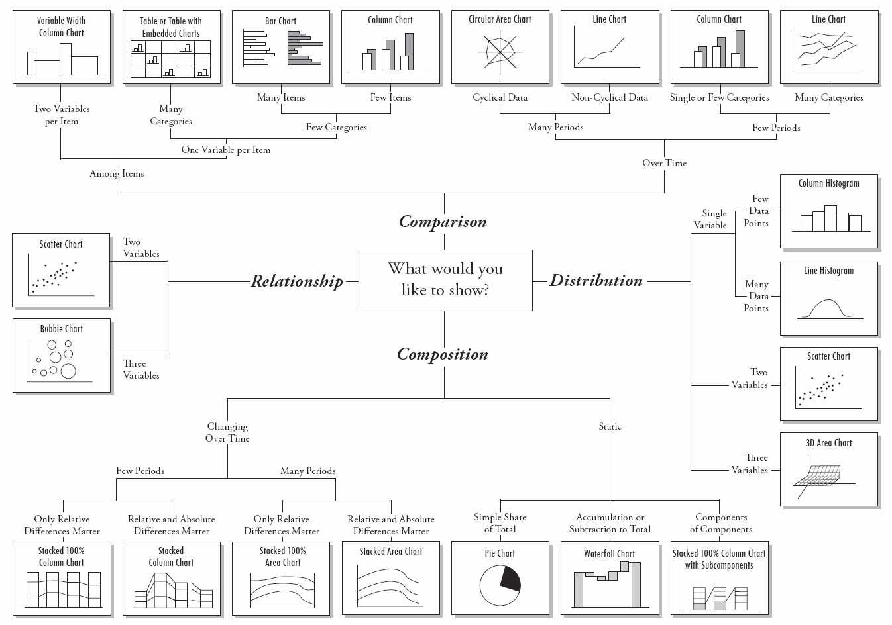
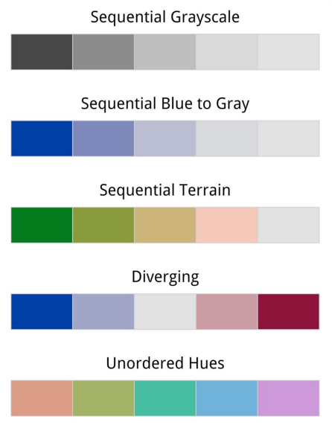
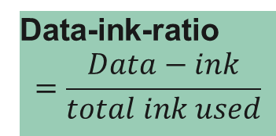
Data Visualisation in a Nutshell
3
1
Data-ink-ratio
$$=\frac{Data−ink}{total ink used}$$
2
Color Scales
Abela (2013)
Abela (2013)
Notes:
Core messages:
Advantage of visualisation
«A picture is Worth a Thousands Words»
1 Data and purpose define the visualisation type
Bar charts
Line charts
Pie charts
Heatmaps
Scatterplot
Histogram and density plots
…
2 Choose color wisely (color scales, accessibility)
3 Ink-Data-Ratio: only «print» what is really needed

Slide 4






Libraries for Data Visualisation on the Web
D3.js
Notes:
Core message:
There are several JavaScript based frameworks for visualisation
D3.js is one among them, established and already on market more than 10 years

Slide 5
D3.js: Introduction
D3 = Data-Driven Documents
Dynamic, interactive visualisations
Refers to the DOM (Document Object Model)
Open-source JavaScript library for visualizing data – since 2011
Builts on existing web standards
D3 is very flexible, BUT is a low-level toolbox
  No concept of «charts» → you have to compose a variety of elements (shapes, axis, animation, …)
  Even easy visualisations need signifcant amount of coding
  D3 is for maximum individualisation and expressiveness, not quick standard visualisations
Notes:
Source: What is D3? | D3 by Observable (d3js.org)

Slide 6
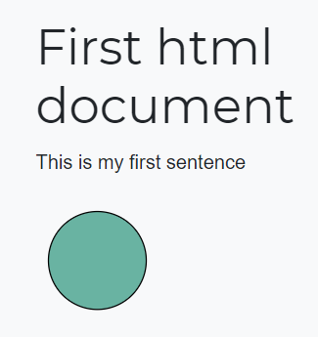
D3.js: The SVG HTML-Tag
<!DOCTYPE html>
<h1>First html document</h1>
<p>This is my first sentence</p>
<svg>
<circle style="fill: #69b3a2" stroke="black" cx=50 cy=50 r=40></circle>
</svg>
SVG = Scalable Vector Graphics (W3C standard)
XML-based vector image format (2D)
Various shapes (lines, circles, rectangles, text, …)
Supports interactivity and animation
All major desktop browser support SVG
Probably some limited support on mobile browsers
→ A D3.js chart is a set of SVG shapes!
Notes:
Sources:
SVG – Wikipedia
An introduction to d3.js in 10 basic examples (d3-graph-gallery.com)

Slide 7
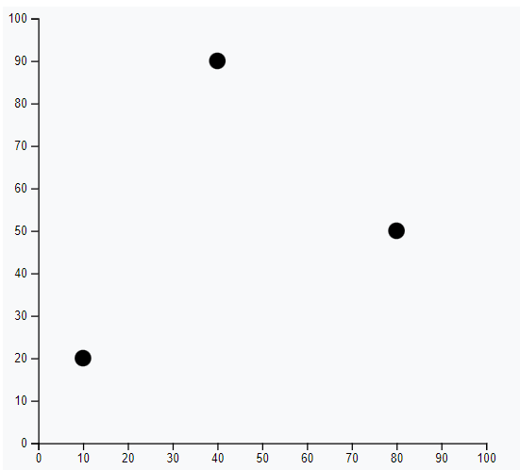
D3.js: An easy Example
<div id="scatter_area"></div>
var svG = d3.select("#scatter_area")
.append("svg")
.attr("width", 450)
.attr("height", 400)
.append("g")
.attr("transform", "translate(30, 20)");
var data = [ {x:10, y:20}, {x:40, y:90}, {x:80, y:50} ]
var x = d3.scaleLinear()
.domain([0, 100])
.range([0, 420]);
svG .append('g’)
.attr("transform", "translate(0," + 450 + ")")
.call(d3.axisBottom(x));
var y = d3.scaleLinear()
.domain([0, 100])
.range([380, 0]);
svG
.append('g’)
.call(d3.axisLeft(y));
svG
.selectAll("whatever")
.data(data)
.enter()
.append("circle")
.attr("cx", function(d){ return x(d.x) })
.attr("cy", function(d){ return y(d.y) })
.attr("r", 7)
Notes:
Source: An introduction to d3.js in 10 basic examples (d3-graph-gallery.com)
Remark: A bit of code (for styling) is not included in this slide (for space reason)
→ Copying this code 1:1 will not lead to the exact some result

Slide 8
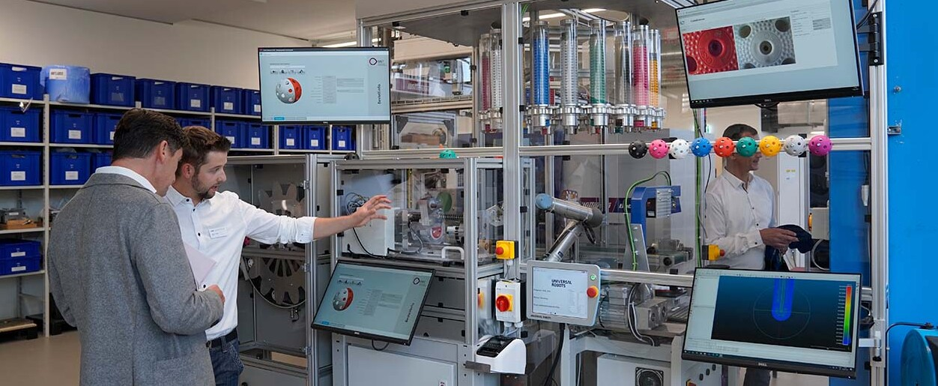
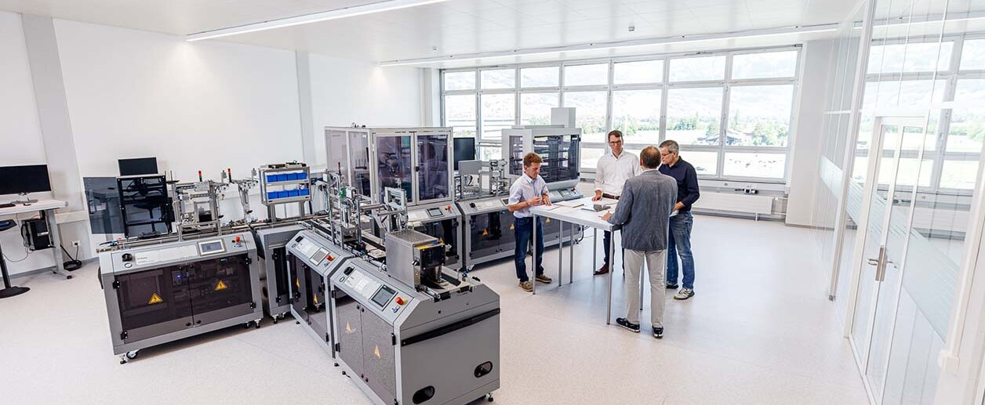
SmartFactory@OST: Production Sites
Rapperswil
Buchs
Notes:
Rapperswil: production of floorball balls
Buchs: production of wireless charger

Slide 9
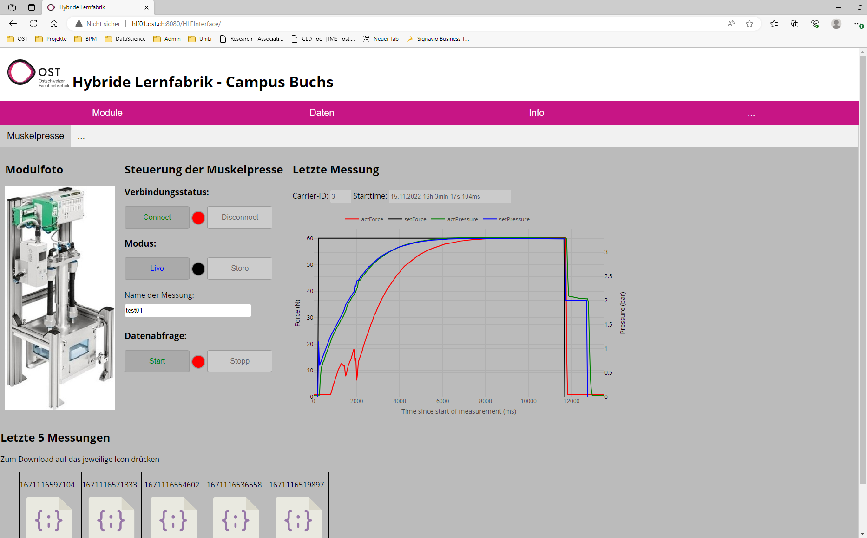
SmartFactory@OST: REST-API
http://hlf01.ost.ch:8080/HLFInterface/getData?db=MusclePress+measurement=test01
Notes:
Link to the overview (printscreen): http://hlf01.ost.ch:8080/HLFInterface/getDBs
Caution: it is not possible to fetch data from a localhost through the mentioned REST-API (security reasons)

Slide 10
SmartFactory@OST: JSON Data from REST-API
{"datapoints":
[
{
"time": "2022-12-15T14:31:53.908Z",
"actForce": 0.9033478498458862,
"actPressure": 0.03900265693664551,
"setForce": 0.0,
"setPressure": 5.548867557081394E-5,
"carrierID": "3",
"startTime": "1671114713908"
},
{
…
}
]
}
Timestamp of measurement
Measurement values
Transportation box
Start time of production
Notes:
Timestamp and measurement values are need for the visualisation
Transportation box is irrelevant
StartTime would be needed, if all data is fetched -> group by StartTime
-> in the example / exercise a single production run is given (no grouping needed)

Slide 11
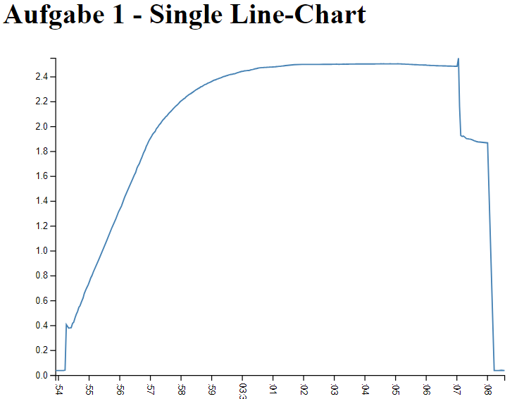
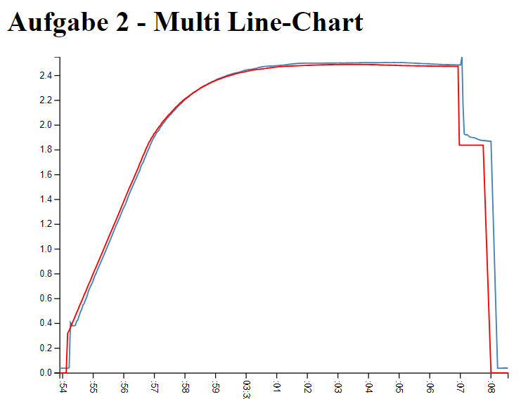
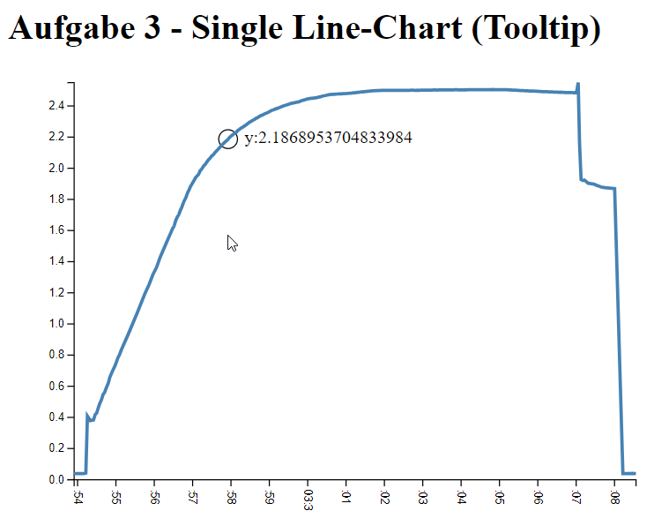
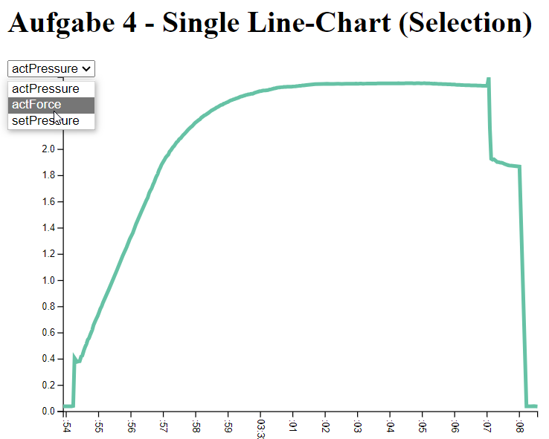
SmartFactory@OST: Exercises
Notes:
Detailed description of the exercises in the Web project

Slide 12
Literature
Abela, A. V. (2013). Advanced presentations by design: Creating communication that drives action (Second edition). Pfeiffer, A Wiley Imprint.

