Slide 1

Web Development Fundamentals
Web Services
Prof. Dr. Matthias Baldauf
School of Management / Institute for Information and Process Management

Slide 2
Web Services
Machine-to-machine communication
Calling functions on remote computer or data exchange
Identification of a web service via unique URL
Interface description (input parameters, return format, etc.)
Independent of concrete programming language
Various implementation options for "service-oriented architectures" (SOA):
  SOAP: protocol for the exchange of XML-based messages (quite complex)
  REST: simpler alternative based on web standards (and easy to use with JavaScript!)

Slide 3
RESTful Services
«Representational State Transfer»
Identification of service through URL, communication via HTTP
HTTP method specifies desired operation
Data mostly in JSON format
Use of HTTP response codes, see https://developer.mozilla.org/en-US/docs/Web/HTTP/Status
HTTP method (example) | Examples
GET | Retrieves information about a resource
POST | Inserts a new resource
PUT | Modifies an existing resource
DELETE | Deletes a resource

Slide 4
Ex. Customer management in REST style
GET http://www.example.com/customers/12345
GET http://www.example.com/customers/12345/orders
POST http://www.example.com/customers
PUT http://www.example.com/customers/12345
DELETE http://www.example.com/customers/12345

Slide 5
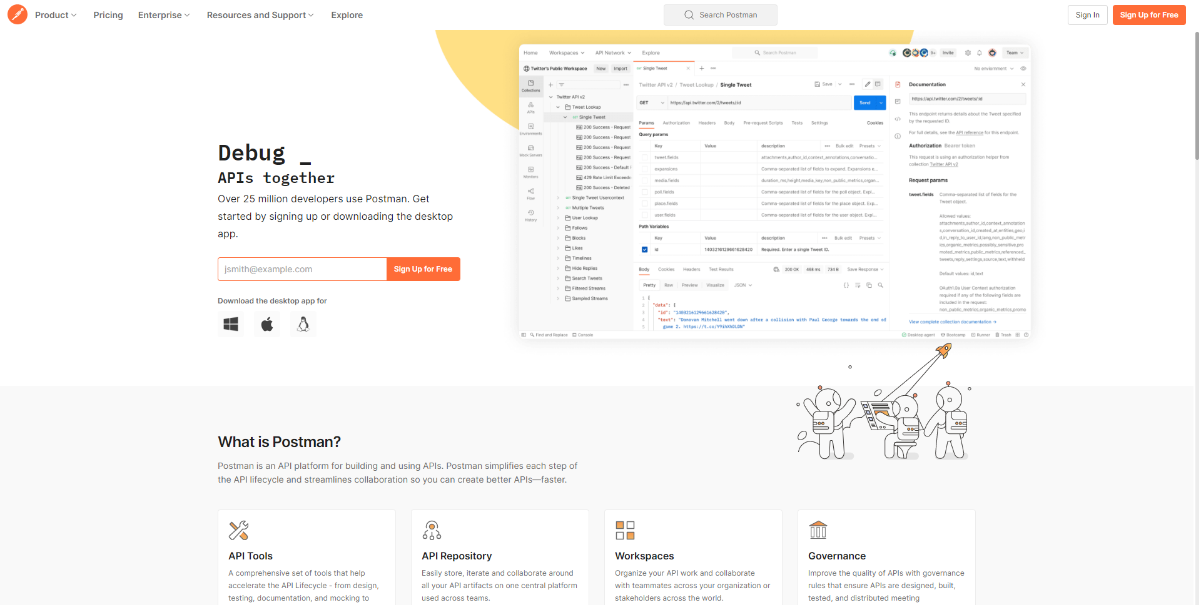
Postman

Slide 6
Exercise
Install Postman
Choose a sample REST service
  https://restcountries.com
  https://exchangerate.host
  http://jservice.io
  https://api.chucknorris.io/
Call selected service with Postman

Slide 7
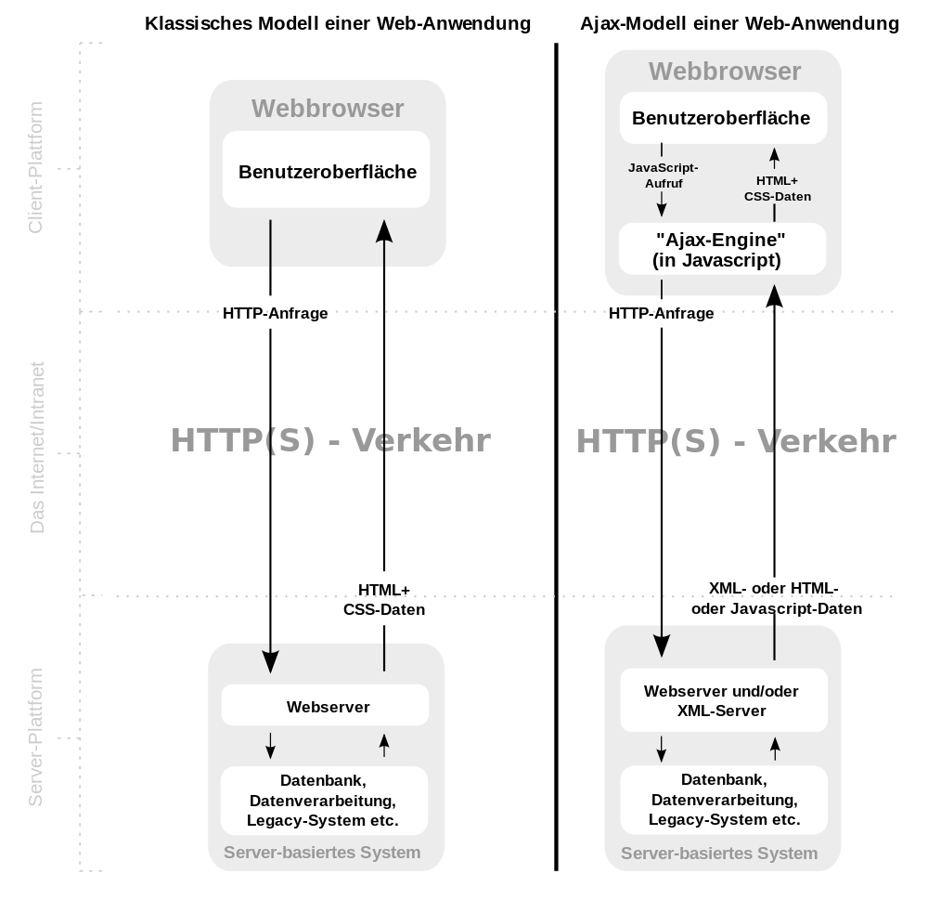
Web service calls in JavaScript: Ajax
Ajax: Asynchronous JavaScript and XML
Web services over HTTP within a web page without reloading the page itself.
"XML" in the name not quite correct anymore, because JSON is often used as data format

Slide 8
Advantages and disadvantages of Ajax?
Notes:
Advantages:
Interactivity, "desktop feeling", better UX!
Reloads only required data, not complete page
Disadvantages
Browser History!
Bookmarking of a status not possible
JS must be enabled

Slide 9
JSON - JavaScript Object Notation
Compact data format in easy to read text form for data exchange
Adapted from object notation in JavaScript:
Data is stored in name/value pairs
"firstname": "Matthias"
Data are separated by commas
"firstname": "Matthias", "familyname": "Baldauf"
Curved brackets indicate objects
"lecturer" : { "firstname": "Matthias", "familyname": "Baldauf" }
Square brackets indicate arrays
"modules" : [1, 2, 3]

Slide 10
JSON data types
Data type | Examples
String | "WBDG is my favorite module!"
Number | 123, 1.23
Boolean value | true, false
Null value | null
Array | ["St.Gallen", "Rapperswil", "Buchs"]
Object | {"id": 1, "name": "WBDG", "lecturer": "Baldauf"}

Slide 11
JSON example
{
"id": 1,
"modulename": "WBDG",
"year": 2023,
"semester": "FS",
"description": "WBDG is part of the Business Software Development major...",
"lecturer": {
"id": 12,
"familyname": "Baldauf",
"firstname": "Matthias",
"degree": "Dr."
},
"students": [
{
"id": 23,
"familyname": "Mustermann",
"firstname": "Max"
},
{ ... }
]
}
Useful JSON tools:
https://jsonlint.com/
https://jsonformatter.org/

Slide 12
Working with JSON in JavaScript
Access to values via key, either with dot or bracket notation
let jsonObject = { "id":1, "modulename": "WBDG", "students": [12, 23, 34, 45] };
// two ways to access JSON elements
console.log(jsonObject.id); // Points notation
console.log(jsonObject["modulename"]); // Bracket notation
console.log(jsonObject.students[0]); // Access array

Slide 13
Working with JSON in JavaScript
Loop through items of an array or JSON object
jsonObject.students.forEach(function (item, index) { // iterate over all array elements
console.log(index + ": " + item);
});
jsonObject.map((item, index) => { // iterate over all object elements
console.log(index + ": " + item);
})

Slide 14
Working with JSON in JavaScript
Important: Distinguish between JSON object and its text representation!
JSON.parse turns a string into a JSON object, JSON.stringify vice versa
let jsonString = '{ "id":1, "modulename": "SWI1" }'; // plain string, no object!
console.log(jsonString);
let jsonObjectFromString = JSON.parse(jsonString);
console.log(jsonObjectFromString);
let jsonStringFromObject = JSON.stringify(jsonObjectFromString);
console.log(jsonStringFromObject);

Slide 15
JSON example
{
"id": 1,
"modulename": "WBDG",
"year": 2023,
"semester": "FS",
"description": "WBDG is part of the Business Software Development major...",
"lecturer": {
"id": 12,
"familyname": "Baldauf",
"firstname": "Matthias",
"degree": "Dr."
},
"students": [
{
"id": 23,
"familyname": "Mustermann",
"firstname": "Max"
}
]
}
Exercise: How to access
year
lecturer‘s last name
first student of the list
Notes:
Exercise: access to year, access to last name, access to first student of the list.

Slide 16
Ajax calls with fetch
Function fetch, call with URL of the service and various parameters
Callbacks to define behavior on success/failure of the service call.
let requestOptions = {
method: "GET"
// various others possible
};
fetch("<SERVICE_URL>", requestOptions)
.then(response => response.json()) // Interpret response as JSON
.then(data => console.log("success", data)) // success case
.catch(error => console.log("error", error));
https://developer.mozilla.org/en-US/docs/Web/API/Fetch_API
https://wiki.selfhtml.org/wiki/JavaScript/Window/fetch

Slide 17
Ajax calls with fetch
Other variants
fetch("<SERVICE_URL>", requestOptions)
.then(function (response) { // write your own function here ...
//...
return response.json();
})
.then(data => handleData(data)) // or define a function to process the data
.catch(error => console.log("error", error));
function handleData(data) {
console.log(JSON.stringify(data));
}
https://developer.mozilla.org/en-US/docs/Web/API/Fetch_API
https://wiki.selfhtml.org/wiki/JavaScript/Window/fetch

Slide 18
Ajax calls with fetch
The fetch() method returns a promise
  Either use .then and .catch as in previous slides or
  it is possible to use async / await
let test_function = async function () {
let response = await fetch(<API_URL>);
let data = await response.json();
return data;
}
→ The code "waits" for the resolution of the promise before it continues

Slide 19
Exercise
Choose a sample service
  https://restcountries.com
  https://exchangerate.host
  https://api.chucknorris.io/
Call selected service with fetch
Output some relevant parts of the response

Slide 20
Transfer form data
let form = document.getElementById("myform");
// the form element with id myform
let data = new FormData(form);
// FormData creates a key/value list of all input elements with name attribute!
let requestOptions = {
method: "POST", // transferring data mostly done with POST method
body: data
};
// call fetch with these requestOptions

Slide 21
Exercise
Create a simple form (e.g., with one text field and one selection menu) in HTML
Add a button for submitting the form data via POST using the fetch method
Destination address: https://matthiasbaldauf.com/wbdg23/submitdatajson (returns all passed values in JSON format)
Additional task:
  How to access the HTTP response code in the callback function?

