Slide 1

Exercise Simulation
Simulation Smart Factory @ OST & Lotsizing
Roger Rinderer
Department

Slide 2
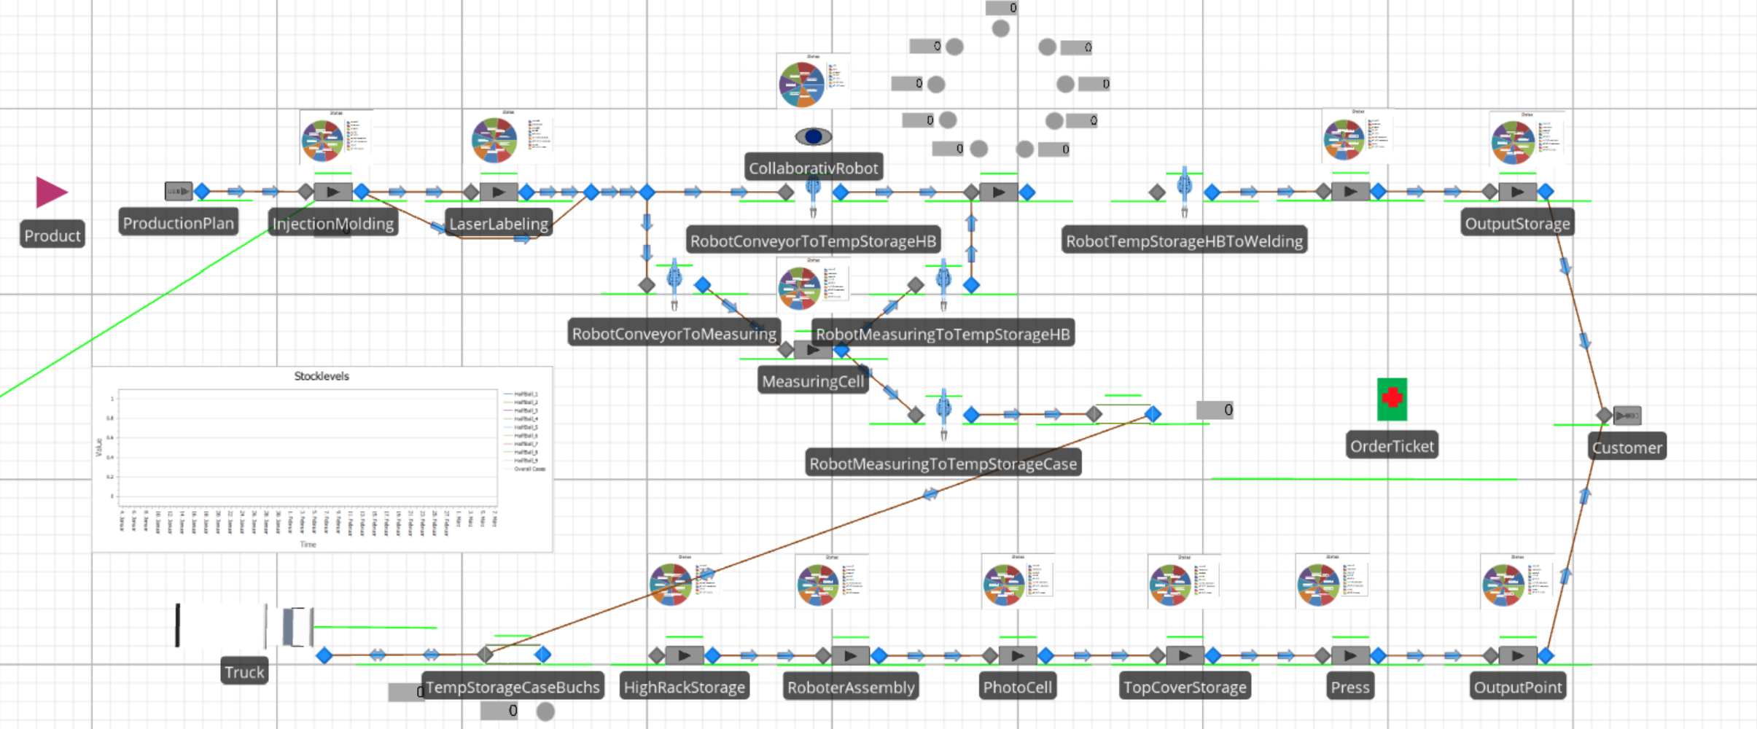
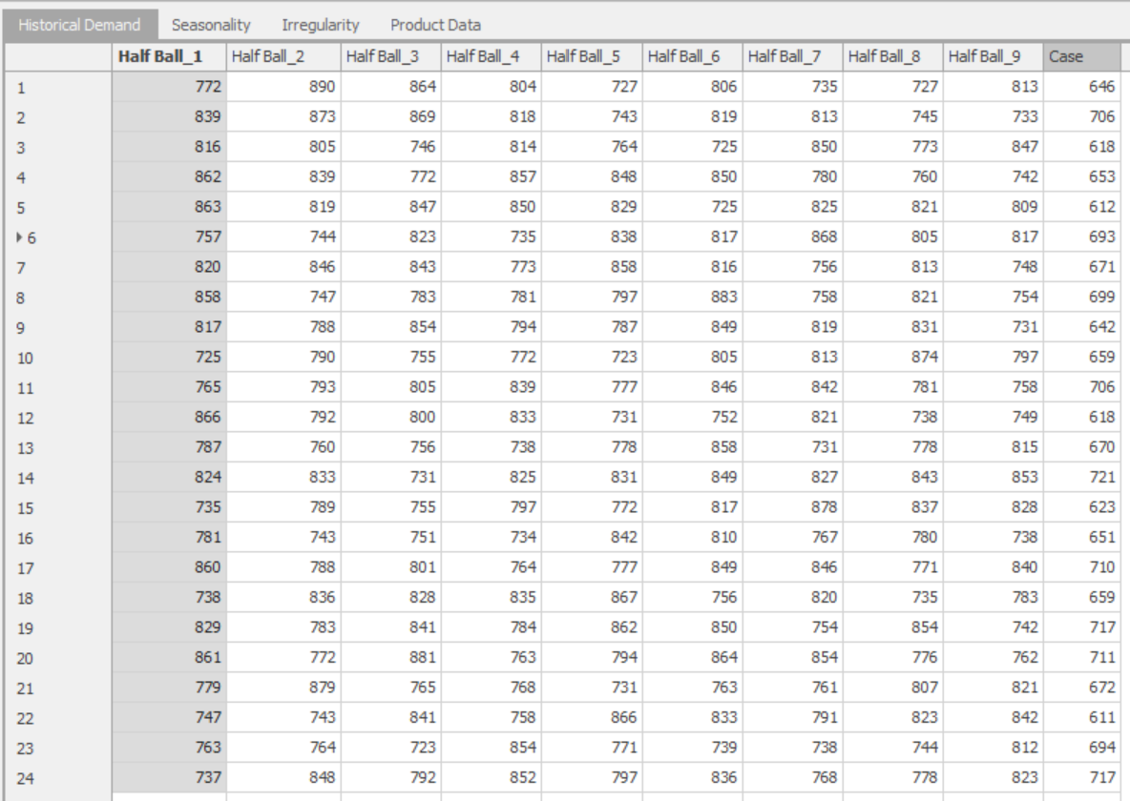
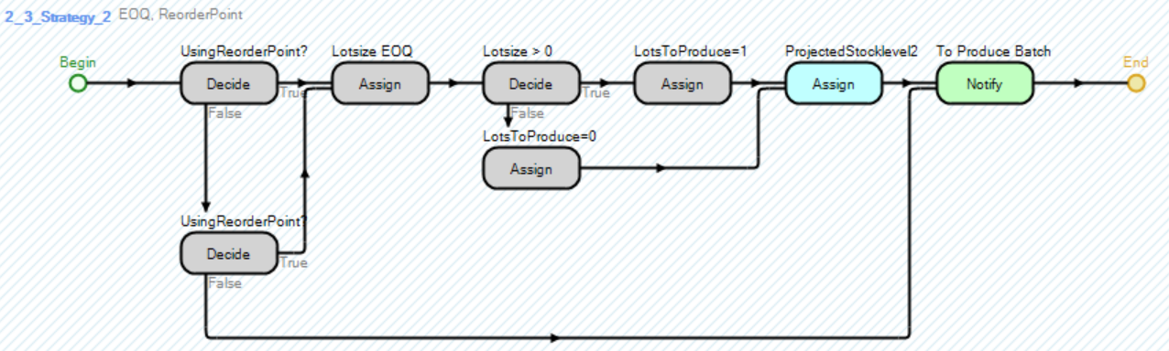
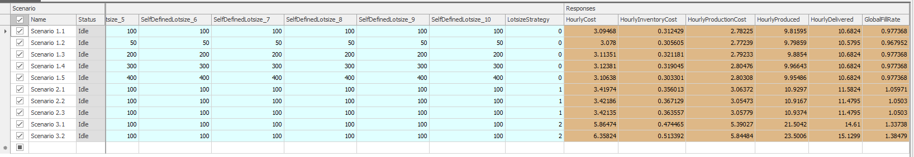
Content Exercise Simulation Smart Factory @ OST
  Introduction (W1)
Implementation Facility Smart Factory @ OST (W1)
    Production Process Rapperswil
Data Integration (W1)
    Historical Demand
Programming and Implementing the Lotsize Strategies (W2)
    EOQ
Conducting Experiments (W2)
    Irregularity Demand
    Interpreting the results

Slide 3
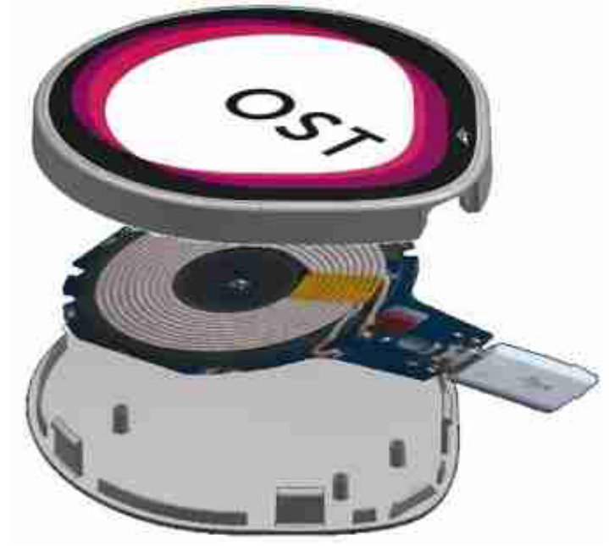
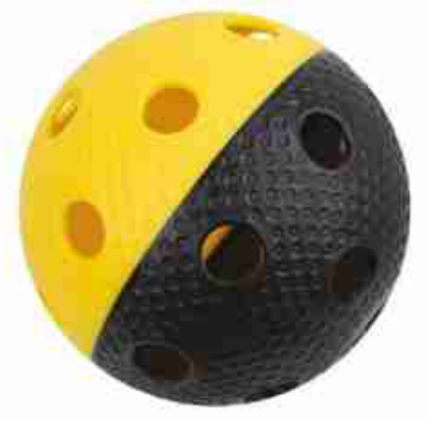
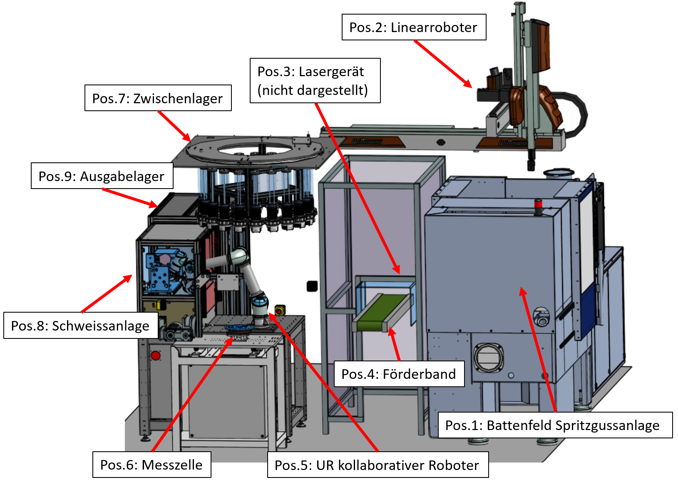
Simulation Smart Factory @ OST
Introduction
In this exercise you going to finalize the simulation of the production process of two products produced within the Smart Factory @ OST and conducting experiments to derive central findings for the lotsize problem.
The floorball (UHB) is completely produced within the process in Rapperswil
For the wireless-charger the cases are produced on the same process as the UHB but assembled within the process in Buchs
To get an impression of the production process in Rapperswil have a look at the following picture and also a link to a video: https://www.youtube.com/watch?v=STYMdLa_lcM

Slide 4
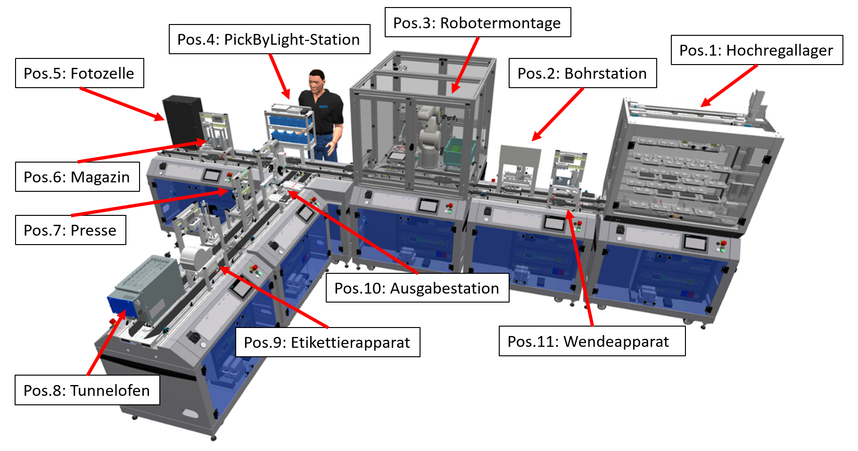
Simulation Smart Factory @ OST
Content
To get an impression of the production process in Buchs have a look at the following picture
To conduct this exercise you need the simulation software Simio, which is accessible over the VDI-Client
Open the Simio-File: Simulation_Ex_Lotsizing_base.spfx
Do not worry about the errors. They will disappears when you have finalised the model

Slide 5
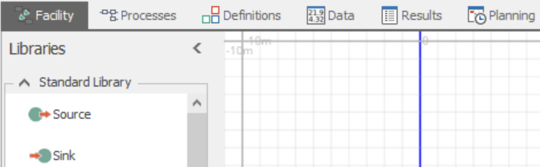
Simulation Smart Factory @ OST
Content
The model is already prepared to some degree but some aspects are missing, which you going to finalize within this exercise
With this, you tackle some of the key task while working with the methodology simulation
The model contains different standard libraries like source, servers, sink and paths, which you can find in the Facility. Furthermore, the model is controlled by a specific process logic, which you can find in the Processes
To conduct this exercise, use the provided overviews to find the orientation where the source, servers and so on are located in the model and follow the given instructions in the following.
Now we start with the finalization of the production process of Rapperswil “Unihockeyball”.
As you can see within the model the internal logistics and the production process in Buchs is already prepared due to time reasons

Slide 6
Content Exercise Simulation Smart Factory @ OST
Introduction (W1)
  Implementation Facility Smart Factory @ OST (W1)
    Production Process Rapperswil
Data Integration (W1)
    Historical Demand
Programming and Implementing the Lotsize Strategies (W2)
    EOQ
Conducting Experiments (W2)
    Irregularity Demand
    Interpreting the results

Slide 7
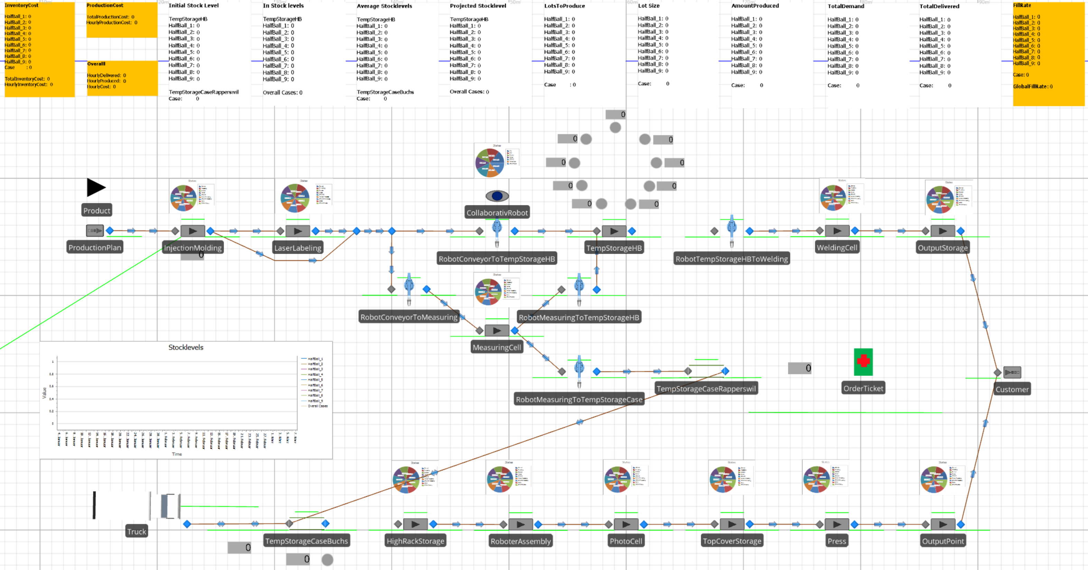
Implementation of the Facility «Smart Factory @ OST»
Content

Slide 8
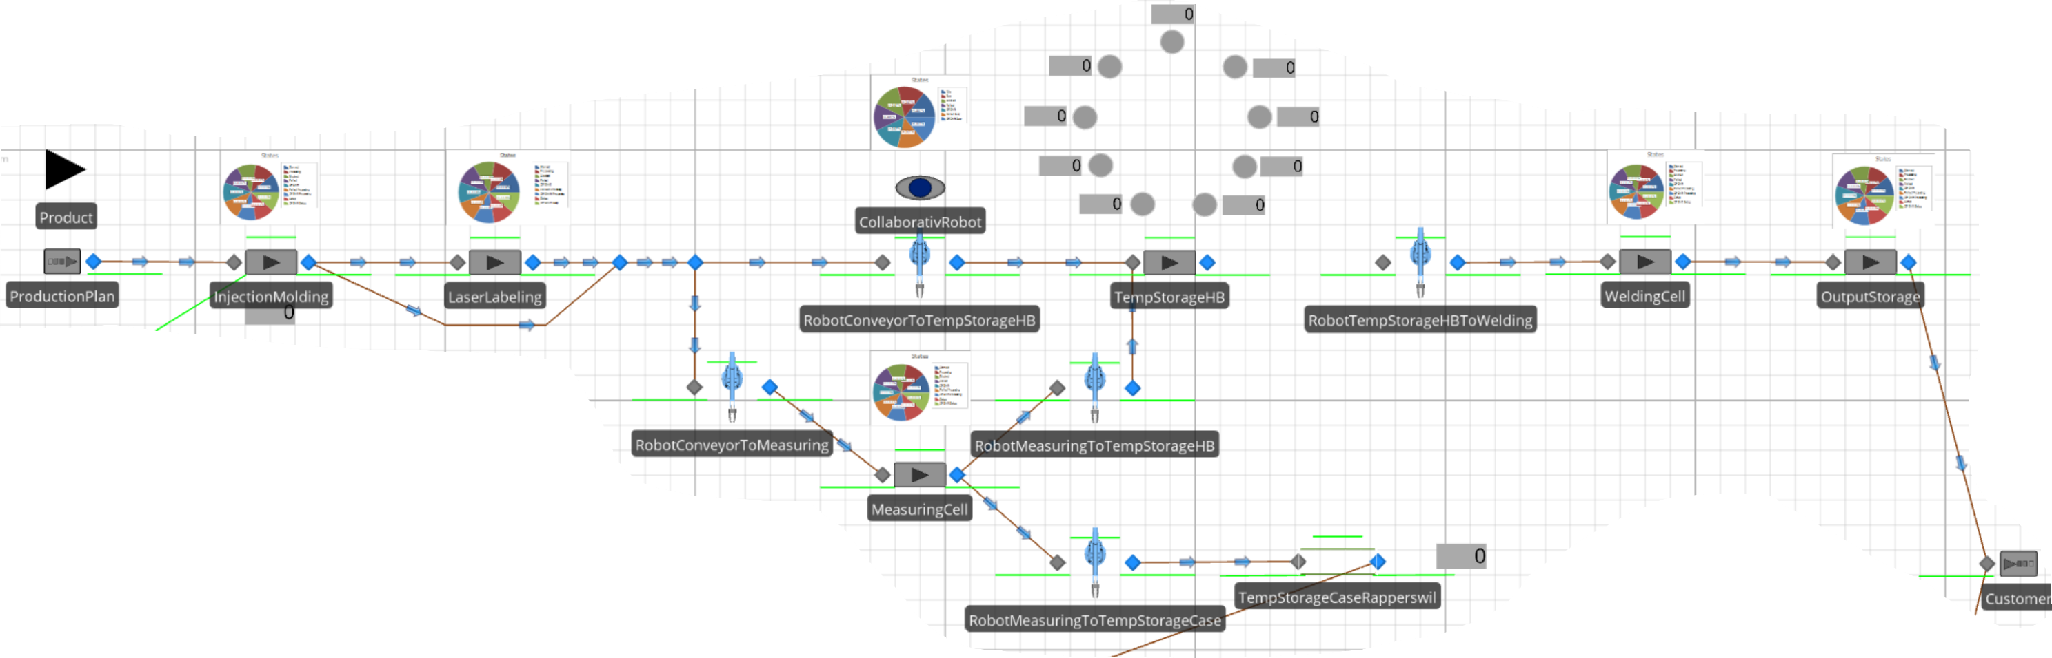
Overview: Production Process Rapperswil
Production Process Rapperswil
Your task to implement

Slide 9
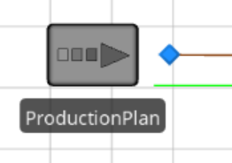
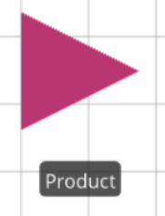
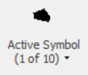

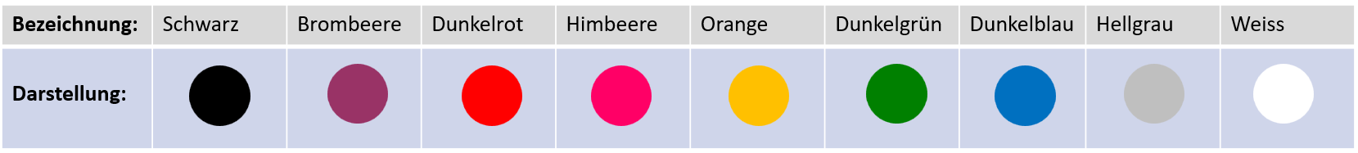
ModelEntity & Source
Production Process Rapperswil
In the Facility you find the ModelEntity product to represent the ten different products, which are produced in the manufacturing cell “Unihockeyball”
If you select the product icon and the Active Symbol field you will see the ten different products consisting of nine different coloured HalfBalls (HBs) and the case of the smart charger
Further you see the Source ProductionPlan where the ten different products are going to be generated according to the individual demand
How this generation process is done, you will see later. Now, we just want to make sure that the production process is finalized and connected to the process logic.
Let’s start the modelling…

Slide 10
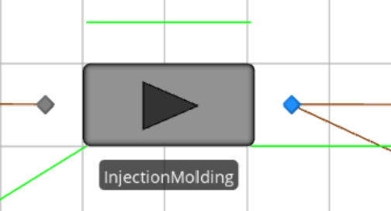
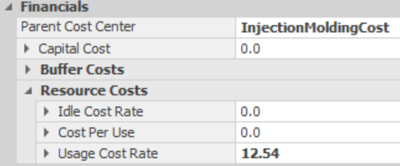
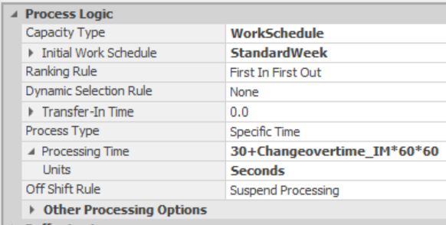
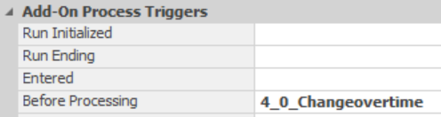
Server: Injection Molding
Production Process Rapperswil
Add a Server per drag & drop next to the source and name it InjectionMolding
Adjust in the properties for this Server the Work Schedule (which is already prepared in “Data”) and the Processing Time with the corresponding Changeovertime_IM state-variable (which is also already prepared in “Definitions”)
Adjust the Cost Center for the production cost
And the Add-On Process Trigger for the Changeovertime_IM. You find some already prepared processes within the “Processes” part of Simio. Don’t worry for now, just make the adjustment, you will dive into that later

Slide 11
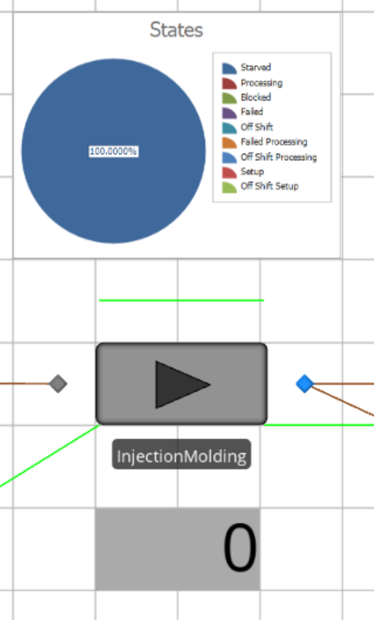

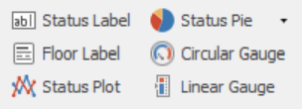
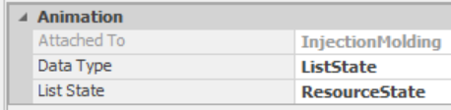
Server: Injection Molding
Production Process Rapperswil
Add a Status Label to observe the cost at this server. For that, you have to select the server and you find the Status Label in the upper left of the following selection
To show the cost which occurs at this process step you need to set the following Expression for the Status Label
Add also an attached Status Pie to this Server to show the utilization
Again, for that you need to select the Server and find it in the upper left of the tool
Adjust the properties as follows

Slide 12
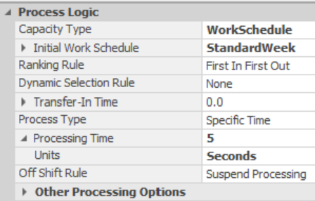
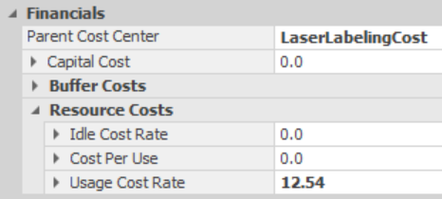
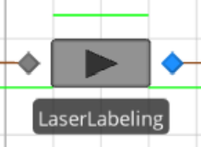
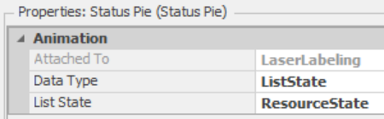
Server: Laser Labeling
Production Process Rapperswil
Don’t worry about the Paths. First, we implement all the servers.
The next Server is the LaserLabeling
Add a Server and name it LaserLabeling. If you need to check where exactly the Server is located in the model use the overview provided at the beginning
Adjust the properties of the Server with the Work Schedule, Processing Time and Production Cost
Implement an attached Status Pie to visualize the utilization of the Server with the following settings

Slide 13
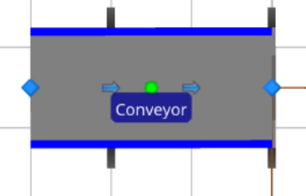
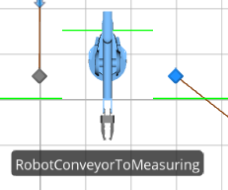
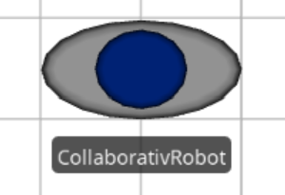
Conveyor, CollaborativeRobot and TempStorageHB
Production Process Rapperswil
As you can see the next process step with the Conveyor is already implemented
After the Conveyor follows the decision, if the parts have to be measured or directly go to the stock.
Regarding the handling of the parts, as you can see it is done by the CollaborativeRobot and is already prepared as well.
Due to the fact that the CollaborativeRobot has five different tasks for each task a server is implemented.
To make sure that this tasks are executed one at the time (FIFO) each Server (task) is subordinated the Resource CollaborativeRobot

Slide 14
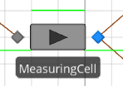
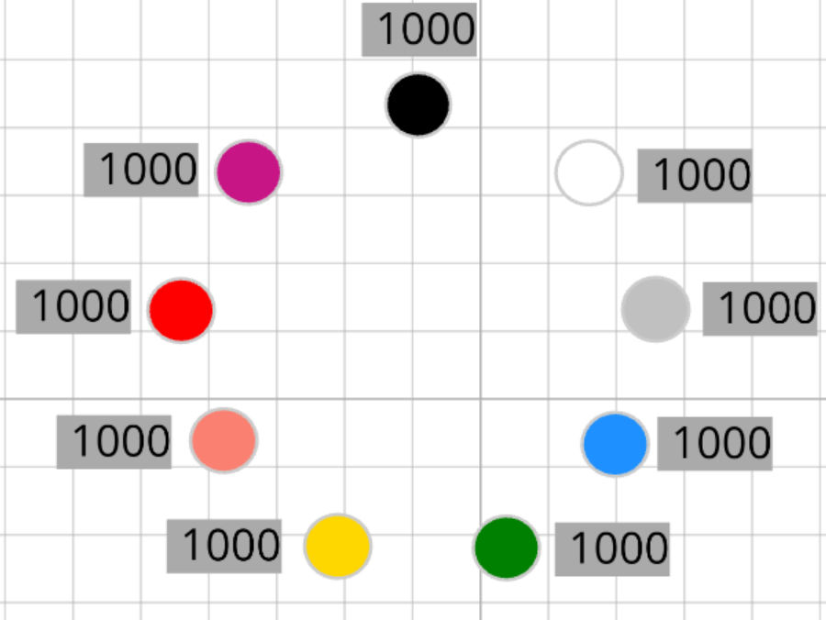
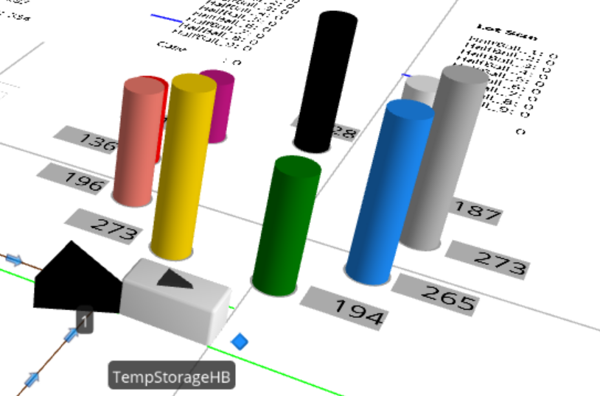
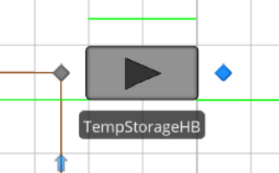
Conveyor, CollaborativeRobot and TempStorageHB
Production Process Rapperswil
If a part needs to be measured the Server MeasuringCell is also already prepared and connected with the corresponding Paths
If a HB directly goes to the stock the TempStorageHB is also already prepared with a Server. (Theoretically there is no need for a Server here but it makes the modelling of the entity flow easier)
To visualize the stock levels of each HB you can see the nine Status Labels and the corresponding Stacked Bars. If you later run the model and press key «3» you going to see the Stacked Bar in 3D-Mode

Slide 15
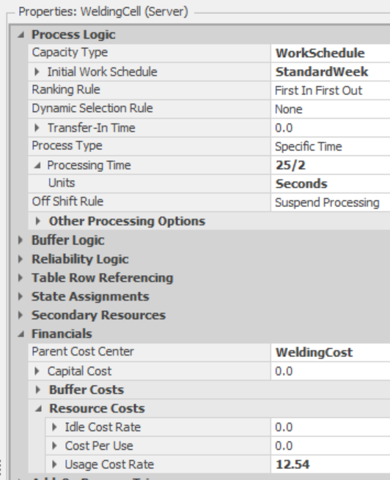
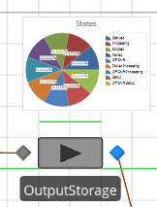
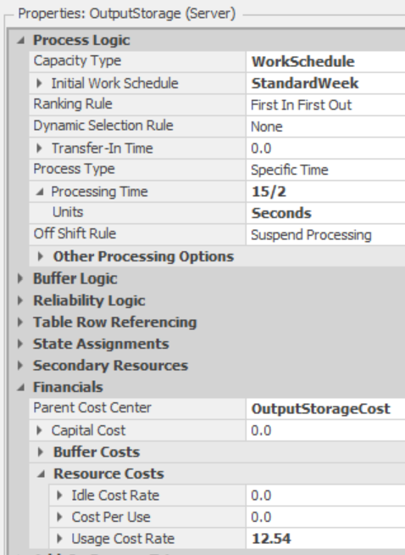
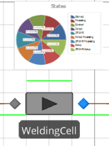
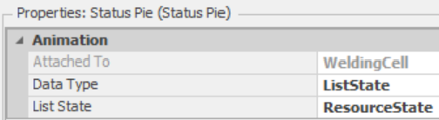
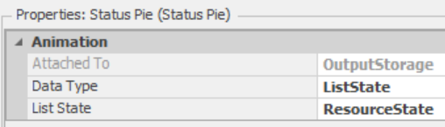
Server: Welding Cell & Output Storage
Production Process Rapperswil
Now, if a order for a floorball comes in, the CollaborativeRobot takes two HB and hand them over to the welding cell. For that…
Add a Server with an attached Status Pie, name it WeldingCell and adjust the properties
After the welding process, the floorball is handed over to the customer. For that…
Add a Server with an attached Status Pie, name it OutputStorage and adjust the properties

Slide 16
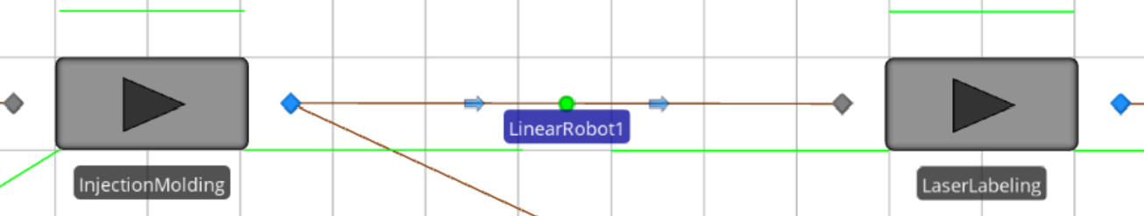
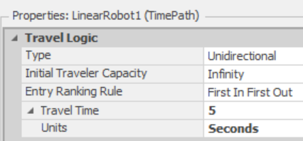
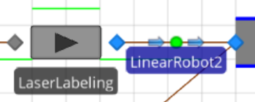
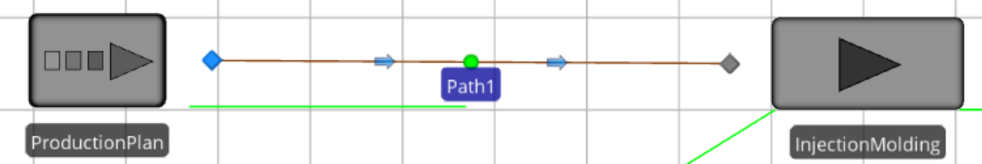
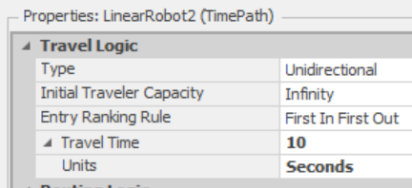
Paths and TimePaths
Production Process Rapperswil
Now as you have finalized the implementation of the Servers according to the process steps, we need to connect theses with regard to the material flow.
This connection is done with Paths (no time) and TimePaths (duration for traveling). So the Paths needs no further adjustments
Add the Paths and TimePaths as follows
Add a Paths from the Server ProductionPlan to the Server InjectionMolding
To implement the handing of the LinearRobot add a TimePath from the InjectionMolding to the LaserLabeling
And also one from the LaserLabeling to the BeginnConveyor, which is a TansferNode just to mention

Slide 17
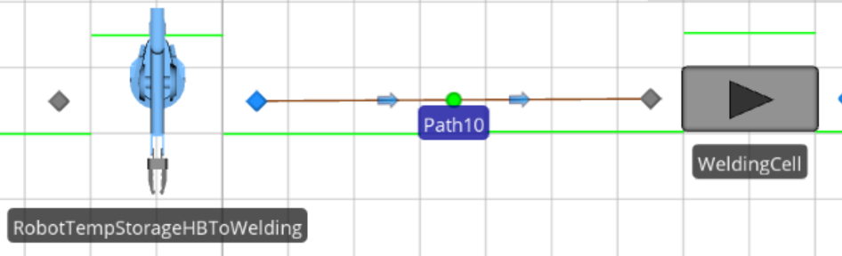
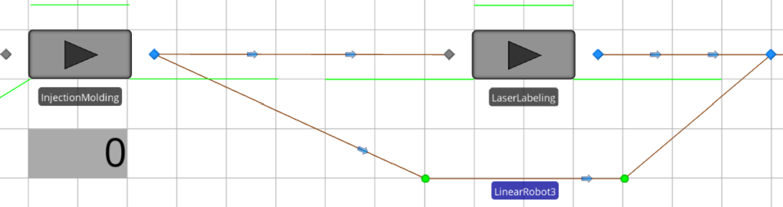
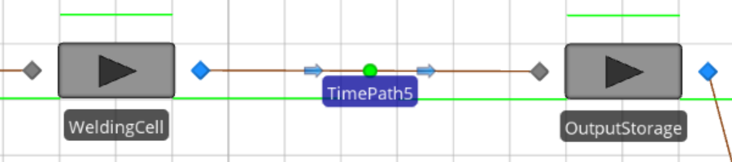
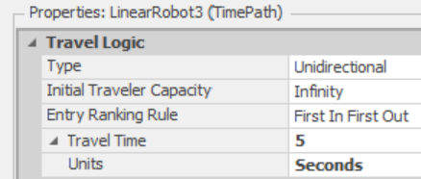
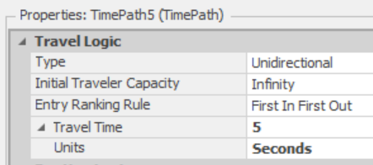
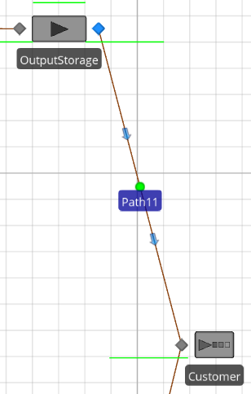
Paths and TimePaths
Production Process Rapperswil
Now, because of the fact that cases for the wireless charger are not have to be labeled add a another TimePath as a short track around the LaserLabeling from the InjectionMolding to the BeginnConveyor.
To proceed with the connection add a Path from the robot task “RobotTempStorageHBToWelding” to the WeldingCell
And a TimePath from the WeldingCell to the OutputStorage
And a Path from the OutputStorage to the Customer

Slide 18
Simulation Smart Factory @ OST
Production Process Rapperswil
Now, you have finished the implementation of the production process in Rapperswil.
Maybe some comments to the rest of the model.
After the production process in Rapperswil the production process of Buchs was implemented. As you can see it is just a serial process flow where automatically the cases of the wireless charger are combined with the electronic part.
The modelling itself is done quite similar as you did for the production process in Rapperswil.
To connect these production processes and taking care of the logistic of the cases an internal logistic was implemented. The truck is triggered each month to transport the cases from the TempStorageCaseRapperswil to the TempStorageCaseBuchs.
Feel free to have a look by your own on how this is implemented.
However, to conduct experiments to derive central finding of the lotsize problem later on we need to include demand data for each product...

Slide 19
Content Exercise Simulation Smart Factory @ OST
Introduction (W1)
Implementation Facility Smart Factory @ OST (W1)
    Production Process Rapperswil
  Data Integration (W1)
    Historical Demand
Programming and Implementing the Lotsize Strategies (W2)
    EOQ
Conducting Experiments (W2)
    Irregularity Demand
    Interpreting the results

Slide 20



Import Data in Simio
Data Integration

Slide 21




Data Tables
Data Integration
To prepare the data, which is used for the process logic, we need to import this data from Excel in Simio
Open the Excel-File: «Input_Data für Simulation Smart_Factroy_OST.xlsx»
The data consists four data sets. Therefore, three data sets contains demand data with different patterns and the other one contains a summary of further product specific data e.g. the yearly storage cost or the setup cost to calculate the EOQ later
Before we are able to import this data, we need to prepare some aspects in Simio
For that go to Data and Tables in Simio.
As you can see the “Seasonality”, “Irregularity” and “ProductData” is already prepared, but the “HistoricalDemand” data set is missing.
To add the “HistoricalDemand” make sure you are in the Schema part. Then add a Data Table and name it “HistoricalDemand”. Make sure you choose the same name as is given in the Excel-File.

Slide 22



Properties
Data Integration
Within the table “HistoricalDemand” add a integer Property, name it “HalfBall_1” and adjust the settings
Do the same for the other “HalfBall_2” … “HalfBall_9” and the “Case”
Now the preparation of the data sets within Simio is done but the connection to the specific Excel-File is missing. For that we need to create a Binding.

Slide 23








Data Connector
Data Integration
Change to Data Connectors and create a “Excel Data Importer”. Write the File-Name of the Excel-File exactly the same with .xlsx. Make sure that the Excel-File is stored at the same place on your computer as the Simio-File
Then go back to the Table “HistoricalDemand” and change to the Content part
Now we need to create the binding between the “HistoricalDemand” table in Simio and the worksheet in the Excel-File. For that select Create Binding and choose your “Excel Data Importer 1”
Now, close the Excel-File
Within the “Worksheet” you should be able to select the specific data set from the Excel-File by using the drop down menu, also give a Specific Range and klick Import Table.

Slide 24
Data Connector
Data Integration
If everything is fine, you should see the imported numbers.
Now, we go a step further and do some programming within Simio.

