Slide 1

Exercise Simulation
Simulation Smart Factory @ OST & Lotsizing
Roger Rinderer
Department

Slide 2
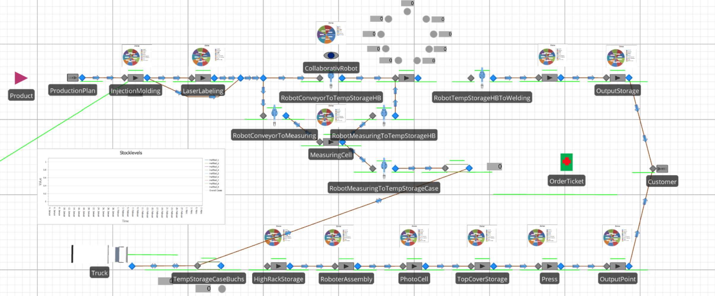
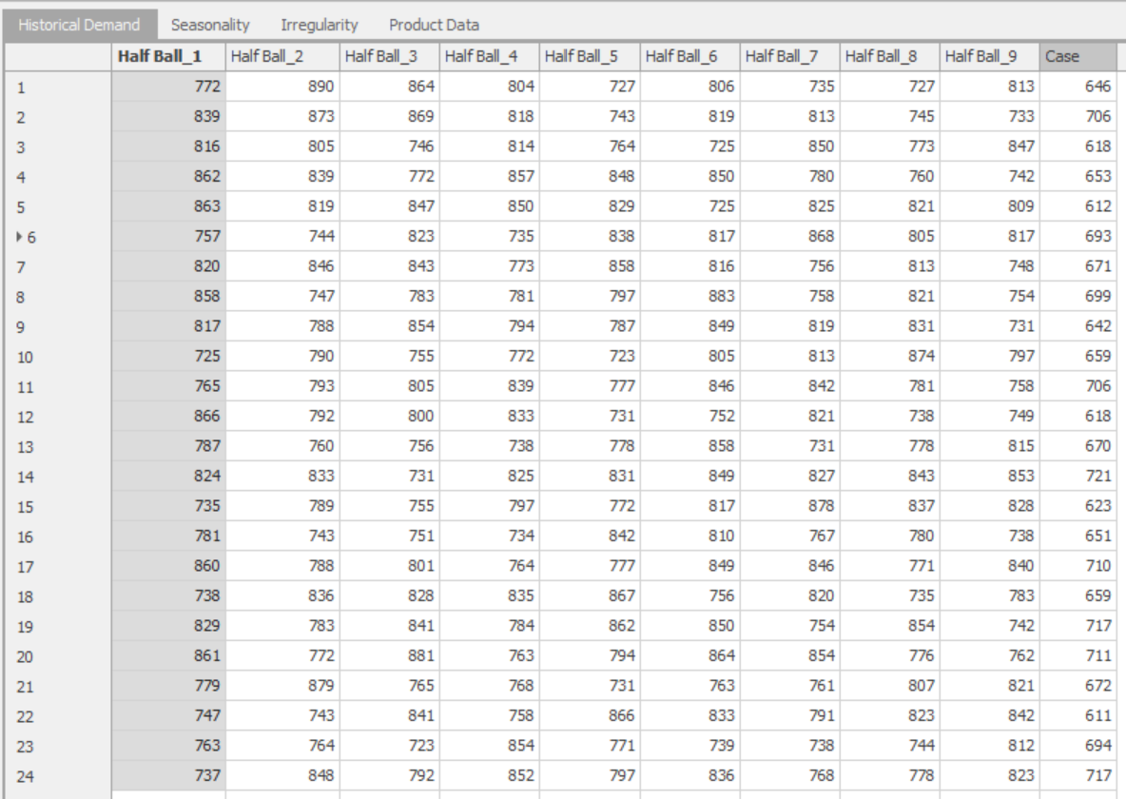
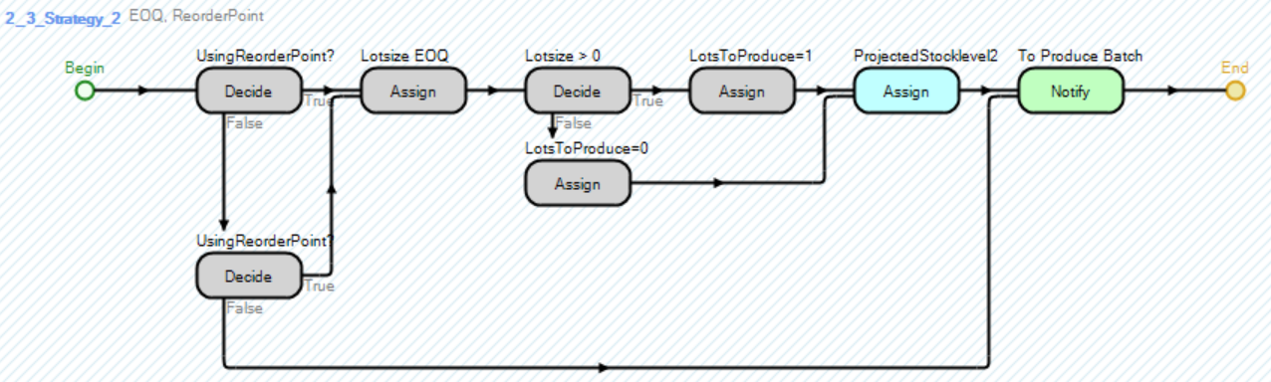
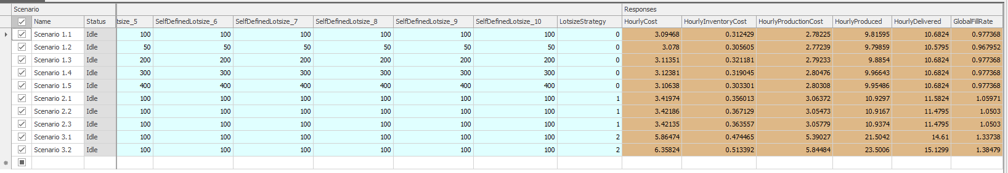
Content Exercise Simulation Smart Factory @ OST
Introduction (W1)
Implementation Facility Smart Factory @ OST (W1)
    Production Process Rapperswil
Data Integration (W1)
    Historical Demand
  Programming and Implementing the Lotsize Strategies (W2)
    EOQ
Conducting Experiments (W2)
    Irregularity Demand
    Interpreting the results

Slide 3
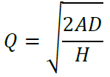
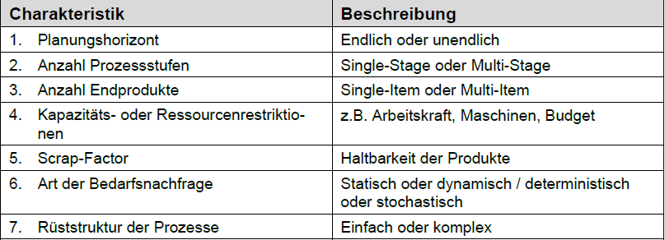
Lotsize problem – Some comments
Programming and implementing the Lotsize Strategy
The underlying question of the lotsizing problem is simply formulated «What quantity of a product should we produce to achive the optimal output?»
Depending on how many process characteristics are considered, this influences the complexity of the model.
However, one approach to compute this optimal lotsize quantitiy is the EOQ-Formula. Within this approach the optimal lotsize is defined by opimizing the yearly storage cost and the setup cost.
To experiment with this formula later on, we need to implement this formula in the process logic of Simio.
Besides this EOQ-Formula there are further Lotsize Strategies, which are already implemented:
  User defined lotsize, where you can choose your own lotsize
  Lot To Lot, where for each month the montly average demand (MAD) for a product is produced

Slide 4
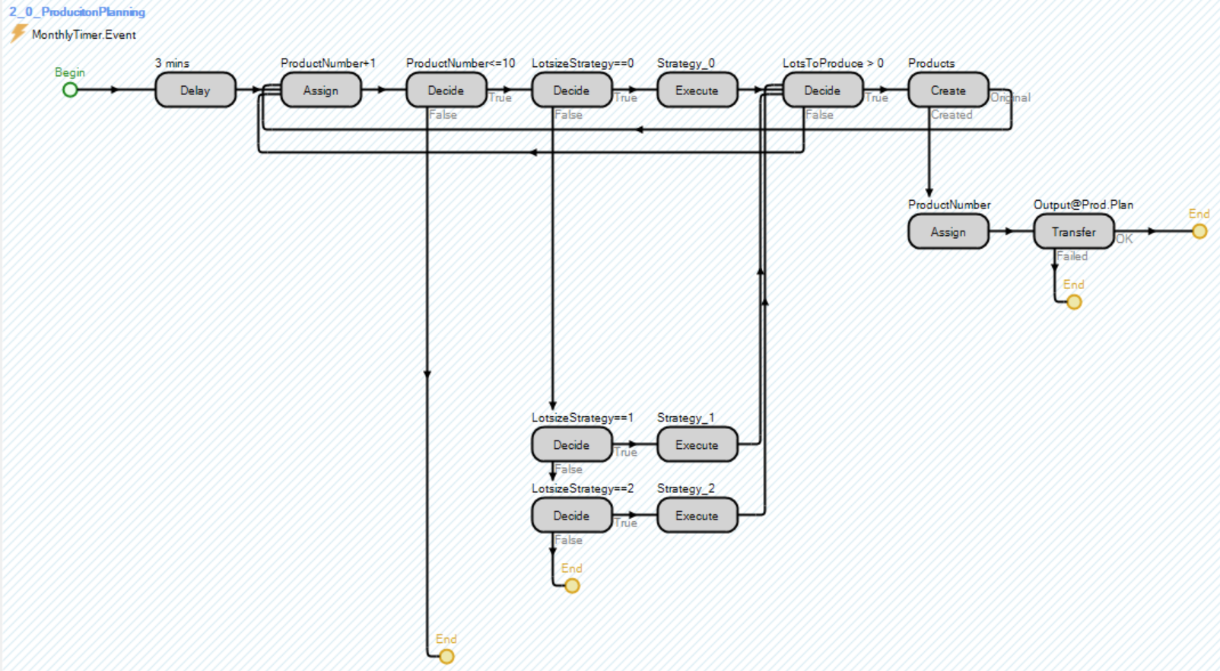
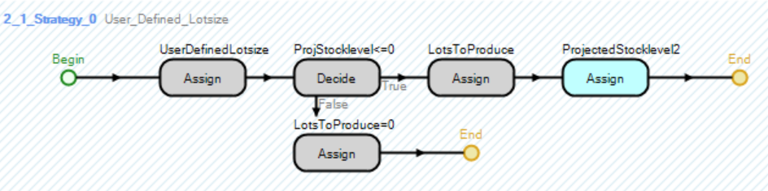
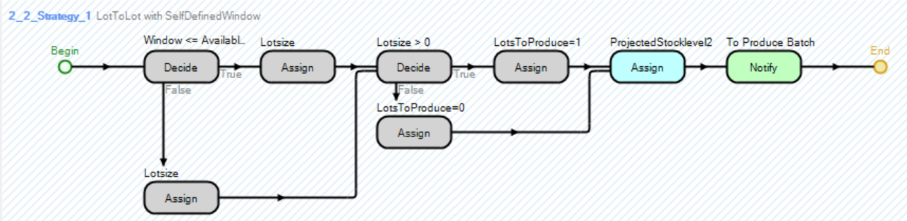
Programming Lotsize Strategie
Programming and implementing the Lotsize Strategy
Your task to implement

Slide 5
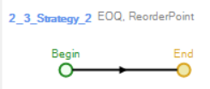
Programming the Production Planning
Programming and implementing the Lotsize Strategy
Before you have implemented the facility of the Smart Factory @ OST and imported some data. Now we dive into the process logic of the model. For that you have already prepared some Add-On Process Triggers.
Within Simio go to Processes.
There you find five categories. All of them contains some processes that controls the model. Feel free to look through on your own.
May you have recognised that in the category 2_ProductionPlanning a process is missing. This is where you will implement the computation of the Lotsize according to the EOQ-Formula
This part of the model is chosen, because the lotsize for your model will be calculated there and tested afterwards in the experiments.

Slide 6

Programming the Production Planning
Programming the Production Planning
Further, as you can see the 2_0_Production Planning process is already there
This process is the main process of this category and triggers the subprocesses (lotsize strategies) according to the chosen control parameter to create the products (entities) and transfer them into the model
The decision if a product is produced depends on the projected stock level of an individual product. The calculation of the projected SL is already implemented. Here it is only checked if there are lots to produce

Slide 7
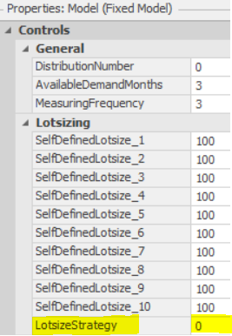
Strategy_0 (User_Defined_Lotsize)
Programming the Production Planning
Furthermore, as you can see two of the subprocesses (lotsize strategies) are already implemented.
The first one is the User_Defined_Lotsize strategy. Within the Facility you will find some controls parameter SelfDefinedLotsize (default: 100) where you can change the lotsize for each product as well as the LotsizeStrategy (default: 0)

Slide 8
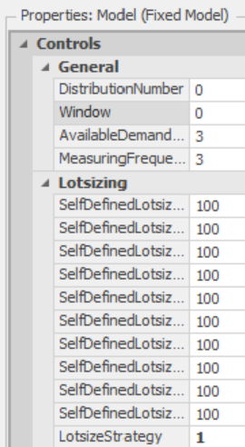
Strategy_1 (LotToLot with SelfDefinedWindow)
Programming the Production Planning
The second one is the LotToLot strategy
Within this strategy we can decide if we want to produce the amount according to the demand for the current month (0) or 1, 2, 3 month in the future.
For that if you change the LotsizeStrategy parameter in the Controls of the model (Facility) to 1, a Window parameter occurs
However let’s implement the EOQ-Method…

Slide 9
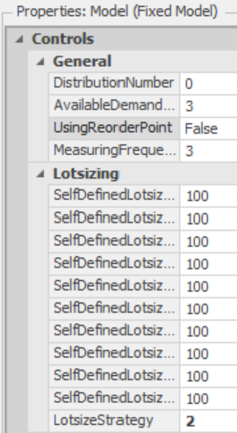
Strategy_2 (EOQ, ReorderPoint)
Programming the Production Planning
Within this strategy we calculate the EOQ as the lotsize. For that we can first define if we want to use the ReorderPoint as the trigger for the production or the negative projected Stocklevel. For that you will find the parameter ReorderPoint as well in the controls of the model (Facility)
Now go back to the “Processes” and we start programming the 2_3_Strategy_2 (EOQ, ReorderPoint)

Slide 10
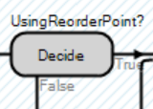
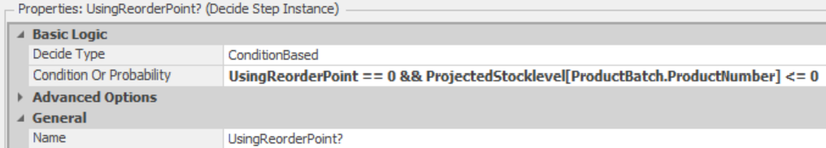
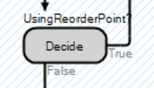
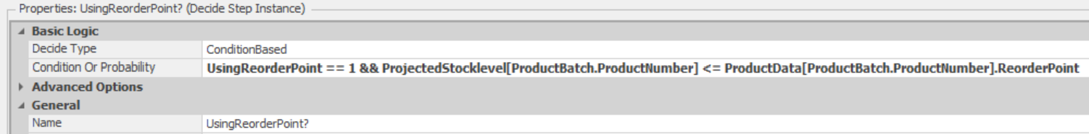

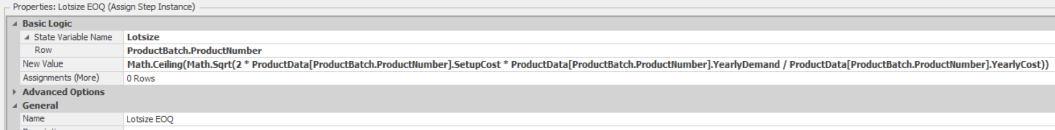
Strategy_2 (EOQ, ReorderPoint)
Programming the Production Planning
Add a Decide step to decide if we use the ReorderPoint or not
If true add an Assign step to calculate the lotsize with the EOQ-Formula
If false add a Decide step as a stop criterion

Slide 11
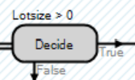
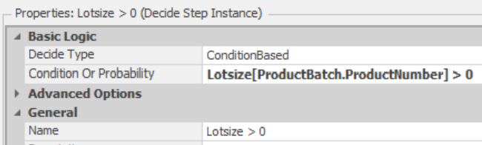

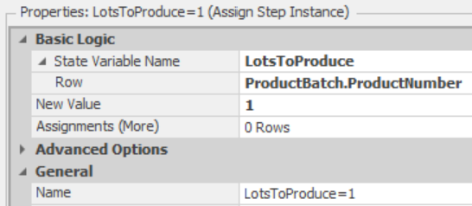
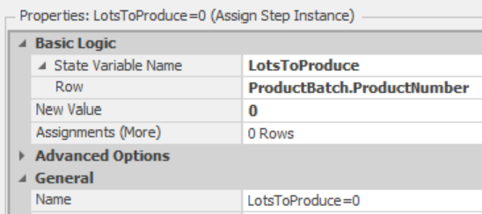

Strategy_2 (EOQ, ReorderPoint)
Programming the Production Planning
Add an Decide step to decide if the there is a lotsize or not
If false add an Assign step to set the lots to produce to 0
If true add an Assign step to set the lots to produce to 1 and to produce the amount

Slide 12


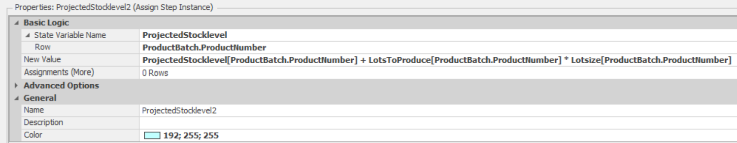
Strategy_2 (EOQ, ReorderPoint)
Programming the Production Planning
Add an Assign Step to update the projected stocklevel
The Notify step you can ignore
Make sure you connect the steps the right way as provided in the overview of the process
Now you have finished the programming and also whole implementation. The model is now prepared to go for the experiments

Slide 13
Content Exercise Simulation Smart Factory @ OST
Introduction (W1)
Implementation Facility Smart Factory @ OST (W1)
    Production Process Rapperswil
Data Integration (W1)
    Historical Demand
Programming and Implementing the Lotsize Strategies (W2)
    EOQ
  Conducting Experiments (W2)
    Irregularity Demand
    Interpreting the results

Slide 14
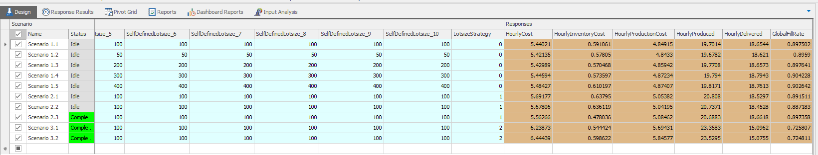
Conducting Experiments
Conducting Experiments

Slide 15
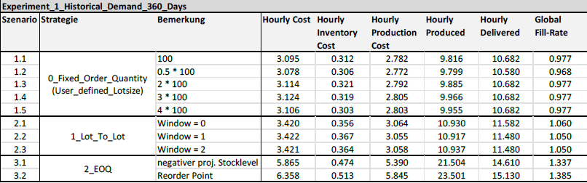
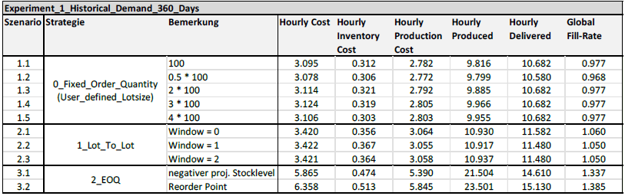
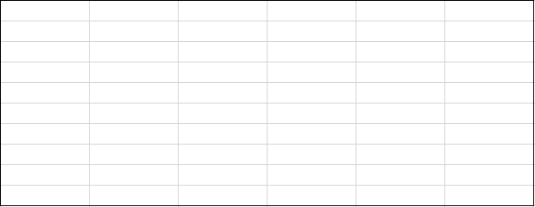
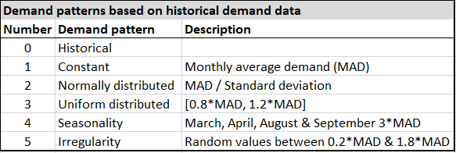
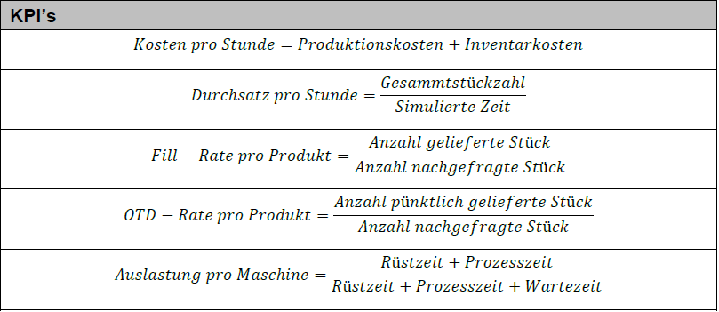
Experiment plan
Conducting Experiments
After you finalized the model. We are able to run some experiments to get an understanding of the performance of the different Lotsize-Strategies.
We first need an experiment plan with ten different scenarios, which we use to test each of the three Lotsize-Strategy the same way under six different Demand-Patterns and judge the results of five different KPI’s.
The three lotsize strategies are as implemented the SelfDefinedLotsize, the LotToLot with Window and the EOQ with/without ReorderPoint

Slide 16
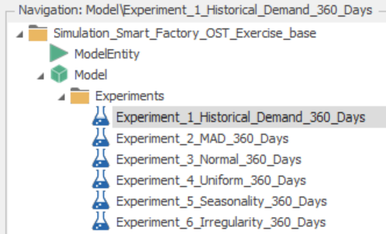
Setting up the experiments in Simio
Conducting Experiments
The KPI’s which shows the performance of the different Lotsize-Strategies are shown in the Facility or in the following picture.
If you are wondering, how the data for the demand pattern is computed, please have a look in the Processes. The process is called 1_1_MonthlyDemandDefinition.
If you are wondering how the computation of the KPI’s is implemented have a look at the process category 5_Calculation.
To switch to the experiment mode, you will find the following selection in the upper right of the tool.
If you look through the six experiments for each Demand Pattern you realize that the experiments 1 – 5 are already done and we have the results.
So your job is now to set up and execute the experiment 6 for the Irregularity demand data

Slide 17
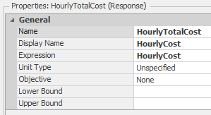

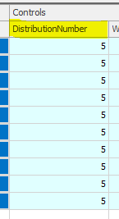
Setting up and conducting the experiments in Simio
Conducting Experiments
To set up the experiments 6 you have to add a Response variable for each of the five KPI. Do that for all KPI’s and adjust the properties according to the given example of the HourlyCost variable.
Now before you can run the experiment, you need to adjust the parameter which chooses the right DemandPattern. Currently your job is to set up the experiment for the demand pattern Irregularity. Therefore, you need to set the DistributionNumber to 5 in each row.

Slide 18

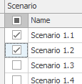

Setting up and conducting the experiments in Simio
Conducting Experiments
Now, you are able to run the experiment to see the performance of the three lotsize strategies under irregular demand.
TIPP: Don’t run all the experiments at the same time. Select just one or two at the time
Notice: Within the SelfDefinedLotsize strategy, if you use a factor for e.g. the value 100, you can observe, if the granularity of the chosen lotsize may have an impact of the results. Because, according to Lots to produce formula the number of lots is rounded up the next integer to make sure to produce an amount of products, which fulfils the required quantity for a specific month
After you have run the experiments, compare and analyse the results of the different lotsize strategies. Discuss also with your neighbour.
What have you discovered?

