Slide 1

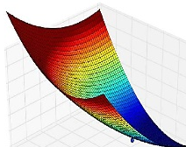

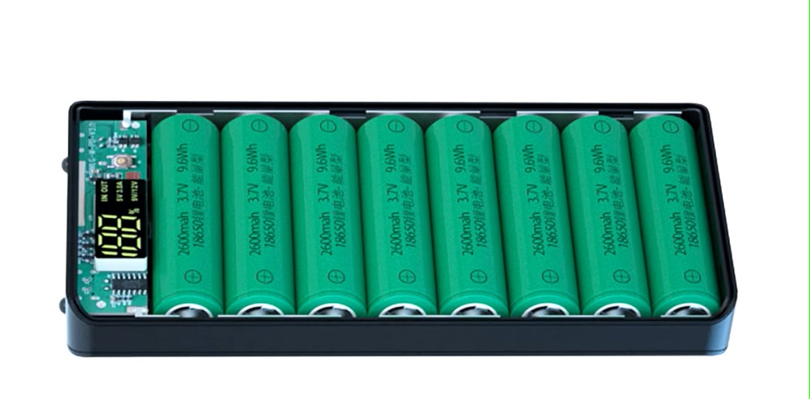





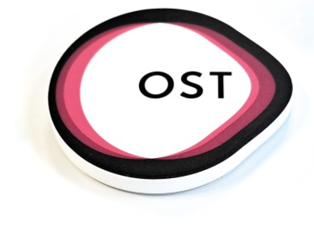

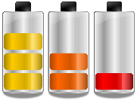
Li-Ion Battery Course
Modelling and Validation
Li-Ion Battery Cells
Thermal Design
Circular Economy
Battery Manage-
ment System
Standard and Regulations
Charging Strategies
Battery Ageing

Slide 2
Standards and Regulations
Learning objectives
Students know the most common, application-specific certifications for battery systems
Students know the process and legal loopholes of CE certification
Students will be able to define the necessary work packages for CE certification of a product

Slide 3
Table of Content
Introduction about CE
Safety an CE directives over the entire life cycle of a product
Transport of dangerous goods
What must be observed to be able to affix the CE certificate?
Recycling
Other signs around the world (Examples)

Slide 4
Introduction
Introduction of the Product Safety Directive 2001/95/EC by the European Community
“The distributor (seller/importer) must do everything possible to ensure the safe operation of their products” Directive 2001/95/EC
According to the directive, it is important to know that:
  the distributor is responsible and liable for his product over the entire life cycle of the product
  also applies to the import and redistribution of products
What is the Directive essentially about?
  Protect the customer from dangerous products
  Protect the manufacturer from uninformed customers
  Protect the environment from excessive damage
Notes:
ACHTUNG: Wer Ware aus dem Ausland importiert und weiterverkauft oder weitergibt, ist dafür Verantwortlich und haftbar (Vorsicht vor Aliexpress, Temu, Joom und co.)

Slide 5
Introduction
Protect the customer from dangerous products
  The aim is to prevent potentially dangerous machines and devices from coming onto the market
  For example: junk, cheap stuff and reducing the risk of injury
Protect the manufacturer from unknowing customers
  The aim is to prevent machines and equipment from falling into unsuitable hands
  Informing the customer of risks and dangers
  Define how long a product may be used
  ➔ User manual, training
Protect the environment from excessive damage
  The customer must be shown where the machine or appliance can be returned

Slide 6

Introduction CE-directives
Several directives have been created from the Product Safety Directive to ensure the safety of various product types ➔ CE directives
CE directives are issued by the EU and are binding overriding regulations for products in the EU area
The individual EU countries issue country-specific standards to comply with product safety in accordance with the CE Directive in the respective country
To simplify market introduction, many standards have been homologated (i.e. the same for all EU countries)
CE Directive (EU-wide requirements for a product)
More than 20 directives
Standards (country-specific requirements for a product)
1000’s of standards

Slide 7
Introduction CE-directives
In addition to the CE directives (to protect manufacturers, customers and the environment), there are other directives and laws that must be complied within the life cycle of a product
Fundamental:
  Consideration of safety and protection from development up to and including disposal of the product
Examples
  Protection of employees in the company (handling, assembly...)
  Safety of shipping personal during transportation and handling

Slide 8



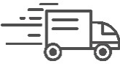


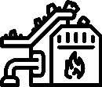

Overview
CE directives and Responsible offices for safety
Suva
Raw materials
Production Distribution
CE
ADR/ IMDG/ IATA
Recycling
Transport
Development
Burning
Transport
Consume
ADR/ IMDG/ IATA
CE
Disposal
CE
Notes:
Suva: Schweizerischen Unfallversicherungsanstalt
ADR: „Accord européen relatif au transport international des marchandises dangereuses par route“ (grenzüberschreitenden Transport von Gefahrgut)
IMDG: International Maritime Dangerous Goods Code (Schiff)
IATA: International Air Transport Association (Flugzeug)
CE: „Conformité Européenne“

Slide 9
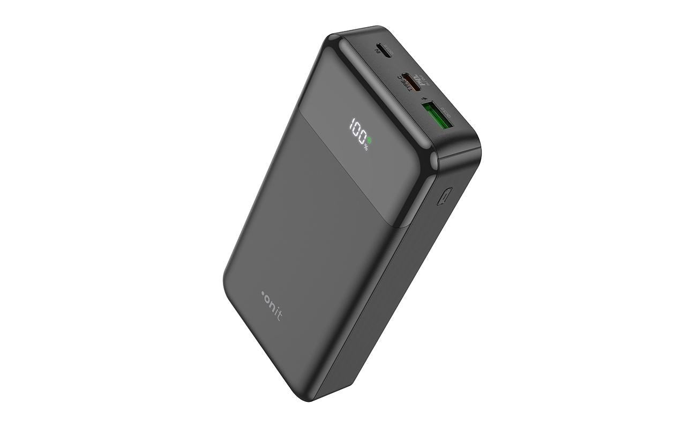
Development of a Powerbank
Powerbank example
  The following is an example of what placing a Powerbank on the market can look like
Attention: The example in this presentation is not complete and does not serve as a template!
Notes:
Anhand dieses Beispiels soll die Prozedur einer CE-Zertifizierung mit allen zusätzlichen Regelungen betrachtet werden.
Achtung: Das Beispiel in dieser Präsentation ist nicht Vollständig und dient keinesfalls als Vorlage!

Slide 10
Development of a Powerbank
Powerbank example
A Powerbank is to be developed and sold by our company
(placing on the market)
8 x 18650 Lithium-Ion
  Cells
  Are purchased
  Arranged in a 4p2s configuration
BMS is integrated
  BMS is purchased separately
  Overvoltage and undervoltage monitored
  Temperature monitored
  Overcurrent monitored (electronically disconnecting)
  Balancer
Interfaces
  Display for charging status
  USB port for charging the power bank
  2 x USB port for discharging (e.g. charging cell phone)
Powerbank should be suitable for travel
Is sold to the end customer (placing on the market)

Slide 11
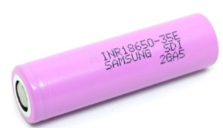
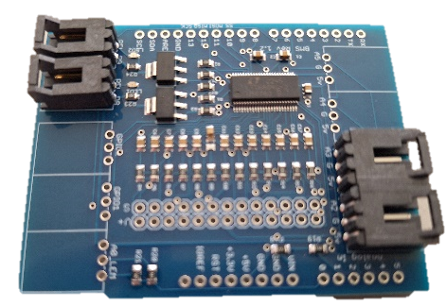
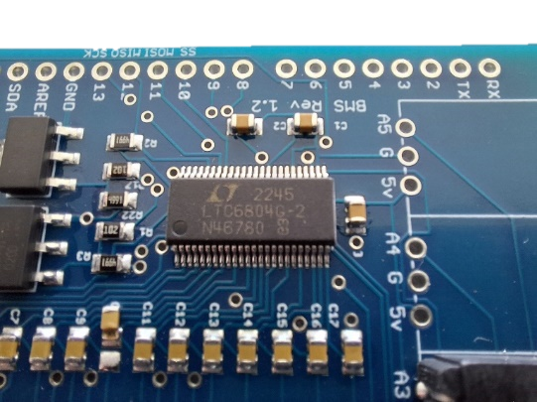
Development of a Powerbank
Powerbank example
Specification of the cells
  Samsung INR18650-30Q
  2.5 … 4.2 V
  2950 mAh
  10.8 Wh
BMS specification
  LTC6804G-2 BMS chip for up to 12 cells
  Transistors and resistors for balancer
Notes:
Batteriezellen an sich sind nicht an die Kennzeichnungspflicht gekoppelt. Da wir jedoch einen BMS (Batteri Management System) Verbauen wird es zu einem Gerät mit verbauten Zellen

Slide 12
EU targets for environmental protection
CE directives and Responsible offices for safety
Suva
Raw materials
Production Distribution
CE
ADR/ IMDG/ IATA
Recycling
Transport
Development
Burning
Transport
Consume
ADR/ IMDG/ IATA
CE
Disposal
CE
Notes:
Bei dem Beispiel in den Folien werden neben den CE-Richtlinien auch andere Vorschriften, die über die Lebensdauer der Powerbank vorhanden sind, beachtet.
Vor allem sind dies SUVA- und Transport-Vorschriften

Slide 13
EU targets for environmental protection
CE directives and Responsible offices for safety
Suva
Raw materials
Production Distribution
CE
ADR/ IMDG/ IATA
Recycling
Transport
Development
Burning
Transport
Consume
ADR/ IMDG/ IATA
CE
Disposal
CE

Slide 14

Production and distribution
Suva
Produktion
Vertrieb
Operational safety (Suva)
  Employees must be protected against accidents during production
  For example, mounting the power bank ➔ Train employees
    Prevent short circuits (prevent fire and explosion hazards)
    Prevent the cells from being installed incorrectly
    Good and accurate assembly descriptions and procedures
    …
Notes:
Dieses Thema wird nur sehr kurz angeschnitten da es eigentlich um das Inverkehr-bringen geht.

Slide 15

EU targets for environmental protection
CE directives and Responsible offices for safety
Suva
Raw materials
Production Distribution
CE
ADR/ IMDG/ IATA
Recycling
Transport
Development
Burning
Transport
Consume
ADR/ IMDG/ IATA
CE
Disposal
CE

Slide 16
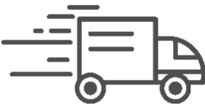
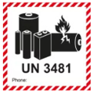
Transport
ADR/ IMDG/ IATA
Transport
Battery cells and batteries are declared as hazardous goods
Requirements for the transportation of dangerous goods
  Road / Rail: ADR / RID
  Sea freight: IMDG
  Air freight: IATA
Mandatory labeling on the transport packaging for battery cells and batteries
All these transport regulations require proof in accordance with UN 38.3 standard
  This standard defines mechanical and electrical tests that the battery must fulfill without damage
Notes:
ADR: „Accord européen relatif au transport international des marchandises dangereuses par route“ (grenzüberschreitenden Transport von Gefahrgut auf Strasse)
RID: «Règlement concernant le transport international ferroviaire des marchandises dangereuses» (grenzüberschreitenden Transport von Gefahrgut auf Schiene)
IMDG: International Maritime Dangerous Goods Code (Schiff)
IATA: International Air Transport Association (Flugzeug)

Slide 17
Transport
ADR/ IMDG/ IATA
Transport
Tests according to UN 38.3 standard
  Test T1: Altitude simulation (at 11.6 kPa at 20°C ± 5°C)
  Test T2: Thermal test (72 °C ± 2 °C and - 40 °C ± 2 °C)
  Test T3: Vibration (half-sine 1...8 g at 7 ... 200 Hz)
  Test T4: Impact (shock load 50 g 11 ms)
  Test T5: External short circuit (short-circuited at 55°C)
  Test T6: Impact/crushing (mass dropped onto)
  Test T7: Overcharging (double current and 1.2 times the voltage)
  Test T8: Forced discharge (discharge with maximum current)
During the tests, the battery cells and batteries must not outgas, burn or explode
Notes:
Für Zellen, Batteriepackete, Batterien… werden nicht immer alle Versuche benötigt. Siehe nächste Folie

Slide 18
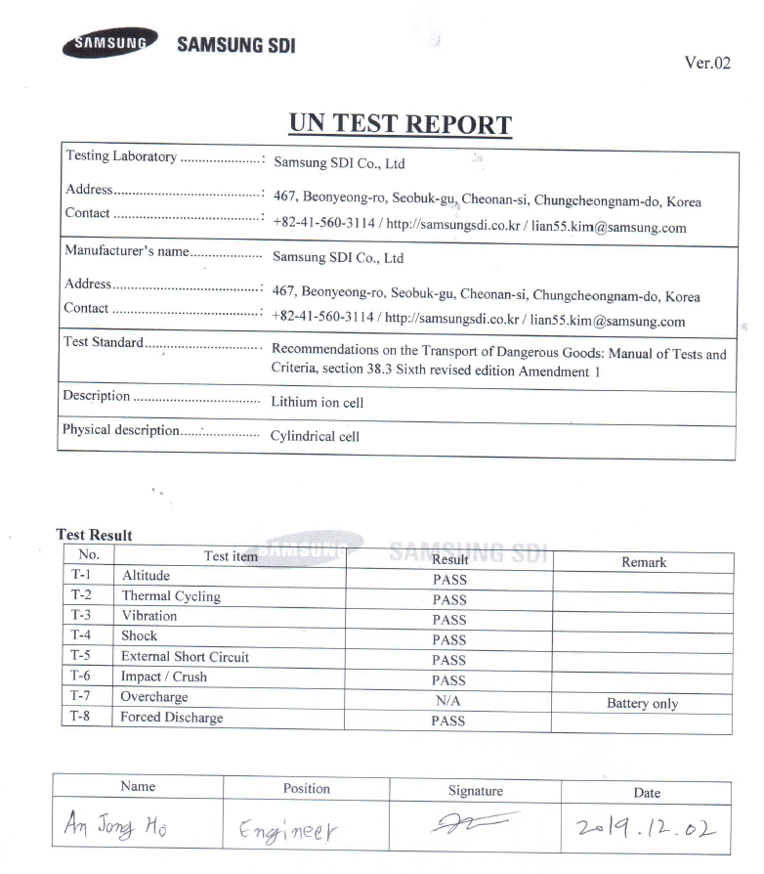
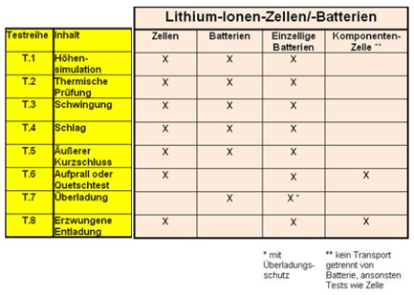
Transport
ADR/ IMDG/ IATA
Transport
Checking when buy cells that the UN test is available
Before selling the Powerbank
➔ Transport to the test laboratory
Test table for the transportation of batteries
Notes:
Vor dem Kauf muss geprüft werden ob die Zelle UN 38.3 geprüft ist
Nach der Entwicklung und Zusammenbau unserer Powerbank (Vor dem Verkauf) muss diese wieder im Labor noch einmal untersucht werden
Schwanzbeisser: wir haben keine UN-Test für die Batterie. Wir dürfen diese eigentlich nicht zum Testen schicken. ➔ Sondervorschriften zum Versenden von ungetesteten Batterien Beachten ➔ nächste Folien

Slide 19
EU targets for environmental protection
CE directives and Responsible offices for safety
UN 38.3
Transport Testlabor
Suva
Raw materials
Production Distribution
CE
ADR/ IMDG/ IATA
Recycling
Transport
Development
Burning
Transport
Consume
ADR/ IMDG/ IATA
CE
Disposal
CE

Slide 20
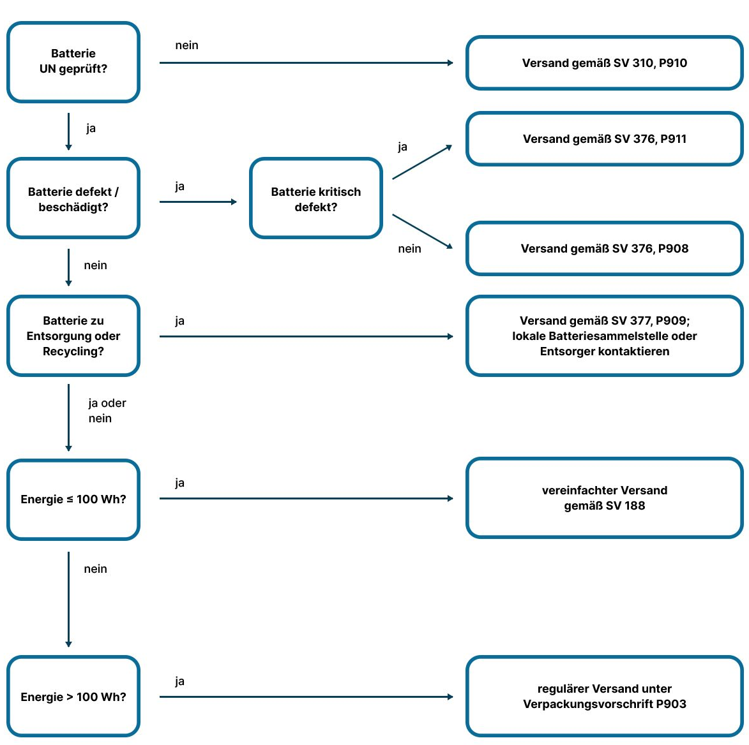
Transport
ADR/ IMDG/ IATA
Transport
Powerbank example:
No UN certificate is yet available for the power bank
  Transportation to provide UN 38.3 proof
➔ Shipping according to
  Special provision
  SV310
  Packaging instruction
  P910
Notes:
Beispiel anhand der Vorschriften für den Strassen-Verkehr ADR
SV = Sondervorschrift
P = Packungsvorschrift

Slide 21
Transport
ADR/ IMDG/ IATA
Transport
Special provision and packaging instruction
SV 310
  Specifies the quantity of battery cells and batteries that may be transported together
  Refers to the packaging instruction P 910
P 910
  Packaging only in safety containers (type-tested packaging)
  Note on the transport document “CARRIAGE ACCORDING TO SPECIAL WRITING 310”
  Attach class 9 hazard label for lithium batteries
  Attach UN 3xxx note

Slide 22
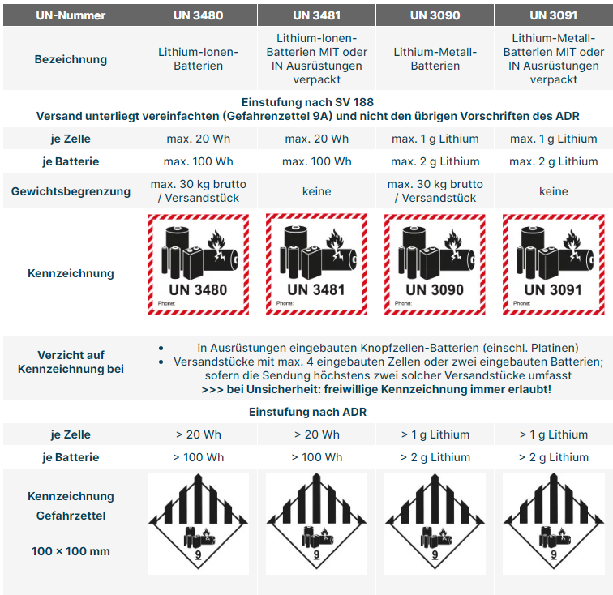
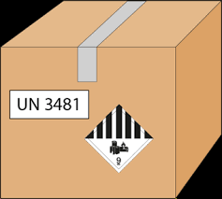
Transport
ADR/ IMDG/ IATA
Transport
Marking of the packaging in accordance with transport regulation
SV 188
Notes:
Wir haben Lithium-Ionen-Batterien in einem Gerät verbaut (Die Zellen sind in der Powerbank eingebaut) ➔ Markierung gemäss UN 3481
Unsere Batterie hat 87 Wh ist also grösser als 20 Wh ➔ Markierung gemäss ADR anbringen

Slide 23
EU targets for environmental protection
CE directives and Responsible offices for safety
Suva
Raw materials
Production Distribution
CE
ADR/ IMDG/ IATA
Recycling
Transport
Development
Burning
Transport
Consume
ADR/ IMDG/ IATA
CE
Disposal
CE
Notes:
Die Powerbank ist nun geprüft und kann verkauft und versendet werden.
Die neuen Powerbanks müssen dennoch gemäss SV 188 für den Transport gekennzeichnet werden ➔ siehe nächste Folie

Slide 24
Transport
ADR/ IMDG/ IATA
Transport
Transportation of the power bank to the customer
The powerbank has 87 Wh
➔ Simplified shipping SV 188
Notes:
Batterie ist nun geprüft und kann verkauft werden.
Die neuen Powerbanks müssen dennoch für den Transport gekennzeichnet werden

Slide 25
EU targets for environmental protection
CE directives and Responsible offices for safety
Suva
Raw materials
Production Distribution
CE
ADR/ IMDG/ IATA
Recycling
Transport
Development
Burning
Transport
Consume
ADR/ IMDG/ IATA
CE
Disposal
CE

Slide 26
CE-Richtlinien
CE
Consume
Product safety
  Protect the customer from dangerous products
  Protect the manufacturer from uninformed customers
  Protect nature from excessive damage
Notes:
Ist die Batterie «verkauft» muss die Sicherheit des Kunden und des Verkäufers) beachtet werden.
Der Schutz der Natur wird später behandelt (Protect nature coms in Slide WEEE and BattG)

Slide 27
CE directives
CE
Consume
Possible approach to CE certification and CE marking
CE directive (steps to CE marking)
  Define product
  Determine guidelines
  Determine the standards from the directives
  Notified body
  Carry out conformity assessment procedure
  Preparation of the technical documentation
  Drafting the EC declaration of conformity and affixing the CE mark
Extremely difficult and time-consuming
External help is recommended for registrations

Slide 28
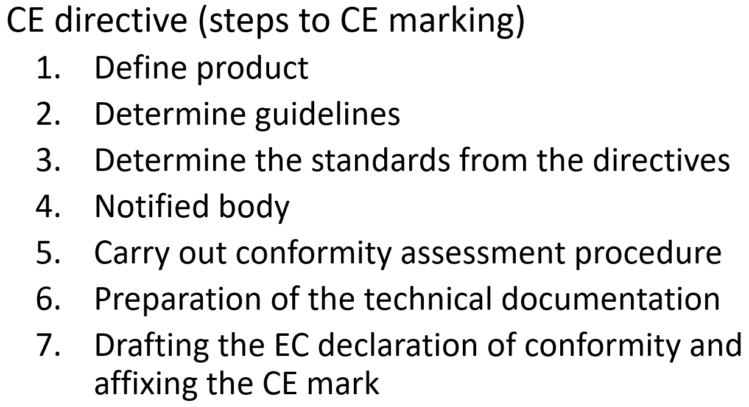

CE directives
CE
Consume
Define product
  Determine intended use
  What is the product
    Complete or incomplete machine, electrical device, protective equipment, toy, medical device...
  Ambient conditions
    For indoor areas, outdoor areas or explosive atmospheres
  What does the product consist of
    Toxic ingredients
  Who is the product intended for
    Children, Private individuals, Professionals
  For which market?
    Where is the product marketed?
    EU, China, USA...
Notes:
Diese Fragestellungen sind von Produkt zu Produkt unterschiedlich

Slide 29
CE directives
CE
Consume
Powerbank example
Define product
  Device for adult private individuals
  Device with electronic components
  No moving parts
  Device is suitable for travel (road, rail and air)
  Environmental conditions
  For indoor use ➔ no IP protection class
  Protected from cold and heat
  Service life 10 years or 2000 charging cycles
  For sale in the EU
  Maintenance-free…
Notes:
Alle diese Punkte werden später im Manual niedergeschrieben und ebenfalls am Kunden übergeben.
Der Kunde soll unterrichtet werden, was er mit dem Produkt machen darf.
Absicherung des Herstellers
Sicherheit gegenüber Verletzungen durch falsche Anwendung durch Kunden

Slide 30
CE directives
Possible approach to CE certification and CE marking
CE directive (steps to CE marking)
  Define product
  Determine guidelines
  Determine the standards from the directives
  Notified body
  Carry out conformity assessment procedure
  Preparation of the technical documentation
  Drafting the EC declaration of conformity and affixing the CE mark

Slide 31
CE directives
CE
Consume
Identify directives
Once the product has been defined, the directives that the product must fulfill can be determined
This involves more than 20 EU directives:
  Machinery Directive
  Electrical equipment
  Personal protective equipment
  …

Slide 32
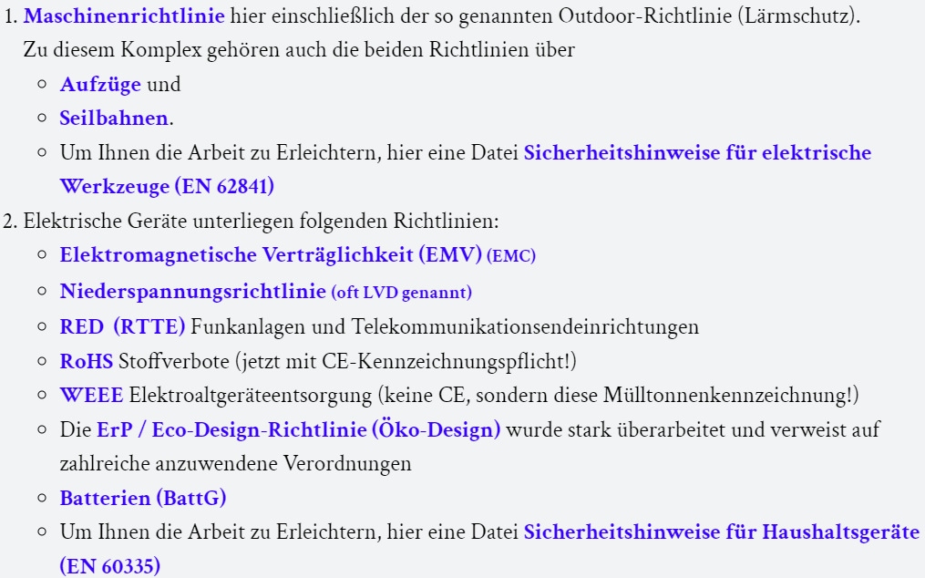
CE directives
CE
Consume
Powerbank example
Identify directives
  CE-Richtlinienübersicht - Klassifizierung (ce-zeichen.de)
…
Notes:
Jedes der Punkte kurz abfragen ob für uns relevant ist.
1. Maschinenrichtlinie ➔ nicht relevant für unsere Powerbank
2 Elektrisches Gerät ➔ Ja für uns relevant ➔ Unterpunkte durchgehen
Einzige Richtlinien, die nicht relevant für uns ist die RED (RTTE) und der letzte Punkt: Haushaltsgeräte ➔ der Rest wird behandelt
Es gibt noch mehr Richtlinien, die hier nicht aufgeführt sind. Bei Bedarf kann der Link angeklickt werden, um die grobe Übersicht zu zeigen

Slide 33
CE directives
CE
Consume
Relevant Directives
  EMV (2014/30/EU)
  Niederspannung (2014/35/EU)
  RoHS (2011/65/EU)
  WEEE (2012/19/EG)
  Eco-Design-Richtlinie (2009/125/EG)
  Batterierichtlinie
    2006/66/EG Alt
    (EU) 2023/1542 ab August 2024

Slide 34

CE directives (EMV)
CE
Consume
Electromagnetic compatibility (EMC)
  Check whether the device emits too much EMC radiation
  Check what influence EMC radiation has on the device
Notes:
EMC = Electromagnetic compatibility
EMV = Elektromagnetische Verträglichkeit

Slide 35
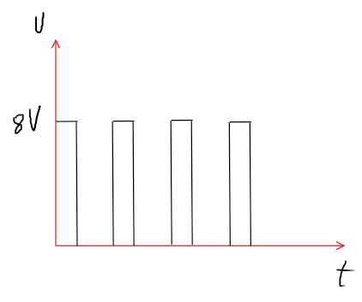
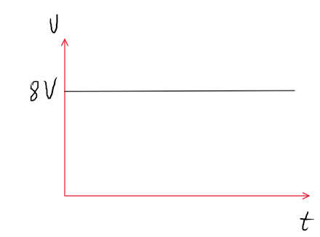
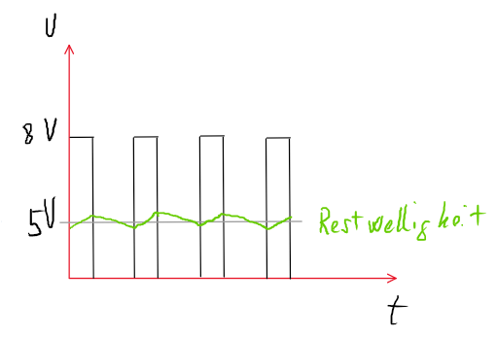
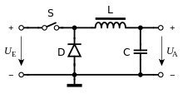
CE directives (EMV)
CE
Consume
Example of battery output
  Integrated DC-DC voltage converter from battery voltage (U_{E}) to USB voltage (U_{A})
Together with the PWM and filter, the “S” switch generates an EM field

Slide 36
CE directives
CE
Consume
Relevant Directives
  EMV (2014/30/EU)
  Niederspannung (2014/35/EU)
  RoHS (2011/65/EU)
  WEEE (2012/19/EG)
  Eco-Design-Richtlinie (2009/125/EG)
  Batterierichtlinie (2006/66/EG)

Slide 37
CE directives (Low Voltage Directive)
CE
Consume
Low Voltage Directive
  Require a risk analysis!
  This Directive applies to electrical equipment designed for use with a rated voltage between 50 and 1 000 V for alternating current and between 75 and 1 500 V for direct current
➔ Is this not applicable for our battery?
  Can a dangerous voltage build up across the LC element?
  For example, with EMV irradiation
  This must be clarified with a specialist
Notes:
Es soll abgeklärt werden ob über die Spule mit Kondensator gefhärliche Spannungen entstehen kann

Slide 38
CE directives (RoHS)
CE
Consume
Relevant Directives
  EMV (2014/30/EU)
  Niederspannung (2014/35/EU)
  RoHS (2011/65/EU)
  WEEE (2012/19/EG)
  Eco-Design-Richtlinie (2009/125/EG)
  Batterierichtlinie (2006/66/EG)

Slide 39
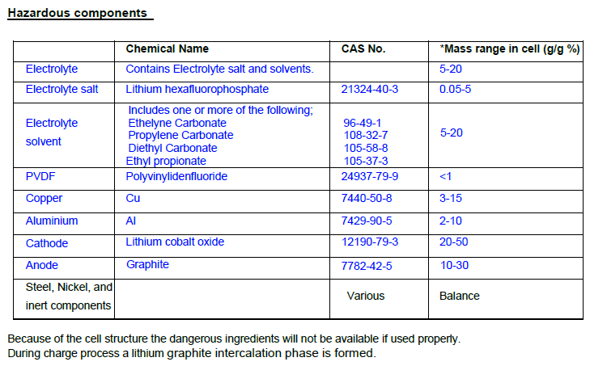
CE directives (RoHS)
CE
Consume
RoHS (Restriction of Hazardous Substances)
The following materials are restricted
  Plumb (0,1 %)
  Quicksilver (0.1 %)
  Cadmium (0.01 %)
  Hexavalent chromium (0.1 %)
  Polybrominated biphenyls (PBB) (0.1 %)
  Polybrominated diphenyl ethers (PBDE) (0.1 %)
  …
➔ Cell does not fall under the RoHS restrictions
Components of the cell from safety data sheet

Slide 40
CE directives (RoHS)
CE
Consume
RoHS (Restriction of Hazardous Substances)
CAUTION: All components of the power bank must be checked
➔ Obtain safety data sheets for each electronic and mechanical component in the battery.
  Example:
    Solder may contain lead
    What is the housing of the power bank made of?
    What materials is the battery level indicator made of?

Slide 41
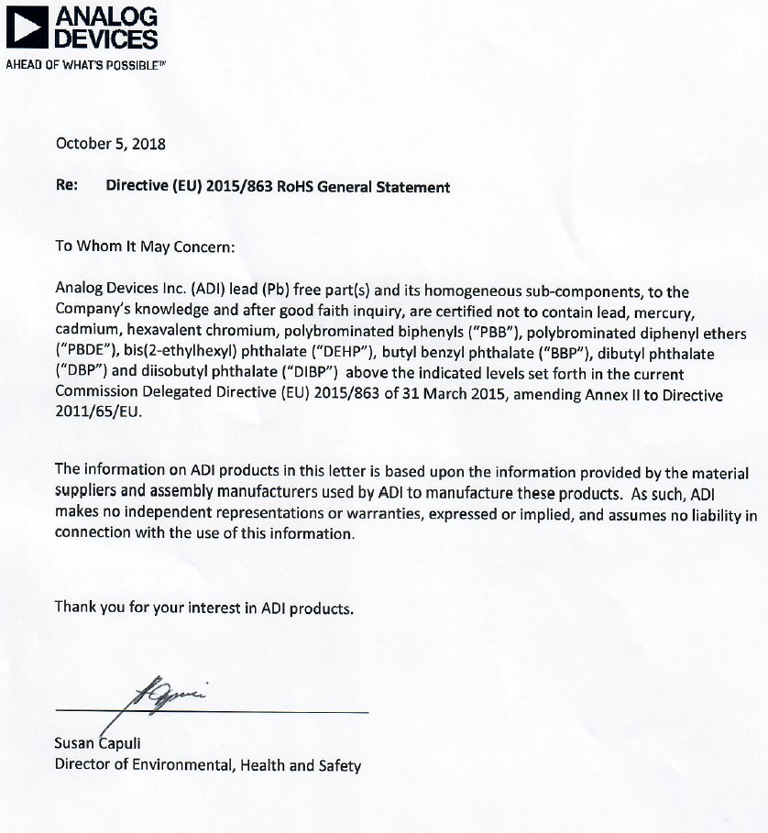
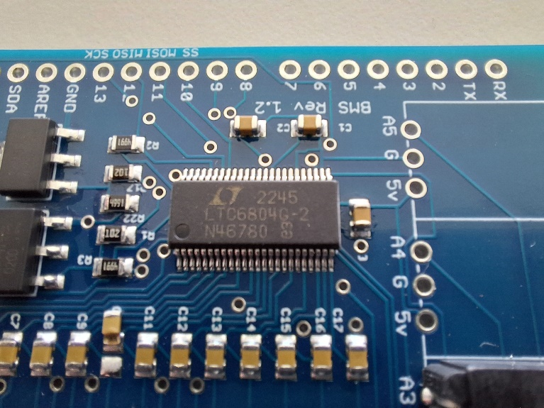
CE directives (RoHS)
CE
Consume
RoHS (Restriction of Hazardous Substances)
Safety data sheet LTC 6804
➔ Seems to be OK

Slide 42
EU targets for environmental protection
CE directives and Responsible offices for safety
Suva
Raw materials
Production Distribution
CE
ADR/ IMDG/ IATA
Recycling
Transport
Development
Burning
Transport
Consume
ADR/ IMDG/ IATA
CE
Disposal
CE
Notes:
Bei CE wird auch der Kunde wird in die Pflicht genommen. Nachstehende Folien sollen dies behandeln.

Slide 43
CE directives
WEEE (CE)
Disposal
Product safety
  Protect the customer from dangerous products
  Protect the manufacturer from uninformed customers
  Protect the environment from excessive damage
Notes:
Das RoHS ist ebenfalls für den Umweltschutz. Pass hier jedoch nicht rein… Stiftet Verwirrung.

Slide 44
EU targets for environmental protection
Environmental protection Status quo: producing, consuming and burning
Raw materials
Production Distribution
Recycling
Transport
Development
Burning
Transport
Consume
Disposal
Notes:
Kurz zeigen, wie es meistens heute läuft ➔ Kaufen und nach Gebrauch in den Müll schmeissen
Es ist dem Kunden VERBOTEN Elektrogeräte (Vor allem Batterien) in den Hausmüll zu entsorgen

Slide 45
EU targets for environmental protection
Environmental protection Goal: Circular economy
Raw materials
Production Distribution
Recycling
Transport
Development
Burning
Transport
Consume
Disposal
Notes:
Das Ziel des CE ist es so viele Ressourcen wie möglich zu bewahren und wiederzuverwenden.

Slide 46
CE directives (WEEE)
WEEE (CE)
Disposal
Relevant Directives
  EMV (2014/30/EU)
  Niederspannung (2014/35/EU)
  RoHS (2011/65/EU)
  WEEE (2012/19/EG)
  Eco-Design-Richtlinie (2009/125/EG)
  Batterierichtlinie (2006/66/EG)

Slide 47
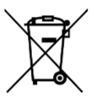
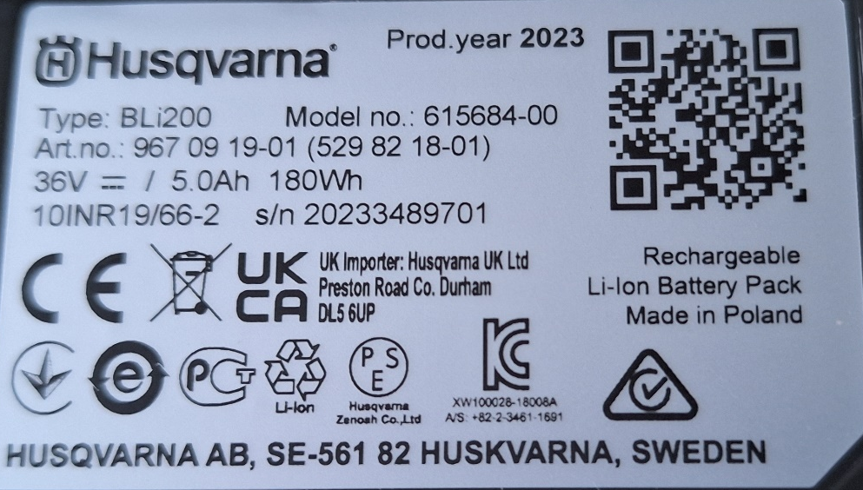
CE directives (WEEE)
WEEE (CE)
Disposal
WEEE Waste Electrical and Electronic Equipment Disposal
(no CE-marking but the waste garbage can-mark)
  Regulates the financial aspects of collecting old appliances
  The sale of electrical appliances in the EU is subject to registration. In every country in which the product is sold!
    In DE, for example, in the EAR register
  Used appliances should be collected again to extract recyclable materials
Notes:
WEEE ist die «nicht in den Hausmüll» Kennzeichnung. Dieses Zeichen muss ebenfalls auf die Powerbank

Slide 48
CE directives
WEEE (CE)
Disposal
Relevant Directives
  EMV (2014/30/EU)
  Niederspannung (2014/35/EU)
  RoHS (2011/65/EU)
  WEEE (2012/19/EG)
  Eco-Design-Richtlinie (2009/125/EG)
  Batterierichtlinie (2006/66/EG)

Slide 49
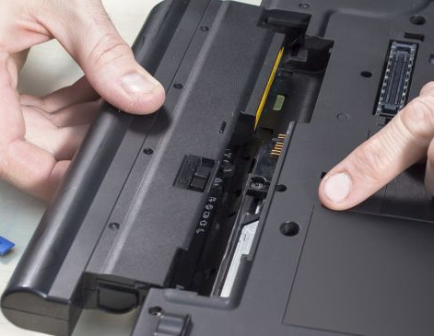
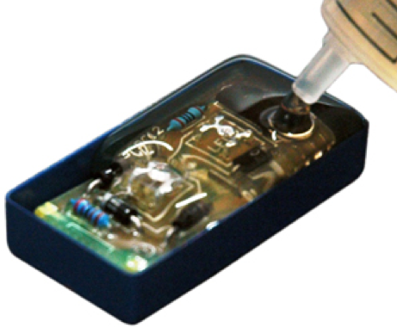
CE directives (Öko-Design)
WEEE (CE)
Disposal
ErP / Eco-Design- directives (Öko-Design)
  Environmentally friendly design:
    Reducing energy and resource consumption, recovering resources
    Improving the reparability of products
  Removable batteries
    Excempel: Cell phones and notebooks come with removable batteries again from 2027
Notes:
Der Klient oder Recykler soll ab 2027 die Batteriezellen aus dem Gerät entfernen und getrennt entsorgen können.

Slide 50
CE directives (Öko-Design)
WEEE (CE)
Disposal
What does this mean for our power bank?
  Battery cells can be removed via the screw-on lid
  Attention: The customer can now insert new cells into the power bank
    ➔ It must be noted in the manual that only original cells may be installed (Samsung INR18650-30Q)
Notes:
Wir können entscheiden ob wir die Powerbank so entwickeln wird, dass die Zellen bis 2027 nicht entfernbar sind.
Ab 2027 muss die Powerbank jedoch so entwickelt sein, dass die Zellen entfernt werden können (Beim Verkauf von neuen Powerbanks).
ACHTUNG: Der Klient kann die Zellen dann auch selber wechseln. Im Manual muss deutlich darauf hingewiesen werden, dass nur die Samsung INR18650-30Q verwendet werden darf!

Slide 51
EU targets for environmental protection
CE directives and Responsible offices for safety
Suva
Raw materials
Production Distribution
CE
ADR/ IMDG/ IATA
Recycling
Transport
Development
Burning
Transport
Consume
ADR/ IMDG/ IATA
CE
Disposal
CE
Notes:
Der Klient hat die Batterie an einer Sammelstelle abgegeben. Die Sammelstelle transportiert die Batterie zum Recycling ➔ Nicht mehr Problem des Klienten

Slide 52
Transport
ADR/ IMDG/ IATA
Transport
Transporting the power bank for disposal
  Battery old and used up / defective?
  Transport for recycling
Notes:
Der Klient selbst bringt die Batterie zu einer Sammelstelle. Diese muss anschliessend die Batterie für den Transport richtig verpacken und versenden.

Slide 53
EU targets for environmental protection
CE directives and Responsible offices for safety
Suva
Raw materials
Production Distribution
CE
ADR/ IMDG/ IATA
Recycling
Transport
Development
Burning
Transport
Consume
ADR/ IMDG/ IATA
CE
Disposal
CE
Notes:
Die Verschiedenen Recycling varianten werden im «09ITBO_CircularEconomySustainability»

Slide 54
CE directives
BattG, ElektroG (CE)
Recycling
Relevant Directives
  EMV (2014/30/EU)
  Niederspannung (2014/35/EU)
  RoHS (2011/65/EU)
  WEEE (2012/19/EG)
  Eco-Design-Richtlinie (2009/125/EG)
  Batterierichtlinie (2006/66/EG)

Slide 55

CE directives
BattG, ElektroG (CE)
Recycling
Batteries (BattG, ElektroG)
Valid for batteries of all types
  The sale of batteries must be reported. In every country in which the product is sold! (Same as WEEE)
  Inform take-back systems about the quantity and type of batteries (slightly different in every country)
  Proof of how many Wh you have sold and later prove how many Wh batteries could be collected again
    In DE, for example, in the EAR register
    In Switzerland INOBAT register
The Powerbank must be labeled in such
a way that it clearly identifies the distributor

Slide 56
EU targets for environmental protection
CE directives and Responsible offices for safety
Suva
Raw materials
Production Distribution
CE
ADR/ IMDG/ IATA
Recycling
Transport
Development
Burning
Transport
Consume
ADR/ IMDG/ IATA
CE
Disposal
CE

Slide 57
CE directives
Possible approach to CE certification and CE marking
CE directive (steps to CE marking)
  Define product
  Determine guidelines
  Determine the standards from the directives
  Notified body
  Carry out conformity assessment procedure
  Preparation of the technical documentation
  Drafting the EC declaration of conformity and affixing the CE mark
Notes:
Die Richtlinien sind nun ermittelt.
Aus den Richtlinien sollen nun die Länderspezifischen Testnormen ermittelt werden.
Anstatt den Länderspezifischen Normen können auf EU- oder International weite Normen ermittelt werden

Slide 58

Standards and regulations
Determine the standards from the directives
  The country-specific standards according to which the power bank is to be tested can be determined from the CE directives identified

Slide 59
Standards and regulations
Overview of standards
  DIN (German institute for standardization)
  EN (European standard)
  SN (Swiss standard)
  ISO (International organization for standards) «Mechanic»
  IEC (International electrotechnical commission) «Electrotechnics»
  UN (Transport standards for dangerous goods)
  VDE (German Electrical Engineering Association)
  UL (Product safety standards for batteries in the US-market)
Notes:
Übersicht der Normen es die der EU zu gültig sind.

Slide 60
Standards and regulations
Example: Selection of a standard
CEN - CENELEC - Search standards (cencenelec.eu)
  EMV (German)
  ➔ EN 61000
Online Browsing Platform (OBP) (iso.org)
  Powerbank
  ➔ ISO 2789
Notes:
CEN Beispiel direkt im Internett zeigen. Einstellungen ist auf nächster (Ausgeblendeter) Folie gezeigt.
Welche Normen wirklich angewendet sollen muss individuell entschieden werden. (Auch mit Hilfe von Normen-Spezialisten)

Slide 61
Standards and regulations
Example: Selection of a standard
Standards determined from the directives
  EN 61000-6-x (EMV compatibility)
  ISO 2789:2022 (Information and documentation)
  IEC 62133-2 (Requirements for batteries)
  DIN EN 61140 (Protection against electric shock)
  DIN EN IEC 63000 (RoHS: Assessment of electrical and electronic equipment with regard to the restriction of hazardous substances)
  …
Additional standards for travel
  UL 1642 (requirements for cells in the US market)
  UL 2054 (requirements for battery in the US market)
  …
Notes:
Die DIN EN 61140 ist ausgeraut da es nicht sicher ist ob ein Elektrischer Schock überhaupt auftreten kann. Siehe Folie 35
In einem Realen fall muss dies mit einem Elektronik-/ EMV-Spezialisten abgeklärt werden

Slide 62
CE directives
Possible approach to CE certification and CE marking
CE directive (steps to CE marking)
  Define product
  Determine guidelines
  Determine the standards from the directives
  Notified body
  Carry out conformity assessment procedure
  Preparation of the technical documentation
  Drafting the EC declaration of conformity and affixing the CE mark

Slide 63

Standards and regulations
Notified body (= Benannte Stelle)
Clarify which tests can be carried out yourself
Check whether officially certified testing institutes (notified body) must be used to carry out a conformity assessment procedure (safety-related requirements)
Notes:
Benannte Stellen (Notified body) sind vom Staat akkreditierte Prüfstellen

Slide 64
CE directives
Possible approach to CE certification and CE marking
CE directive (steps to CE marking)
  Define product
  Determine guidelines
  Determine the standards from the directives
  Notified body
  Carry out conformity assessment procedure
  Preparation of the technical documentation
  Drafting the EC declaration of conformity and affixing the CE mark

Slide 65

Standards and regulations
Carry out conformity assessment procedures
Carry out or have carried out and document the tests specified in point three (selection of standards) in accordance with the standard
Notes:
Die Versuche müssen nun nach Norm durchgeführt werden. Versuche die im Betrieb selbst durchgeführt werden dürfen, können im Haus durchgeführt werden.
Versuche (Meistens Sicherheitsrelevant) die gemäss Abklärungen in Punkt 4 auswärts gemacht werden müssen, müssen von einer benannten Stelle durchgeführt werden.

Slide 66
CE directives
Possible approach to CE certification and CE marking
CE directive (steps to CE marking)
  Define product
  Determine guidelines
  Determine the standards from the directives
  Notified body
  Carry out conformity assessment procedure
  Preparation of the technical documentation
  Drafting the EC declaration of conformity and affixing the CE mark

Slide 67
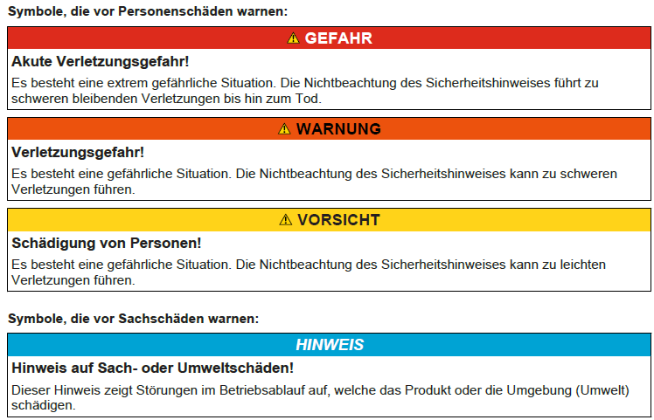

Standards and regulations
Preparation of technical documentation
Operating instructions with, for example:
  Intended use (How and who may use the product)
  Information on hazards
  Information on restrictions
  How long the product may be used
  Indication of which cells may be used
  Define service intervals, if applicable
Notes:
Das Erstellen der Dokumentation (Technische Dokumentation, Manuals, Datenblätter, Versuchsdurchführung) wird von unserm Betrieb durchgeführt.

Slide 68
CE directives
Possible approach to CE certification and CE marking
CE directive (steps to CE marking)
  Define product
  Determine guidelines
  Determine the standards from the directives
  Notified body
  Carry out conformity assessment procedure
  Preparation of the technical documentation
  Drafting the EC declaration of conformity and affixing the CE mark

Slide 69
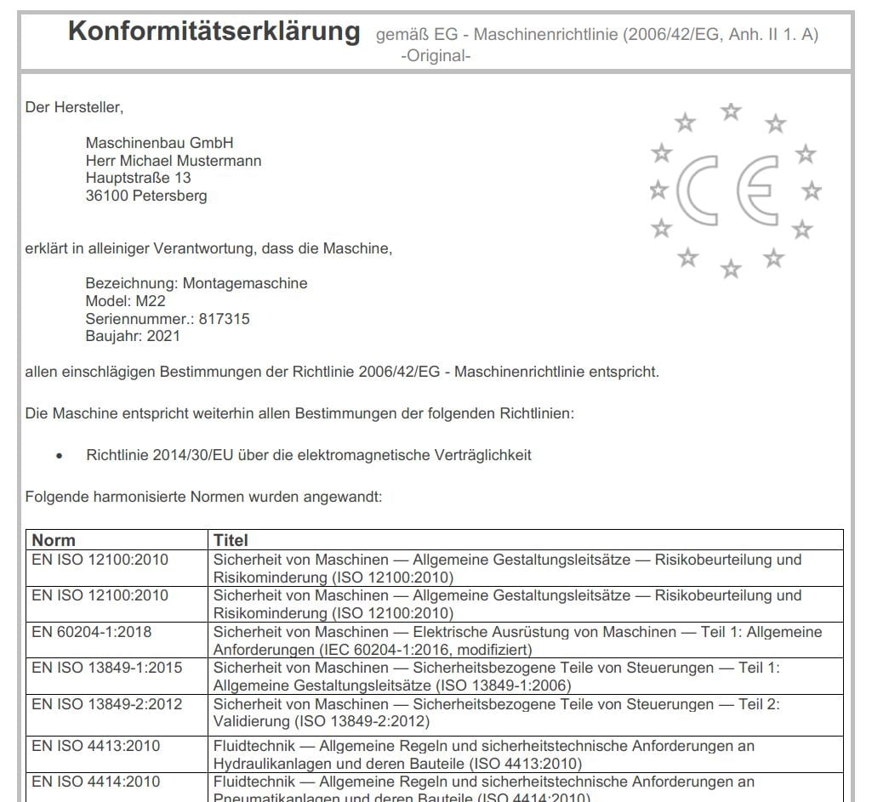
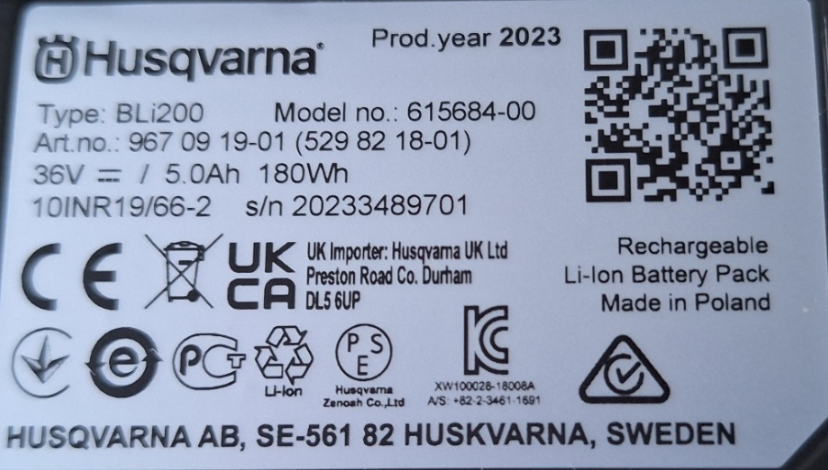


Standards and regulations
Drafting the EC declaration of conformity and affixing the CE mark
Information on the manufacturer and the product
Information on the standards applied to ensure safe operation of the product
Affix the CE mark to the product
Sell the powerbank
Beispiel einer Erklärung
Notes:
Das CE-Zeichen bringt der Hersteller selber an (Selbstdeklaration).
Es wird von niemanden geprüft ob die CE-Prüfungen richtig durchgeführt worden sind. Erst wenn etwas Passiert, werden die Prüfungen angeschaut.

Slide 70

The technical documentation with evidence must be enclosed with the battery
The end customer should be encouraged to read the instructions for use
➔ Manufacturer is no longer liable for errors made by the customer
Notes:
Die Dokumente werden der Batterie beigefügt oder auf dem Internett veröffentlicht. Wenn die Dokumente auf dem Internett veröffentlicht werden, muss deutlich angegeben werden wo die Dokumentation heruntergeladen werden kann.

Slide 71

CE in Switzerland
General Comments
In the EU, the CE mark must be affixed to a machine or device before it can be placed on the market
In Switzerland, it is not obligatory to affix the CE mark
  For the Swiss market, there is the Swiss conformity mark (CH mark)
  However, the CH mark is not recognized in the EU. The CE mark must be affixed in the EU
  In Switzerland, the sale of CE-marked products is recognized (harmonized standards)
➔ Tackling CE certification right from the start

Slide 72
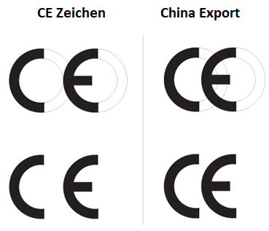
Caution
Caution when purchasing electronic products
C E not equal CE

Slide 73










Other signs
Conformity Europa
May not be disposed of in household waste
Conformity England
Conformity Ukraine
China RoHS
Conformity Russia
Recycling Lithium Ion batteries
Electro Magnetic Compatibility China
Type approval Korea
Conformity Australian

Slide 74
Summary
In Europe, the CE mark must be affixed to certain products before they can be placed on the market
It is extremely difficult to keep track of all CE directives
  If something happens to the product due to non-compliance with a directive, you are liable and liable to prosecution
  It is recommended to seek professional help when drawing up a CE certificate
In addition to the directives, there are other safety regulations (e.g. Suva)
Depending on the place of sale (outside the EU) there are country
specific directives-Beware of self-imported products. The importer or seller is responsible for the product!
Notes:
In Europa müssen an gewisse Produkte das CE-Zeichen angebracht sein, damit diese im Umlauf gebracht werden dürfen
Alle CE-Richtlinien zu erfassen ist extrem schwierig
Passiert etwas mit dem Produkt wegen nicht Einhaltung einer Richtlinie ist man haftbar und strafbar
Es wird empfohlen professionelle Hilfe beim Erstellen eines CE-Zertifikat einzuholen
Neben den Richtlinien gibt es weiter Sicherheitsvorschriften (z.b. Suva)
Je nach Verkaufsort (Ausserhalb der EU) gibt es Landes Eigene Richtlinien
Vorsicht vor selbst Importierten Produkten. Der Importeur oder Verkäufer ist für das Produkt verantwortlich!

