Slide 1
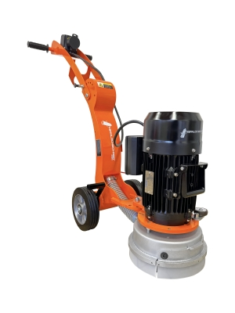
Case study - Floor grinding machine
Task - Dimensioning a battery
A mains-powered floor grinding machine is to be converted to battery operation. In battery mode, the machine should be able to work effectively for at least 4 hours independently of the mains. The battery is charged overnight.
Determine the dimensions of the battery required for this.

Slide 2
Case study - Floor grinding machine
The current floor grinding machine has the following technical data:
Motor
Rated power 2.2 kW
Mains connection 230 V, 50…60 Hz, 1 Ph
Idle speed 2600 1/min.
max. Torque 43 Nm
Grinding wheel
Nominal speed 1410 1/min.
Diameter 250 mm
Machine
max. weight (without battery) 35 kg
max. weight (with battery) 60 kg

Slide 3
Case study - Floor grinding machine
The following lithium-ion cells are available :
NITECORE IMR 18650
Samsung SDI INR 18650-30Q
LG 18650HG2
ENERDAN UR18650F (Sanyo)
Energy Inside N18650CP-35E
LithiumWorks ANR26650M1B

Slide 4
Case study - Floor grinding machine
Task 1: Select a suitable battery cell.
Should a prismatic cell, a round cell or a pouch cell be considered for this application as a first step?
In principle, all 3 cell formats are possible. As the design of the floor grinding machine is predominantly rotationally symmetrical, a rotationally symmetrical battery could also be realized, especially with round cells.

Slide 5
Case study - Floor grinding machine
Task 1: Select a suitable battery cell.
Is an energy cell or a power cell more suitable for the above application?
Since no power/current peaks are to be expected in this application (as with a cordless screwdriver, for example), but rather a continuous drive power is required over a longer period of time, an energy cell is more suitable.

Slide 6
Case study - Floor grinding machine
Task 1: Select a suitable battery cell.
Estimate the service life of the battery (in years) using the data sheet information for the selected lithium-ion cell.
Assumption: The floor grinding machine is in use 75% of the working days of the year.
Working days per year: around 230 days
230 days • 75% = 173 days (with 1 discharge cycle per day)
max. 800 cycles (according to datasheet Energy Inside)
800 cycles / 173 days per year = 4.6 years

Slide 7
Case study - Floor grinding machine
Task 2: Select a suitable voltage level for the battery.
Electric motors are available for a wide range of nominal voltages. Explain what needs to be considered when determining the battery voltage.
Select the voltage as high as possible/sensible in order to keep current and (thus electrical losses) as low as possible.
800 V, 400 V or 100 V not considered due to safety concerns.
48 V, 36 V or 12 V are interesting, as there are many DC motors from different suppliers available for these voltage level.
48 V DC selected
(many motor suppliers & low voltage level, therefore lower SI requirements)

Slide 8
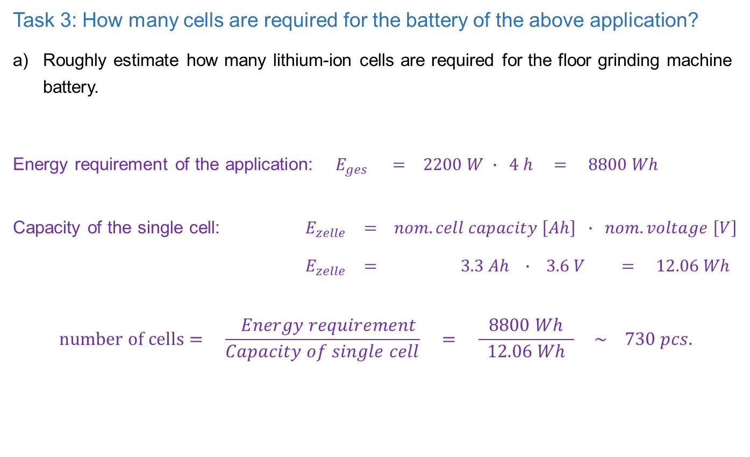
Case study - Floor grinding machine
Task 3: How many cells are required for the battery of the above application?
Roughly estimate how many lithium-ion cells are required for the floor grinding machine battery.
Energy requirement of the application: $E_{ges} = 2200 W ∙ 4 h = 8800 Wh$
Capacity of the single cell: $E_{zelle} = nom. cell capacity \left[Ah\right] ∙ nom. voltage \left[V\right]$
$E_{zelle} = 3.3 Ah ∙ 3.6 V = 12.06 Wh$
$$number of cells= \frac{ Energy requirement}{Capacity of single cell} = \frac{8800 Wh}{ 12.06 Wh } \sim 730 pcs.$$

Slide 9
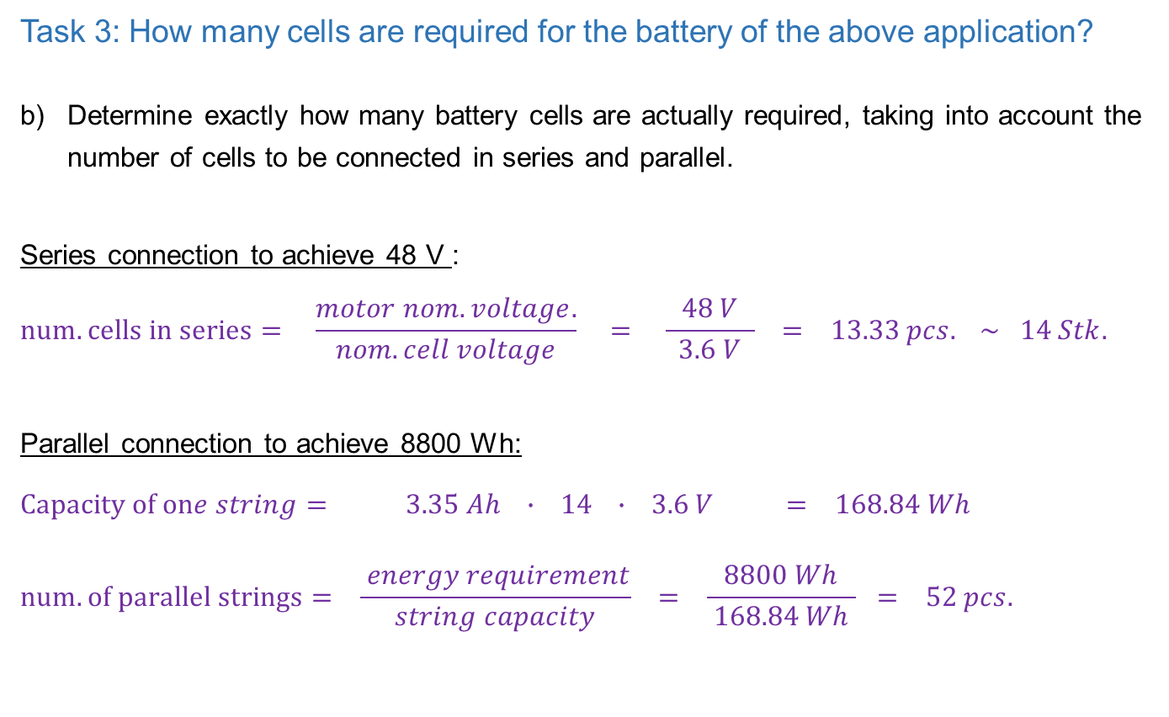
Case study - Floor grinding machine
Task 3: How many cells are required for the battery of the above application?
Determine exactly how many battery cells are actually required, taking into account the number of cells to be connected in series and parallel.
Series connection to achieve 48 V :
$$num. cells in series= \frac{motor nom. voltage.}{ nom. cell voltage } = \frac{48 V}{ 3.6 V } = 13.33 pcs. \sim 14 Stk.$$
Parallel connection to achieve 8800 Wh:
$$Capacity of one string= 3.35 Ah ∙ 14 ∙ 3.6 V = 168.84 Wh$$
$$num. of parallel strings= \frac{ energy requirement}{string capacity} = \frac{8800 Wh}{ 168.84 Wh } = 52 pcs.$$

Slide 10
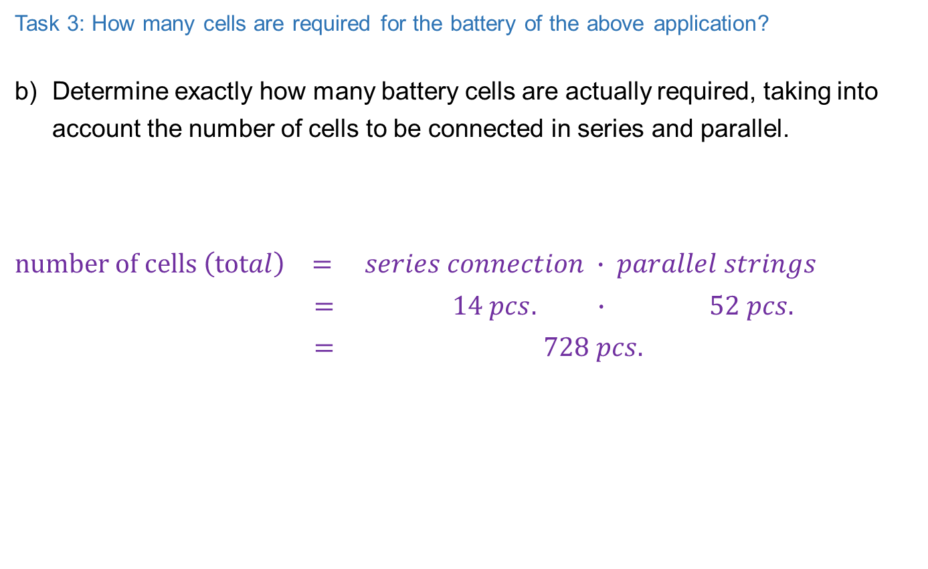
Case study - Floor grinding machine
Task 3: How many cells are required for the battery of the above application?
Determine exactly how many battery cells are actually required, taking into account the number of cells to be connected in series and parallel.
$$number of cells \left(total\right) = series connection ∙ parallel strings$$
$$= 14 pcs. ∙ 52 pcs.$$
$$= 728 pcs.$$

Slide 11
Case study - Floor grinding machine
Task 4 What voltage range must the inverter/converter cover?
As battery cells do not provide a constant terminal voltage over the entire state of charge (SoC), an inverter is required for AC motors and a DC/DC converter for DC motors. This converts the battery voltage to a constant voltage level.
See next slide

Slide 12
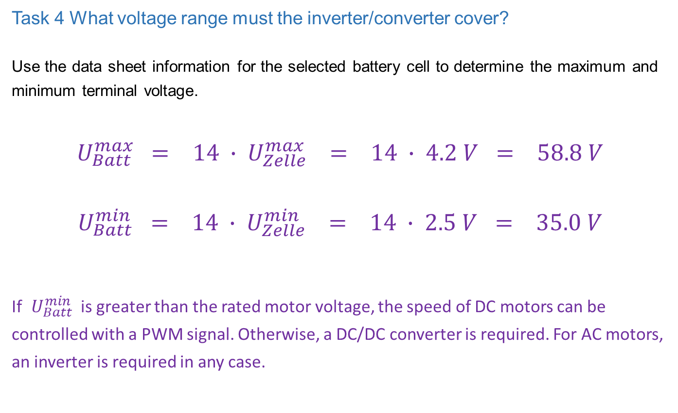
Case study - Floor grinding machine
Task 4 What voltage range must the inverter/converter cover?
Use the data sheet information for the selected battery cell to determine the maximum and minimum terminal voltage.
$$U_{Batt}^{max} = 14 ∙ U_{Zelle}^{max} = 14 ∙ 4.2 V = 58.8 V$$
$$U_{Batt}^{min} = 14 ∙ U_{Zelle}^{min} = 14 ∙ 2.5 V = 35.0 V$$
If $U_{Batt}^{min}$ is greater than the rated motor voltage, the speed of DC motors can be controlled with a PWM signal. Otherwise, a DC/DC converter is required. For AC motors, an inverter is required in any case.

Slide 13
Case study - Floor grinding machine
Task 5 How heavy will the planned battery be?
Estimate approximately how much the battery for the floor grinder will weigh. Can the specification be met? If not, what can be done to reduce the weight.
weight single cell = 49 g (according to datasheet)
Total weight all cells = number of cells • weight single cell
= 728 pcs. • 49 g/pcs. = 35.6 kg
Weight battery pack = Total weight all cells + 20% (enclosure, electronis, cabeling)
= 1.2 • Total weight all cells = 42.8 kg

