Slide 1
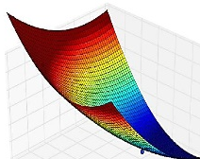

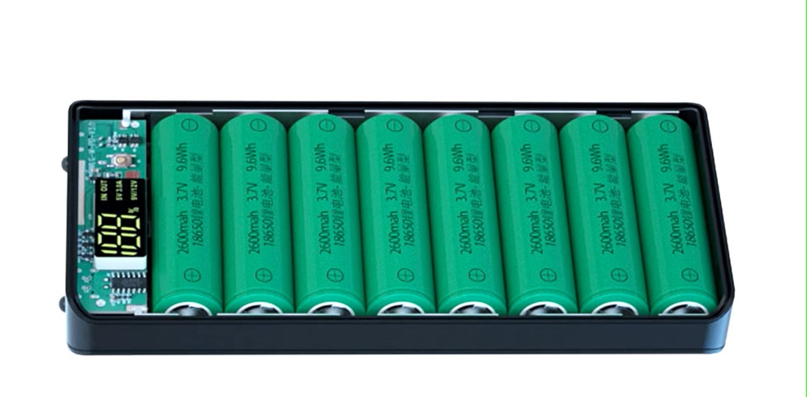








Battery Course
Modelling and Validation
Li-Ion Battery Cells
Thermal Design
Circular Economy
Battery Manage-
ment System
Standard and Regulations
Charging Strategies
Battery Ageing

Slide 2
Model Validation
Learning objectives
Students know the significance and purpose of conducting experiments for model validation.
Students learn theoretical methods of model validation.
Students can assess the validity of a model.

Slide 3
Table of Content
What is model verification vs. model validation
Empirical validity
  Methods for model validation
  The main challenges with experimental data
  Measures of quality for model validation
Experimental data for the validation of Li-Ion cell models

Slide 4
1. Validation vs. verification
Validation …
Verification …
… is the process of checking whether your simulation model is a good representation of the real system.
… is the process of checking whether your simulation model is correctly implemented and free of errors.

Slide 5
1. Verification
Checking the plausibility of results.
  Causality: The cause should precede the effect in both the reality and the model.
  Balance: Principles of energy and material conservation are respected.
  Value ranges and units: Check for inconsistent values such as negative volumes.
Comparison with another model
  Two models with different methodologies and implementations must produce the same results.
Many software engineering techniques used for software verification are applicable to simulation model verification.

Slide 6
1. Validation
Depending on the field of application of a model, there are different criteria for its validity.
Empirical validity: Agreement between measurement data and simulation results.
Theoretical validity: Consistency of the model with accepted theories.
Heuristic validity: The potential to test hypotheses, explain phenomena or reveal correlations.

Slide 7
2. Empirical validity
Main challenges regarding experimental data:
Not all physical quantities can be measured easily.
The temporal or spatial resolution is not satisfactory.
Too much measurement data is available, requiring the relevant data to be extracted beforehand.

Slide 8
2. Dos and Don’ts
Use a different data set than for parameter estimation.
Use of application-relevant test scenarios, i.e. input and output variables.
Make sure that the experimental data is free of systematic errors, i.e. was the intended quantity measures.
The resolution and accuracy of measurements must be an order of magnitude lower than the intended model accuracy.

Slide 9
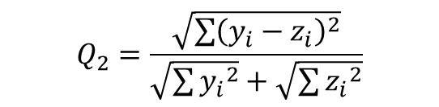
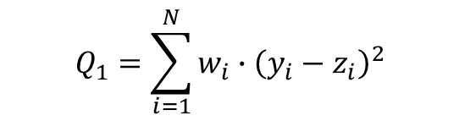

2. Measure of model quality
Qualitative comparison with measured data:
Often requires expert knowledge.
Quantitative assessment of the model deviation:
Weighted quality functional Normalized measure of
deviation
Root mean square
$$Q_{1}=\sum_{i=1}^{N}{{w_{i}∙\left(y_{i}−z_{i}\right)}^{2}}$$
$$Q_{2}=\frac{\sqrt{\sum{{\left(y_{i}−z_{i}\right)}^{2}}}}{\sqrt{\sum{{y_{i}}^{2}}}+\sqrt{\sum{{z_{i}}^{2}}}}$$
$$Q_{3}=\sqrt{\frac{1}{N}\sum_{i=1}^{N}{{\left(y_{i}−z_{i}\right)}^{2}}}$$

Slide 10
3. Experimental data of Li-Ion cells
Voltage on cell terminals
State of Charge
Experimental data for model validation
Surface temperature
Released heat

Slide 11
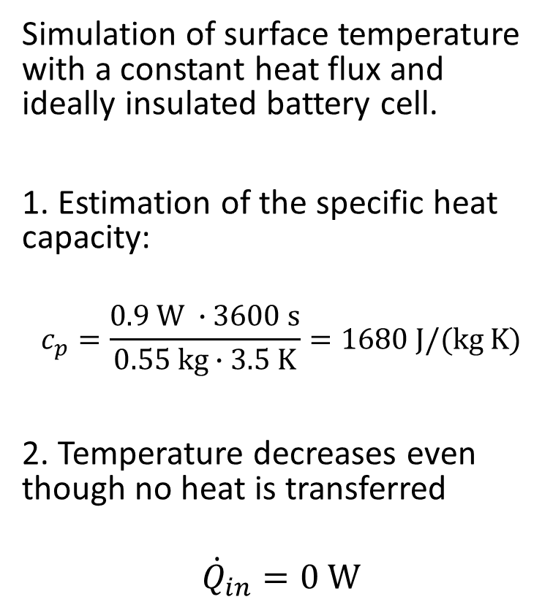


3. Example: Plausibility of results
Simulation of surface temperature with a constant heat flux and ideally insulated battery cell.
1. Estimation of the specific heat capacity:
$$c_{p}=\frac{0.9 \text{W} ∙3600 \text{s}}{0.55 \text{kg}∙3.5 \text{K}}=1680 \text{J}\text{/(}\text{kg} \text{K}\text{)}$$
2. Temperature decreases even though no heat is transferred
$${\dot{Q}}_{in}=0 \text{W}$$
$$Q_{in}=\int{{\dot{Q}}_{in}}ⅆt$$
?
$$∆T=\frac{Q_{in}}{m∙c_{p}}$$
?

Slide 12
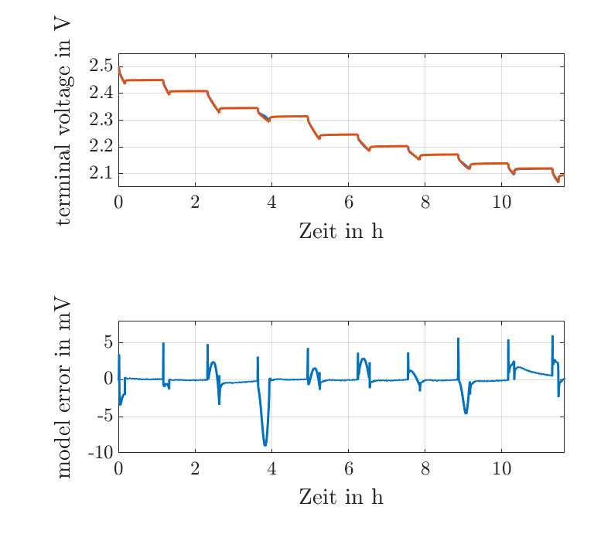
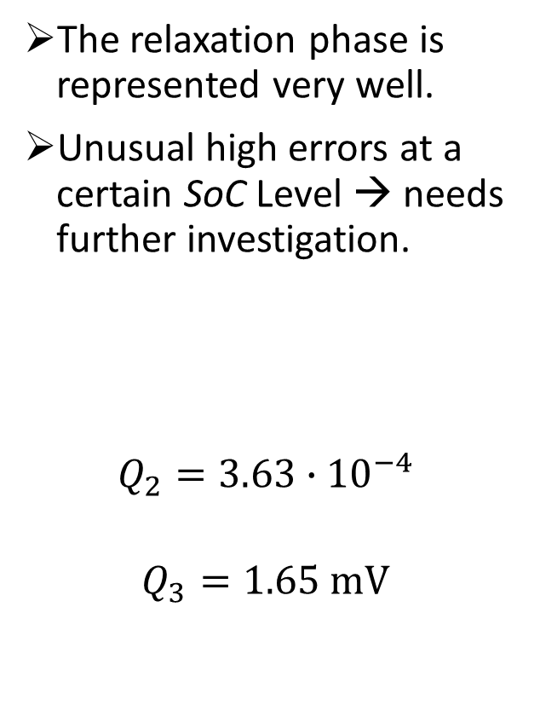
3. Example: Quantitative quality
The relaxation phase is represented very well.
Unusual high errors at a certain SoC Level → needs further investigation.
$$Q_{2}=3.63∙{10}^{−4}$$
$$Q_{3}=1.65 \text{mV}$$

Slide 13

Literature
D. J. Murray-Smith, Testing and validation of computer simulation models: principles, methods and applications. Springer International Publishing Switzerland, 2015.
ISBN: 978-3-319-15098-7
978-3-319-15099-4 (eBook)

