Slide 1

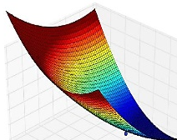

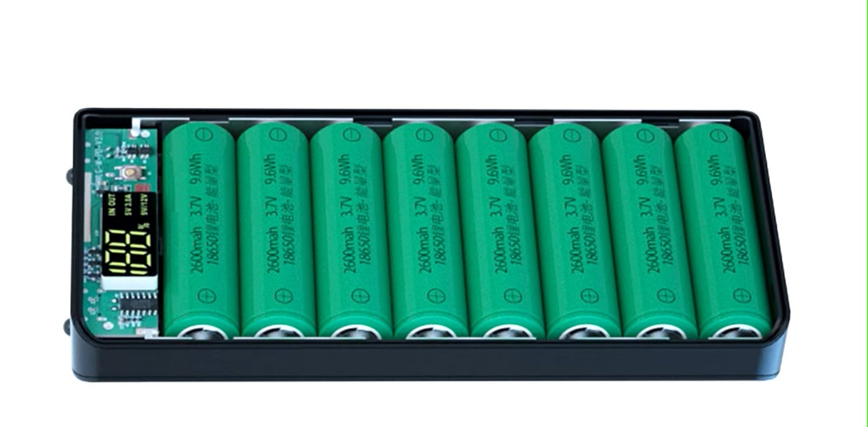








Li-Ion Battery Course
Modelling and Validation
Li-Ion Battery Cells
Thermal Design
Circular Economy
Battery Manage-
ment System
Standard and Regulations
Charging Strategies
Battery Ageing

Slide 2
Thermal Design
Learning objectives
  Detect and analyze internal and external heat sources
  Recognize and analyze heat input from external sources
  Knowing the most important mechanisms for releasing heat into the environment
  Establish and analyze the overall heat balance
  Select simulation tools for determining the spatially resolved temperature distribution and know the basic procedure for their application

Slide 3


Why Thermal Design
Battery-powered applications such as electric vehicles are used in a wide variety of climate zones :
In addition, the temperature conditions vary between day and night.

Slide 4
Operating temperature range
Operating temperature range of the energy storage system
The operating temperature must not be exceeded at any time.
In most cases, this can only be ensured by actively cooling or heating the battery storage system.
If active cooling is not sufficient, derating must be used in some cases to prevent overheating.
Energy Storage System (Battery)
+20 … +30 °C

Slide 5
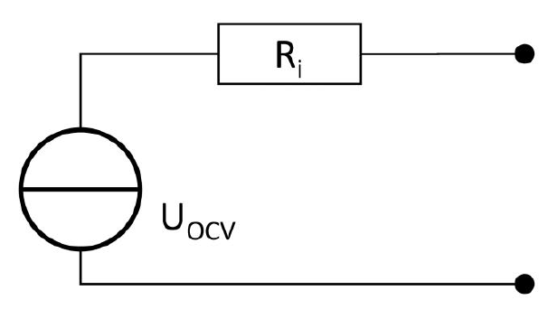
Heat generation
Heat is generated inside a battery cell during charging and discharging. However, the exact physical and chemical processes will not be explicitly considered below.
The cell will be considered here as a series connection consisting of an internal resistance and an ideal voltage source.
Equivalent Circuit Model of a Battery Cell
Discharge
Charge
U_{terminal}
U_{OpenCircuit} ≙ OCV

Slide 6
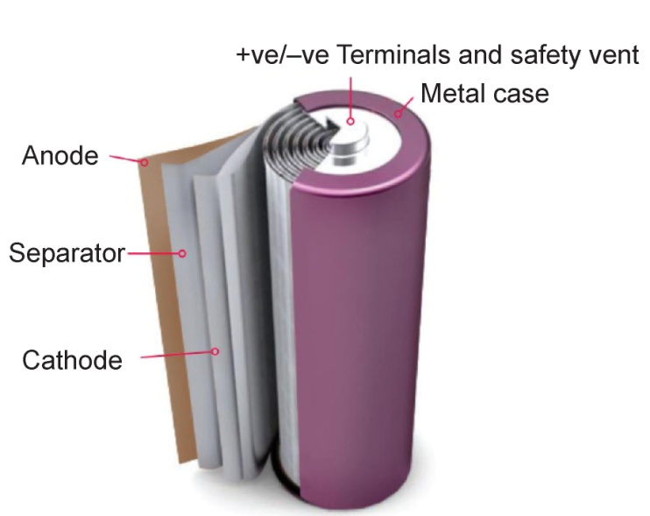

Heat generation
Heat is generated inside the battery cell as a result of the current flow through the internal resistance $R_{i}$ due to the power loss.
$$P_{Loss} = R_{i}∙I^{2} = \frac{d}{dt} Q_{Heating}$$
The heat generation is distributed almost evenly over the entire active material.

Slide 7
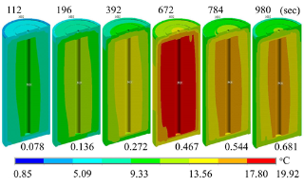

Heat Generation
The heat produced causes the temperature inside the cell to rise.
$$\frac{d}{dt} Q_{Heating} = m ∙c ∙ \frac{d}{dt} θ$$
Due to heat dissipation to the environment or to a cooling medium, the surface temperature is lower, which leads to a temperature gradient from the inside to the outside.

Slide 8
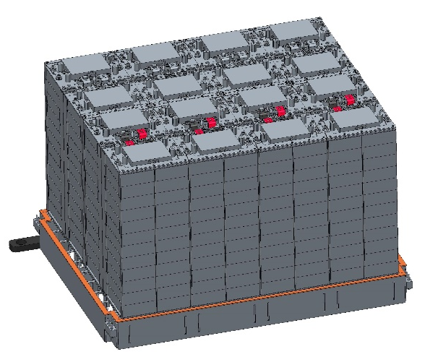
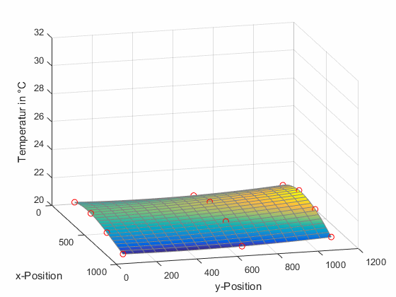
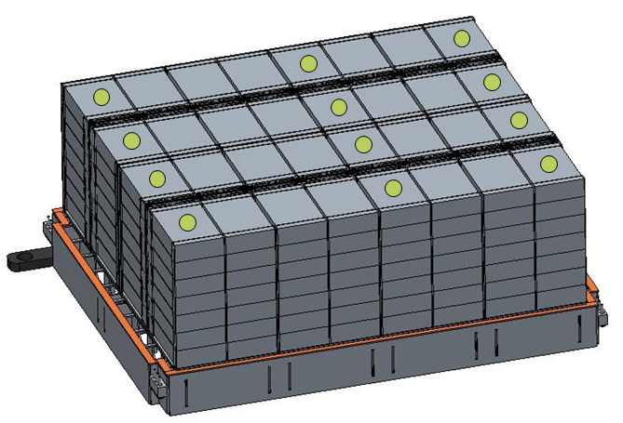
Internal temperature build-up
Temperature increase during recuperation (i.e. charging with 0.3 C) during the descent of the E-Dumper (field measurements):
Temperature increase
(without cooling)
≈ 10 K
Despite the mass of the battery pack of 2000 kg
Temperature measurement points

Slide 9
Potential risks
The cell core temperature must not exceed a value of +60 °C, otherwise there is a risk of thermal runaway.
Another reason why the cell temperature should be kept within a narrow range is cell ageing.

Slide 10
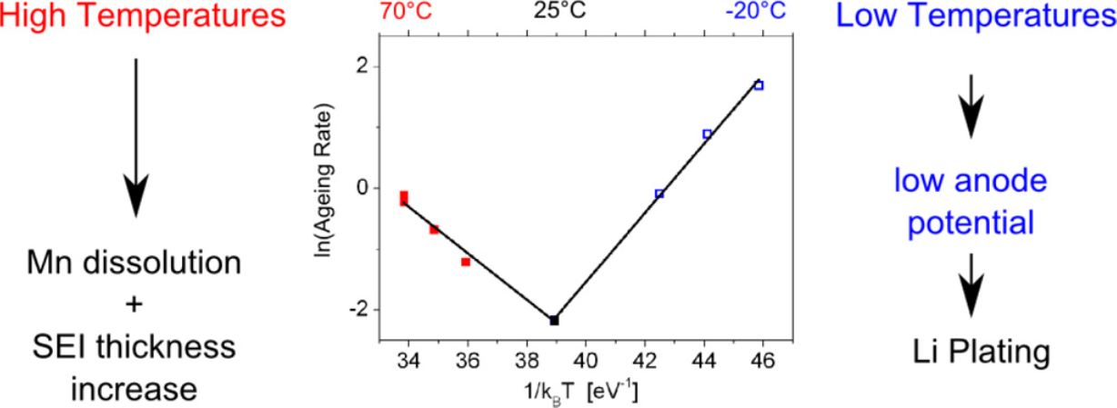
Aging due to temperature
At the ZSW in Ulm, commercially available 18650 high-performance cells with an NMC/LMO cathode and a graphite/C anode were cycled at different temperatures. The following was determined:
Arrhenius-Plot
ToDo: Aging rate definieren
Waldmann et. al.: Journal of Power Sources 262 (2014) 129-135.

Slide 11
Aging due to temperature
At the ZSW in Ulm, commercially available 18650 high-performance cells with an NMC/LMO cathode and a graphite/C anode were cycled at different temperatures. The following was determined:
Techn. Darstellung
⇨
Waldmann et. al.: Journal of Power Sources 262 (2014) 129-135.

Slide 12
Conclusion Temperature influence on ageing
Cyclical ageing of Li-ion cells at different temperatures
Temperatures > +25 °C cause faster ageing
Temperatures < 0 °C are also significantly more “damaging”
Optimum temperature range +20 ... +30 °C
In general, the ageing of battery cells means that
R_{i} ↑ and cell capacity ↓

Slide 13
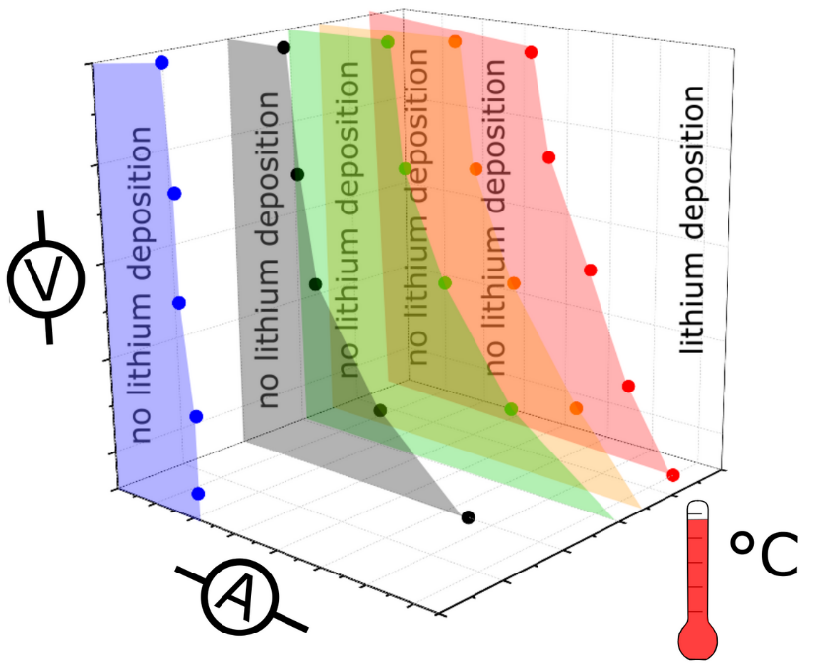
Possible counter measures
De-Rating of the maximum load current for a “cold” battery
If a battery is completely cooled down in winter, for example, the peak power is limited so that it can begin to heat up due to internal losses.
CAUTION:
Li plating occurs in the cell at low temperatures. This damages the cell, as Li is deposited and is therefore missing for the transport of charge carriers. In addition, the built-up Li layer increases the transport resistance.
Quelle: www.zsw-bw.de/projekt/batterien/mat4bat-langlebige-fahrzeugbatterien.html

Slide 14
Design of the thermal management system
To dimension the thermal management system, the maximum cooling or heating capacity that will ever be required must be known.
There are situations in which many components radiate heat at the same time. In other scenarios, some components are not in operation while others are working at maximum power.
This concurrency factor should always be considered to avoid oversizing the thermal management system.
There are also situations in which individual assemblies need to be cooled while others require heat. The advantages of so-called heat recovery should always be considered when designing heat management systems.

Slide 15
Design of the thermal management system
Concurrency factor of heat generation
For instance in electric vehicles:
When the battery is charging, the vehicle will not drive, i.e. the onboard charger will never be in operation at the same time as the inverter and the electric motor.
In winter, the cab must be heated, while the inverter and motor may give off heat.
The use of a heat pump to heat the passenger compartment has proven to be advantageous during the transitional season. The electrical consumption per volume of circulating air is significantly lower than when heating purely electrically.
If a bi-directional heat pump is used, which can also provide cooling if required, there is no need for an additional module.

Slide 16
Design of the thermal management system
Always keep in mind :
Each thermal management system draws its energy from the battery.
This means that the electrical consumption of the thermal management system directly reduces the range or operating time of the application (except when charging).
A super-efficient thermal management system that has an integrated bi-directional heat pump and utilizes all the possibilities of heat recovery is expensive and has a correspondingly high weight.

Slide 17
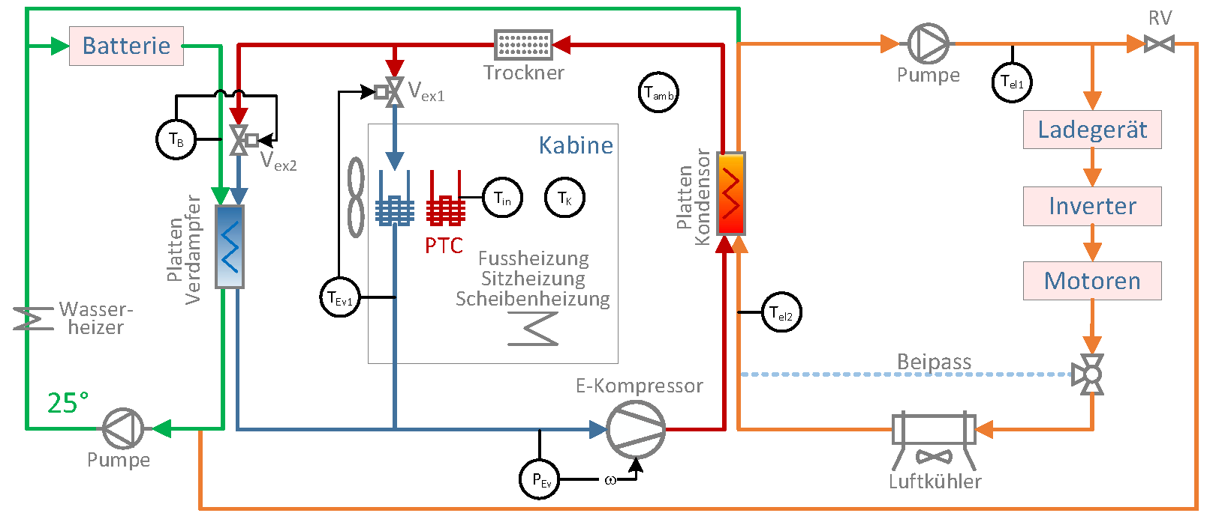
Design of the thermal management system
Example: Thermal management system of the e-dumper

