Slide 1

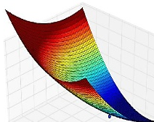

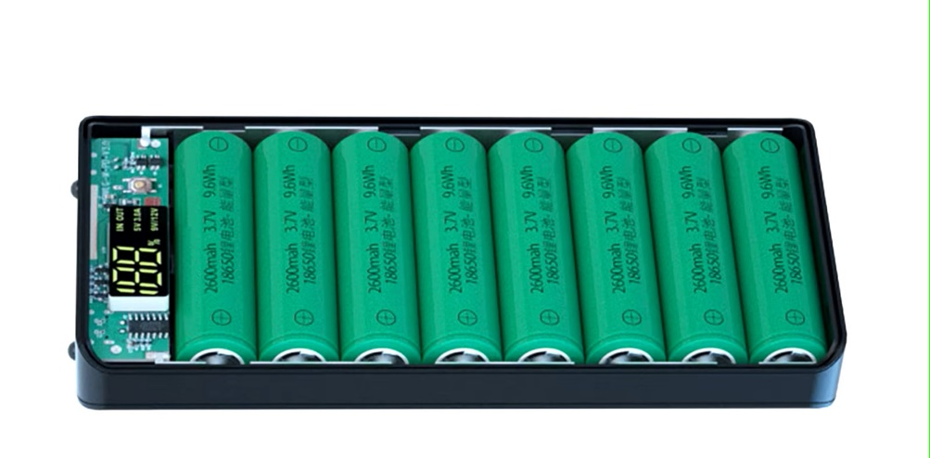





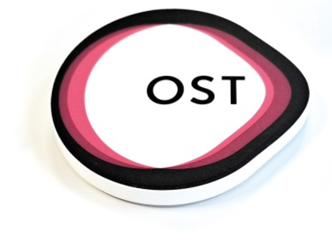

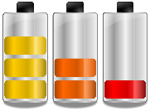
Li-Ion Battery Course
Modelling and Validation
Li-Ion Battery Cells
Thermal Design
Circular Economy
Battery Manage-
ment System
Standard and Regulations
Charging Strategies
Battery Ageing

Slide 2
Battery Management System
Learning objectives
Students understand the necessity and tasks of a battery management system
Students are familiar with the basic functions such as balancing, SoC/SoH estimation of a BMS
Students gain initial experience with a BMS in the laboratory

Slide 3
Agenda
Recap Battery Cell
  Cell Characteristic
  C-Rate
Battery Systems
  Definitions
  Challenges
Introduction to BMS
Core Functions BMS
  Monitoring
  Estimation
  High-Voltage Contactors
  Cell Balancing
  Communication
Battery Management IC’s

Slide 4
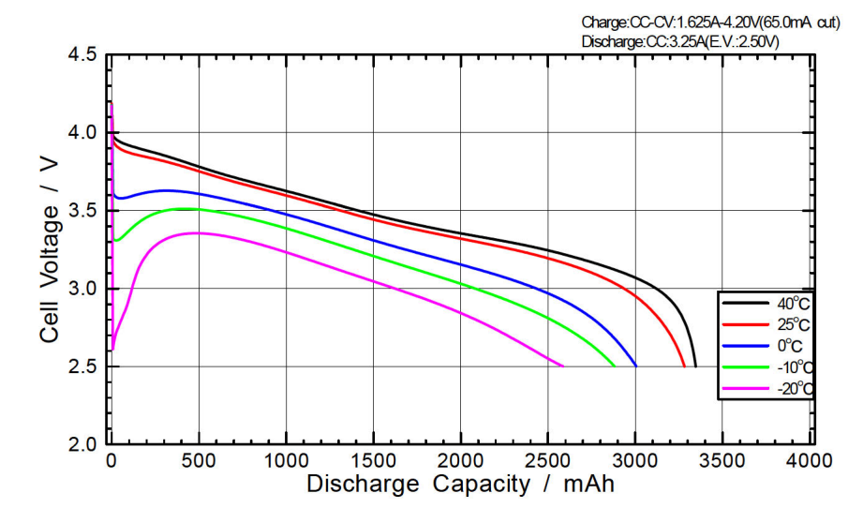
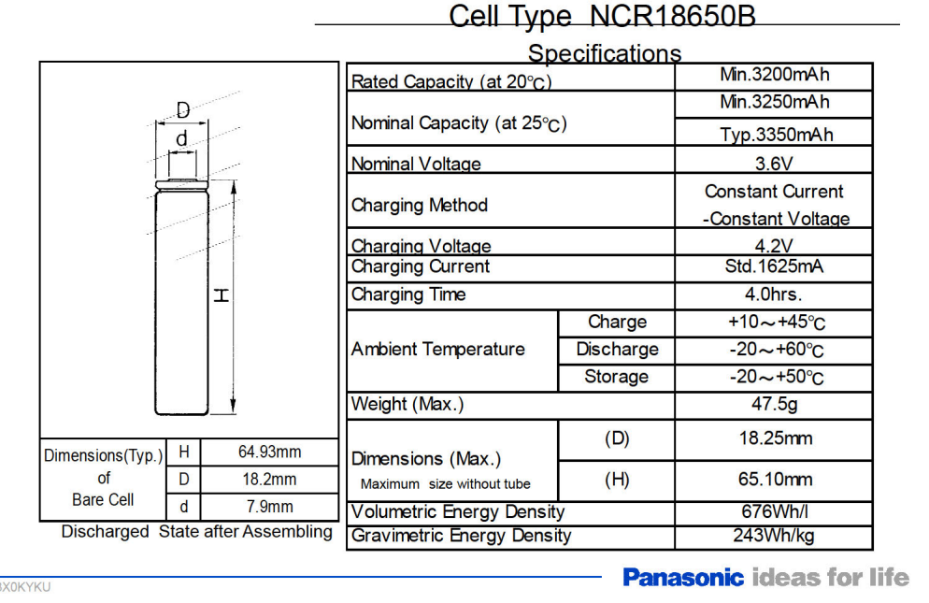
Recap Cell
Cell Characteristic
A Lithium-Ion Cell has the following main electrical characteristics
Capacity [mA]: The Energy that a battery can deliver in one discharge process
Nominal Voltage [V]: Average Voltage which the battery operates
Peak Voltage [V]: Maximum Voltage a battery can reach when fully charged
Discharge cut-off voltage [V]: Minimum Voltage when fully discharged.
Internal Resistor[Ω]: Resistance in parallel to the output
Notes:
https://doi.org/10.1016/B978-0-444-62616-5.00020-6
https://swissbatt24.ch/media/pdf/e2/71/5e/NCR18650B-Datasheet-Panasonic-Specifications.pdf

Slide 5
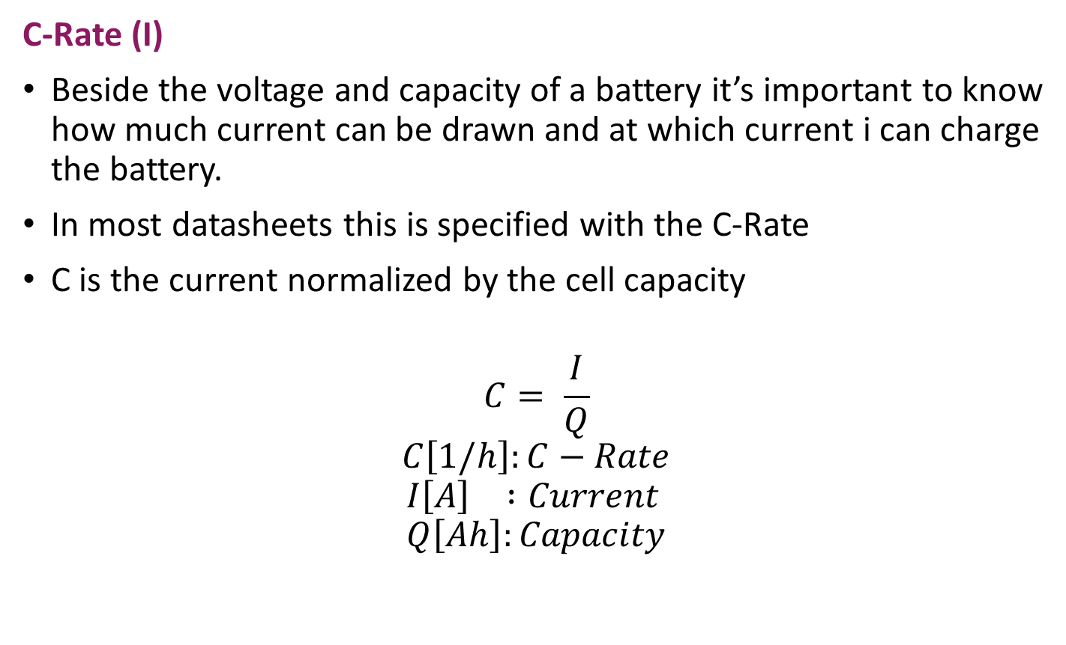
Recap Cell
C-Rate (I)
Beside the voltage and capacity of a battery it’s important to know how much current can be drawn and at which current i can charge the battery.
In most datasheets this is specified with the C-Rate
C is the current normalized by the cell capacity
$$C= \frac{I}{Q}$$
$$C\left[1/h\right]:C−Rate$$
$$I\left[A\right] :Current \\ Q\left[Ah\right]:Capacity$$
Notes:
Quelle: EMO

Slide 6
Recap Cell
C-Rate (II)
The higher the C-rate, the faster the battery can be charged or discharged
The battery heats up at higher C rates. This also influences the ageing of the battery. (The specified lifespan usually refer to a C-rate of 1 for charge/discharge cycles)
C-Rate | Time to charge/discharge
2C | 30min
1C | 1
0.5C | 2h
Notes:
Quelle: EMO

Slide 7
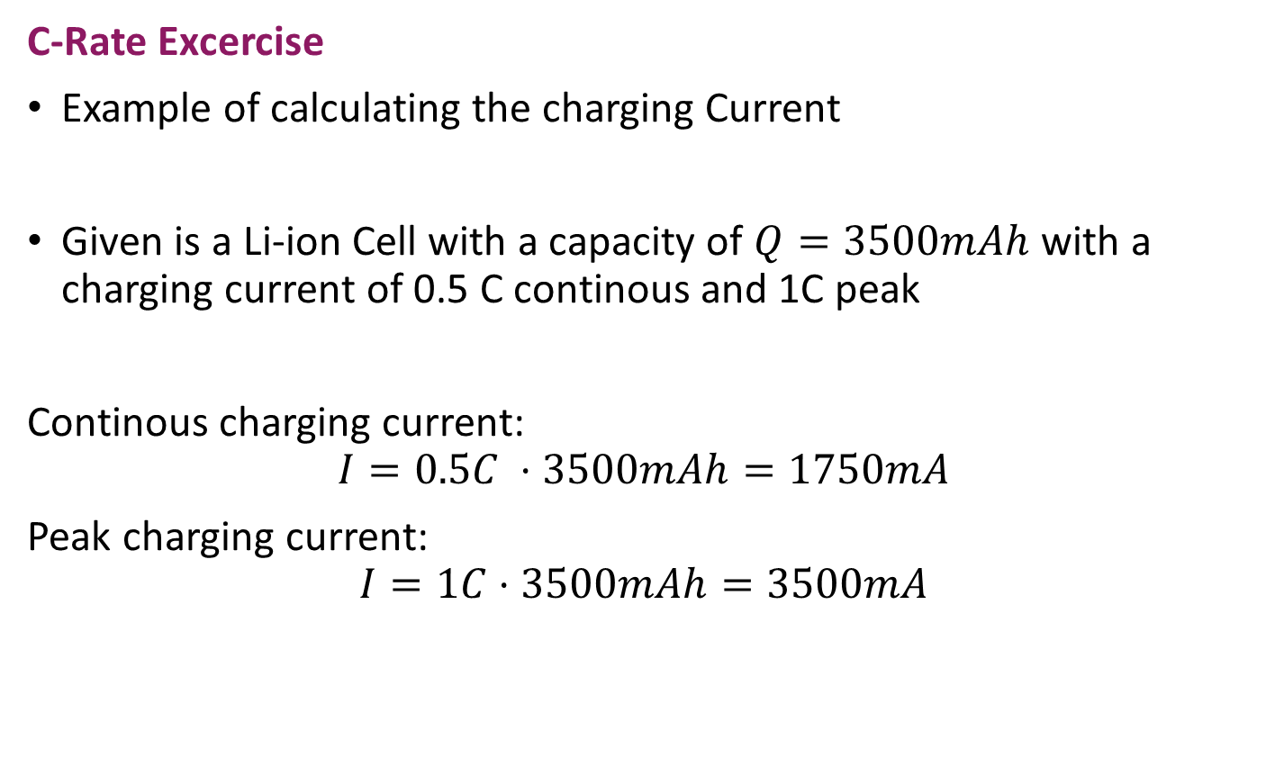
Recap Cell
C-Rate Excercise
Example of calculating the charging Current
Given is a Li-ion Cell with a capacity of $Q=3500mAh$ with a charging current of 0.5 C continous and 1C peak
Continous charging current:
$$I=0.5C ⋅3500mAh=1750mA$$
Peak charging current:
$$I=1C⋅3500mAh=3500mA$$
Notes:
Quelle: EMO

Slide 8
Agenda
Recap Battery Cell
  Cell Characteristic
  C-Rate
Battery Systems
  Definitions
  Challenges
Introduction to BMS
Core Functions BMS
  Monitoring
  Estimation
  High-Voltage Contactors
  Cell Balancing
  Communication
Battery Management IC’s

Slide 9
Battery System
Definitions
To get into the Theory of Battery Systems some Definitions are needed. These definitions are not standardized and must therefore be e.g. in a project beginning first clarified
Cell: Electrochemical Cell (smalles component of a battery)
Block: parallel circuit of cells
String: series circuit of cells
Module: Unit of blocks and strings which represents a usefull subunit
Battery/Battery pack: Energy storage build out of Modules

Slide 10
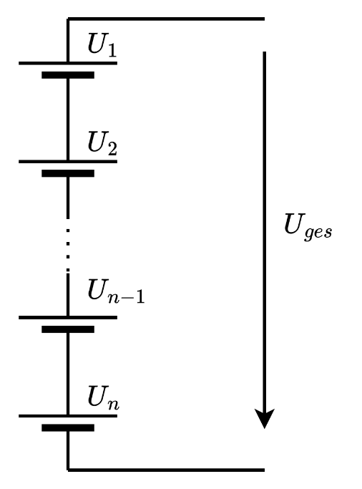

Battery System
Battery-String
To achieve the desired Voltage, cells must be connected in series.
$$U_{tot}= \sum_{n=1}^{N}{U_{n}}$$

Slide 11
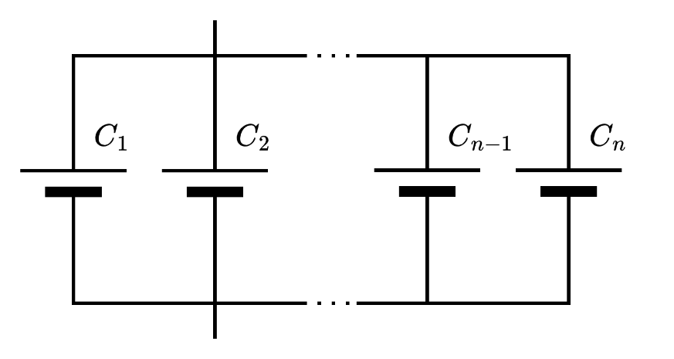

Battery System
Battery-Block
To achieve the desired capacity, cells must be connected in parallel.
$$C_{tot}= \sum_{n=1}^{N}{C_{n}}$$

Slide 12
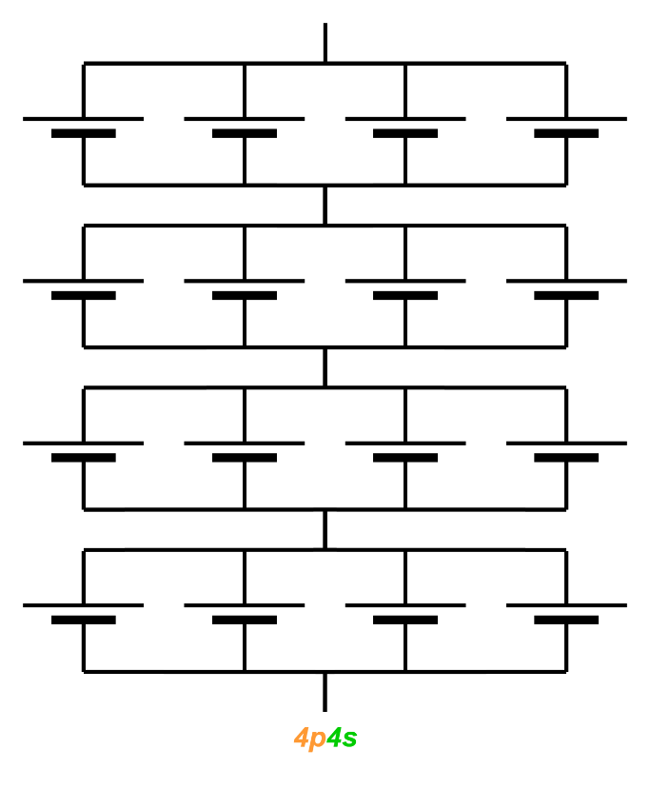
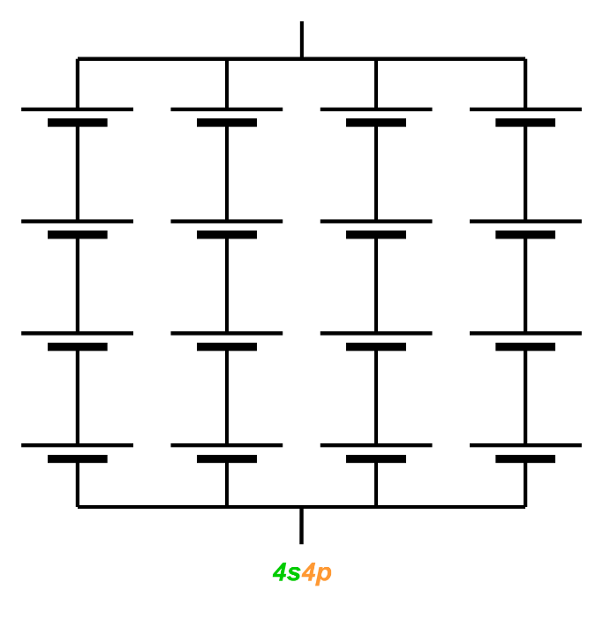

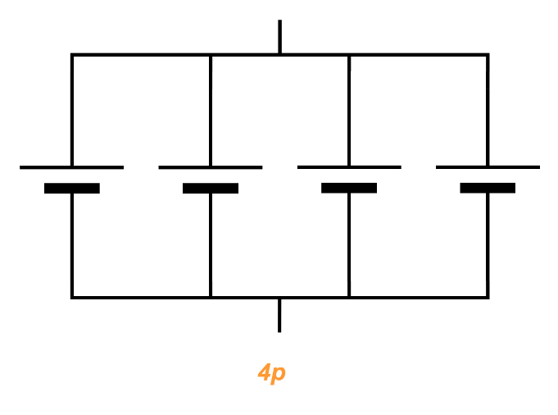
Battery System
Terminology of battery circuits
Cells in Series (s)
Cells in Parallel(p)
the order of p and s is important
Notes:
Nomeklatur aus EMO

Slide 13
Battery System
Battery System Excercise
You are tasked with designing a battery pack for an electric scooter that requires a total energy storage of minimal 1 kWh and a nominal voltage of 48V (±0.5V). You will use 18650 lithium-ion cells, each with the following specifications:
Nominal Voltage: 3.7V
Capacity: 2500mAh (2.5Ah)
Calculate the number of cells needed in series to achieve the required nominal voltage of the pack.
Calculate the number of parallel strings needed to achieve the required total capacity (energy).
Determine the total number of cells in the battery pack.
Would it make sense to divide this battery pack into modules

Slide 14
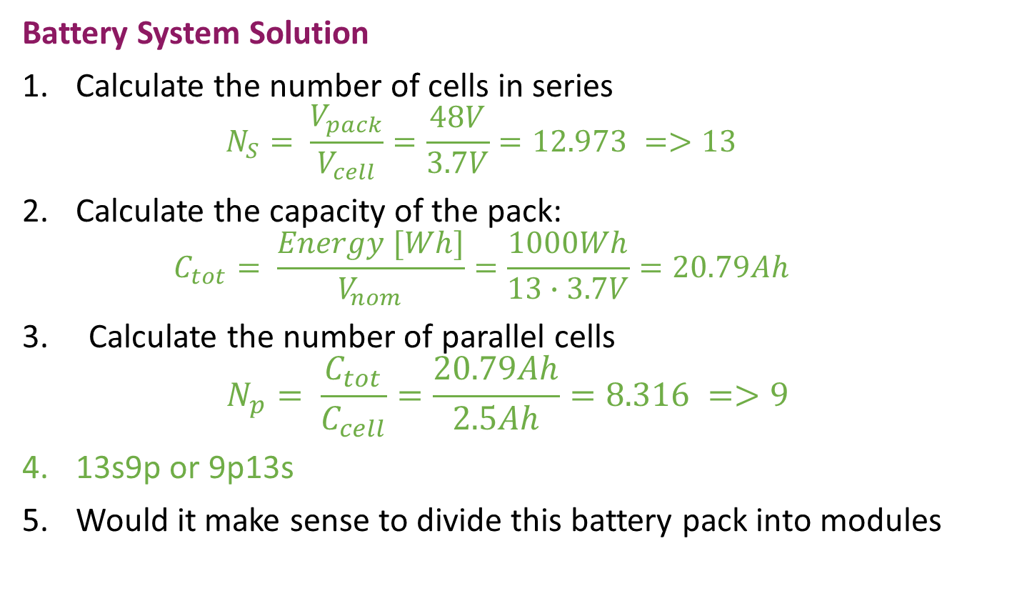
Battery System
Battery System Solution
Calculate the number of cells in series
  $$N_{S}= \frac{V_{pack}}{V_{cell}}=\frac{48V}{3.7V}=12.973 =>13$$
Calculate the capacity of the pack:
  $$C_{tot}= \frac{Energy [Wh]}{V_{nom}}=\frac{1000Wh}{13∙3.7V}=20.79Ah$$
3. Calculate the number of parallel cells
$$N_{p}= \frac{C_{tot}}{C_{cell}}=\frac{20.79Ah}{2.5Ah}=8.316 =>9$$
13s9p or 9p13s
Would it make sense to divide this battery pack into modules

Slide 15
Battery System
Challenges for Operation with Battery Systems (I)
While operating one cell seems trivial, use a group of cells is more demanding.
What could happen to the circuit
  Shortages
  Open connection
What could happen when charging or discharging
  Over-charging and Over-discharging
  Over-current during charging
  and discharging
  Over- and under temperature
Notes:
https://doi.org/10.1007/s43236-020-00122-7

Slide 16
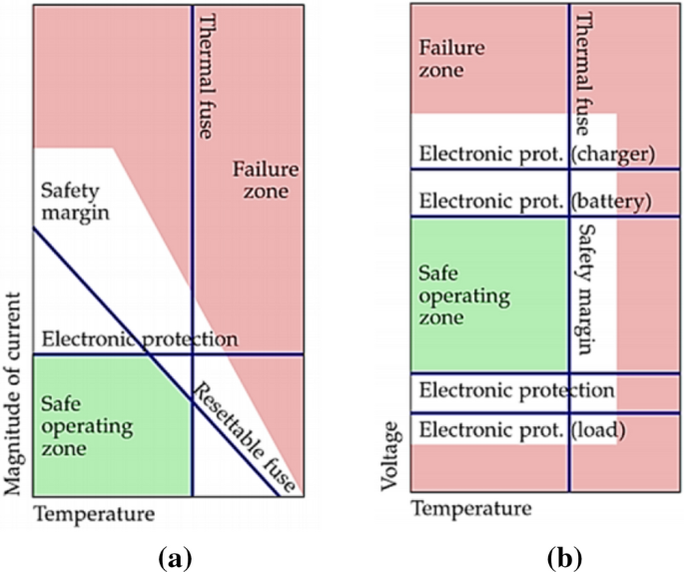
Battery System
Challenges for Operation with Battery Systems (II)
Each cell in a battery pack must
be operated in a safe zone.
Therefore, a battery cannot
be connected directly to a
system without regard to safety.
Temperature, current and
voltage also influence each
other
Notes:
https://doi.org/10.1007/s43236-020-00122-7

Slide 17
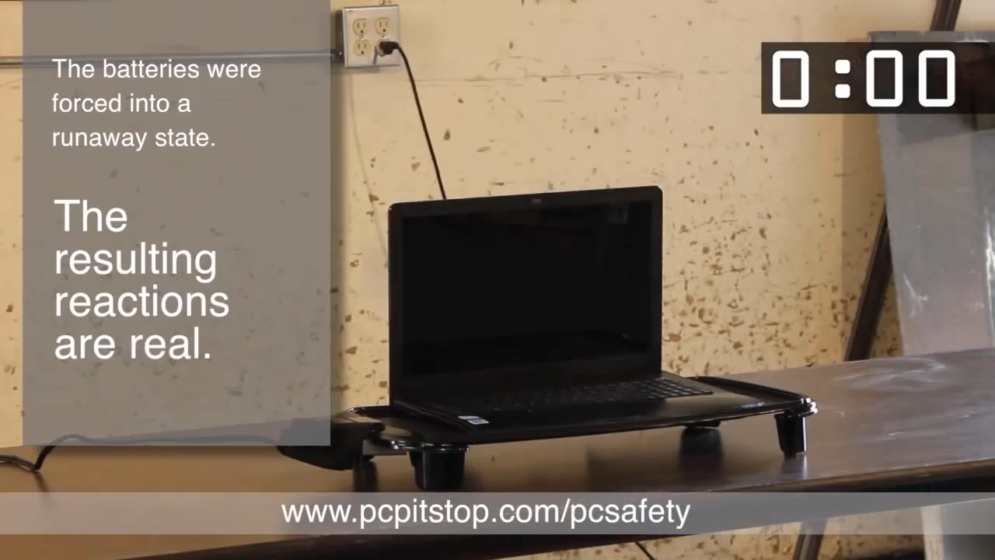
Battery System
Thermal Runaway (I)
Notes:
Quelle: EMO

Slide 18
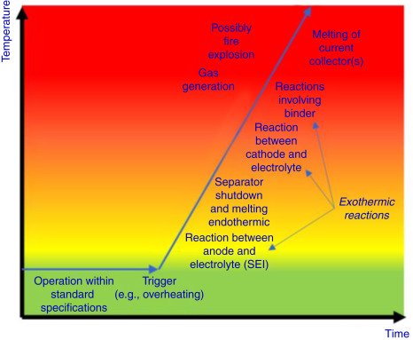
Battery System
Thermal Runaway (II)
Rapid self-heating caused by exothermic reactions in a battery.
Triggered by faults like overcharging, short circuits, or cooling failure.
Occurs when the heat generation is greater than the heat dissipation.
Notes:
https://doi.org/10.1016/B978-0-323-42977-1.00008-X

Slide 19
Agenda
Recap Battery Cell
  Cell Characteristic
  C-Rate
Battery Systems
  Definitions
  Challenges
Introduction to BMS
Core Functions BMS
  Monitoring
  Estimation
  High-Voltage Contactors
  Cell Balancing
  Communication
Battery Management IC’s

Slide 20
BMS
Introduction (I)
There are many things that can go wrong. Therefore, a system is needed that monitors and controls while operating with a battery
When systems are developed with a battery, system and user safety must be guaranteed. This can be achieved with a BMS
Definition:
A BMS is an embedded system that monitor and control the performance and safety. It influences the efficiency and varies in complexity and cost depending on the application. It consists of hardware, firmware or even software
Notes:
Quelle 1: https://ch.mathworks.com/discovery/battery-management-system.html
Quelle 2: ISBN: 978-0-443-18862-6
Quelle 3: https://www.samarins.com/glossary/battery-sensor.html (Bild)

Slide 21
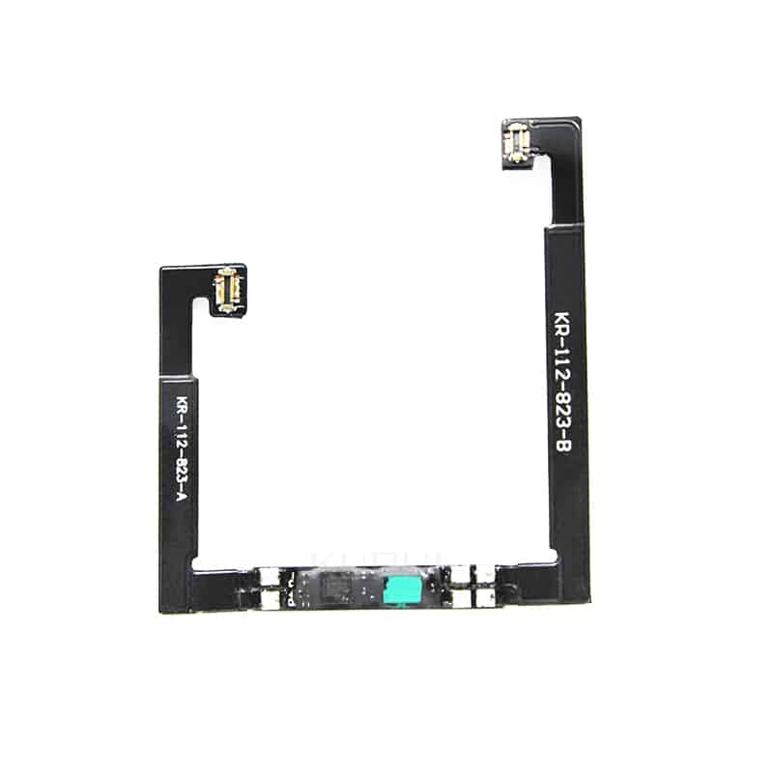
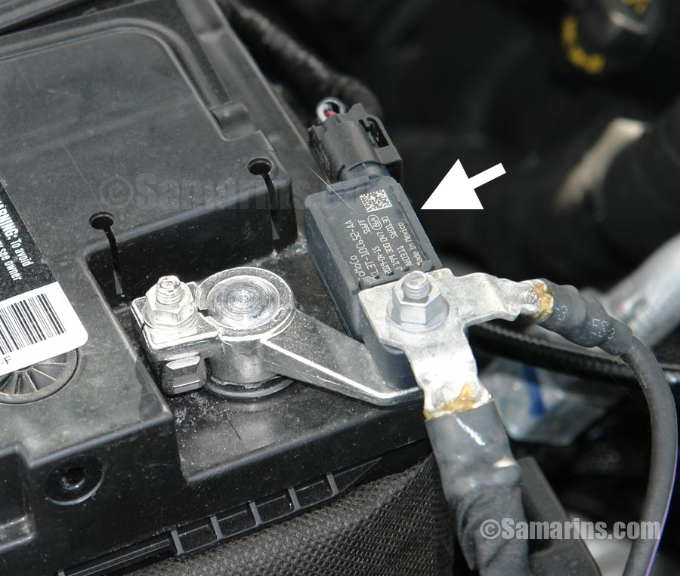
BMS
Introduction (II)
Due to its different requirements, a bms can be very different
Vehicle lead Battery
Iphone BMS
Notes:
Quelle 1: https://ch.mathworks.com/discovery/battery-management-system.html
Quelle 2: ISBN: 978-0-443-18862-6
Quelle 3: https://www.samarins.com/glossary/battery-sensor.html (Bild)

Slide 22
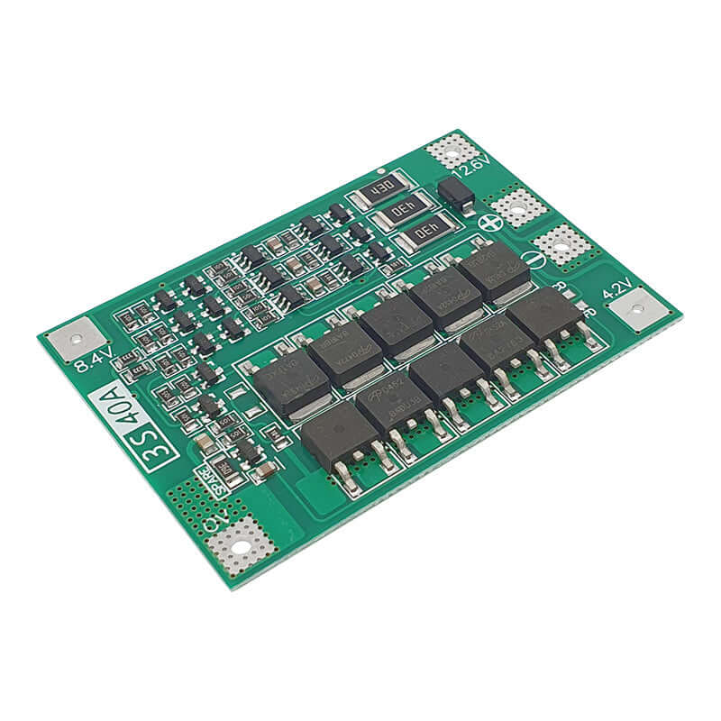
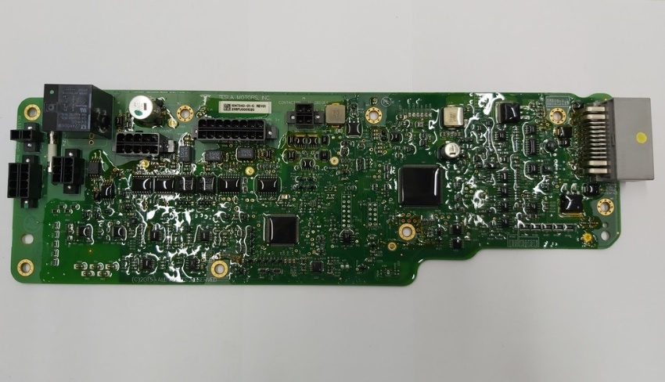
BMS
Introduction (II)
Due to its different requirements, a bms can be very different
Universal BMS
Tesla EV BMS
Notes:
Quelle 1: https://ch.mathworks.com/discovery/battery-management-system.html
Quelle 2: ISBN: 978-0-443-18862-6
Quelle 3: https://www.samarins.com/glossary/battery-sensor.html (Bild)

Slide 23
Agenda
Recap Battery Cell
  Cell Characteristic
  C-Rate
Battery Systems
  Definitions
  Challenges
Introduction to BMS
Core Functions BMS
  Monitoring
  Estimation
  High-Voltage Contactors
  Cell Balancing
  Communication
Battery Management IC’s

Slide 24
BMS
Core Functions of a BMS
Monitoring
Is needed to track key parameter, which are needed for control and estimation of the Battery System.
Protection
The system can be controlled using the monitored parameters to prevent unsafe conditions.
Cell Balancing
Ensures all cells in the battery pack maintain the same voltage level to prevent overcharging or undercharging. This improves battery performance, extends lifespan, and enhances safety.
Communication
Interfaces can be used to communicate with higher-level systems. Tasks can be distributed across several systems and computing power can be optimized.
Notes:
http://mocha-java.uccs.edu/ECE5720/ECE5720-Notes01.pdf

Slide 25
BMS
Monitoring
Monitor Parameters to control the system
  Voltage
  Current
  Temperature
Monitor Parameters for user Information
  Charge status (Phone, EV, Housbattery)
  Health of my Battery
Notes:
http://mocha-java.uccs.edu/ECE5720/ECE5720-Notes01.pdf

Slide 26
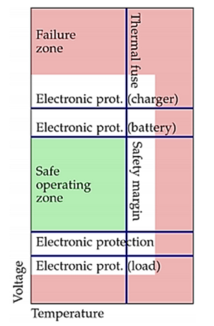
BMS
Voltage Monitoring
Voltage Monitoring is needed to prevent over- and undervoltage. Therfore all cellvoltages must be measured
IC’s for measuring multiple cell voltages or analog to digital converters are used
Required for the derivation of other parameters like SOC, SOH and cell balancing
Notes:
http://mocha-java.uccs.edu/ECE5720/ECE5720-Notes01.pdf

Slide 27
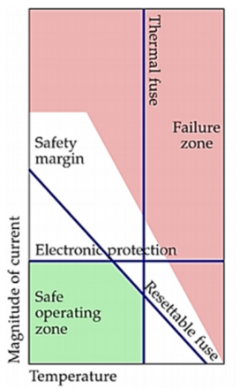
BMS
Current Monitoring (I)
Is needed to detect overcurrent, or short circuit and correct charge/discharge rates.
Mainly done over shunt or Hall effect
Required for the derivation of other parameters like SOC, SOH
Notes:
http://mocha-java.uccs.edu/ECE5720/ECE5720-Notes01.pdf

Slide 28
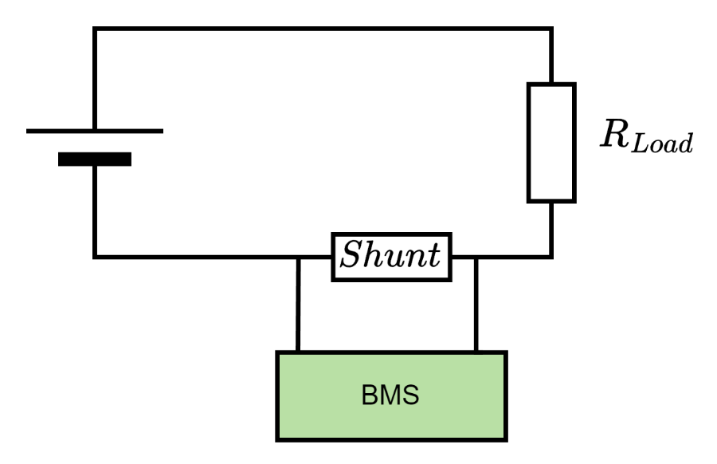

BMS
Current Monitoring (II)
A Shunt sensor is a high-presicion resistor.
The resistance must be small so that no significant energy is consumed (<< 1Ω)
Most BMS IC’s have pins for shunt connection
Current is calculated over the voltage drop and the known resistance
$$I= \frac{U_{R}}{R}$$
Notes:
http://mocha-java.uccs.edu/ECE5720/ECE5720-Notes01.pdf

Slide 29
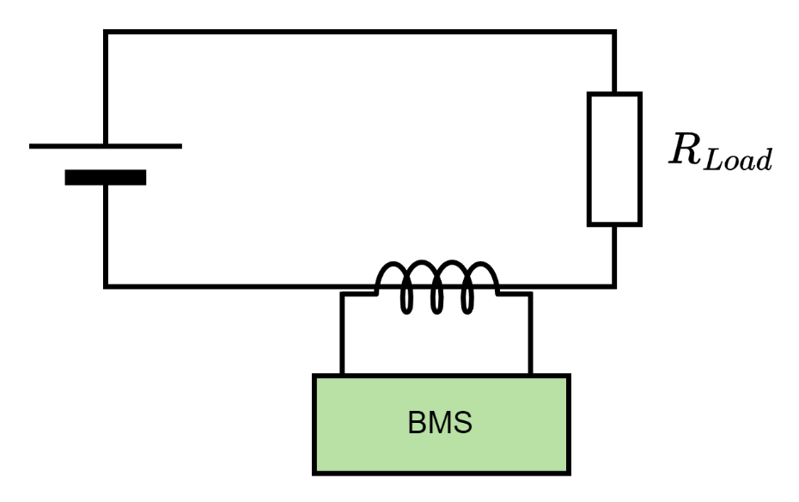
BMS
Current Monitoring (III)
A Hall-effect sensor measures the magnetic field which is generated through the current in a conductor.
No connection is needed
Notes:
http://mocha-java.uccs.edu/ECE5720/ECE5720-Notes01.pdf

Slide 30
BMS
Temperatur Monitoring (I)
Prevents thermal runaway and detect out of range temperatures.
High Temperatures decrease battery life
Low Temperatures lower the capacity of the battery
Can be used to heat or cool the battery.
Notes:
http://mocha-java.uccs.edu/ECE5720/ECE720-Notes01.pdf
https://ch.mathworks.com/discovery/battery-management-system.html

Slide 31
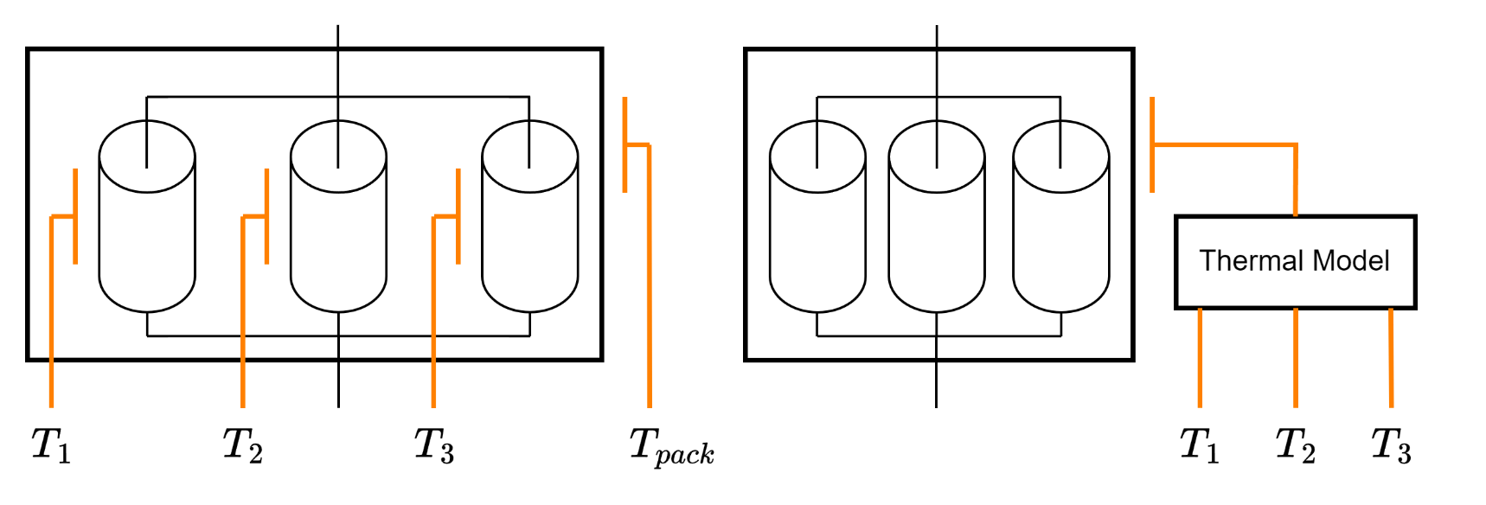
BMS
Temperatur Monitoring (II)
Temperature of each cell is needed which leads to high measurement effort
Repleacment of measurments can be done with accurate thermal models which make it possible to derive temperatures with less sensors
Notes:
http://mocha-java.uccs.edu/ECE5720/ECE5720-Notes01.pdf

Slide 32
BMS
Temperatur Monitoring (III)
A temperature sensor converts a temperatur into a voltage, which can be measured.
This voltage can be measured and calculated back into a temperature.
BMS IC’s have interfaces to these sensors.
Notes:
http://mocha-java.uccs.edu/ECE5720/ECE5720-Notes01.pdf

Slide 33
BMS
Temperatur Monitoring (IV)
Temperature sensors, produce a voltage signal wich can be measured over an ADC.
Thermocouples are temperature sensors that generate a voltage proportional to the temperature difference between two different metals. The generated voltage is measured and converted into a temperature by the BMS system.
Thermistor are temperature sensor that changes its resistance with temperature. The resistance affect the voltage which can be measured.
Notes:
http://mocha-java.uccs.edu/ECE5720/ECE5720-Notes01.pdf

Slide 34
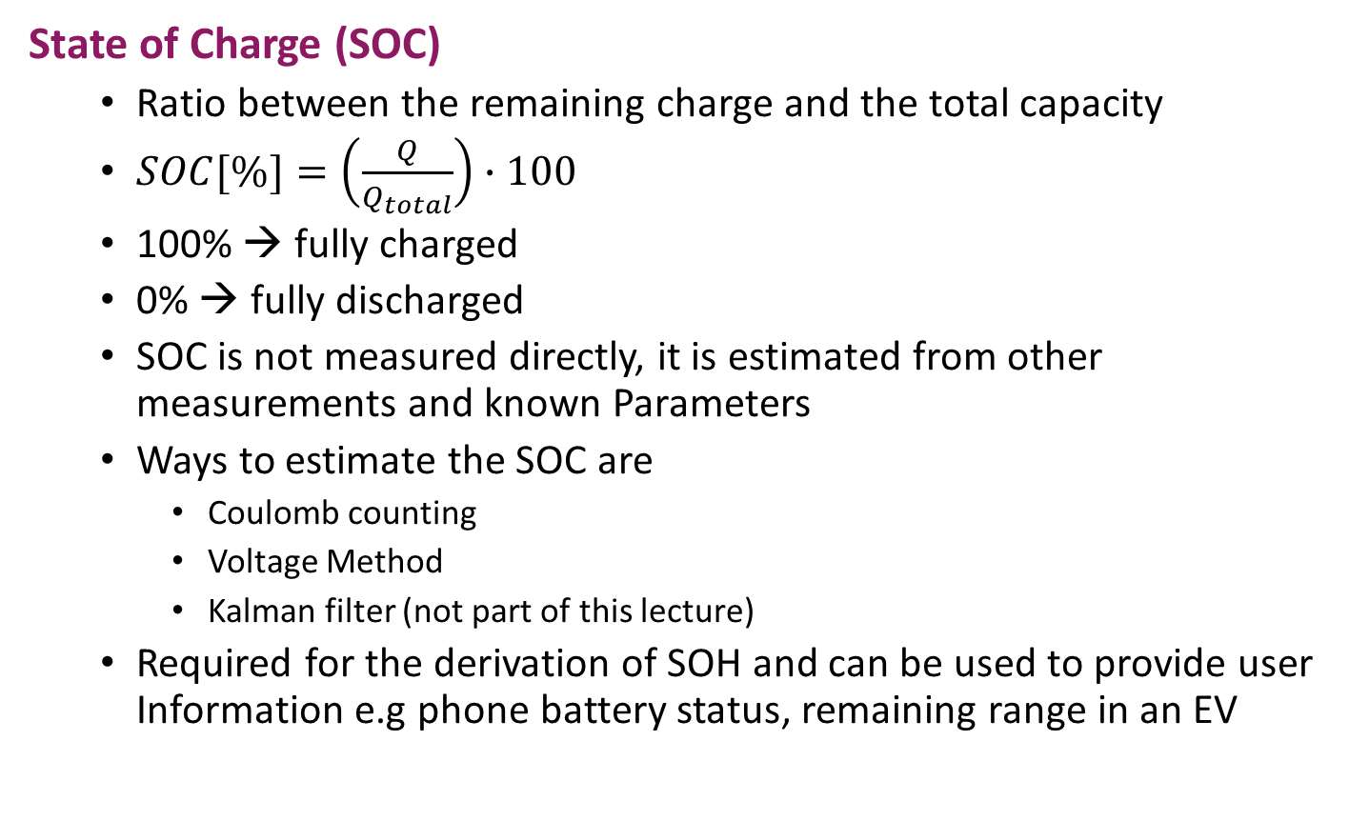
BMS
State of Charge (SOC)
  Ratio between the remaining charge and the total capacity
  $SOC[\%]=\left(\frac{Q}{Q_{total}}\right)∙100$
  100% → fully charged
  0% → fully discharged
  SOC is not measured directly, it is estimated from other measurements and known Parameters
  Ways to estimate the SOC are
    Coulomb counting
    Voltage Method
    Kalman filter (not part of this lecture)
  Required for the derivation of SOH and can be used to provide user Information e.g phone battery status, remaining range in an EV
Notes:
https://www.analog.com/en/resources/technical-articles/a-closer-look-at-state-of-charge-and-state-health-estimation-tech.html

Slide 35
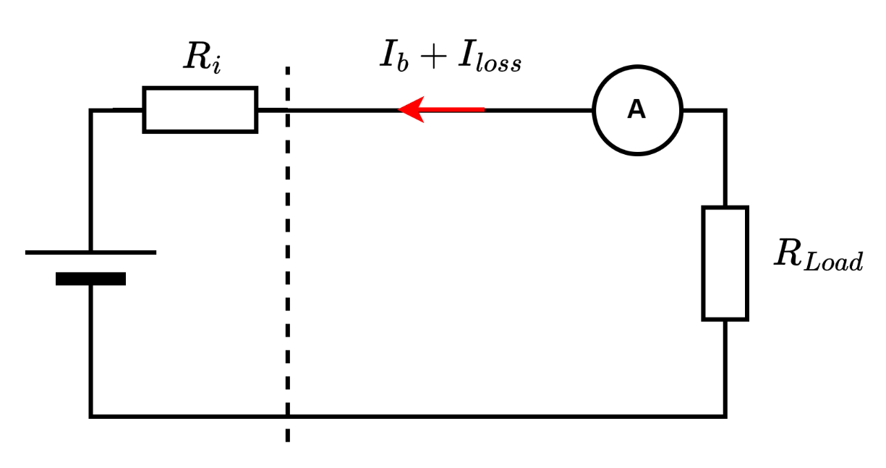

BMS
Coulomb counting (Amper hour counting/ Current integration)
  Most common technique
  Initial SOC needed
  $$SOC=SOC\left(t_{0}\right)+\frac{1}{C_{rated}}\int_{t_{0}}^{t_{0}+τ}{\left(I_{b}−I_{loss}\right) dt}$$

Slide 36
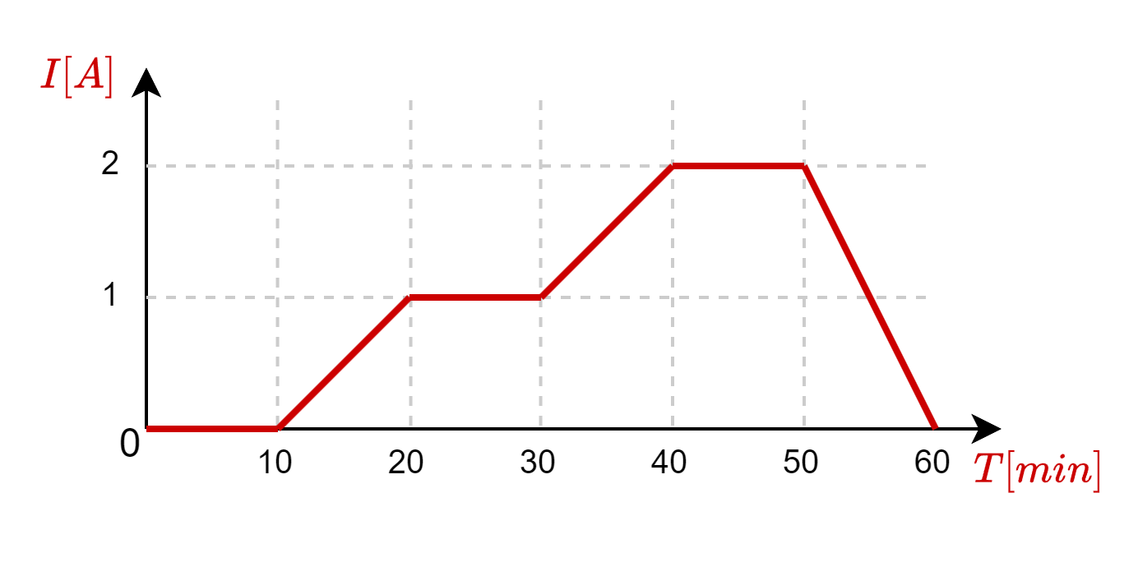
BMS
Coulomb counting Exercise
Calculate the State of Charge after the following Current data during discharging
The initial SOC is 90 % and the batteries capacity is 3500 mAh

Slide 37
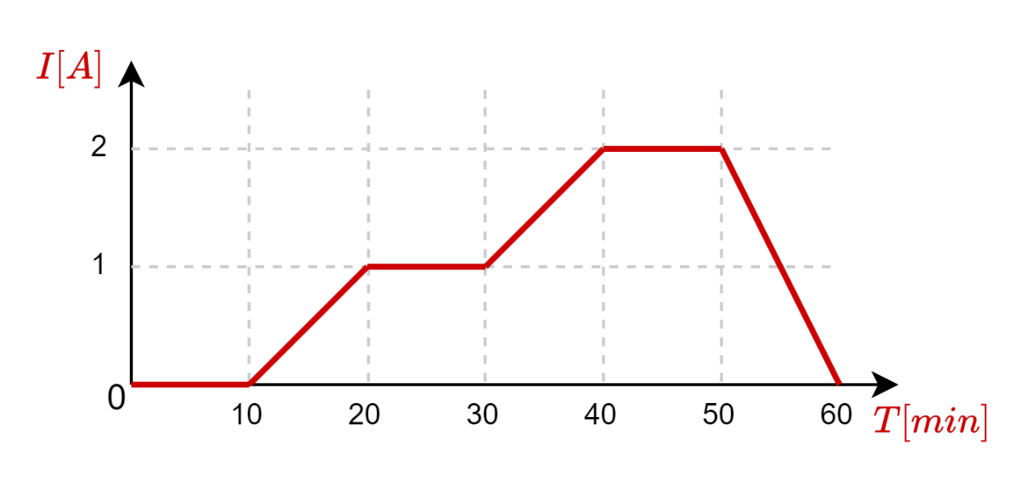
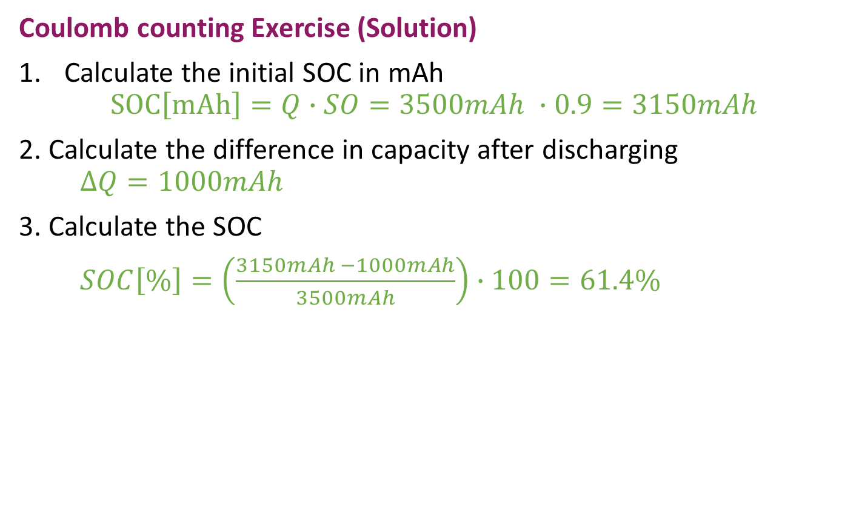
BMS
Coulomb counting Exercise (Solution)
Calculate the initial SOC in mAh
$SOC\left[mAh\right]=Q∙SO=3500mAh ∙0.9=3150mAh$
2. Calculate the difference in capacity after discharging
$∆Q=1000mAh$
3. Calculate the SOC
$SOC\left[\%\right]=\left(\frac{3150mAh −1000mAh}{3500mAh}\right)∙100=61.4\%$

Slide 38
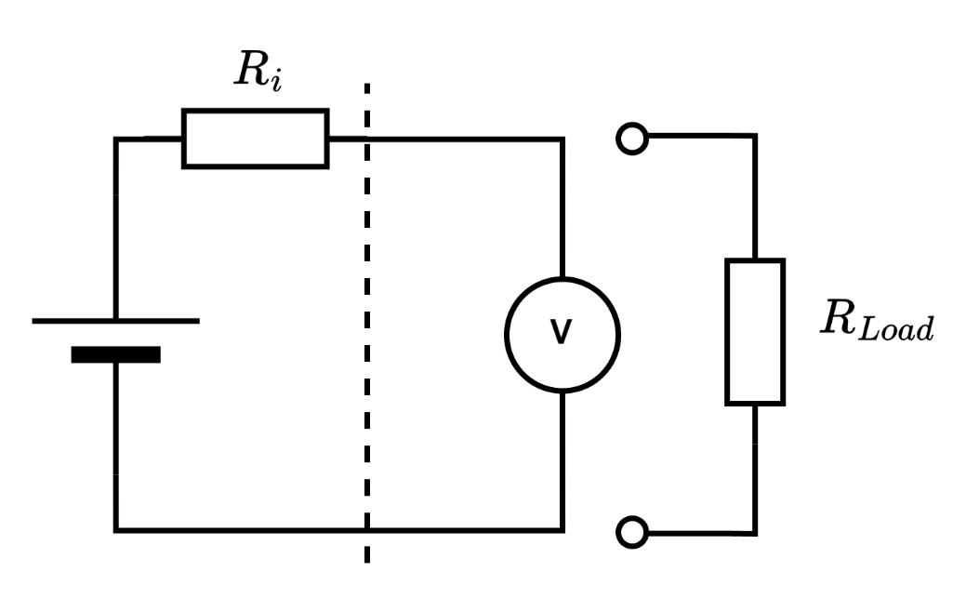
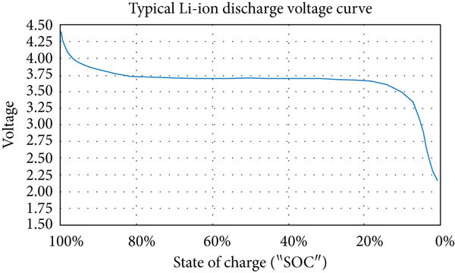
BMS
Voltage Method
  Known discharge curve
  Inaccurate for flat curves
  Measurement heavily disturbed by charging and discharging
  Battery must be floating
Notes:
http://dx.doi.org/10.1155/2022/1648433

Slide 39
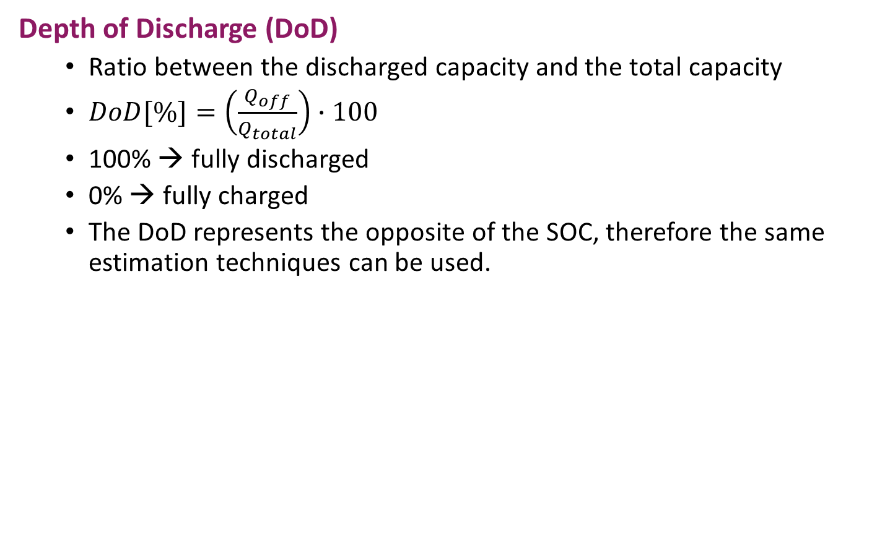
BMS
Depth of Discharge (DoD)
  Ratio between the discharged capacity and the total capacity
  $DoD[\%]=\left(\frac{Q_{off}}{Q_{total}}\right)∙100$
  100% → fully discharged
  0% → fully charged
  The DoD represents the opposite of the SOC, therefore the same estimation techniques can be used.
Notes:
https://www.analog.com/en/resources/technical-articles/a-closer-look-at-state-of-charge-and-state-health-estimation-tech.html

Slide 40
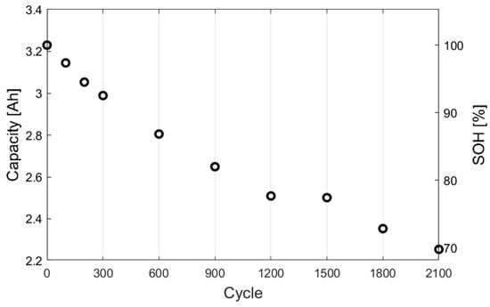

BMS
State of Health (SOH)
  Charged capacity as percentage compared to the nominal capacity
  $SOH[\%]=\left(\frac{Q}{Q_{Nom}}\right)∙100$
  SOC needed to estimate SOH
Notes:
https://doi.org/10.3390/app14209569

Slide 41
BMS
Protection
Simply measuring parameters is not enough if no actions are taken. A BMS actively intervenes in the system to prevent critical conditions. For instance, it disconnects the charging source in case of overcharging, limits current flow during overcurrent, or shuts down the system when overheating is detected, ensuring safety and preventing damage.
The design and level of protection is the system designer's responsibility, depending on the specific application and requirements. There are

Slide 42
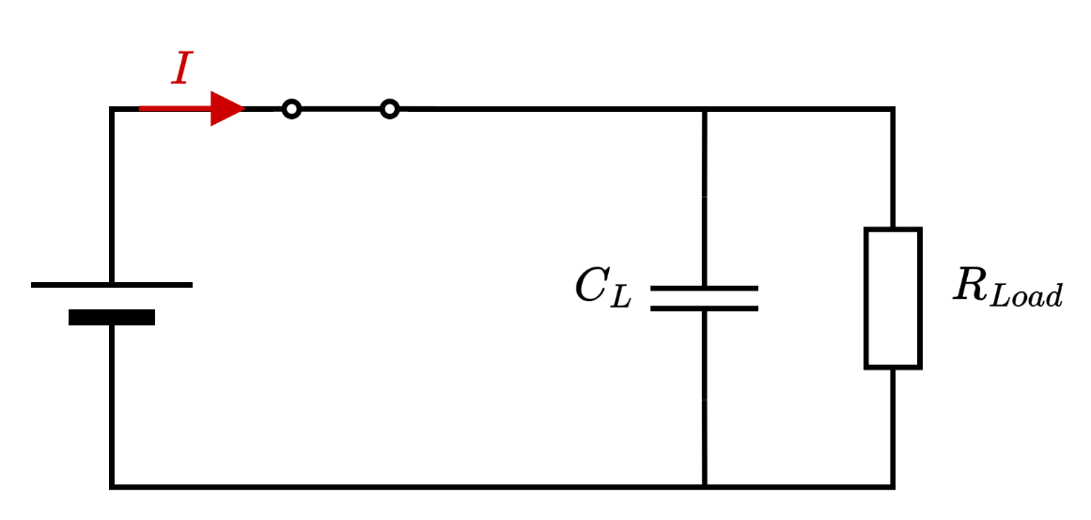
BMS
High-Voltage Contactors (I)
Some BMS can disconnect the load from the battery. If the load is Capacitive, which is mostly the case, the inrush current can easily peak to a few 100 A.
  At high frequencies, capacitors form a short circuit!
To prevent this, high voltage systems have a pre-charge function where first the capacitor gets pre-charged and then the main switch close.
Notes:
https://www.ti.com/lit/wp/slvaf35a/slvaf35a.pdf?ts=1732605588418

Slide 43
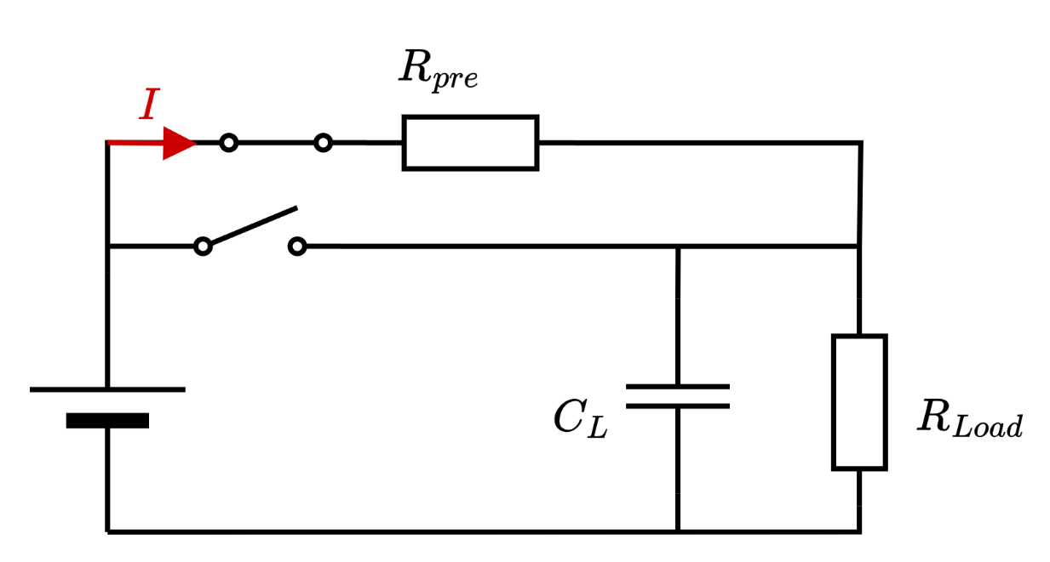

BMS
High-Voltage Contactors (II)
To prevent this, high voltage systems have a pre-charge function where first the capacitor gets pre-charged and then the main switch close.
$I_{max}= \frac{U_{BAT}}{R_{pre}}$
Notes:
https://www.ti.com/lit/wp/slvaf35a/slvaf35a.pdf?ts=1732605588418

Slide 44
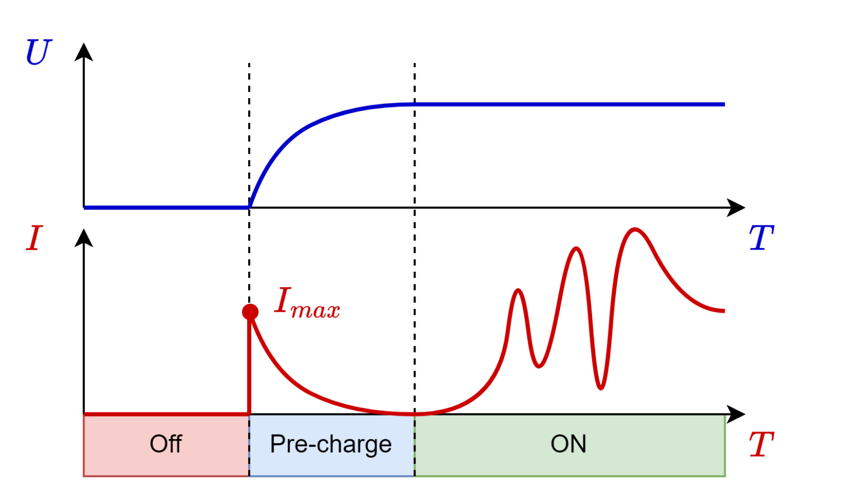

BMS
High-Voltage Contactors (III)
To prevent this, high voltage systems have a pre-charge function where first the capacitor gets pre-charged and then the main switch close.
$I_{max}= \frac{U_{BAT}}{R_{pre}}$
Notes:
https://liionbms.com/php/precharge.php

Slide 45
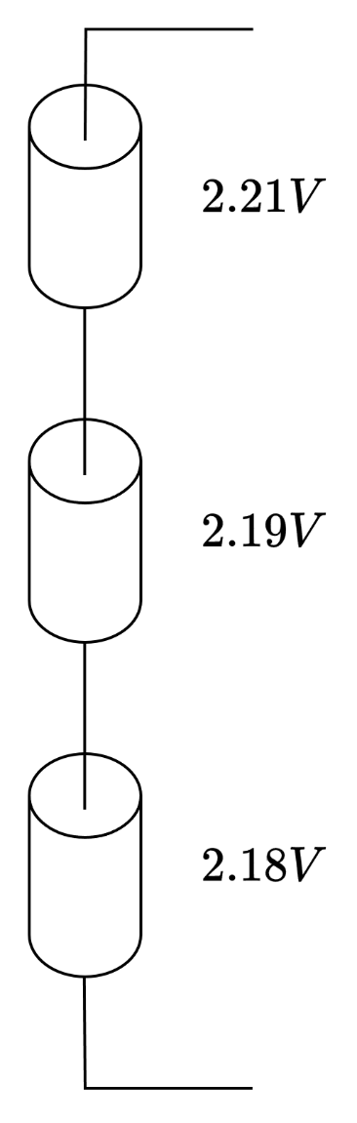
BMS
Cell Balancing
Not every cell has the same behavior due to manufacturing tolerances and different ageing. Therefore, all cells connected in series must be monitored.
Parallel blocks balance themselves
To Charge each cell to the maximum without overcharging some cells, a balancing is needed.
There are three main cell balancing approaches
  Resistive
  Capacitive
  Inductive
Notes:
Quelle 1: EMO
Quelle 2: https://www.ti.com/download/trng/docs/seminar/Topic%202%20-%20Battery%20Cell%20Balancing%20-%20What%20to%20Balance%20and%20How.pdf

Slide 46
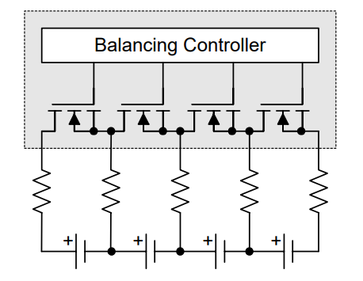
BMS
Resistive Cell Balancing
  Discharge cell via a resistor.
  Internal or External FETs to control the balancing
  Energy is wasted
Notes:
Quelle 1: EMO
Quelle 2: https://www.ti.com/download/trng/docs/seminar/Topic%202%20-%20Battery%20Cell%20Balancing%20-%20What%20to%20Balance%20and%20How.pdf

Slide 47
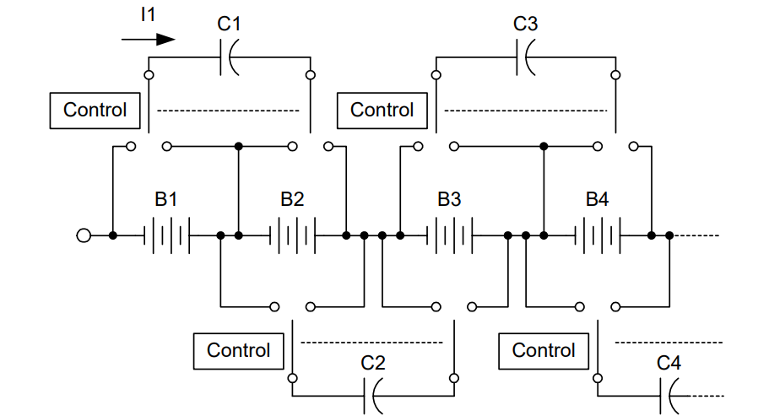
BMS
Capacitive cell balancing
  Capacitor as Energy storage
  Load the Capacitor with a higher Voltage Cell
  Discharge the Capacitor with a lower Voltage Cell
  Energy is being redistributed
  Charging a Capacitor is inefficient (50%)
  Transfer rate is proportional to the voltage differences
Notes:
Quelle 1: EMO
Quelle 2: https://www.ti.com/download/trng/docs/seminar/Topic%202%20-%20Battery%20Cell%20Balancing%20-%20What%20to%20Balance%20and%20How.pdf

Slide 48
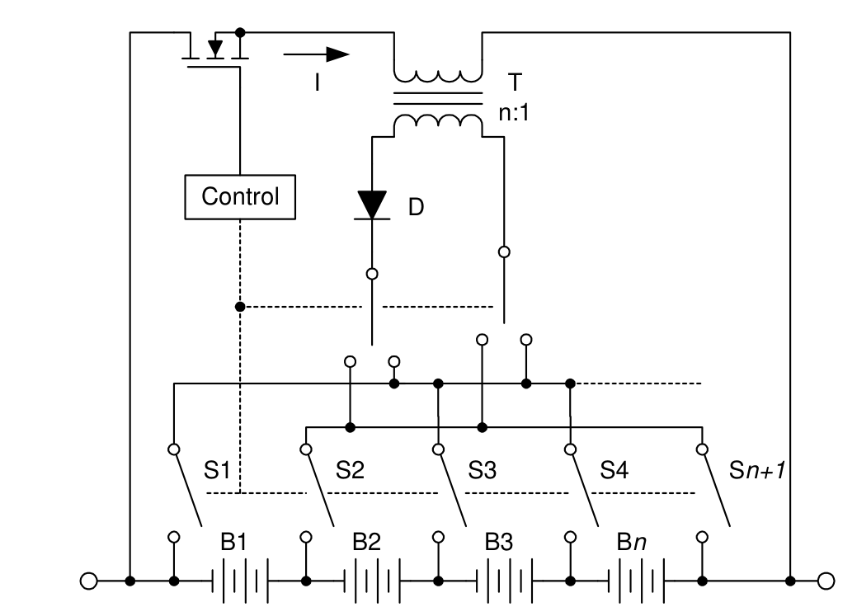
BMS
Inductive cell balancing
  Transfer Pack Energy into one cell
  Expensive
  Transformer needed
  Efficiency not optimal
Notes:
Quelle 1: EMO
Quelle 2: https://www.ti.com/download/trng/docs/seminar/Topic%202%20-%20Battery%20Cell%20Balancing%20-%20What%20to%20Balance%20and%20How.pdf

Slide 49
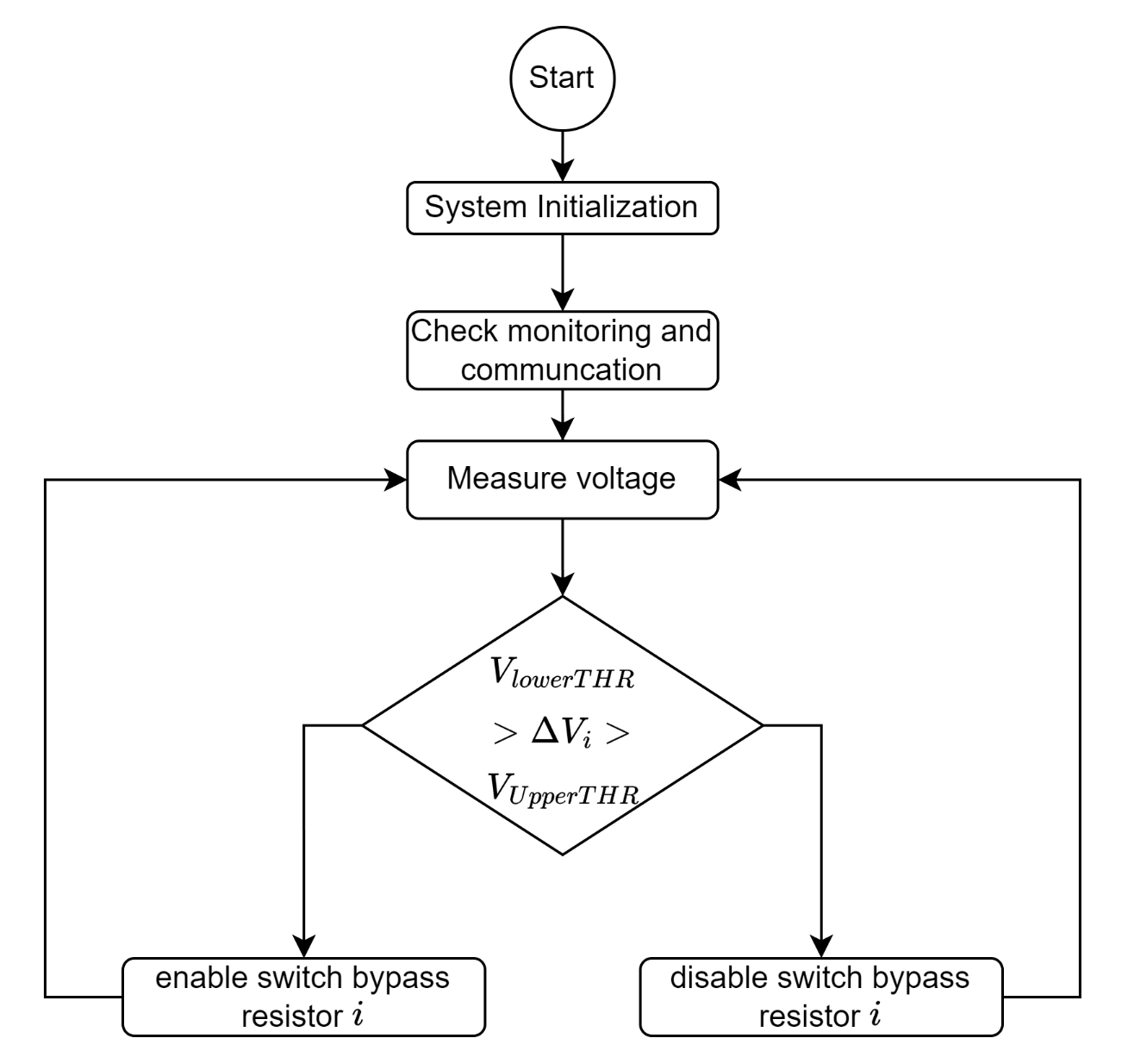
BMS
Cell balancing Algorithms (I)
A simple approach to cell balancing
There are some problems with this algorithm
  To which cell should be corrected
  How accurate are the measurements
  Are external influences are considered
  Only for resistive cell balancing
Notes:
Quelle 1: EMO
Quelle 2: https://www.ti.com/download/trng/docs/seminar/Topic%202%20-%20Battery%20Cell%20Balancing%20-%20What%20to%20Balance%20and%20How.pdf

Slide 50
BMS
Cell balancing Algorithms (II)
A voltage-based algorithm
  Δ60% SOC ≈ Δ 100mV !
  Complex analogue front-end is required to measure this voltage differences
Notes:
Quelle 1: EMO
Quelle 2: https://www.ti.com/download/trng/docs/seminar/Topic%202%20-%20Battery%20Cell%20Balancing%20-%20What%20to%20Balance%20and%20How.pdf

Slide 51
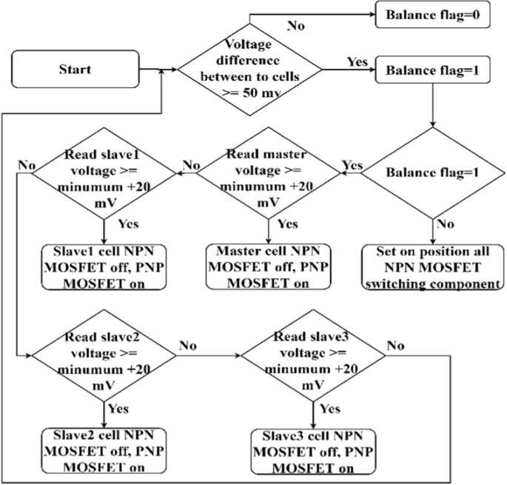
BMS
Cell balancing Algorithms (III)
When do we start cell balancing
  During charging?
  Near the end of charging?
  During discharging?
Notes:
https://doi.org/10.1007/s43236-021-00320-x

Slide 52
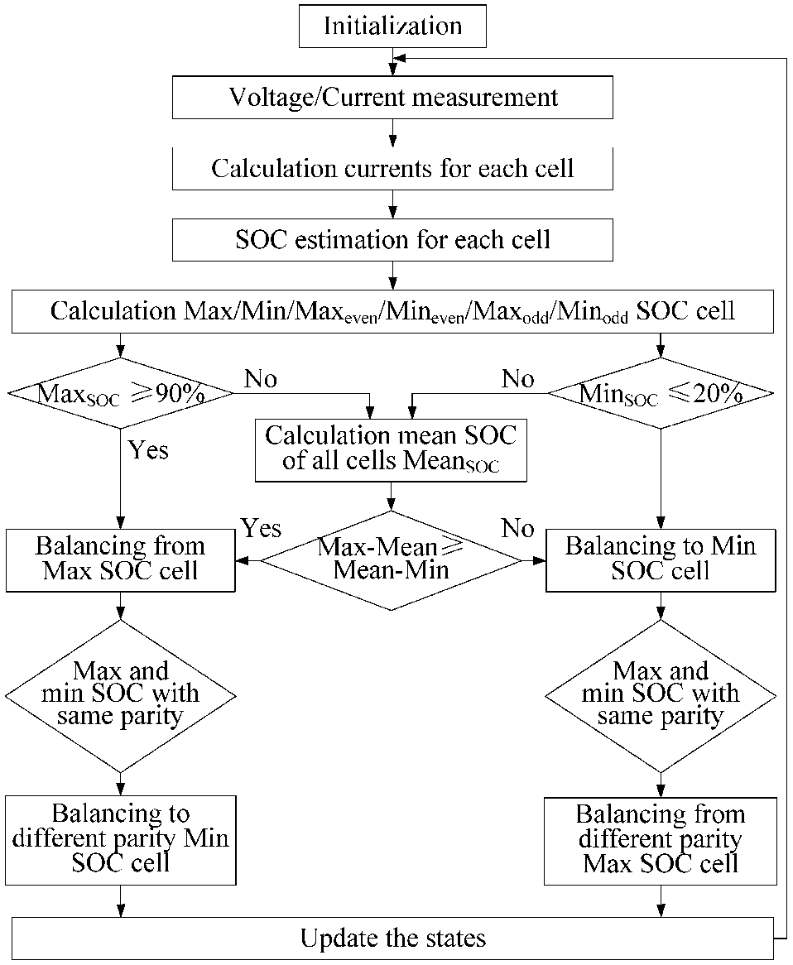
BMS
Cell balancing Algorithms (II)
A SOC approach to cell balancing
Notes:
Quelle 1: https://doi.org/10.3390/en6062726
Quelle 2: https://www.ti.com/download/trng/docs/seminar/Topic%202%20-%20Battery%20Cell%20Balancing%20-%20What%20to%20Balance%20and%20How.pdf

Slide 53
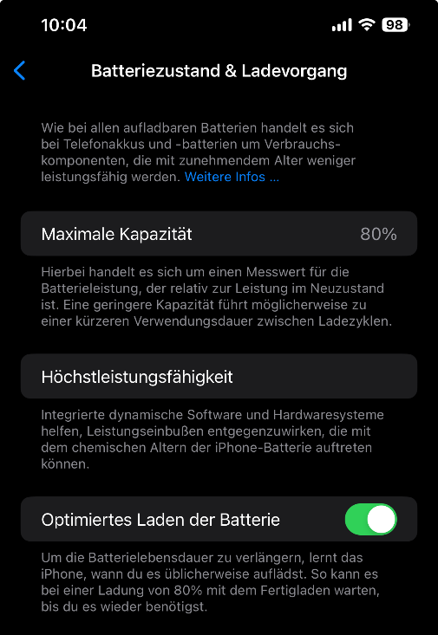
BMS
Communication (I)
Sometimes a BMS need to interface with other systems
  Electric Vehicle
  Home Automation
  Robotics
  Data Analytics
  Host Controllers
  Etc..
There are common protocols
  CAN (std. Automotive)
  I2C (slow serial bus)
  UART (serial communication protocol)
  SPI (fast serial bus)

Slide 54
Agenda
Recap Battery Cell
  Cell Characteristic
  C-Rate
Battery Systems
  Definitions
  Challenges
Introduction to BMS
Core Functions BMS
  Monitoring
  Estimation
  High-Voltage Contactors
  Cell Balancing
  Communication
Battery Management IC’s

Slide 55
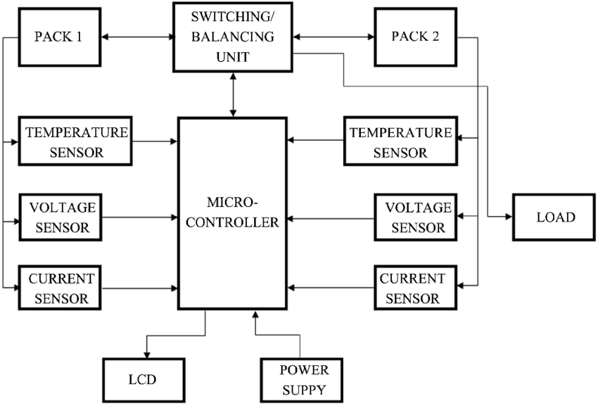
BMS
Battery Management IC’s (I)
The central component of a BMS is an IC which processes data, calculates critical values, and controls key peripherals.
Notes:
http://dx.doi.org/10.4236/epe.2022.1412042

Slide 56
BMS
Battery Management IC’s (II)
Microcontroller-Based
  Programmable for custom algorithms
  Suitable for complex BMS designs with communication protocols (e.g., CAN, I2C, UART)
  Higher flexibility for integrating advanced features like SoC estimation
Dedicated BMS IC’s
  Special designed for battery management.
  Integrated functions like cell monitoring, balancing, and thermal management.
  Simplifies hardware design, reducing development time.
Notes:
https://www.ti.com/lit/ds/symlink/bq76905.pdf?ts=1733044762805&ref_url=https%253A%252F%252Fwww.ti.com%252Fproduct%252FBQ76905

Slide 57
BMS
Battery Management IC’s Exercise (I)
This exercise helps you to understand how a BMS IC, such as the BQ76905, works by exploring its datasheet. You will practice reading datasheets to extract important information needed to design a BMS.
1. General Specification
What is the maximum number of cells the BQ76905 can monitor?
What type of batteries is this IC designed for (chemistry)?
2. Electrical Characteristics
What is the input voltage range for the battery cells?
What is the accuracy of the voltage measurements?
3. Cell Balancing
What type of cell balancing does the BQ76905 support?
What is the typical internal balancing current, and how is it configured?
Notes:
https://www.ti.com/lit/ds/symlink/bq76905.pdf?ts=1733044762805&ref_url=https%253A%252F%252Fwww.ti.com%252Fproduct%252FBQ76905

Slide 58
BMS
Battery Management IC’s Exercise (II)
This exercise helps you to understand how a BMS IC, such as the BQ76905, works by exploring its datasheet. You will practice reading datasheets to extract important information needed to design a BMS.
4. Protection
How does the IC detect overcurrent conditions?
What overvoltage and undervoltage thresholds can be programmed?
5. Temperature Monitoring
How the Temperature is measured and what is the recommended type of the sensor.
6. Communication
What communication protocol does the IC use?
What are the data rates supported by this interface?
Notes:
https://www.ti.com/lit/ds/symlink/bq76905.pdf?ts=1733044762805&ref_url=https%253A%252F%252Fwww.ti.com%252Fproduct%252FBQ76905

Slide 59
BMS
Battery Management IC’s Exercise (III)
This exercise helps you to understand how a BMS IC, such as the BQ76905, works by exploring its datasheet. You will practice reading datasheets to extract important information needed to design a BMS.
7. Application Design
Look at the typical application diagram. Which external components are required for proper operation?
What is the purpose of the sense resistor in the circuit?
Notes:
https://www.ti.com/lit/ds/symlink/bq76905.pdf?ts=1733044762805&ref_url=https%253A%252F%252Fwww.ti.com%252Fproduct%252FBQ76905

Slide 60
BMS
Battery Management IC’s Exercise (I)
This exercise helps you to understand how a BMS IC, such as the BQ76905, works by exploring its datasheet. You will practice reading datasheets to extract important information needed to design a BMS.
1. General Specification
What is the maximum number of cells the BQ76905 can monitor?
5 Cells
What type of batteries is this IC designed for (chemistry)?
Li-ion, Li-polymer, LiFePO4, LTO
2. Electrical Characteristics
What is the input voltage range for the battery cells?
-0.3V to 40V in relation to ground (absolute maximum ratings)
What is the accuracy of the voltage measurements?
16 Bit (typ. 4mV on cell Voltage)
3. Cell Balancing
What type of cell balancing does the BQ76905 support?
Passive cell balancing -> resistive
What is the typical internal balancing current, and how is it configured?
50mA, host controller is needed to use cell balancing
Notes:
https://www.ti.com/lit/ds/symlink/bq76905.pdf?ts=1733044762805&ref_url=https%253A%252F%252Fwww.ti.com%252Fproduct%252FBQ76905

Slide 61
BMS
Battery Management IC’s Exercise (II)
This exercise helps you to understand how a BMS IC, such as the BQ76905, works by exploring its datasheet. You will practice reading datasheets to extract important information needed to design a BMS.
4. Protection
How does the IC detect overcurrent conditions?
The current gets measured over a shunt. If the voltage of the resistor is higher than the threshold, overcurrent is detected.
What overvoltage and undervoltage thresholds can be programmed?
3mV to 123mV in 2mV steps
5. Temperature Monitoring
What types of temperature measurements can be used
Internal temperature measurement
External thermistor temperature measurement.
6. Communication
What communication protocol does the IC use?
I2C
What communication speeds are supported by this interface?
100-kHz and 400-kHz
Notes:
https://www.ti.com/lit/ds/symlink/bq76905.pdf?ts=1733044762805&ref_url=https%253A%252F%252Fwww.ti.com%252Fproduct%252FBQ76905

Slide 62
BMS
Battery Management IC’s Exercise (III)
This exercise helps you to understand how a BMS IC, such as the BQ76905, works by exploring its datasheet. You will practice reading datasheets to extract important information needed to design a BMS.
7. Application Design
Look at the typical application diagram. Which external components are required for proper operation?
- Host-controller e.g. microcontroller or soc with I2C
- Bypassing resistor
- FETs
- Shunt resistor
- General capacitors, diodes and resistors
What is the purpose of the R21 resistor in the typical Application circuit?
- The resistor is connected with the internal coulomb-counter, which measures the voltage drop and calculates the current.
Notes:
https://www.ti.com/lit/ds/symlink/bq76905.pdf?ts=1733044762805&ref_url=https%253A%252F%252Fwww.ti.com%252Fproduct%252FBQ76905

Slide 63
BMS
Summary (I)
Battery systems face several challenges due to the characteristics of individual cells:
Fault Scenarios: Overcharging, overcurrent, or overheating can lead to catastrophic failures like thermal runaway.
Cell Imbalances: Cells age differently and can develop voltage or capacity mismatches. This affects the overall performance of the pack.
Temperature Sensitivity: High temperatures accelerate degradation, while low temperatures reduce capacity.
The BMS addresses these issues by monitoring and actively controlling the system, ensuring all cells remain within safe operating limits.

Slide 64
BMS
Summary (II)
A Battery Management System (BMS) is an essential component of modern battery packs, ensuring safety, performance, and longevity. It performs three critical roles:
Monitoring: Tracks parameters such as voltage, current, and temperature to maintain stable operation.
Protection: Actively intervenes to prevent unsafe conditions like overcharging, over-discharging or overheating.
Control: Manages the charging and discharging process, balancing cells to maximize efficiency and extend battery life.
Without a BMS, operating complex battery packs, such as those used in electric vehicles, would be unsafe and inefficient.

Slide 65
BMS
Summary (III)
The choice between a microcontroller-based or dedicated IC BMS depends on the application’s complexity, budget, and performance requirements.
Microcontroller-Based BMS
  Advantages: Highly customizable and programmable, allowing implementation of advanced algorithms such as Kalman filters for SoC estimation or custom fault detection.
  Use Case: Ideal for complex systems like electric vehicles or renewable energy storage, where flexibility and communication protocols (e.g., CAN, I2C) are critical.
  Trade-Off: Requires more design effort, higher development costs, and additional components.
Dedicated IC BMS
  Advantages: Simplifies hardware design with integrated features like cell monitoring, balancing, and thermal management.
  Use Case: Suitable for simpler systems, such as consumer electronics, where cost and compactness are priorities.
  Trade-Off: Limited customization and scalability compared to microcontroller-based solutions.

