Slide 1

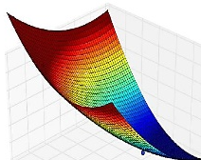

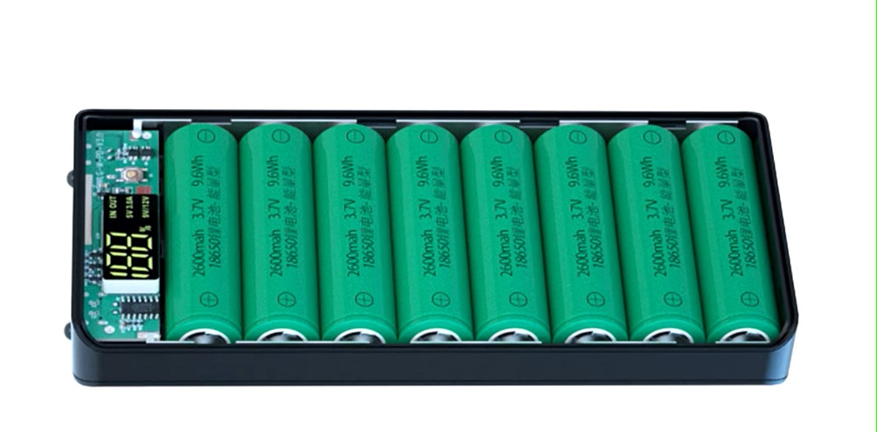






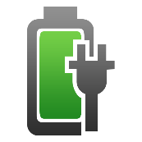
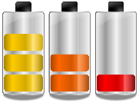
Li-Ion Battery Course
Modelling and Validation
Li-Ion Battery Cells
Thermal Design
Circular Economy
Battery Manage-
ment System
Standard and Regulations
Charging Strategies
Battery Ageing

Slide 2
Charging Strategies
Learning objectives
Students will be able to
  name the different charging strategies for charging secondary electrochemical storage systems and know how they work in principle
  differentiate between the advantages and disadvantages of each charging strategy and select the most practical one for the respective application
  differentiate between the corresponding chargers and formulate a requirement profile for a charger for a corresponding application
  explain the problems that arise when charging two or more battery cells connected in parallel and discuss the resulting effects on the final application
  name possible solutions to the problem of charging batteries in parallel and compare their advantages and disadvantages in terms of technical feasibility and economic viability

Slide 3
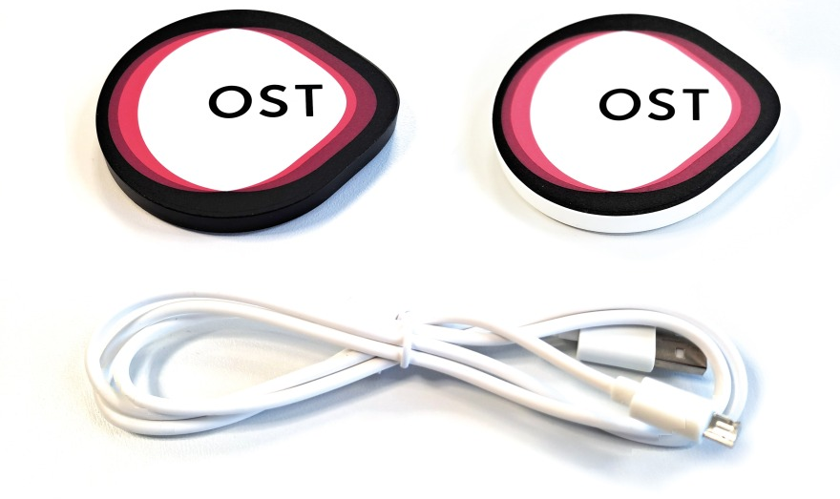
Agenda
Example of cell designs
  Battery Packs and Cell design
  Devices using Batteries
Charing a consumer electronics
Build a consumer electronics
Charging an electric vehicle (EV)
  Electric power – recap
  Charging Stations
  Charging Profiles
  Charging Efficiency
Conclusion

Slide 4
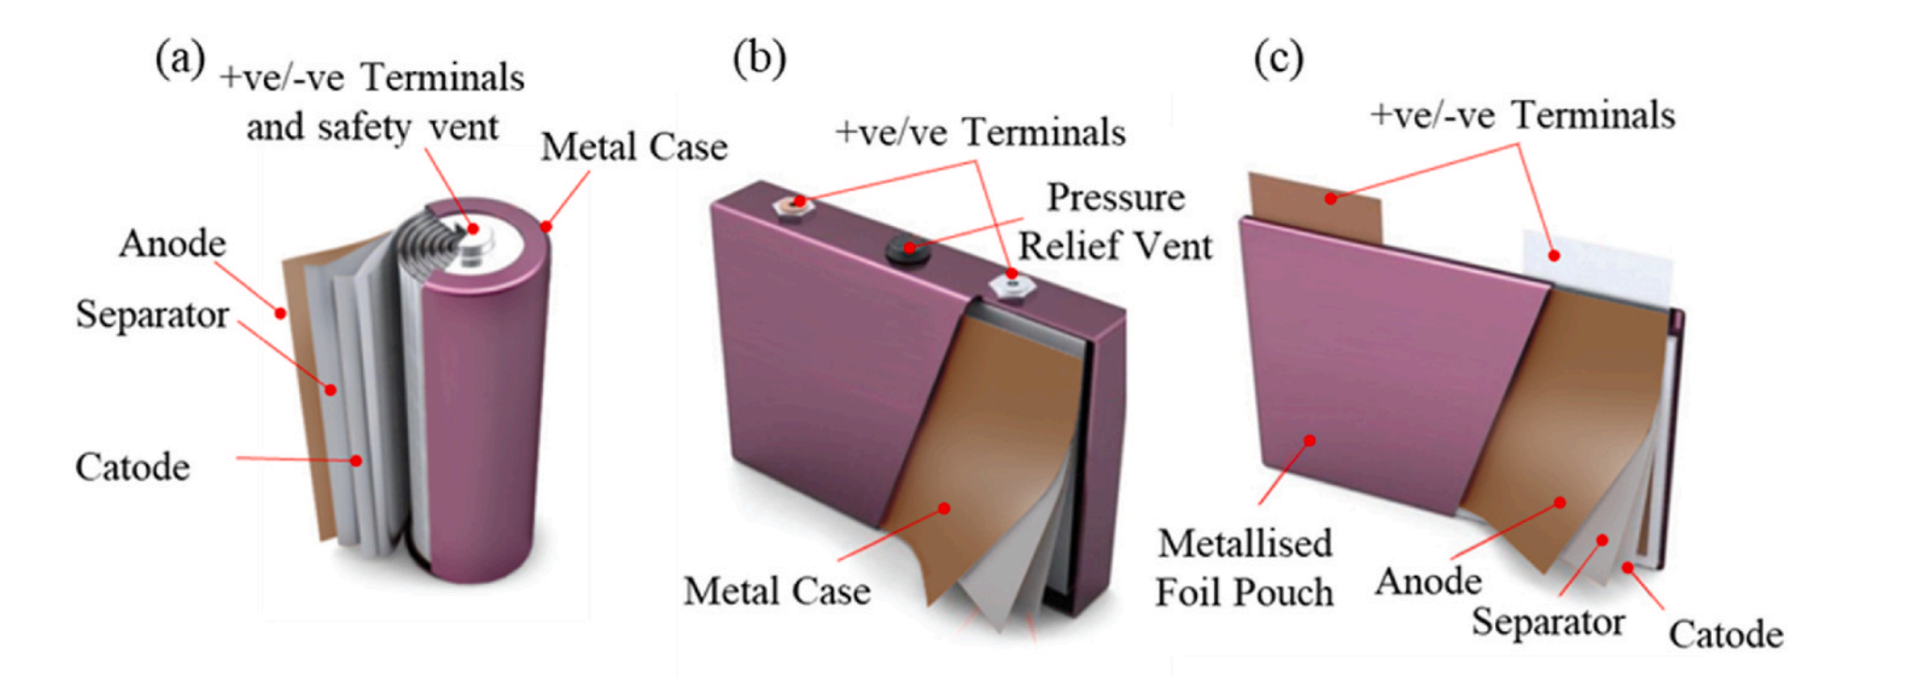
Example of cell designs
Cell design is based on product requirement:
cost, safety, cycle life, energy density and power density.
Cell design changes requirement of different material in implemented & characteristics, management systems and controls.
Cell design influences a second life scenario and a recycling process
Cylindrical cell
Prismatic cell
Pouch cell
Fig. 1. Types of cell construction. (a) Cylindrical cell; (b) Prismatic cell; (c) Pouch cell
O. E. Rojas and M. A. Khan, “A review on electrical and mechanical performance parameters in lithium-ion battery packs,” Journal of Cleaner Production, vol. 378, p. 134381, Dec. 2022, doi: 10.1016/j.jclepro.2022.134381.

Slide 5
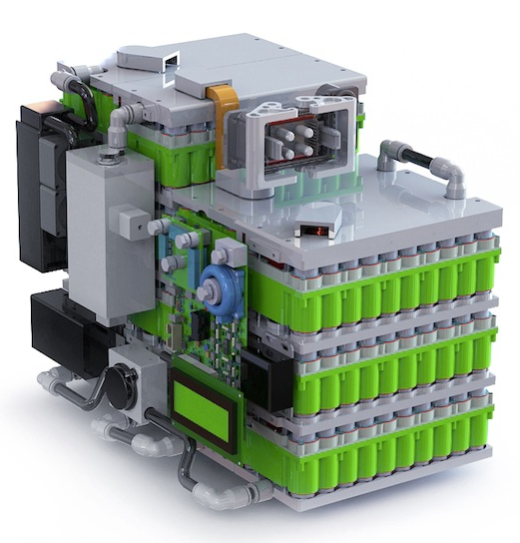
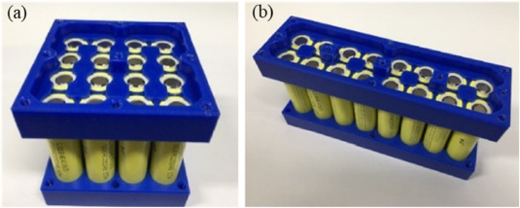
Battery pack out of single cell
Battery pack is made out of single battery cells to:
Increase voltage, max. current, capacity
Better customized design, but more material (housing) and weight
  > 50% of weight is not electrochemistry
Increase requirement on safety, electronics (BMS) → less efficient
O. E. Rojas and M. A. Khan, “A review on electrical and mechanical performance parameters in lithium-ion battery packs,” Journal of Cleaner Production, vol. 378, p. 134381, Dec. 2022, doi: 10.1016/j.jclepro.2022.134381.

Slide 6
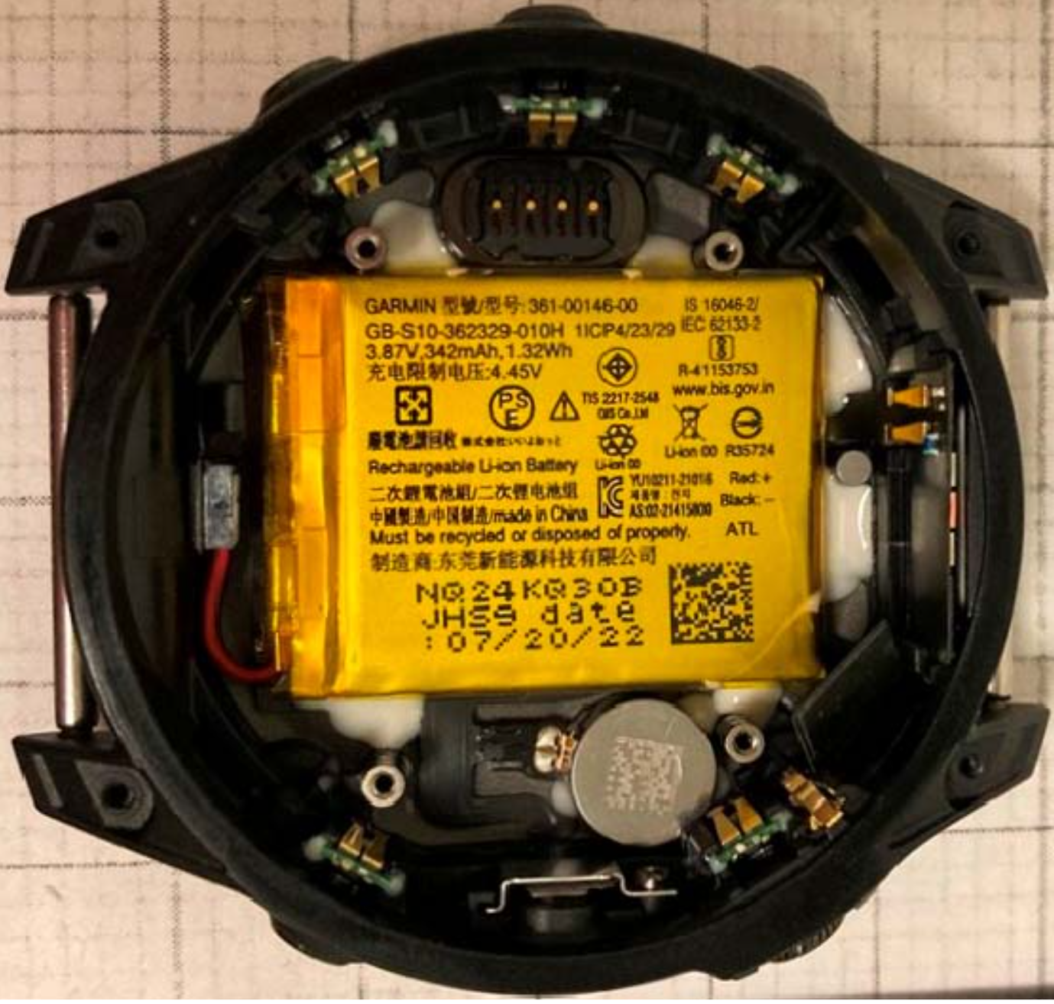
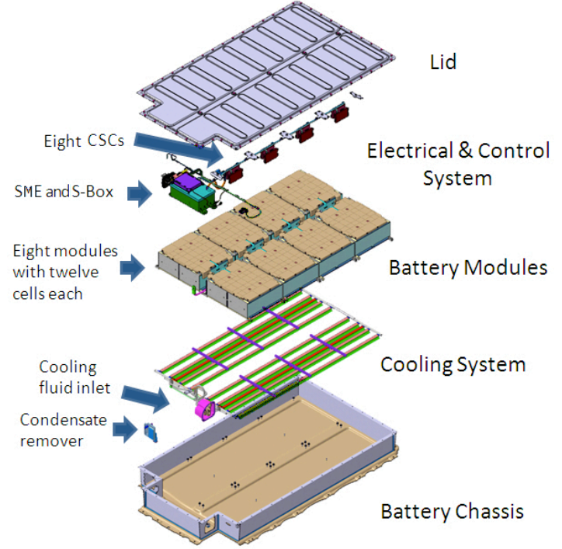

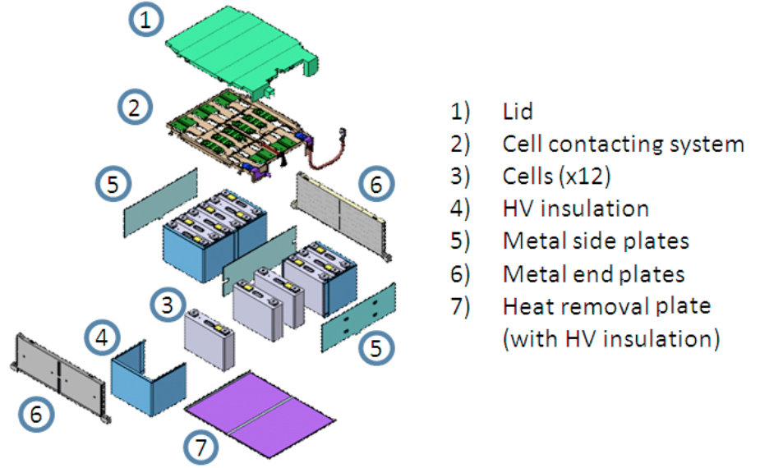
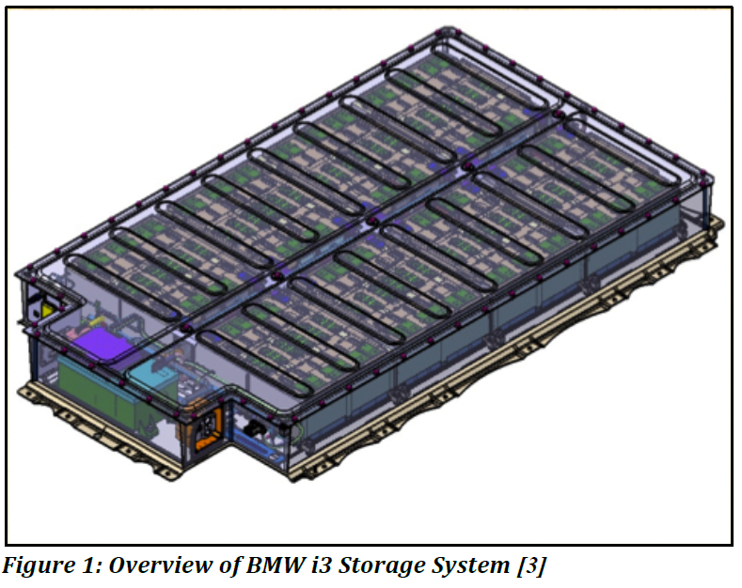
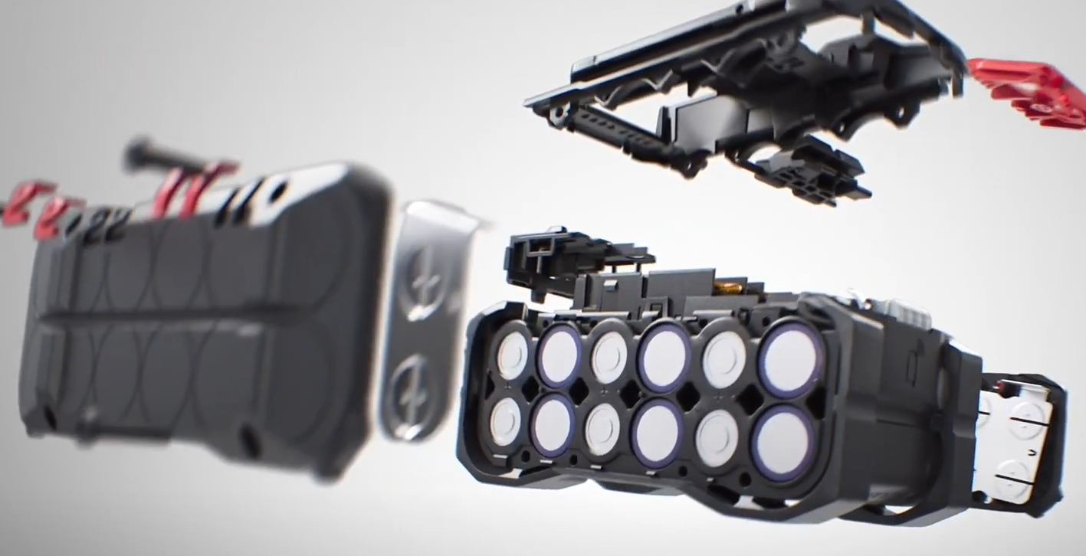
Products using battery cells
Every product has a standardized or customize battery cell / pack:
Pouch cell: in smart watch Garmin Fenix 7 Pro
Cylindrical cell: as battery pack in Hilti battery
Prismatic cell: as battery pack in BMW i3
https://fcc.report/FCC-ID/IPH-A04523/6510630
https://www.youtube.com/watch?app=desktop&v=6PI6B_3Ei4U
http://dx.doi.org/10.13140/RG.2.2.35999.71841

Slide 7
Agenda
Example of cell designs
  Battery Packs and Cell design
  Devices using Batteries
Charing a consumer electronics
Build a consumer electronics
Charging an electric vehicle (EV)
  Electric power – recap
  Charging Stations
  Charging Profiles
  Charging Efficiency
Conclusion

Slide 8
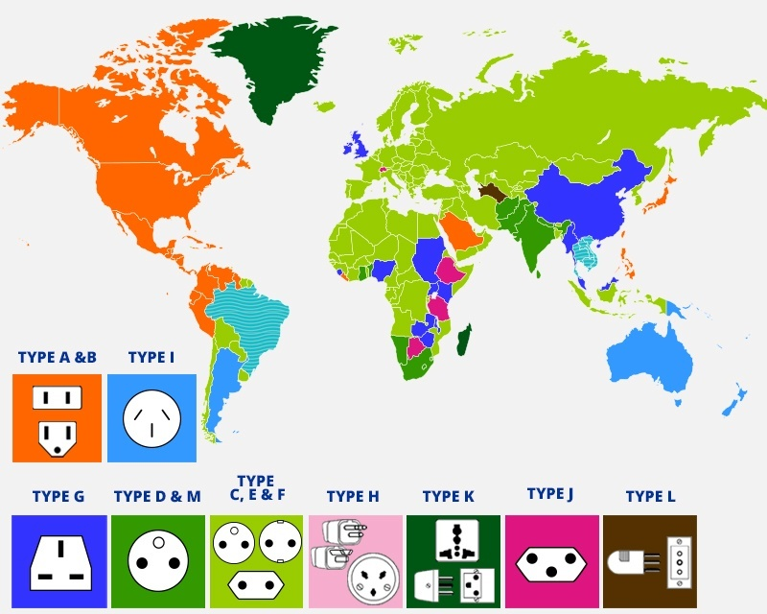
Charging battery cells by its usage
Every product with its requirements, usage and battery cell or pack has its unique charging strategies:
Where to charge the battery?
  Voltage – Limitation
  Current – Limitation
  Power – Limitation
  Wired or Wireless
  Connectors
What are the safety conditions?
  Maximal current
  Maximal temperature
  Regulation over BMS
  Limitation over BMS
  Undercharging
  Overcharging
Example of
«non-standardized standard»
Environment
Battery - Design
Variation in:
Voltage, Frequency and Connectors
https://myea.uky.edu/packing/plugging-abroad

Slide 9
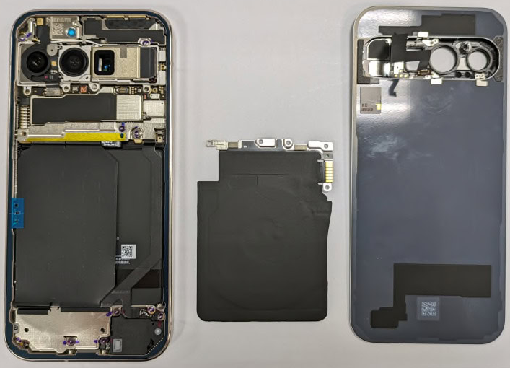
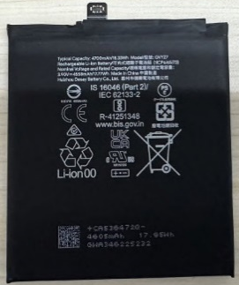
Charging a consumer electronics
Google Pixel 9 Pro
How to charge a smartphone or a smart watch!
What kind of energy does the environment provide?
How fast should it be charged?
Which temperature should not be passed?
External Power Source
Power Plug
Power Converter
Device Connection
Device BMS
Battery 1 Cell Pouch
https://www.androidauthority.com/google-pixel-9-pro-fold-ncc-3461263/

Slide 10
Charging a consumer electronics
Google Pixel 9 Pro
How to charge a smartphone or a smart watch!
What kind of energy does the environment provide?
How fast should it be charged?
Which temperature should not be passed?
230V 50Hz AC Typ J
55% in 30 minutes
< 45°C (usage: < 35°C)
External Power Source
Power Plug
Power Converter
Device Connection
Device BMS
Battery 1 Cell Pouch
Google Pixel 9 Pro Datasheet:
Battery capacity: 4700mAhn (min. 4558mAh)
Charging over: USB-C or Qi Wireless Charging
Fast Charge: 55% in 30 minutes with 27W
Google Pixel 9 Pro Pictures:
Battery Voltage: 3.90V
https://www.androidauthority.com/google-pixel-9-pro-fold-ncc-3461263/

Slide 11
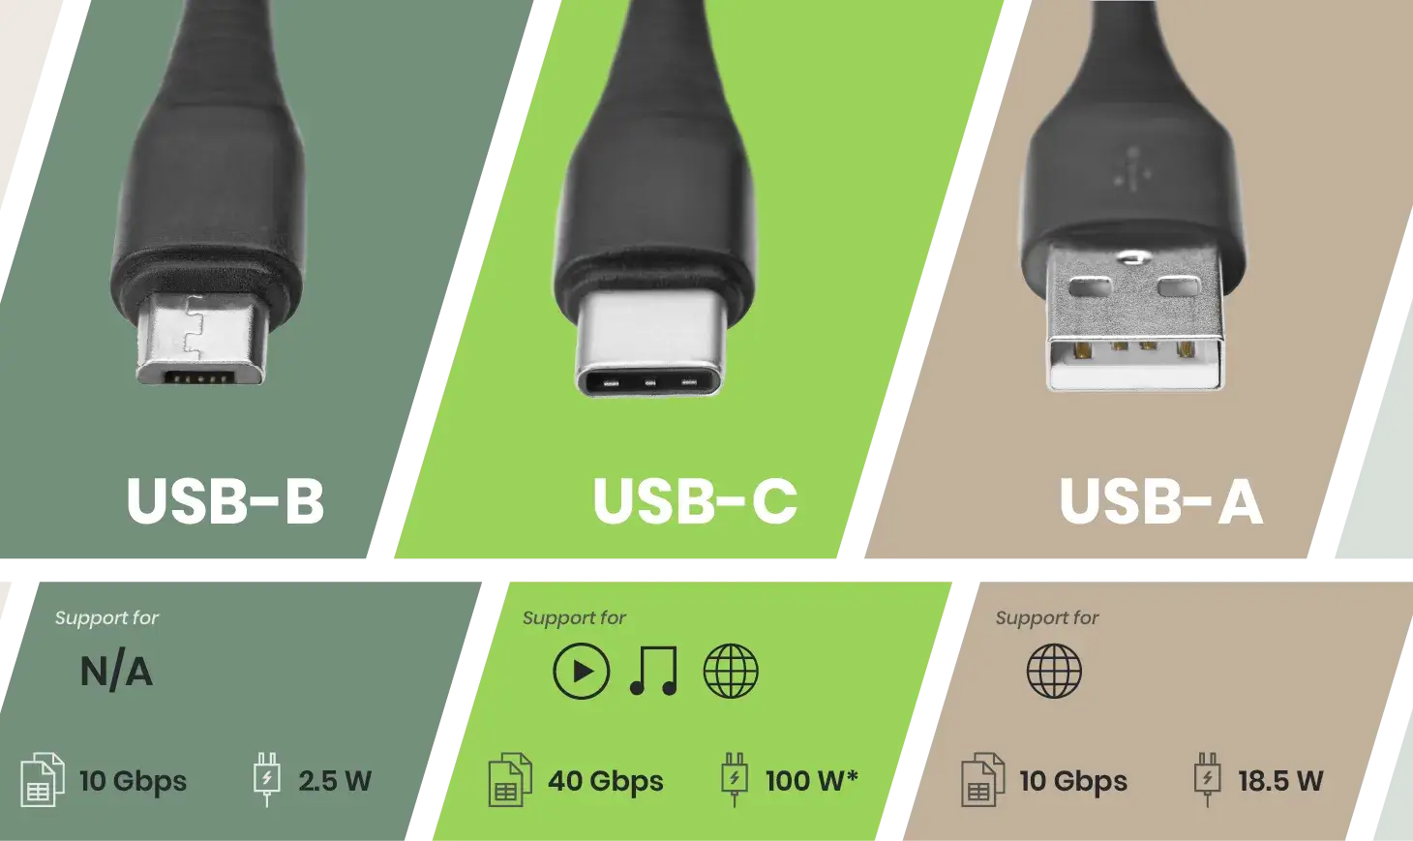
Charging a consumer electronics
Google Pixel 9 Pro
How to charge a smartphone or a smart watch!
What kind of energy does the environment provide?
How fast should it be charged?
Which temperature should not be passed?
230V 50Hz AC Typ J
55% in 30 minutes
< 45°C (usage: < 35°C)
External Power Source
Power Plug
Power Converter
Device Connection
Device BMS
Battery 1 Cell Pouch
230V 50Hz
Typ J
To be defined
USB-C (Qi)
internal
4700mAh
3.90V
Voltage of USB: 5.0V (for USB-A)
Current needed: 55% in 1/2h of 4.7Ah
0.55 / 0.5h * 4.7Ah = 5.17A
Power needed: 5.17A * 3.9V = 20.16W
Problem? Maximal current of USB-A is 3A (18.5W)
https://www.sct.com.tw/articles/usb-a-vs-usb-b-vs-usb-c-whats-the-difference-usb-types-comparison

Slide 12
Charging a consumer electronics
Design Power Converter
USB-A with max. 18.5W and max. 3A
USB-C with max. 100W and max. 3A
  Cable diameters limits maximal current
same current, different power?
External Power Source
Power Plug
Power Converter
Device Connection
Device BMS
Battery 1 Cell Pouch
230V 50Hz
Typ J
To be defined
USB-C (Qi)
internal
4700mAh
3.90V
Voltage of USB: 5.0V (for USB-A)
Current needed: 55% in 1/2h of 4.7Ah
0.55 / 0.5h * 4.7Ah = 5.17A
Power needed: 5.17A * 3.9V = 20.16W
Problem? Maximal current of USB-A is 3A (18.5W)
https://www.sct.com.tw/articles/usb-a-vs-usb-b-vs-usb-c-whats-the-difference-usb-types-comparison

Slide 13
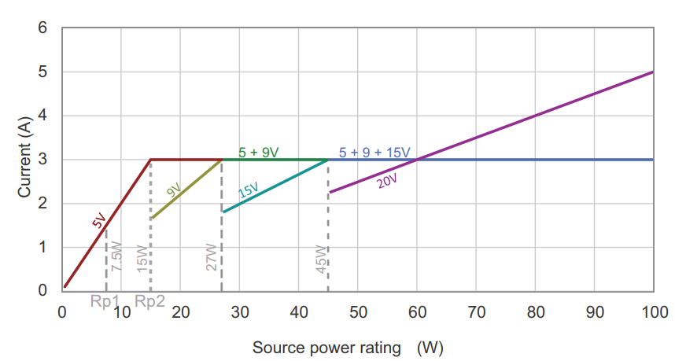
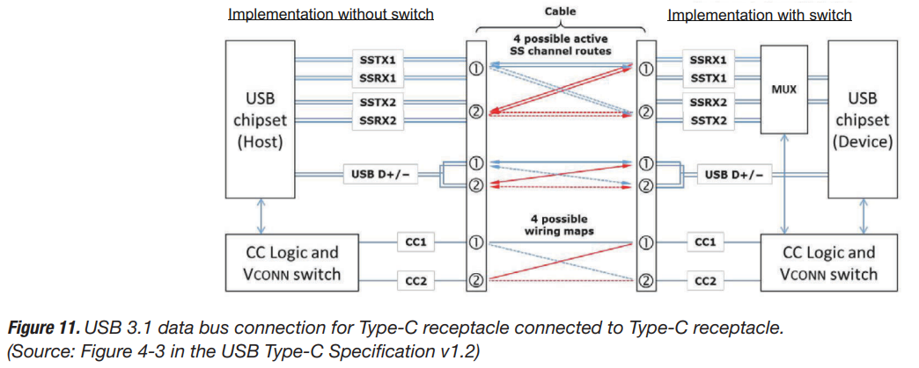
Charging a consumer electronics
Design Power Converter
USB PD (power delivery) specification v3.0
USB-C with max. 100W and max. 3A
  Changing Voltage from 5 to 9, 15 or 20V
  (Maximal: 100W with 5A at 20V)
  5A is a special cable and mode → regularly only max. 3A
  Maximal: 60W with 3A at 20V
Charging mode must be communicated over CC-Lines of USB-C.
https://www.ti.com/lit/wp/slyy109b/slyy109b.pdf?ts=1731913617238&ref_url=https%253A%252F%252Fwww.google.com%252F

Slide 14
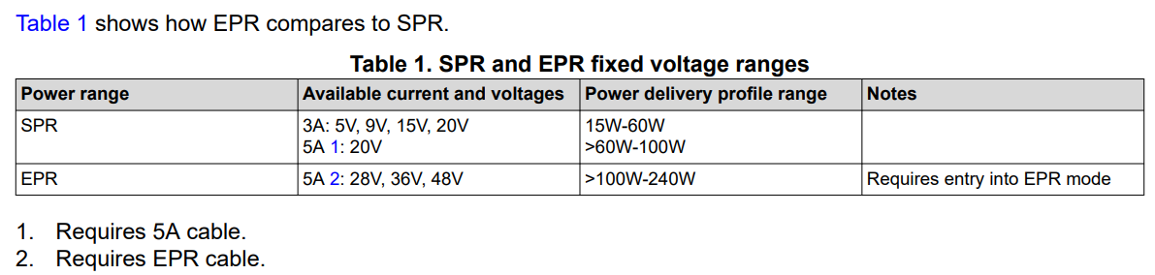
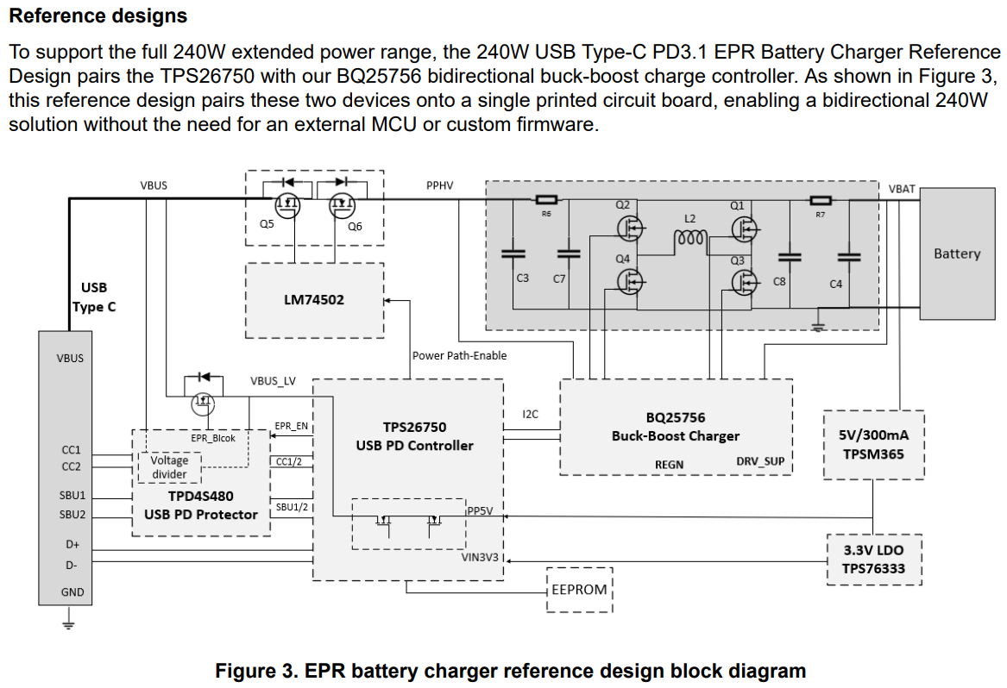
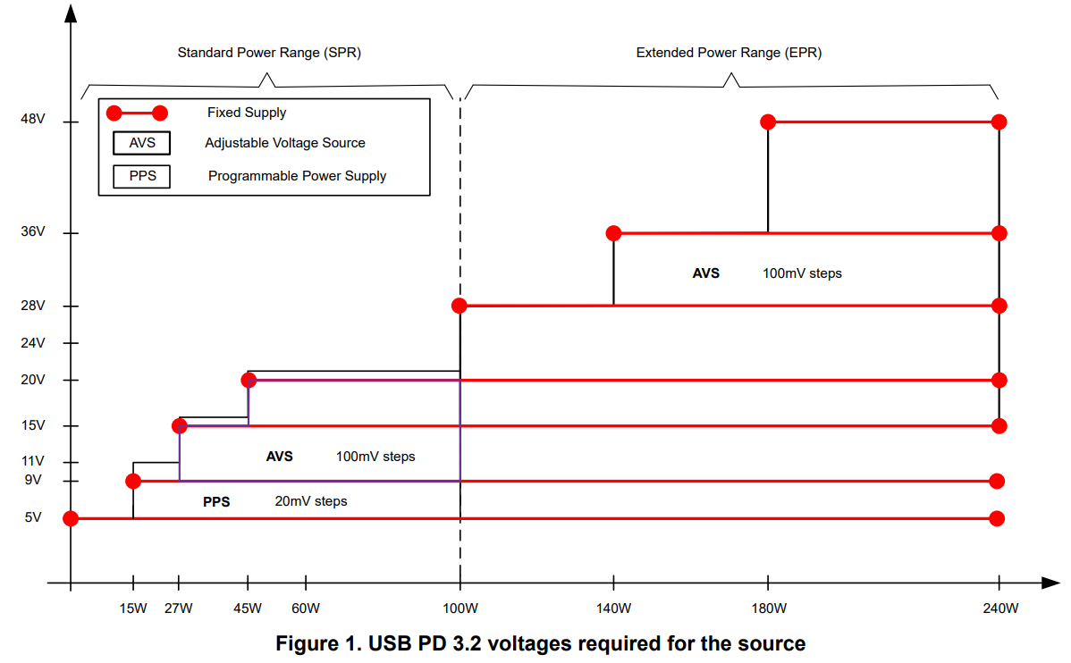
Charging a consumer electronics
New Generation: USB PD with Extended Power Range
SPR = Standard Power Range (USB PD 3.0)
EPR = Extended Power Range (USB PD 3.1)
Reference Design for Battery Charging
USB-C with 240W
https://www.ti.com/lit/ta/ssztd49a/ssztd49a.pdf?ts=1731942123014&ref_url=https%253A%252F%252Fwww.ti.com%252Fproduct%252Fde-de%252FTPS26750

Slide 15
Charging a consumer electronics
Google Pixel 9 Pro
Back to design of power converter:
USB PD 3.0 or higher
230V AC to USB converter
USB-C connector
230V 50Hz AC Typ J
55% in 30 minutes
< 45°C (usage: < 35°C)
External Power Source
Power Plug
Power Converter
Device Connection
Device BMS
Battery 1 Cell Pouch
230V 50Hz
Typ J
USB PD charger
USB-C
internal
4700mAh
3.90V
Voltage of USB: 9.0V (for USB-C PD)
Current needed: 55% in 1/2h of 4.7Ah
0.55 / 0.5h * 4.7Ah = 5.17A
Power needed: 5.17A * 3.9V = 20.16W
Current over USB cable: 20.16W / 9.0V = 2.24A
Maximal current is < 3A (2.24A)
https://www.androidauthority.com/google-pixel-9-pro-fold-ncc-3461263/

Slide 16
Agenda
Example of cell designs
  Battery Packs and Cell design
  Devices using Batteries
Charing a consumer electronics
Build a consumer electronics
Charging an electric vehicle (EV)
  Electric power – recap
  Charging Stations
  Charging Profiles
  Charging Efficiency
Conclusion

Slide 17
Build a consumer electronics
Design a device with a battery
USB-C Connector
230V AC to USB converter
Lithium battery
External Power Source
Power Plug
Power Converter
Device Connection
Device BMS
Battery 1 Cell Pouch
230V 50Hz
Typ J
USB PD charger
USB-C
internal
4700mAh
3.90V
Voltage of USB: 9.0V (for USB-C PD)
Current needed: 55% in 1/2h of 4.7Ah
0.55 / 0.5h * 4.7Ah = 5.17A
Power needed: 5.17A * 3.9V = 20.16W
Current over USB cable: 20.16W / 9.0V = 2.24A
Maximal current is < 3A (2.24A)
https://www.androidauthority.com/google-pixel-9-pro-fold-ncc-3461263/

Slide 18
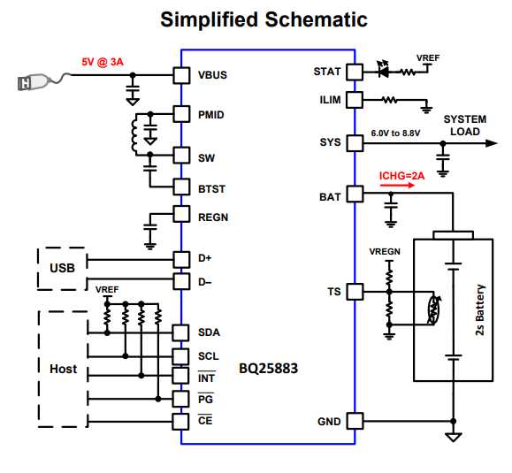
Build a consumer electronics
Charing Chips can be used to make a charging of a consumer electronics easy.
These kind of chips control the charging and discharging of a battery. Some of these chips have integrated a temperature monitoring.
It provides 2 voltages for the battery and for they system. And It changes automatically between charging, discharging or direct power.
Power Converter
Device Connection
Device BMS
Battery 1 Cell Pouch
USB PD charger
USB-C
internal
4700mAh
3.90V
https://www.ti.com/lit/ds/symlink/bq25883.pdf?ts=1733928935845&ref_url=https%253A%252F%252Fwww.ti.com%252Fproduct%252Fde-de%252FBQ25883

Slide 19
Agenda
Example of cell designs
  Battery Packs and Cell design
  Devices using Batteries
Charing a consumer electronics
Build a consumer electronics
Charging an electric vehicle (EV)
  Electric power – recap
  Charging Stations
  Charging Profiles
  Charging Efficiency
Conclusion

Slide 20
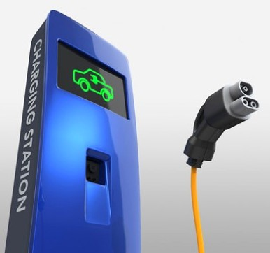
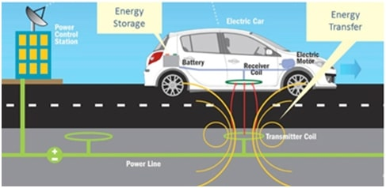
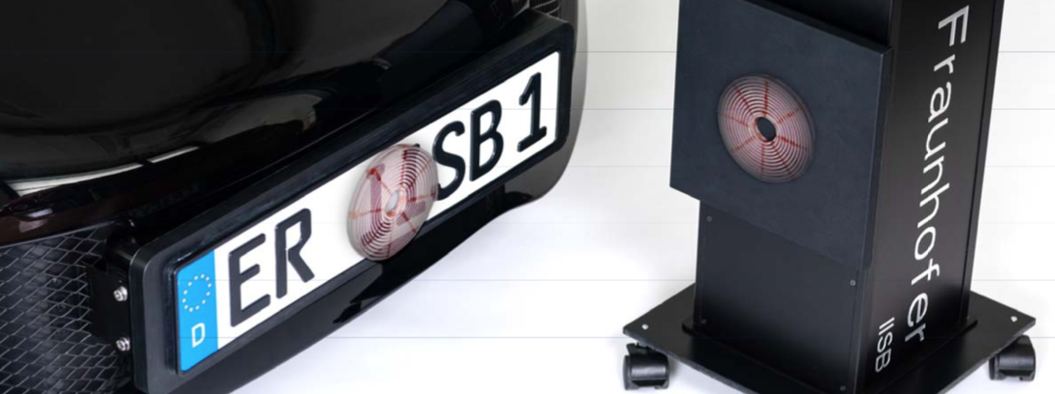
Wired vs. Inductive Charging
Wired Charging
Inductive Charging
https://www.iisb.fraunhofer.de/de.html
https://engineering.electrical-equipment.org/electrical-distribution/wireless-power-transfer-wpt.html
https://powerelectronicsworld.net/article/104789/UK_Needs_Plan_To_Power_36_Million_Electric_Cars_By_2040

Slide 21
Wired vs. Inductive Charging
Wired Charging
Inductive Charging
Most common method for Evs
Remains standard for home charging
Efficiency
90 - 98% depending on power
Charging
Rapid Charge 11kW/22kW
Fast Charge 50kW
Ulta Fast Charge >150kW
‘Future technology’
Very common in consumer electronics
Efficiency
Mains to battery up to 90 - 93%
Charging power
3.6kW to 11kW

Slide 22
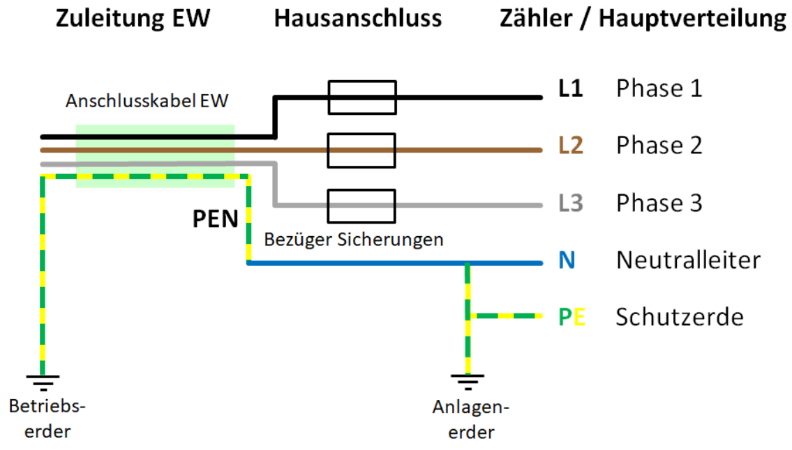
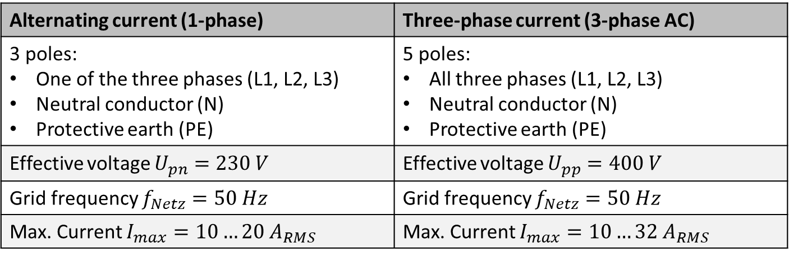
Power Grid - House Connection
Alternating current (1-phase) | Three-phase current (3-phase AC)
3 poles: One of the three phases (L1, L2, L3) Neutral conductor (N) Protective earth (PE) | 5 poles: All three phases (L1, L2, L3) Neutral conductor (N) Protective earth (PE)
Effective voltage $U_{pn}=230 V$ | Effective voltage $U_{pp}=400 V$
Grid frequency $f_{Netz}=50 Hz$ | Grid frequency $f_{Netz}=50 Hz$
Max. Current $I_{max}=10…20 A_{RMS}$ | Max. Current $I_{max}=10…32 A_{RMS}$

Slide 23
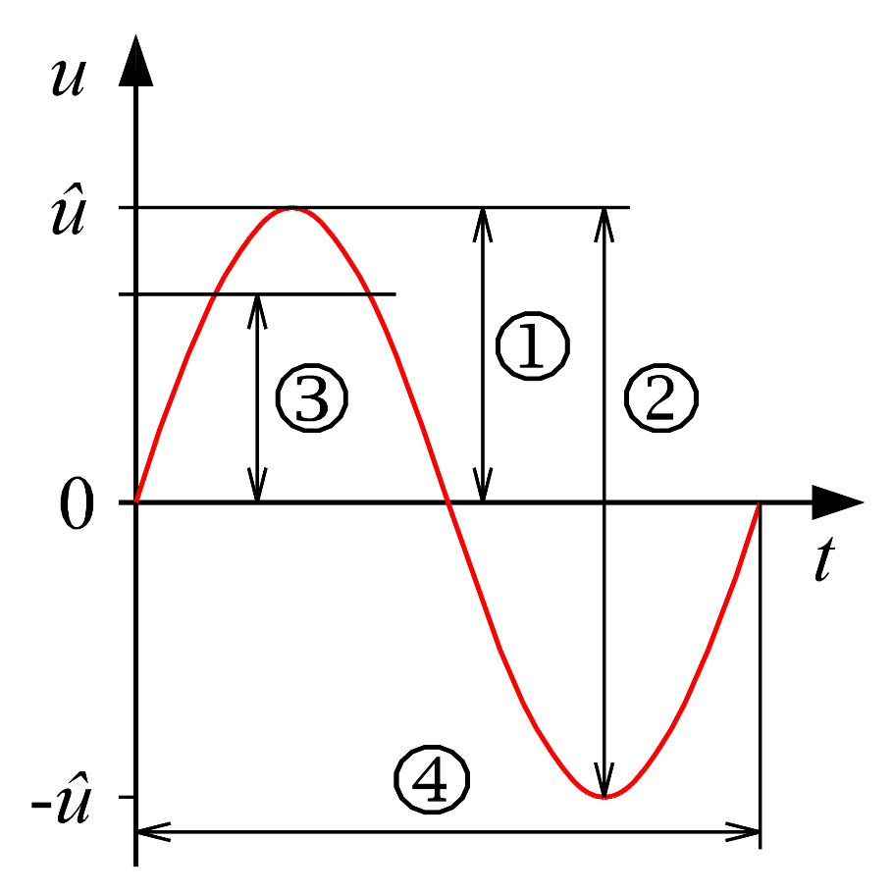
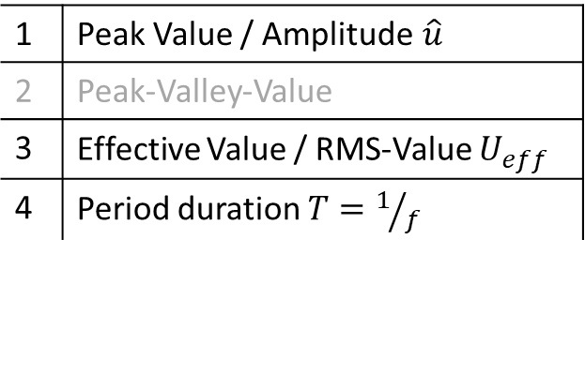

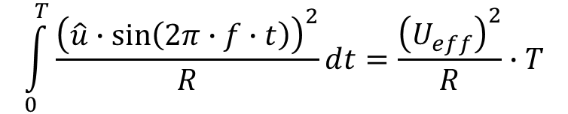
Effective value
The RMS value is the r Root Mean Square (RMS value) of a time-varying physical quantity (voltage, current).
The RMS value depends on the course over time, i.e. the shape of the curve.
$$u\left(t\right)=\hat{u}∙sin\left(2π∙f∙t\right)⁡$$
$$\int_{0}^{T}{\frac{{\left(\hat{u}∙sin\left(2π∙f∙t\right)\right)}^{2}}{R}}ⅆt=\frac{{\left(U_{eff}\right)}^{2}}{R}∙T$$
1 | Peak Value / Amplitude$\hat{u}$
2 | Peak-Valley-Value
3 | Effective Value / RMS-Value $U_{eff}$
4 | Period duration $T=1/f$

Slide 24
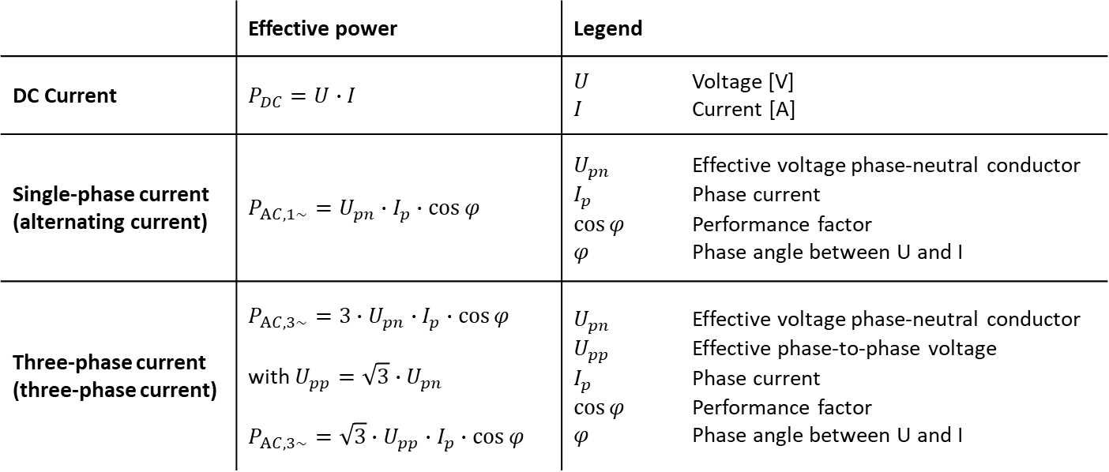
Electrical power
 | Effective power | Legend
DC Current | $P_{DC}=U∙I$ | $U$ Voltage [V] $I$ Current [A]
Single-phase current (alternating current) | $P_{AC,1\sim }=U_{pn}∙I_{p}∙\cos{φ}$ | $U_{pn}$ Effective voltage phase-neutral conductor $I_{p}$ Phase current $\cos{φ}$ Performance factor $φ$ Phase angle between U and I
Three-phase current (three-phase current) | $P_{AC,3\sim }={3∙U}_{pn}∙I_{p}∙\cos{φ}$ with $U_{pp}=\sqrt{3}∙U_{pn}$ $P_{AC,3\sim }={\sqrt{3}∙U}_{pp}∙I_{p}∙\cos{φ}$ | $U_{pn}$ Effective voltage phase-neutral conductor $U_{pp}$ Effective phase-to-phase voltage $I_{p}$ Phase current $\cos{φ}$ Performance factor $φ$ Phase angle between U and I

Slide 25
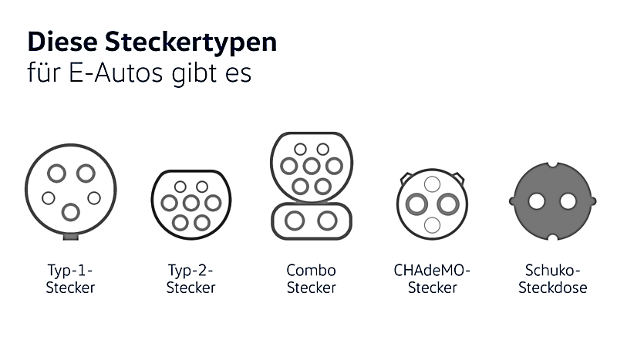
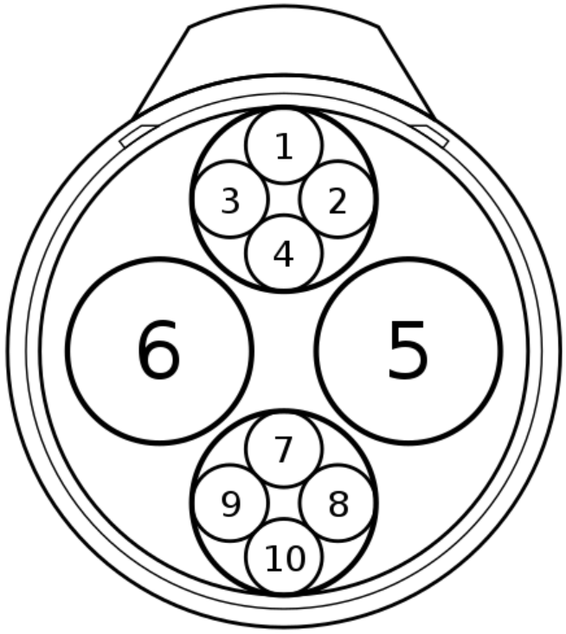
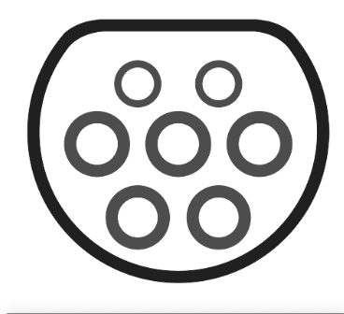
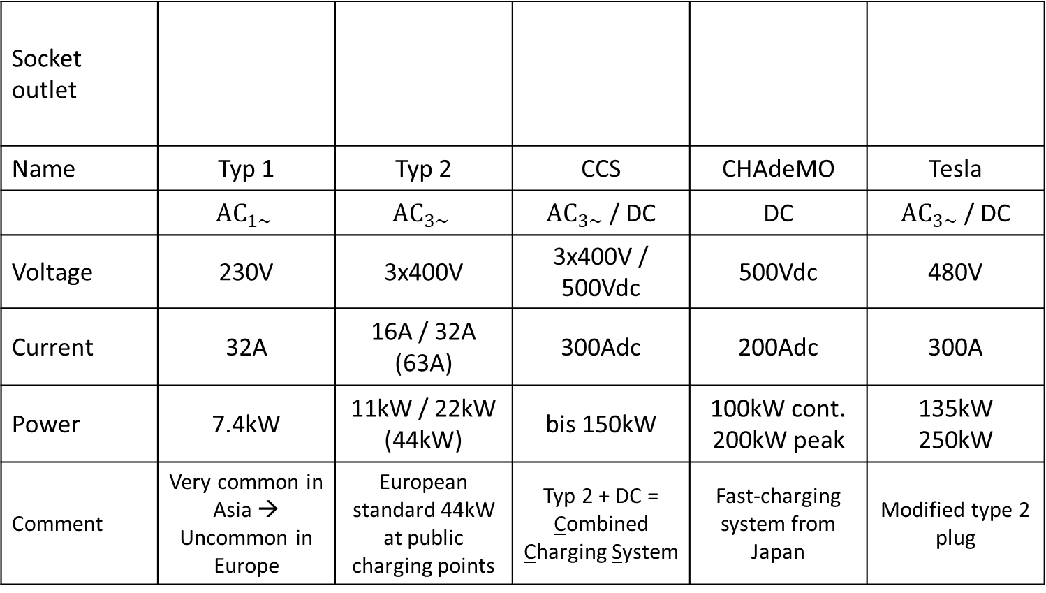
Socket outlet images Charging Stations
Socket outlet
Name | Typ 1 | Typ 2 | CCS | CHAdeMO | Tesla
 | $${\text{AC}}_{1\sim }$$ | $${\text{AC}}_{3\sim }$$ | ${\text{AC}}_{3\sim }$ / DC | DC | ${\text{AC}}_{3\sim }$ / DC
Voltage | 230V | 3x400V | 3x400V / 500Vdc | 500Vdc | 480V
Current | 32A | 16A / 32A (63A) | 300Adc | 200Adc | 300A
Power | 7.4kW | 11kW / 22kW (44kW) | bis 150kW | 100kW cont. 200kW peak | 135kW 250kW
Comment | Very common in Asia → Uncommon in Europe | European standard 44kW at public charging points | Typ 2 + DC = Combined Charging System | Fast-charging system from Japan | Modified type 2 plug

Slide 26
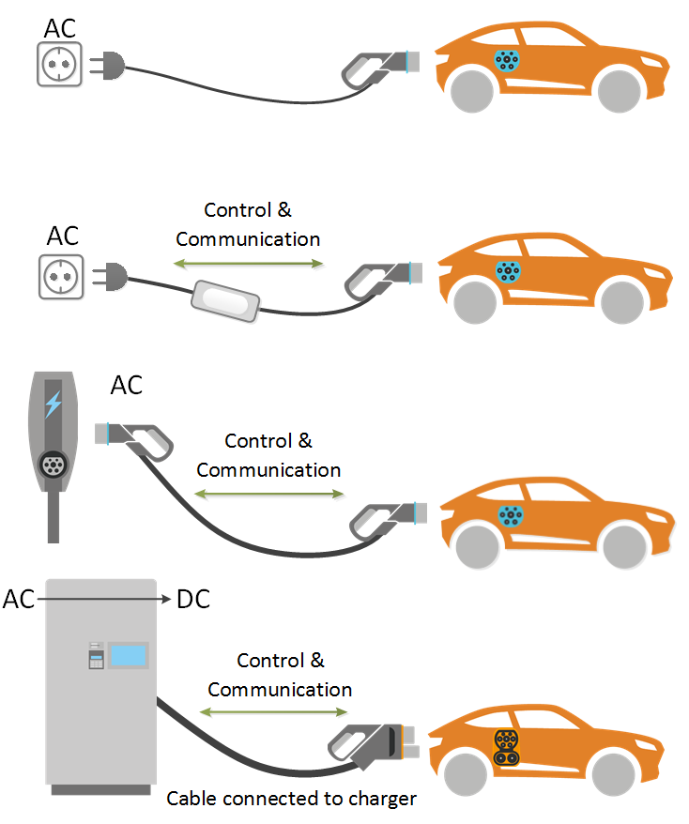
Charging Modes
Mode 1
Direct charging at a conventional socket with alternating current (AC). No communication between socket and vehicle. Only for short-term emergency charging.
Mode 2
Connection to a conventional socket via a charging cable with an in-cable control box (ICCB). Communication between ICCB and vehicle enables basic safety-relevant functionality.
Mode 3
Charging with alternating current (AC) can only be carried out at a dedicated type 1, type 2 socket or a mode 3 charging cable permanently connected to the installation. Communication between charging station and vehicle.
Mode 4
Fast charging with direct current (DC). Communication between charging station and vehicle required.

Slide 27
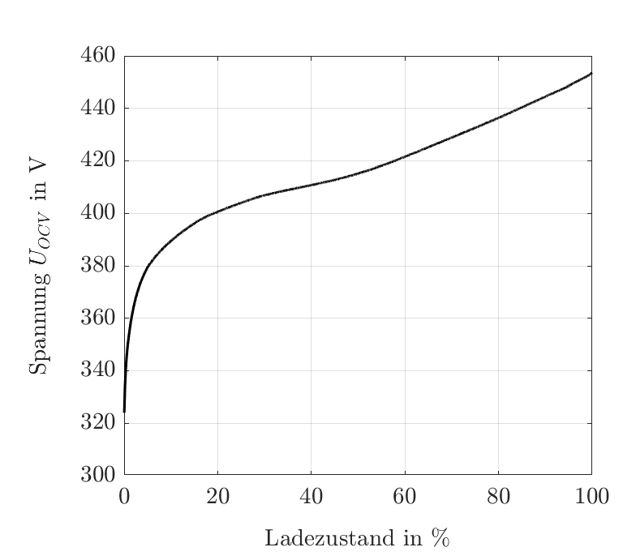
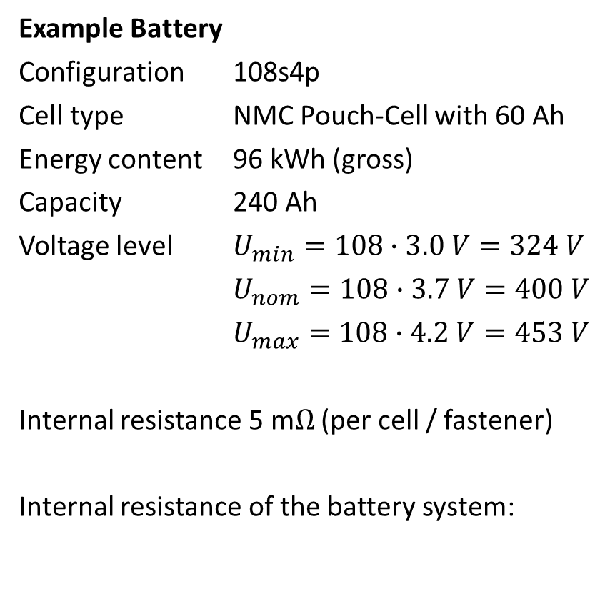
Battery System equivalent Circuit Diagram
Battery system equivalent circuit diagram
Example Battery
Configuration 108s4p
Cell type NMC Pouch-Cell with 60 Ah
Energy content 96 kWh (gross)
Capacity 240 Ah
Voltage level $U_{min}=108∙3.0 V=324 V$
$U_{nom}=108∙3.7 V=400 V$
$U_{max}=108∙4.2 V=453 V$
Internal resistance 5 m$Ω$ (per cell / fastener)
Internal resistance of the battery system:
R_{i}
U_{OCV}

Slide 28
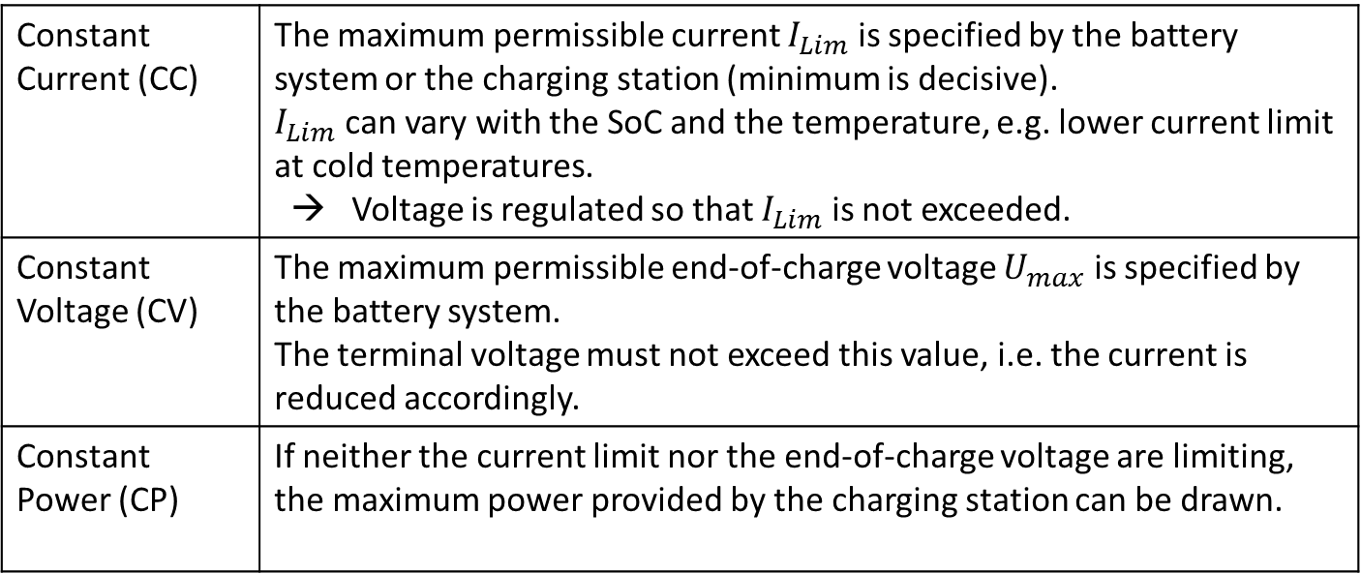

Charging Duration
Charging duration (theoretically): $t_{Charge}[h]=\frac{E_{Bat}[kWh]}{P_{Charge}[kW]}$
The charging power is NOT constant when charging :
Constant Current (CC) | The maximum permissible current $I_{Lim}$ is specified by the battery system or the charging station (minimum is decisive). $I_{Lim}$ can vary with the SoC and the temperature, e.g. lower current limit at cold temperatures. → Voltage is regulated so that $I_{Lim}$ is not exceeded.
Constant Voltage (CV) | The maximum permissible end-of-charge voltage $U_{max}$ is specified by the battery system. The terminal voltage must not exceed this value, i.e. the current is reduced accordingly.
Constant Power (CP) | If neither the current limit nor the end-of-charge voltage are limiting, the maximum power provided by the charging station can be drawn.

Slide 29
Charging Profiles
 | Limiting factors
Charging station | max. Power, max. Current, max. Voltage
Battery system | max. Current,. permitted Voltage range (min. & max.)
CC-CV Mode
CP-CV Mode

Slide 30
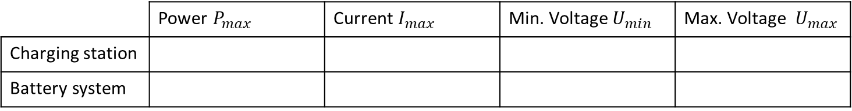
Combined Charging Profiles
 | Power $P_{max}$ | Current $I_{max}$ | Min. Voltage $U_{min}$ | Max. Voltage $U_{max}$
Charging station
Battery system

Slide 31

Example CC-CV with 22kW
The constant charging current (CC phase) is calculated from the maximum charging power and the final charging voltage.
Maximum charging power: $P_{max}=U_{max}∙I_{CC}$

Slide 32
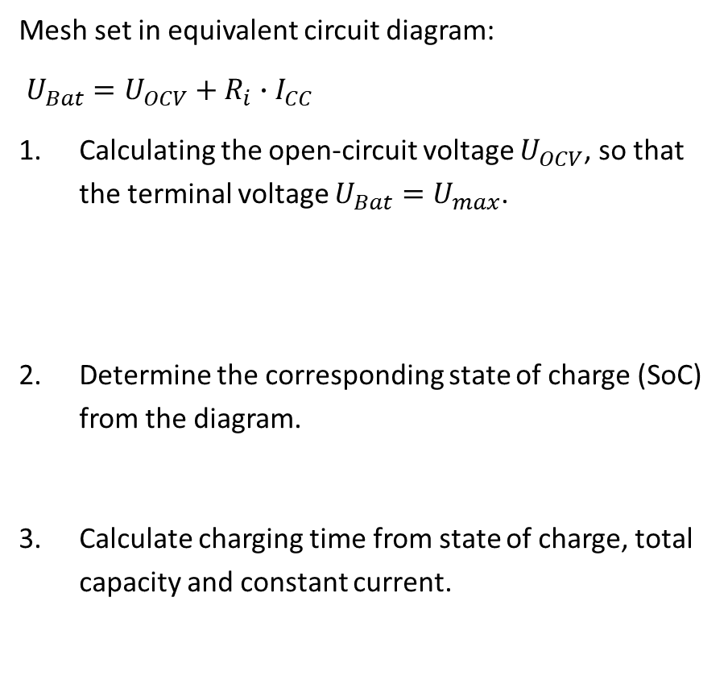
Charging duration in CC-Phase
Mesh set in equivalent circuit diagram:
$U_{Bat}=U_{OCV}+R_{i}∙I_{CC}$
Calculating the open-circuit voltage $U_{OCV}$, so that the terminal voltage $U_{Bat}=U_{max}$.
Determine the corresponding state of charge (SoC) from the diagram.
Calculate charging time from state of charge, total capacity and constant current.
R_{i}
U_{OCV}

Slide 33
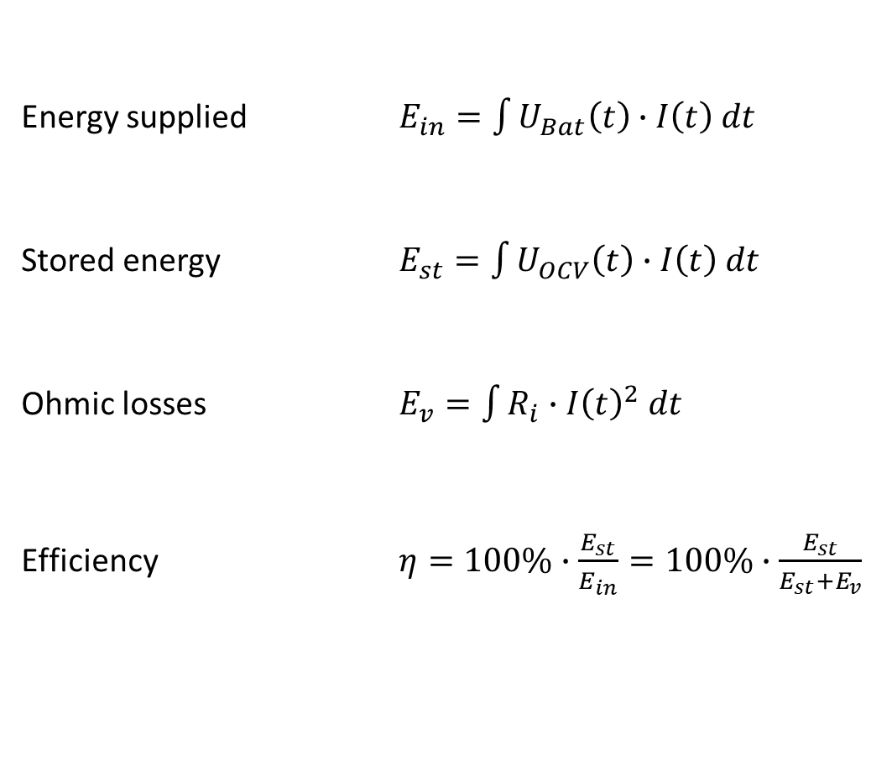
Charging Efficiency
Energy supplied $E_{in}=\int{U_{Bat}\left(t\right)∙I\left(t\right) dt}$
Stored energy $E_{st}=\int{U_{OCV}\left(t\right)∙I\left(t\right) dt}$
Ohmic losses $E_{v}=\int{R_{i}∙{I\left(t\right)}^{2} dt}$
Efficiency $η=100\%∙\frac{E_{st}}{E_{in}}=100\%∙\frac{E_{st}}{E_{st}+E_{v}}$
R_{i}
U_{OCV}

Slide 34
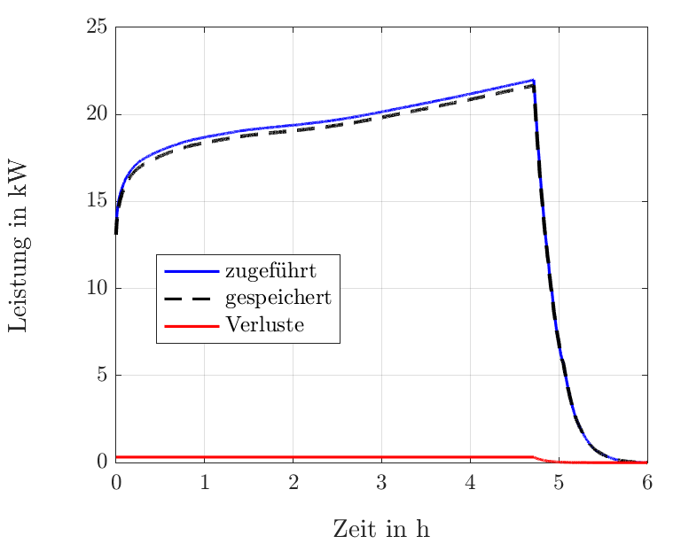
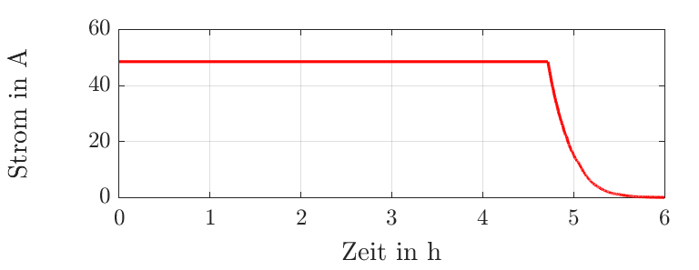
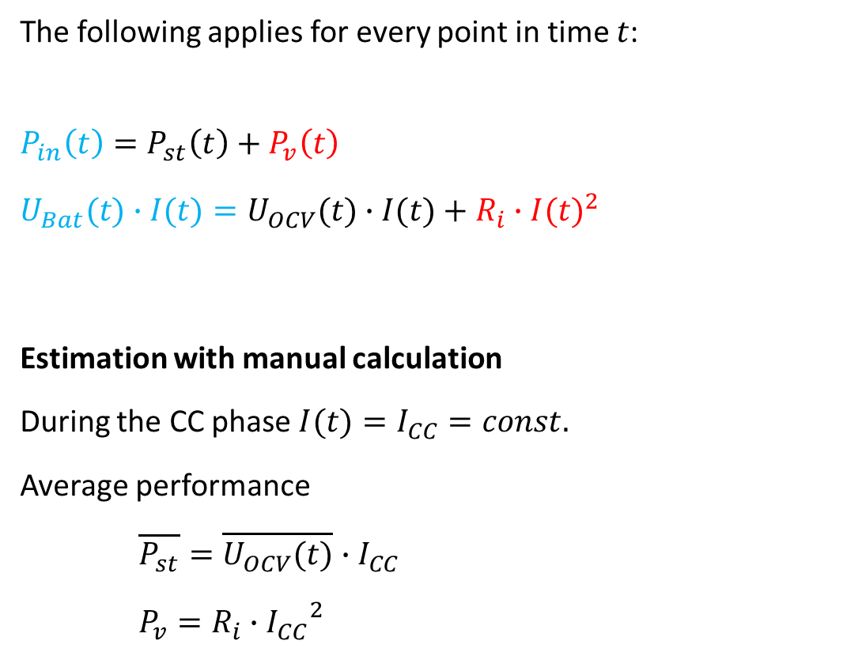
Charging Efficiency
The following applies for every point in time $t$:
$$P_{in}\left(t\right)=P_{st}\left(t\right)+P_{v}\left(t\right)$$
$$U_{Bat}(t)∙I(t)=U_{OCV}(t)∙I(t)+R_{i}∙{I(t)}^{2}$$
Estimation with manual calculation
During the CC phase$I(t)=I_{CC}=const.$
Average performance
$\overline{P_{st}}=\overline{U_{OCV}(t)}∙I_{CC}$
$P_{v}=R_{i}∙{I_{CC}}^{2}$
R_{i}
U_{OCV}

Slide 35
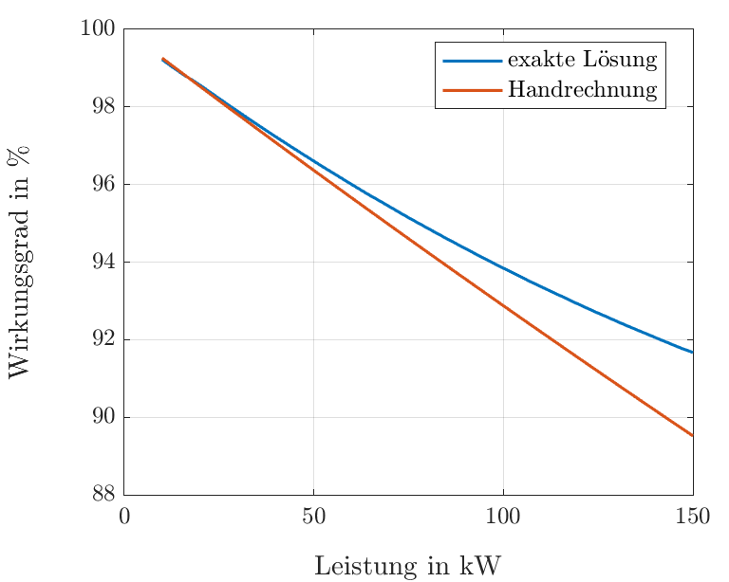
Charging Efficiency
As the charging power increases, the losses increase and the efficiency decreases.
For low charging capacities, the manual calculation agrees well with the exact solution.
For higher charging capacities, the efficiency is estimated too low (conservative approach).
The actual efficiency tends towards a constant minimum.

Slide 36
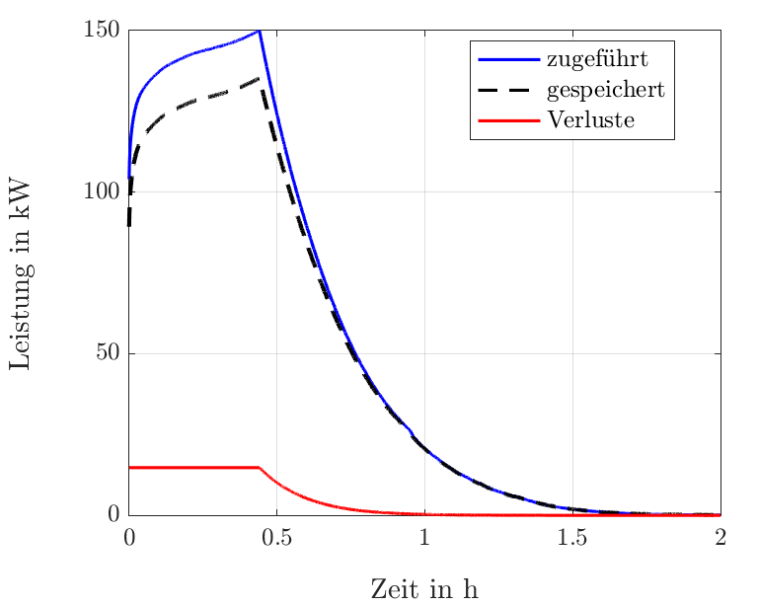
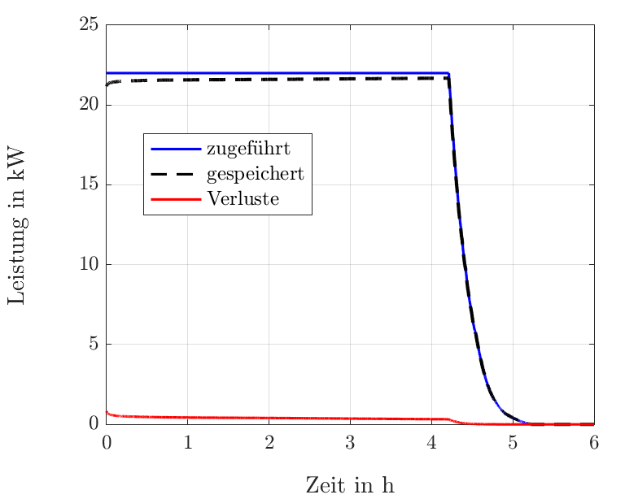

Comparison 22kW vs. 150kW
 | max. Charging Power 22kW | max. Charging Power 150kW
CC-CV
CP-CV

Slide 37


Comparison 22kW vs. 150kW
Power | Charging profile | % SoC | after t_{cc} hours | t_{100%} | Efficiency of loading
$$22 \text{kW}$$ | CC-CV | $$95 \text{\%}$$ | $$4.7 \text{h}$$ | ca. $5.5 \text{h}$ | $$98.4 \text{\%}$$
 | CP-CV | $$95 \text{\%}$$ | $$4.2 \text{h}$$ | ca. $5 \text{h}$ | $$98.2 \text{\%}$$
$$150 \text{kW}$$ | CC-CV | $$60 \text{\%}$$ | $$0.44 \text{h}$$ | ca. $1.32 \text{h}$ | $$91.6 \text{\%}$$
 | CP-CV | $$60 \text{\%}$$ | $$0.41 \text{h}$$ | ca. $1.29 \text{h}$ | $$91.3 \text{\%}$$
The additional benefit of ‘Constant Power (CP)’ is not relevant (especially for high C rates).
In a first approximation, the losses are linear to the charging power.
  Double the charging power → 4 times the power loss ($I^{2}∙R$), but this only has an effect for about half the time.
The higher the charging power, the lower the SoC when the final charging voltage is reached ($U_{max})$, i.e. the earlier the CV phase begins.

Slide 38
Agenda
Example of cell designs
  Battery Packs and Cell design
  Devices using Batteries
Charing a consumer electronics
Build a consumer electronics
Charging an electric vehicle (EV)
  Electric power – recap
  Charging Stations
  Charging Profiles
  Charging Efficiency
Conclusion

Slide 39
Conclusion
The efficiency is usually >95%, but can drop to 90% for very high C rates.
Ultra-fast charging ...
  is bad for the service life due to the high C-rate.
  is less efficient than slow charging.
  requires active cooling to dissipate the heat generated.
  is based on the assumption of driving empty, then refueling (analogous to the combustion engine).
  is currently a clear user requirement despite all the disadvantages.
Inductive charging methods are currently only available for low power levels.
  Interesting concept for the future if there is a high level of area coverage.
  Frequent recharging with low power is more gentle.

