Slide 1

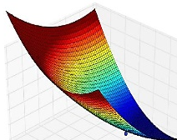

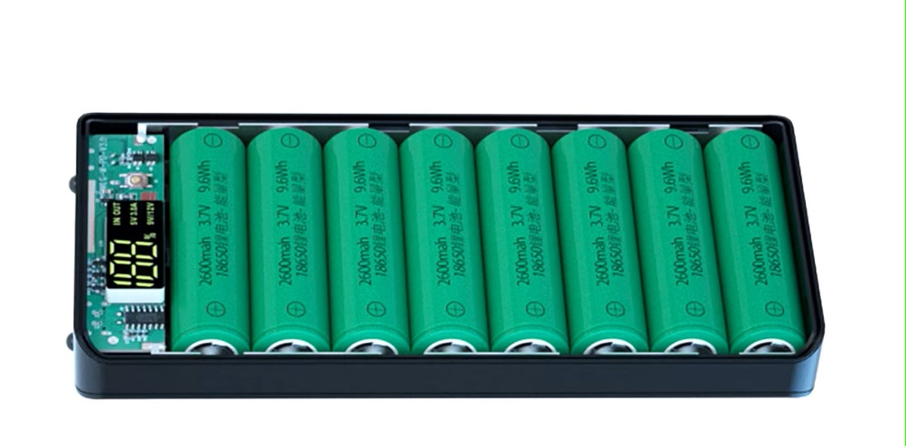







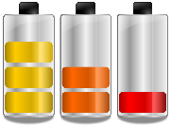
Li-Ion Battery Course
Modelling and Validation
Li-Ion Battery Cells
Thermal Design
Circular Economy
Battery Manage-
ment System
Standard and Regulations
Charging Strategies
Battery Ageing

Slide 2
Battery Ageing
Learning objectives
Students are able to explain the ageing process of a battery from the perspective of the application
Students know different ageing mechanisms
  at the SEI (solid electrolyte interface)
  lithium plating
  aging in the cathode and anode material
Students can determine optimized operating conditions for discharging and charging for a given application

Slide 3
Abbreviations & Definitions
Key Term | Definition
Capacity | Capacity refers to how much electric charge the battery can store, expressed in ampere hours (Ah).
Internal resistance | Internal resistance is a characteristic of each battery and can be considered a limiting factor to the power capability of a battery. It correlates to the internal losses generated when the battery is charged or discharged.
State of charge (SOC) | State of charge measures the remaining level of charge in relation to the maximum available capacity.
Depth of discharge (DOD) | Depth of discharge refers to the percentage of capacity that has been discharged from the battery relative to the total available capacity.
Anode and cathode | In the field of batteries, the anode is defined as the electrode that releases electrons during discharge while the cathode absorbs electrons. In most lithium-ion batteries the anode is carbon based. Plating occurs in the anode.
Intercalation | In lithium-ion batteries, intercalation is a reaction where lithium ions insert themselves between the sheets of the anode material. We want this to happen.
Electrochemical potential | Simply speaking, electrochemical potential in a battery is a measure of the difference between the two used active materials’ willingness to absorb or emit an electron.

Slide 4
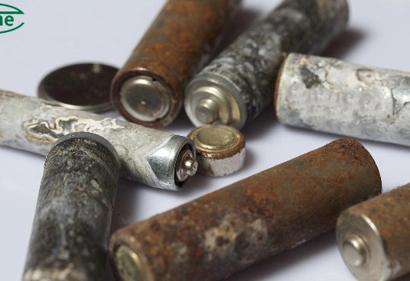
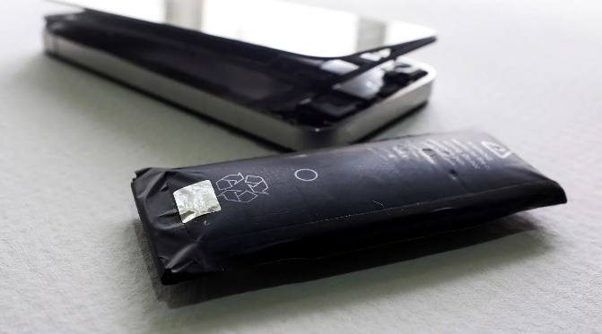
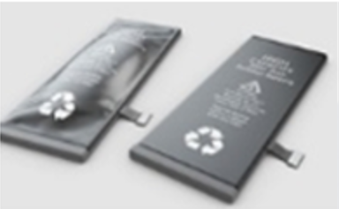

Battery Ageing
What is battery ageing?
X
?
?
?

Slide 5
Battery Ageing
What is battery ageing?

Slide 6
Phenomenological battery ageing
Battery ageing
Decrease
Storage Capacity Q
Increase
Internal Resistance Ri

Slide 7
Phenomenological battery ageing
Decrease in storage capacity Q
Batteries lose capacity as they age. This means that
  an e-vehicle can no longer drive as far as it originally could without stopping to recharge.
  in the case of stationary energy storage systems, the battery can store less energy and therefore generate less yield.
How quickly the capacity decreases depends on many factors, including the type of battery, the charging and discharging rates, the temperature of the battery and the number of cycles it has undergone.

Slide 8
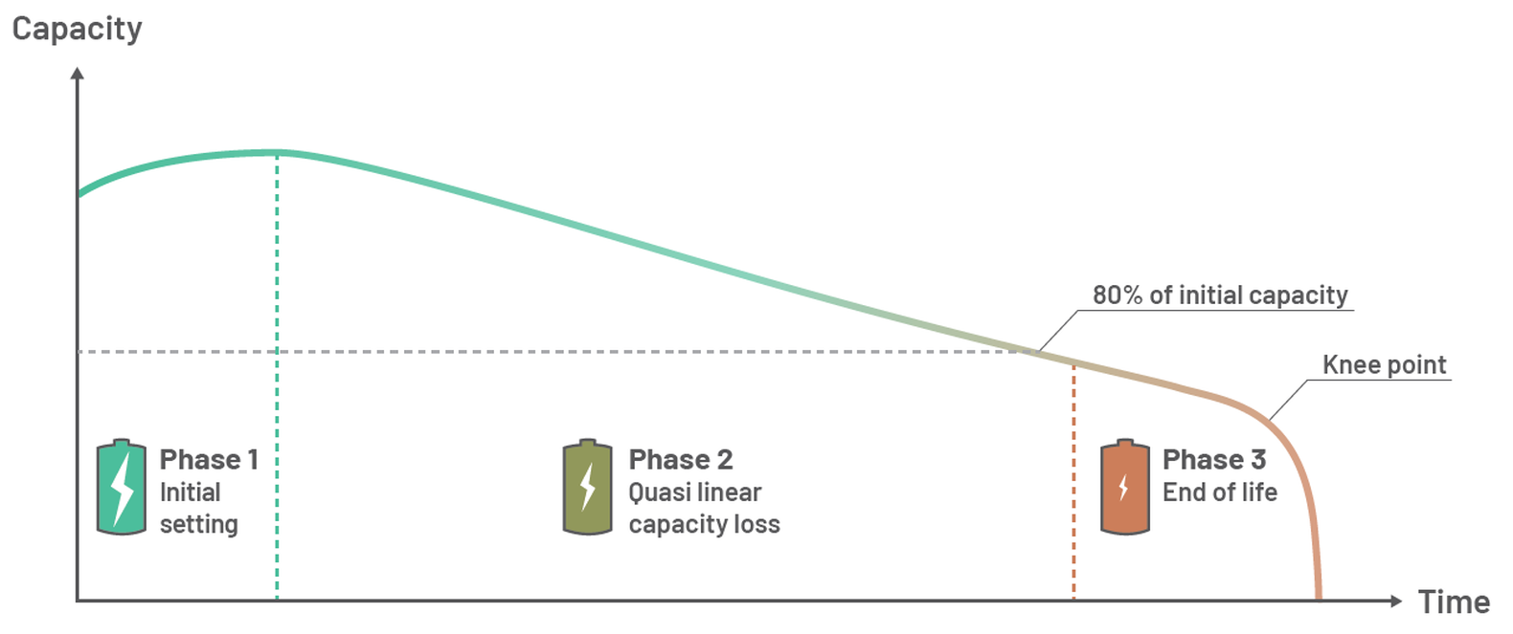
Phenomenological battery ageing
Decrease in storage capacity Q
Looking at the ageing of a lithium-ion battery over time, the ageing process can be roughly divided into three phases.
Typical battery capacity life cycle
aus Internetseite ACCURE Battery Intelligence GmbH
URL: https://www.accure.net/battery-knowledge/blog-battery-aging#key_terms (abgerufen am 13.12.2024)

Slide 9
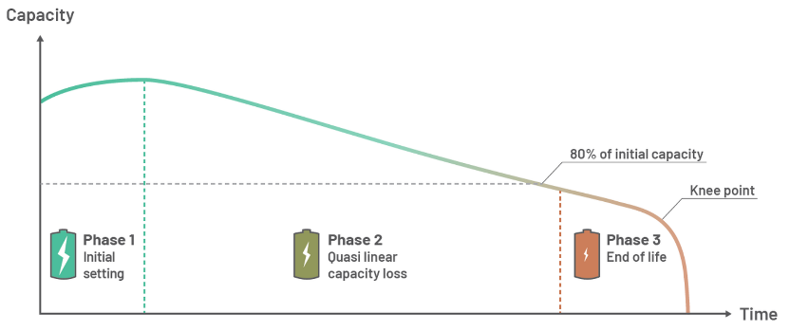
Phenomenological battery ageing
Phases of the consumption curve of the storage capacity Q
Initial Settling
At the beginning of a battery's service life, various chem. processes take place. This can temporarily increase the capacity even though the battery is being used. One reason for this increase is the anode overhang effect. Lithium, which is stored in the part of the anode that is slightly wider than the cathode and does not participate directly in the chem. reactions, is relocated and thus increases the number of Li-ions that can be stored.

Slide 10
Phenomenological battery ageing
Phases of the consumption curve of the storage capacity Q
Quasi-linear capacity loss
In the second phase, there is a strong correlation between the capacity loss and the use of the battery. As a rule of thumb, the relationship between the two is more or less linear if the battery is used under more or less constant operating conditions.

Slide 11
Phenomenological battery ageing
Phases of the consumption curve of the storage capacity Q
Cutoff-Point
The third phase begins at around 50 ... 85% of the original storage capacity when the “Cutoff-Point” occurs. This marks a rapid drop in capacity over several cycles and signals the end of the battery's service life.

Slide 12
Phenomenological battery ageing
Increase in internal resistance R_{i}
In contrast to capacity loss, the internal resistance of a battery increases over time.
This in turn leads to a reduction in performance, which is particularly relevant for hybrid electric vehicles (HEV). Increasing internal resistance in an HEV means that you can no longer accelerate as quickly as before and less energy can be recuperated when braking.
For operators of stationary storage systems, this means lower efficiency and performance.

Slide 13
Causes for battery ageing
Battery ageing
Decrease
Storage Capacity Q
Increase
Internal Resistance Ri
Caused by
Caused by
Decrease in free Li+ ions in the electrolyte
Decrease in the Li+ absorption capacity of the anode (e.g. graphite)
Decrease in the Li+ absorption capacity of the cathode (e.g. the NMC)
Increase in SEI thickness
Occurrence of lithium plating (anode & cathode)
Decrease in permeability of the separator
Partial loss of electrical contacting of active material (anode & cathode)

Slide 14
Causes for battery ageing
What causes capacity losses and increase in internal resistance?
The main cause of ageing in lithium-ion batteries (loss of capacity and increase in internal resistance) is the growth of the SEI layer:
The SEI layer forms on the negative electrode during the first charging cycle (also known as the formation cycle).
The SEI becomes thicker over time and is mainly influenced by the electrolyte chemistry and the mechanical stress of the active materials.
The SEI is usually formed on the anode, which is usually made of graphite (sometimes mixed with silicon).
(SEI = Solid-Electrolyte-Interface)

Slide 15
Causes for battery ageing
What causes capacity losses and increase in internal resistance?
The increase in SEI binds lithium. As a result, fewer lithium ions are available for the charging and discharging reactions and the battery capacity decreases.
In addition, the Li-ions pass through the SEI layer during the charging and discharging process. The thicker this layer is, the more difficult it is for the ions to move through it. For this reason, the internal resistance increases.
In addition to SEI growth, there are numerous other processes - such as cracking and corrosion - that influence battery ageing.

Slide 16
How to minimize battery ageing?
Categorization of battery ageing phenomena
Calendric aging
gradual ageing of batteries over time, even if they are not used. (This is comparable to the ageing of humans, even if we do nothing all day long)
Cyclic aging
“Wear and tear” of the batteries occurs with every charge and discharge cycle. Every time a battery is used, a certain degree of ageing occurs.
Reversible aging
There are effects that lead to a “recovery” of the cells after a load (such as the anode overhang effect). These are referred to as reversible ageing mechanisms.

Slide 17
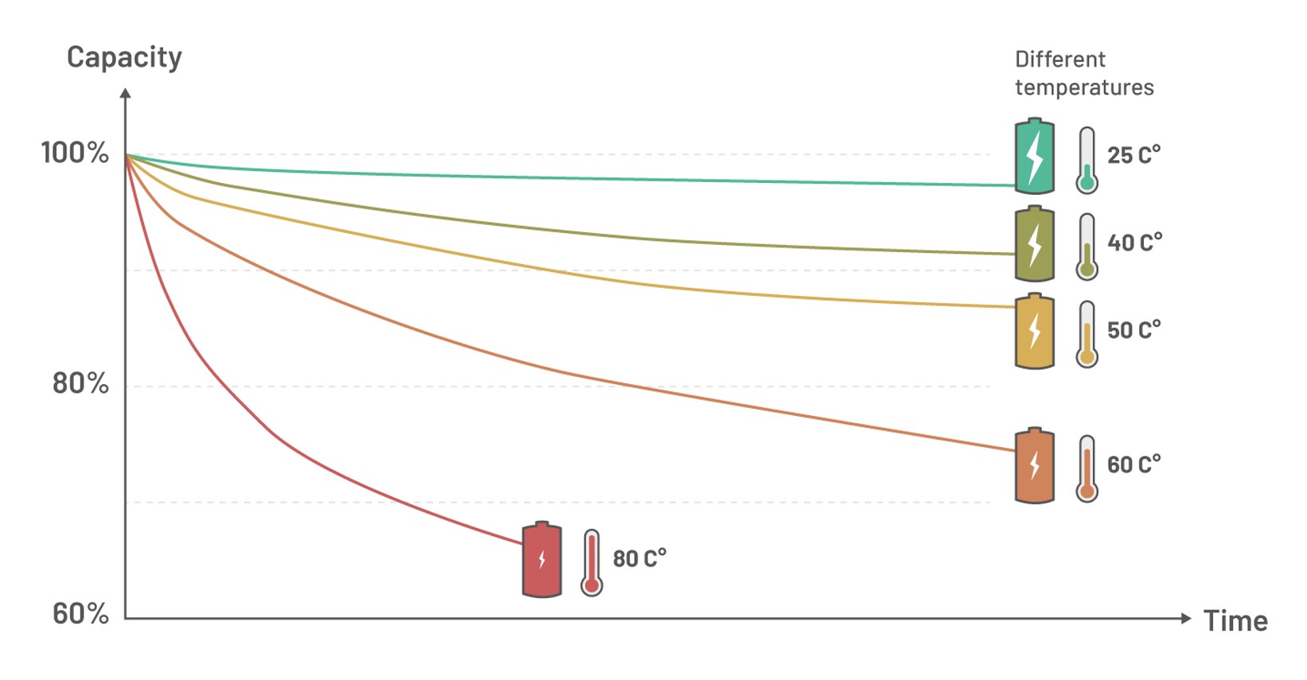
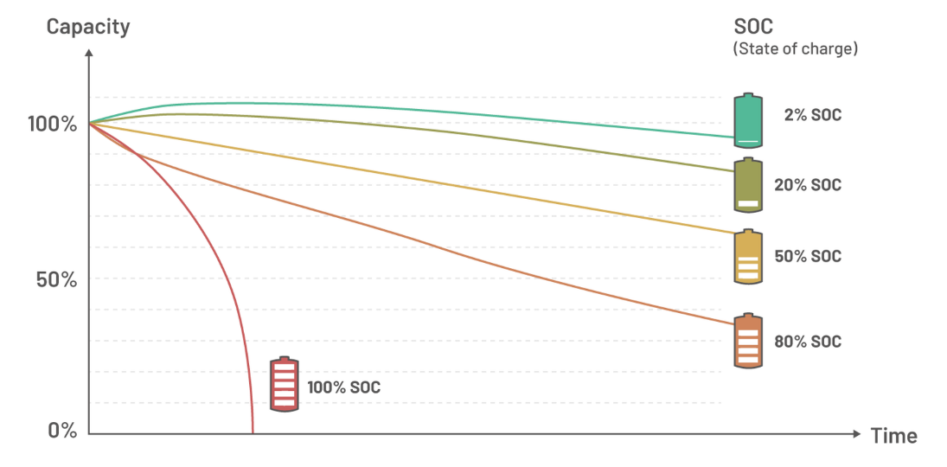
How to minimize battery ageing?
Influences on the calendaric ageing
The most important factors for calendar ageing are:
Temperature und State-of-Charge (SOC)
aus Internetseite ACCURE Battery Intelligence GmbH
URL: https://www.accure.net/battery-knowledge/blog-battery-aging#key_terms (abgerufen am 13.12.2024)
Decrease in capacity over time as a function of temp.
Capacity decrease over time depending on the SoC

Slide 18
How to minimize battery ageing?
Influences on the calendaric ageing
The most important factors for calendar ageing are:
Temperature und State-of-Charge (SOC)
High temperatures and high SOC lead to increased battery ageing (even if the battery is not in use).
Lowering the average battery temperature by 10 °C can double the service life of a battery.
CAUTION:
If a battery is operated at temperatures that are too low, lithium can be deposited (lithium plating). This leads to additional ageing processes.

Slide 19
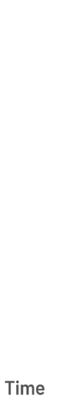
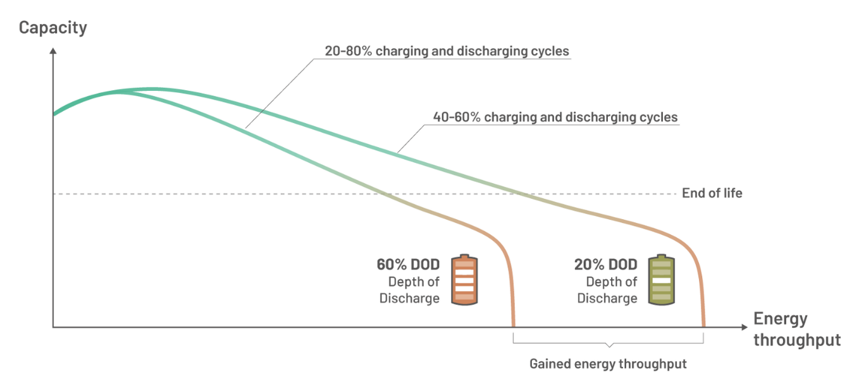
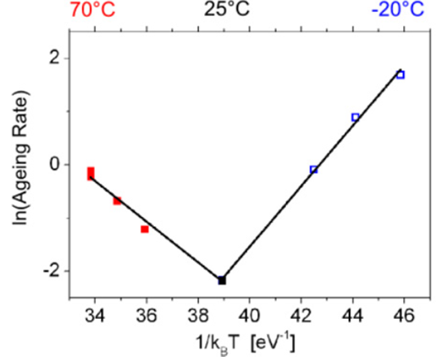
How to minimize battery ageing?
Influences on the cyclic ageing
The most important factors for calendar ageing are:
Temperature and energy throughput
aus Internetseite ACCURE Battery Intelligence GmbH
URL: https://www.accure.net/battery-knowledge/blog-battery-aging#key_terms
(abgerufen am 13.12.2024)
Capacity reduction as a function of energy throughput
Ageing rate as a function of temp.
Waldmann et. al.: Journal of Power Sources 262 (2014) 129-135.

Slide 20
How to minimize battery ageing?
Influences on the cyclic ageing
The most important factors for calendar ageing are:
Temperature and energy throughput
Both high and low temperatures damage a battery cell during operation. Ideally, the operating temperature should be around 25 °C.
Likewise, high energy throughputs lead to faster ageing of batteries.
Energy throughput is the amount of energy that flows through a battery in relation to the time period in which it is transferred.

Slide 21
How to minimize battery ageing?
Influences on the cyclic ageing
The energy throughput in turn depends on the level of the charging and discharging currents and the depth of discharge (DoD), i.e. how deeply a battery is discharged.
However, it should be noted that “small” cycles are less damaging than “large” ones, as can be seen in the figure above. For example, three cycles with a depth of discharge of 20% are less damaging than one cycle with a depth of discharge of 60%, assuming that the total energy throughput was the same. This means that the battery can withstand more cycles if the depth of discharge (DoD) remains within a certain range.

Slide 22
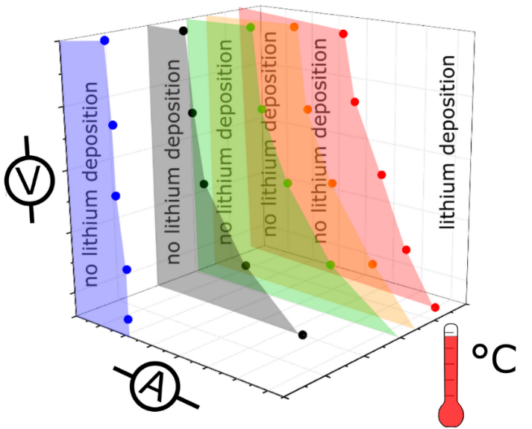
How to minimize battery ageing?
Influences on the cyclic ageing
The charging power also influences the cyclical service life. A high charging capacity or “fast charging” leads to increased ageing.
  One reason for this is that the temperature
  rises when a battery is charged at high power,
  which leads to accelerated ageing
  Another reason is the increased risk of
  lithium plating. This occurs more frequently
  at lower temperatures in particular.
In addition to temperature, charging power, energy throughput and DoD, there are numerous other effects that accelerate battery ageing.

Slide 23
Lithium plating in LIB
Li-plating is a metallic lithium deposit on the anode surface. Lithium that cannot be incorporated into the anode material by intercalation is deposited on the anode particles. It has long been known that Li-plating in (LIB) has a detrimental effect on battery life and safety.
Li-plating occurs when the electrochemical potential of the anode is equal to or lower than the potential of metallic lithium. This means that the lithium ions arriving at the anode cannot distinguish the anode material from metallic lithium and are deposited in metallic form.
In the widely used NMC-LIB types in particular, the anode material consists of graphite. When saturated with Li-ions, its potential corresponds to that of metallic lithium. For this reason, Li-plating occurs preferentially on this material.

Slide 24
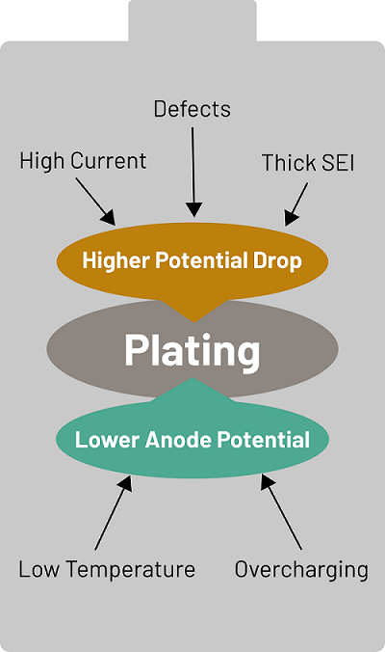
Lithium plating in LIB
Li-plating occurs in particular during the charging process under two conditions:
  Low temperatures
  High currents
In addition, there are other factors
hat influence Li plating, as shown in
the adjacent figure.
These are explained in detail below.

Slide 25
Lithium plating in LIB
Li-plating can also occur if the anode is overcharged. However, this does not happen in normal operation unless there is a fault in the cell production. Normally, the anode is oversized compared to the cathode to ensure that no overcharging of the anode can occur.
The best charging temperature for lithium-ion batteries is between 10 °C and 30 °C in order to achieve the best performance and low ageing.
Low temperatures significantly hinder ion diffusion within the anode material, causing the Li-ions to accumulate on the surface. This reduces the potential of the anode surface to or below the potential of metallic lithium, creating the conditions for deposition.

Slide 26
Lithium plating in LIB
Fast charging is one of the most requested functions and requires high currents to shorten the time it takes to charge the battery. During fast charging, the high current causes lithium ions to accumulate on the surface of the anode, which reduces the electrochemical potential in the same way as the low diffusion rates during charging. The electrochemical potential decreases in the same way as the low diffusion rates cause when charging at low temperatures.
High currents can also occur locally within the cells at various points due to manufacturing defects such as cracks or impurities on the anode surface, leading to localized Li plating.
If the current is very high, deposition can occur at moderate temperatures, and if the temperature is very low, it can also occur at low currents. While Li-plating is more likely to occur at low temperatures or high currents, it can also occur at normal charging rates and temperatures between 5 ... 10 °C.

Slide 27
Lithium plating in LIB
Li-plating also triggers the phenomenological aging phenomena: Decrease in capacity and increase in internal resistance. This is particularly due to the fact that Li ions are bound in the plating layer.
However, a reversible ageing process can also occur under favorable circumstances. The plating leads to temporary metallic Li deposits on the anode surface. Over time, these deposits can be reused in a subsequent discharge or diffuse back into the anode. All lithium recovered in this way is called reversible plating and has no further effect on the cell.

Slide 28
Lithium plating in LIB
However, depending on the severity and morphology of the plating layer, some of the deposited lithium may react with the electrolyte or damage the anode surface. This is referred to as irreversible Li plating. As soon as this occurs, it also becomes self-reinforcing.
During normal operation, the anode surface is covered by the protective SEI layer. This layer forms in the early days of a battery and continues to grow slowly over time. The occurrence of Li-plating can damage this layer and force a new formation of the SEI, whereby electrolyte and lithium are consumed. As lithium is consumed in this undesirable reaction, the deposition reduces the amount of active lithium content in the cell, resulting in a loss of capacity.

Slide 29
Lithium plating in LIB
In addition, metallic lithium can lose contact with the anode surface and become completely covered by insulating SEI, making it inert and leading to a further loss of capacity. The capacity loss caused by the coating is much greater than the loss caused by normal battery ageing.
This newly formed SEI layer may also have a different morphology, being much thicker than the original layer and containing voids created by the deposited metallic lithium. This impedes the flow of ions through the SEI and increases the internal resistance of the cell. Increased internal resistance in turn reduces the performance of the battery by reducing the maximum available power through increased internal resistance losses.

Slide 30
Lithium plating in LIB
The accumulation of lithium reaction products in the cell is also associated with sudden “death” or the knee-point effect. Here, the ageing rate of the cell is suddenly and drastically increased, with the cell losing its remaining capacity within a few cycles. For the 1st life application of a battery, the planned end of a cell's service life is when it has a remaining usable capacity of approx. 70 ... 80%. After this, the cell can still be used in a 2nd life application. The cell can then still be used sensibly until the kink point effect is reached. The earlier this occurs, the shorter the service life during 2nd Life use.

Slide 31
Lithium plating in LIB
Apart from the considerable loss of capacity and the increased internal resistance, Li-plating also impairs the safety of the battery. Li-ions look for the shortest path to deposit and therefore prefer areas that are already coated with lithium. This can lead to local growth, which ultimately results in a so-called lithium dendrite on the anode surface. Dendrites look similar to narrow trees with pointed branches.
In the worst case, these dendrites can pierce the separator between the anode and cathode and cause an internal short circuit in the cell. Short circuits lead to a rapid self-discharge of the cell and can even lead to a thermal runaway and thus to a battery fire.

Slide 32
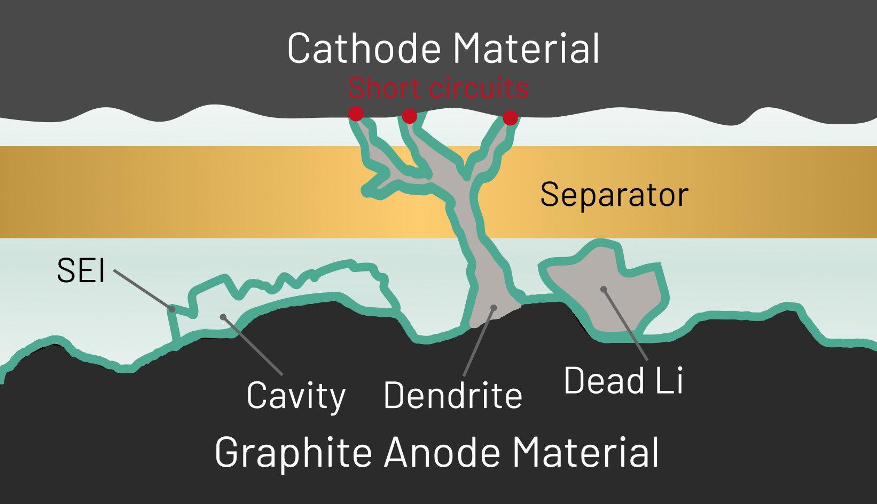
Lithium plating in LIB
Consequences of lithium plating inside a LIB cell
aus Internetseite ACCURE Battery Intelligence GmbH
URL: https://www.accure.net/battery-knowledge/blog-guide-to-lithium-plating-in-lithium-ion-batteries (abgerufen am 13.12.2024)

Slide 33
Lithium plating in LIB
If the deposit is detected during the charging process, it can be prevented. However, most existing methods can only detect a plating event when it has already occurred. One of these methods is the observation of the discharge curve on a stripping plateau. This is a plateau in the cell voltage. It occurs because the metallic lithium deposits on the anode surface generate a higher discharge voltage.Translated with DeepL.com (free version)

Slide 34
Lithium plating in LIB
There are also experimental methods for detecting Li-plating during the charging process using additional external devices, such as very accurate measurement of changes in cell temperature or measurement of cell thickness. However, these methods require expensive additions to the battery management system (BMS).
There are some promising research results that attempt to utilize the change in internal resistance during Li-plating. These methods could be used in the near future to detect plating directly during the charging process and warn the user or abort the charging process if Li plating is detected.Translated with DeepL.com (free version)

Slide 35
Lithium plating in LIB
However, most applications currently only measure cell voltage, current and temperature. In addition, the temperature is not usually recorded on every cell, so it cannot be used to detect Li plating on a single cell. The current signal can therefore also not be used for plating detection. The threshold value at which Li plating occurs depends on the temperature.
In practice, the cell voltage is therefore the most reliable indicator for detecting the onset of Li plating.

Slide 36
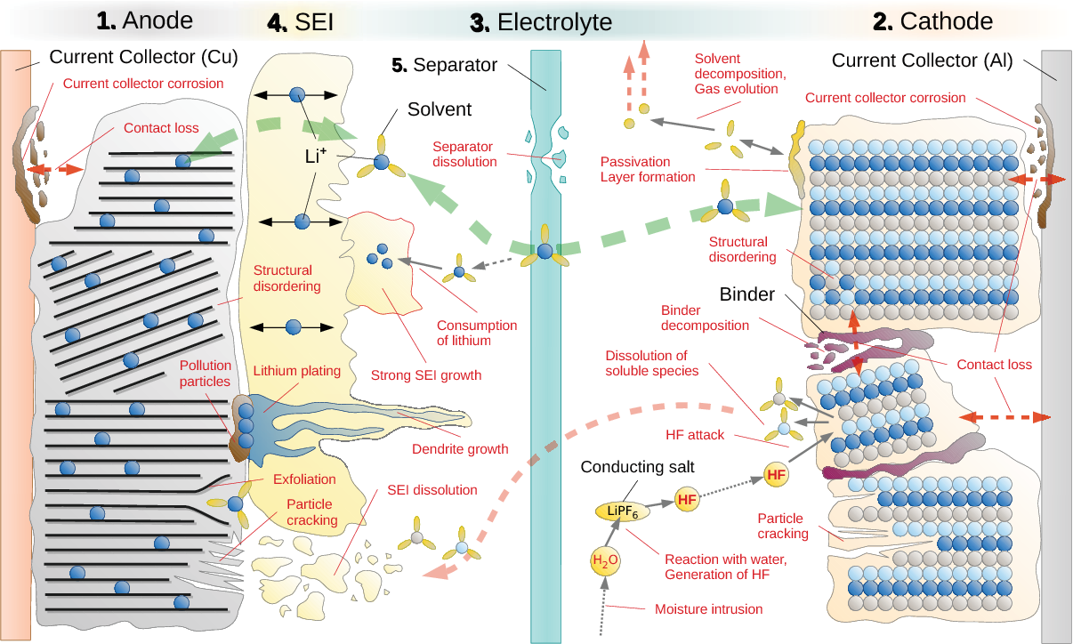
Internal processes of battery ageing
Overview of possible internal reactions and degradation processes that lead to battery ageing.

Slide 37
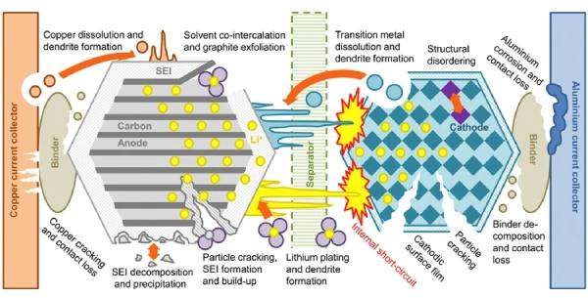
Internal processes of battery ageing
Overview of possible internal reactions and degradation processes that lead to battery ageing.

Slide 38
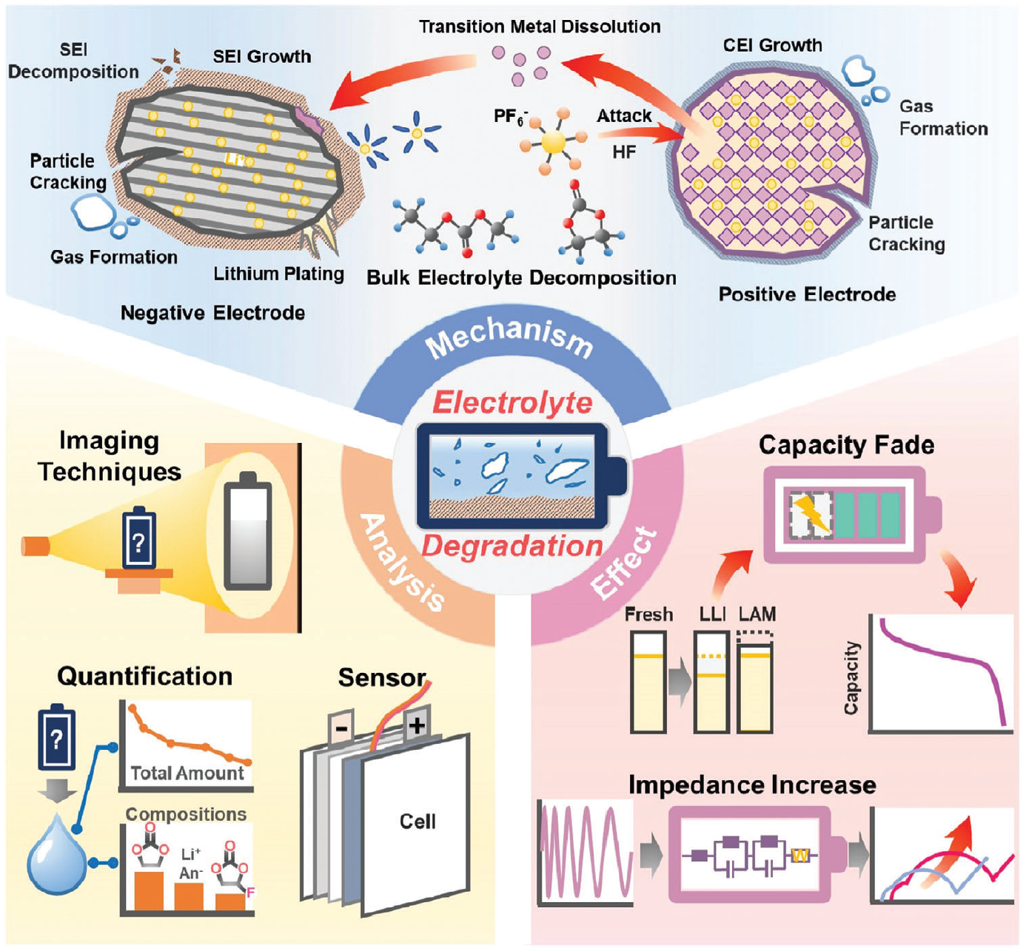
Internal processes of battery ageing
Overview of possible internal reactions and degradation process, the phenomenological effects and their analysis.

Slide 39
Influence of ageing on LIB safety
Battery tests according to SI standards and in publications are usually carried out with unused cells. However, battery cells are only “unused” for a small part of their lifetime.
Understanding the abuse response of aged cells compared to unused cells is crucial for the development of efficient and safe energy storage systems, especially for 2nd life systems.

Slide 40

How to minimize battery ageing?
Tips for extending the battery life of electric vehicles (EVs)
Do not fully charge the battery immediately after returning home if you have only driven a small part of the full range. Fully charging the battery accelerates the aging process so much that many car manufacturers require users to manually release the battery to charge to 100%.
Some EVs offer smart features where the user can input the time the car needs to be charged to avoid a high SOC over long periods of time. For example, if the user has to be at work at 7am, the vehicle will start charging at 4am, even if it was already plugged in before.
It is also recommended to only fast charge the electric vehicle when necessary. Fast charging uses high currents, which can lead to high temperatures. Both are very detrimental in terms of battery ageing.

Slide 41

How to minimize battery ageing?
Tips for extending the battery life of industrial battery
energy storage systems
Battery ageing is often overlooked in the field of large storage systems. Most large-scale storage systems work with software that does not fully take battery ageing into account. For example, the software is designed to optimize the revenue generated but neglects the degradation costs of market participation.
To optimize the total cost of ownership (TCO) of storage systems on an industrial scale, the degradation costs of the various cycles must be considered. With a digital twin, the costs of each cycle can be tracked and consolidated and compared across systems. With the knowledge of the revenue and cost of market participation, the overall operation can be optimized to achieve the maximum total value of the system.

Slide 42
How to minimize battery ageing?
Tips for extending the battery life of home storage systems
Private households with photovoltaic systems on the roof use battery storage systems to increase their own electricity consumption. On most days, home battery systems store more energy than is consumed. As a result, the storage systems are operated in high SOC ranges of 50 ... 100%, which leads to increased ageing. To reduce ageing, the system settings should postpone battery charging until later in the day. This way, the batteries spend less time in higher states of charge overall.
In addition, predictive battery analytics can calculate a maximum required SOC value based on actual usage behavior over time. With this information, the system can determine a user-specific SOC value and thus significantly reduce the average state of charge and extend the service life.

Slide 43

How to minimize battery ageing?
Tips for extending the battery life of consumer goods
such as e-bikes, smartphones, tablets and laptops
A common mistake is that LIBs remain fully charged most of the time. Below are recommendations for adjusting the charging process to prolong battery life and increase safety:
It is best to charge the device in the morning after getting up, rather than before going to bed. If the device is charged during the night, it will remain fully charged for a longer period, which should be avoided.
For notebooks, it is advisable to limit the maximum charge level to around 50% if it is connected to the power supply. (Do not forget to increase the threshold value before disconnecting from the mains for longer periods, e.g. when traveling).

Slide 44
How to minimize battery ageing?
Tips for extending the battery life of consumer goods
such as e-bikes, smartphones, tablets and laptops
It is fine to set a higher SOC value if necessary. For safety reasons, a lower SOC value is recommended when taking the computer on an airplane.
Other consumer goods such as electric toothbrushes, electric shavers or power tools should only be charged when the SOC value is 20% or less and not after each use.
Do not fully charge electric bicycles all the time. Instead, only fully charge when the full capacity is required for long distances. If the e-bike is to be stored for a longer period of time, it is recommended to discharge the battery to 20-50% before storage.
Do not charge e-bikes outdoors when it is cold, as this can lead to Li-plating.

Slide 45
Key Takeaways
Key takeaways
The ageing of LIBs can be divided into “cyclical” and “calendar” ageing.
Several ageing mechanisms take place simultaneously on all components of a LIB.
The charge/discharge rate and the temperature have a major influence on ageing.
The “safety” depends on the ageing conditions.
Li-plating lowers the temperatures at which thermal runaway occurs. (thermal runaway) sets in.
Modern LIBs that are operated at the limits of the specification “live” for hundreds to thousands of cycles.

