Slide 1

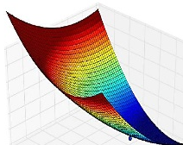

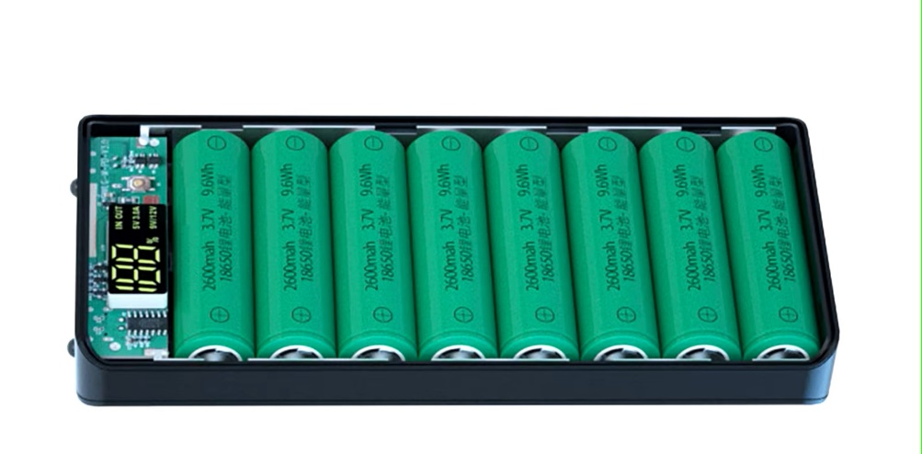








Li-Ion Battery Course
Modelling and Validation
Li-Ion Battery Cells
Thermal Design
Circular Economy
Battery Manage-
ment System
Standard and Regulations
Charging Strategies
Battery Ageing

Slide 2
Educational Objects
Learning objectives
Students will be able to
  understand the basic procedure for an LCA and explain the individual steps
  define the scope of the investigation and be aware of its influence on the result
  analyze the critical components and consider them in detail
  calculate and compare the lifetime carbon footprint
Additionally, for the LCA of the "OST-Gadget Battery Pack“
  convert the electricity consumption into the corresponding emission factor (CO₂ equivalent)
  understand the influence of the electricity mix with which a battery is charged.
  understand the impact of gray energy on the CO₂ footprint.

Slide 3
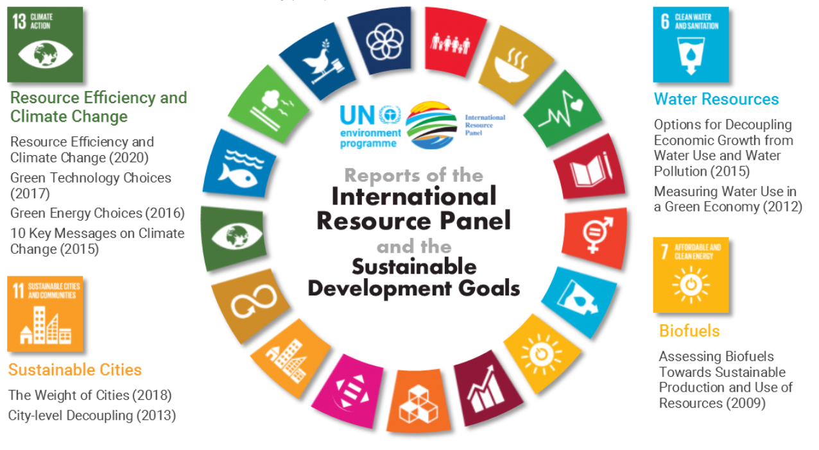
Agenda
Global Sustainable
Battery Lifecycle
Primary Resources (Origin and Quantity)
Battery emits CO₂?
  Grey energy in fuel and electricity
  Electrical vs. combustion vehicle
  Car life cycle and alternatives
Afterlife of a Battery
  1st Life ends
  2nd Life starts
  Recycle process of a battery

Slide 4








Review: EU targets for environmental protection
Review: CE directives and Responsible offices for safety
Suva
Raw materials
Production Distribution
CE
ADR/ IMDG/ IATA
Recycling
Transport
Development
Burning
Transport
Consume
ADR/ IMDG/ IATA
CE
Disposal
CE
Notes:
Bei dem Beispiel in den Folien werden neben den CE-Richtlinien auch andere Vorschriften, die über die Lebensdauer der Powerbank vorhanden sind, beachtet.
Vor allem sind dies SUVA- und Transport-Vorschriften

Slide 5
Global Sustainable Goals
IRP: International Resource Panel
  Global science-policy platform
  Part of UNEP: United Nations Environment Program (since 2007)
  Goals: Share Knowledge & Improved usage of natural resources
Facts of last 5 decades:
  2x global population
  > 3x usage of natural resources
  < 90% biodiversity losses
Challenges (expected till 2060):
  2x usage of natural resources (irreversible consequences)
Outcomes
  IRP Global Material Flows Database
  IRP Publications
  Collaborations & Scientific Studies
https://www.resourcepanel.org/about-us

Slide 6
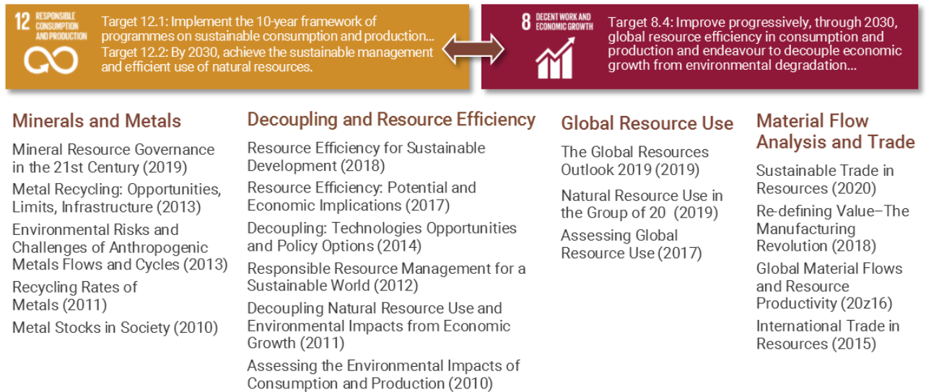
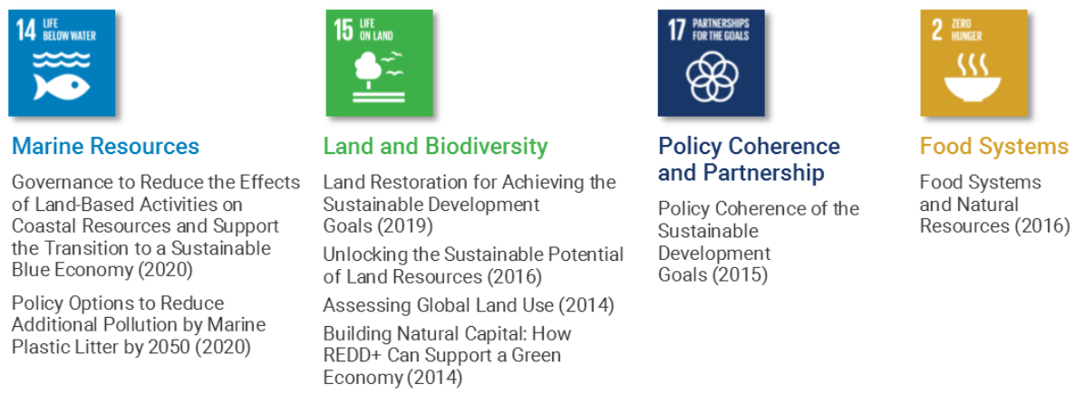
Sustainable and Batteries
12: Responsible Consumption & Production
  Metal Recycling
  Mineral Resource Governance
  Re-define Value – The Manufacturing Revolution
13: Resource Efficiency & Climate Change
  Green technology choice
  Resource efficiency
Relevant secondary reports and topics
  7: Biofules
  8: Decent Work & Economic Growth
  11: Sustainable Cities
  15: Land & Biodiversity
  17: Policy Coherence & Partnership
https://www.resourcepanel.org/about-us

Slide 7
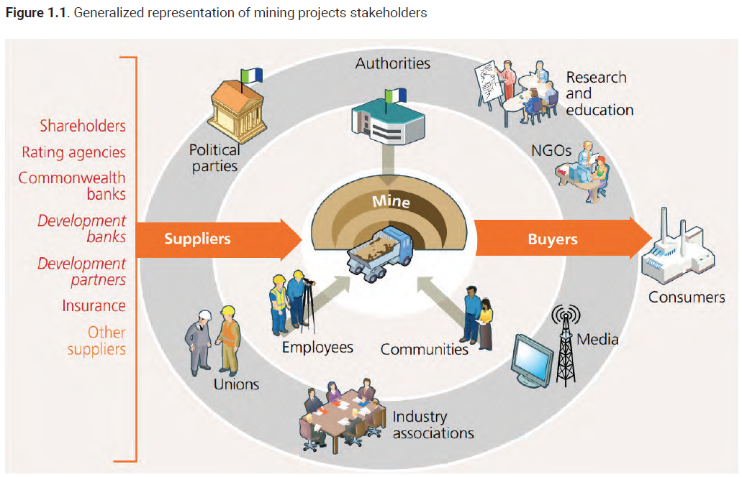
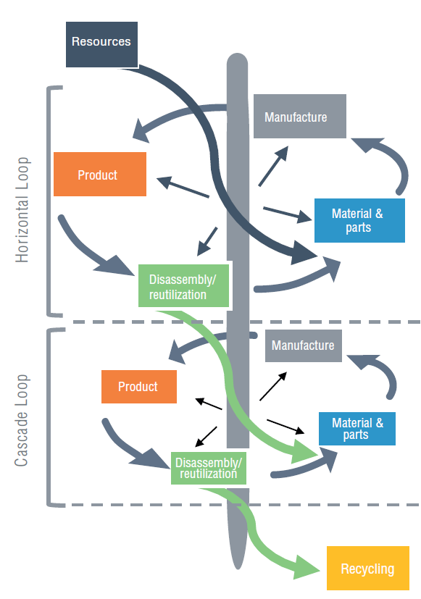
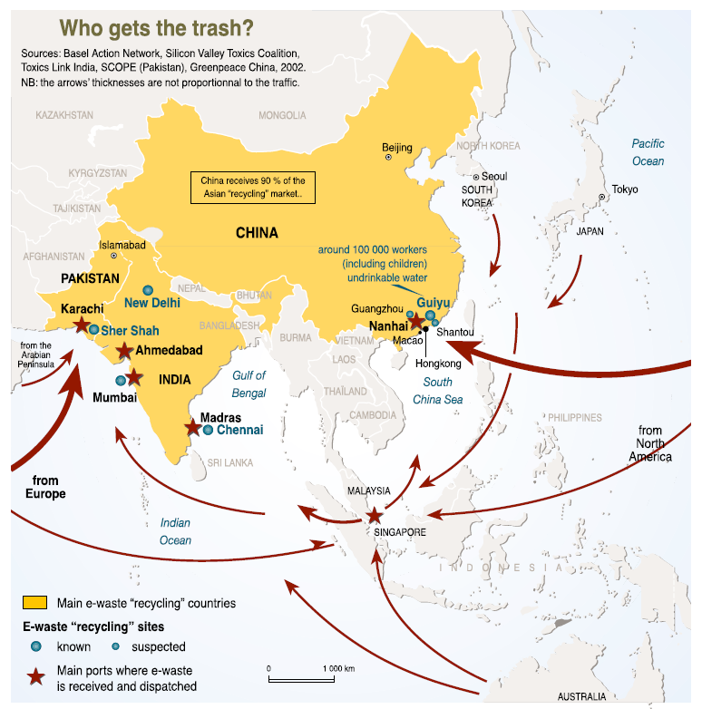
Global Sustainable Goals in Production
12: Responsible Consumption & Production
These reports give a short overview of a global product live cycle.
These can not answer all question, but give hints to understand the global complexity:
  Who are the stakeholders of all resources of a battery?
  Where does our e-waste go? / India or China?
  How could we optimize our product live cycle?
https://www.resourcepanel.org/about-us

Slide 8
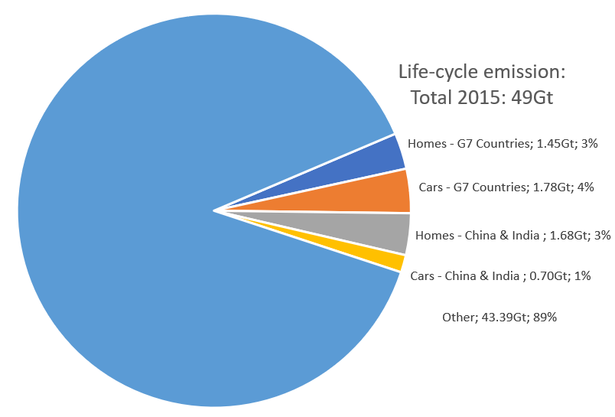
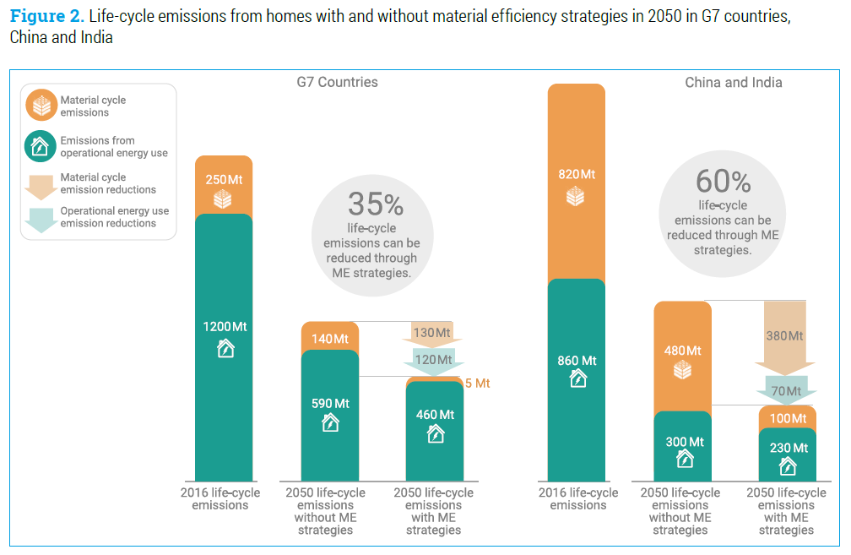
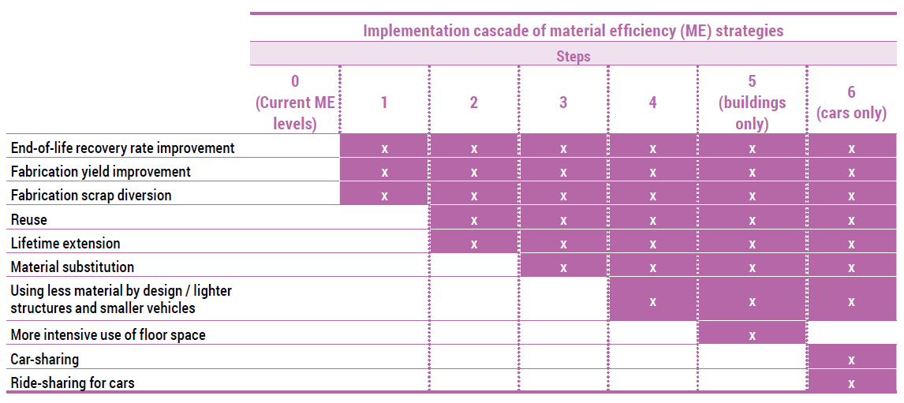
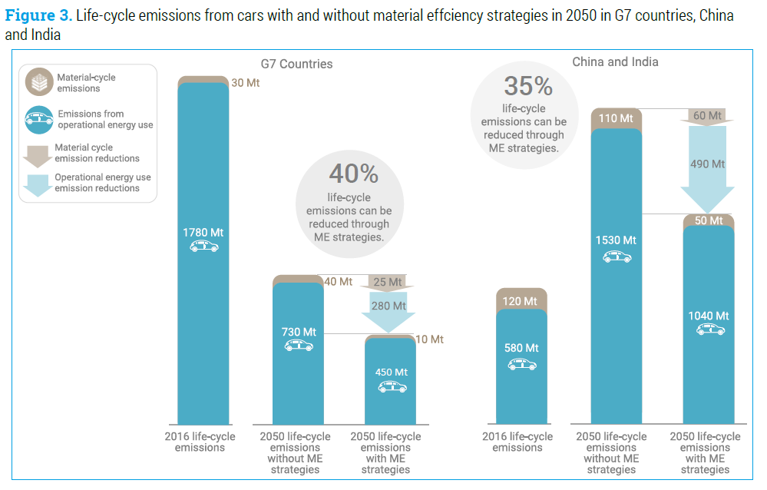
Global Sustainable Goals for Resources
13: Resource Efficiency & Climate Change
Green technology choice / Resource efficiency
Emission for material consumption for cars and homes of G7 and China & India emit 11% over whole Life-cycle of all materials.
Goal to 2050: Improvement of 40% by ME strategy (material efficiency)
Batteries have a big impact on this transition
https://www.resourcepanel.org/about-us

Slide 9
UN cooperation for environmental protection
Connecting to CE directives and Responsible offices for safety
Suva
Raw materials
Production Distribution
CE
ADR/ IMDG/ IATA
Recycling
Transport
Development
Burning
Transport
Consume
ADR/ IMDG/ IATA
CE
Disposal
CE
Notes:
Bei dem Beispiel in den Folien werden neben den CE-Richtlinien auch andere Vorschriften, die über die Lebensdauer der Powerbank vorhanden sind, beachtet.
Vor allem sind dies SUVA- und Transport-Vorschriften

Slide 10
Agenda
Global Sustainable
Battery Lifecycle
Primary Resources (Origin and Quantity)
Battery emits CO₂?
  Grey energy in fuel and electricity
  Electrical vs. combustion vehicle
  Car life cycle and alternatives
Afterlife of a Battery
  1st Life ends
  2nd Life starts
  Recycle process of a battery

Slide 11
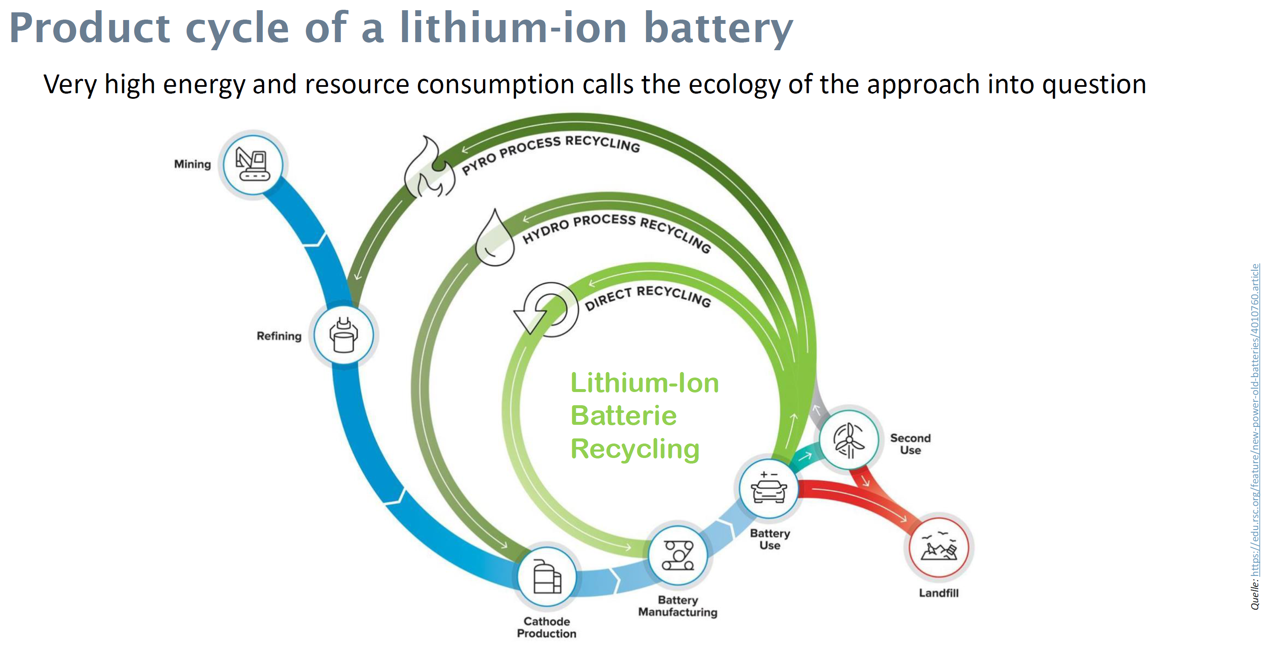
The life cycle (LCA) of a lithium-ion battery
A life cycle of a battery is similar as any other product in a market.
1st Life of a Battery
  Get the resources
  Refine the resources
  Production of battery
  Usage of a battery
  End of life (EOL) process of a product
    Dump / Disposal or
    Afterlife
    2nd Life (Re using a battery)
    3rd Life (Re use parts of a battery)
    Recycle process
      Recreating usable resources
    No dump / disposal
path dependent
LCA = life cycle assessment
New power, old batteries | Feature | https://edu.rsc.org/feature/new-power-old-batteries/4010760.articleRSC Education

Slide 12
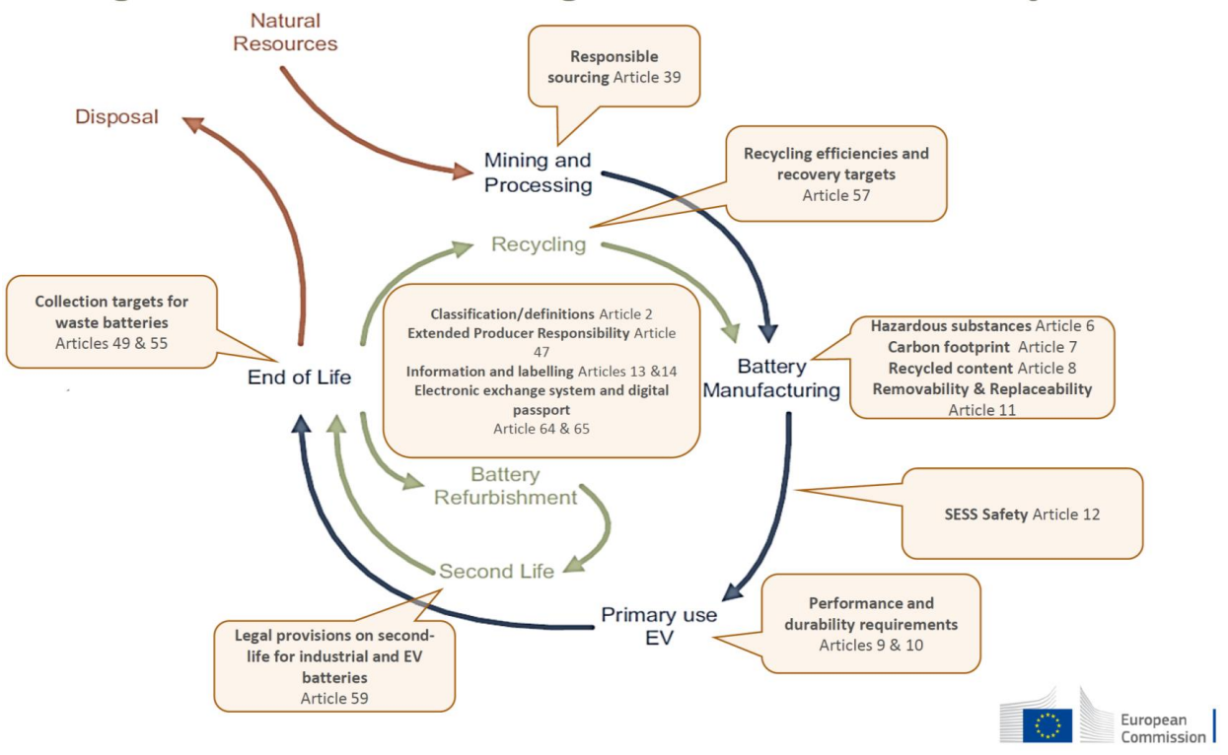
New battery regulation:
Covering the entire battery value chain
As in the LCA of a battery, EU regulates the battery value chain.
Supporting:
  2nd Life
    Re using a battery
  3rd Life
    Re use parts of a battery
  Recycle process
Avoiding:
  Disposal
  Acquisition of new natural resources
LCA = life cycle assessment
https://eit.europa.eu/sites/default/files/industrial_policy_for_european_battery_alliance.pdf

Slide 13
Agenda
Global Sustainable
Battery Lifecycle
Primary Resources (Origin and Quantity)
Battery emits CO₂?
  Grey energy in fuel and electricity
  Electrical vs. combustion vehicle
  Car life cycle and alternatives
Afterlife of a Battery
  1st Life ends
  2nd Life starts
  Recycle process of a battery

Slide 14
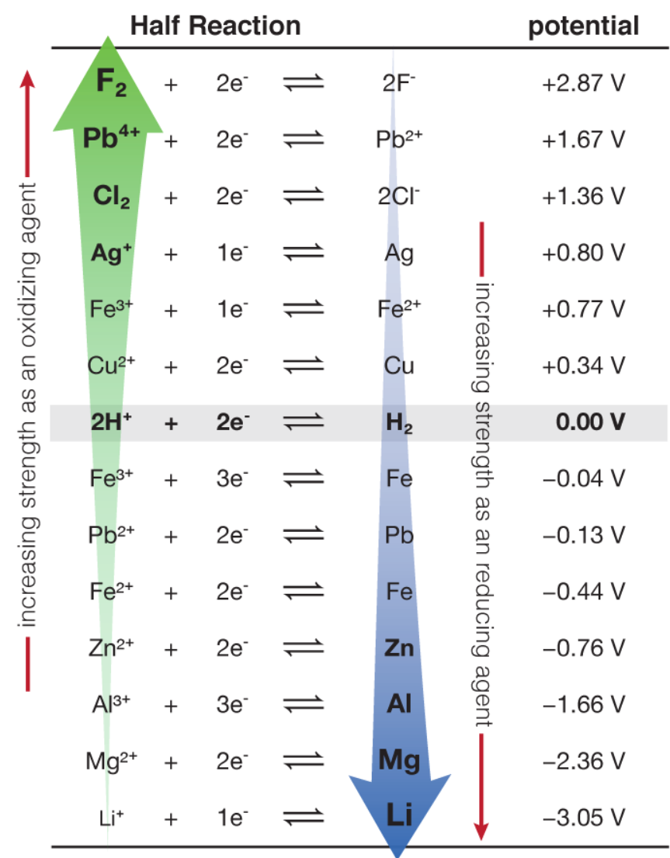
Lithium as basic material for batteries
Use materials for batteries
Main: Lithium
Additional: Graphite, Nickel, Manganese, Copper, Aluminum, Vanadium, Cobalt, Zinc
Types of Lithium-ion batteries
Lithium-Nickel-Manganese-Cobalt Graphite Oxide (NMC)
Lithium-Nickel-Cobalt-Aluminum Graphite Oxide (NCA)
Lithium Iron Phosphate (LFP)
Lithium Titanate (LTO)
ch302.cm.utexas.edu/echem/echem-cells/selector.php?name=std-red-potentials

Slide 15
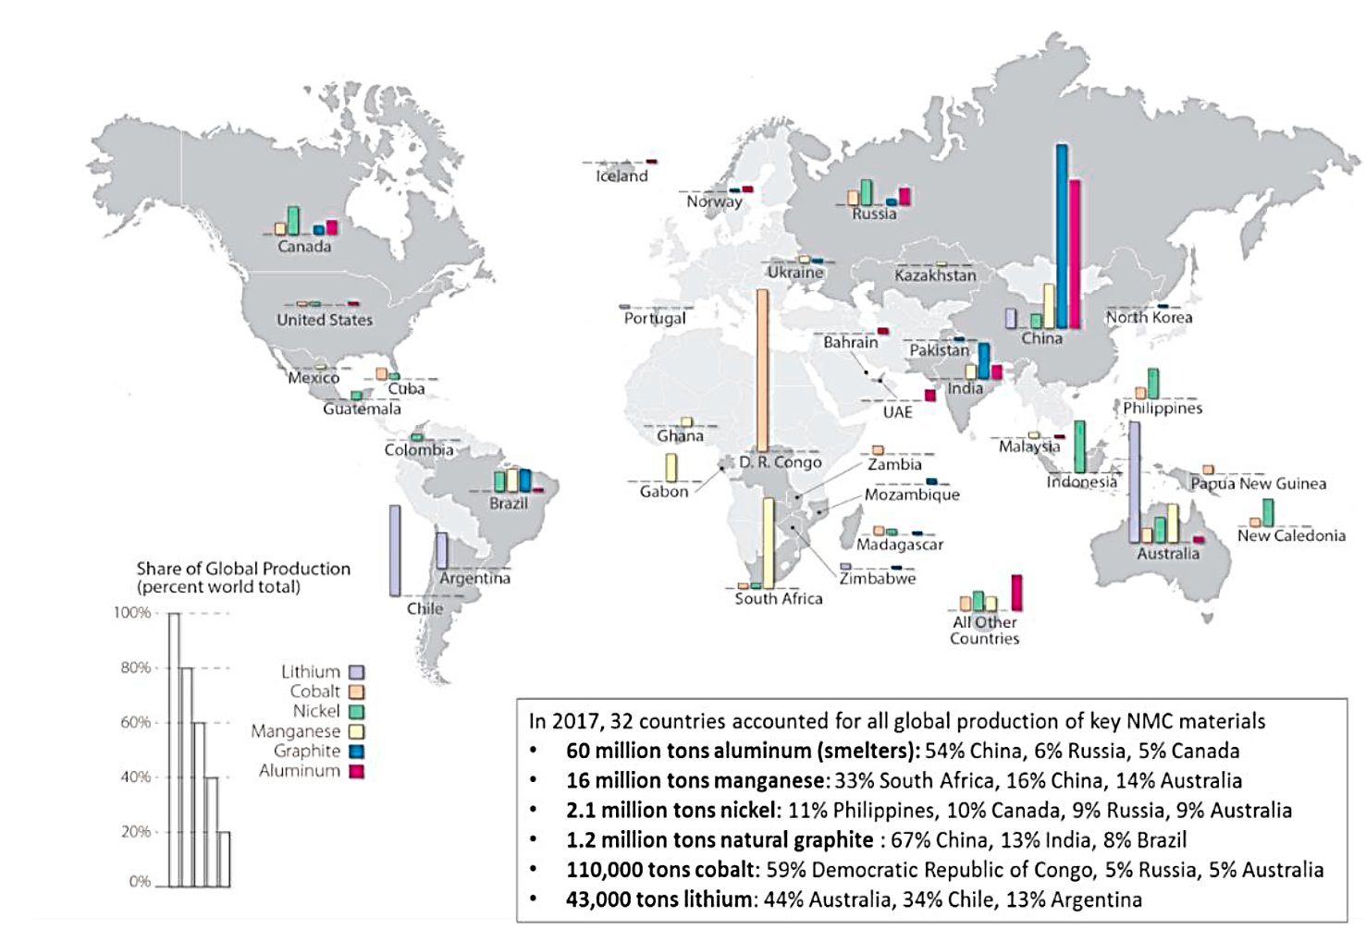
Lithium-Ion Batteries: raw materials origins
Raw Materials
Lithium
Graphite
Nickel
Manganese
Copper
Aluminum
Vanadium
Cobalt
Zinc
D. Steward, A. Mayyas, and M. Mann, “Economics and Challenges of Li-Ion Battery Recycling from End-of-Life Vehicles,” Procedia Manufacturing, vol. 33, pp. 272–279, 2019, doi: 10.1016/j.promfg.2019.04.033.

Slide 16
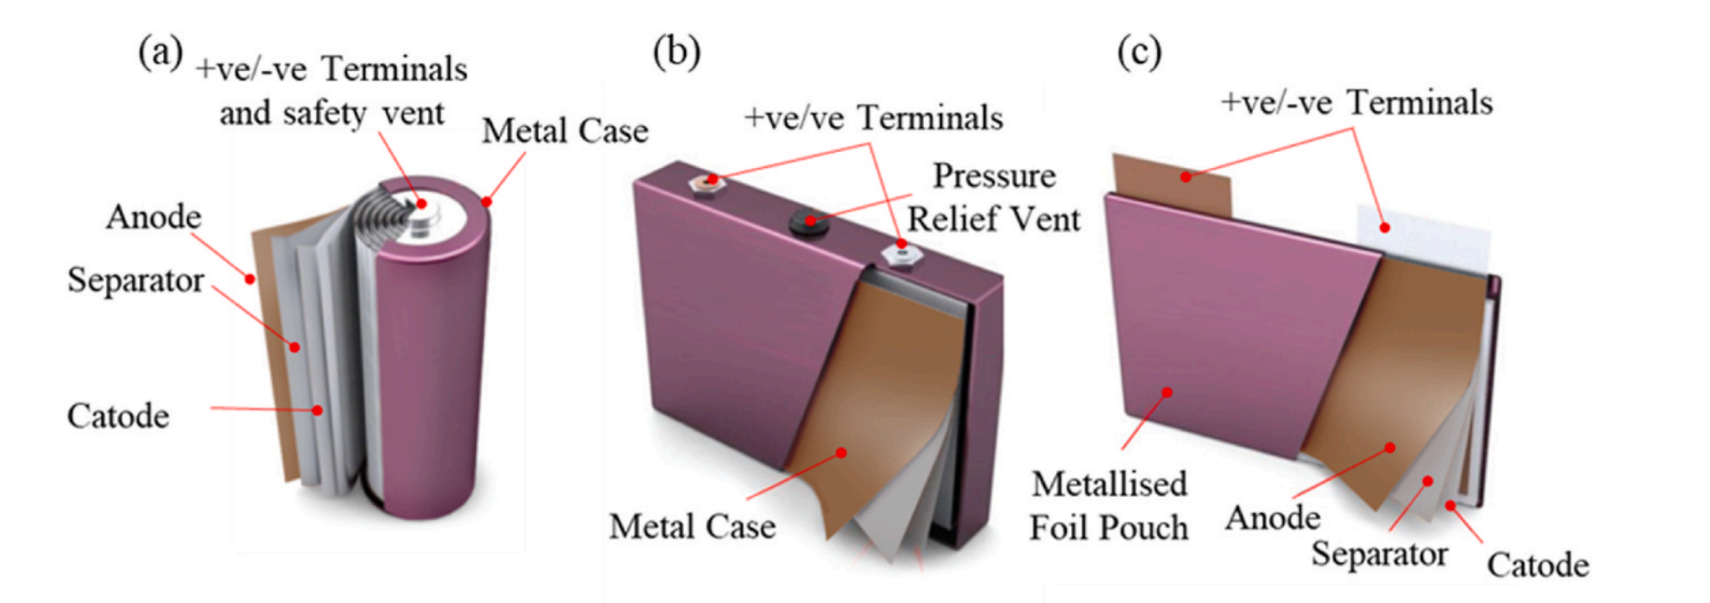
Example of cell designs
Cell design is based on product requirement:
cost, safety, cycle life, energy density and power density.
Cell design changes requirement of different material in implemented & characteristics, management systems and controls.
Cell design influences a second life scenario and a recycling process
Cylindrical cell
Prismatic cell
Pouch cell
Fig. 1. Types of cell construction. (a) Cylindrical cell; (b) Prismatic cell; (c) Pouch cell
O. E. Rojas and M. A. Khan, “A review on electrical and mechanical performance parameters in lithium-ion battery packs,” Journal of Cleaner Production, vol. 378, p. 134381, Dec. 2022, doi: 10.1016/j.jclepro.2022.134381.

Slide 17
Agenda
Global Sustainable
Battery Lifecycle
Primary Resources (Origin and Quantity)
Battery emits CO₂?
  Grey energy in fuel and electricity
  Electrical vs. combustion vehicle
  Car life cycle and alternatives
Afterlife of a Battery
  1st Life ends
  2nd Life starts
  Recycle process of a battery

Slide 18

CO₂ emission specifications CH/EU
Since July 2012, CO₂ emission regulations for new passenger cars have been in force in Switzerland, as in the EU.
Cars registered for the first time in Switzerland may not emit more than 130 grams of CO₂ per kilometer on average. This target was valid until the end of 2019, and a target value of 95 grams of CO₂ per kilometer has applied to passenger cars since 2020. It changed in 2021 to 118 grams of CO₂ per kilometer.
From 2020, additional CO₂ emission regulations will be introduced for delivery vans and light articulated semi trucks (LNF). They must comply with a target value of 147 grams of CO₂ per kilometer. Based on the target value, each importer's fleet must comply with an individual target. If they exceed this, a penalty will be imposed.
Fuel | Weight | Heating value | CO₂-Emission
1l Petrol | 750 g | 9.0 kWh/l | 2392 gCO₂/l
1l Diesel | 835 g | 10.3 kWh/l | 2640 gCO₂/l
$$≈\frac{9500\frac{\text{g}CO_{2}}{100 \text{km}}}{2500\frac{\text{g}CO_{2}}{l}}=3.8\frac{l}{100 \text{km}}$$
Limit value per 100 km
CO₂ emissions per litre
Source: FAQ - CO2-Emissionsvorschriften für Personenwagen (admin.ch)

Slide 19
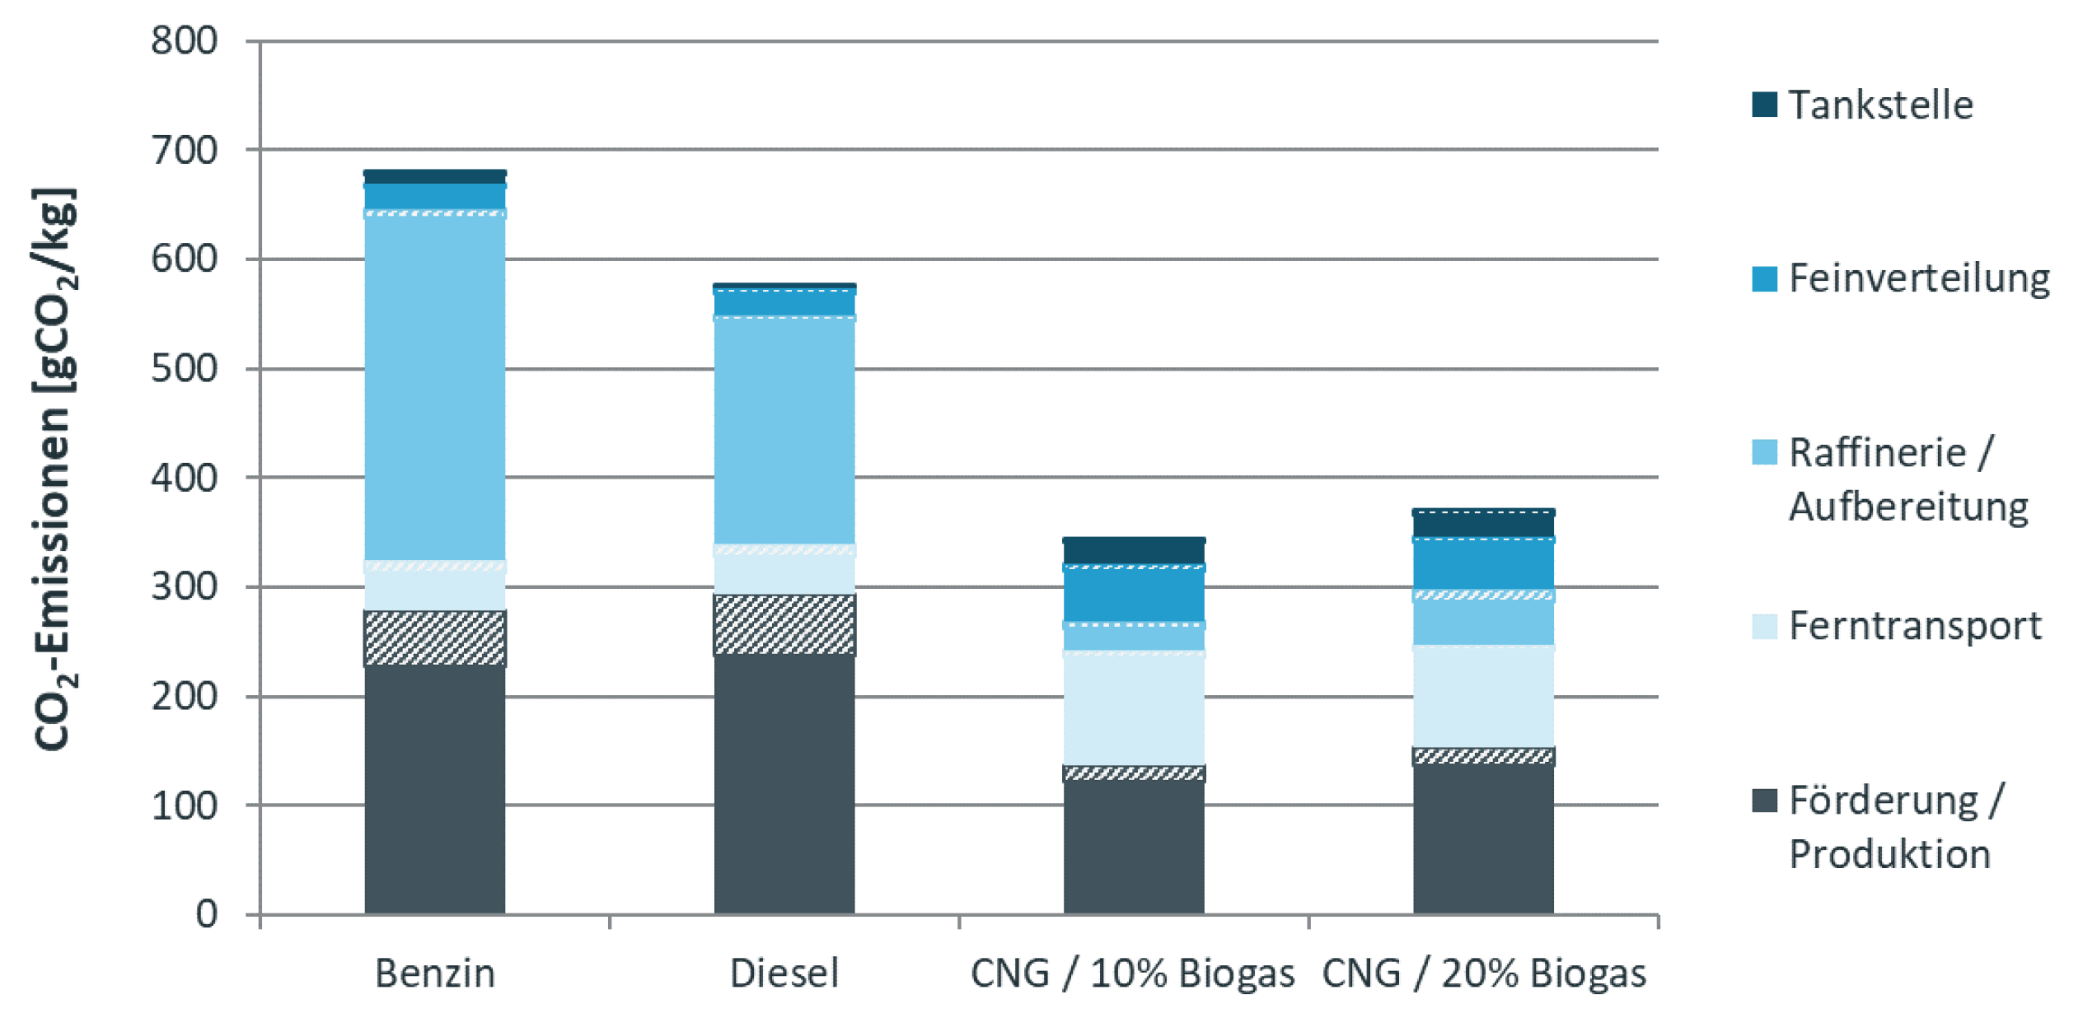
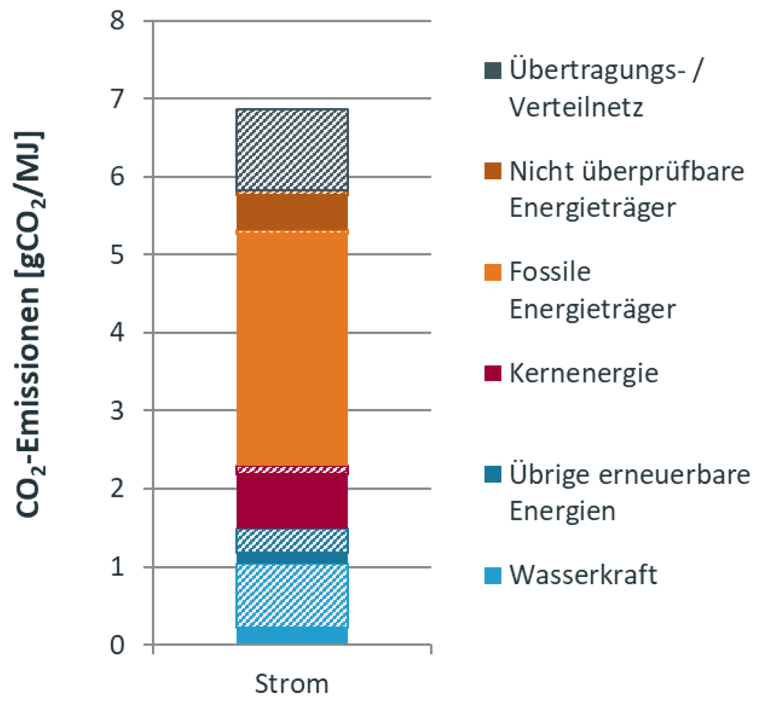


Grey Energy
Grey energy is the amount of energy required to manufacture, transport, store, sell and dispose of a product.
Petrol: $300 \text{g}CO_{2}\text{/}\text{kWh}$ in a Swiss petrol station with $600 \text{g}CO_{2}\text{/}\text{kg}$*.
Electric: $2\text{5 }\text{g}CO_{2}\text{/}\text{kWh}$ in a Swiss electricity mix with $7 \text{g}CO_{2}\text{/}\text{MJ}\text{.}$
*Density of petrol ≈ $0.75 k\text{g}\text{/}l$
Source: «Umweltkennwerte 2021 der Strom- und Treibstoffbereitstellung» https://pubdb.bfe.admin.ch/de/publication/download/10616

Slide 20
Grey Energy - Comparing
→ Electric vehicles are 2–4 times more energy-efficient and cost-efficient.
 | Petrol / Diesel | Electricity
CO₂- Emission (incl. Gray Energy) | $$3 \text{kg}\text{/}l= 300 \text{g}CO_{2}\text{/}\text{kWh}$$ | $25 \text{g}CO_{2}\text{/}\text{kWh}$ (Sweden)* $130 \text{g}CO_{2}\text{/}\text{kWh}$ (Germany)* $775 \text{g}CO_{2}\text{/}\text{kWh}$ (Poland)*
Costs per Energy | $$1.50 –1.90 \text{€}/l = 15−19 \text{Cent}/\text{kWh}$$ | $28 \text{Cent}\text{/}\text{kW}$ (Germany) $13 \text{Cent}\text{/}\text{kWh}$ (Poland)
Usage of a car | $$4 \text{l}\text{/100 }\text{km} =40 \text{kWh}\text{/100 }\text{km}$$ | $15 \text{kWh}\text{/100 }\text{km}$ (Average)
Costs per usage | $$6.00 −7.20€\text{/100 }\text{km}$$ | $4.20€\text{/100 }\text{km}$ (Germany) $1.95€\text{/100 }\text{km}$ (Poland)
* Source (2022): https://app.electricitymaps.com/co?lang=de

Slide 21
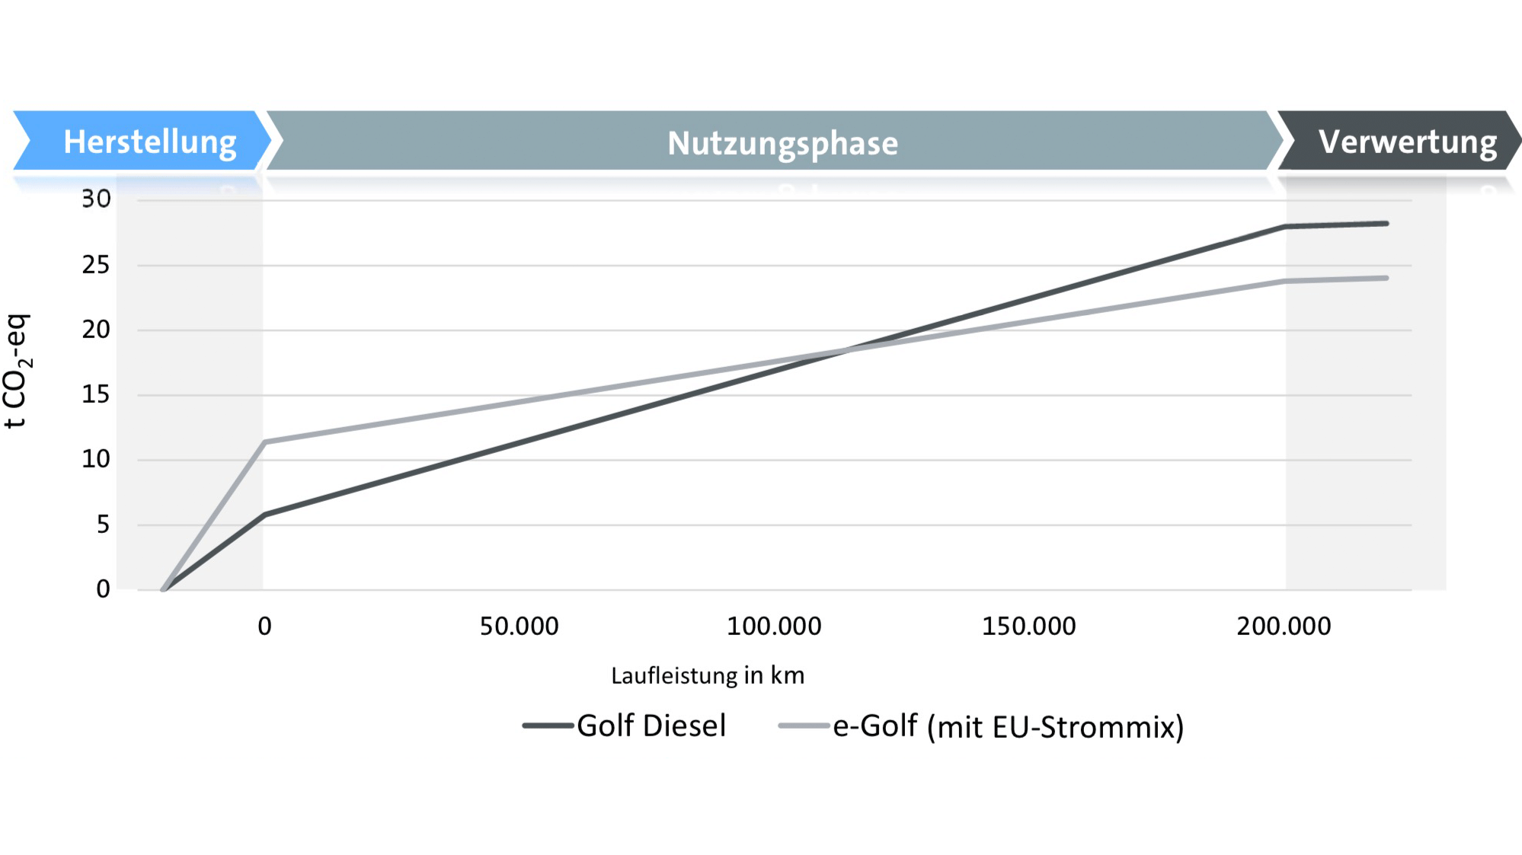

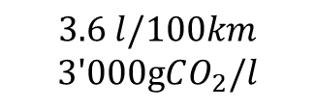
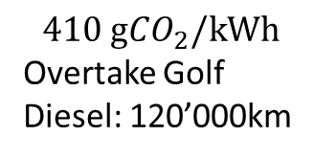
Combustion vs. Electric - Life cycle assessment
$$3.6 l/100km$$
$$\text{3′000}\text{g}CO_{2}\text{/}l$$
$$410 \text{g}CO_{2}\text{/}\text{kWh}$$
Overtake Golf Diesel: 120’000km
Change electricity mix at home
$$100 \text{g}CO_{2}\text{/}\text{kWh}$$
Overtake Golf Diesel: 70’000km
Source: https://www.heise.de/newsticker/meldung/VW-Studie-E-Autos-sind-klimafreundlicher-als-Verbrenner-4407953.html

Slide 22
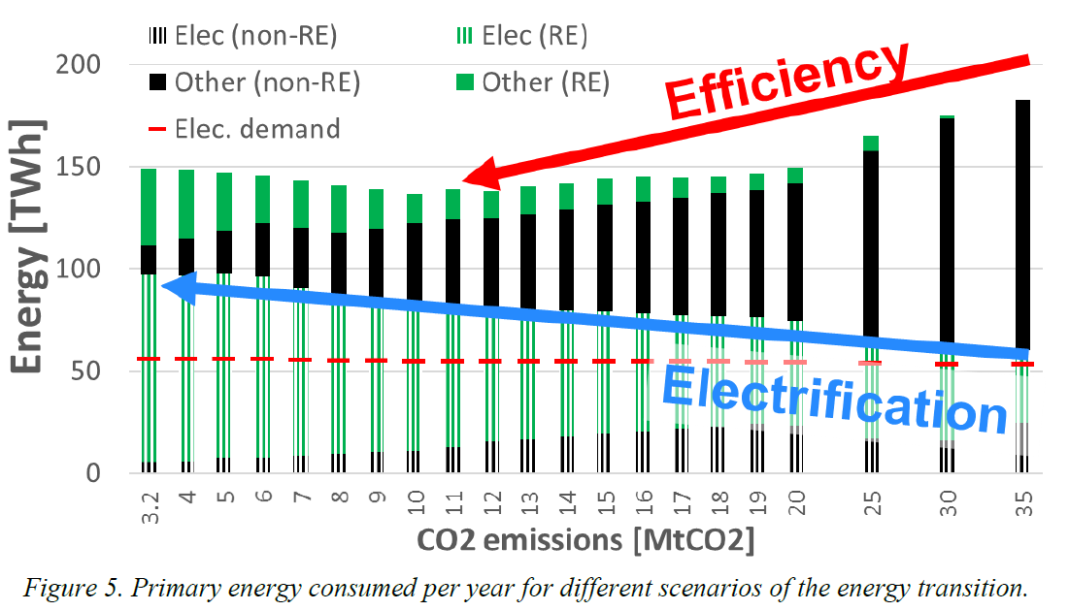
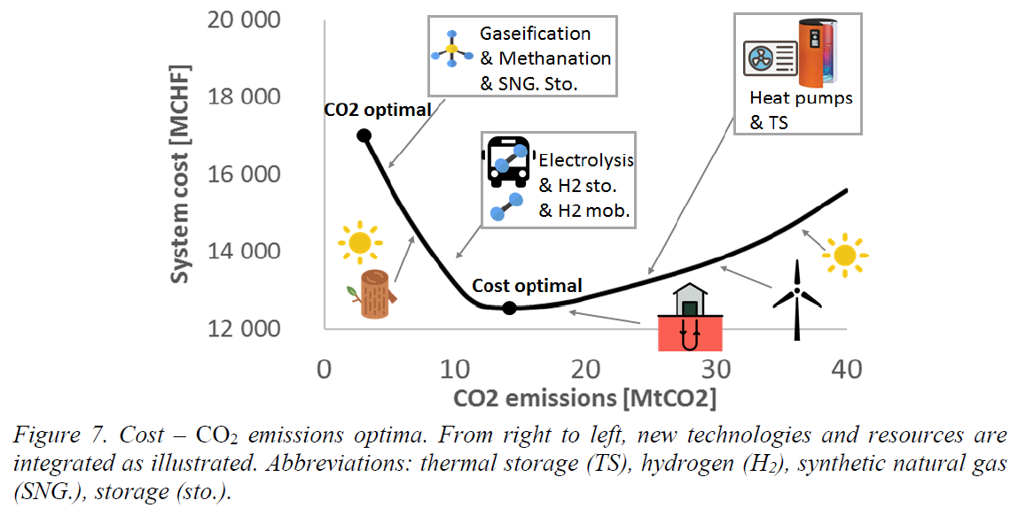
Electrification reduces CO₂ emissions
The study discusses the importance of integrating efficient technologies and renewable energy sources to reduce CO₂ emissions. It shows the role of storage technologies in maintaining system flexibility and the significance of sectoral electrification in achieving optimal CO₂ emission levels.
In 2015 Switzerland had an emission of 35MtCO₂ by consumption of 183TWh energy (2023: 33MtCO₂)
Goal: reduce CO₂ emission
Improve efficiency: Implement newer and more efficient technology
Reduce power consumption to 137TWh and improve emission to 10 MtCO₂
Cost-emission trade-off: More efficient system has its higher costs: < 14 MtCO₂
Big impact on energy consumption: home heating systems, mobility
Solution:
Transitioning to smaller, localized energy systems supported by local storage solutions, such as batteries, can reduce grid losses for heat and electric systems
RE = renewable energies
TD = typical days
G. Limpens, S. Moret, G. Guidati, X. Li, F. Maréchal, H. Jeanmart, “The role of storage in the Swiss energy transition”, PROCEEDINGS OF ECOS 2019 - JUNE 23-28, 2019, WROCLAW, POLAND
Notes:
analyze the transition pathway,
how primary energy supply changes as a reduction in CO2 emissions is gradually imposed; → analysis of the CO2 optimal scenario. 3rd, the trade-off between cost VS CO2 emissions of energy system is assessed by means of a Pareto analysis.
Finally, optimal storage technologies mix in energy transition.
Result based on data like 12 TDs --- energy transition is forced to reduce CO2 emissions, ---START Swiss in 2015: 35 MtCO2/y
Figure 5 shows how the primary energy consumption decreases as we impose a reduction of CO2 emissions in the system. Indeed, the
energy transition is associated with a reduction of primary energy used. In the first (high emissions) scenario, the system needs almost 183 TWh of primary energy. (@ 35MTCo2)
reduced to 137 TWh at 10 MtCO2/y and
slightly increases at lower CO2 emissions.
This primary energy reduction is achieved thanks to the integration of more efficient technologies.
technology “efficient” == consumes less primary energy or improved service than a traditional technology, such as an electric vehicle which consumes less electricity for mobility than a traditional gasoline car,
or a HP which consumes less primary energy than a boiler to supply the same quantity of heat. The plateau observed at emission levels around 10 MtCO2/y represents the minimum primary energy required, as the full potential of efficient technologies (heat pumps, DHN, trains, CHP and BEV) has been exploited. At lower CO2 emissions, the system relies more on storage technologies to provide flexibility to the system. This extra capacity implies energy losses, which explain the small increase in primary energy consumption.
Additionally, Figure 5 shows the electricity sector (stripes) compared to the rest (heating and mobility, plain), and the RE integration (green). We observe a direct correlation between reducing CO2 emissions, increasing the RE share and the electrification of the system. The electricity sector is the first one to achieve a high share of RE. Then, electrification through technologies such as electric vehicles, trains or heat pumps… allows heat and mobility sectors to use electricity from renewable sources. Additionally, limited RE resources can also be integrated in the heat and mobility sectors. In our work, the renewable resources for heat supply are geothermal, biomass and thermal solar. Geothermal appears as a promising resource (mostly for direct heating) and starts to be used once CO2 emissions are lower than 25 Mt. Thermal solar does not appear as a promising technology for two reasons. First, it has a negative correlation with heat demand. Indeed, when there is strong irradiation, heat demand is usually low. Second, thermal solar needs to be backed up during lack of sun, which is normally done by fossil fuel boilers.
Once the system shifts to heat pumps and combined heat and power, the lack of flexibility makes thermal storage profitable. At lower CO2 emissions than 10 Mt/y, biomass is used in boilers for industrial heating. The electricity end use demand plus the grid losses remain more or less constant during the transition. Hence, the exceeding part of electricity represents the electrification of the other sectors. We observe that most of the final renewable energy consumed in heat and mobility sectors comes from the electrification.
At the optimal CO2 emissions (3.2 MtCO2), only the municipal solid waste, later called waste, still emits CO2. The latter has a high fossil component, such as plastics. Waste is valorised during winter in district heating network (DHN) through CHPs and also used in industrial boilers for high temperature heat generation. In this study, waste CHP units supply a minimum share of 20% of DHN heat.

Slide 23
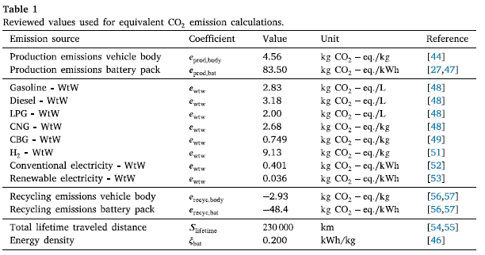
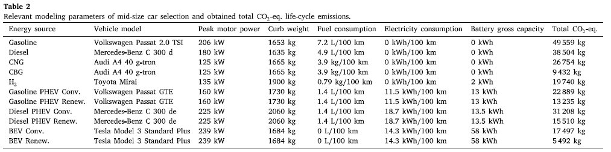
CO₂ during car life cycle - Data
PHEV: Plug-in Hypbrid Electric Vehicle
BEV: Battery Electric Vehicle
CNG: Compressed Natural Gas
CBG: Compressed Biogas
Driven distance in lifetime: 230’000 km
Appr.: similar weight, motor power and car size
J. Buberger, A. Kersten, M. Kuder, R. Eckerle, T. Weyh, T. Thiringer, „Total CO2-Equivalent Life-Cycle Emissions from Commercially Available Passenger Cars“, doi: 10.1016/j.rser.2022.112158.

Slide 24
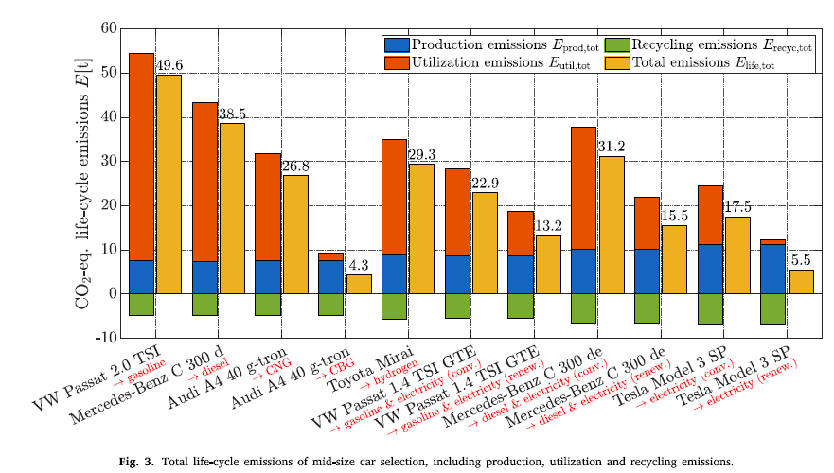
CO₂ during car life cycle - Conclusion
Production Emissions: EVs have the highest emissions during the production and recycling phases compared to other types of vehicles.
Operational Emissions: Even when powered by non-renewable electric energy, EVs have lower emissions during operation than internal combustion engine vehicles.
Recycling Emissions: EVs can recover more CO₂ emissions than recycling conventional vehicles. Therefore, it is even more urgent to prioritize the recycling of EVs.
Energy Source Impact: The gap in emissions between using non-renewable and renewable electric energy is significant.
Conclusion:
In terms of usage, an EV is the most efficient option.
To optimize emissions, focus on second-life applications for the vehicle or its components and then the EV.
CO₂-Emision ranking in this study:
Audi A4 with Compressed Biogas (125kW Motor)
Tesla Model 3 SP with Battery (239kW Motor)
10. Mercedes-Benz with Diesel (180kW Motor)
J. Buberger, A. Kersten, M. Kuder, R. Eckerle, T. Weyh, T. Thiringer, „Total CO2-Equivalent Life-Cycle Emissions from Commercially Available Passenger Cars“, doi: 10.1016/j.rser.2022.112158.

Slide 25
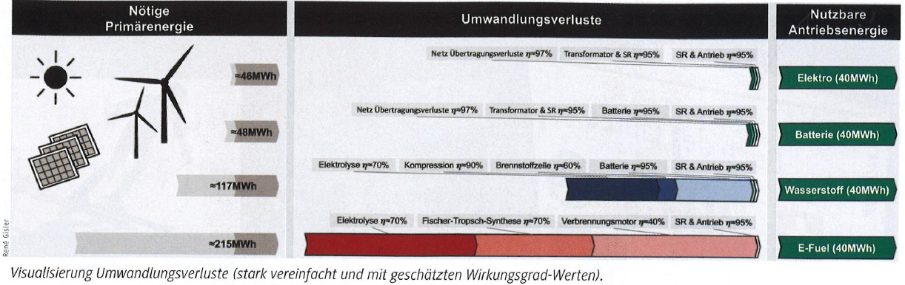
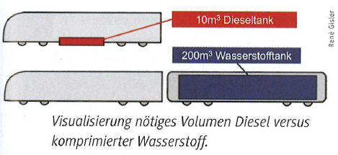
CO₂ per km depending on electric source
This study focused on the energy transformation of Class 1 trains in the USA. The aim of the transformation is to compare and distribute energy sources with lower CO₂ emissions. The potential for improving CO₂ emissions is significant: in 2019, all Class 1 railroads in the USA used 12.8 billion liters of diesel (12.8 x 10⁹liter diesel).
3 key points out of this study:
Efficiency of energy sources in an electric train:
  Direct electricity: 87.0%
  Electricity over a battery: 83.3%
  Hydrogen Fuel: 34.2%
  E-Fuel: 18.6%
Value of different technologies in energy transformation:
  E-Fuel is a legitimate option during the transformation process to utilize the existing base of trains.
  As things stand, rechargeable batteries are only suitable for short distances.
  Hydrogen fuel could be an option but requires further development.
Challenges in transitioning from Diesel to Hydrogen:
  Replacing a diesel tank with a hydrogen tank is problematic due to volume requirements.
  For the same amount of power, hydrogen requires significantly more volume than diesel.
    10m³ of diesel vs. 200m³ of hydrogen for 40MWh of operating power.
  Despite hydrogen's higher energy density (2.6 times that of diesel), the larger volume needed poses a challenge.
R. Gisler (FAEL, Swiss Engieering), “Alternative Energieträger im Transportwesen,” Polyscope, vol. 12, pp. 10-11, 2023.

Slide 26
Agenda
Global Sustainable
Battery Lifecycle
Primary Resources (Origin and Quantity)
Battery emits CO₂?
  Grey energy in fuel and electricity
  Electrical vs. combustion vehicle
  Car life cycle and alternatives
Afterlife of a Battery
  1st Life ends
  2nd Life starts
  Recycle process of a battery

Slide 27
Aging Process of a Battery
Cyclic Aging
Cell chemistry
State of charge (SoC)
Temperature
Level of discharge or DoD (depth of discharge)
Charge and discharge rate
Calendar aging – in storage
Cell chemistry
State of charge (SoC)
temperature
The ageing process determines when the next step is taken.

Slide 28
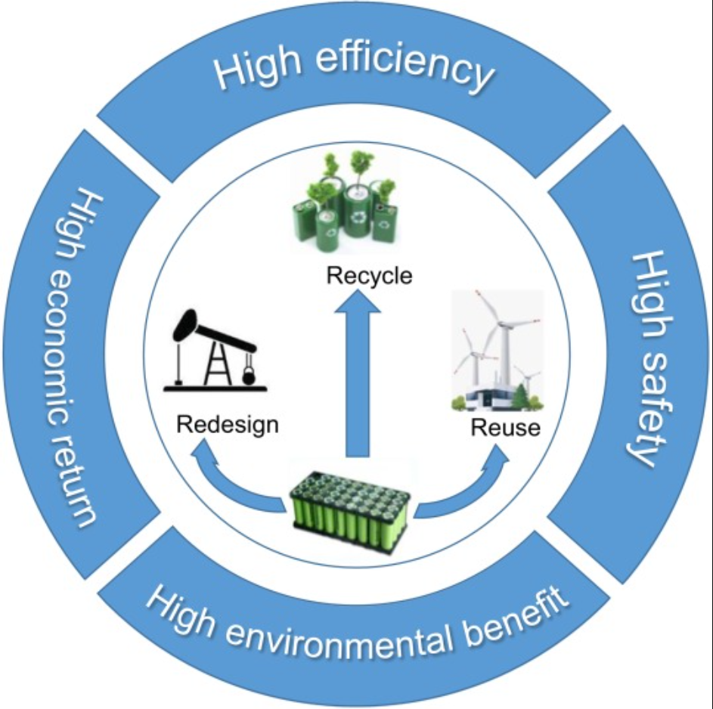
Afterlife of a Battery
Recycle
3rd Life
2nd Life
Q. Wei, Y. Wu, S. Li, R. Chen, J. Ding, and C. Zhang, “Spent lithium ion battery (LIB) recycle from electric vehicles: A mini-review,” Science of The Total Environment, vol. 866, p. 161380, Mar. 2023, doi: 10.1016/j.scitotenv.2022.161380.

Slide 29
2nd Life vs. Re-Use
Second life: Repurpose
  Using a product or component for a new application. It creates a new value to a new use case. And it is not the same product, as it was when it was first launched.
    different purpose/application/function/
  Problems at recertification of a product. The battery has to fulfill still all safety regulation in this new application. A second life creates technically a new battery, with all its regulations.
Third life: Re-use / Repair, Rebuild, Remanufacture, Re-Assembling
  Using a product or component in the same way, has it has been launched in the market.
    same purpose/application/function/context
Source: ICBR 2020 – Second Life of Industrial Batteries for E-Mobility – The Regulatory Aspects; Willy Tomboy

Slide 30
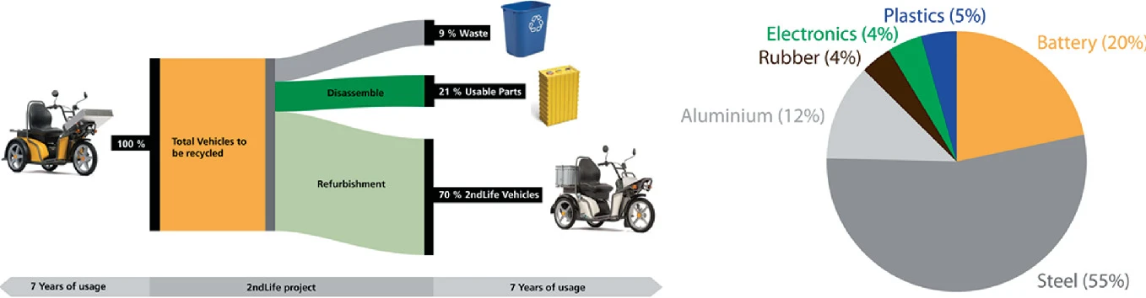
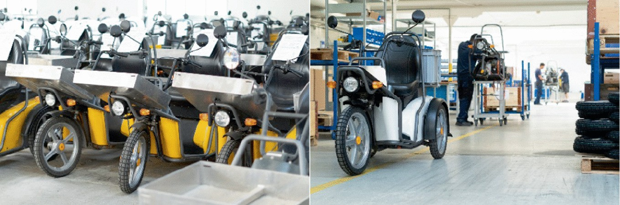
Second Life Battery - Use Case
KYBURZ SecondLife project
Majority of the KYBURZ DXPs are refurbished, and those which are recycled result in good yields
E. Wilhelm, W. Hahn, and M. Kyburz, “KYBURZ Small Electric Vehicles: A Case Study in Successful Deployment,” in Small Electric Vehicles, A. Ewert, S. Schmid, M. Brost, H. Davies, and L. Vinckx, Eds., Cham: Springer International Publishing, 2021, pp. 143–155. doi: 10.1007/978-3-030-65843-4_11.

Slide 31

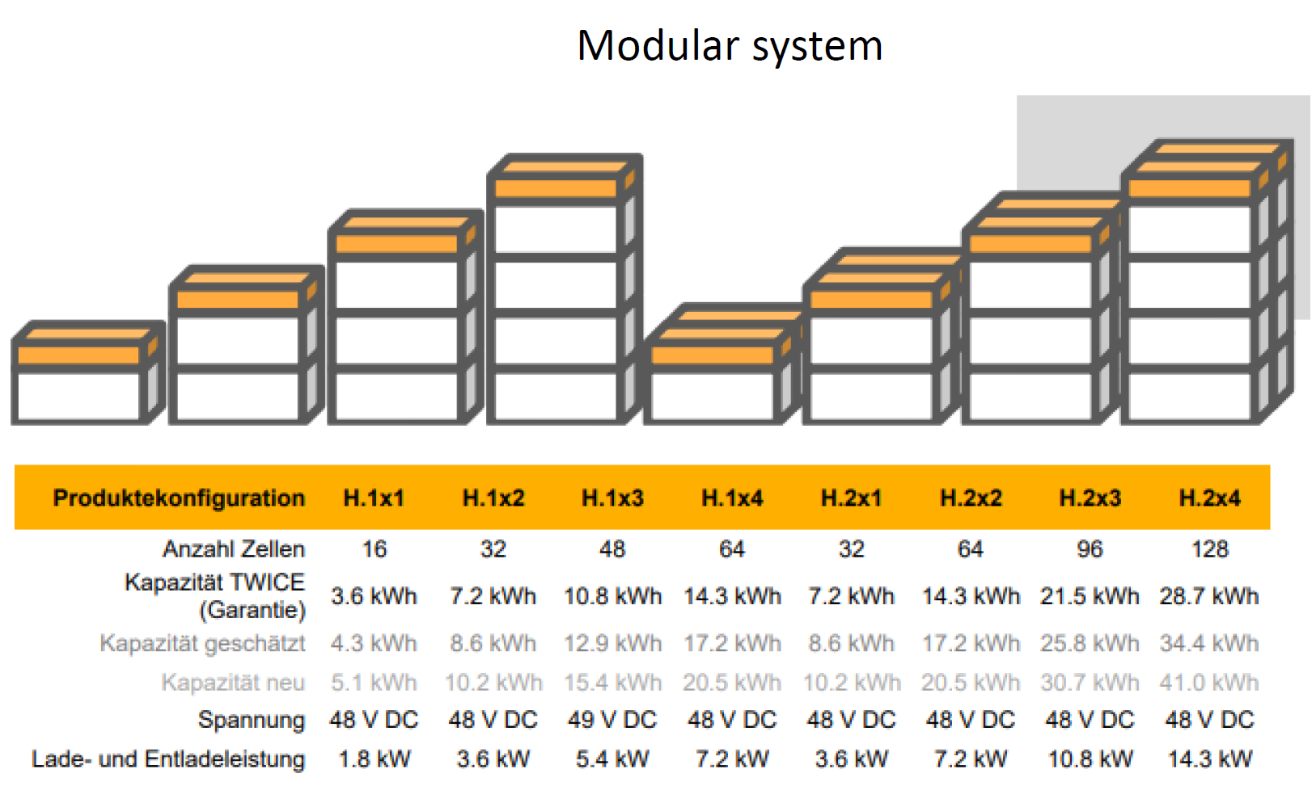
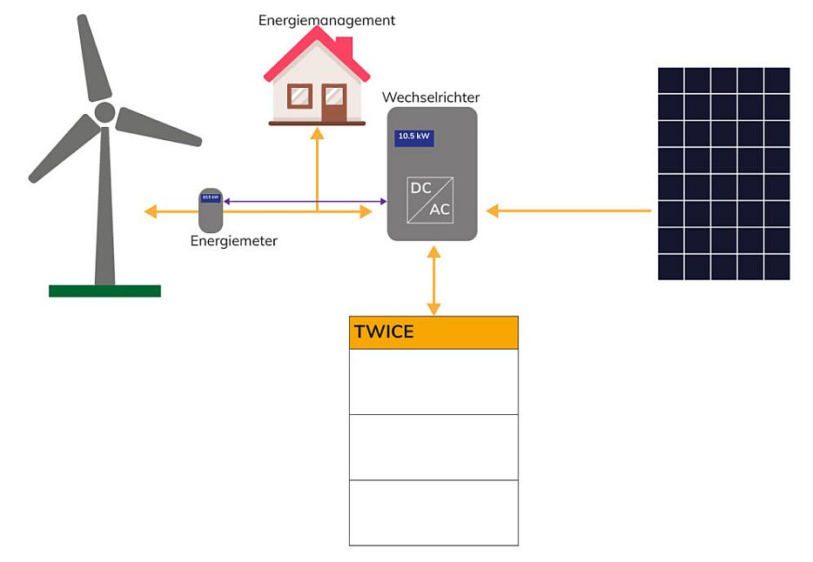
Second Life Battery - Use Case
«Ein zweites Leben für KYBURZ-Lithium-Batterien»
  2021 PoC: TWICE Energy AG
  2022 Go To Market: Modual AG
    https://modual.ch/de/ueber-uns/
  Creating new battery storage with old KYBURZ batteries
Source: https://kyburz-switzerland.ch/de/pxsde/twice-energiespeicher

Slide 32
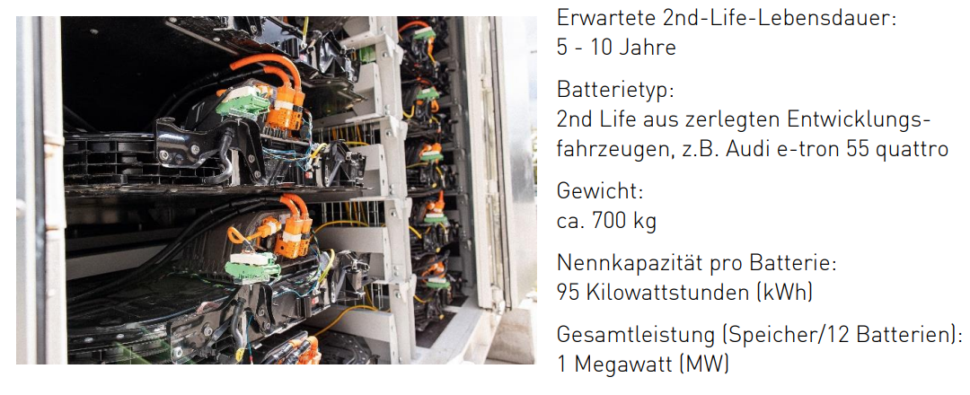
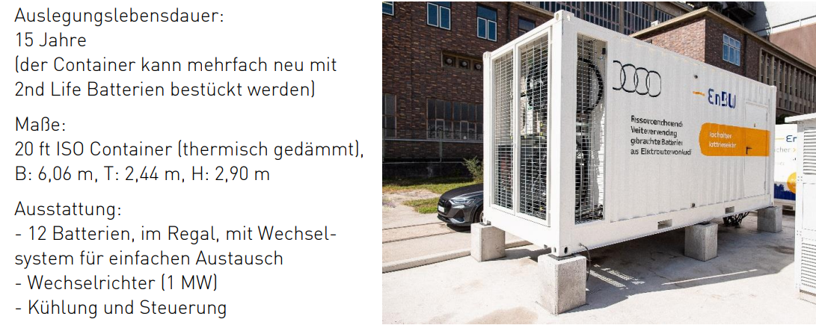
Second Life Battery - Use Case
«Der Second-Life-Batteriespeicher von Audi und EnBW»
Audi and EnBW have partnered to repurpose high-voltage batteries from decommissioned EVs into a stationary storage system for renewable energy.
The pilot facility will store energy, balance grid fluctuations, and improve supply stability. With a 1 MW capacity it can power 3,000 households for an hour.
Second-life batteries are used to optimize renewable energy and reduce waste. The project aims to enhance grid flexibility and support the energy transition, with plans for future applications in utilities and industries.
high voltage battery
battery storage container
Source: https://www.enbw.com/media/presse/images/pressemitteilungen/2022/enbw-audi-batteriespeicher/20221202_2ndlifebatteriespeicher_enbw_audi_eckdaten.pdf

Slide 33
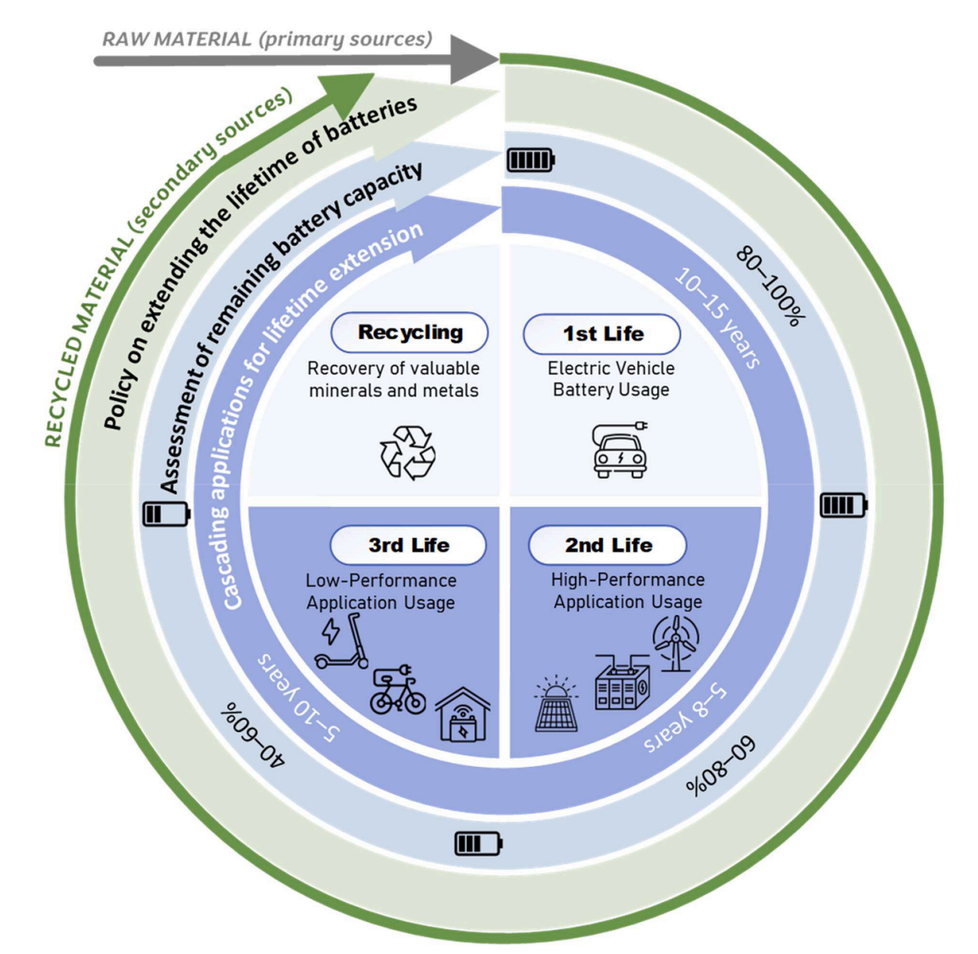
Third Life Battery - Use Case
Thrid Life Application
no market realization suitable for series production yet.
Individual e-battery cells are detached from large battery packs and assembled into a new battery.
A. R. Quinteros-Condoretty et al., “Conceptual model for extending electric vehicle battery lifetime,” Resources, Conservation and Recycling, vol. 212, p. 107943, Jan. 2025, doi: 10.1016/j.resconrec.2024.107943.

Slide 34
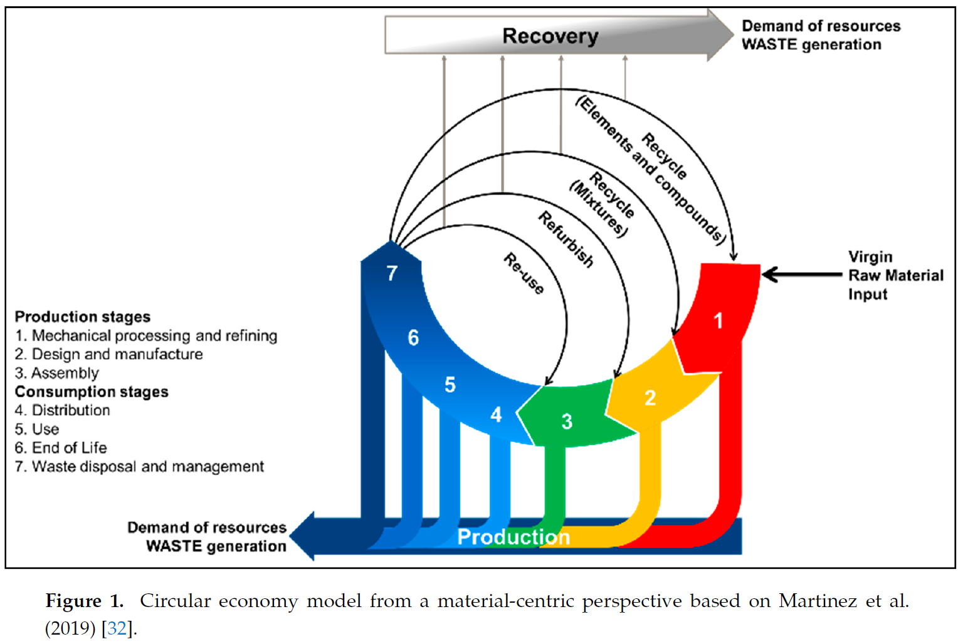
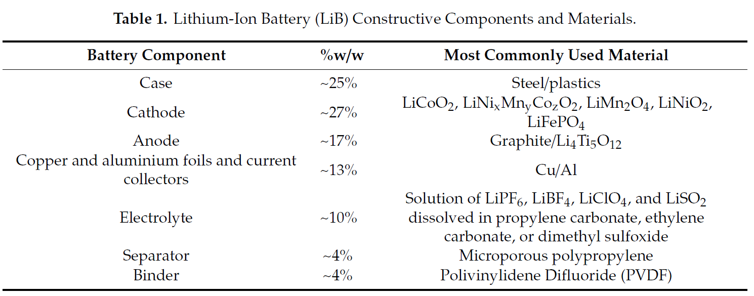
Recycling – theoretical process
Components of a battery:
  In this example 25% is case
  This can increase up to ~50% depending on battery pack design
Recycling process recover as many material as possible
O. Velázquez-Martínez, J. Valio, A. Santasalo-Aarnio, M. Reuter, and R. Serna-Guerrero, “A Critical Review of Lithium-Ion Battery Recycling Processes from a Circular Economy Perspective,” Batteries, vol. 5, no. 4, p. 68, Nov. 2019, doi: 10.3390/batteries5040068.

Slide 35
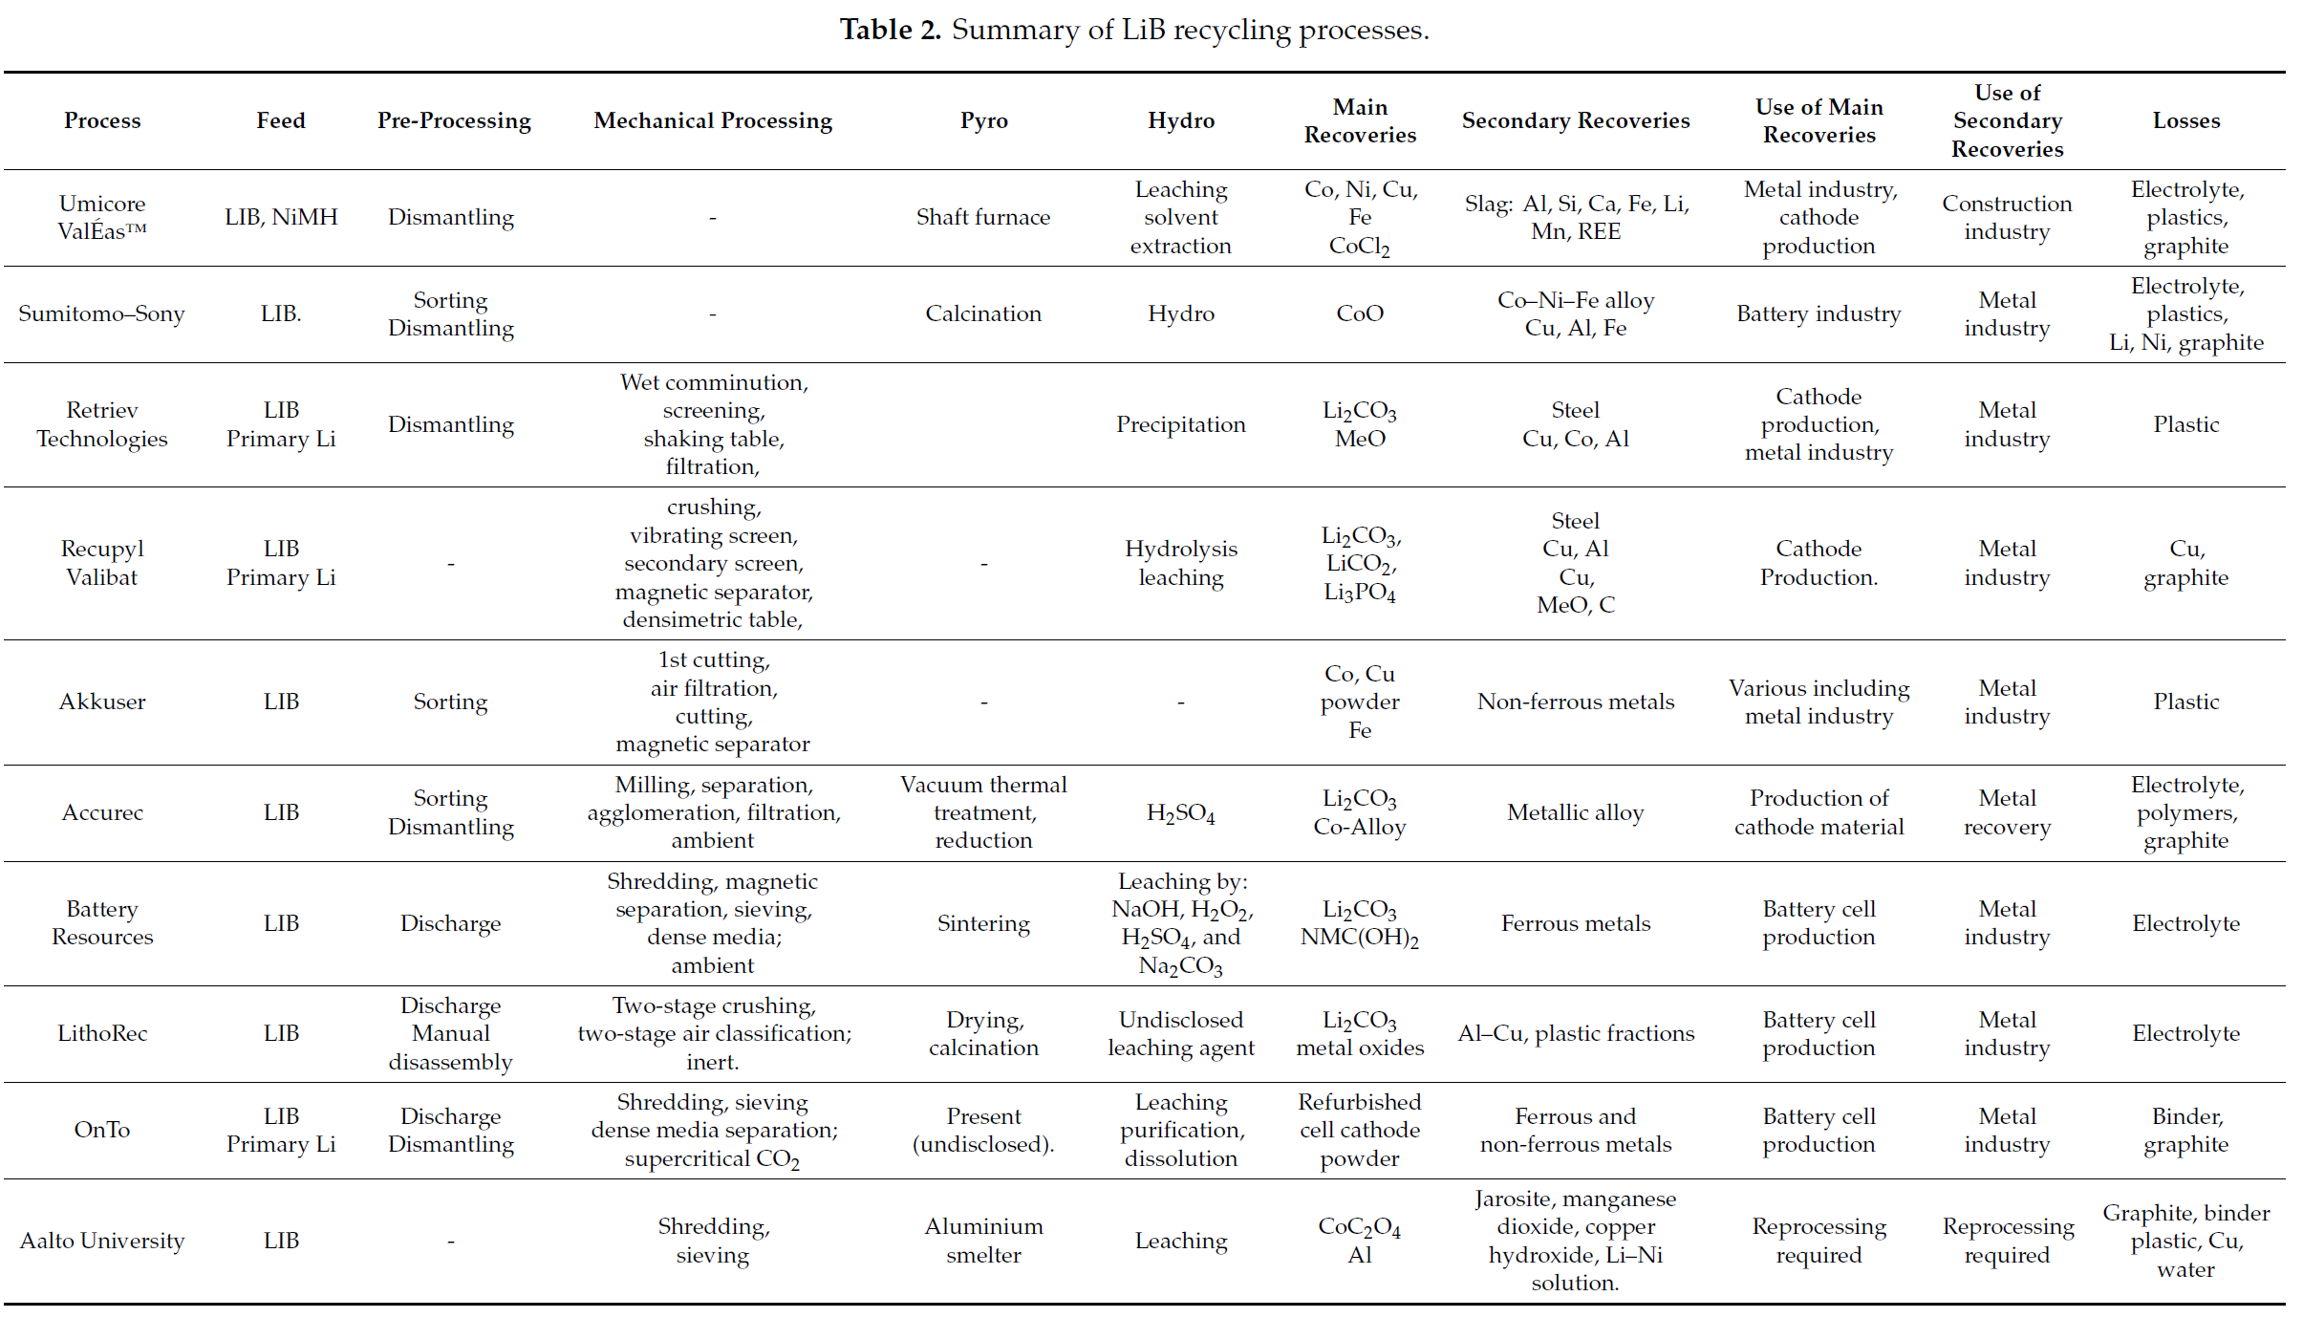
Recycling - theoretical process
Summary of an outcome of a recycle process
O. Velázquez-Martínez, J. Valio, A. Santasalo-Aarnio, M. Reuter, and R. Serna-Guerrero, “A Critical Review of Lithium-Ion Battery Recycling Processes from a Circular Economy Perspective,” Batteries, vol. 5, no. 4, p. 68, Nov. 2019, doi: 10.3390/batteries5040068.

Slide 36
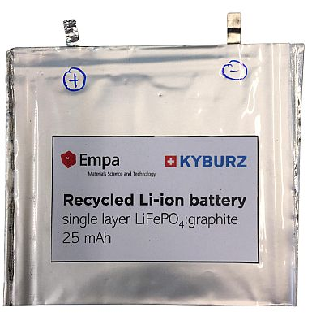

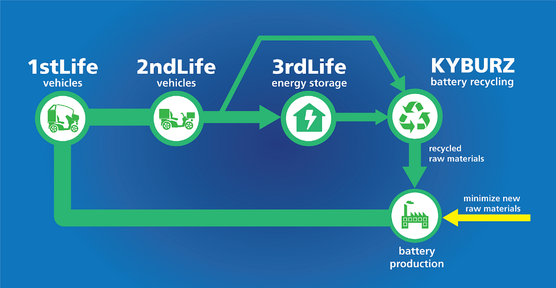
Recycling – use case
KYBURZ
  2017: Start Recyling
  2020: Recycling process with 91% of the materials separated and recovered
  2022: Successful feasibility study of LFP cell from recycled material.
  2024: Start and cooperation with EU ReUse Project
  2027: Goal: customized solution for customers
Source: https://kyburz-switzerland.ch/de/energiespeicher#

Slide 37

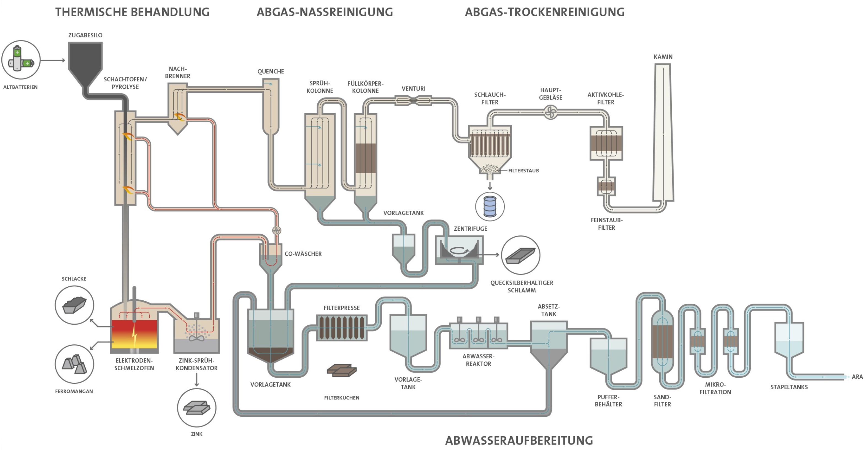
Recycling – use case
Batrec
  The schematic illustration shows our battery recycling plant in Switzerland, which comprises 3 processes. Firstly, thermal treatment, then wet scrubbing and finally filtering of the residual gases.
Source: https://batrec.ch/de/batterie-recycling/knopfzellen/

Slide 38
Conclusion
Know your resources and use them responsible.
Batteries are efficient and helps to improve electrification, which is more efficient than nonrenewable energy.
Like any other product, a battery should be used over a long time.
A long-time usage can be achieved by: → 2nd Life.
  Repurpose/ Re-use/ Repair/ Rebuild/ Remanufacture/ Re-Assembling
Central Europe don’t have much resources. Therefore, keep materials inside a local economy by re-using or recycled it and creating a circular economy.

