Slide 1

Mixed Reality in the Web
A-Frame, Three.js and WebXR

Slide 2
Agenda
An Introduction to Mixed Reality
Technical Foundations of Augmented and Virtual Reality
MR Technology for the Web: A-Frame, Three.js and WebXR
Fundamentals of A-Frame

Slide 3
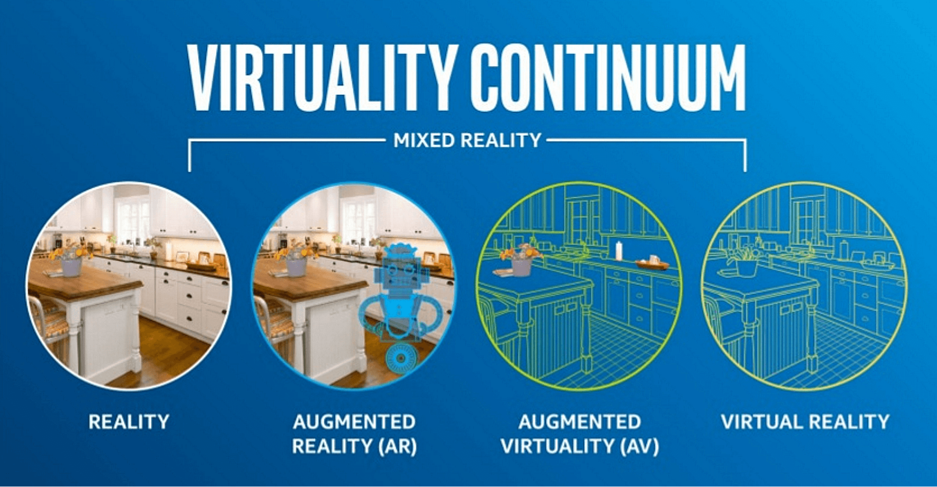

Slide 4
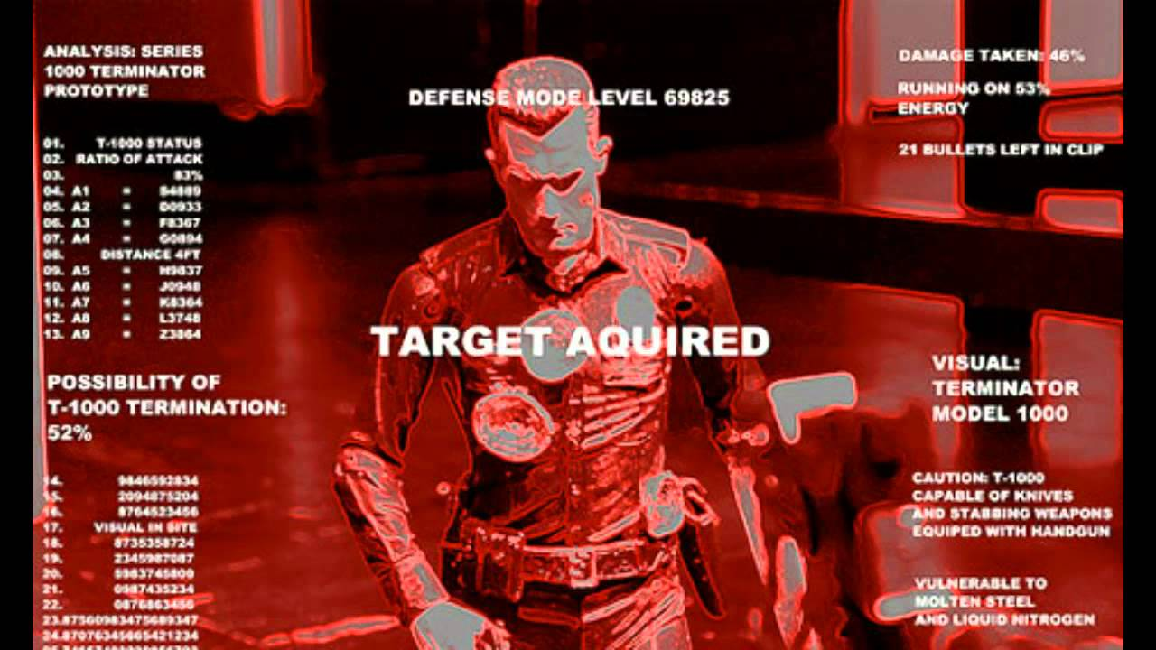
Terminator

Slide 5
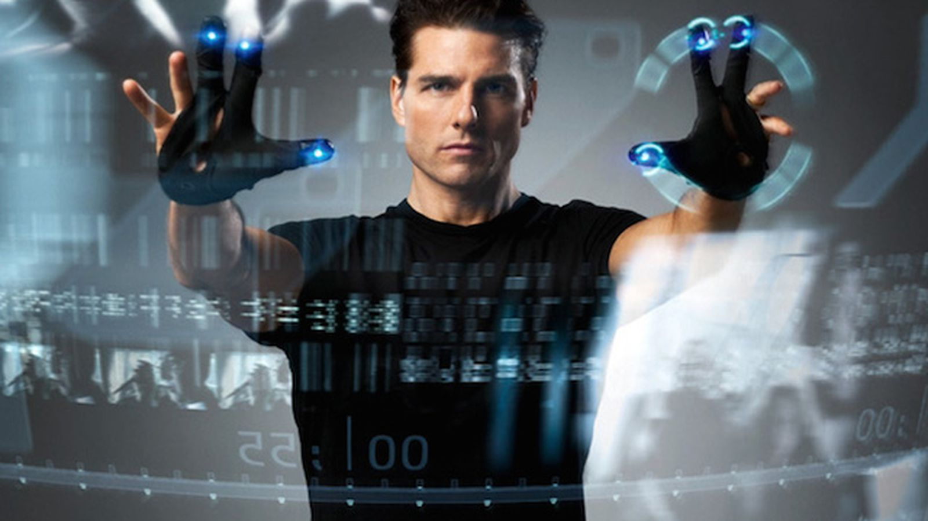
Minority Report

Slide 6
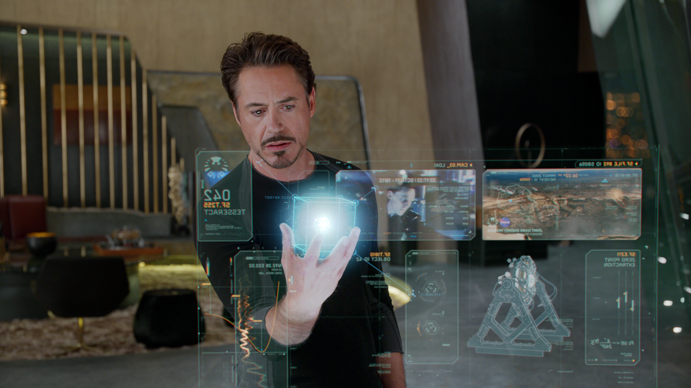
Iron Man

Slide 7
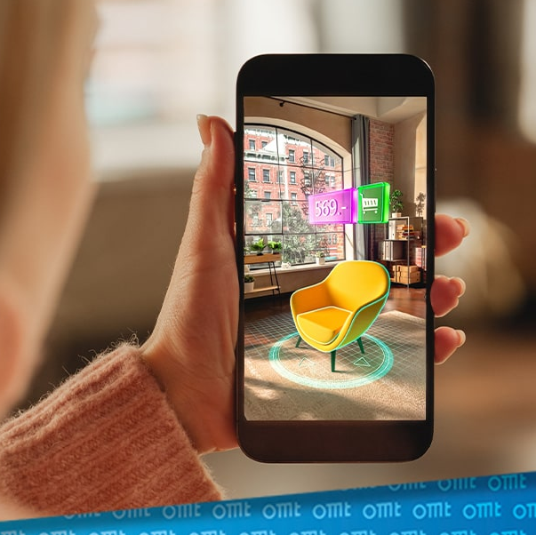
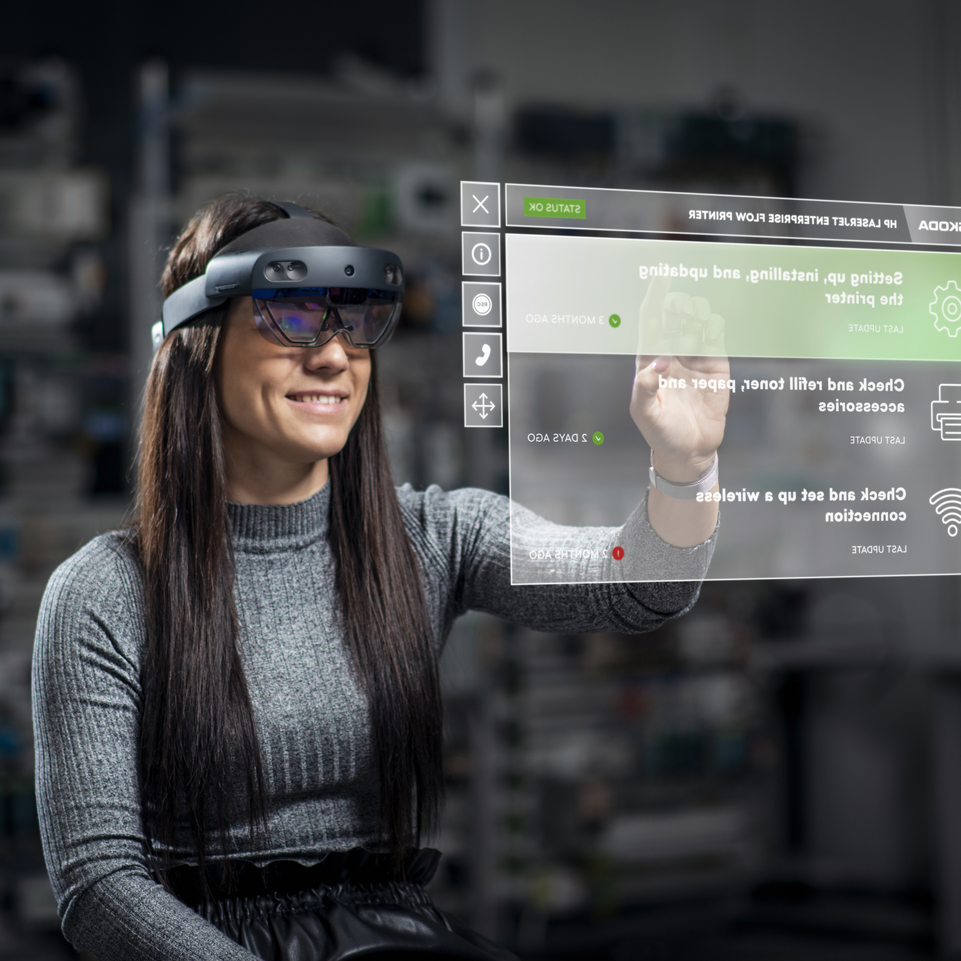
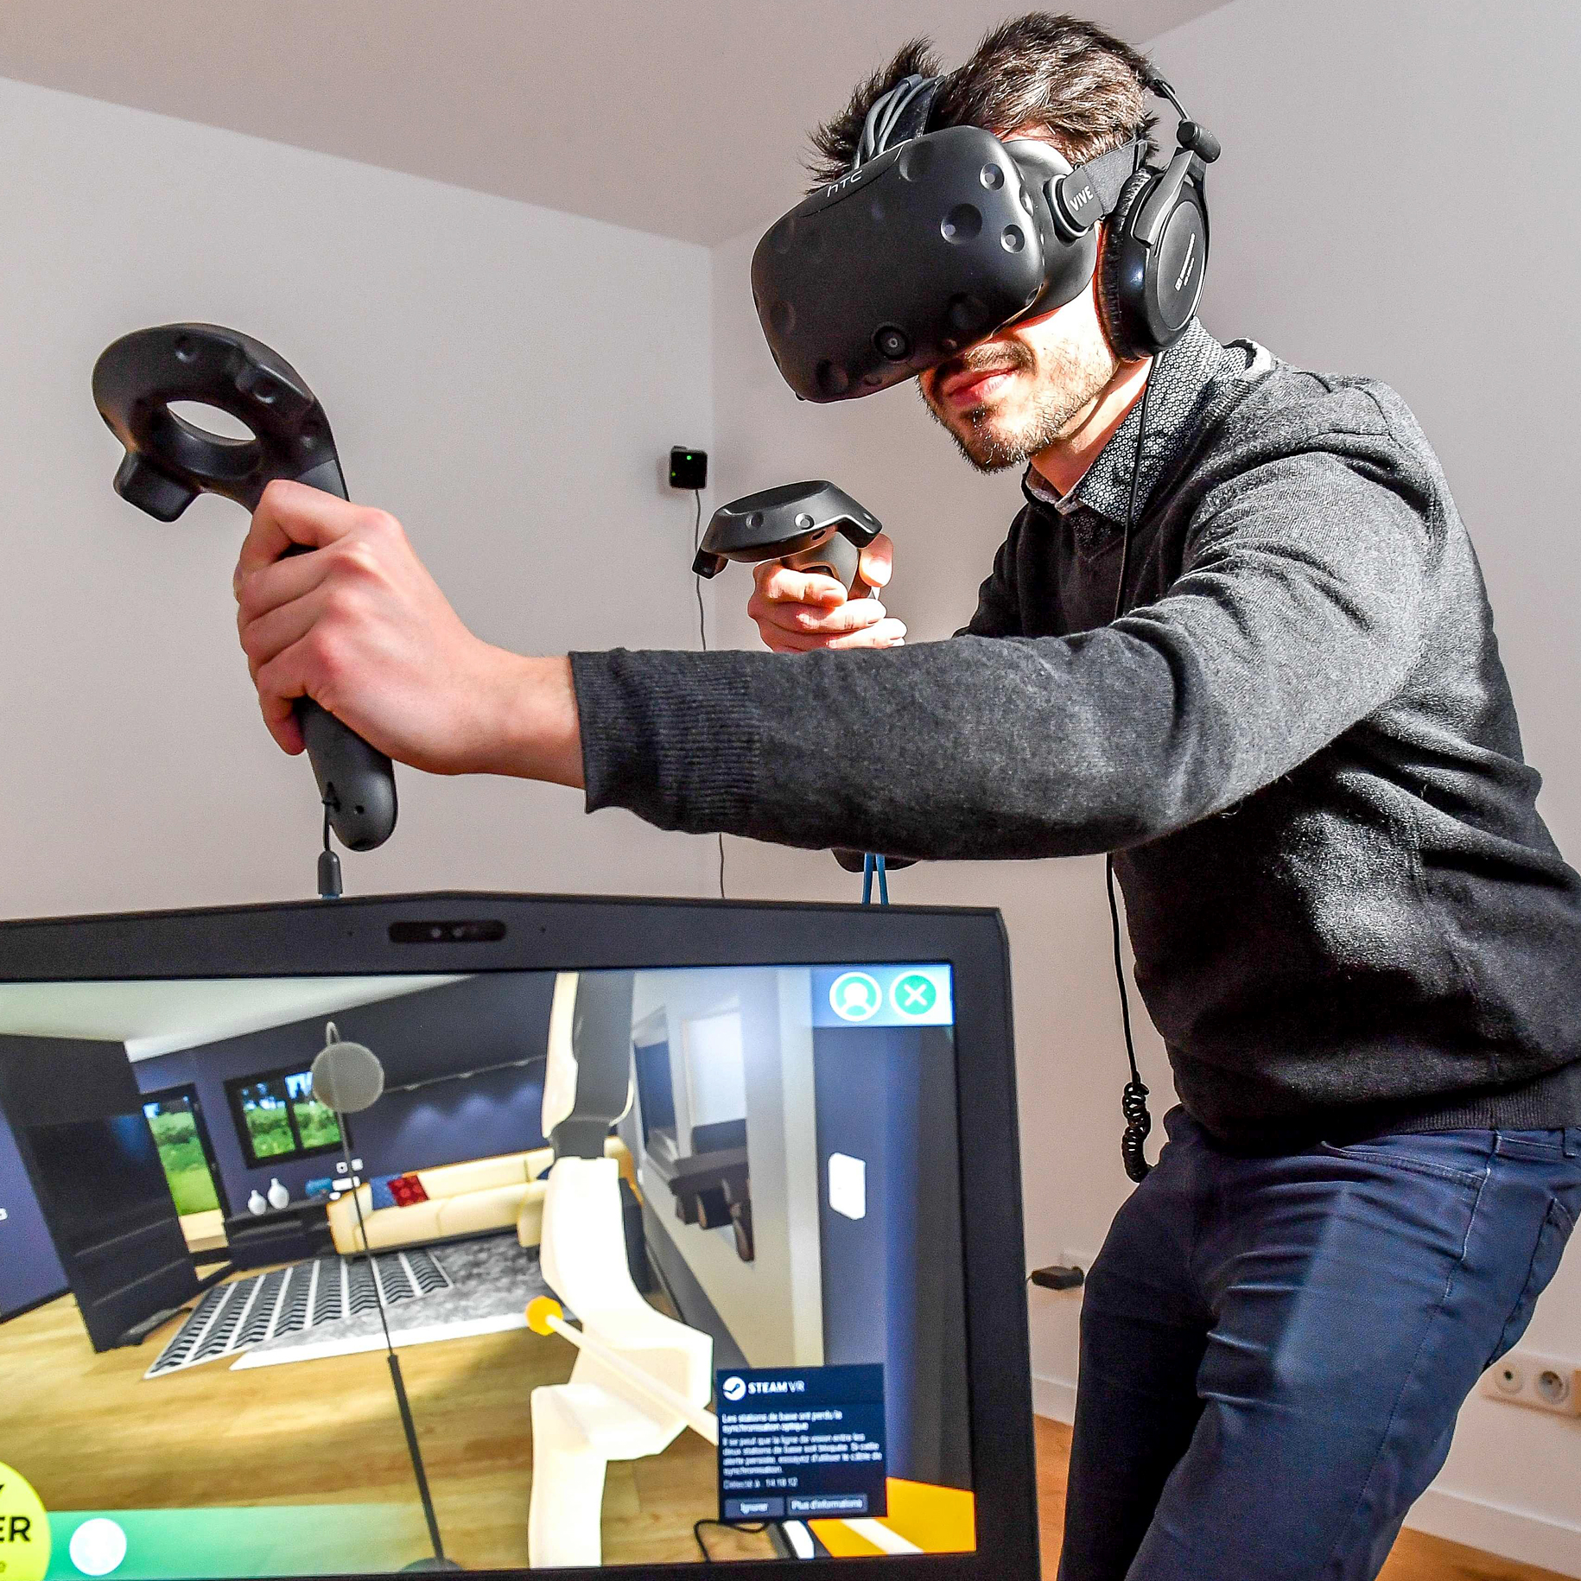
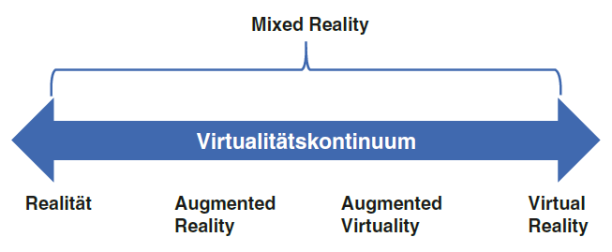
Augmented and Virtual Reality
Quelle: Augmented Reality im E-Commerce. Mehrwert oder Gag? (omt.de)
Quelle: ŠKODA AUTO testet Augmented Reality-Brillen zur Maschinenwartung und für technische Schulungen - Škoda Storyboard (skoda-storyboard.com)
Quelle: What is VR? The devices and apps that turn the real world virtual (nbcnews.com)
Harwardt (2022, S.63)
Notes:
Der Begriff Augmented Reality (AR) bezeichnet den Einsatz von IT-Systemen, um die
Wahrnehmung, beziehungsweise die Darstellung der realen, physischen Welt um virtuelle,
digitale Aspekte zu ergänzen. Digitale Informationen oder Objekte werden in das
Sichtfeld des Betrachters eingeblendet, so dass sich zum Beispiel Informationen aus
3D-Modellen, Berechnungen aus IT-Systemen oder Sensordaten mit der realen Welt
verknüpfen lassen. Exemplarisch werden einem Monteur die Arbeitsanweisungen zur
Montage eines Produkts (Texte, Zeichnungen) virtuell in das Sichtfeld seiner VR-Brille
(Virtual Reality) ergänzt. Dabei wird das Abbild der realen Umgebung mit digitalen
Zusatzinformationen angereichert. Weitere Anwendungen sind Anweisungen für die
wegeoptimierte Kommissionierung von Teilen in einem Lager oder Reparaturanweisungen.
Dadurch lassen sich Aufgaben schneller und mit weniger Fehlern erledigen, da die
relevanten Daten kontextsensitiv vorliegen.
Auch wenn virtuelle Realität (Virtual Reality, VR) und erweiterte Realität (Augmented
Reality, AR) immer mehr an Bedeutung gewinnen, so gibt es auch hier keine einheitliche
Definition dieser beiden Termini. Bei VR geht es um die Ausblendung der realen Umwelt
und die Fokussierung auf eine „in Echtzeit computergenerierten, interaktiven, virtuelle
Umgebung“.63 Die Möglichkeit, dass ein Mensch in dieser virtuellen Realität interagieren
kann, ist ein wesentliches Charakteristikum von VR. Hardware- und Softwaresysteme, die
diese virtuellen Realitäten realisieren, nennt man VR-Systeme.
Von der virtuellen Realität muss die erweiterte Realität abgegrenzt werden. Bei AR
geht es um die Anreichung der realen Welt mit zusätzlichen Informationen oder sonstigen
Computer-generierten Inhalten (siehe Abb. 3.14). Bei AR überwiegt der Anteil der realen
Welt, bei VR der Anteil der virtuellen Welt.68 Kennzeichnend für AR ist, dass die zusätzlichen
Informationen und Inhalte nicht statisch sind, sondern sie sind abhängig von der
Perspektive des Nutzer, z. B. verändern sich die angezeigten Informationen, wenn man
unterschiedliche Objekte ansieht. Durch die weite Verbreitung von mobilen Geräten wie
Smartphones und Tablets gewinnt AR in den letzten Jahren immer mehr an Bedeutung.
Bekannte Unternehmen wie Otto oder IKEA nutzen beispielsweise die erweiterte
Realität, damit Kunden in ihren eigenen vier Wänden erleben können, wie ein Möbelstück
dort wirken könnte.

Slide 8
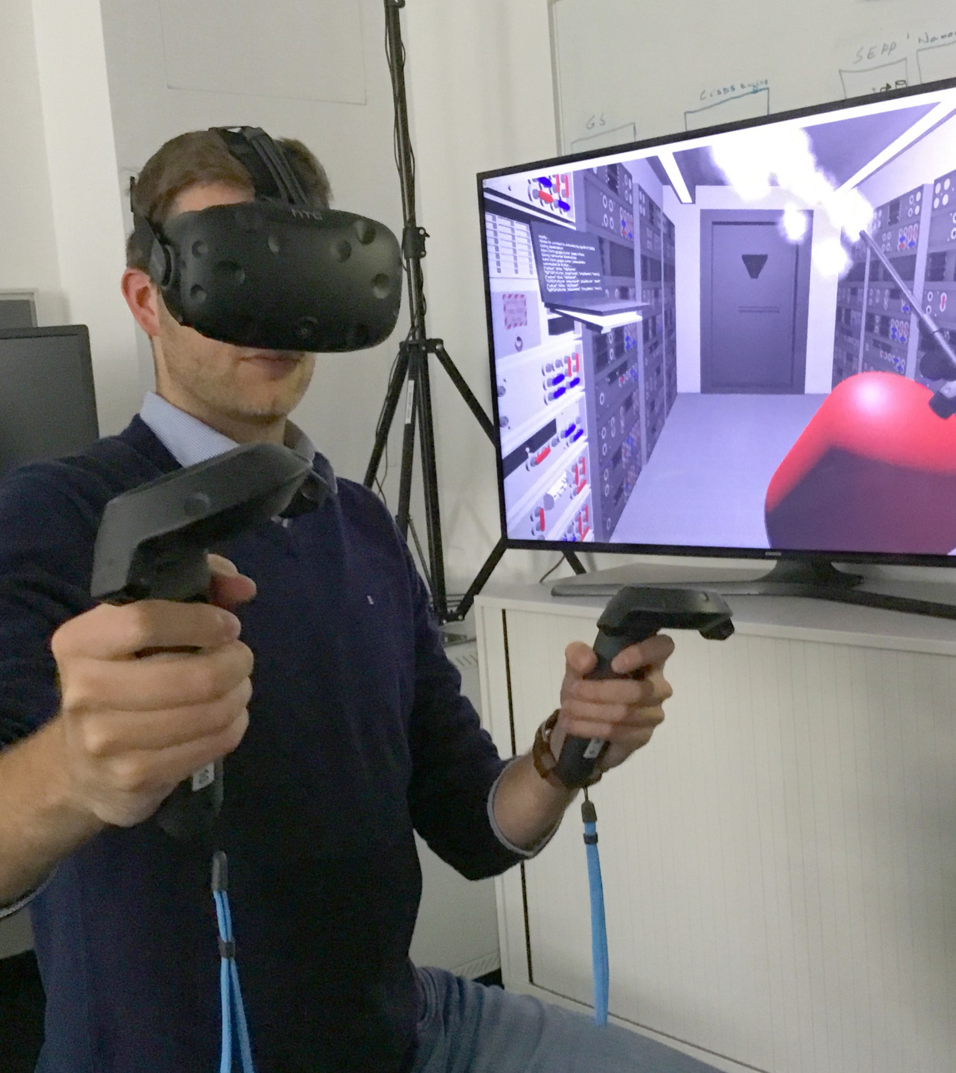

Virtual Reality
Augmented Reality

Slide 9
Virtual Reality
Augmented Reality
Creation
Realistic images required
Display
Fully immersive, wide field of view
Tracking
Low to medium accuracy sufficient
Creation
Minimal graphics sufficient
Display
“Non-immersive,” small field of view
Tracking
Highest accuracy required

Slide 10
Core Components
Tracking
Display
Input Devices
Developer Tools

Slide 11
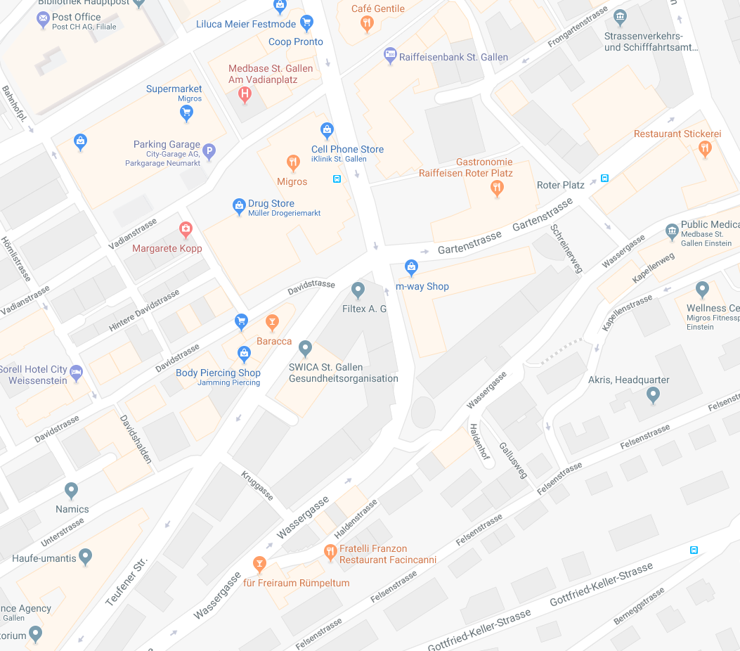
Tracking through Geo Sensors
GPS for location determination
Compass for direction determination
Acceleration sensors for inclination determination
Digital content to be displayed is georeferenced
Advantages
  Relatively easy to implement
  Low hardware requirements
Disadvantages
  Inaccurate, less robust tracking
  Ignores occlusions caused by buildings

Slide 12
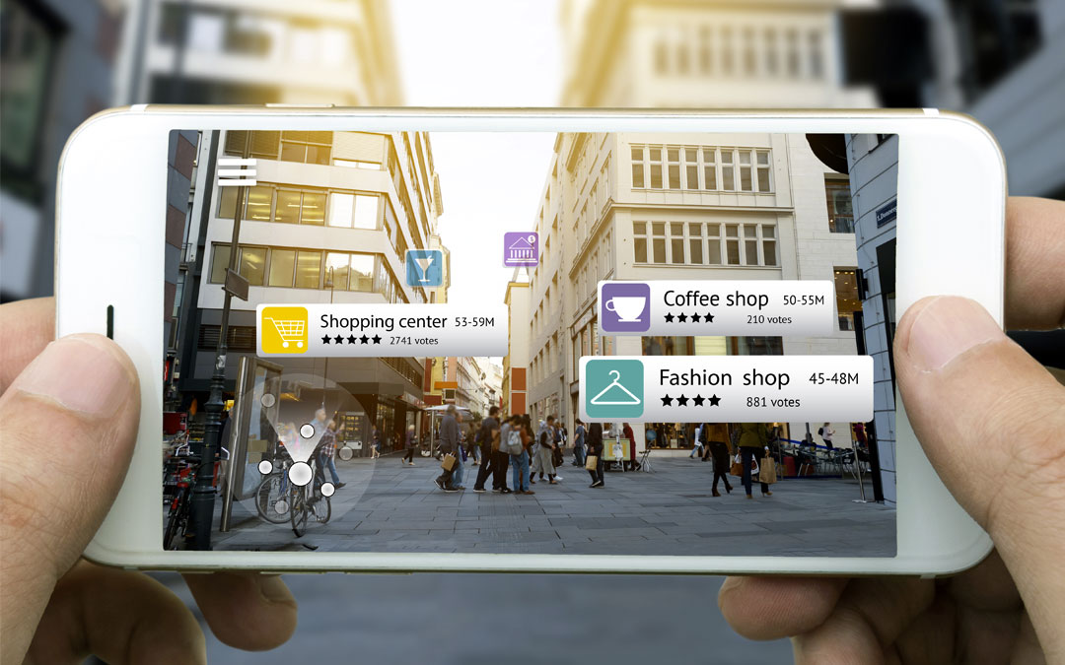

Slide 13
Tracking through Image Recognition
AR Marker
Natural Features
SLAM

Slide 14
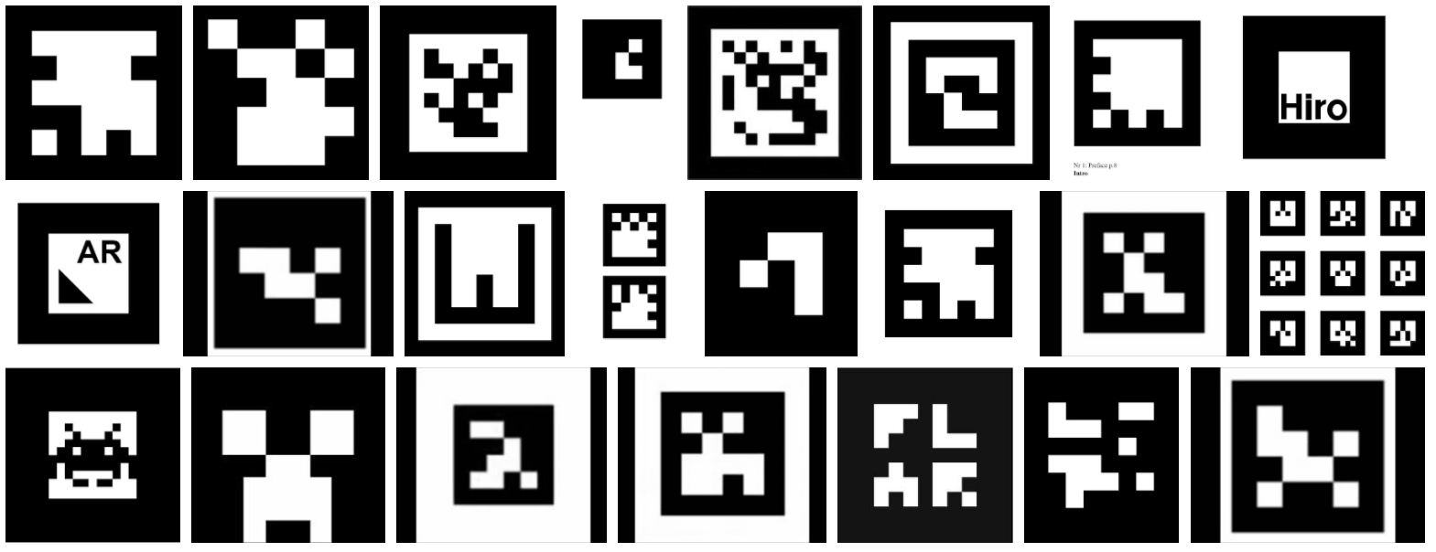
AR Marker

Slide 15
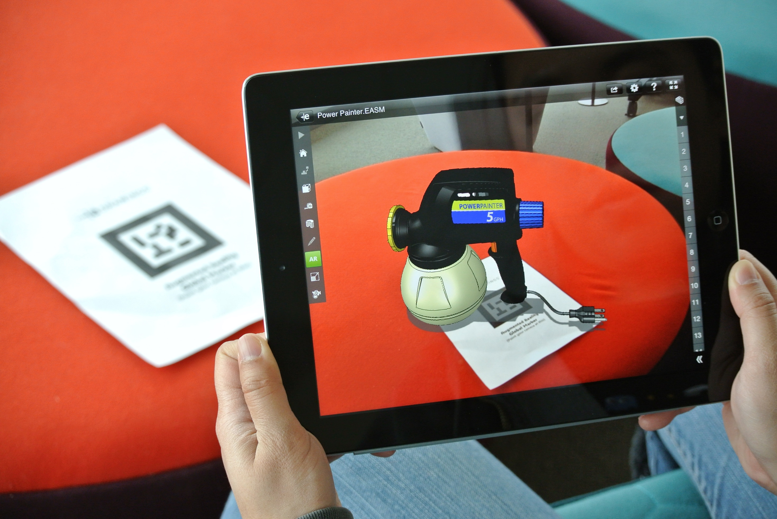

Slide 16


Slide 17
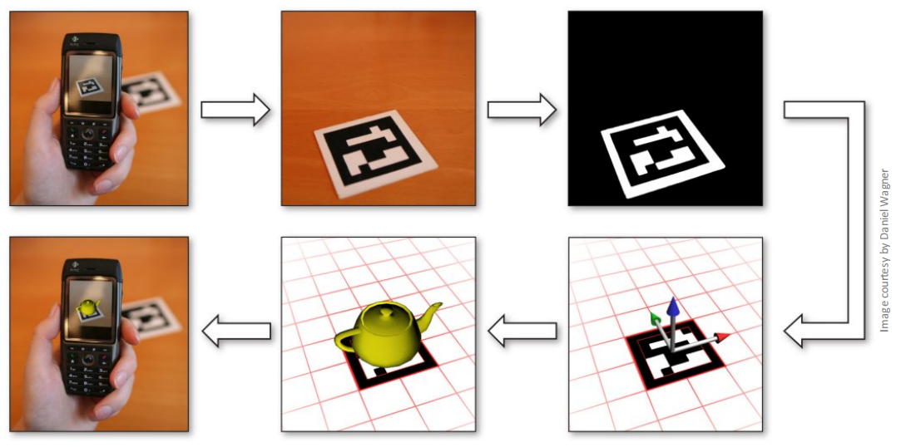
Detection Pipeline for Mobile Augmented Reality

Slide 18
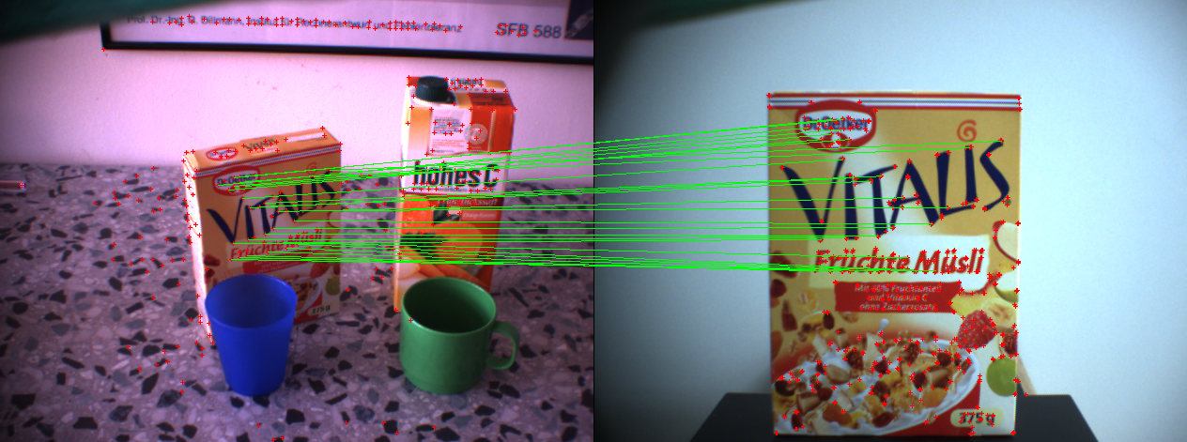
Natural Feature Tracking
Identification of so-called natural features, i.e., distinctive image elements
Description of these natural features using “descriptors”
Important: rotation and scale invariant!

Slide 19


Slide 20
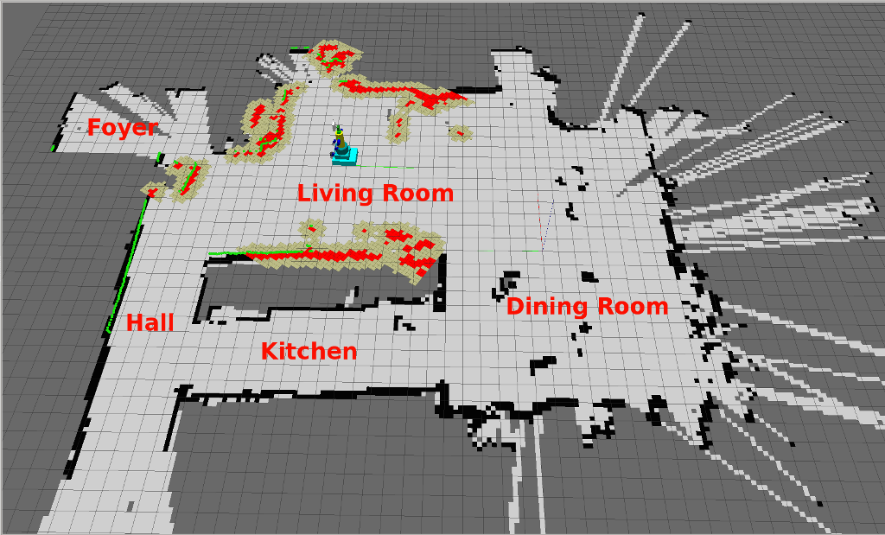
SLAM
Simultaneous Localization and Mapping
Origins in robotics, markerless tracking!

Slide 21
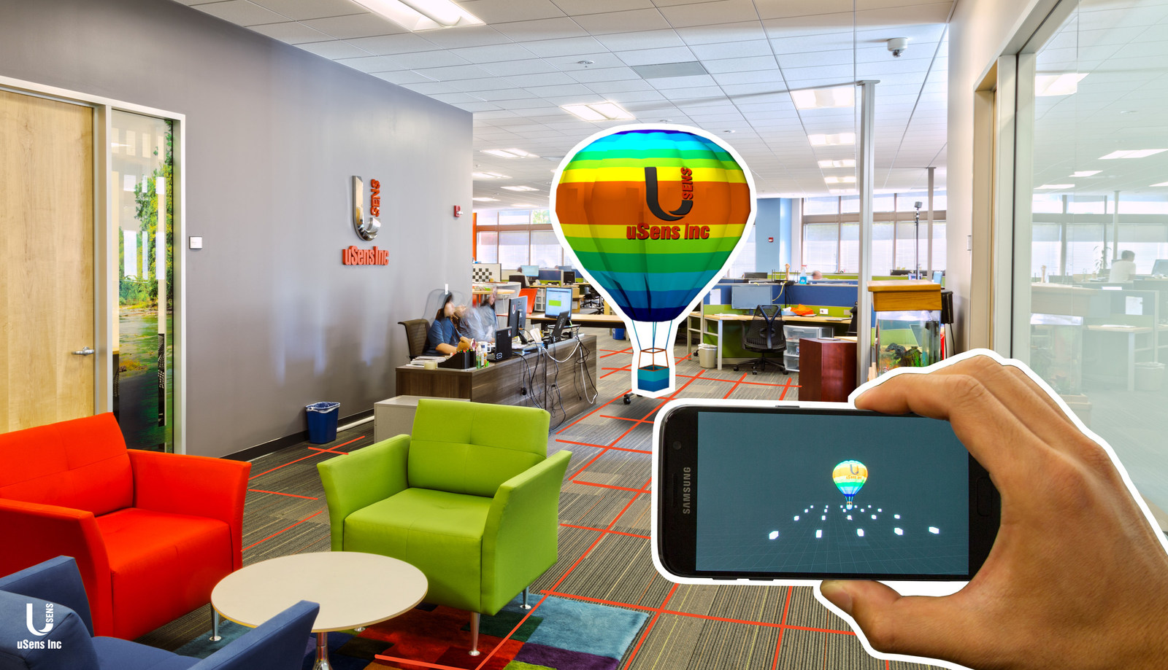

Slide 22
Displays
How to consume Mixed Reality content?

Slide 23
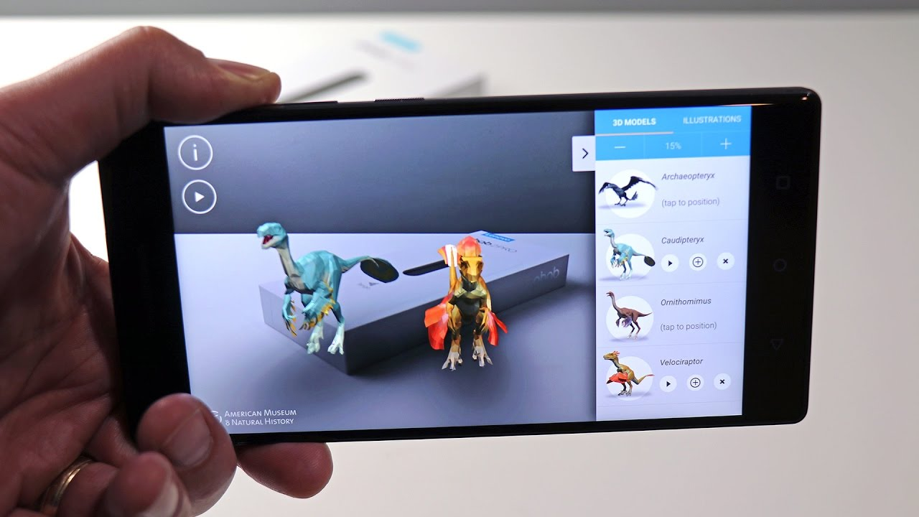

Slide 24
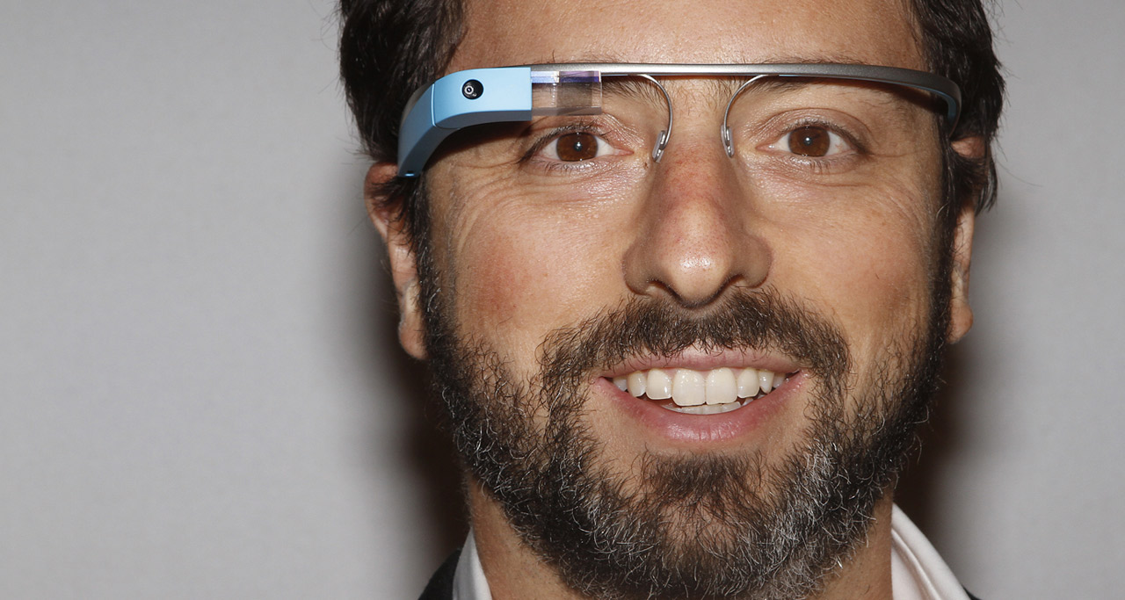

Slide 25
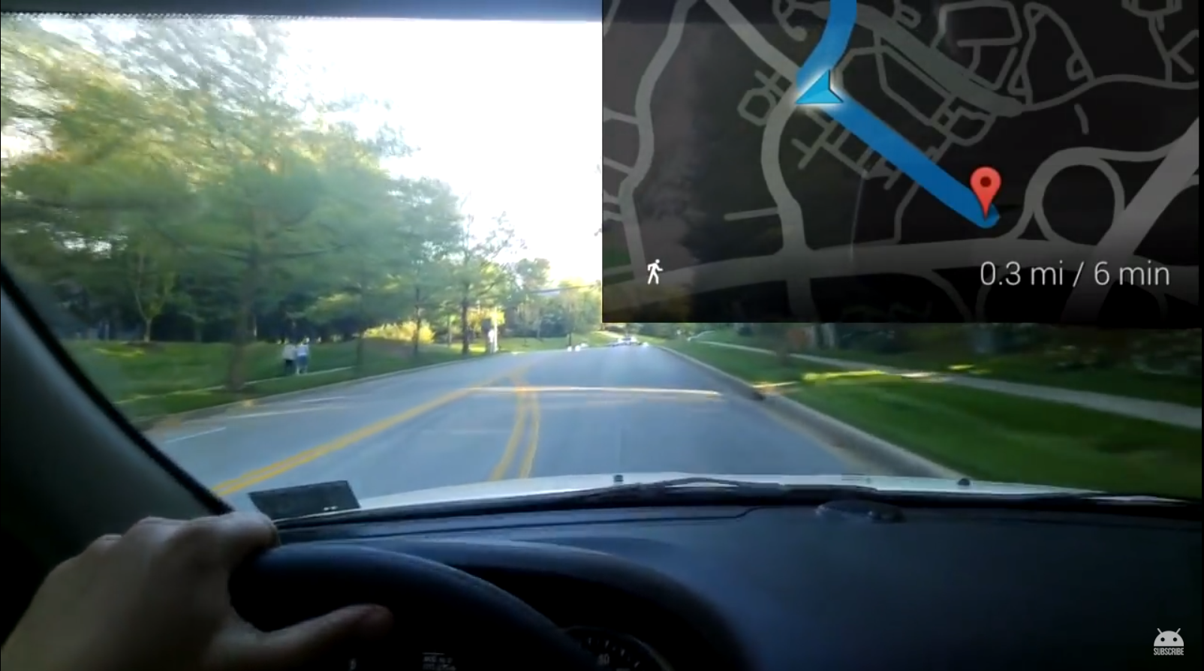

Slide 26
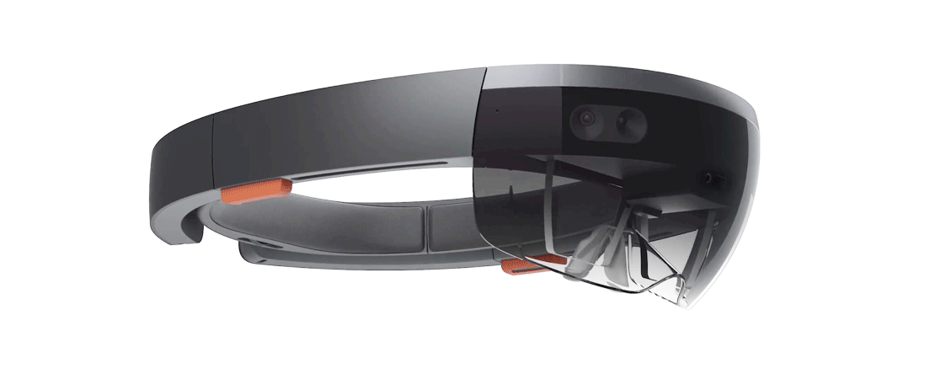
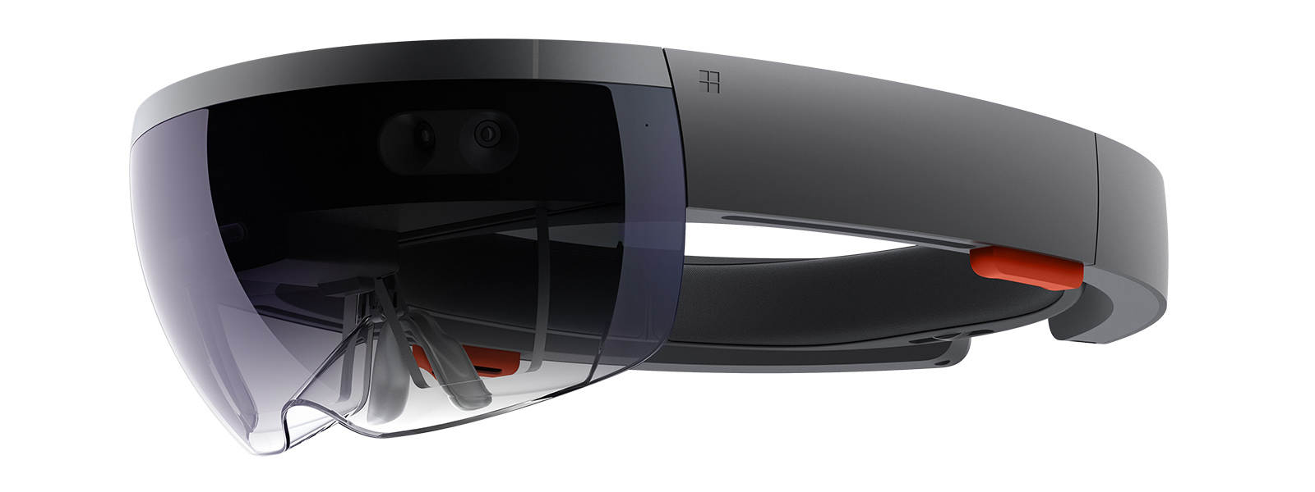
Hololens

Slide 27
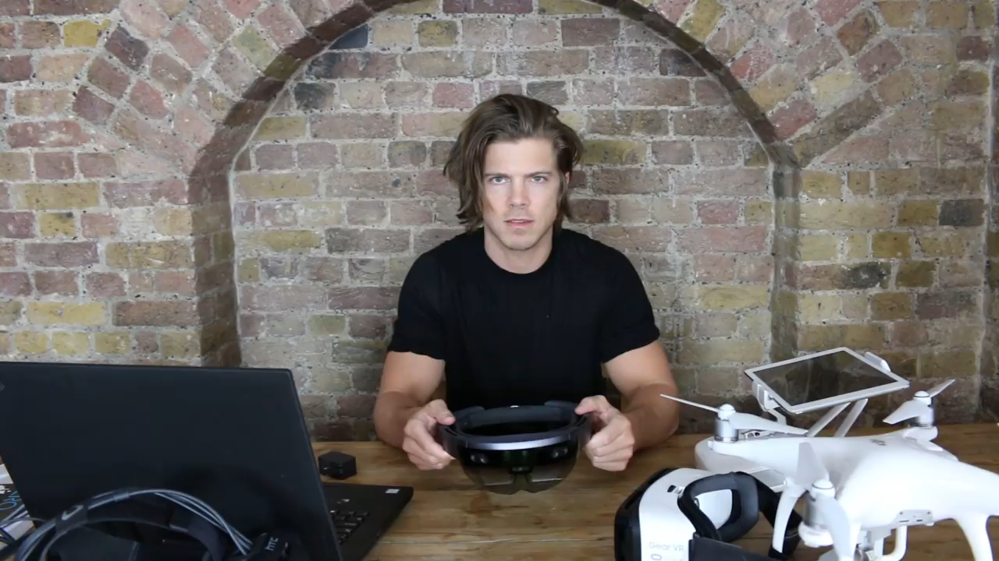
https://www.youtube.com/watch?v=ihKUoZxNClA
Notes:
https://www.youtube.com/watch?v=ihKUoZxNClA

Slide 28
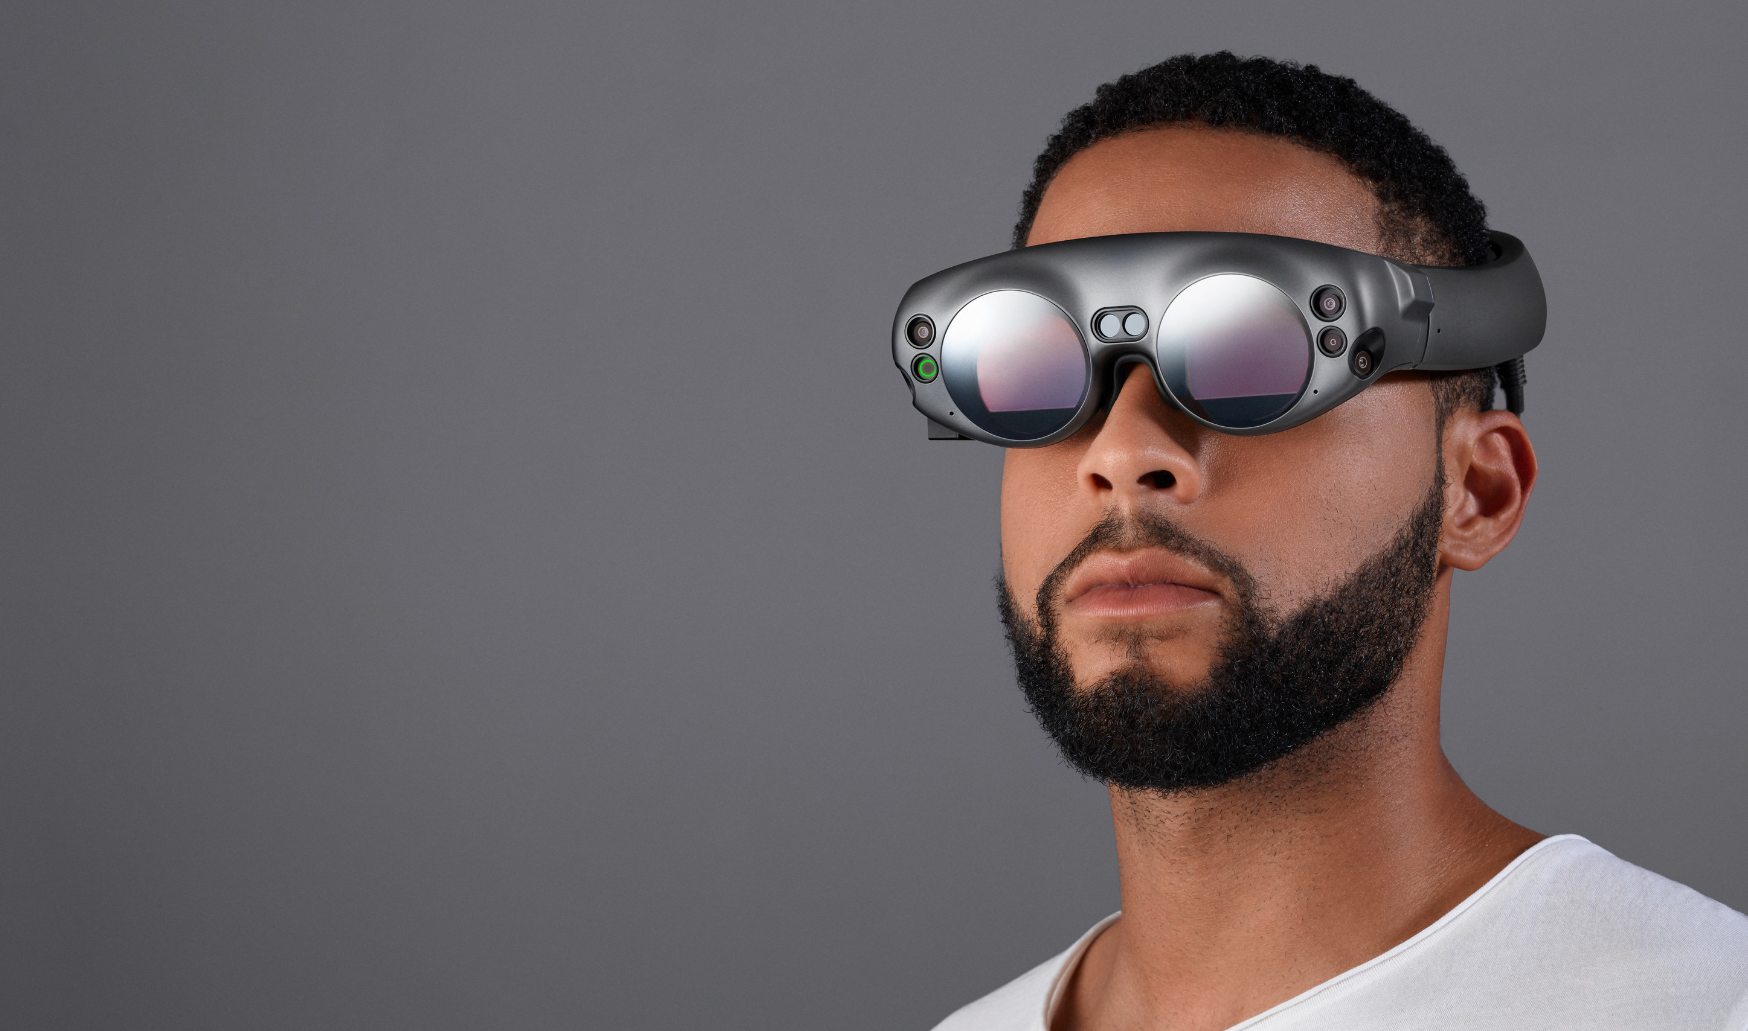
Magic Leap
Notes:
https://www.youtube.com/watch?v=B-h1b4MqMHA

Slide 29


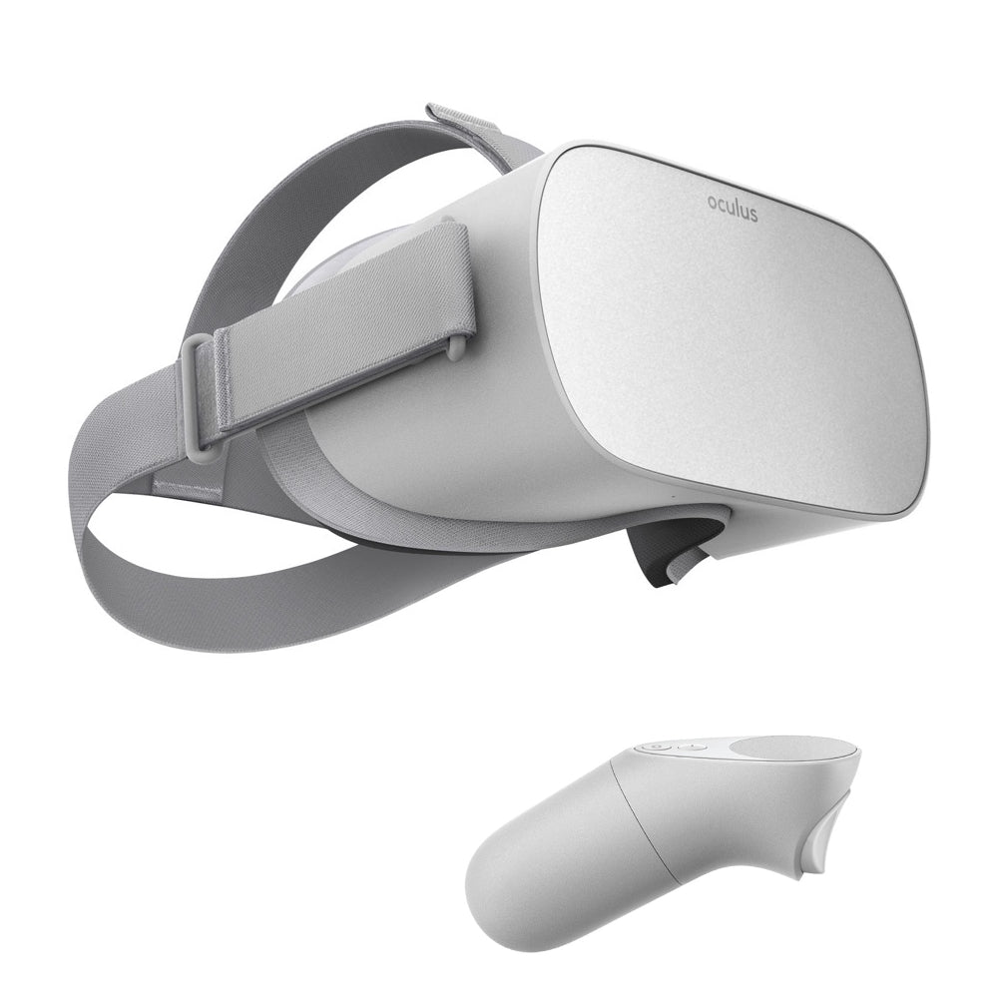
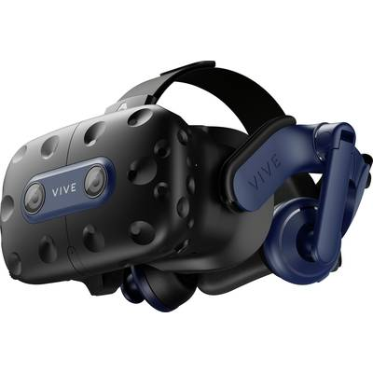
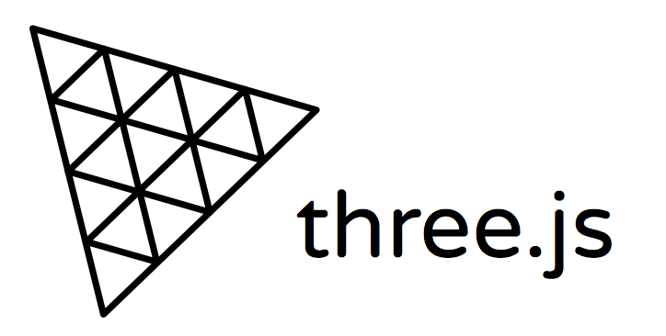
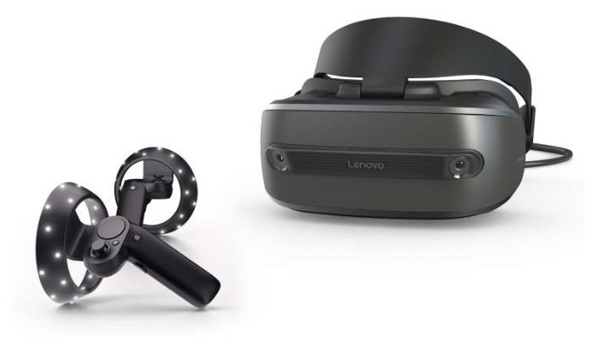
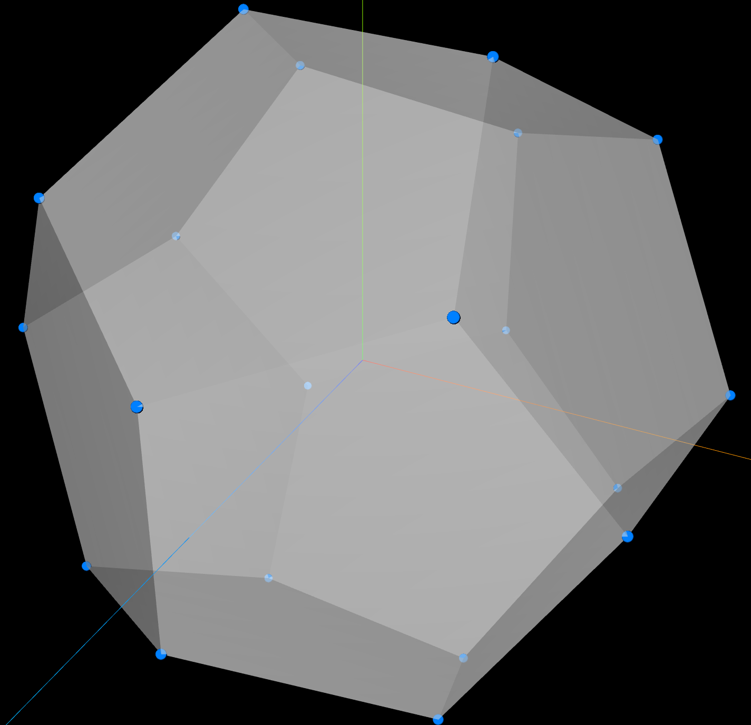
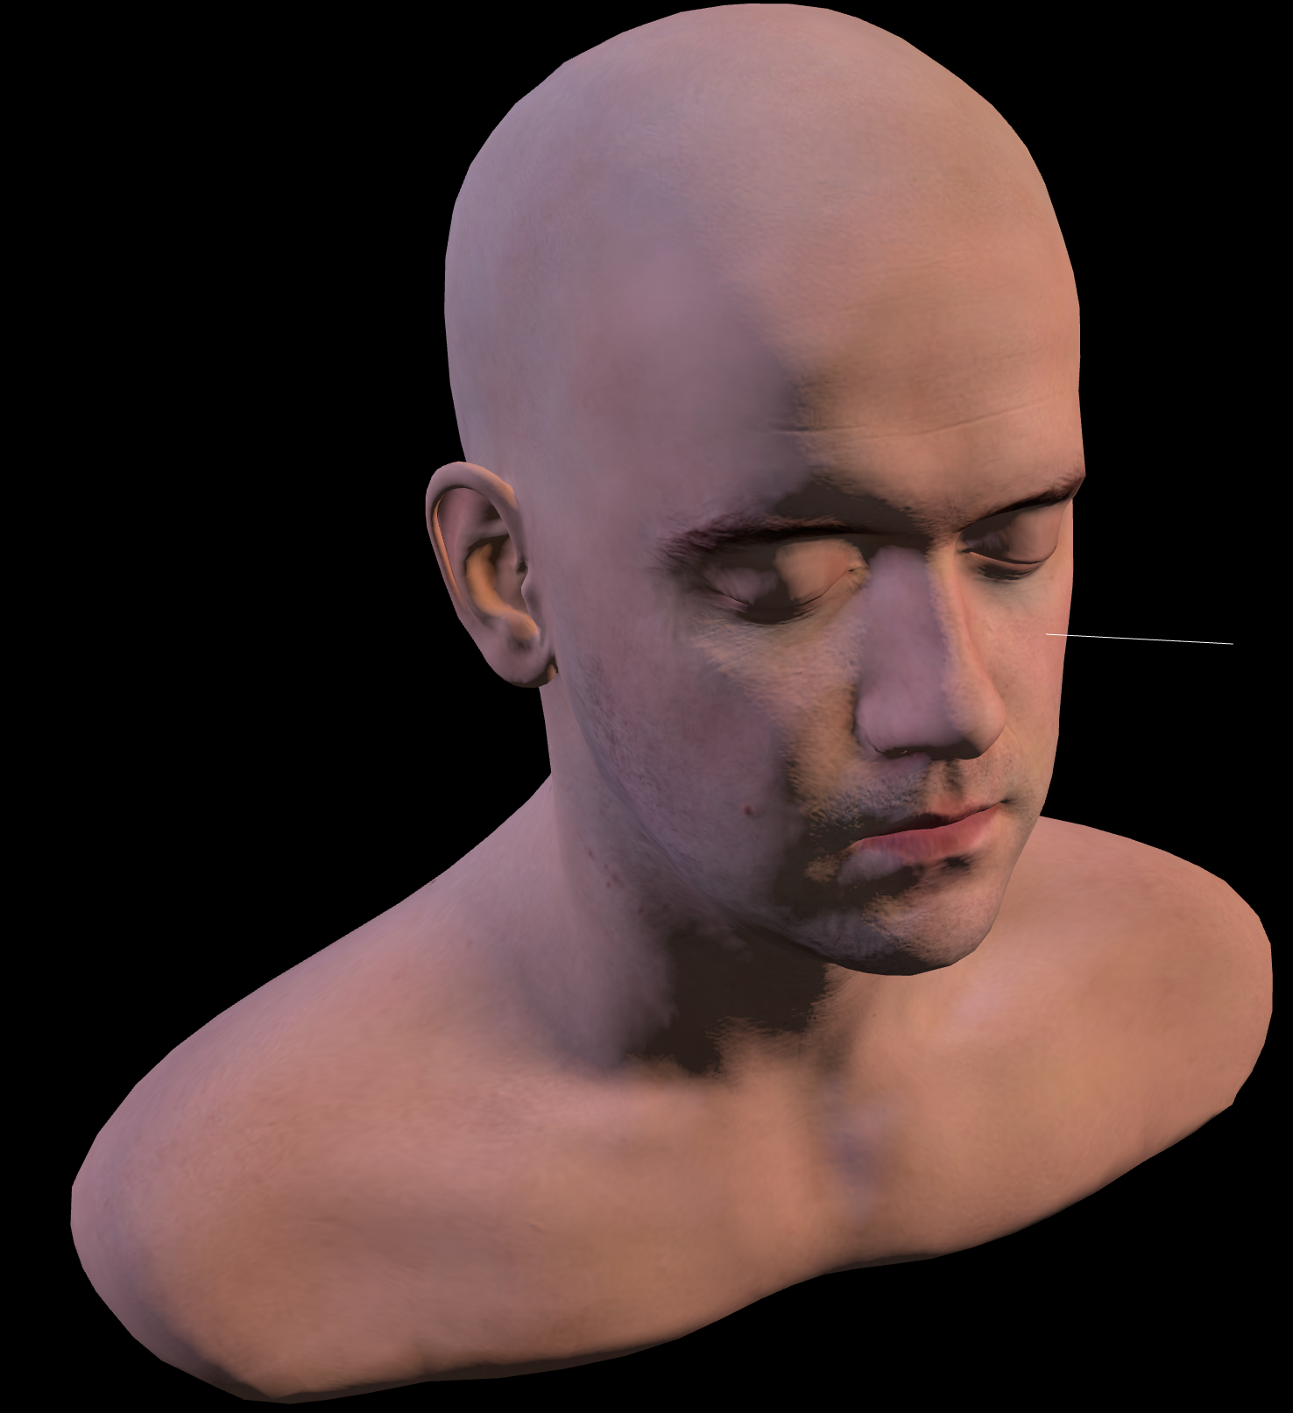
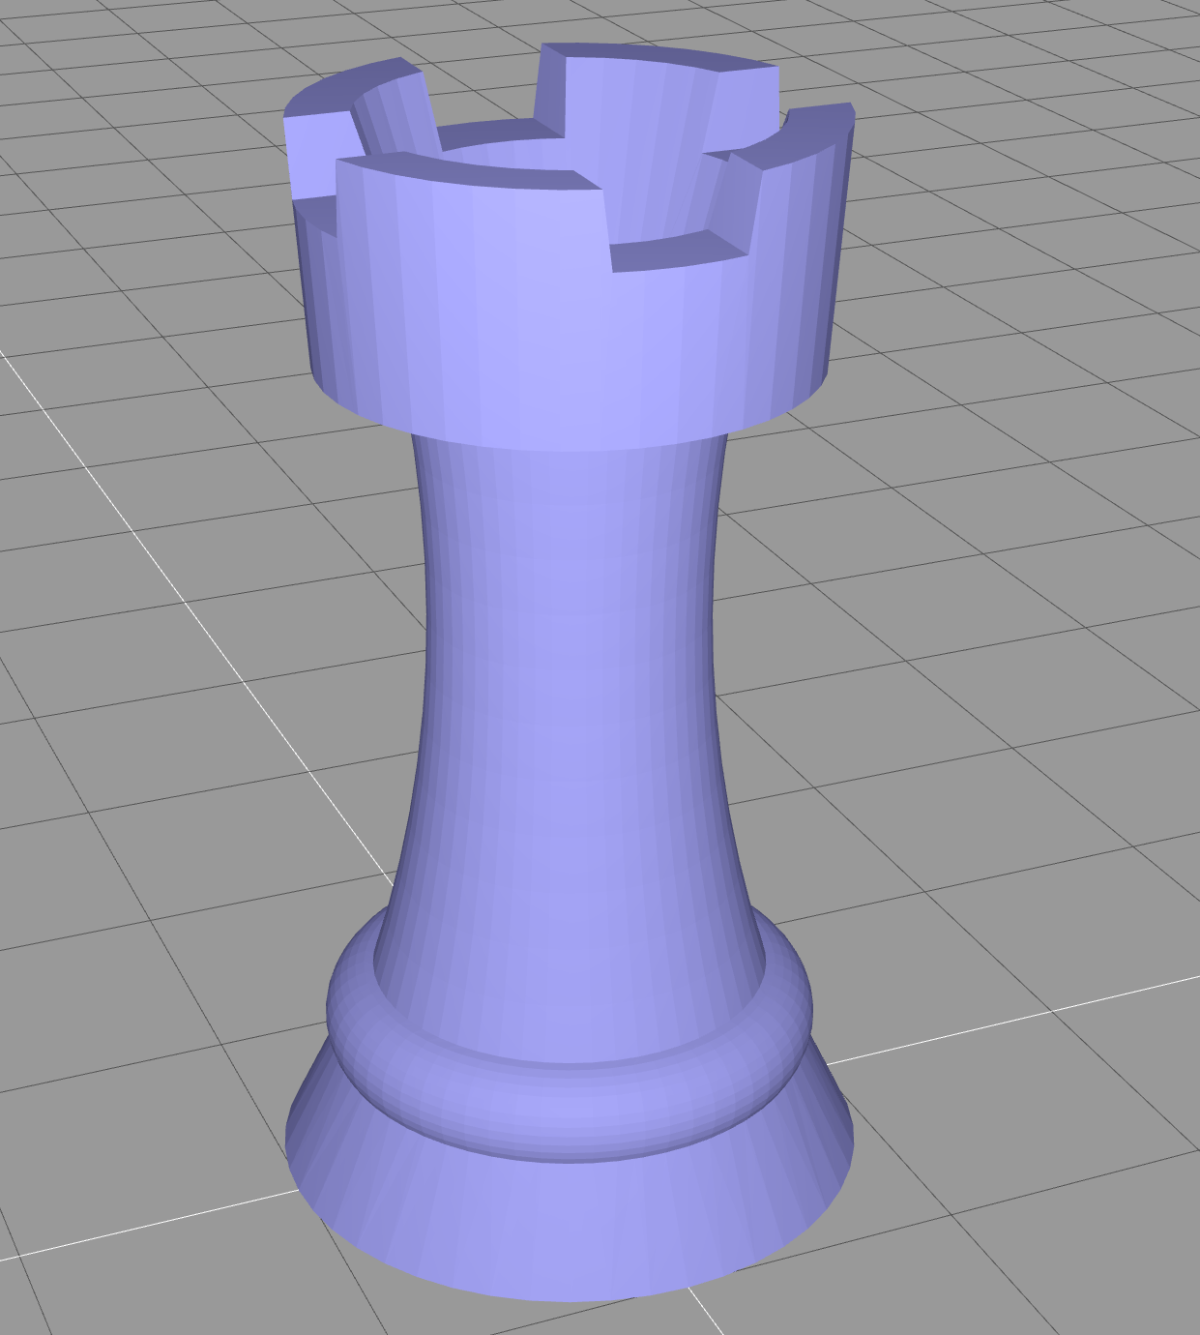
A-Frame, Three.js and WebXR
A-Frame is a web framework for building virtual reality (VR) experiences. A-Frame is based on top of HTML, the core is a powerful entity-component framework that provides a declarative, extensible, and composable structure to three.js.
A-Frame uses the WebXR API to gain access to VR headset sensor data (position, orientation) to transform the camera and to render content directly to VR headsets.
Three.js is a cross-browser JavaScript library and application programming interface (API) used to create and display animated 3D computer graphics in a web browser using WebGL.

Slide 30
What is an "entity-component-system" Architecture?
"Entity component system (ECS) is a software architectural pattern mostly used in video game development for the representation of game world objects. An ECS comprises entities composed from components of data, with systems which operate on entities' components.
ECS follows the principle of composition over inheritance, meaning that every entity is defined not by a type hierarchy, but by the components that are associated with it. Systems act globally over all entities which have the required components."
Notes:
Wikipedia: Entity component system - Wikipedia

Slide 31



What is an "entity-component-system" Architecture?
Entity: An entity represents a general-purpose object. In a game engine context, for example, every coarse game object is represented as an entity. Usually, it only consists of a unique id.
Component: A component labels an entity as possessing a particular aspect, and holds the data needed to model that aspect. For example, every game object that can take damage might have a Health component associated with its entity.
System: A system is a process which acts on all entities with the desired components. For example, a physics system may query for entities having mass, velocity and position components, and iterate over the results doing physics calculations on the sets of components for each entity.
entity "avatar"
component "health"
component "position"
component "mass"
system "physics"
Notes:
Wikipedia: Entity component system - Wikipedia

Slide 32
Why using A-Frame, an ECS?
The benefits of ECS include:
  Greater flexibility when defining objects by mixing and matching reusable parts.
  Eliminates the problems of long inheritance chains with complex interwoven functionality.
  Promotes clean design via decoupling, encapsulation, modularization, reusability.
  Most scalable way to build a VR application in terms of complexity.
  Proven architecture for 3D and VR development.
  Allows for extending new features (possibly sharing them as community components).
Notes:
Entity-Component-System – A-Frame (aframe.io)

Slide 33
Using "pre-defined" entities, components and systems
<html>
<head>
<script src="https://aframe.io/releases/1.4.0/aframe.min.js"></script>
<script src="https://unpkg.com/aframe-animation-component@3.2.1/dist/aframe-animation-component.min.js"></script>
<script src="https://unpkg.com/aframe-particle-system-component@1.0.x/dist/aframe-particle-system-component.min.js"></script>
<script src="https://unpkg.com/aframe-extras.ocean@%5E3.5.x/dist/aframe-extras.ocean.min.js"></script>
<script src="https://unpkg.com/aframe-gradient-sky@1.4.0/dist/gradientsky.min.js"></script>
</head>
<body>
<a-scene>
<a-entity id="rain" particle-system="preset: rain; color: #24CAFF; particleCount: 5000"></a-entity>
<a-entity id="sphere" geometry="primitive: sphere"
material="color: #EFEFEF; shader: flat"
position="0 0.15 -5"
light="type: point; intensity: 5"
animation="property: position; easing: easeInOutQuad; dir: alternate; dur: 1000; to: 0 -0.10 -5; loop: true"></a-entity>
<a-entity id="ocean" ocean="density: 20; width: 50; depth: 50; speed: 4"
material="color: #9CE3F9; opacity: 0.75; metalness: 0; roughness: 1"
rotation="-90 0 0"></a-entity>
<a-entity id="sky" geometry="primitive: sphere; radius: 5000"
material="shader: gradient; topColor: 235 235 245; bottomColor: 185 185 210"
scale="-1 1 1"></a-entity>
<a-entity id="light" light="type: ambient; color: #888"></a-entity>
</a-scene>
</body>
</html>
Import pre-defined ECSs
entity
component
system
Notes:
Entity-Component-System – A-Frame (aframe.io)

Slide 34
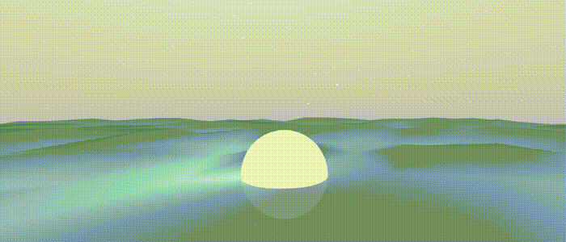
Using "pre-defined" entities, components and systems

Slide 35
Writing own ECSs - Entity
Entities are placeholder objects, to which components (and systems) can be plugged in to provide appearance, behaviour, and functionality.
Hence, writing an own entity is very simple:
<a-entity id="name"></a-entity>

Slide 36
Writing own ECSs - Component
A component is a reusable and modular chunk of data that we plug into an entity to add appearance, behavior, and/or functionality
Components are roughly analogous to CSS. Like how CSS rules modify the appearance of elements, component properties modify the appearance, behavior, and functionality of entities
Components need to be registered BEFORE they are used in the HTML
// Registering component in bar-component.js
AFRAME.registerComponent('bar', {
schema: {
color: {default: '#FFF'},
size: {type: 'int', default: 5}
},
init: function () {},
update: function () {},
tick: function () {},
tock: function () {},
remove: function () {},
pause: function () {},
play: function () {}
});
<!-- Usage of `bar` component. -->
<html>
<head>
<script src="https://aframe.io/releases/1.4.0/aframe.min.js"></script>
<script src="bar-component.js"></script>
</head>
<body>
<a-scene>
<a-entity bar="color: red; size: 20"></a-entity>
</a-scene>
</body>
</html>
Notes:
Component – A-Frame (aframe.io)

Slide 37
Writing own ECSs - System
Systems can help separate logic and behavior from data if desired. We let systems handle the heavy lifting, and components only worry about managing its data through its lifecycle methods
A system is registered similarly to a component
AFRAME.registerSystem('my-system', {
schema: {}, // System schema. Parses into `this.data`.
init: function () {
// Called on scene initialization.
},
// Other handlers and methods.
createComplexObject: function (data) {
// Do calculations and stuff with data.
return new ComplexObject(data);
}
});

Slide 38
In A-Frame, one has access to the DOM API and JS…
Example 1: Using JavaScript
AFRAME.registerComponent('log', {
schema: {type: 'string'},
init: function () {
var stringToLog = this.data;
console.log(stringToLog);
}
});
Example 2: Using the DOM API
var sceneEl = document.querySelector('a-scene');

