Slide 1
Mensch-zentrierte Entwicklung von Automatisierungsprozessen
Wissensnugget

Slide 2
Lernziele
(1) Sie verstehen, weshalb Automatisierungsprozesse mensch-zentriert entwickelt werden sollten.
(2) Sie kennen einen mensch-zentrierten Entwicklungsansatz und können diesen selbst anwenden.
(3) Sie können diesen Ansatz auf die Entwicklung von Automatisierungsprozessen anwenden.

Slide 3
Mensch-zentrierte Entwicklung
Wieso & Wie?

Slide 4
Traditionelle Innovationsauslöser
Historisch herrschten in der Vergangenheit vorwiegend zwei Innovationsansätze vor:
Der technologie-orientierte Ansatz oder «Technology Push» und der markt-orientierte Ansatz, oder «Market Pull».
Technology Push
Innovation
Technologien
Market Pull
Märkte
In diesem Ansatz erfolgt die Innovationsentwicklung vorwiegend auf der Basis einer Technologieentwicklung.
In diesem Ansatz erfolgt die Innovationsentwicklung vorwiegend auf der Basis traditioneller Marktforschung.

Slide 5
Traditionelle und neue Innovationsauslöser
In der Praxis zeigten sich zunehmend die Beschränkungen der beiden traditionellen Innovationsansätze. Die design-getriebene Innovationentwicklung entstand aus der Beobachtung, dass radikale Innovation häufig aufgrund eines tiefen Verständnisses für die Kund:innen und dem daraus erfolgten Erkennen latenter Bedürfnisse entstanden.
Technology Push
Innovation
Kunden-bedürfnisse
Technologien
Market Pull
Design Driven
In diesem Ansatz erfolgt die Innovationsentwicklung vorwiegend auf der Basis eines vertieften Verständnisses für die Nutzer:innen und dem Entdecken latenter vorher unerkannter Bedürfnisse.
Design

Slide 6
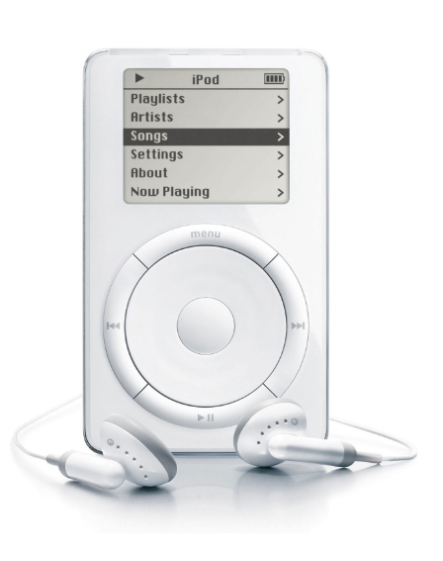
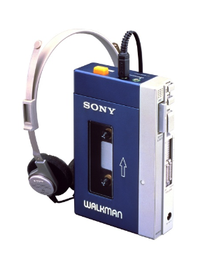
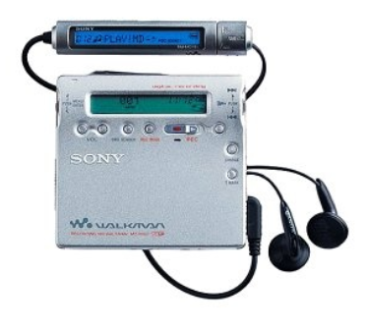
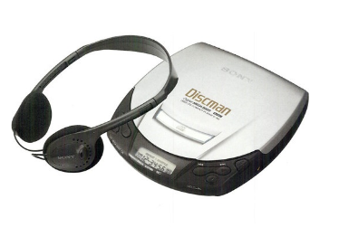
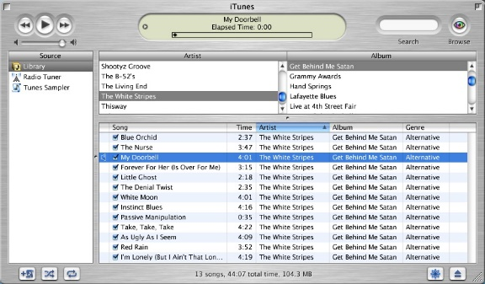

Inkrementelle vs. Radikale Innovation
Das Beispiel des Sony Walkmans illustriert diesen Wandel im Innovationsdenken. Der Sony Walkman war jahrzehntelang das marktbeherrschende Produkt für Musik unterwegs. Die Entwicklung erfolgte primär technologisch und marktgetrieben, vom Walkman zum Discman zum Minidiscman. Der iPod stellte eine als intelligente Kombination unterschiedlicher Aspekte (wie dem Design, der Nutzerführung, der iTunes-Anbindung und der Marketingstrategie) ein neuartiges Produkterlebnis dar. Über Nacht verdrängte der iPod den Walkman aus dem Markt.
Notes:
Global Engagement Levels
Their latest survey (1) across 142 countries has shown that only 13% of employees are engaged in their jobs, while 63% are not engaged and 24% are actively disengaged.
Interviews and responses to their Q12 questionnaire indicate that only a small fraction of employees work with passion, feel connected to their company, drive innovation and move the organization forward.
An overwhelming majority of employees are essentially “checked out and sleepwalking through their workday”. They are putting time, but no energy, into their work.
And worse yet, the actively disengaged, almost twice the number of the engaged, are not just unhappy, they “undermine what their engaged coworkers accomplish”.
In the United States (2), the cost of active disengagement is estimated to be up to $550 billion annually and may be as much as $186 billion in Germany and $112 billion in the United Kingdom.
Engagement affects key performance indicators: Low levels are associated with higher absenteeism, turnover, safety incidents, defects and theft, as well as poor customer service.
Variations in Engagement Levels
There are marked regional differences with regard to engagement. For example, in the U.S., at the top, the engaged and actively disengaged represent 30% and 18%, respectively, in Australia the scores were 24% and 16%, Latin America 21% and 19%, Western Europe 14% and 20%, Southeast Asia 12% and 14%, Middle East and North Africa 10% and 35%, Japan 7% and 24%, India 9% and 31% and in China, at the bottom, only 6% are engaged whereas 26% are actively disengaged.
Within Europe, the figures ranged from Denmark, at the top, at 21% and 10%, respectively, Switzerland 16% and 8%, Italy 14% and 18%, Germany 14% and 24%, to France, at the bottom, with only 9% engaged and almost 3 times as many actively disengaged at 26%.
Gender differences are small, but women nevertheless report higher engagement levels at 33% compared to men at 28%, despite persisting workplace inequality in their disfavor with regard to salary and promotion.
There are also some variations regarding the type of job. Managers, for example, are more engaged at 32.5% than professional workers at 28.8%, clerical and service workers at 25% and transportation workers at 16%.
Company and team size also influences engagement: organizations and work units with fewer than 10 employees have significantly higher engagement levels. Clearly managers with larger teams face a more challenging task of motivating and engaging their subordinates.
Paradoxically, remote workers, who work on a telecommuting basis, often from their homes, indicated a higher level of engagement at 32% compared to on-site employees at 28%.
Finally, engagement varies according to generation: “traditionalists” (born 1925-1945) have the highest level of engagement at 41% followed by “millennials” (born after 1980) at 33% compared to the largest portion of the work force, the “baby boomers” (1946-1964) at 26% who are also the most highly disengaged at 25%.

Slide 7
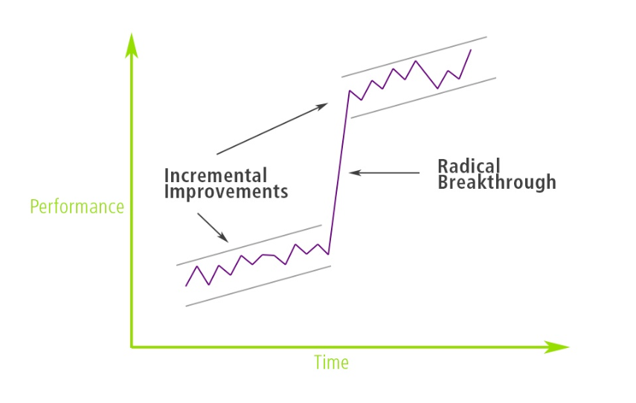
Inkrementelle vs. Radikale Innovation
Für Unternehmen ist es wichtig ein Gleichgewicht zwischen inkrementellen (verbessernden) Innovation und radikalen (disruptiven) Innovation zu finden. Inkrementelle Innovationen helfen die Basisinnovation finanziell auszuschlachten. Die radikale Innovation verhindert das Zurückbleiben hinter den Konkurrenten.

Slide 8
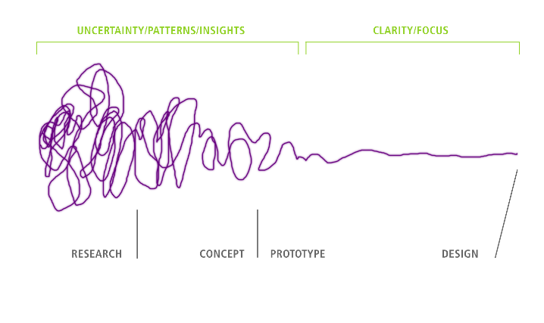
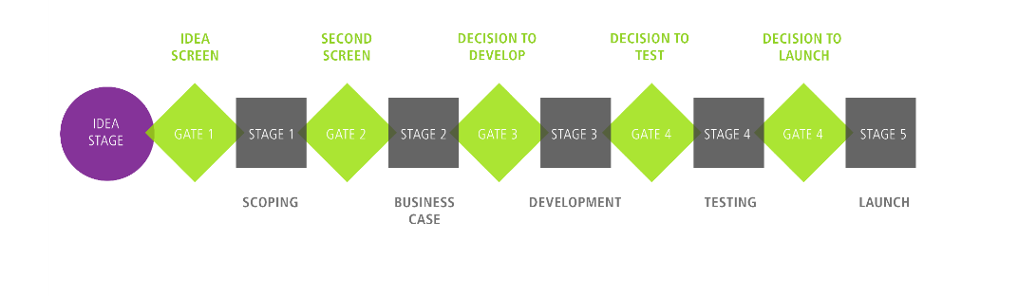
Inkrementelle vs. Radikale Innovation
Während sich inkrementelle Innovationen, mit einem klaren Ziel, gut über einen klassischen Stage-Gate-Prozess steuern lassen, erweist sich die radikale Innovationsentwicklung als chaotischer, da das Ziel, welches erreicht werden soll, zu Beginn unklar bleibt. Der Design Thinking-Ansatz hat sich als Prozessmethode empfohlen, welche Unternehmen durch den chaotisch kreativen Prozess leitet.
Inkrementelle Innovationen
Radikale Innovationen
Notes:
Global Engagement Levels
Their latest survey (1) across 142 countries has shown that only 13% of employees are engaged in their jobs, while 63% are not engaged and 24% are actively disengaged.
Interviews and responses to their Q12 questionnaire indicate that only a small fraction of employees work with passion, feel connected to their company, drive innovation and move the organization forward.
An overwhelming majority of employees are essentially “checked out and sleepwalking through their workday”. They are putting time, but no energy, into their work.
And worse yet, the actively disengaged, almost twice the number of the engaged, are not just unhappy, they “undermine what their engaged coworkers accomplish”.
In the United States (2), the cost of active disengagement is estimated to be up to $550 billion annually and may be as much as $186 billion in Germany and $112 billion in the United Kingdom.
Engagement affects key performance indicators: Low levels are associated with higher absenteeism, turnover, safety incidents, defects and theft, as well as poor customer service.
Variations in Engagement Levels
There are marked regional differences with regard to engagement. For example, in the U.S., at the top, the engaged and actively disengaged represent 30% and 18%, respectively, in Australia the scores were 24% and 16%, Latin America 21% and 19%, Western Europe 14% and 20%, Southeast Asia 12% and 14%, Middle East and North Africa 10% and 35%, Japan 7% and 24%, India 9% and 31% and in China, at the bottom, only 6% are engaged whereas 26% are actively disengaged.
Within Europe, the figures ranged from Denmark, at the top, at 21% and 10%, respectively, Switzerland 16% and 8%, Italy 14% and 18%, Germany 14% and 24%, to France, at the bottom, with only 9% engaged and almost 3 times as many actively disengaged at 26%.
Gender differences are small, but women nevertheless report higher engagement levels at 33% compared to men at 28%, despite persisting workplace inequality in their disfavor with regard to salary and promotion.
There are also some variations regarding the type of job. Managers, for example, are more engaged at 32.5% than professional workers at 28.8%, clerical and service workers at 25% and transportation workers at 16%.
Company and team size also influences engagement: organizations and work units with fewer than 10 employees have significantly higher engagement levels. Clearly managers with larger teams face a more challenging task of motivating and engaging their subordinates.
Paradoxically, remote workers, who work on a telecommuting basis, often from their homes, indicated a higher level of engagement at 32% compared to on-site employees at 28%.
Finally, engagement varies according to generation: “traditionalists” (born 1925-1945) have the highest level of engagement at 41% followed by “millennials” (born after 1980) at 33% compared to the largest portion of the work force, the “baby boomers” (1946-1964) at 26% who are also the most highly disengaged at 25%.

Slide 9


Design Thinking als Innovationsansatz
In den vergangenen 10 bis 15 Jahren hat sich das Design Thinking als Innovationsansatz etabliert. Die Vorteile des – häufig totgesagten – Ansatzes liegt vor allem in der konsequenten Ausrichtung auf die expliziten und impliziten bzw. latenten Nutzendenbedürfnisse sowie dem frühen, lösungsorientierten Prototypings. Als Methodik wurde sie primär von der international tätigen Designagentur IDEO propagiert, welches personell seinen Ursprung an der Stanford University hatte. Die offizielle Geschichtsschreibung verweist deshalb auf den Kurs «Mechanical Engineering Design» von Larry Leifer als Ursprung der Design Thinking-Methode. Daneben gibt es aber einen älteren wissenschaftlichen Diskurs zur Design Cognition, welcher seinen Ursprung im Design Methods Movement im Grossbritannien der 1960er Jahre findet. Die beiden Entwicklungsrichtungen weisen aber nur sehr wenig Berührungspunkte auf.

Slide 10

Design Thinking als Innovationsansatz
Mittlerweile verfügen alle grösseren Unternehmen, von Coca Cola bis IBM, über einen eigenen Design-Thinking-Prozess. Wie versuchen sogar die Unternehmenskultur zu einer Design-getriebenen Kultur zu transformieren, wie beispielsweise IBM.
«All-told, the company is investing more than $100-million in an effort to become a design-centered corporation.»
- Liz Stinson, Wired Magazine
Notes:
Global Engagement Levels
Their latest survey (1) across 142 countries has shown that only 13% of employees are engaged in their jobs, while 63% are not engaged and 24% are actively disengaged.
Interviews and responses to their Q12 questionnaire indicate that only a small fraction of employees work with passion, feel connected to their company, drive innovation and move the organization forward.
An overwhelming majority of employees are essentially “checked out and sleepwalking through their workday”. They are putting time, but no energy, into their work.
And worse yet, the actively disengaged, almost twice the number of the engaged, are not just unhappy, they “undermine what their engaged coworkers accomplish”.
In the United States (2), the cost of active disengagement is estimated to be up to $550 billion annually and may be as much as $186 billion in Germany and $112 billion in the United Kingdom.
Engagement affects key performance indicators: Low levels are associated with higher absenteeism, turnover, safety incidents, defects and theft, as well as poor customer service.
Variations in Engagement Levels
There are marked regional differences with regard to engagement. For example, in the U.S., at the top, the engaged and actively disengaged represent 30% and 18%, respectively, in Australia the scores were 24% and 16%, Latin America 21% and 19%, Western Europe 14% and 20%, Southeast Asia 12% and 14%, Middle East and North Africa 10% and 35%, Japan 7% and 24%, India 9% and 31% and in China, at the bottom, only 6% are engaged whereas 26% are actively disengaged.
Within Europe, the figures ranged from Denmark, at the top, at 21% and 10%, respectively, Switzerland 16% and 8%, Italy 14% and 18%, Germany 14% and 24%, to France, at the bottom, with only 9% engaged and almost 3 times as many actively disengaged at 26%.
Gender differences are small, but women nevertheless report higher engagement levels at 33% compared to men at 28%, despite persisting workplace inequality in their disfavor with regard to salary and promotion.
There are also some variations regarding the type of job. Managers, for example, are more engaged at 32.5% than professional workers at 28.8%, clerical and service workers at 25% and transportation workers at 16%.
Company and team size also influences engagement: organizations and work units with fewer than 10 employees have significantly higher engagement levels. Clearly managers with larger teams face a more challenging task of motivating and engaging their subordinates.
Paradoxically, remote workers, who work on a telecommuting basis, often from their homes, indicated a higher level of engagement at 32% compared to on-site employees at 28%.
Finally, engagement varies according to generation: “traditionalists” (born 1925-1945) have the highest level of engagement at 41% followed by “millennials” (born after 1980) at 33% compared to the largest portion of the work force, the “baby boomers” (1946-1964) at 26% who are also the most highly disengaged at 25%.

Slide 11
Design Thinking als Innovationsansatz
Mensch
Desirability
Design Thinking sucht nach Innovationen an der Schnittstelle von Mensch, Technologie und Business. Es fragt zuerst danach, was die Nutzenden wollen (Desirability), danach wie das technologisch umgesetzt werden kann (Feasibility) und schliesslich wie das wirtschaftlich gangbar gestaltet werden kann (Viability).
THE
SWEET
SPOT
Technologie
Feasibility
Business
Viability
Notes:
Global Engagement Levels
Their latest survey (1) across 142 countries has shown that only 13% of employees are engaged in their jobs, while 63% are not engaged and 24% are actively disengaged.
Interviews and responses to their Q12 questionnaire indicate that only a small fraction of employees work with passion, feel connected to their company, drive innovation and move the organization forward.
An overwhelming majority of employees are essentially “checked out and sleepwalking through their workday”. They are putting time, but no energy, into their work.
And worse yet, the actively disengaged, almost twice the number of the engaged, are not just unhappy, they “undermine what their engaged coworkers accomplish”.
In the United States (2), the cost of active disengagement is estimated to be up to $550 billion annually and may be as much as $186 billion in Germany and $112 billion in the United Kingdom.
Engagement affects key performance indicators: Low levels are associated with higher absenteeism, turnover, safety incidents, defects and theft, as well as poor customer service.
Variations in Engagement Levels
There are marked regional differences with regard to engagement. For example, in the U.S., at the top, the engaged and actively disengaged represent 30% and 18%, respectively, in Australia the scores were 24% and 16%, Latin America 21% and 19%, Western Europe 14% and 20%, Southeast Asia 12% and 14%, Middle East and North Africa 10% and 35%, Japan 7% and 24%, India 9% and 31% and in China, at the bottom, only 6% are engaged whereas 26% are actively disengaged.
Within Europe, the figures ranged from Denmark, at the top, at 21% and 10%, respectively, Switzerland 16% and 8%, Italy 14% and 18%, Germany 14% and 24%, to France, at the bottom, with only 9% engaged and almost 3 times as many actively disengaged at 26%.
Gender differences are small, but women nevertheless report higher engagement levels at 33% compared to men at 28%, despite persisting workplace inequality in their disfavor with regard to salary and promotion.
There are also some variations regarding the type of job. Managers, for example, are more engaged at 32.5% than professional workers at 28.8%, clerical and service workers at 25% and transportation workers at 16%.
Company and team size also influences engagement: organizations and work units with fewer than 10 employees have significantly higher engagement levels. Clearly managers with larger teams face a more challenging task of motivating and engaging their subordinates.
Paradoxically, remote workers, who work on a telecommuting basis, often from their homes, indicated a higher level of engagement at 32% compared to on-site employees at 28%.
Finally, engagement varies according to generation: “traditionalists” (born 1925-1945) have the highest level of engagement at 41% followed by “millennials” (born after 1980) at 33% compared to the largest portion of the work force, the “baby boomers” (1946-1964) at 26% who are also the most highly disengaged at 25%.

Slide 12
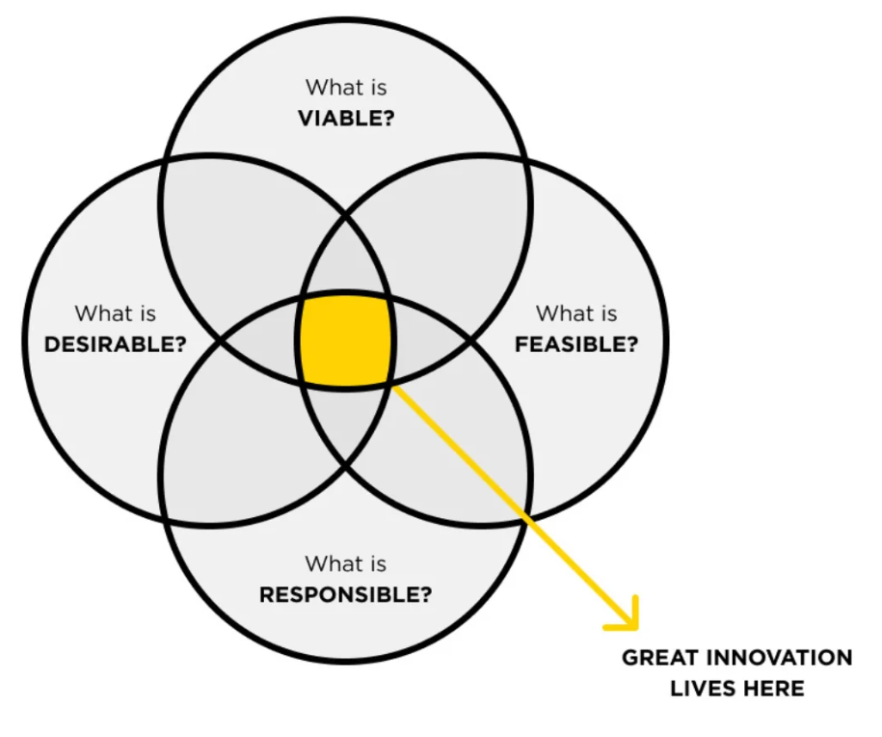
Design Thinking als Innovationsansatz
Aktuell findet sich häufig auch eine Erweiterung des Ansatzes, welche das Mitdenken der ökologischen, ökonomischen und sozialen Nachhaltigkeit integriert (Triple Bottom Line).
Notes:
Global Engagement Levels
Their latest survey (1) across 142 countries has shown that only 13% of employees are engaged in their jobs, while 63% are not engaged and 24% are actively disengaged.
Interviews and responses to their Q12 questionnaire indicate that only a small fraction of employees work with passion, feel connected to their company, drive innovation and move the organization forward.
An overwhelming majority of employees are essentially “checked out and sleepwalking through their workday”. They are putting time, but no energy, into their work.
And worse yet, the actively disengaged, almost twice the number of the engaged, are not just unhappy, they “undermine what their engaged coworkers accomplish”.
In the United States (2), the cost of active disengagement is estimated to be up to $550 billion annually and may be as much as $186 billion in Germany and $112 billion in the United Kingdom.
Engagement affects key performance indicators: Low levels are associated with higher absenteeism, turnover, safety incidents, defects and theft, as well as poor customer service.
Variations in Engagement Levels
There are marked regional differences with regard to engagement. For example, in the U.S., at the top, the engaged and actively disengaged represent 30% and 18%, respectively, in Australia the scores were 24% and 16%, Latin America 21% and 19%, Western Europe 14% and 20%, Southeast Asia 12% and 14%, Middle East and North Africa 10% and 35%, Japan 7% and 24%, India 9% and 31% and in China, at the bottom, only 6% are engaged whereas 26% are actively disengaged.
Within Europe, the figures ranged from Denmark, at the top, at 21% and 10%, respectively, Switzerland 16% and 8%, Italy 14% and 18%, Germany 14% and 24%, to France, at the bottom, with only 9% engaged and almost 3 times as many actively disengaged at 26%.
Gender differences are small, but women nevertheless report higher engagement levels at 33% compared to men at 28%, despite persisting workplace inequality in their disfavor with regard to salary and promotion.
There are also some variations regarding the type of job. Managers, for example, are more engaged at 32.5% than professional workers at 28.8%, clerical and service workers at 25% and transportation workers at 16%.
Company and team size also influences engagement: organizations and work units with fewer than 10 employees have significantly higher engagement levels. Clearly managers with larger teams face a more challenging task of motivating and engaging their subordinates.
Paradoxically, remote workers, who work on a telecommuting basis, often from their homes, indicated a higher level of engagement at 32% compared to on-site employees at 28%.
Finally, engagement varies according to generation: “traditionalists” (born 1925-1945) have the highest level of engagement at 41% followed by “millennials” (born after 1980) at 33% compared to the largest portion of the work force, the “baby boomers” (1946-1964) at 26% who are also the most highly disengaged at 25%.

Slide 13

Design Thinking als Innovationsansatz
Klassischerweise finden sich sechs Phasen entlang des Design Thinking-Ansatzes (verstehen, beobachten, definieren, generieren, prototypen und testen), wobei die einzelnen Phasen nicht abgeschlossen werden, sondern offen bleiben für Erkenntnisse, die während des Prozesses generiert werden und das nochmalige Durchlaufen einer vorhergehenden Phase nötig machen.
User
verstehen
Verhalten
beobachten
Sichtweise
definieren
Ideen
generieren
Prototypen
entwickeln
Lösungen
testen
Notes:
Global Engagement Levels
Their latest survey (1) across 142 countries has shown that only 13% of employees are engaged in their jobs, while 63% are not engaged and 24% are actively disengaged.
Interviews and responses to their Q12 questionnaire indicate that only a small fraction of employees work with passion, feel connected to their company, drive innovation and move the organization forward.
An overwhelming majority of employees are essentially “checked out and sleepwalking through their workday”. They are putting time, but no energy, into their work.
And worse yet, the actively disengaged, almost twice the number of the engaged, are not just unhappy, they “undermine what their engaged coworkers accomplish”.
In the United States (2), the cost of active disengagement is estimated to be up to $550 billion annually and may be as much as $186 billion in Germany and $112 billion in the United Kingdom.
Engagement affects key performance indicators: Low levels are associated with higher absenteeism, turnover, safety incidents, defects and theft, as well as poor customer service.
Variations in Engagement Levels
There are marked regional differences with regard to engagement. For example, in the U.S., at the top, the engaged and actively disengaged represent 30% and 18%, respectively, in Australia the scores were 24% and 16%, Latin America 21% and 19%, Western Europe 14% and 20%, Southeast Asia 12% and 14%, Middle East and North Africa 10% and 35%, Japan 7% and 24%, India 9% and 31% and in China, at the bottom, only 6% are engaged whereas 26% are actively disengaged.
Within Europe, the figures ranged from Denmark, at the top, at 21% and 10%, respectively, Switzerland 16% and 8%, Italy 14% and 18%, Germany 14% and 24%, to France, at the bottom, with only 9% engaged and almost 3 times as many actively disengaged at 26%.
Gender differences are small, but women nevertheless report higher engagement levels at 33% compared to men at 28%, despite persisting workplace inequality in their disfavor with regard to salary and promotion.
There are also some variations regarding the type of job. Managers, for example, are more engaged at 32.5% than professional workers at 28.8%, clerical and service workers at 25% and transportation workers at 16%.
Company and team size also influences engagement: organizations and work units with fewer than 10 employees have significantly higher engagement levels. Clearly managers with larger teams face a more challenging task of motivating and engaging their subordinates.
Paradoxically, remote workers, who work on a telecommuting basis, often from their homes, indicated a higher level of engagement at 32% compared to on-site employees at 28%.
Finally, engagement varies according to generation: “traditionalists” (born 1925-1945) have the highest level of engagement at 41% followed by “millennials” (born after 1980) at 33% compared to the largest portion of the work force, the “baby boomers” (1946-1964) at 26% who are also the most highly disengaged at 25%.

Slide 14
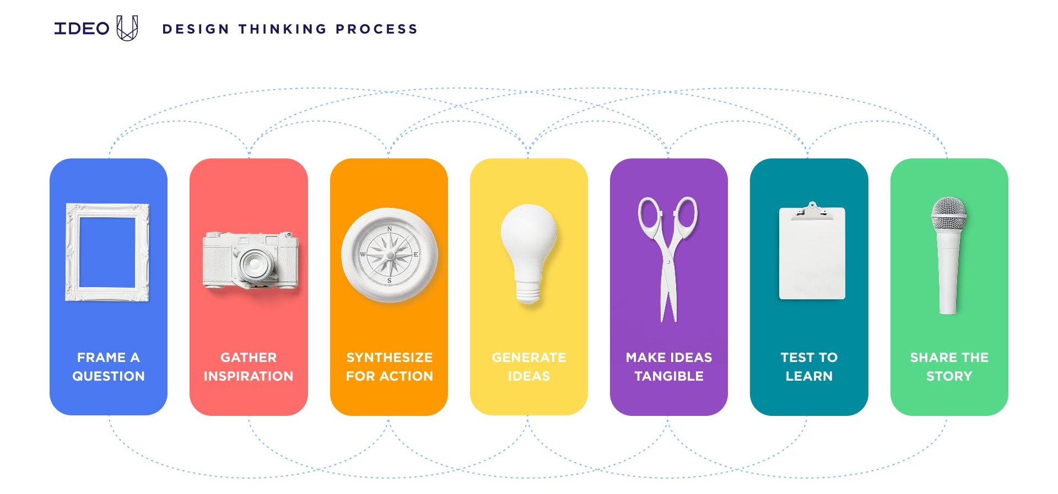
Design Thinking als Innovationsansatz
In der Praxis finden sich aber häufig angepasste beziehungsweise weiterentwickelte Prozessabläufe, welche beispielsweise einzelnen Aspekten wie der Inspirationsfindung oder dem überzeugenden Präsentieren der Lösungen mehr Raum zugestehen (z.B. IDEO Design Thinking Process).
Notes:
Global Engagement Levels
Their latest survey (1) across 142 countries has shown that only 13% of employees are engaged in their jobs, while 63% are not engaged and 24% are actively disengaged.
Interviews and responses to their Q12 questionnaire indicate that only a small fraction of employees work with passion, feel connected to their company, drive innovation and move the organization forward.
An overwhelming majority of employees are essentially “checked out and sleepwalking through their workday”. They are putting time, but no energy, into their work.
And worse yet, the actively disengaged, almost twice the number of the engaged, are not just unhappy, they “undermine what their engaged coworkers accomplish”.
In the United States (2), the cost of active disengagement is estimated to be up to $550 billion annually and may be as much as $186 billion in Germany and $112 billion in the United Kingdom.
Engagement affects key performance indicators: Low levels are associated with higher absenteeism, turnover, safety incidents, defects and theft, as well as poor customer service.
Variations in Engagement Levels
There are marked regional differences with regard to engagement. For example, in the U.S., at the top, the engaged and actively disengaged represent 30% and 18%, respectively, in Australia the scores were 24% and 16%, Latin America 21% and 19%, Western Europe 14% and 20%, Southeast Asia 12% and 14%, Middle East and North Africa 10% and 35%, Japan 7% and 24%, India 9% and 31% and in China, at the bottom, only 6% are engaged whereas 26% are actively disengaged.
Within Europe, the figures ranged from Denmark, at the top, at 21% and 10%, respectively, Switzerland 16% and 8%, Italy 14% and 18%, Germany 14% and 24%, to France, at the bottom, with only 9% engaged and almost 3 times as many actively disengaged at 26%.
Gender differences are small, but women nevertheless report higher engagement levels at 33% compared to men at 28%, despite persisting workplace inequality in their disfavor with regard to salary and promotion.
There are also some variations regarding the type of job. Managers, for example, are more engaged at 32.5% than professional workers at 28.8%, clerical and service workers at 25% and transportation workers at 16%.
Company and team size also influences engagement: organizations and work units with fewer than 10 employees have significantly higher engagement levels. Clearly managers with larger teams face a more challenging task of motivating and engaging their subordinates.
Paradoxically, remote workers, who work on a telecommuting basis, often from their homes, indicated a higher level of engagement at 32% compared to on-site employees at 28%.
Finally, engagement varies according to generation: “traditionalists” (born 1925-1945) have the highest level of engagement at 41% followed by “millennials” (born after 1980) at 33% compared to the largest portion of the work force, the “baby boomers” (1946-1964) at 26% who are also the most highly disengaged at 25%.

Slide 15

Design Thinking als Innovationsansatz
Design Thinking stellt mehr ein Mindset dar, als einen Innovationsprozess. Es hebt dabei besonders folgende Charakteristika hervor:
Design Thinking Mindset
Co-evolutiv
Mensch-zentriert
Handlungs-orientiert
Fehlertolerant
Kollaborativ
Build-to-think
Notes:
Global Engagement Levels
Their latest survey (1) across 142 countries has shown that only 13% of employees are engaged in their jobs, while 63% are not engaged and 24% are actively disengaged.
Interviews and responses to their Q12 questionnaire indicate that only a small fraction of employees work with passion, feel connected to their company, drive innovation and move the organization forward.
An overwhelming majority of employees are essentially “checked out and sleepwalking through their workday”. They are putting time, but no energy, into their work.
And worse yet, the actively disengaged, almost twice the number of the engaged, are not just unhappy, they “undermine what their engaged coworkers accomplish”.
In the United States (2), the cost of active disengagement is estimated to be up to $550 billion annually and may be as much as $186 billion in Germany and $112 billion in the United Kingdom.
Engagement affects key performance indicators: Low levels are associated with higher absenteeism, turnover, safety incidents, defects and theft, as well as poor customer service.
Variations in Engagement Levels
There are marked regional differences with regard to engagement. For example, in the U.S., at the top, the engaged and actively disengaged represent 30% and 18%, respectively, in Australia the scores were 24% and 16%, Latin America 21% and 19%, Western Europe 14% and 20%, Southeast Asia 12% and 14%, Middle East and North Africa 10% and 35%, Japan 7% and 24%, India 9% and 31% and in China, at the bottom, only 6% are engaged whereas 26% are actively disengaged.
Within Europe, the figures ranged from Denmark, at the top, at 21% and 10%, respectively, Switzerland 16% and 8%, Italy 14% and 18%, Germany 14% and 24%, to France, at the bottom, with only 9% engaged and almost 3 times as many actively disengaged at 26%.
Gender differences are small, but women nevertheless report higher engagement levels at 33% compared to men at 28%, despite persisting workplace inequality in their disfavor with regard to salary and promotion.
There are also some variations regarding the type of job. Managers, for example, are more engaged at 32.5% than professional workers at 28.8%, clerical and service workers at 25% and transportation workers at 16%.
Company and team size also influences engagement: organizations and work units with fewer than 10 employees have significantly higher engagement levels. Clearly managers with larger teams face a more challenging task of motivating and engaging their subordinates.
Paradoxically, remote workers, who work on a telecommuting basis, often from their homes, indicated a higher level of engagement at 32% compared to on-site employees at 28%.
Finally, engagement varies according to generation: “traditionalists” (born 1925-1945) have the highest level of engagement at 41% followed by “millennials” (born after 1980) at 33% compared to the largest portion of the work force, the “baby boomers” (1946-1964) at 26% who are also the most highly disengaged at 25%.

Slide 16
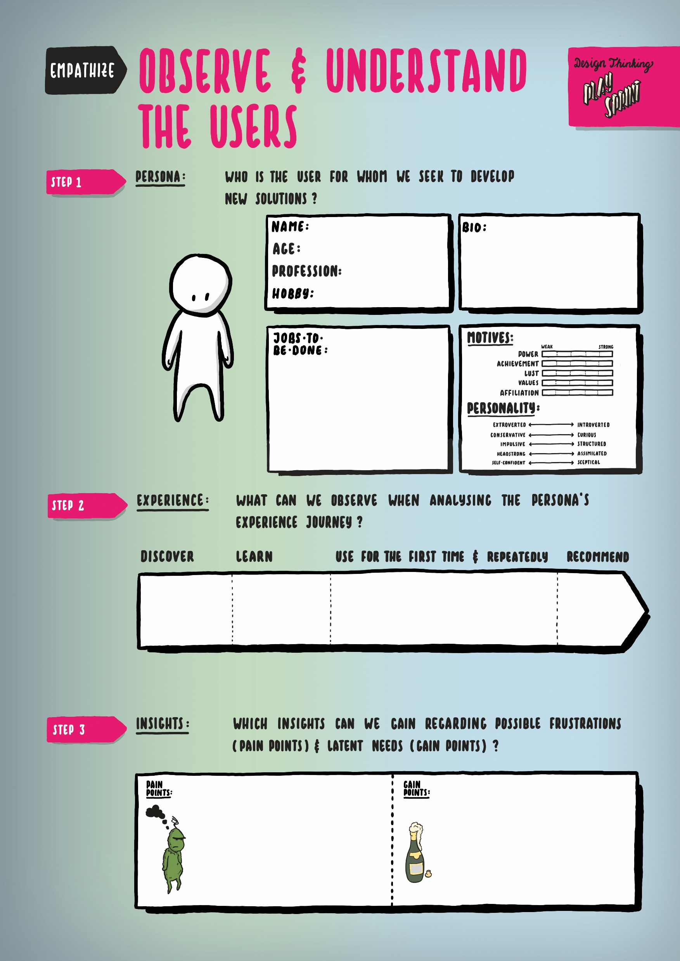
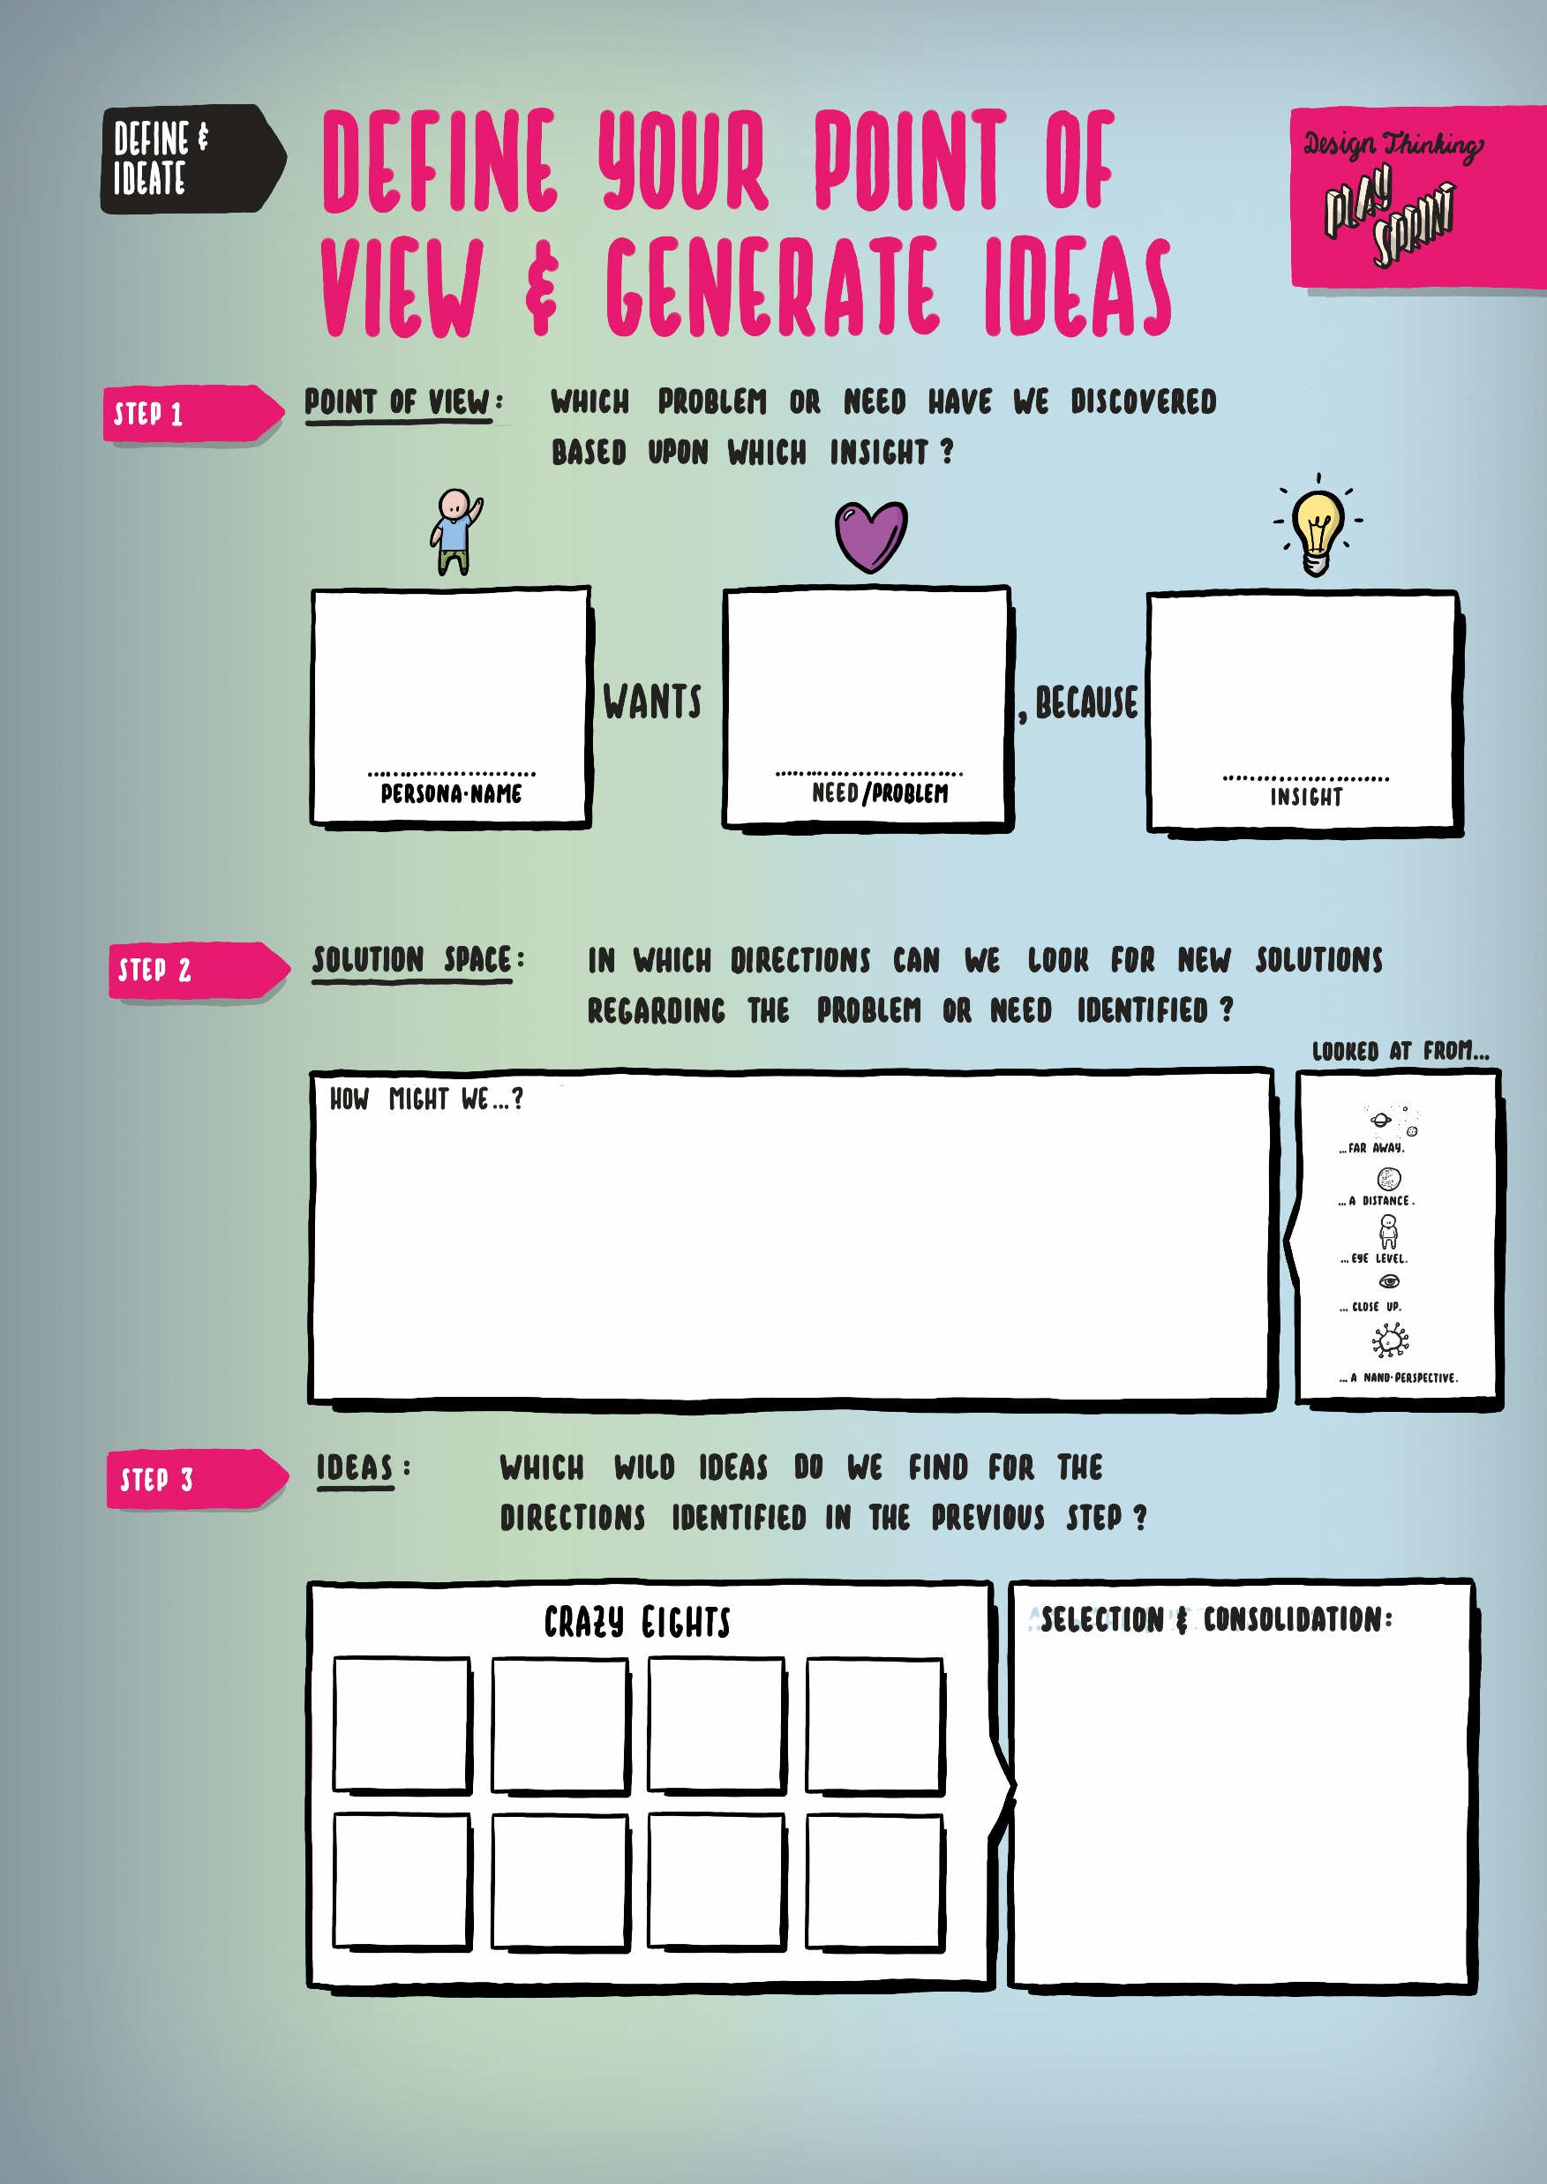
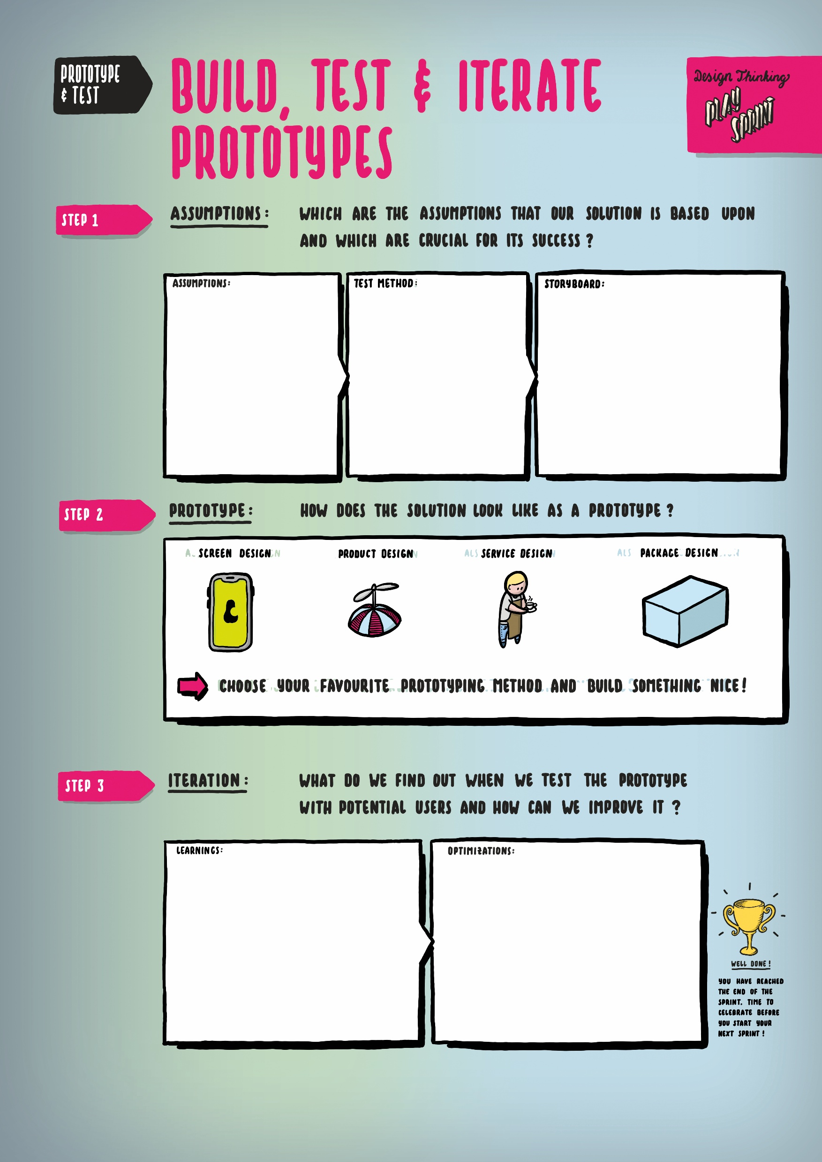
Design Thinking Play Sprint
Der Design Thinking Play Sprint stellt die wichtigsten Denk- und Arbeitsschritte, die in der mensch-zentrierten Innovationsentwicklung durchlaufen werden sollten zusammen.
Notes:
Global Engagement Levels
Their latest survey (1) across 142 countries has shown that only 13% of employees are engaged in their jobs, while 63% are not engaged and 24% are actively disengaged.
Interviews and responses to their Q12 questionnaire indicate that only a small fraction of employees work with passion, feel connected to their company, drive innovation and move the organization forward.
An overwhelming majority of employees are essentially “checked out and sleepwalking through their workday”. They are putting time, but no energy, into their work.
And worse yet, the actively disengaged, almost twice the number of the engaged, are not just unhappy, they “undermine what their engaged coworkers accomplish”.
In the United States (2), the cost of active disengagement is estimated to be up to $550 billion annually and may be as much as $186 billion in Germany and $112 billion in the United Kingdom.
Engagement affects key performance indicators: Low levels are associated with higher absenteeism, turnover, safety incidents, defects and theft, as well as poor customer service.
Variations in Engagement Levels
There are marked regional differences with regard to engagement. For example, in the U.S., at the top, the engaged and actively disengaged represent 30% and 18%, respectively, in Australia the scores were 24% and 16%, Latin America 21% and 19%, Western Europe 14% and 20%, Southeast Asia 12% and 14%, Middle East and North Africa 10% and 35%, Japan 7% and 24%, India 9% and 31% and in China, at the bottom, only 6% are engaged whereas 26% are actively disengaged.
Within Europe, the figures ranged from Denmark, at the top, at 21% and 10%, respectively, Switzerland 16% and 8%, Italy 14% and 18%, Germany 14% and 24%, to France, at the bottom, with only 9% engaged and almost 3 times as many actively disengaged at 26%.
Gender differences are small, but women nevertheless report higher engagement levels at 33% compared to men at 28%, despite persisting workplace inequality in their disfavor with regard to salary and promotion.
There are also some variations regarding the type of job. Managers, for example, are more engaged at 32.5% than professional workers at 28.8%, clerical and service workers at 25% and transportation workers at 16%.
Company and team size also influences engagement: organizations and work units with fewer than 10 employees have significantly higher engagement levels. Clearly managers with larger teams face a more challenging task of motivating and engaging their subordinates.
Paradoxically, remote workers, who work on a telecommuting basis, often from their homes, indicated a higher level of engagement at 32% compared to on-site employees at 28%.
Finally, engagement varies according to generation: “traditionalists” (born 1925-1945) have the highest level of engagement at 41% followed by “millennials” (born after 1980) at 33% compared to the largest portion of the work force, the “baby boomers” (1946-1964) at 26% who are also the most highly disengaged at 25%.

Slide 17
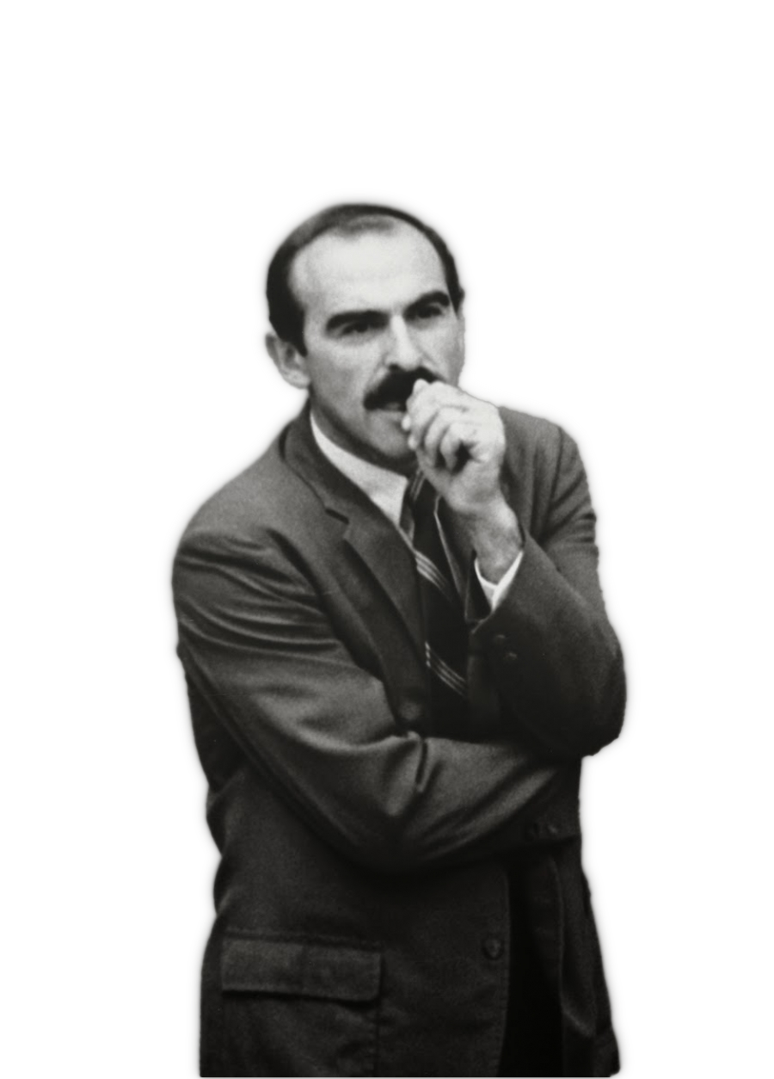
Design Thinking Play Sprint: Persona
Zunächst geht es darum, zu verstehen, was die Nutzenden wirklich wollen. Die Persona ist ein Hilfsmittel, dass hilft sich in eine konkrete Person zu versetzen.
«People don’t want to buy a quarter-inch drill. They want a quarter-inch hole!»
- Theodore Levitt

Slide 18
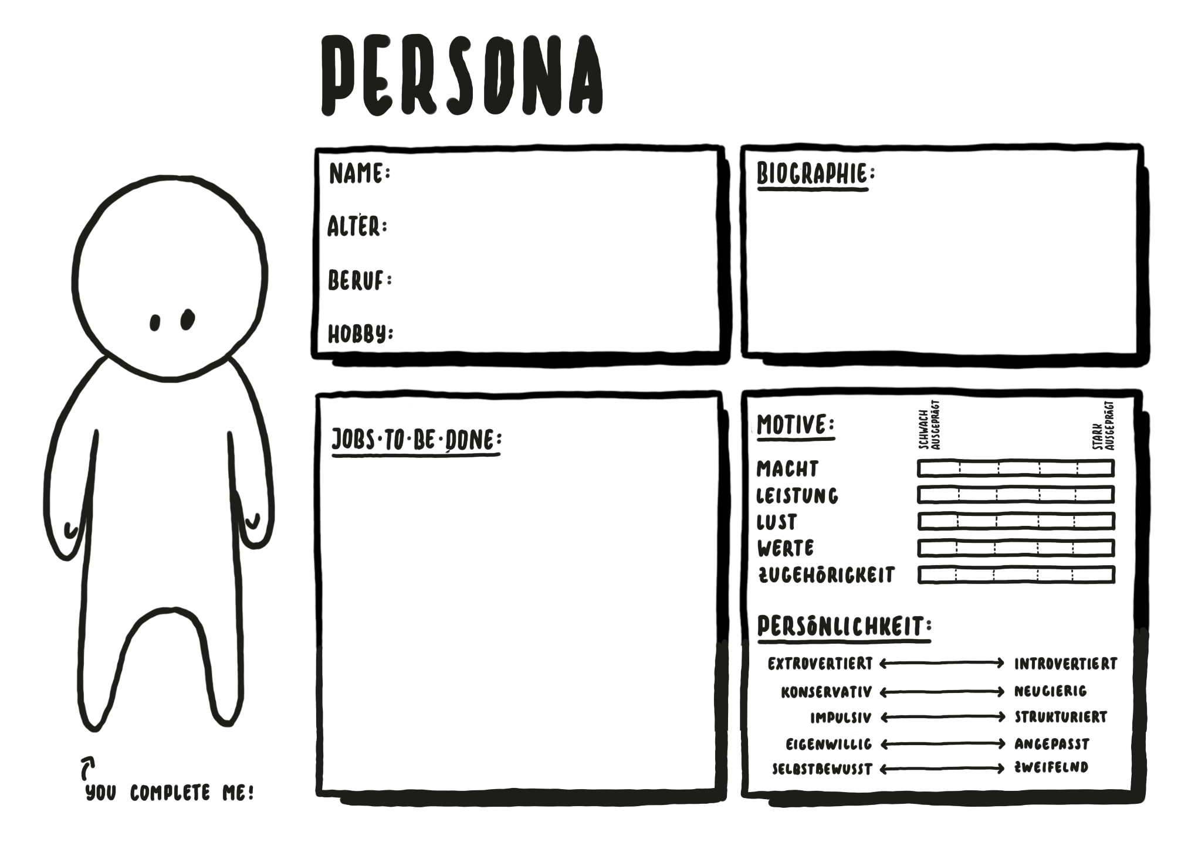
Design Thinking Play Sprint: Persona
In der Praxis findet sich eine Vielzahl unterschiedlicher Persona-Variationen. Wichtig ist, dass eine ganz konkrete Vorstellung einer Person erarbeitet wird. Das impliziert neben dem Erfassen der Personendaten und den Aufgaben, welche die Person im Zusammenhang mit dem zu bearbeitenden Thema erledigen möchte (Jobs-to-be-done) auch das Festhalten der Persönlichkeitsausprägungen.

Slide 19
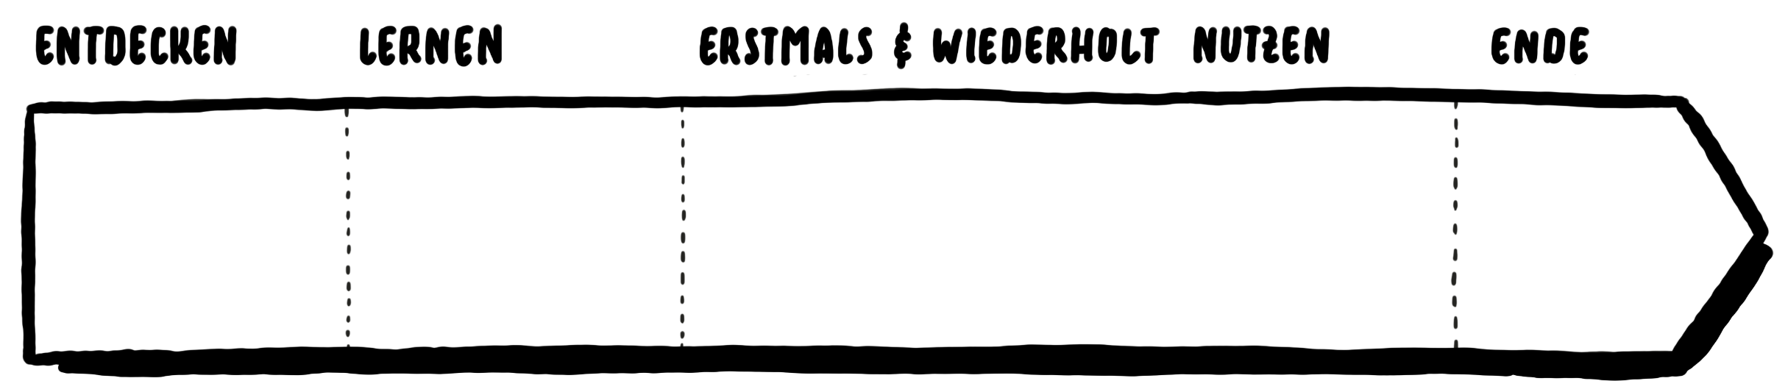
Design Thinking Play Sprint: Customer Journey & Story Map
Nachdem die Persona entwickelt wurde, wird versucht das konkrete Verhalten in einer typischen Nutzungssituation zu beobachten. Dazu wird eine Customer Journey oder eine Story Map entwickelt. Zu beachten ist, dass die gesamte Kette der Berührungspunkte (Touchpoints) vom Erstkontakt bis zur wiederholten Nutzung oder Empfehlung betrachtet wird.
(1) Vorlaufphase
Entdecken & Recherchieren
Auswählen & Entscheiden
(2) Kauf- & Nutzungsphase
Kaufen
(Erst-)Nutzen
(3) Nachlaufphase
Binden & Rückgewinnen
Weiterempfehlen

Slide 20
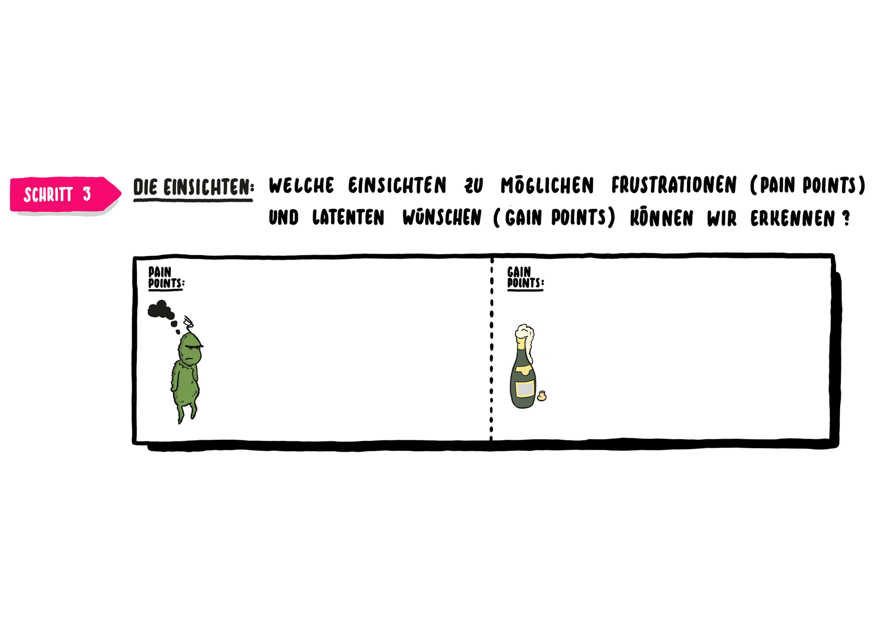
Design Thinking Play Sprint: Pain Points & Gain Points
Im letzten von drei Schritten in der Empathise-Phase werden aufgrund der in der Customer Journey erhobenen Probleme, Frustrationen und Opportunitäten die Pain Points (was die Nutzenden aktuell frustriert) und Gain Points (was die Nutzenden erfreuen würde) festgehalten. Damit sollten insbesondere latente, von den Nutzenden nicht in der direkten Befragung genannten, Punkte erkannt werden.

Slide 21
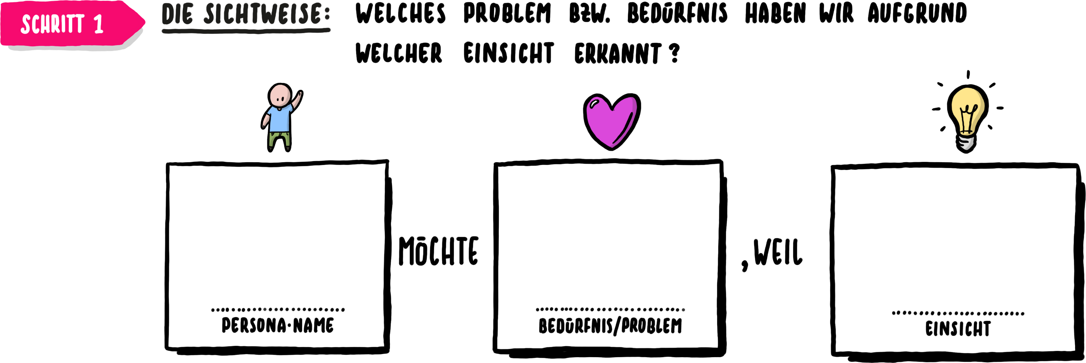
Design Thinking Play Sprint: Sichtweise
In der Phase ‘Define & Ideate’ geht es zunächst um die Formulierung des konkreten Kernbedürfnisses bzw. -problems für die gewählte Person, die auf einer Einsicht beruht, die in der vorhergehenden Phase erhoben wurde.

Slide 22
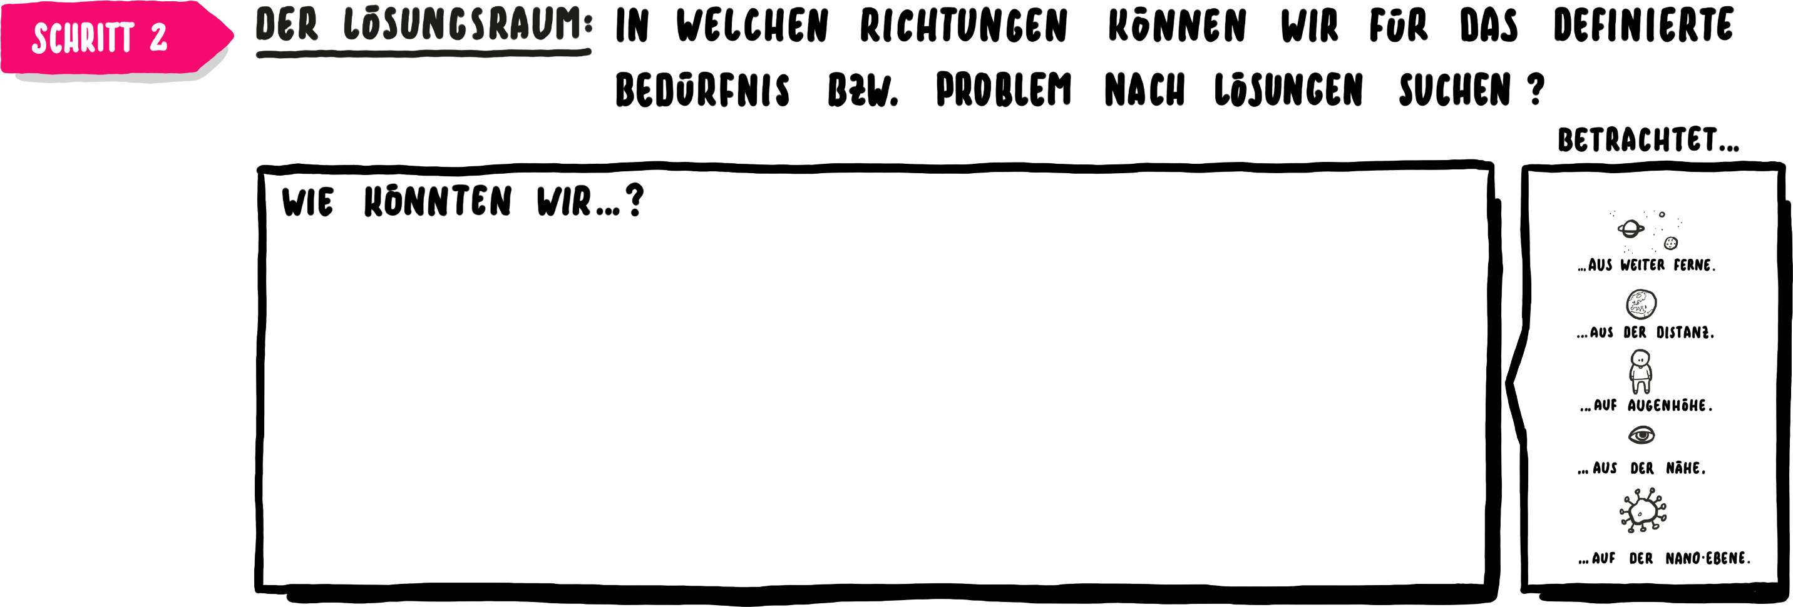
Design Thinking Play Sprint: Lösungsraum
Basierend auf der formulierten Sichtweise, wird im Anschluss der Lösungsraum geöffnet. Dazu werden zunächst die Richtungen festgehalten, in diesen nach Ideen gesucht werden soll. Dazu empfiehlt sich die Formulierung von sogenannten «Wie könnten wir…»-Fragen. Diese sollen die Suchrichtung für die unterschiedlichen Problemdimensionen angeben.

Slide 23
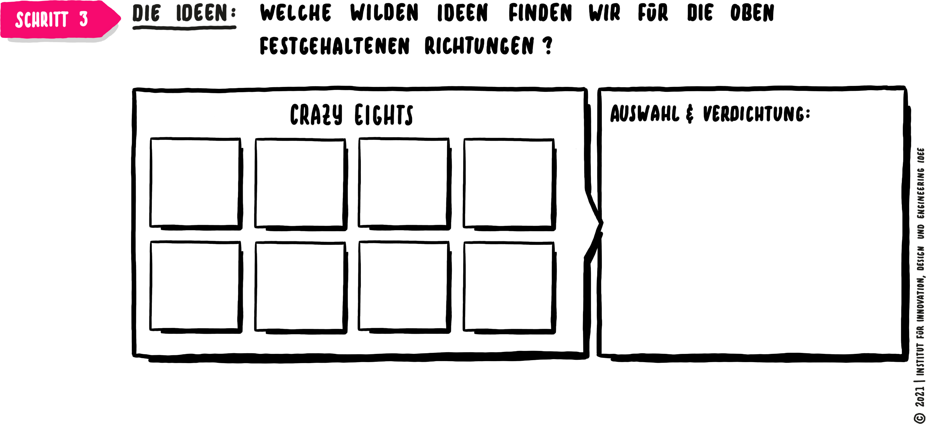
Design Thinking Play Sprint: Ideenfindung
Im dritten Schritt der ‘Define & Ideate’-Phase wird in den definierten Suchrichtungen nach Ideen gesucht. Es empfiehlt sich die Crazy Eights-Methode zu verwenden, die nach acht wilden Ideen fragt. Dies vor allem aus dem Grund, die selbstauferlegte Zensur zu umgehen. In den meisten Fällen, lassen sich die wilden Ideen wieder auf eine konkret nutzbare Ebene zurück bringen.

Slide 24
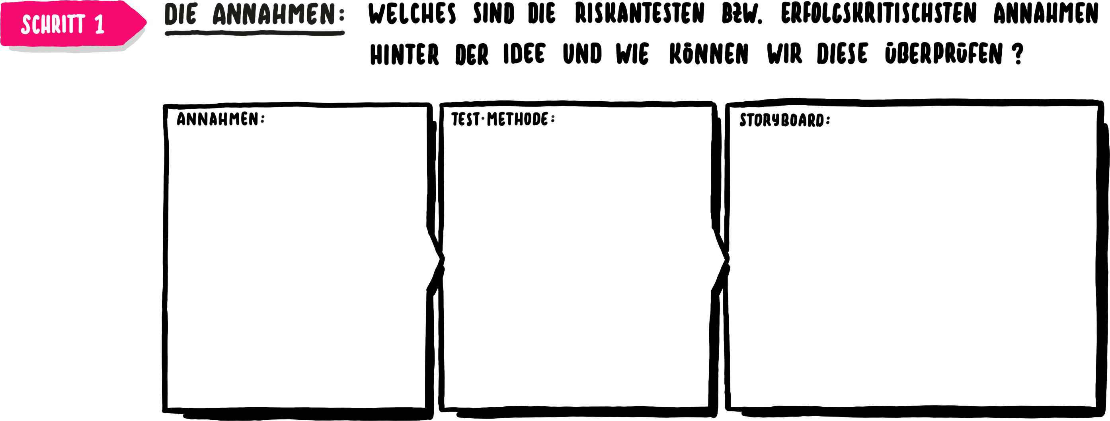
Design Thinking Play Sprint: Erfolgskritischste Annahmen
In der dritten Phase ‘Build, Text & Iterate’ wird zunächst nach den riskantesten Annahmen gefragt. Die Frage ist dabei, welche Annahmen von der die Lösungsidee ausgeht, würde falls falsch, die Lösung verunmöglichen. In einem ersten Schritt wird deshalb untersucht, wie diese Annahme in einem Prototypen möglichst einfach und schnell getestet werden kann und was dazu entwickelt werden muss.

Slide 25
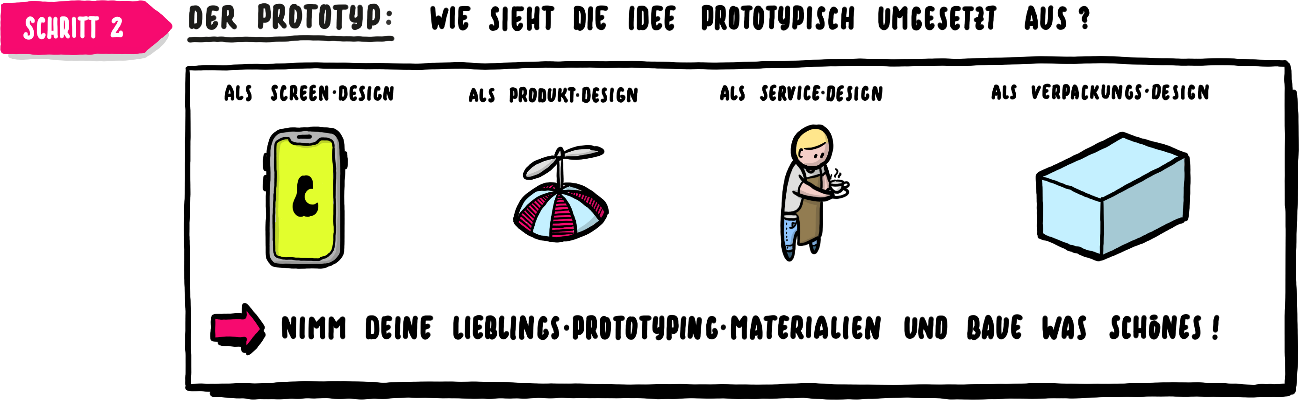
Design Thinking Play Sprint: Prototype
Im zweiten Schritt wird auf der Basis der identifizierten, erfolgskritischen Annahmen ein Prototyp entwickelt. Dieser kann in digitaler Form, als physisches Produkt oder als Papier-Prototyp umgesetzt werden. Das entscheidende Kriterium ist, wie die Annahmen möglichst schnell und kostengünstig mit realen Nutzenden getestet werden können.

Slide 26
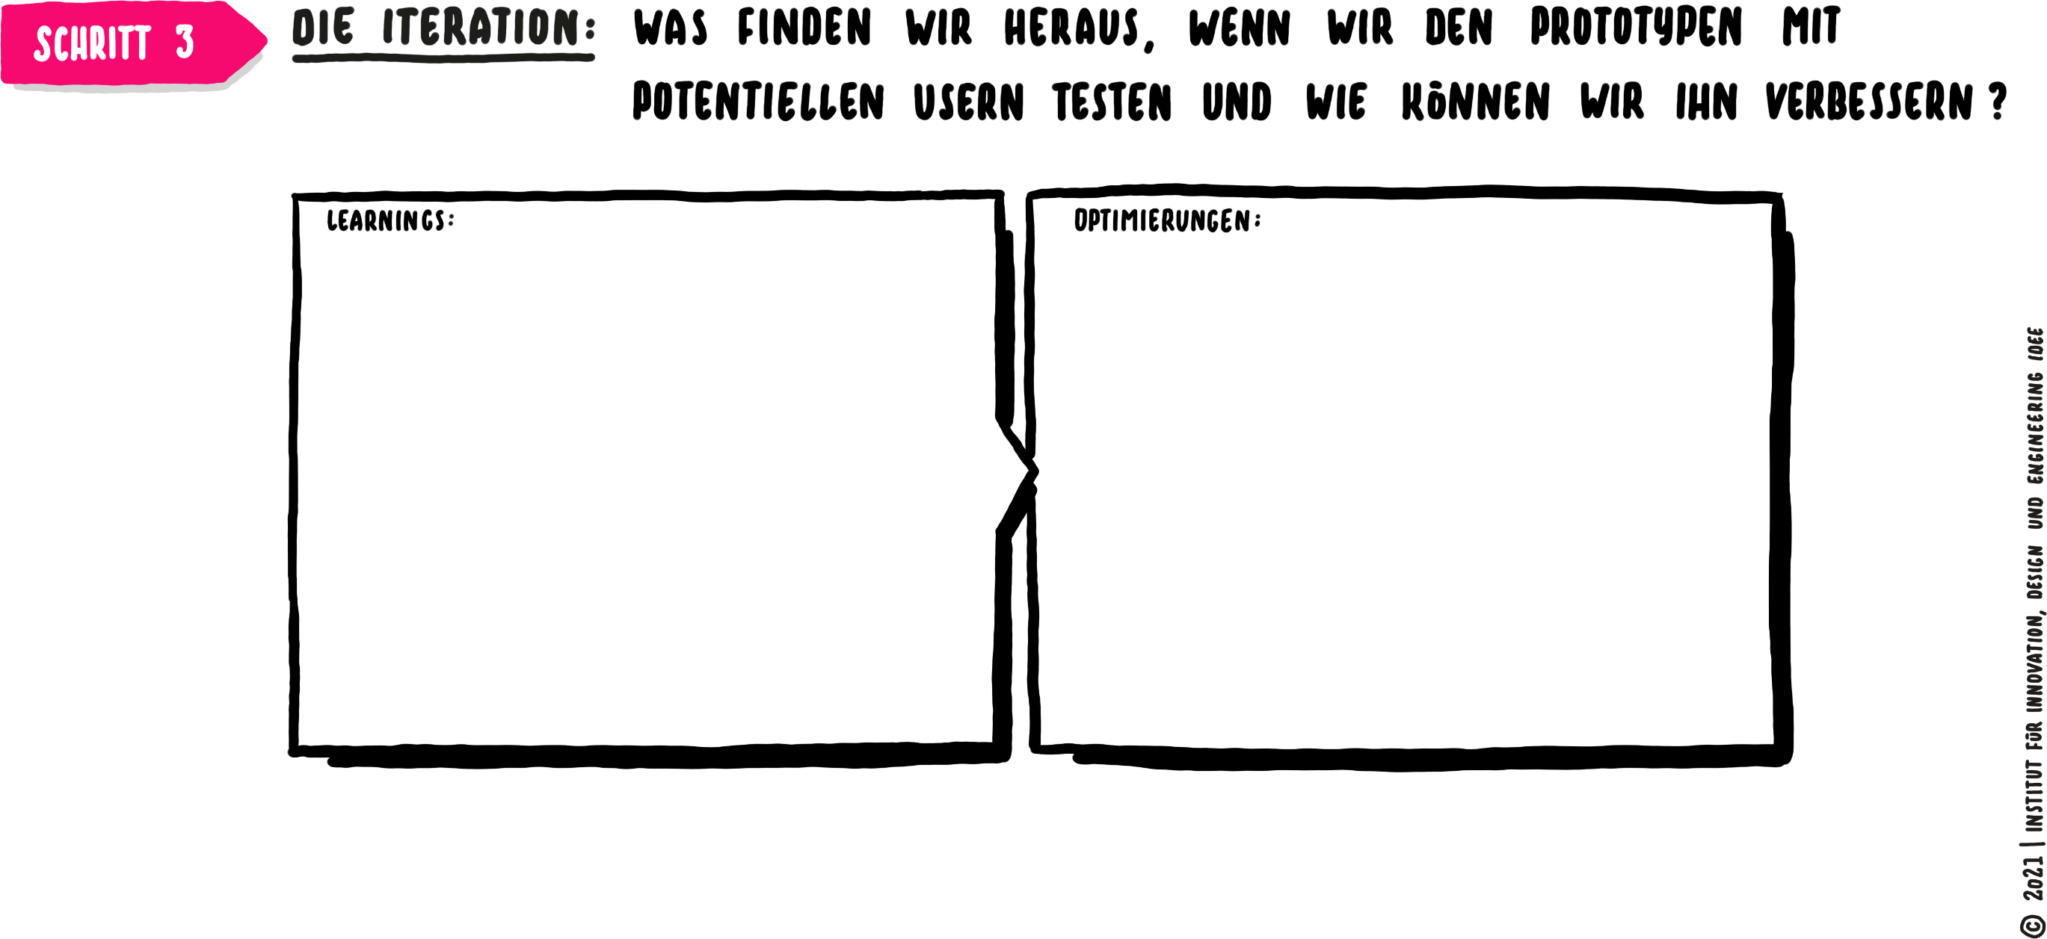
Design Thinking Play Sprint: Iteration
Abschliessend wird in dieser Phase der Prototyp getestet und aufgrund der gewonnenen Erkenntnisse beziehungsweise Learnings optimiert. Dieser Schritt wird im Sinne eines Loops so oft wiederholt bis ein akzeptables Endergebnis entwickelt wurde.

Slide 27
Mensch-zentrierte Automatisierungsprozesse

Slide 28
Automatisierungsprozesse
In der Praxis finden sich unterschiedliche Arten von Automatisierungsprozessen. Sechs häufig anzutreffende Formen sind folgende:
Workflow-Automatisierung / Business Process Management
End-to-End-Prozesse werden durch Software orchestriert, standardisiert und transparent gemacht. So lassen sich komplexe Abläufe über Abteilungs- und Systemgrenzen hinweg effizient steuern.
IT- und Infrastruktur-Automatisierung
IT-Tasks wie System-Deployments, Monitoring oder Backups werden automatisiert, um Geschwindigkeit, Stabilität und Sicherheit in DevOps- und Cloud-Umgebungen zu erhöhen.
Robotic Process Automation
Software-Roboter übernehmen regelbasierte, wiederkehrende Aufgaben in digitalen Prozessen, indem sie wie ein Mensch mit Anwendungen interagieren. Besonders geeignet für Backoffice-Prozesse mit klaren Regeln.
Industrielle Automatisierung
Maschinen, Roboter und IoT-Sensoren steuern Produktions- und Logistikprozesse automatisch. Ziel ist eine hohe Präzision, Produktivität und Echtzeitreaktion in industriellen Umgebungen.
Conversational Automation
Chatbots und Sprachassistenten automatisieren den Kundendialog und interne Anfragen. Sie bieten Self-Service und entlasten Support-Teams von Standardanfragen.
KI-gestützte Automatisierung
Durch die Kombination von RPA, Machine Learning und KI können auch unstrukturierte Daten verarbeitet werden. Damit lassen sich komplexere Aufgaben automatisieren, die bisher menschliches Urteilsvermögen erfordert haben.

Slide 29
Automatisierungsprozesse & Design Thinking
Design Thinking kann auf unterschiedliche Art und Weise zur Entwicklung der einzelnen Automatisierungsprozesse angewendet werden. Im folgenden werden pro Automatisierungstyp konkrete Vorgehensideen skizziert
Robotic Process Automation
Software-Roboter übernehmen regelbasierte, wiederkehrende Aufgaben in digitalen Prozessen, indem sie wie ein Mensch mit Anwendungen interagieren. Besonders geeignet für Backoffice-Prozesse mit klaren Regeln.
Empathie: Welche repetitiven Tätigkeiten belasten Mitarbeitende am meisten?
Ideation: Wie könnte ein Bot diese Arbeit so übernehmen, dass Mitarbeitende entlastet, aber nicht entmündigt werden?
Test: Prototypische Bot-Skripte mit Endanwender:innen prüfen, ob sie wirklich den Alltag erleichtern.

Slide 30
Automatisierungsprozesse & Design Thinking
Design Thinking kann auf unterschiedliche Art und Weise zur Entwicklung der einzelnen Automatisierungsprozesse angewendet werden. Im folgenden werden pro Automatisierungstyp konkrete Vorgehensideen skizziert
Workflow-Automatisierung / Business Process Management
End-to-End-Prozesse werden durch Software orchestriert, standardisiert und transparent gemacht. So lassen sich komplexe Abläufe über Abteilungs- und Systemgrenzen hinweg effizient steuern.
Empathie: Welche Medienbrüche, Wartezeiten oder Frustrationen erleben Nutzer:innen im Prozess?
Definition: User Journey des Gesamtprozesses visualisieren
Ideation & Test: Lösungen entwickeln, die nicht nur effizient sind, sondern auch Transparenz und Kontrollmöglichkeiten für Mitarbeitende bieten.

Slide 31
Automatisierungsprozesse & Design Thinking
Design Thinking kann auf unterschiedliche Art und Weise zur Entwicklung der einzelnen Automatisierungsprozesse angewendet werden. Im folgenden werden pro Automatisierungstyp konkrete Vorgehensideen skizziert
IT- und Infrastruktur-Automatisierung
IT-Tasks wie System-Deployments, Monitoring oder Backups werden automatisiert, um Geschwindigkeit, Stabilität und Sicherheit in DevOps- und Cloud-Umgebungen zu erhöhen.
Empathie: IT-Teams und Endnutzer:innen einbeziehen: Welche Ausfälle oder Verzögerungen stören am meisten?
Ideation: Ideen für Automatisierungen entwickeln, die Sicherheit UND Bedienbarkeit verbessern.
Prototyping & Test: Automatisierte Skripte in Sandbox-Umgebungen gemeinsam testen.

Slide 32
Automatisierungsprozesse & Design Thinking
Design Thinking kann auf unterschiedliche Art und Weise zur Entwicklung der einzelnen Automatisierungsprozesse angewendet werden. Im folgenden werden pro Automatisierungstyp konkrete Vorgehensideen skizziert
Industrielle Automatisierung
Maschinen, Roboter und IoT-Sensoren steuern Produktions- und Logistikprozesse automatisch. Ziel ist eine hohe Präzision, Produktivität und Echtzeitreaktion in industriellen Umgebungen.
Empathie: Arbeiter:innen in der Produktion oder Logistik beobachten – wo gibt es Belastungen (z. B. Monotonie, Gefährdung, Ergonomie)?
Ideation: Automatisierungsideen gemeinsam entwickeln, die Sicherheit und Arbeitserleichterung priorisieren.
Prototyping & Test: Kleine Pilotzellen oder digitale Zwillinge nutzen, um neue Lösungen im realen Umfeld erfahrbar zu machen.

Slide 33
Automatisierungsprozesse & Design Thinking
Design Thinking kann auf unterschiedliche Art und Weise zur Entwicklung der einzelnen Automatisierungsprozesse angewendet werden. Im folgenden werden pro Automatisierungstyp konkrete Vorgehensideen skizziert
Conversational Automation
Chatbots und Sprachassistenten automatisieren den Kundendialog und interne Anfragen. Sie bieten Self-Service und entlasten Support-Teams von Standardanfragen.
Empathie: Kund:innen oder Mitarbeitende fragen: Welche Fragen/Anliegen treten häufig auf? Wo fühlen sie sich durch bisherige Systeme nicht verstanden?
Definition & Ideation: Personas und typische Dialog-Szenarien entwickeln.
Prototyping & Test: Prototypische Dialog-Flows im Rollenspiel oder mit Click-Dummies erproben.

Slide 34
Automatisierungsprozesse & Design Thinking
Design Thinking kann auf unterschiedliche Art und Weise zur Entwicklung der einzelnen Automatisierungsprozesse angewendet werden. Im folgenden werden pro Automatisierungstyp konkrete Vorgehensideen skizziert
KI-gestützte Automatisierung
Durch die Kombination von RPA, Machine Learning und KI können auch unstrukturierte Daten verarbeitet werden. Damit lassen sich komplexere Aufgaben automatisieren, die bisher menschliches Urteilsvermögen erfordert haben.
Empathie: Welche Entscheidungen oder Auswertungen sind für Nutzer:innen komplex, zeitraubend oder fehleranfällig?
Definition & Ideation: Klarstellen, wo KI sinnvoll unterstützt, und wo menschliches Urteil unverzichtbar bleibt.
Prototyping & Test: KI-Prototypen (z. B. Dokumentenklassifizierung) in realen Workflows evaluieren, Nutzerfeedback sammeln und Vertrauensfragen klären.

Slide 35
Anwendung

Slide 36
Anwendung
Versuchen Sie die erlernten Methoden und Vorschläge an einem konkreten, selbstgewählten Beispiel anzuwenden. Gehen Sie dabei wie folgt vor:
(1) Suchen Sie sich einen Bereich bzw. ein Thema aus, das Sie genauer untersuchen möchten.
(2) Definieren Sie ein relevante Nutzendengruppe und entwickeln Sie eine Persona dafür.
(3) Halten Sie die aktuelle User Journey mit den unterschiedlichen Berührungspunkten und Handlungen fest.
(4) Identifizieren Sie die wichtigsten Pain und Gain Points.
(5) Benennen Sie das Kernproblem, identifizieren Sie eine geeignete Automatisierungsart, öffnen Sie den Lösungsraum und suchen Sie nach Ideen. Nutzen Sie dazu auch die Vorschläge zu den einzelnen Automatisierungsarten.
(6) Bauen Sie einen Prototypen, testen Sie diesen und optimieren Sie diesen entlang der gewonnenen Erkenntnisse.

Slide 37
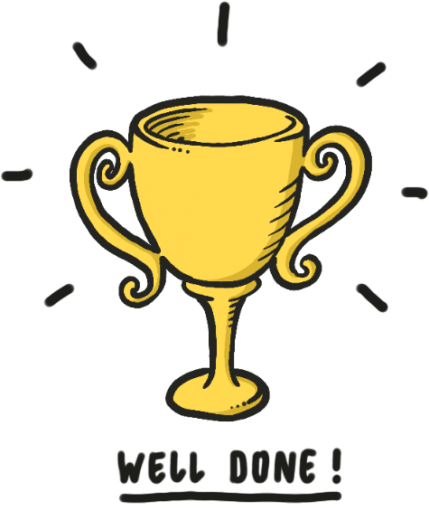
Herzliche
Gratulation!
Sie haben Ihr Ziel erreicht.

