Slide 1

Digital Manufacturing
Ex04 – Cloud Computing
Lukas Kretschmar, MSc FHO in Engineering (ICT & BEP)
Industrial Engineering (OST-RJ)

Slide 2

Digital Manufacturing
Create physical and virtual Assets
Send Sensor Data to the Cloud
Receive Machine Data on your Asset
Create a Dashboard for your Mock Machine (Raspberry Pi)
  Visualize the Temperatures
  Layout your Tiles

Slide 3

Create your Account for Siemens MindSphere
Preparation

Slide 4
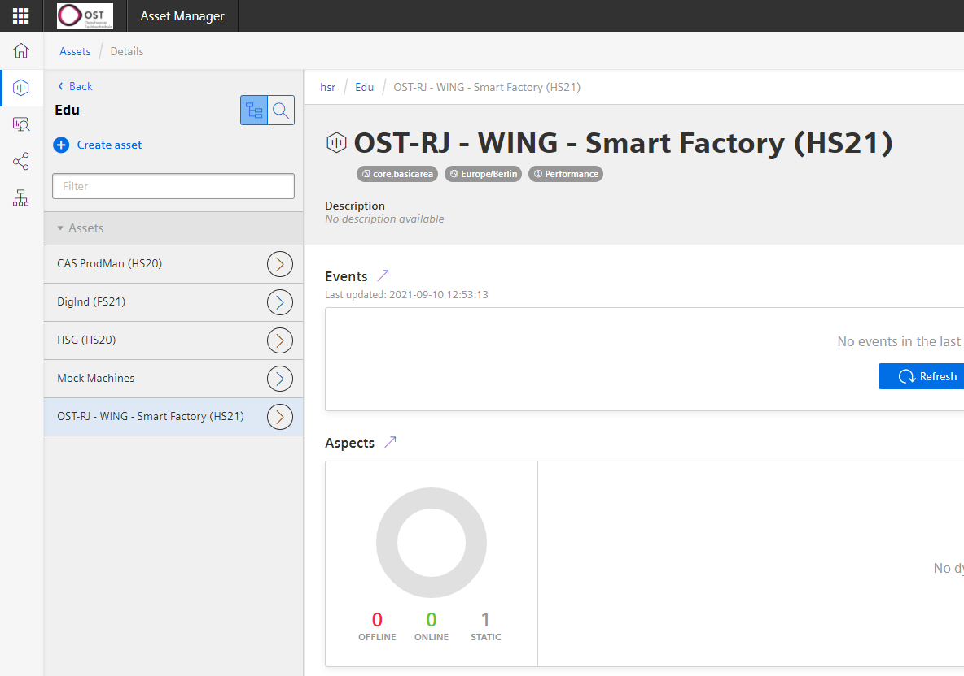
Create your Siemens MindSphere Account
Creating MindSphere Account
In this exercise, you will send your sensor data to the cloud
You'll use Siemens MindSphere as cloud platform
And to do so, you’ll need to create an account to work with the platform
You have received an e-mail from Siemens with a link to create an account
Just follow the steps to create your login

Slide 5
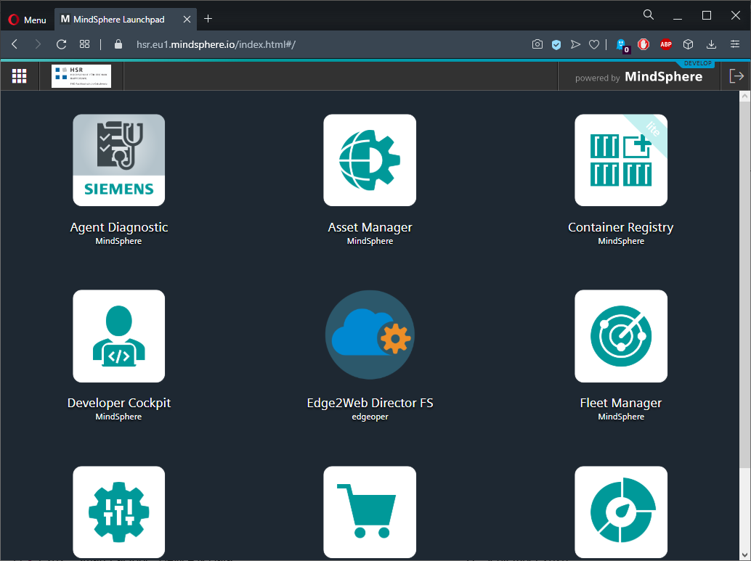
Test your Login
Creating MindSphere Account
After creating the account, test your login to be ready for the exercise
Just use the following link, and if you see the page below, it worked
  https://hsr.eu1.mindsphere.io
  Your page may look different (fewer icons)

Slide 6
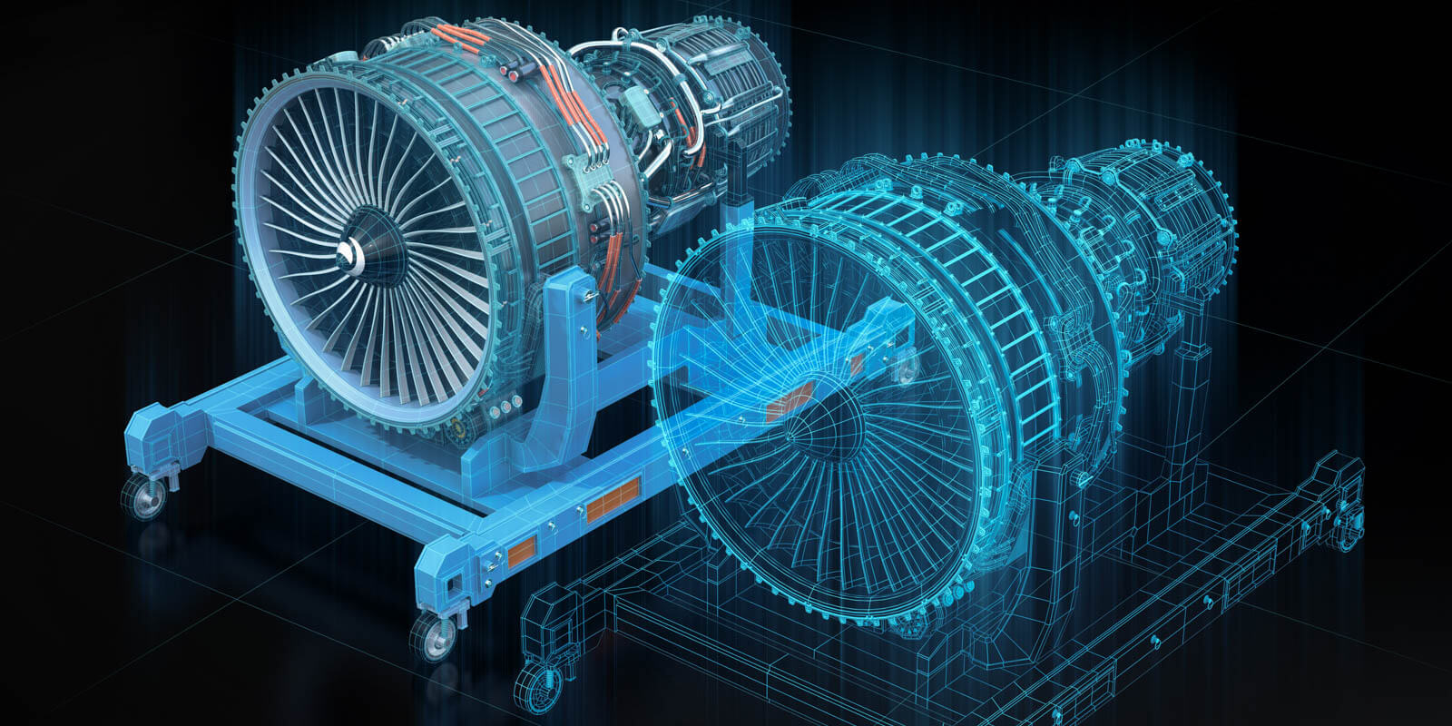
Physical Asset
Get your Digital Twin up and running (Part 1)

Slide 7
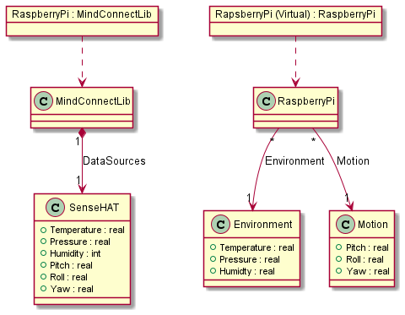
Physical Asset
Physical Asset

Slide 8
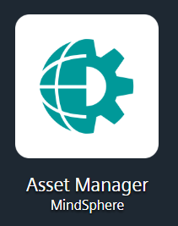

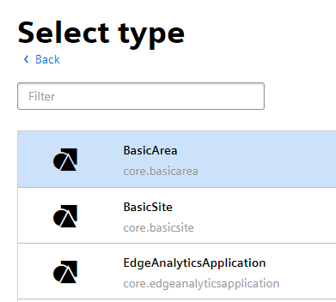

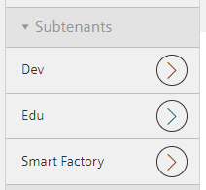
Create an Asset for your Assets
Physical Asset
Login to MindSphere
https://hsr.eu1.mindsphere.io
Open the Asset Manager
Open the Asset list
Navigate to the course asset
Edu > DIMA (HS21)
Create a new child asset (top right corner)
Select BasicArea as type and click Create (bottom right corner)
Enter your name as
the assets name
You should now see
your asset in the
asset list on the left

Slide 9
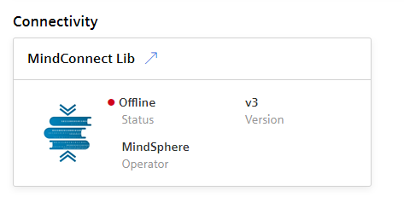
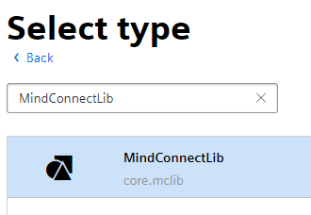
Create your physical Asset
Physical Asset
Select your created asset
Again, create a child asset
but this this time it must be of
type MindConnectLib
Give it the name Raspberry Pi [Nr of RPi]
e.g. Raspberry Pi 42
You'll see your asset in the list on the left
Select your created MindConnectLib asset
On the bottom of the left side, you'll find a Connectivity group
Click the arrow in the box's heading

Slide 10
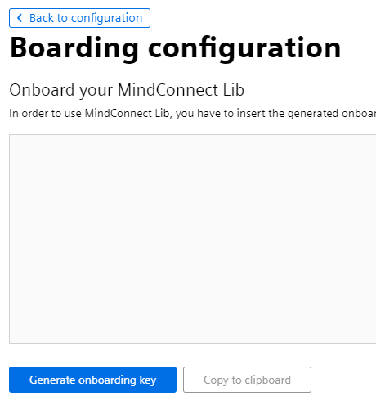
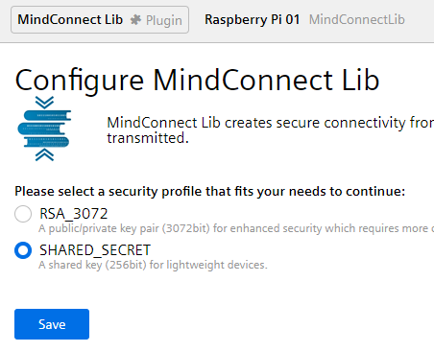
Configure your MindConnectLib Asset
Physical Asset
The first time you open a MindConnectLib asset, you'll get redirected to the configuration screen
Select SHARED_SECRET
  A shared secret is something your asset and your Raspberry Pi will know, so it can identify itself within the MindSphere platform when sending data
Click save to
get to the next view
On the next screen, click Back to configuration

Slide 11

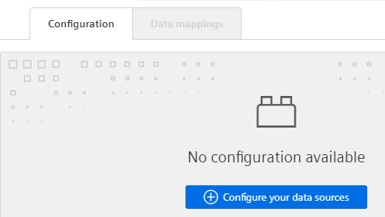
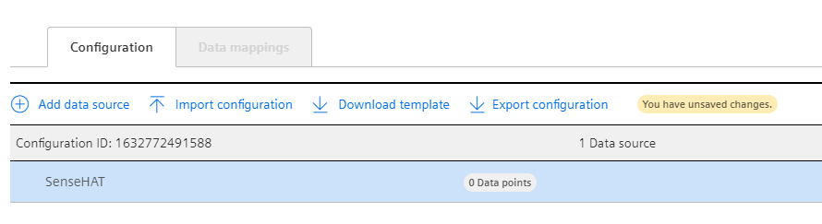
Create your Data Source
Physical Asset
Create a new configuration
Add a new data source,
give it a meaningful name
(e.g. SenseHAT) and click Accept
  A data source just groups your data points and has no further meaning

Slide 12
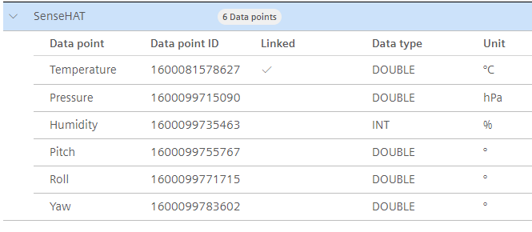

Create your Data Points
Physical Asset
For each variable you used in the last exercise (temperature, pressure, humidity, etc) do the following steps
  Click Add data point
  Enter a meaningful name
  Choose a type according to the data that will be sent
  Define a unit
    Units are used later in data point mappings
When completed, save your changes
When completed, your data source should look like below
You have successfully prepared your physical asset in MindSphere
Next, you'll complete the configuration on your Raspberry Pi

Slide 13

Send Data to the Cloud
Fire and forget

Slide 14

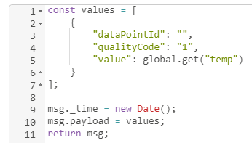
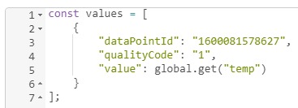
Update the existing Content
Send Data to the Cloud
Open Node-RED
Switch to the MindSphere flow
Open the MindSphere Objects node
You'll find the following code
Go to your data source on MindSphere, to get the data point id
Copy the value and paste it to your property in the flow

Slide 15
Value must be string
Send Data to the Cloud
To avoid any troubles later in the exercise, please note the following
  Values sent to MindSphere MUST be of type string (text)
  It doesn't matter what data type you'll use on the cloud, when sending, it must be string
In the example, the global variable temp contains a string
  The toFixed() method stores the value as string
For your code, this might be relevant
  The easiest way for you is to use the toFixed() method every time you want to send a value

Slide 16
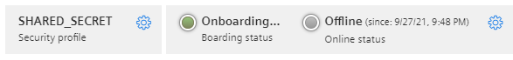
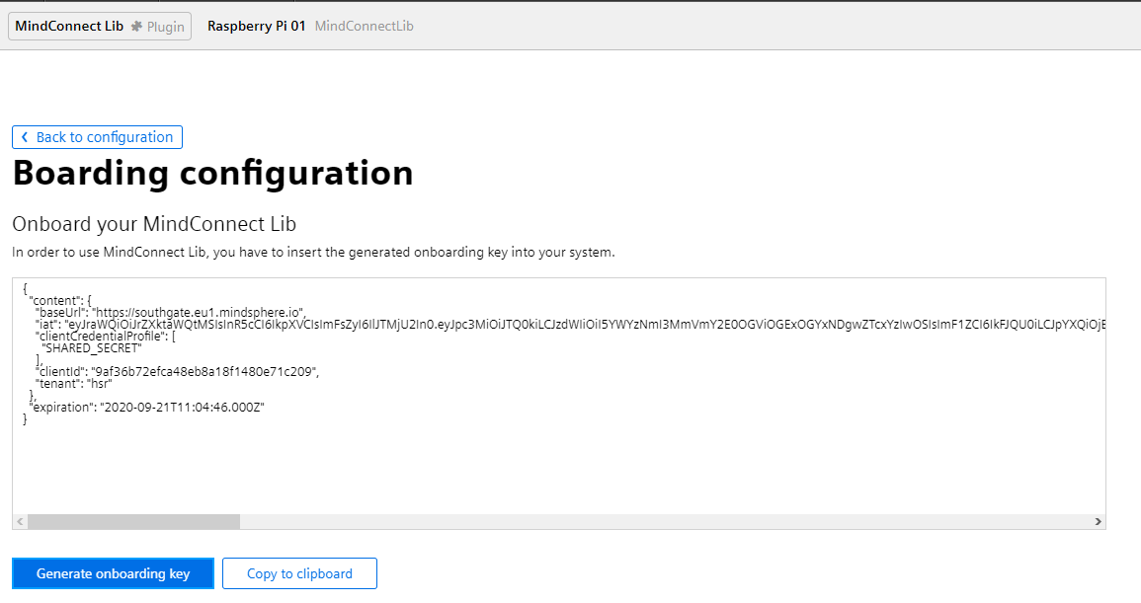
Generate the Secret used for Communication
Physical Asset
On the top right corner, open the onboarding menu
Click Generate onboarding key
In the field above the button, the secret – in the form of a JSON object – will be shown

Slide 17

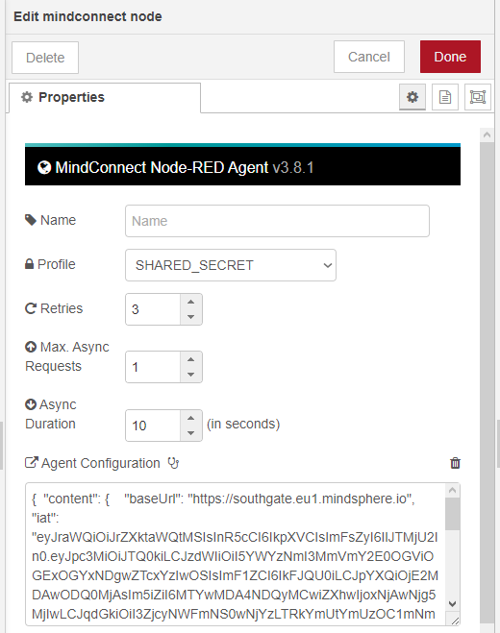
Configure your MindConnect Node
Physical Asset
Click Copy to clipboard (or select all the content within the field and copy it)
Open your Node-RED webpage
Switch to the MindSphere flow
Select the MindConnect node
Paste the key
into the field
You have
successfully
configured your
node

Slide 18

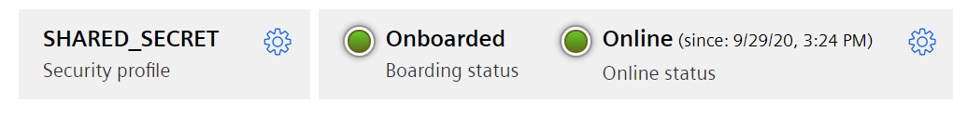

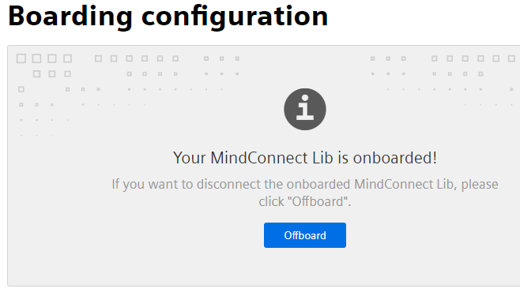
Deploy the Update
Send Data to the Cloud
Let's check if your changes were successful
Deploy the changes you made in Node-RED
After a while, you're MindConnect node should change
  From
  To
If you still have errors, please check
  Is the data point id correct
  Is the shared secrete still set
Important
  Sometimes, the node will still show errors
  In this case, create a new shared secret on MindSphere and replace it in the MindConnect node

Slide 19
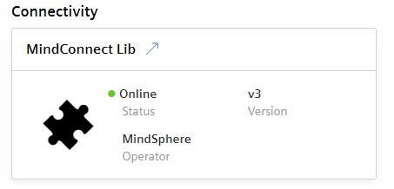

Check if Data is received
Send Data to the Cloud
Physical Asset
MindConnectLib
Navigate to your physical asset in the Asset Manager
Select your physical asset
You should see that the state is Online
You can also open the MindConnectLib type
On the top right corner, you should see the following information
Device has sent data once
Device is currently sending data

Slide 20
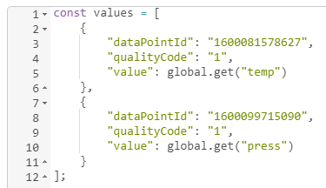
Extend your Data
Send Data to the Cloud
Being able to send the temperature to the cloud, let's extend the object to send the other data as well
  Add the pressure to the data object
  Deploy the flow again to check if it still works
Repeat it for humidity, pitch, roll and yaw
Please note
  Always deploy your flow after each change so you are sure your code works as expected
    Debugging an error isn't easy
  If you run into an issue
    Double check your data point id
      Using the same id twice (copy/paste error) will result in an error
    Check if you have the objects in the array separated with commas
    Check if the last entry has no comma
      Entries in an array or properties in an object MUST NOT end with a comma

Slide 21
Virtual Asset
Get your Digital Twin up and running (Part 2)

Slide 22
Virtual Asset
Virtual Asset

Slide 23
Steps to create a virtual Asset
Virtual Asset
Compared to the physical asset, a virtual asset is a bit more complex to create
  We have to define the type ourselves first
  And then we can create the asset
Creating a virtual asset requires the following steps
  Creating aspects
  Creating a type
  Creating the asset
Please note
  The terms and distinction between aspects and types is MindSphere specific
  Other platforms may use other names, but the concepts used will be the same

Slide 24

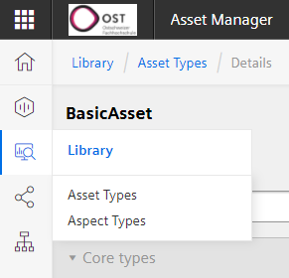
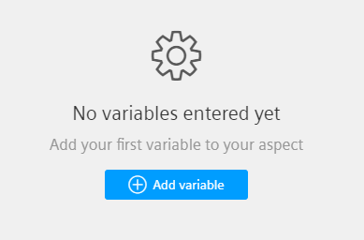
Creating an Aspect
Virtual Asset
An aspect is the building block of types
  It contains variables which will be used to map on the data points of physical assets
Aspects are here for reusability
  You can understand aspects as groups of variables
  Used wisely, you don't
  have to redefine
  variables multiple times
Open the Aspects view in the Asset Manager
Click Create aspect
Enter a name according the following
pattern:
Edu_[YourFullName]_Environment
e.g.: Edu_DoeJohnny_Environment
Click Add variable
Add the variables for … at the bottom
  Temperature
  Pressure
  Humidity
Save your aspect

Slide 25

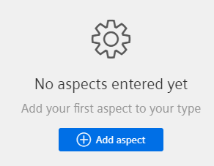
Creating a Type
Virtual Asset
A type is the base for your assets
  The type is an abstract definition what variables (within aspects) will appear together
  Multiple assets can use the same type, imagine it as a blueprint
Like aspects, types are here for reusability
Open the Types view in the Asset Manager
Create a new type
Enter the name with the following
pattern:
Edu_[YourFullName]_RaspberryPi
e.g.: Edu_DoeJohnny_RaspberryPi
Open the Aspects group
Click Add aspect
Give the meaningful
name and select your
aspect
Save your type

Slide 26

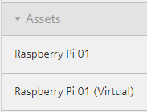
Create your virtual Asset
Virtual Asset
Now it's time to create your virtual asset
Open the Assets view in the Asset Manager
Navigate to your assets
Click Create asset
Filter for your type Edu_[YourFullName]_RaspberryPi
Select the type and click Create
Give your asset a name
We suggest Raspberry Pi [Nr] (Virtual)
Click Save to create your asset
Your virtual asset is now visible in your list on the left
Create before
Created now

Slide 27

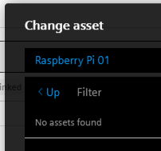
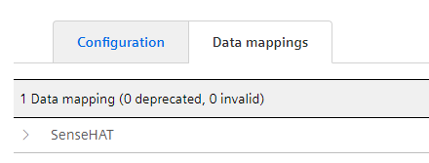
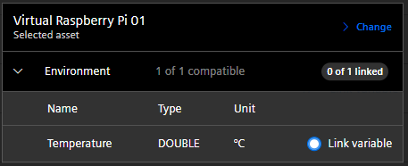
Mapping your virtual Asset on your physical Asset
Virtual Asset
Select your physical asset in the Asset Manager
Open the MindConnectLib
Switch to the Data mappings tab
Open your data source (e.g., SenseHAT)
Select Link variable (on the right side of a data point)
A view will open pointing to the current data point
Click > Change to navigate to your virtual asset
In the Change asset dialog, click < Up
Select your virtual asset
and click Accept
Select Link variable for your data point
  You'll only see variables that are compatible in type and unit
Click Accept

Slide 28
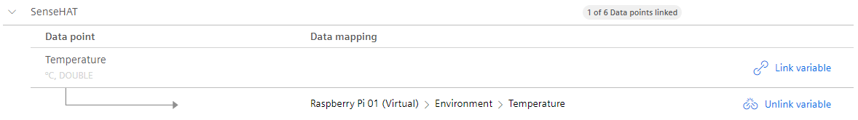
Complete your virtual Asset and the Links
Virtual Asset
You should now see that your data point is link with your variable
  With Unlink variable you can remove the link between a data point and a variable
Now, do the mapping for all the other data points
  Add also the missing aspect
  And extend your type of the virtual asset

Slide 29
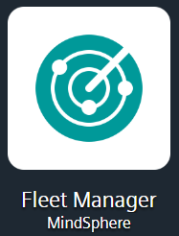
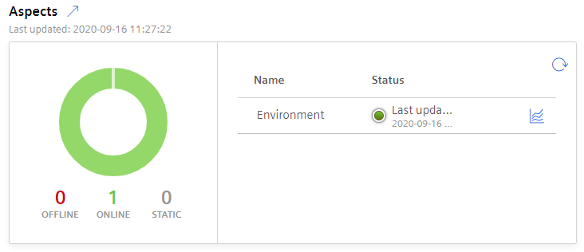
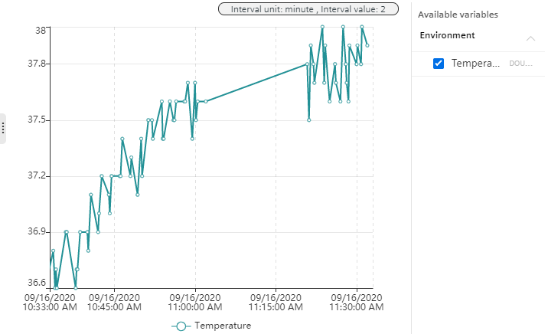
Check if Data is received
Virtual Asset
On your virtual Asset
In the Fleet Manager
Select your virtual asset in the Asset Manager
You should see the following in the details
  You can also open a simple time series visualization of the received data
Open the Fleet Manager
Search for your virtual asset
Select your asset
Choose Time Series
Select the variables
on the right side
that you want to
see the data from

Slide 30

Machine Data in the Cloud
Let's have some Fun with real Data

Slide 31
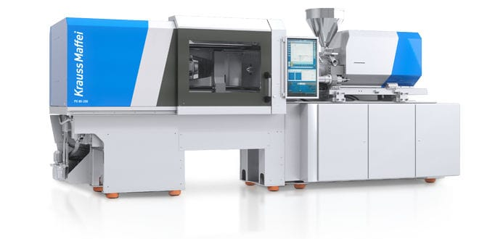
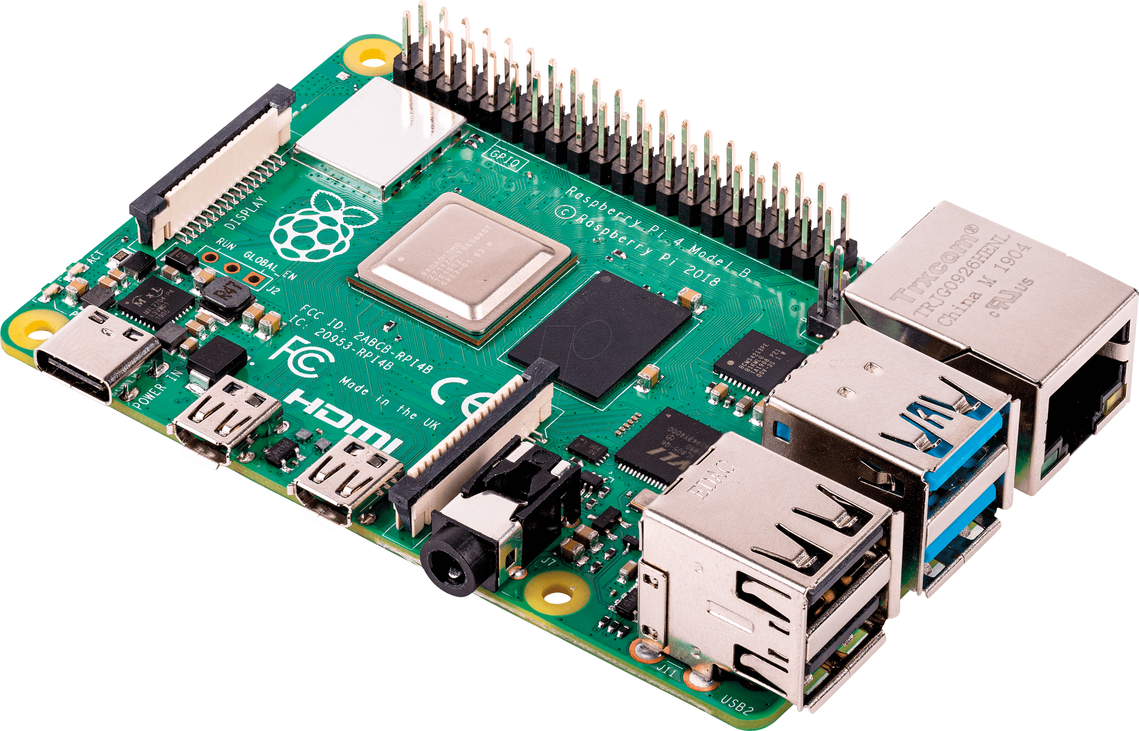
The Scenario
Machine Data in the Cloud
Your Raspberry Pi is actually a mock machine
  It contains data of real production cycles collected on a Krauss Maffei PX 120-038
  When it has power and configured, it will send data between 07:30 and 20:30 every day
With the next steps, you'll prepare your Raspberry Pi and MindSphere to send and receive this data
  This is a preparation for the next exercise
In the next exercise, there will be another Raspberry Pi that will send more data of the same production cycle to get the full scenario
Your Raspberry Pi
  Sending 2 Data Points
Other Raspberry Pi
  Sending 20+ Data Points

Slide 32
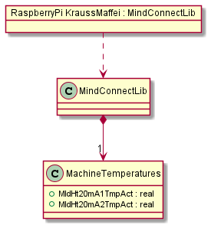
Create your physical Asset
Machine Data in the Cloud
Your Raspberry Pi is prepared to send real machine data to the cloud
In this part of the exercise, you'll complete what's needed so the data from your Raspberry Pi reaches MindSphere
First, define a physical asset according to the definition on the right side on MindSphere
Data points are
  MldHt20mA1TmpAct (°C)
  MldHt20mA2TmpAct (°C)

Slide 33
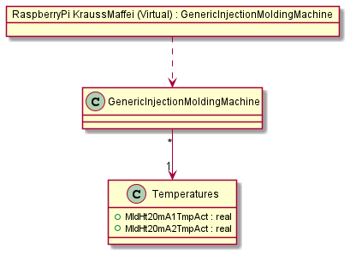
Create your virtual Asset
Machine Data in the Cloud
We have already prepared the aspects and types for your virtual asset
Create a new virtual asset, using the type GenericInjectionMoldingMachine
  We’ve already prepared the type containing the aspect with the two variables
  You just have to use this type
Link the data points of your physical asset with the variables of your newly create virtual asset
Type already exists

Slide 34
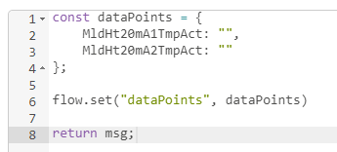
Prepare your Raspberry Pi
Machine Data in the Cloud
Your Raspberry Pi comes prepared with real machine data
Switch to the Machine flow
Here, you'll find a quite complex logic
  It basically reads machine data from a list of files
  And sends it to MindSphere
  Every file represents a full production cycle
Feel free to check the logic
  But you don't have to change anything
  Just the two points on the right side
Define your data points in the Configure MindSphere node
  Don't change the names, just assign the data point ids
Get the MindConnect node to work
  Enter your shared secret

Slide 35
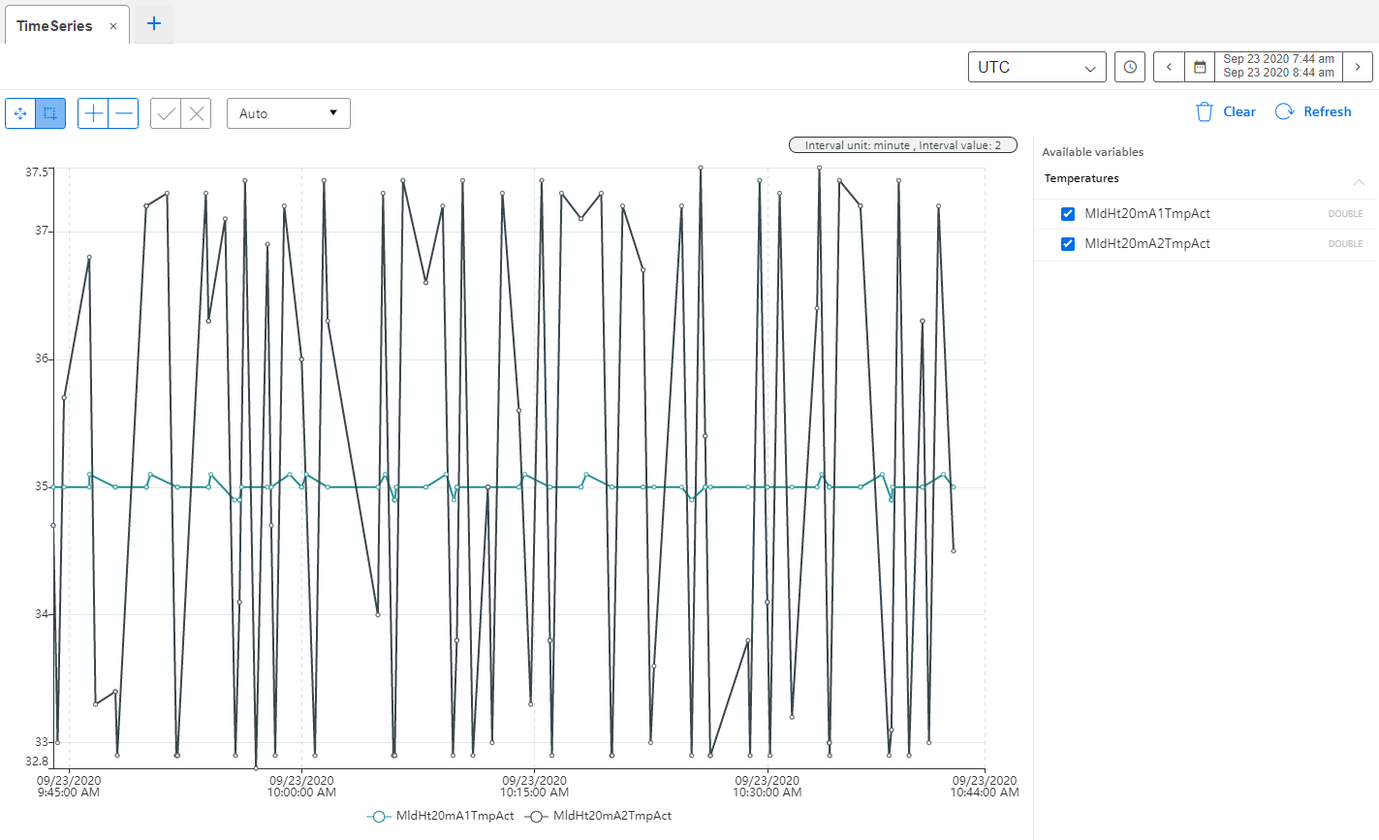
Test your Work with the Fleet Manager
Machine Data in the Cloud
Open the Fleet Manager
Check if you receive data
  It may take a while until you see data points

Slide 36
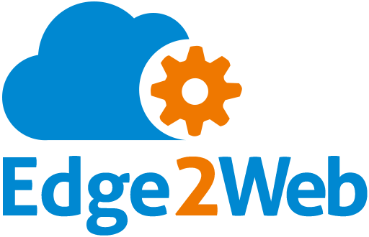
Edge2Web
Data Viz made easy, well, kinda…

Slide 37
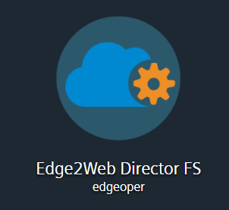
What is Edge2Web
Edge2Web
https://hsr.eu1.mindsphere.io
A simple way to
  Visualize data
  Build your own dashboard
It offers building blocks to define your logic
  But is JavaScript-based and can run custom code
It's integrated into the Siemens MindSphere

Slide 38


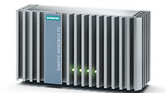
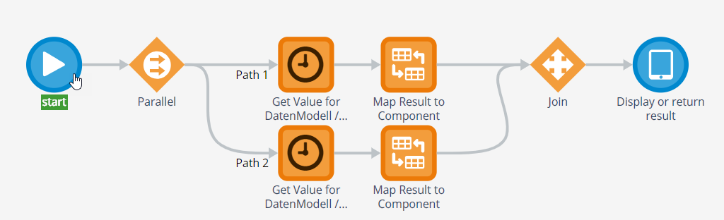
Overview
Edge2Web
API
Data Lake
Asset ID: 123456789
Aspect: Aspect 1
Variable: Variable 1
Variable 2
…
Designer
Test
Runtime
Flow

Slide 39
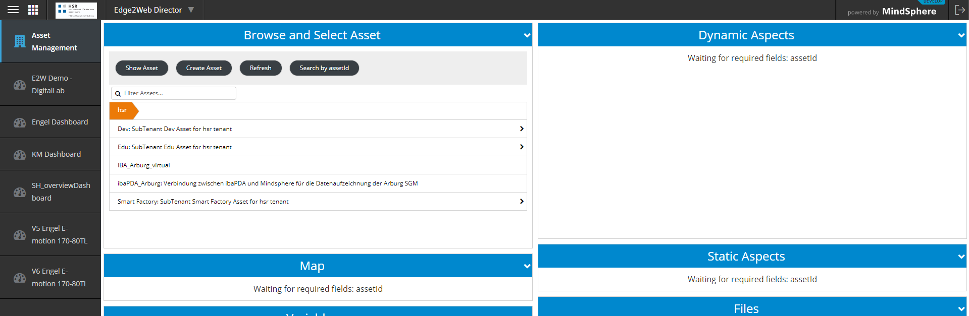
The Asset Management
Edge2Web
A simple visualization of your asset

Slide 40
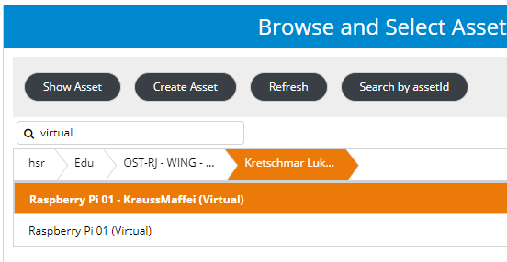
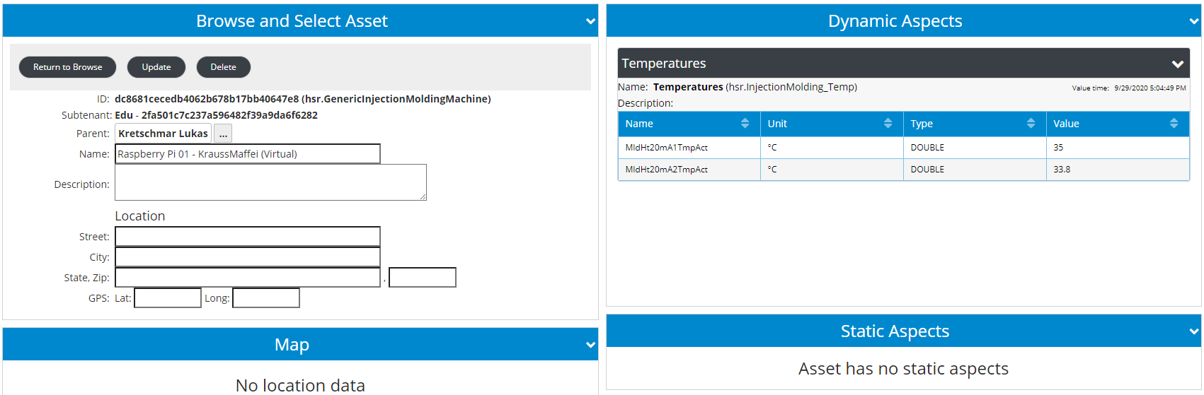
Using the Asset Management
Edge2Web
Navigate to your Asset
Click Show Asset to see details
  You can navigate back with Return to Browse
Your Asset's id that is needed to access it

Slide 41
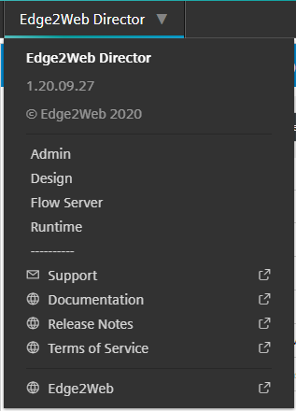
How to switch between Views
Edge2Web
Click on Edge2Web Director
  A detail view will open
Click on the view you want to open
  The default is Runtime

Slide 42
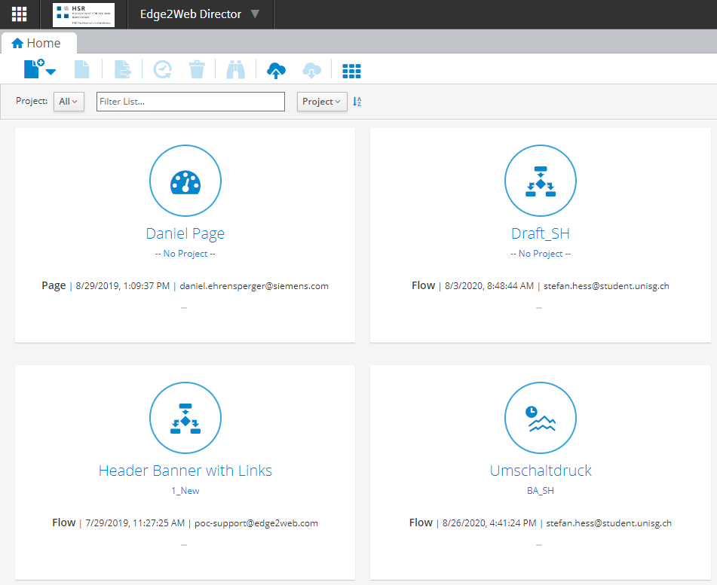
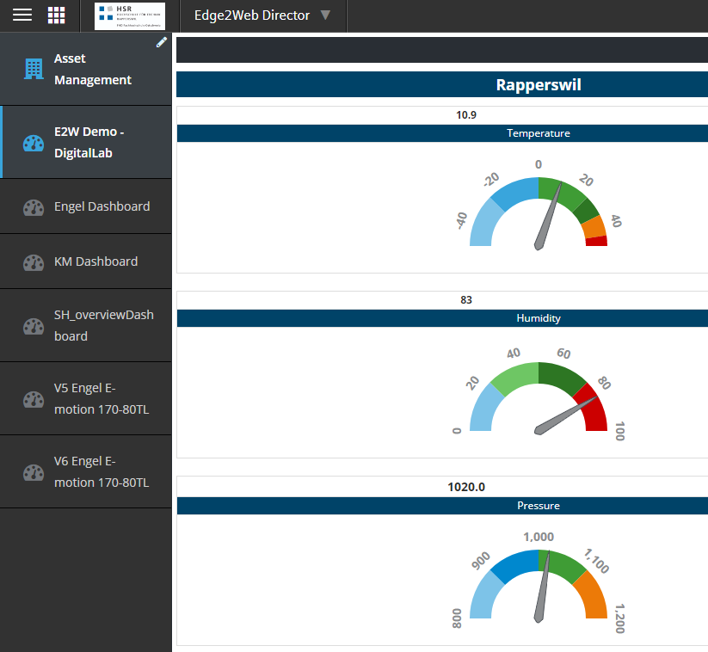
The two relevant Views for you
Edge2Web
Design
Runtime
Used to create all your components
Used to view your dashboards

Slide 43

The two relevant Types for you
Edge2Web
Page
Flow
Defines the layout
Is your dashboard
Get data from an asset
Can manipulate data
Defines how data is visualized
Can also be as simple as a heading
  Contains no actual logic

Slide 44
Naming Patterns
Edge2Web
IMPORTANT
Names must be unique through the whole application
  And you cannot change the name after your page/flow was created
Please use the following naming patterns
Project
Page & Flow
Edu_OST-HS21_[Lastname][Firstname]
  E.g. Edu_OST-HS21_DoeJohnny
Edu_OST-HS21_[Nr]_[Name]
  Nr = The number of your Raspberry Pi
  Name = The name of your component
    You are free in choosing the name
Please follow these patterns, otherwise you might run into naming conflicts
And you make our work easier when we have to clean up

Slide 45

Create a Dashboard
Getting started

Slide 46

A new Dashboard
Create a Dashboard
Create a new Page
Use a project name with the following pattern
  Edu_OST-HS21_[Lastname][Firstname]
  e.g. Edu_OST-HS21_DoeJohnny
  Please always use this for all your components in E2W
Define a name for your dashboard
Choose a layout at your discretion
  At the end, you need to show 6 tiles

Slide 47

The new Dashboard
Create a Dashboard
Properties of selected Component or Page
Toolbar
Layout/Dashboard

Slide 48

The Toolbar
Create a Dashboard
Show/hide properties
Customize layout
Save changes
Test page/flow
Save as new page/flow
Change layout

Slide 49


Make it visible in the Runtime View
Create a Dashboard
Enter the label that should be shown
Set the checkbox to Display in Menu
Save the changes
Switch to the Runtime
  Your dashboard should be
  listed here

Slide 50


Add a Heading
Create a Dashboard
Switch to the Design view
Select your project in the dropdown
Add a new Flow
Enter a name
Click Ok
  A new tab will be opened
Select the End node
  The Properties view will change and show you an editor
  Move on to the next slide
At the end, it will look something like that

Slide 51



Editor
Create a Dashboard
Switch between edit mode and preview
You are completely free in defining your heading
  The tools should be self explanatory
You can get the heading from the previous slide by applying the following steps
  Create a table with a single cell
  Click into the cell to open the
  context menu
  Choose a background color
  Enter the text
  Format the text as
  bold, centered, white
  and change the size
    You can also change the type to Heading 1 if you want
  Save your changes
Tools
Structure/Preview of your Visualization

Slide 52


Tag your Flows
Create a Dashboard
To find your components easier later, you can set tags on your flows
You can do this with the following steps
  Select the Start node
  Click into the Tags filed in the properties view
  Select an existing tag or enter a new one

Slide 53



Add a Component to your Page
Create a Dashboard
Switch back to your dashboard
Click on the cell you want
to add your heading to
A menu will open where you can add a new component or select an existing one
  If you have tagged your flow, you can open the tag from the menu and look for your flow
  Otherwise, you can go to All Components and search for your flow
Drag & drop your component to the cell you want to have it
Save your changes

Slide 54

Visualize the Temperature
Let's turn up the Heat!

Slide 55

Create the Flow
Visualize the Temperature
In this step, you'll visualize a single value
Create a new flow
Click on the Start step
Click on Append Step to insert a new step
  An orange step will be added in between the Start and End steps
In the properties view, change the name to something meaningful (e.g. Get Temperature)
Change the Step Type to Call
Select MS3CurrentValueInternal$ as Flow
Go to the next slide

Slide 56


Add Parameters to your Flow
Visualize the Temperature
You see that the selected flow expects some input parameters and will return some results
You now have to define these variables in our flow so you can provide their values to the flow
Select the Start node
Select the + next to Fields
  A new entry gets populated
Name the field assetId, change the usage to Input and select the checkbox to mark it as required
Repeat the previous steps for the following fields as well
  aspect (Input, String, required)
  variable (Input, String, required)
  options (Input, Object)
  result (Temp, Number)

Slide 57

The Flow Parameters
Visualize the Temperature
Your fields should now look like

Slide 58


Set default Options
Visualize the Temperature
Click on the … to open the options dialog
In the dialog, define the following object
  Ensure that you select Expression on the top
Close the dialog
  You should see your defined object in the Initialize column

Slide 59


Configure the Call Step
Visualize the Temperature
Select the Call step you added previously
Click the + next to Inputs
Define the mappings as follows
  On the left-hand side are your input parameters you defined in the previous step
  On the right-hand side are the input parameters the Flow of the Call step expects
Click on the + next to Outputs
Define the mappings as follows
  On the left-hand side are the output variables of the Call step
  On the right-hand side are your fields you specified in the previous step
Note on options
  The object we defined in the previous step defines that the value returned by the Call step must be within an interval of the last 60 seconds
  Otherwise, the returned value will be empty

Slide 60



Defining the Visualization
Visualize the Temperature
Select the End step
Add a table with 3 rows
Select the first row
Enter Current value of
Click on Insert Field
Select variable
  A dialog will open
Change Display As to Text
Close the dialog

Slide 61



Visualize the current Temperature
Visualize the Temperature
Select the second row
Add Insert Field with result
Configure the field as shown on the right
  If you specify multiple colors, you always have to define thresholds where the colors should change
  As a consequence, you have to define one threshold less that your number of colors
Your Template should look like the following

Slide 62



Showing the current Temperature
Visualize the Temperature
Select the last row
Add Insert Field with result, again
The value should be shown as Text
Change the Type to Number, and change the Type Format and Unit to the appropriate format
Your control should now look like the following
Template
Preview

Slide 63

Adding Temperature to the Dashboard
Visualize the Temperature
Add your flow to a cell
Open the Properties view (if not already opened on the right-side of your screen)
Select your component
  The Page Properties become Cell Properties
Change the Component Inputs of assetId, aspect and variable from Component to Cell
  Doing this, we can configure the flow individually
Set the assetId to the id of your asset that receives the temperature data from the Raspberry Pi
Set the aspect to Temperatures, since this is the name of the used aspect
Set the variable to MldHt20mA1TmpAct
Go to the next slide

Slide 64





Test your Dashboard
Visualize the Temperature
Your cell should be configured like the following
Switch to the Page Properties back
Set a Refresh Timer
Save your changes
Test your dashboard by clicking
Test Page in the toolbar
  A new tab will open, showing a preview of your dashboard
Congratulations, you are able to visualize data in Edge2Web that was sent from your Raspberry Pi to the Cloud

Slide 65


Reuse your Component
Visualize the Temperature
In the previous step, you just configure the component to read a specific variable of your asset
Now, use the same component, but for the other temperature your Raspberry Pi is sending
Your dashboard now might look like
It's up to you where you want to position the other temperature gauge
When you test your dashboard, the values should change over time

Slide 66


Create a new Flow for the Time Series
Visualize the Temperature
In the previous example, you just visualized a single value
Now, you are going to show the history to see the changes over time
Create a new Flow
Define the fields as follows
Note that you should change the type of the initialization value of endTime to Expression

Slide 67



Calculate the Start Time
Visualize the Temperature
Add a new step to the flow
Define its Step Type as Assign
  Assign is a generic step that you can use to execute JavaScript
Open the editor for the logic
Change the type to JavaScript Function
Enter the following code
Close the editor
Assign the value to the startTime field
We assume that the history is provided in minutes (default is 30)
Since we need microseconds, we calculate the duration and subtract it from the end time

Slide 68


Get the Time Series
Visualize the Temperatures
Add a new step
Change its Step Type to Call
Configure it as shown on the right
  You are free to choose another Name
Your flow should now look like the one below

Slide 69
Remarks: OSTHiFreqTimeSeries
Visualize the Temperature
Please note: OSTHiFreqTimeSeries is an experimental implementation
  The algorithm might not work properly in every scenario
The given time series algorithm cannot handle data with a frequency of 100 Hz
  Thus, we implemented our own algorithm to collect and aggregate this data
  Use aggInterval to define how many values should be aggregated
    The value’s unit is in s (seconds)
    e.g. aggInterval = 1 means 100 data points get reduced to 1 data point

Slide 70


Define the Visualization of the Time Series
Visualize the Temperature
We'll keep it pretty simple for this one
Select the End node
Call Insert Field for result
  For this example, we just keep the defaults
  But feel free to change them as you want

Slide 71


Extend your Dashboard with the Time Series
Visualize the Temperature
Switch to your dashboard
Add the newly created component
Configure the component to show two temperatures used before

Slide 72
Digital Manufacturing
Create physical and virtual Assets
Send Sensor Data to the Cloud
Receive Machine Data on your Asset
Create a Dashboard for your Mock Machine (Raspberry Pi)
  Visualize the Temperatures
  Layout your Tiles

